Slide 1
Database Management
Systems

Slide 2
Contents:
Entity-Relationship Model

Slide 3
Keys
Superkey – A superkey is a set of one or more attributes that, taken collectively, allow identifying uniquely an entity in the entity set.
    customer – {customer-id}, {customer-name, customer-id}, {all attribute}
    customer-name is not a superkey
Candidate Key – The superkey, for which no proper subset is a superkey, is a candidate key. So the minimal superkeys are called is candidate keys.
    {customer-name, customer-street}, {customer-id}
    {customer-id, customer-name} is not a candidate key because customer-id itself is a super key/candidate key.

Slide 4
Keys
Primary Key – The primary key is to denote a candidate key that is chosen by the database designer as the principal means of identifying entities within the entity set.
    A key (primary, candidate and super) is the property of the entity set, rather than of the individual entities.
So, Primary key ⊆ Candidate Key ⊆ Super key

Slide 5














Design of an ER Database Schema
Symbols used in the ER diagram
Entity Set
Many to many
Relationship Set
Many to one
Attribute
One to many
Derived Attribute
One to one
Multi-valued Attribute
Weak Entity Set
Primary Key
Identifying Relationship Set
Total Participation
Partial Key

Slide 6
Cardinality Constraints
We express cardinality constraints by drawing either a directed line (→), signifying “one,” or an undirected line (—), signifying “many,” between the relationship set and the entity set.
One-to-one relationship:
  A customer is associated with at most one loan via the relationship borrower
  A loan is associated with at most one customer via borrower

Slide 7

One-To-Many Relationship
In the one-to-many relationship a loan is associated with at most one customer via borrower, a customer is associated with several (including 0) loans via borrower

Slide 8
Many-To-One Relationships
In a many-to-one relationship a loan is associated with several (including 0) customers via borrower, a customer is associated with at most one loan via borrower

Slide 9

Many-To-Many Relationship
A customer is associated with several (possibly 0) loans via borrower
A loan is associated with several (possibly 0) customers via borrower

Slide 10
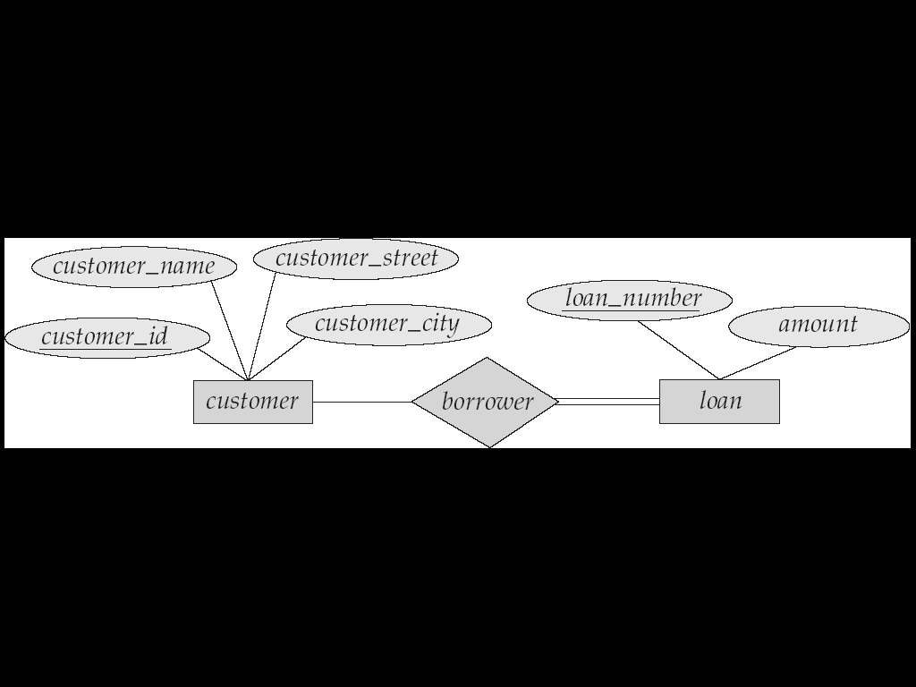
Participation of an Entity Set in a Relationship Set
Total participation (indicated by double line): every entity in the entity set participates in at least one relationship in the relationship set
  E.g. participation of loan in borrower is total
    every loan must have a customer associated to it via borrower
Partial participation: some entities may not participate in any relationship in the relationship set
  Example: participation of customer in borrower is partial

Slide 11
Weak Entity Sets
An entity set that does not have a primary key is referred to as a weak entity set.
The existence of a weak entity set depends on the existence of a identifying entity set
  it must relate to the identifying entity set via a total, one-to-many relationship set from the identifying to the weak entity set
  Identifying relationship depicted using a double diamond
The discriminator (or partial key) of a weak entity set is the set of attributes that distinguishes among all the entities of a weak entity set.

Slide 12
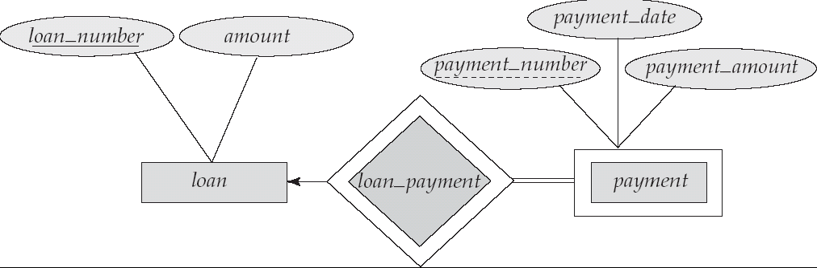
Weak Entity Sets (Cont.)
The primary key of a weak entity set is formed by the primary key of the strong entity set on which the weak entity set is existence dependent, plus the weak entity set’s discriminator.
We depict a weak entity set by double rectangles.
We underline the discriminator of a weak entity set with a dashed line.
payment_number – discriminator of the payment entity set
Primary key for payment – (loan_number, payment_number)

Slide 13
Extended ER Features
Specialization
- Specialization is a process of designating sub-groupings within an entity set.
- It is a top-down design process.
- Example: consider an entity set person, with attributes name, street and city.
A person may be further classified as one of the followings:
(a) customer having additional attribute customer_id.
(b) employee having additional attributes emp_id and salary.
The Specialization of person allows to distinguish among persons according
to whether they are employees or customers.
- In ER diagram, specialization is described by a triangle component labeled
ISA. ISA means “is a” represents for example, that a customer “is a” person.
- The ISA relationship is also referred to as a superclass-subclass relationship.

Slide 14
street
name
city
person
ISA
employee
customer
emp_id
salary
customer_id
Figure13 : ER diagram representing specialization

Slide 15
Generalization
- In generalization, multiple entity sets are synthesized into the higher-level
entity set on the basis of common features.
- It is a bottom-up design process that is a simple inversion of specialization.
- Example:
Although officer, teller and secretary are different types of employees, but they have some common attributes like their name, street, city and salary. These commonalities can be expressed by generalization by generating a new higher-level entity set employee having all common attributes.
street
name
city
emp_id
salary
employee
ISA
officer
teller
secretary
office-no
station-no
hrs-work
hrs-work
Figure14 : ER diagram with generalization

Slide 16
END

