Slide 1
Database Management
Systems

Slide 2
Contents:
Relational Model

Slide 3

Relational Algebra
The relational model uses a collection of tables to represent both data and relationships among those data.
Each table has multiple columns and each column has a unique name.
Relational algebra is a procedural query language
It consists of a set of operations that take one or two relations as input and produce a new relation as output.

Slide 4
Basic structures of a relation
Formally, given sets D₁, D₂, …. D_{n} a relation r is a subset of
D₁ x D₂ x … x D_{n}
Thus, a relation is a set of n-tuples (a₁, a₂, …, a_{n}) where each a_{i} ∈ D_{i}
Example: If
customer_name = {Jones, Smith, Curry, Lindsay}
customer_street = {Main, North, Park}
customer_city = {Harrison, Rye, Pittsfield}
Then r = { (Jones, Main, Harrison),
(Smith, North, Rye),
(Curry, North, Rye),
(Lindsay, Park, Pittsfield) }
R is a relation over
customer_name x customer_street x customer_city

Slide 5
Relational Algebra
Fundamental Operations
  Unary Operations
    Select
    Project
    Rename
  Binary Operations
    Union
    Set Difference
    Cartesian Product
    Others Operations
Set Intersection
Natural Join
Division

Slide 6
Select operation
The select operations selects rows that satisfy a given predicate.
Greek letter sigma (σ) is used to denote selection.
The predicate P appears as a subscript to σ such as σ_{p}(relation).
Example: Select the tuples of loan where the branch is “downtown”.
We write: σ _{branch_name = “downtown”} (loan)
loan_no | branch_name | amount
L -11 | downtown | 3000
L -12 | perryridge | 8000
L-14 | downtown | 5000
L -13 | brighton | 10000
loan_no | branch_name | amount
L -11 | downtown | 3000
L-14 | downtown | 5000

Slide 7
Select operation
Selection predicate supports the following operators:
  Comparison Operators: = , != , < , <= , > , =>
  Combination Operatos: and( Λ ) , or( V ) , not( ¬ )
Example: Select the tuples of loan where the branch is “downtown and
amount is more than 3500.
We write: σ branch_name = “downtown” Λ amount > 3500 (loan)
loan_no | branch_name | amount
L -11 | downtown | 3000
L -12 | perryridge | 8000
L-14 | downtown | 5000
L -13 | brighton | 10000
loan_no | branch_name | amount
L-14 | downtown | 5000

Slide 8
Projection operation
Projection returns a relation with certain attributes left out.
Here, any duplicate rows are eliminated.
Greek letter pi (Π) is used to denote projection.
The attributes that we wish to appear in the result are represented as the subscript to Π such as Π_{A1,A2…...An}(relation).
Example: List all loan numbers and the amount of the loan relation.
We write: Π _{loan_no, amount} (loan)
loan_no | branch_name | amount
L -11 | downtown | 3000
L -12 | perryridge | 8000
L-14 | downtown | 5000
L -13 | brighton | 10000
loan_no | amount
L -11 | 3000
L -12 | 8000
L-14 | 5000
L -13 | 10000

Slide 9
Composition of Relational Operations
Relational-algebra operations can be composed together into a relational-algebra expression.
Result of a relational operation is a relation.
Example: Find those customer names who live in “Harrison”.
We write: Π _{customer_name} (σ _{customer_city = “Harrison”} (customer))
customer_name | customer_street | customer_city
Adams | Spring | Harrison
Curry | North | Rye
Hanes | Main | Harrison
Jones | Walnut | Harrison
Smith | North | Rye
Johnson | Alma | Pittsfield
customer_name
Adams
Hanes
Jones

Slide 10
Composition of Relational Operations
We write: σ _{customer_city = “Harrison”} (customer)
customer_name | customer_street | customer_city
Adams | Spring | Harrison
Curry | North | Rye
Hanes | Main | Harrison
Jones | Walnut | Harrison
Smith | North | Rye
Johnson | Alma | Pittsfield
customer_name | customer_street | customer_city
Adams | Spring | Harrison
Hanes | Main | Harrison
Jones | Walnut | Harrison

Slide 11
Composition of Relational Operations
We write: Π _{customer_name} (σ _{customer_city = “Harrison”} (customer))
customer_name | customer_street | customer_city
Adams | Spring | Harrison
Hanes | Main | Harrison
Jones | Walnut | Harrison
customer_name
Adams
Hanes
Jones

Slide 12
Union Operations
Union operations are needed to combine the output of relational operations.
It is denoted by the symbol U such as r U s, where r and s are relations.
For the union operation to be valid between r and s, the following two conditions should be maintained.
Both relations must be of same arity
They have the same no. of attributes.
Domains of corresponding attributes should be matched.
Commutative operation: r U s = s U r
Eliminate duplicate values.
r
s

Slide 13
Union Operations
Example: Find all names of all bank customers who have either an account or a loan or both.
Find all customers with a loan in the bank.
r = Π _{customer_name} (borrower)
Find all customers with an account in the bank.
s = Π _{customer_name} (depositor)
Combine r and s that is r U s.
r U s = Π _{customer_name} (borrower) U Π _{customer_name} (depositor)

Slide 14
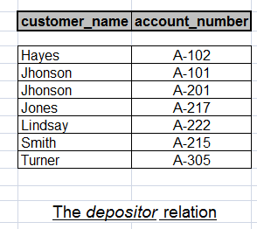
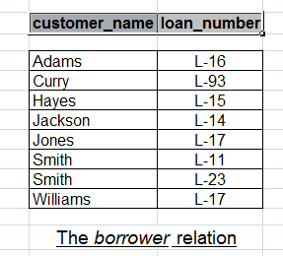
Finds it out:
Find the names of all bank customers who have either an account or a loan or both.

Slide 15
Solution:
Find the customer from depositor
Find the customer from loan

Slide 16
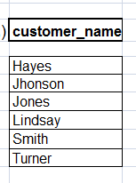
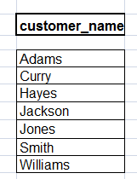
Solution:
Find the customer from depositor
Find the customer from loan

Slide 17
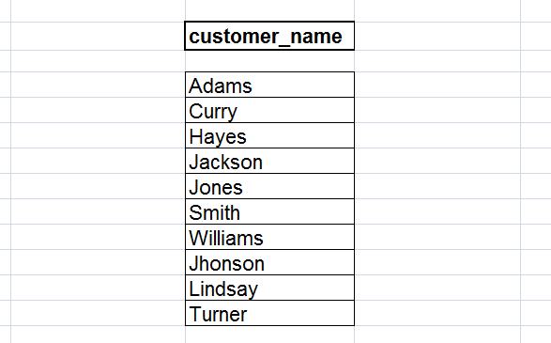
Solution:
Now a union operation
Now
Union

Slide 18
END

