Slide 1
Database Management
Systems
Md. Manowarul Islam
Associate Professor, Dept. of CSE
Jagannath University

Slide 2
Contents:
Course Outline
Recommended textbook
Introduction to Database

Slide 3
Theory Exam:
Number of class test : 2 10+10
Number of Mid-term : 1 30
Final Exam : 1 40
Attendance : 1 10

Slide 4
Database Management
Systems(DBMS)

Slide 5

Database Systems Today

Slide 6
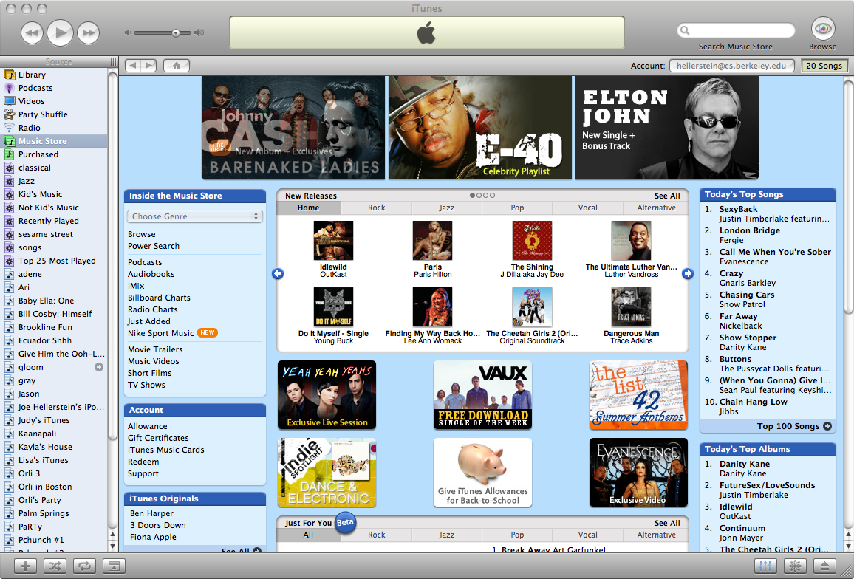
Database Systems Today

Slide 7
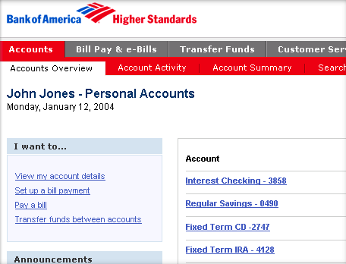
Database Systems Today

Slide 8
What is a Database?
“A set of information held in a computer”
      Oxford English Dictionary
“One or more large structured sets of persistent data, usually associated with software to update and query the data”
      Free On-Line Dictionary of Computing
“A collection of data arranged for ease and speed of search and retrieval”
      Dictionary.com

Slide 9
Database Management Systems
A DBMS is a collection of programs which
  provide management of databases
  control access to data
  contain a query language to retrieve information easily
DBMS
Application
program
End-user

Slide 10
Database Management Systems
DBMS contains information about a particular enterprise
  Collection of interrelated data
  Set of programs to access the data
  This data is called database
DBMS
Application
program
End-user

Slide 11
DBMS:
DBMS contains information about a particular enterprise
    Collection of interrelated data
    Set of programs to access the data
    This data is called database
Goals of DBMS
    Provide an environment that is both convenient and efficient
    Manage large bodies of information
    Ensure the safety and security of the information
    Avoid possible anomalous results

Slide 12
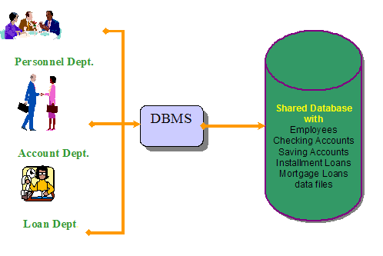
DBMS:
Application
    Banking: All transactions

Slide 13

DBMS:
Application
    Airlines: Reservations, schedules

Slide 14
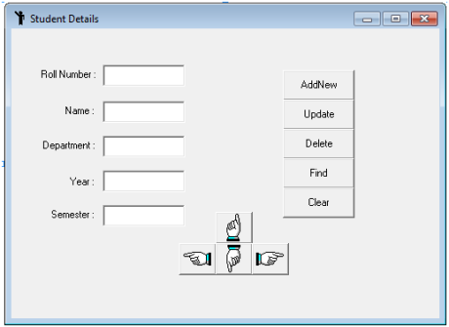
DBMS:
Application
    Universities: Registration, grades

Slide 15

DBMS:
Application
    Sales: Customers, products, purchases

Slide 16

DBMS:
Application
    Online retailers: Order tracking, customized recommendations

Slide 17

DBMS:
Application
    Manufacturing: Production, inventory, orders, supply chain

Slide 18

DBMS:
Application
    Human resources: Employee records, salaries, tax deductions
Databases touch all aspects of our lives

Slide 19
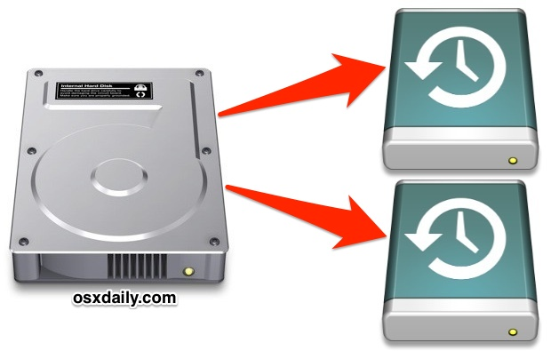
Purpose of DBMS:
Ordinary file system has a number of major drawbacks
Data redundancy and inconsistency
  Multiple file formats, duplication of information in different files
  Higher storage and access cost
  Duplicate data leads to data inconsistency

Slide 20

Purpose of DBMS:
Ordinary file system has a number of major drawbacks
Difficulty in accessing data
  Need to write a new program to carry out each new task

Slide 21
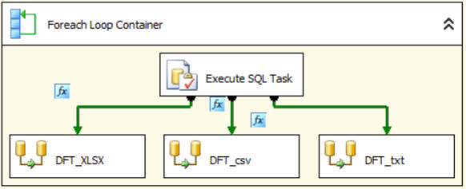
Purpose of DBMS:
Ordinary file system has a number of major drawbacks
3. Data isolation
  Multiple file formats, duplication of information in different files
  Writing new application programs to retrieve the appropriate data is difficult.

Slide 22

Purpose of DBMS:
Ordinary file system has a number of major drawbacks
4. Integrity problems
    Integrity constraints (e.g. account balance > 0) become “buried” in program code rather than being stated explicitly
    Hard to add new constraints or change existing ones

Slide 23
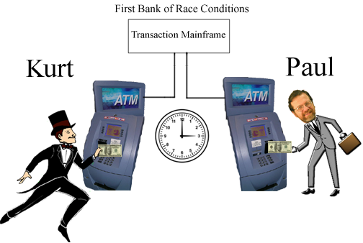
Purpose of DBMS:
Ordinary file system has a number of major drawbacks
5. Atomicity problems
  Failures may leave database in an inconsistent state with partial updates carried out
  Example: Transfer of funds from one account to another should either complete or not happen at all

Slide 24
Purpose of DBMS:
Ordinary file system has a number of major drawbacks
6. Concurrent-access anomalies
    Concurrent accessed needed for performance
    Uncontrolled concurrent accesses can lead to inconsistencies
    Example: Two people reading a balance and updating it at the same time

Slide 25

Purpose of DBMS:
Ordinary file system has a number of major drawbacks
7. Security problems
  Hard to provide user access to some, but not all, data
  every user of the database system should be able to access all the data
Database systems offer solutions to all the above problems

Slide 26
Data abstraction:
Database designer need to use complex data structure
All user are not computer trained-hide the complexity
Level of abstraction
  Physical level
  Logical level
  View level

Slide 27
Data abstraction:
Physical level
  Describes how data are actually stored
  Describes complex low-level data structures in detail
Logical level
    Describes what data stored in database
    Describes what relationships exist among those data
    View Level
        Describe only part of the entire database.
        Views can also hide information (such as an employee’s salary) for security purposes.

Slide 28

Data abstraction:

Slide 29
Instance and Schemas:
Schemas
  The overall design of the database
  Schemas are changed infrequently
  Variable declaration (with type definition) of a programming language
Instance
    Actual content of the database at a particular point in time
    Analogous to the value of a variable

Slide 30
Some Commercial Database Management Systems
Oracle – Oracle 8i, Oracle9i, Oracle 10g
Microsoft SQL Server
IBM DB2/DB2UDB
Informix
Sybase
MySQL
Ingress
PostgreSQL

Slide 31
For Personal Computers
Microsoft Access
FoxPro
dBase

Slide 32
End

