Slide 1
Database Management
Systems

Slide 2
Contents:
Functional Dependency

Slide 3
Functional Dependencies
Functional Dependencies
We say an attribute, B, has a functional dependency on another attribute, A, if for any two records, which have
the same value for A, then the values for B in these two records must be the same. We illustrate this as:
  A → B
Example: Suppose we keep track of employee email addresses, and we only track one email address for each employee. Suppose each employee is identified by their unique employee number. We say there is a functional dependency of email address on employee number:
    employee number → email address
91.2814

Slide 4
Functional Dependencies
EmpNum
EmpEmail
EmpFname
EmpLname
123
jdoe@abc.com
John
Doe
456
psmith@abc.com
Peter
Smith
555
alee1@abc.com
Alan
Lee
633
pdoe@abc.com
Peter
Doe
787
alee2@abc.com
Alan
Lee
If EmpNum is the PK then the FDs:
EmpNum → EmpEmail
EmpNum → EmpFname
EmpNum → EmpLname
must exist.
91.2814

Slide 5
Database Tables and Normalization
Dependency Diagram
  The primary key components are bold, underlined, and shaded in a different color.
  The arrows above entities indicate all desirable dependencies, i.e., dependencies that are based on PK.
Figure 5.3
Notes:
<DO WITH UNIV- Draw>

Slide 6
Functional Dependencies
EmpNum → EmpEmail
EmpNum → EmpFname
EmpNum → EmpLname
3 different ways you might see FDs depicted
EmpEmail
EmpNum
EmpFname
EmpLname
EmpNum EmpEmail EmpFname EmpLname
91.2814

Slide 7
Determinant
Functional Dependency
EmpNum → EmpEmail
Attribute on the LHS is known as the determinant
  EmpNum is a determinant of EmpEmail
91.2814

Slide 8
Transitive dependency
Transitive dependency
Consider attributes A, B, and C, and where
A → B and B → C.
Functional dependencies are transitive, which means that we also have the functional dependency A → C
We say that C is transitively dependent on A through B.
91.2814

Slide 9
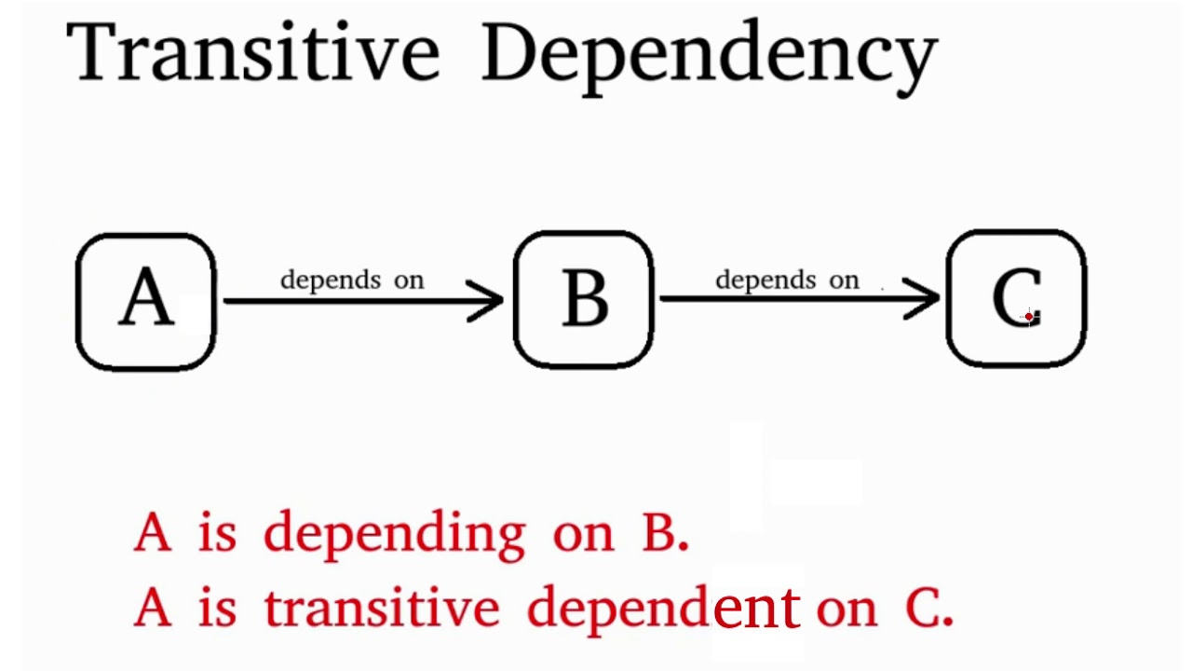
Transitive dependency
91.2814

Slide 10
Transitive dependency
EmpNum → DeptNum
EmpNum EmpEmail DeptNum DeptNname
DeptNum → DeptName
EmpNum EmpEmail DeptNum DeptNname
DeptName is transitively dependent on EmpNum via DeptNum
    EmpNum → DeptName
91.2814

Slide 11
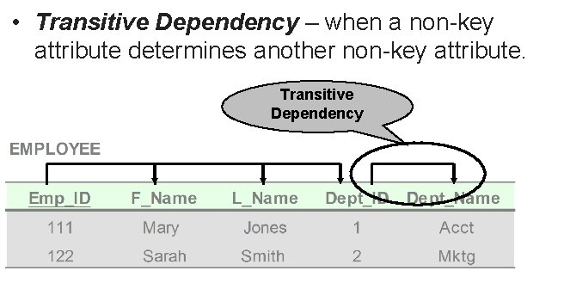
Transitive dependency
91.2814

Slide 12
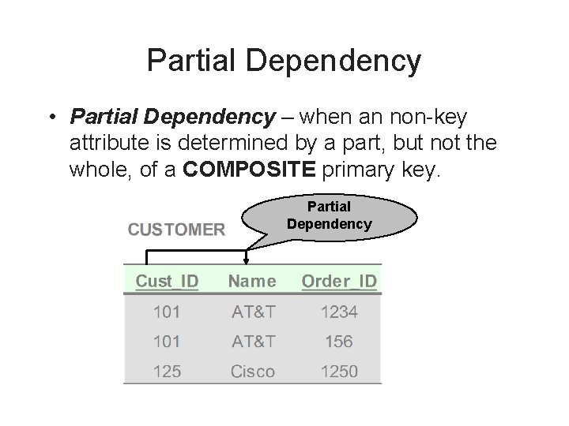
Partial dependency
A partial dependency exists when an attribute B is functionally dependent on an attribute A, and A is a component of a multipart candidate key.

Slide 13

Normal Forms
Normalization is a process of organizing data to minimize data redundancy.
Each normal form is a set of conditions on a schema that guarantees certain properties that are related to redundancy and update anomalies.
The normal forms based on FDs alone form a hierarchy with increasingly strict limitations on the allowed functional dependencies as follows:
- First Normal Form (1NF)
- Second Normal Form (2NF)
- Third Normal Form (3NF)
- Boyce-Codd Normal Form (BCNF)
- Fouth Normal Form (4NF)
- Fifth Normal Form (not examinable)

Slide 14
First Normal From
A table is in the first normal form iff
  The domain of each attribute contains only atomic values, and
  The value of each attribute contains only a single value from that domain.
In layman's terms. it means every column of
your table should only contain single values

Slide 15
Example
For a library
Patron ID | Borrowed books
C45 | B33, B44, B55
C12 | B56

Slide 16
1-NF Solution
Patron ID | Borrowed book
C45 | B33
C45 | B44
C45 | B33
C12 | B56

Slide 17
Example
For an airline
Flight | Weekdays
UA59 | Mo We Fr
UA73 | Mo Tu We Th Fr

Slide 18
1NF Solution
Flight | Weekday
UA59 | Mo
UA59 | We
UA59 | Fr
UA73 | Mo
UA73 | We
… | …

Slide 19
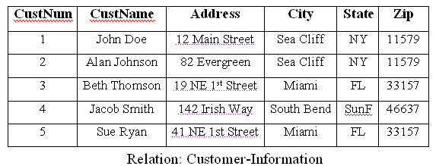
First Normal Form (1NF)
A relation is in 1NF if the following conditions are satisfied:
  Each row of data must have a unique identifier i.e Primary key
  There are no duplicated rows in the table.
  All underlying domains contain atomic values only.
  Entries in a column (attribute, field) are of the same kind.
The 1NF deals only with the basic structure of the relation and does not resolve the problems of redundant information or the anomalies.
Example:

Slide 20
First Normal Form
The following in not in 1NF
EmpNum
EmpPhone
EmpDegrees
123
233-9876
333
233-1231
BA, BSc, PhD
679
233-1231
BSc, MSc
EmpDegrees is a multi-valued field:
  employee 679 has two degrees: BSc and MSc
  employee 333 has three degrees: BA, BSc, PhD
91.2814

Slide 21
First Normal Form
To obtain 1NF relations we must, without loss of information, replace the above with two relations
EmployeeDegree
Employee
EmpNum
EmpDegree
EmpNum
EmpPhone
333
BA
123
233-9876
333
BSc
333
233-1231
333
PhD
679
233-1231
679
BSc
679
MSc
An outer join between Employee and EmployeeDegree will produce the information we saw before
91.2814

Slide 22
First Normal Form (1NF)
A table is considered to be in 1NF if all the fields contain
only scalar values (as opposed to list of values).
Example (Not 1NF)
ISBN
Title
AuName
AuPhone
PubName
PubPhone
Price
0-321-32132-1
Balloon
Sleepy, Snoopy, Grumpy
321-321-1111, 232-234-1234, 665-235-6532
Small House
714-000-0000
$34.00
0-55-123456-9
Main Street
Jones, Smith
123-333-3333, 654-223-3455
Small House
714-000-0000
$22.95
0-123-45678-0
Ulysses
Joyce
666-666-6666
Alpha Press
999-999-9999
$34.00
1-22-233700-0
Visual Basic
Roman
444-444-4444
Big House
123-456-7890
$25.00
Author and AuPhone columns are not scalar
Notes:
Having scalar values also means that all instances of a record type must contain the same number of fields.
A table not in first normal form is called un normalized

Slide 23
1NF - Decomposition
Place all items that appear in the repeating group in a new table
Designate a primary key for each new table produced.
Duplicate in the new table the primary key of the table from which the repeating group was extracted or vice versa.
Example (1NF)
ISBN
AuName
AuPhone
0-321-32132-1
Sleepy
321-321-1111
0-321-32132-1
Snoopy
232-234-1234
ISBN
Title
PubName
PubPhone
Price
0-321-32132-1
Grumpy
665-235-6532
0-321-32132-1
Balloon
Small House
714-000-0000
$34.00
0-55-123456-9
Jones
123-333-3333
0-55-123456-9
Main Street
Small House
714-000-0000
$22.95
0-55-123456-9
Smith
654-223-3455
0-123-45678-0
Ulysses
Alpha Press
999-999-9999
$34.00
0-123-45678-0
Joyce
666-666-6666
1-22-233700-0
Visual Basic
Big House
123-456-7890
$25.00
1-22-233700-0
Roman
444-444-4444
Notes:
1. The designated key will be the primary key of the original table concatenated with one or more data items from the new table.
For the first table the primary key is ISBN
For the second table the primary key is ISBN + Author Name

Slide 24
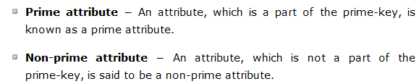
keyword

Slide 25
Second Normal Form (2NF)
A relation is in 2NF if the following conditions are satisfied:
  It is in 1NF.
  All non-key attributes are dependent on the entire key (candidate key).
2NF does not have any partial dependencies. It means that for a table that has concatenated primary key, each column in the table that is not part of the primary key must depend upon the entire concatenated key for its existence.
2NF attempts to reduce the amount of redundant data in a relation by extracting it, placing it in new table(s) and creating relationships between those tables.

Slide 26
Second Normal Form
A table is in 2NF iff
  It is in 1NF and
  no non-prime attribute is dependent on any proper subset of any candidate key of the table
A non-prime attribute of a table is an attribute that is not a part of any candidate key of the table
A candidate key is a minimal superkey

Slide 27
Example
Library allows patrons to request books that are currently out
BookNo | Patron | PhoneNo
B3 | J. Fisher | 555-1234
B2 | J. Fisher | 555-1234
B2 | M. Amer | 555-4321

Slide 28
Example
Candidate key is {BookNo, Patron}
We have
  Patron → PhoneNo
Table is not 2NF
  Potential for
    Insertion anomalies
    Update anomalies
    Deletion anomalies

Slide 29
2NF Solution
Put telephone number in separate Patron table
BookNo | Patron
B3 | J. Fisher
B2 | J. Fisher
B2 | M. Amer
Patron | PhoneNo
J. Fisher | 555-1234
M. Amer | 555-4321

Slide 30

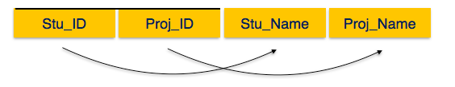
Example
prime key attributes are Stu_ID and Proj_ID
According to the rule, non-key attributes (Stu_Name and Proj_Name ) must
be dependent upon both Stu_ID and Proj_ID
Stu_Name can be identified by Stu_ID and
Proj_Name can be identified by Proj_ID
This is called partial dependency, which is not allowed in Second Normal Form.

Slide 31
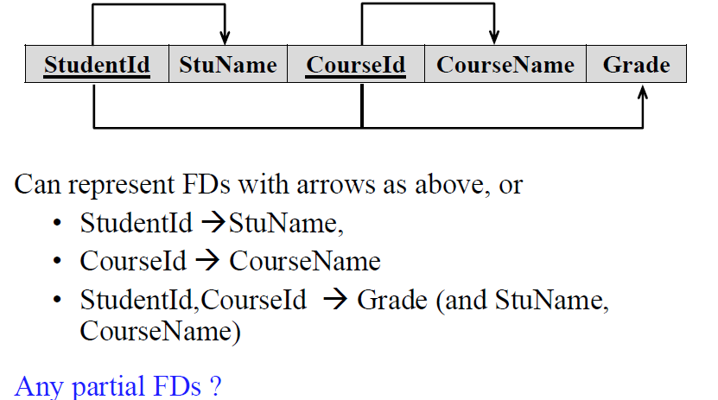
Example

Slide 32
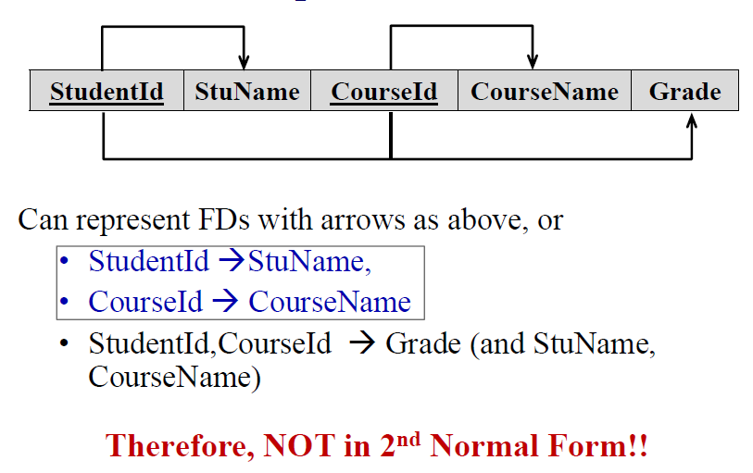
Example

Slide 33

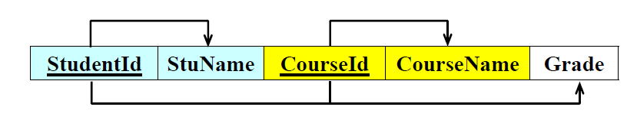


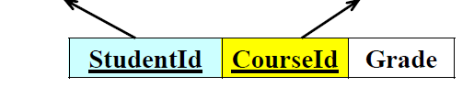

Example

Slide 34
Second Normal Form (2NF)
For a table to be in 2NF, there are two requirements
  The database is in first normal form
  All nonkey attributes in the table must be functionally dependent on the entire primary key
Note: Remember that we are dealing with non-key attributes
Example 1 (Not 2NF)
Scheme → {Title, PubId, AuId, Price, AuAddress}
  Key → {Title, PubId, AuId}
  {Title, PubId, AuID} → {Price}
  {AuID} → {AuAddress}
  AuAddress does not belong to a key
  AuAddress functionally depends on AuId which is a subset of a key

Slide 35
Second Normal Form (2NF)
Example 2 (Not 2NF)
Scheme → {City, Street, HouseNumber, HouseColor, CityPopulation}
  key → {City, Street, HouseNumber}
  {City, Street, HouseNumber} → {HouseColor}
  {City} → {CityPopulation}
  CityPopulation does not belong to any key.
  CityPopulation is functionally dependent on the City which is a proper subset of the key
Example 3 (Not 2NF)
Scheme → {studio, movie, budget, studio_city}
  Key → {studio, movie}
  {studio, movie} → {budget}
  {studio} → {studio_city}
  studio_city is not a part of a key
  studio_city functionally depends on studio which is a proper subset of the key
Notes:
Let us consider the problems with the movie studio database:
Redundancy – City Population is repeated many times
Insertion anomaly – Whenever we add a new record we have to add unnecessary information. We can not add record until we know information about the city population
Deletion anomaly – Whenever we delete a record, useful information is deleted.
Update anomaly – The City Population needs to be updated in more than one location if it changes.

Slide 36
2NF - Decomposition
If a data item is fully functionally dependent on only a part of the primary key, move that data item and that part of the primary key to a new table.
If other data items are functionally dependent on the same part of the key, place them in the new table also
Make the partial primary key copied from the original table the primary key for the new table. Place all items that appear in the repeating group in a new table
Example 1 (Convert to 2NF)
  Old Scheme → {Title, PubId, AuId, Price, AuAddress}
  New Scheme → {Title, PubId, AuId, Price}
  New Scheme → {AuId, AuAddress}
Notes:
If there is a table with columns A,B,C,D with Primary Key (A,B) & D is dependant on A (alone) then to be 2NF, you should reduce (split) tables as:
Table with columns A,D with Primary Key (A)
Table with columns A,B,C with Primary Key (A,B)

Slide 37
2NF - Decomposition
Example 2 (Convert to 2NF)
  Old Scheme → {Studio, Movie, Budget, StudioCity}
  New Scheme → {Movie, Studio, Budget}
  New Scheme → {Studio, City}
Example 3 (Convert to 2NF)
  Old Scheme → {City, Street, HouseNumber, HouseColor, CityPopulation}
  New Scheme → {City, Street, HouseNumber, HouseColor}
  New Scheme → {City, CityPopulation}

Slide 38
Third Normal Form
A table is in 3NF iff
  it is in 2NF and
  all its attributes are determined only by its candidate keys and not by any non-prime attributes

Slide 39
Example
Table BorrowedBooks
BookNo | Patron | Address | Due
B1 | J. Fisher | 101 Main Street | 3/2/15
B2 | L. Perez | 202 Market Street | 2/28/15
Candidate key is BookNo
Patron → Address

Slide 40
3NF Solution
Put address in separate Patron table
BookNo | Patron | Due
B1 | J. Fisher | 3/2/15
B2 | L. Perez | 2/28/15
Patron | Address
J. Fisher | 101 Main Street
L. Perez | 202 Market Street

Slide 41
Third Normal Form (3NF)
Third Normal form applies that every non-prime attribute of table must be dependent on primary key
  There should not be the case that a non-prime attribute is determined by another non-prime
  So this transitive functional dependency should be removed from the table and also the table must be in Second Normal form.

Slide 42
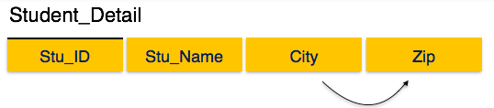
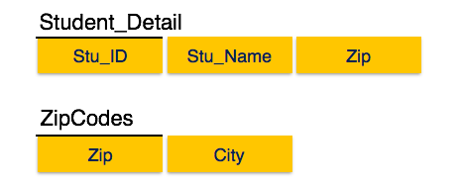
Example
City can be identified by Stu_ID as well as Zip itself.
Neither Zip is a superkey nor is City a prime attribute.
Additionally, Stu_ID → Zip → City, so there exists transitive dependency.

Slide 43
3NF Continue…..
# Consider the relation subject (cno, cname, instructor, office).
Assume that cname is not unique and cno is the only candidate key. The
following functional dependencies exists:
cno → cname ………………….(1)
cno → instructor ………………….(2)
instructor → office …………………..(3)
From (1) and (2) no, we can derive cno → office. So relation is in 2NF.
But relation is not in 3NF (Transitive dependency cno → office).
To overcome this, it is needed to decompose the above relation in the
following two relations:
sub (cno, cname, instructor) and inst (instructor, office)
Now, sub is now in 3NF and so is inst.

Slide 44
Another example
Tournament winners
Candidate key is {Tournament, Year}
Winner →DOB
Tournament | Year | Winner | DOB
Indiana Invitational | 1998 | Al Fredrickson | 21 July 1975
Cleveland Open | 1999 | Bob Albertson | 28 Sept. 1968
Des Moines Masters | 1999 | Al Fredrickson | 21 July 1975

Slide 45
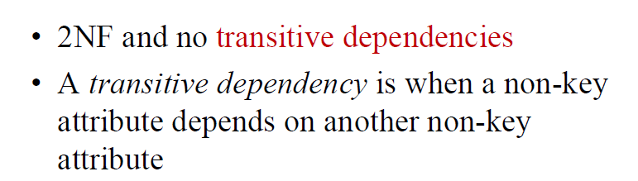
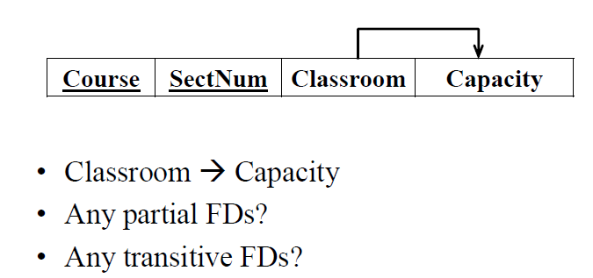
Example

Slide 46
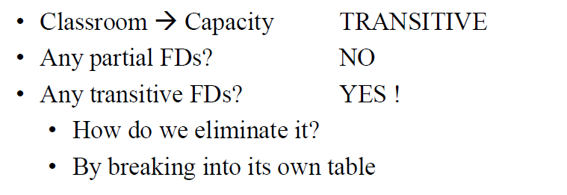
Example

Slide 47

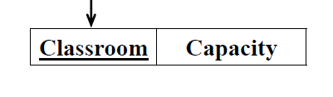
Example

Slide 48
Third Normal Form (3NF)
This form dictates that all non-key attributes of a table must be functionally dependent on a candidate key i.e. there can be no interdependencies among non-key attributes.
For a table to be in 3NF, there are two requirements
  The table should be second normal form
  No attribute is transitively dependent on the primary key
Example (Not in 3NF)
Scheme → {Title, PubID, PageCount, Price }
  Key → {Title, PubId}
  {Title, PubId} → {PageCount}
  {PageCount} → {Price}
  Both Price and PageCount depend on a key hence 2NF
  Transitively {Title, PubID} → {Price} hence not in 3NF
Notes:
In the Book Schema Third Normal Form is violated since a non-key field is dependent on another non-key field and is transitively dependent on the primary key.

Slide 49
Third Normal Form (3NF)
Example 2 (Not in 3NF)
Scheme → {Studio, StudioCity, CityTemp}
  Primary Key → {Studio}
  {Studio} → {StudioCity}
  {StudioCity} → {CityTemp}
  {Studio} → {CityTemp}
  Both StudioCity and CityTemp depend on the entire key hence 2NF
  CityTemp transitively depends on Studio hence violates 3NF
Example 3 (Not in 3NF)
Scheme → {BuildingID, Contractor, Fee}
  Primary Key → {BuildingID}
  {BuildingID} → {Contractor}
  {Contractor} → {Fee}
  {BuildingID} → {Fee}
  Fee transitively depends on the BuildingID
  Both Contractor and Fee depend on the entire key hence 2NF
BuildingID
Contractor
Fee
100
Randolph
1200
150
Ingersoll
1100
200
Randolph
1200
250
Pitkin
1100
300
Randolph
1200
Notes:
Let us consider the problems with the movie studio database:
Redundancy – City Population is repeated many times
Insertion anomaly – Whenever we add a new record we have to add unnecessary information. We can not add record until we know information about the city population
Deletion anomaly – Whenever we delete a record, useful information is deleted.
Update anomaly – The City Population needs to be updated in more than one location if it changes.

Slide 50
3NF - Decomposition
Move all items involved in transitive dependencies to a new entity.
Identify a primary key for the new entity.
Place the primary key for the new entity as a foreign key on the original entity.
Example 1 (Convert to 3NF)
  Old Scheme → {Title, PubID, PageCount, Price }
  New Scheme → {PubID, PageCount, Price}
  New Scheme → {Title, PubID, PageCount}
Notes:
If there is a table with columns A,B,C with Primary Key (A) and C is dependant on B (B → C) then to be 3NF, the tables become
Table with columns B,C with Primary Key (B)
Table with fields A,B with Primary Key ( A), and Foreign Key (B)

Slide 51
3NF - Decomposition
Example 2 (Convert to 3NF)
  Old Scheme → {Studio, StudioCity, CityTemp}
  New Scheme → {Studio, StudioCity}
  New Scheme → {StudioCity, CityTemp}
Example 3 (Convert to 3NF)
  Old Scheme → {BuildingID, Contractor, Fee}
  New Scheme → {BuildingID, Contractor}
  New Scheme → {Contractor, Fee}
BuildingID
Contractor
Contractor
Fee
100
Randolph
Randolph
1200
150
Ingersoll
Ingersoll
1100
200
Randolph
Pitkin
1100
250
Pitkin
300
Randolph

Slide 52
END

