Slide 1
Chapter 12: Indexing and Hashing

Slide 2
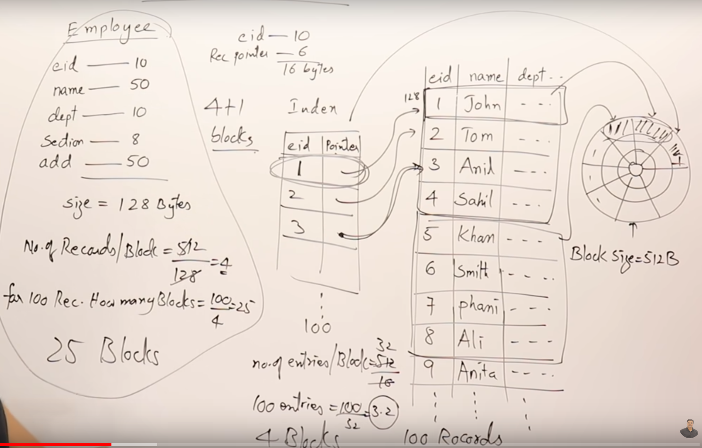

Slide 3
Basic Concepts
Indexing mechanisms used to speed up access to desired data.
  E.g., author catalog in library
Search Key - attribute to set of attributes used to look up records in a file.
An index file consists of records (called index entries) of the form
Index files are typically much smaller than the original file
Two basic kinds of indices:
  Ordered indices: search keys are stored in sorted order
  Hash indices: search keys are distributed uniformly across “buckets” using a “hash function”.
search-key
pointer

Slide 4
Index Evaluation Metrics
Access types supported efficiently. E.g.,
  records with a specified value in the attribute
  or records with an attribute value falling in a specified range of values.
Access time
Insertion time
Deletion time
Space overhead

Slide 5
Ordered Indices
Indexing techniques evaluated on basis of:
In an ordered index, index entries are stored sorted on the search key value. E.g., author catalog in library.
Primary index: in a sequentially ordered file, the index whose search key specifies the sequential order of the file.
  Also called clustering index
  The search key of a primary index is usually but not necessarily the primary key.
Secondary index: an index whose search key specifies an order different from the sequential order of the file. Also called
non-clustering index.
Index-sequential file: ordered sequential file with a primary index.

Slide 6
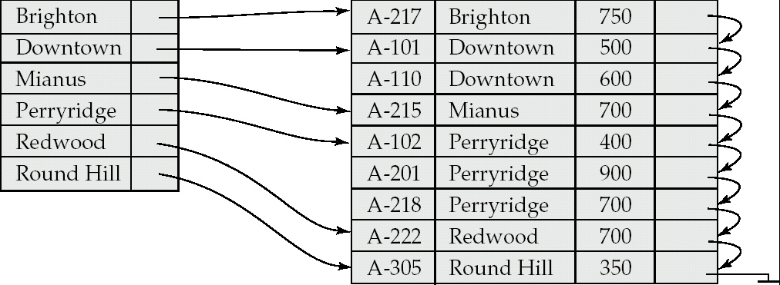
Dense Index Files
Dense index — Index record appears for every search-key value in the file.

Slide 7
Sparse Index Files
Sparse Index: contains index records for only some search-key values.
  Applicable when records are sequentially ordered on search-key
To locate a record with search-key value K we:
  Find index record with largest search-key value < K
  Search file sequentially starting at the record to which the index record points
Less space and less maintenance overhead for insertions and deletions.
Generally slower than dense index for locating records.
Good tradeoff: sparse index with an index entry for every block in file, corresponding to least search-key value in the block.

Slide 8
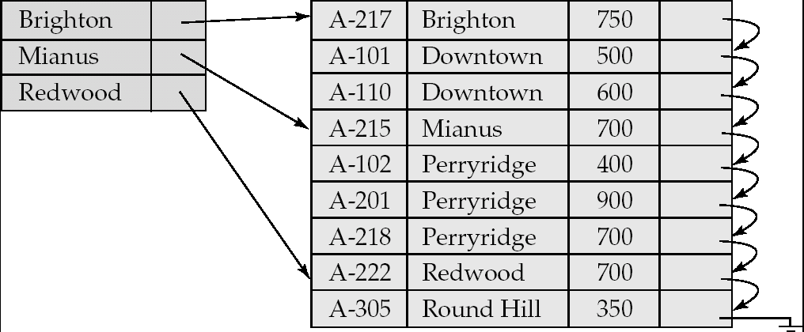
Example of Sparse Index Files

Slide 9
Multilevel Index
If primary index does not fit in memory, access becomes expensive.
To reduce number of disk accesses to index records, treat primary index kept on disk as a sequential file and construct a sparse index on it.
  outer index – a sparse index of primary index
  inner index – the primary index file
If even outer index is too large to fit in main memory, yet another level of index can be created, and so on.
Indices at all levels must be updated on insertion or deletion from the file.

Slide 10
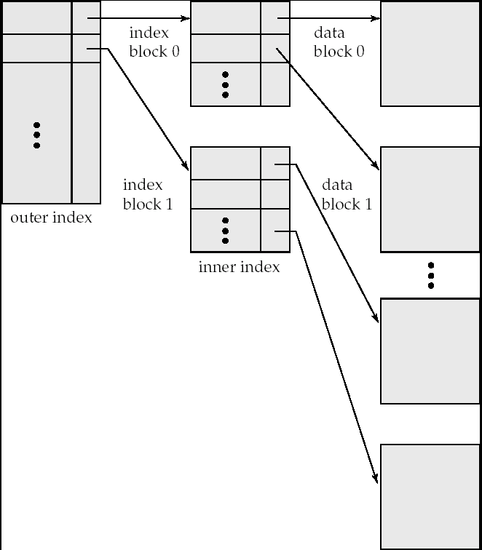
Multilevel Index (Cont.)

Slide 11
Index Update: Insertion
Single-level index insertion:
  Perform a lookup using the search-key value appearing in the record to be inserted.
  Dense indices – if the search-key value does not appear in the index, insert it.
  Sparse indices – if index stores an entry for each block of the file, no change needs to be made to the index unless a new block is created.
    If a new block is created, the first search-key value appearing in the new block is inserted into the index.
Multilevel insertion (as well as deletion) algorithms are simple extensions of the single-level algorithms

Slide 12
Secondary Indices
Frequently, one wants to find all the records whose values in a certain field (which is not the search-key of the primary index) satisfy some condition.
  Example 1: In the account relation stored sequentially by account number, we may want to find all accounts in a particular branch
  Example 2: as above, but where we want to find all accounts with a specified balance or range of balances
We can have a secondary index with an index record for each search-key value
  index record points to a bucket that contains pointers to all the actual records with that particular search-key value.

Slide 13
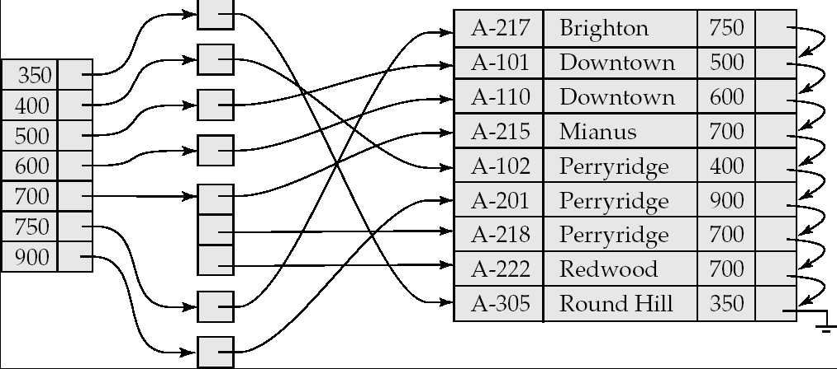
Secondary Index on balance field of account

Slide 14
Primary and Secondary Indices
Secondary indices have to be dense.
Indices offer substantial benefits when searching for records.
When a file is modified, every index on the file must be updated, Updating indices imposes overhead on database modification.
Sequential scan using primary index is efficient, but a sequential scan using a secondary index is expensive
  each record access may fetch a new block from disk

Slide 15
End

