Slide 1
The Relational Algebra
Md. Manowarul Islam
Associate Professor
Jagannath University

Slide 2
Chapter Outline
Relational Algebra
  Unary Relational Operations
  Relational Algebra Operations From Set Theory
  Binary Relational Operations
  Additional Relational Operations
  Examples of Queries in Relational Algebra
Slide <number>

Slide 3
Relational Algebra Overview
Relational algebra is the basic set of operations for the relational model
These operations enable a user to specify basic retrieval requests (or queries)
The result of an operation is a new relation, which may have been formed from one or more input relations
Slide <number>

Slide 4
Relational Algebra
Five operators:
  Union: ∪
  Difference: -
  Selection: σ
  Projection: Π
  Cartesian Product: ×
Derived or auxiliary operators:
  Intersection, complement
  Joins (natural,equi-join, theta join, semi-join)
  Renaming: ρ
Slide <number>

Slide 5
Select Operation – Example
Relation r
A
B
C
D
α
α
β
β
α
β
β
β
1
5
12
23
7
7
3
10
σ_{A=B ^ D > 5} (r)
A
B
C
D
α
β
α
β
1
23
7
10
Slide <number>

Slide 6
Selection
Returns all tuples which satisfy a condition
Notation: σ_{c}(R)
Examples
  σ_{Salary > 40000} (Employee)
  σ_{name = “Smith”} (Employee)
The condition c can be =, <, ≤, >, ≥, <>
Slide <number>

Slide 7
SSN | Name | Salary
1234545 | John | 200000
5423341 | Smith | 600000
4352342 | Fred | 500000
σ_{Salary > 40000} (Employee)
SSN | Name | Salary
5423341 | Smith | 600000
4352342 | Fred | 500000
Slide <number>

Slide 8
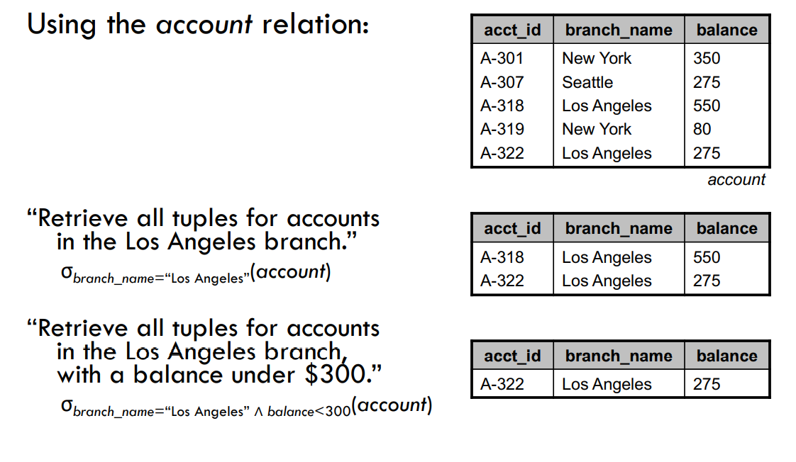
Slide <number>

Slide 9

The COMPANY Database
Slide <number>

Slide 10

The following query results refer to this database state
Slide <number>

Slide 11
Unary Relational Operations: SELECT
Examples:
  Select the EMPLOYEEs whose department # is 4:
σ _{DNO = 4} (EMPLOYEE)
  Select the EMPLOYEEs whose salary > $30,000:
σ _{SALARY > 30,000} (EMPLOYEE)
Slide <number>

Slide 12
SELECT Operation Properties
The SELECT operation σ _{<selection condition>}(R) produces a relation S that has the same schema (same attributes) as R
SELECT σ is commutative:
  σ _{<condition1>}(σ _{< condition2>} (R)) = σ _{<condition2>} (σ _{< condition1>} (R))
A cascade of SELECT operations may be replaced by a single selection with a conjunction of all the conditions:
  σ_{<cond1>}(σ_{< cond2>} (σ_{<cond3>}(R)) = σ <cond1> AND < cond2> AND < cond3>(R)))
Slide <number>

Slide 13

Project Operation
Notation:
where A₁, A₂ are attribute names and r is a relation name.
The result is defined as the relation of k columns obtained by erasing the columns that are not listed
Duplicate rows removed from result, since relations are sets
Example: To eliminate the branch_name attribute of account
∏_{account_number, balance} (account)
Slide <number>

Slide 14
SSN | Name | Salary
1234545 | John | 200000
5423341 | John | 600000
4352342 | John | 200000
Π _{Name,Salary} (Employee)
Name | Salary
John | 20000
John | 60000
Slide <number>

Slide 15
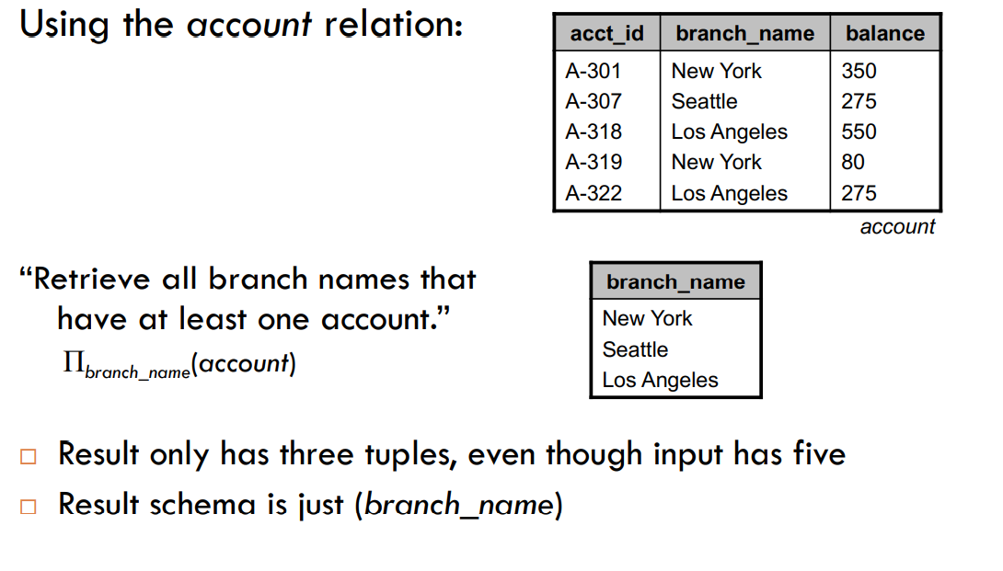
Slide <number>

Slide 16
Unary Relational Operations: PROJECT
PROJECT Operation is denoted by π (pi)
This operation keeps certain columns (attributes) from a relation and discards the other columns.
Example: To list each employee’s first and last name and salary, the following is used:
  π_{LNAME, FNAME,SALARY}(EMPLOYEE)
Slide <number>

Slide 17
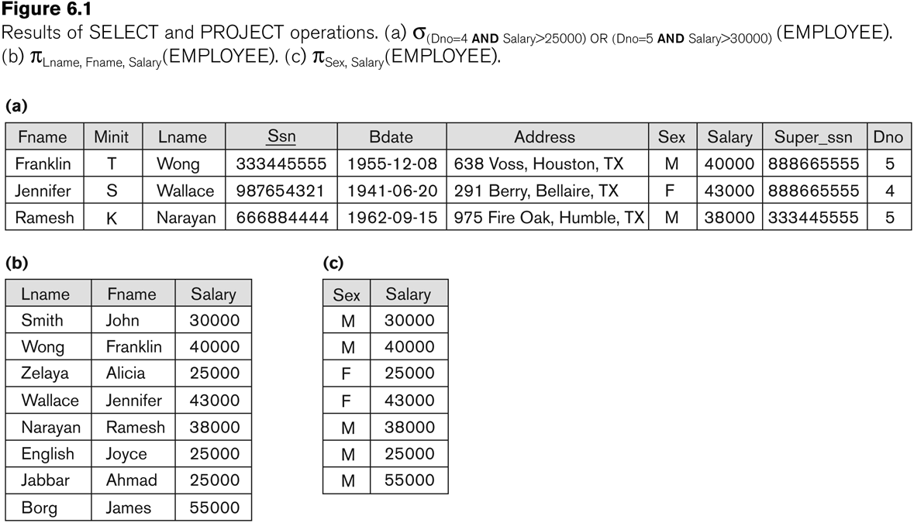
Examples of applying SELECT and PROJECT operations
Slide <number>

Slide 18
Sequence of relational operations
Task: To retrieve the first name, last name, and salary of all employees who work in department number 5.
Solution 1: A single relational algebra expression:
  π_{FNAME, LNAME, SALARY}(σ _{DNO=5}(EMPLOYEE))
Solution 2: a sequence of operations, giving a name to each intermediate relation:
  DEP5_EMPS ← σ _{DNO=5}(EMPLOYEE)
  RESULT ← π _{FNAME, LNAME, SALARY} (DEP5_EMPS)
Slide <number>

Slide 19
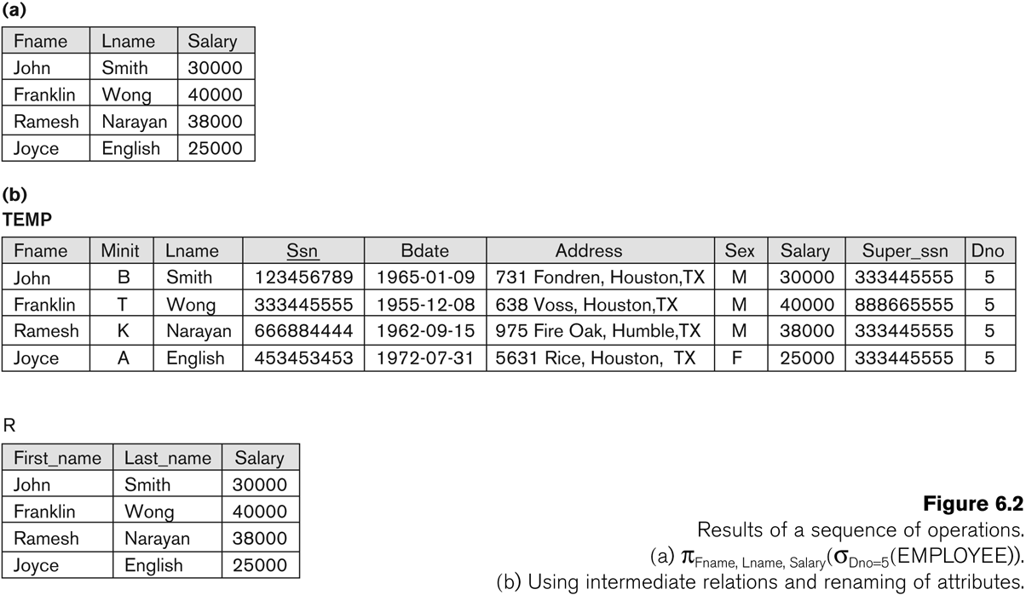
Example of applying multiple operations and RENAME
π_{LNAME, FNAME,SALARY}(σ_{Dno=5} (EMPLOYEE))
Temp = σ_{Dno=5} (EMPLOYEE)
R (First_name, Last_name, Salary)
= π_{LNAME, FNAME,SALARY}(Temp)
* Notice the implied renaming
Slide <number>

Slide 20
Unary Relational Operations: RENAME
The RENAME operator is denoted by ρ (rho)
In some cases, we may want to rename the attributes of a relation or the relation name or both
  Useful when a query requires multiple operations
  Necessary in some cases
Slide <number>

Slide 21
Example of applying multiple operations and RENAME
Temp = σ_{Dno=5} (EMPLOYEE)
R = ρ_{(First_name, Last_name Salary)} (π_{LNAME, FNAME,SALARY}(Temp))
* Notice the explicit renaming
Slide <number>

Slide 22
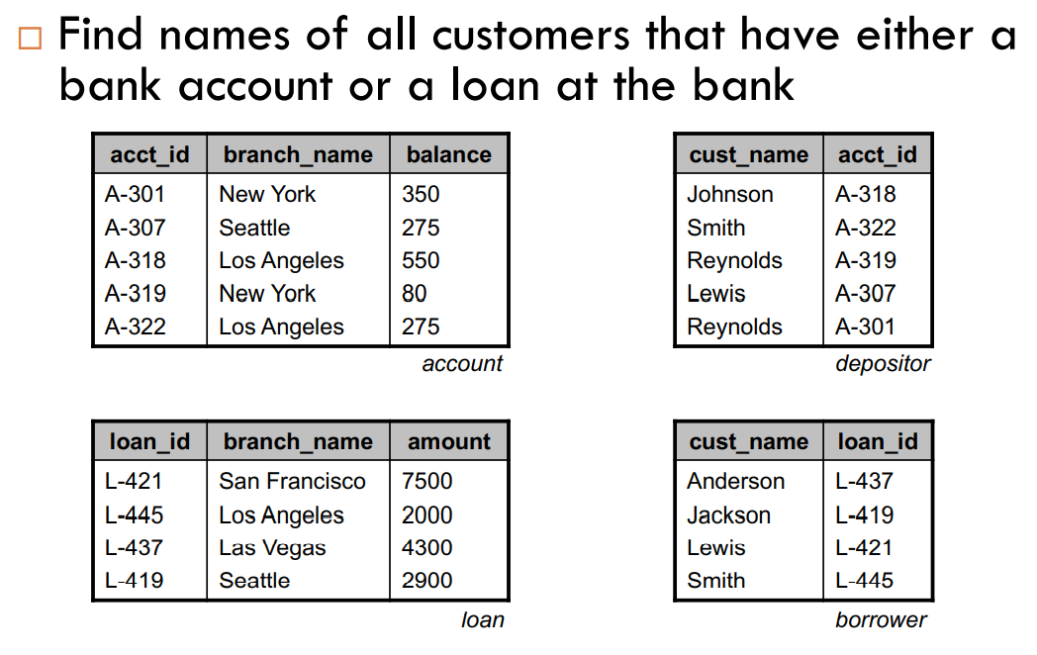
Slide <number>

Slide 23
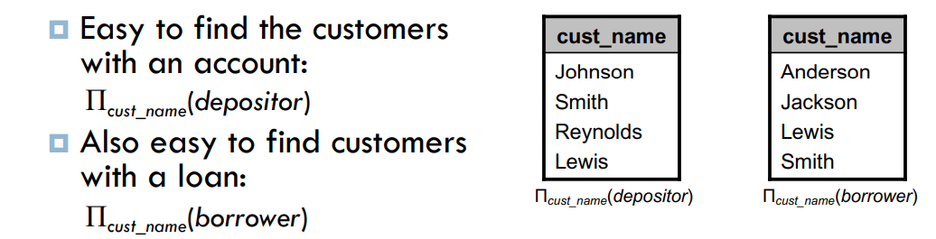
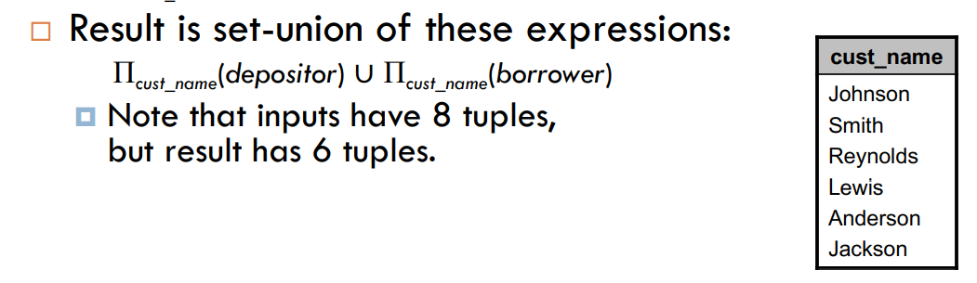
Slide <number>

Slide 24
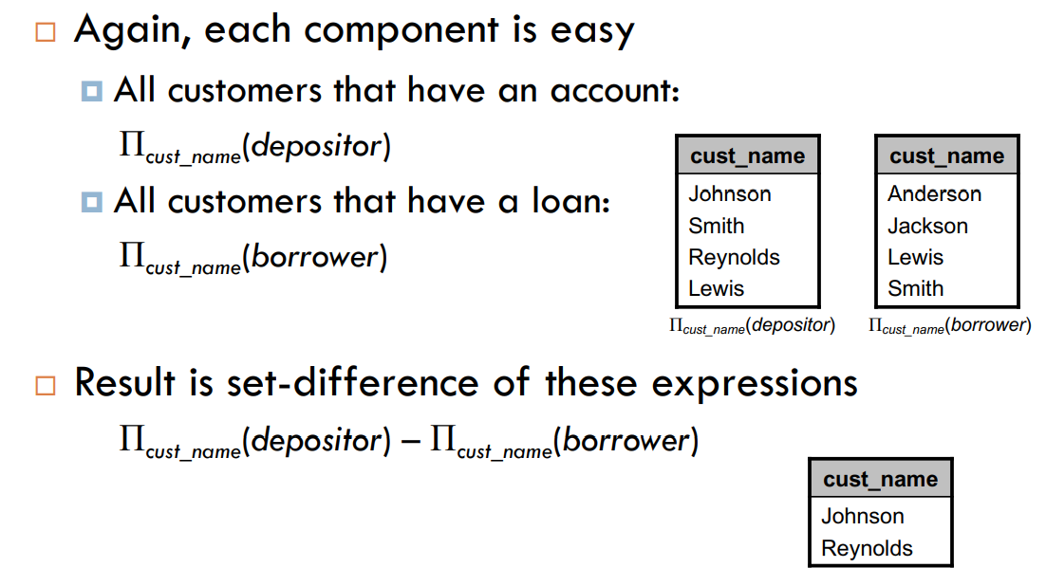
“Find all customers that have an account but not a loan.
Slide <number>

Slide 25
Cartesian Product
Each tuple in R1 with each tuple in R2
Notation: R1 × R2
Example:
  Employee × Dependents
Very rare in practice; mainly used to express joins
Slide <number>

Slide 26
Cartesian-Product Operation – Example
Relations r, s:
A
B
C
D
E
α
β
1
2
α
β
β
γ
10
10
20
10
a
a
b
b
r
s
r x s:
A
B
C
D
E
α
α
α
α
β
β
β
β
1
1
1
1
2
2
2
2
α
β
β
γ
α
β
β
γ
10
10
20
10
10
10
20
10
a
a
b
b
a
a
b
b
Slide <number>

Slide 27
Composition of Operations
A
B
C
D
E
Example: σ_{A=C}(r x s)
r x s
σ_{A=C}(r x s)
α
α
α
α
β
β
β
β
1
1
1
1
2
2
2
2
α
β
β
γ
α
β
β
γ
10
10
20
10
10
10
20
10
a
a
b
b
a
a
b
b
A
B
C
D
E
α
β
β
1
2
2
α
β
β
10
10
20
a
a
b
Slide <number>

Slide 28
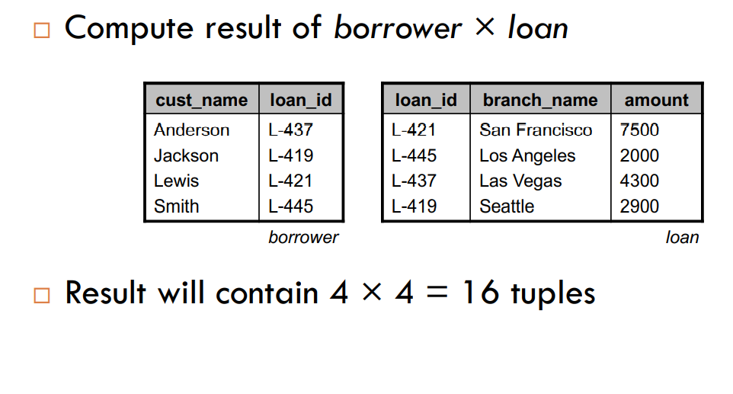
Slide <number>

Slide 29
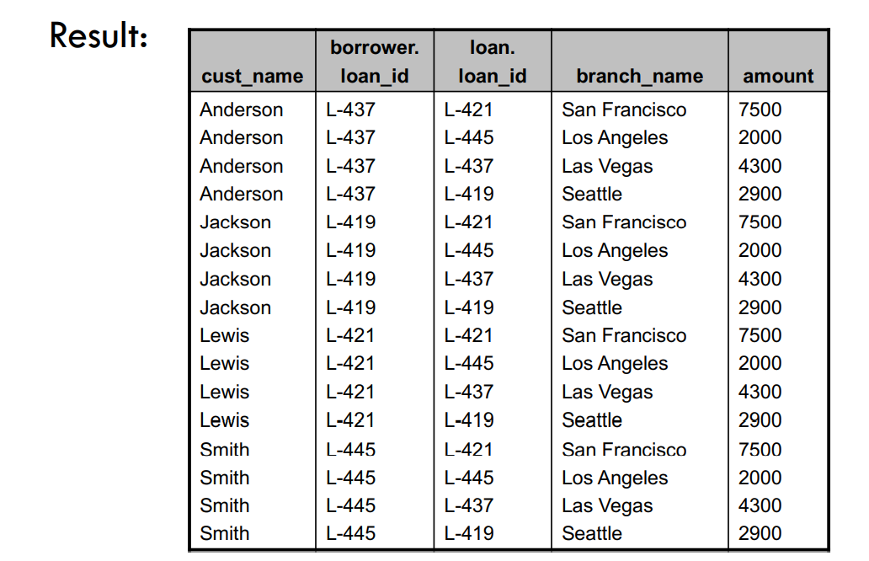
Slide <number>

Slide 30
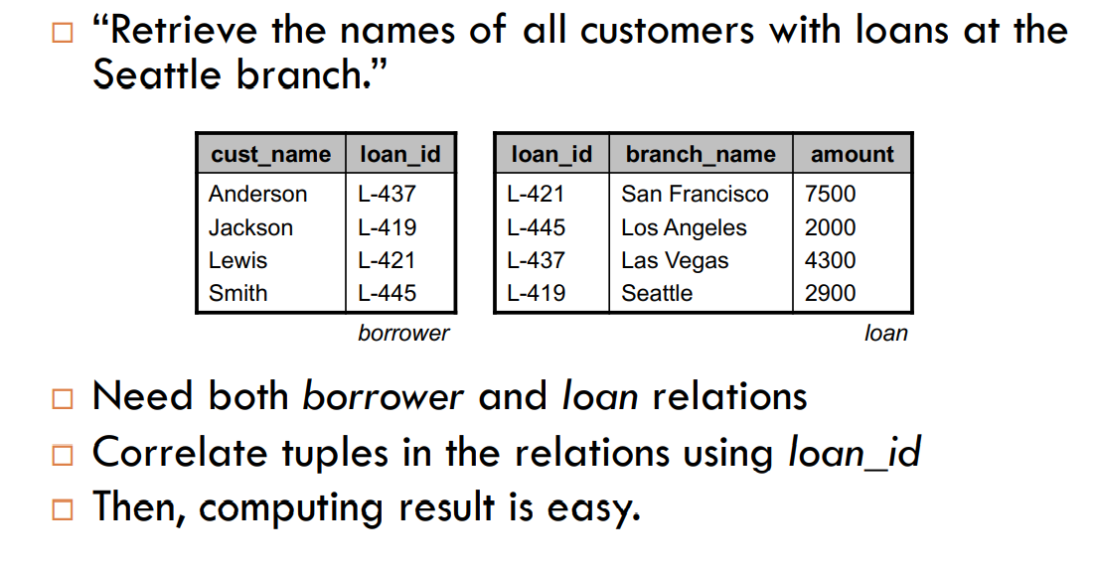
Slide <number>

Slide 31
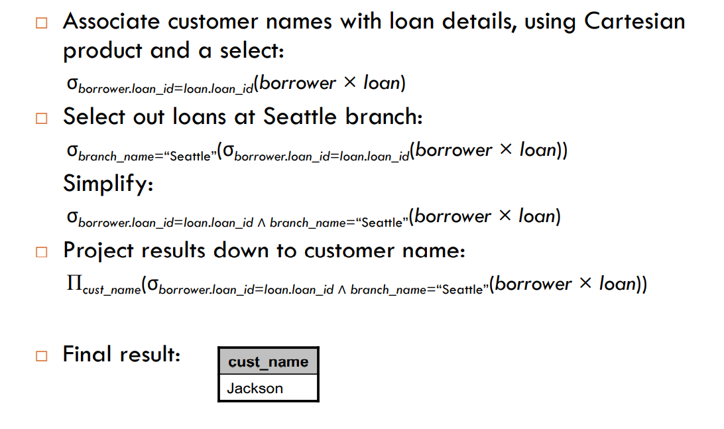
Slide <number>

Slide 32
Example: Find all names of all bank customers who have a loan at Perryridge branch.
We write:
First consider the following query and its corresponding output.
σ _{branch_name=“Perryridge”} (borrower x loan)
Slide <number>

Slide 33
Input: borrower relation
Input: loan
loan_no | customer_name
L -11 | Adams
L -12 | Curry
L-14 | Jones
loan_no | branch_name | amount
L -11 | Perryridge | 1000
L -12 | Downtown | 2000
L-14 | Perryridge | 3000
Output: borrower x loan
borrower.loan_no | customer_name | loan.loan_no | branch_name | amount
L -11 | Adams | L-11 | Perryridge | 1000
L -12 | Curry | L-11 | Perryridge | 1000
L-14 | Jones | L-11 | Perryridge | 1000
L-11 | Adams | L-12 | Downtown | 2000
L-12 | Curry | L-12 | Downtown | 2000
L-14 | Jones | L-12 | Downtown | 2000
L-11 | Adams | L-14 | Perryridge | 3000
L-12 | Curry | L-14 | Perryridge | 3000
L-14 | Jones | L-14 | Perryridge | 3000

Slide 34
Output: σ _{branch_name=“Perryridge”} (borrower x loan)
borrower.loan_no | customer_name | loan.loan_no | branch_name | amount
L -11 | Adams | L-11 | Perryridge | 1000
L -12 | Curry | L-11 | Perryridge | 1000
L-14 | Jones | L-11 | Perryridge | 1000
L-11 | Adams | L-14 | Perryridge | 3000
L-12 | Curry | L-14 | Perryridge | 3000
L-14 | Jones | L-14 | Perryridge | 3000
Now consider the following query and its corresponding output
Π _{customer_name}(σborrower.loan_no=loan.loan_no Λ branch_name=“Perryridge” (borrower x loan))
Output: Π _{customer_name}(σborrower.loan_no=loan.loan_no Λ branch_name=“Perryridge”(borrowerx loan))
customer_name
Adams
Jones
Slide <number>

Slide 35
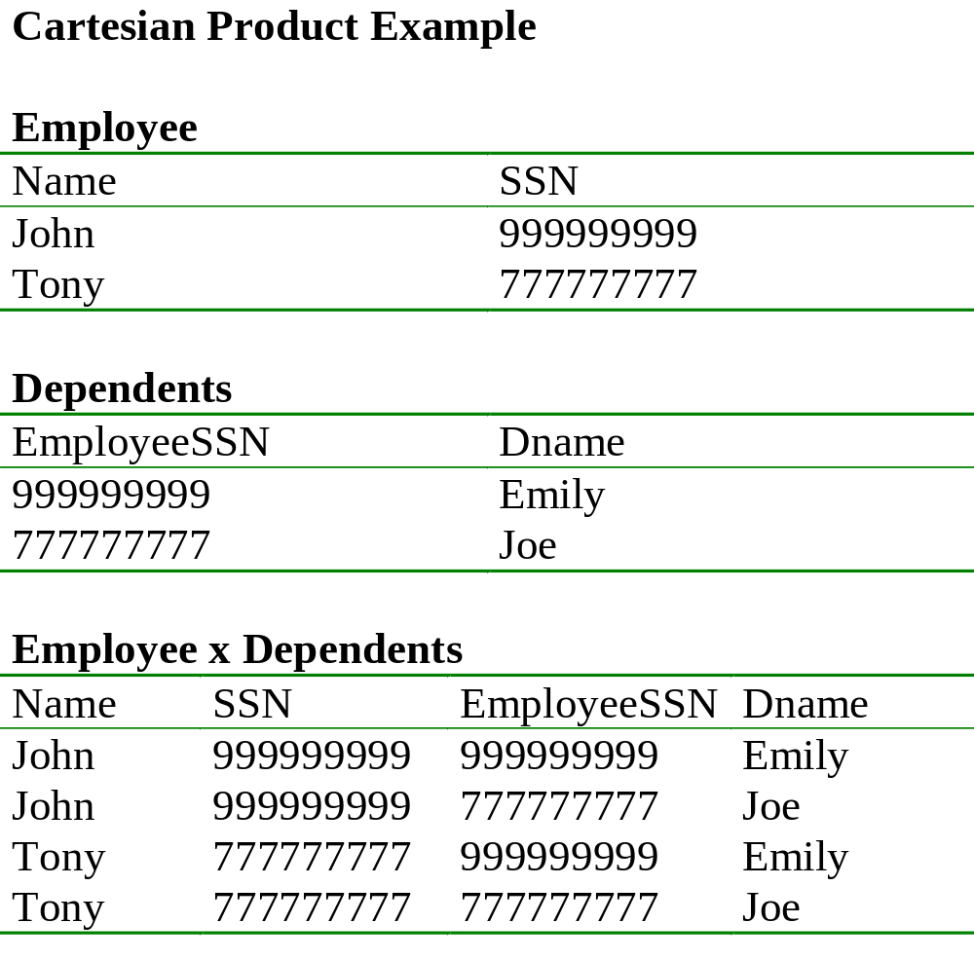
Slide <number>

Slide 36
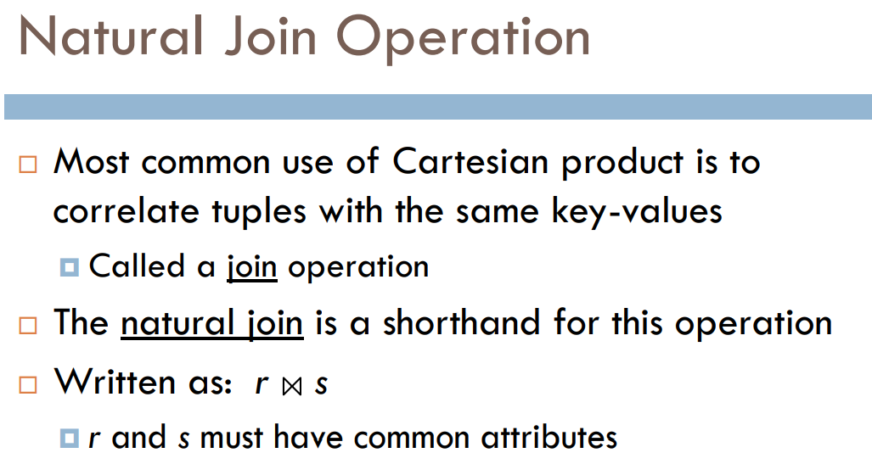
Slide <number>

Slide 37
Natural-Join Operation
Notation: r s
Example:
  R = (A, B, C, D)
  S = (E, B, D)
  Result schema = (A, B, C, D, E)
  r s is defined as:
  ∏_{r.A, r.B, r.C, r.D, s.E} (σ_{r.B = s.B} ∧ _{r.D = s.D} (r x s))
Slide <number>

Slide 38
Natural Join Operation – Example
Relations r, s:
A
B
C
D
B
D
E
α
β
γ
α
δ
1
2
4
1
2
α
γ
β
γ
β
a
a
b
a
b
1
3
1
2
3
a
a
a
b
b
α
β
γ
δ
∈
r
s
r s
A
B
C
D
E
α
α
α
α
δ
1
1
1
1
2
α
α
γ
γ
β
a
a
a
a
b
α
γ
α
γ
δ
Slide <number>

Slide 39
Natural Join
R= S=
R |×| S=
A | B
X | Y
X | Z
Y | Z
Z | V
B | C
Z | U
V | W
Z | V
A | B | C
X | Z | U
X | Z | V
Y | Z | U
Y | Z | V
Z | V | W
Slide <number>

Slide 40
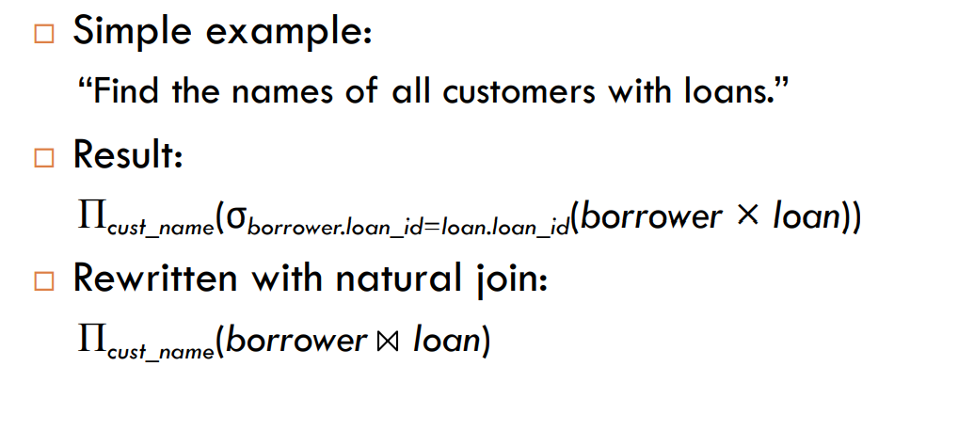
Slide <number>

Slide 41
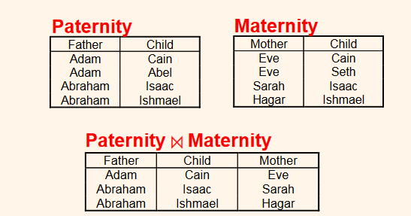

Slide <number>

Slide 42
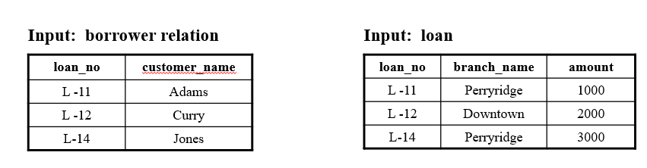
Natural Join Operation
Example: Find all names of all bank customers who have a loan at the bank and find the amount of the loan.
We write, Π _{customer_name, loan_no, amount} (borrower loan)
Output:
customer_name | loan_no | amount
Adams | L-11 | 1000
Curry | L-12 | 2000
Jones | L-14 | 3000

Slide 43
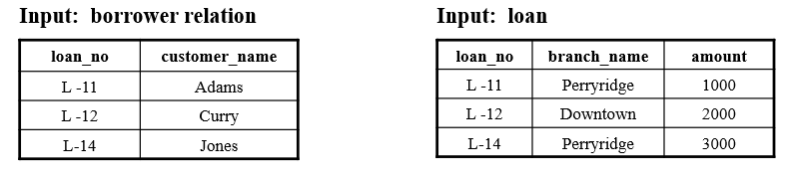
Example: Find all names of all bank customers who have both a loan and an
account at the bank.
We write, Π _{customer_name} (borrower depositor)
Output:
customer_name
Adams
Curry

Slide 44
Aggregate Functions and Grouping
Common functions applied to collections of numeric values include
  SUM, AVERAGE, MAXIMUM, and MINIMUM.
The COUNT function is used for counting tuples or values.
Slide 6- <number>

Slide 45
Aggregate Functions
Aggregate functions take a collection of values and return a single value as a result.
Aggregate functions are:
1. sum( ): Takes a collection of values and return the sum of the values.
2. max( ): Takes a collection of values and return the maximum value.
3. min( ): Takes a collection of values and return the minimum value.
4. count( ): Takes a collection of values and return the no. of values in collection.
5. avg( ): Takes a collection of values and return the average of the values.
It is denoted by using the symbol G such as
_{G1,G2,…Gn} G _{F1 (A,), F2 (A2), … Fm (Am)} (E)
where G represent an aggregation is to be applied and its subscript specifies
the aggregate operations to be applied and G1,G2…Gn constitute a list of
attributes on which to group.

Slide 46
Example: Consider the following relation pt_works.
Input: pt_works Relation
emp_name | branch_name | salary
Adams | Perryridge | 1500
Brown | Perryridge | 1300
Gopal | Downtown | 5300
Islam | Downtown | 1500
Ahmad | Austin | 2500
Query:
Find the total sum of salaries and average salaries of all the part-time employees in the bank.
G _{sum(salary) , average(salary)} (pt_works)
sum(salary) | average(salary)
12100 | 2420

Slide 47
Query:
2. Find the total sum of salaries of all the part-time employees at each branch.
_{branch_name}G _{sum(salary) as sum_of_salary} (pt_works)
branch_name | sum_of_salary
Perryridge | 2800
Downtown | 6800
Austin | 2500
3. Find the total sum of salaries and the maximum salary for part-time employees at each
branch.
_{branch_name}G _{sum(salary), max(salary)} (pt_works)
branch_name | sum(salary) | max(salary)
Perryridge | 2800 | 1500
Downtown | 6800 | 5300
Austin | 2500 | 2500

Slide 48
Aggregate Function Operation
Use of the Aggregate Functional operation ℱ (“script F”)
  ℱ_{MAX (Salary)} (EMPLOYEE) retrieves the maximum salary value from the EMPLOYEE relation
  ℱ_{MIN (Salary)} (EMPLOYEE) retrieves the minimum Salary value from the EMPLOYEE relation
  ℱ_{SUM (Salary)} (EMPLOYEE) retrieves the sum of the Salary from the EMPLOYEE relation
  ℱ_{COUNT (SSN), AVERAGE (Salary)} (EMPLOYEE) computes the count (number) of employees and their average salary
    Note: count just counts the number of rows, without removing duplicates
Slide 6- <number>

Slide 49
Using Grouping with Aggregation
A variation of aggregate operation ℱ allows this:
  Grouping attribute placed to left of symbol
  Aggregate functions to right of symbol
  _{DNO} ℱ_{COUNT SSN, AVERAGE Salary} (EMPLOYEE)
Above operation groups employees by DNO (department number) and computes the count of employees and average salary per department
Slide 6- <number>

Slide 50
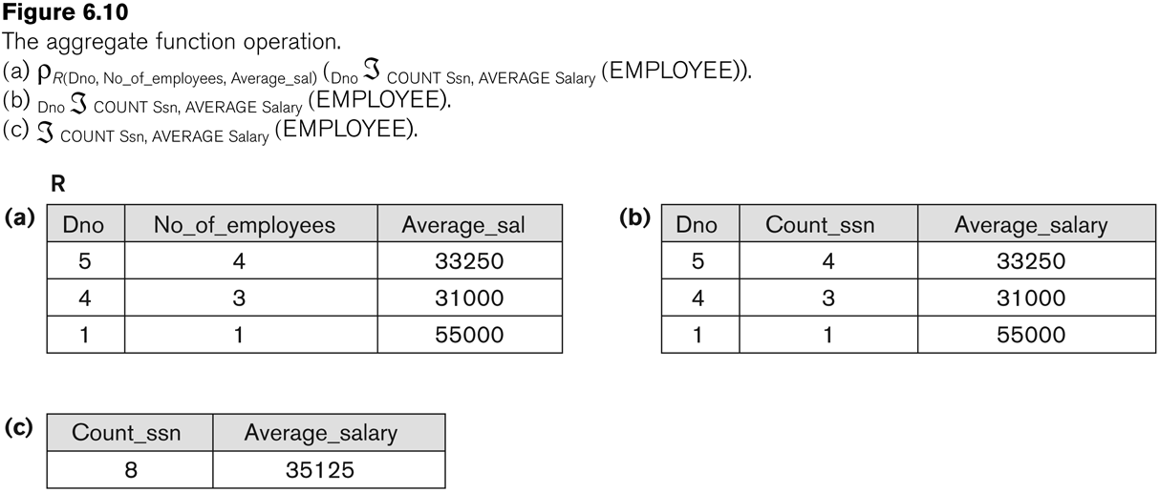
Examples of applying aggregate functions and grouping
Slide 6- <number>

Slide 51
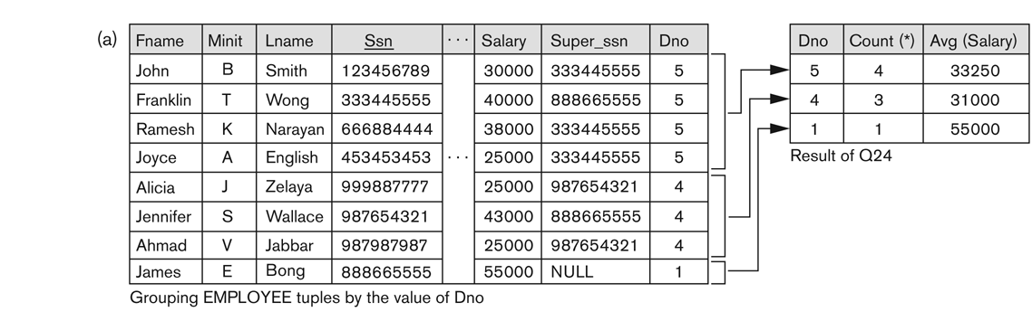
Illustrating aggregate functions and grouping
Slide 6- <number>

Slide 52
Outer Join – Example
Relation loan
loan_number
branch_name
amount
L-170
L-230
L-260
Downtown
Redwood
Perryridge
3000
4000
1700
Relation borrower
customer_name
loan_number
Jones
Smith
Hayes
L-170
L-230
L-155
Slide <number>

Slide 53
Outer Join – Example
Inner Join
loan Borrower
loan_number
branch_name
amount
customer_name
L-170
L-230
Downtown
Redwood
3000
4000
Jones
Smith
Left Outer Join
loan Borrower
loan_number
branch_name
amount
customer_name
L-170
L-230
L-260
Downtown
Redwood
Perryridge
3000
4000
1700
Jones
Smith
null
Slide <number>

Slide 54
Outer Join – Example
Right Outer Join
loan borrower
loan_number
branch_name
amount
customer_name
L-170
L-230
L-155
Downtown
Redwood
null
3000
4000
null
Jones
Smith
Hayes
Full Outer Join
loan borrower
loan_number
branch_name
amount
customer_name
L-170
L-230
L-260
L-155
Downtown
Redwood
Perryridge
null
3000
4000
1700
null
Jones
Smith
null
Hayes
Slide <number>

