Slide 1


Slide 2
ONLINE LIBRARY MANAGEMENT SYSTEM

Slide 3
Presented To Tasniya Ahmed Neela Lecturer, IIT,NSTU
Presented By
Shuvo Islam (ASH1825032M)
Nishat Tasnim Tamanna(BKH1825006F)

Slide 4
TABLE OF CONTENTS
1.
5.
2.
3.
7.
4.
ABOUT THE PROJECT
USECASE DIAGRAM
6.
PURPOSE OF PROJECT
ER DIAGRAM
FUNCTIONAL REQUIREMENT
PROJECT FEATURE
8.
FUTURE PLAN
LANGUAGE USES FOR PROJECT

Slide 5
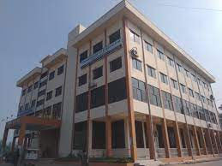
OVERVIEW OF ONLINE LIBRARY MANAGEMENT SYSTEM
Online Library Management system is the kind of automated system where we mainly focused on how we can provide a friendly environment to maintain the details of books and library member. Member logged in our system using unique username/email and password. Fine collection, add books, remove books, approve book, student add etc. work done by admin. student search book then request for a book ,see their profile etc.

Slide 6
PURPOSE OF THE PROJECT
Digital Info records
1
Less time consuming
2
Easy to maintain
3

Slide 7
SOFTWARE REQUIREMENT
• Front end
Html
Css
JavaScript
Bootstrap
• Back end
MySQL
php

Slide 8
FUNCTIONAL REQUIREMENT OF OLMS
Functional requirements refer to the functions which are mandatory to the system. Functional requirements must be able to perform on the software system.

Slide 9
Cont.
1. Login into the system using unique username/email and password
2. Search book using identification number or book name
3. Add and delete book by admin
4. Admin can approve book
5. Admin collect fine
6. Admin and student change their password
7. Admin add student into database
8. Admin search student using student roll and first name
9. Student send request for a one book at a time
10.Student send feedback, admin send announcement

Slide 10
NON FUNCTIONAL REQUIREMENT
Usability Requirement
Availability
Requirement
Accuracy
Performance
requirement

Slide 11
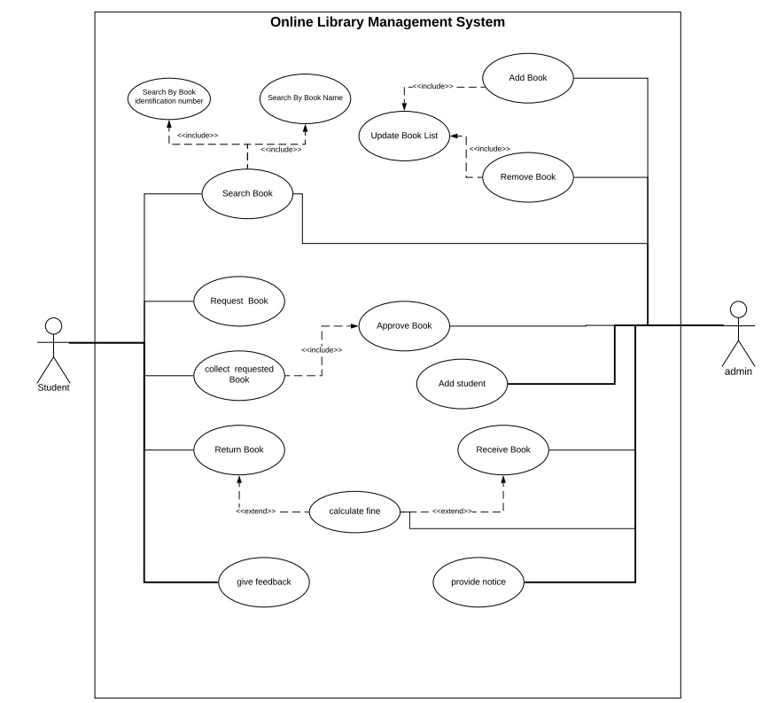
USECASE DIAGRAM OF OLMS

Slide 12
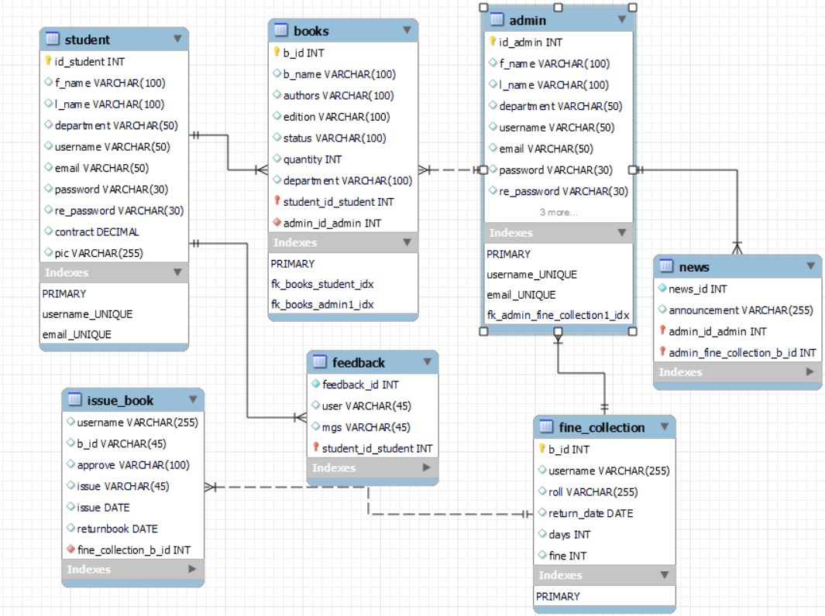
ER DIAGRAM

Slide 13
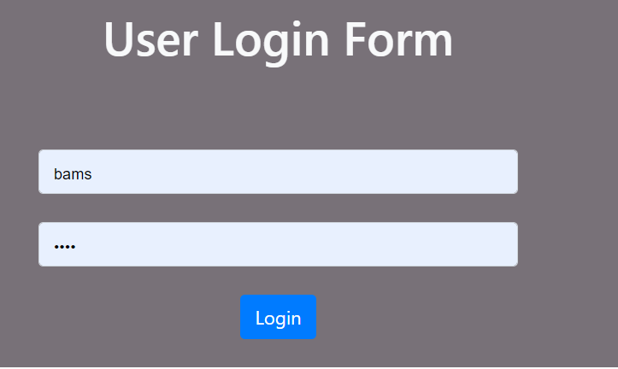
STUDENT FEATURE OF OLMS
Student and admin can logged in our system using their unique username and password

Slide 14
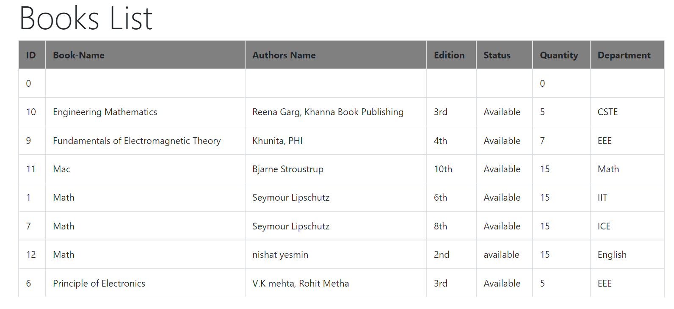
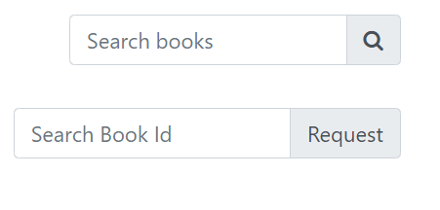
Show book list and search book

Slide 15
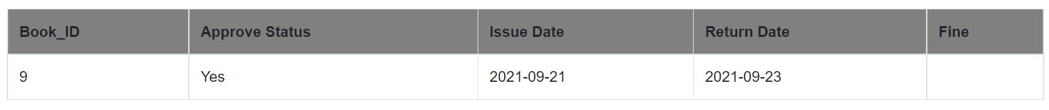
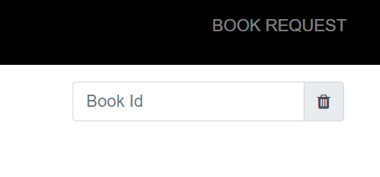
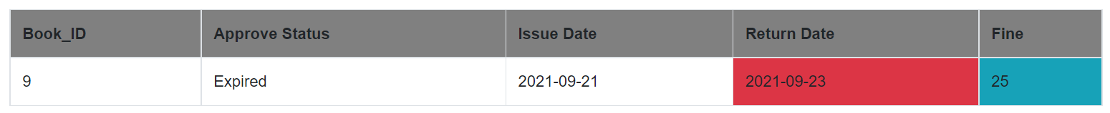
Student can see their issue information

Slide 16
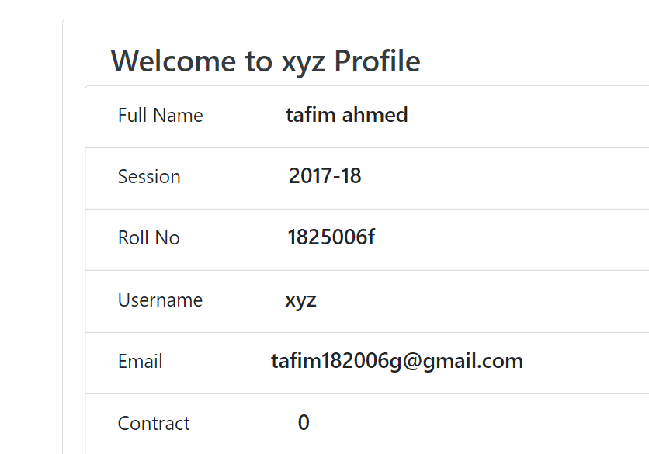
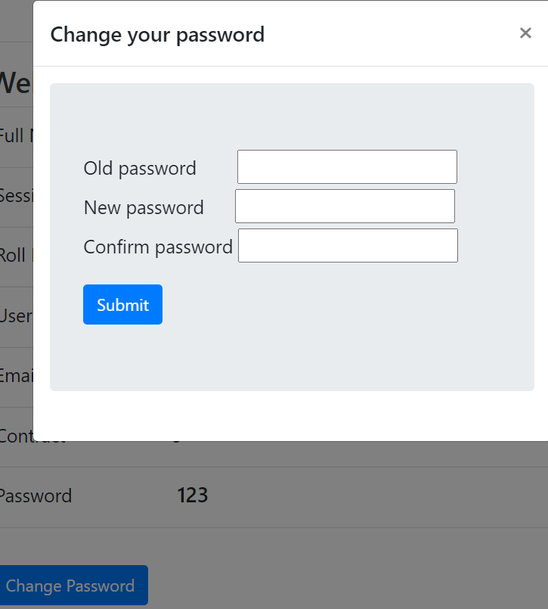
Show student profile

Slide 17
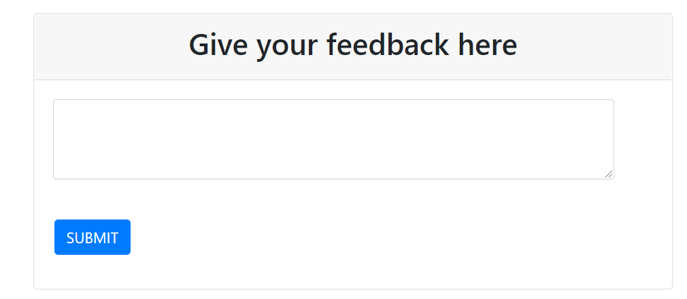
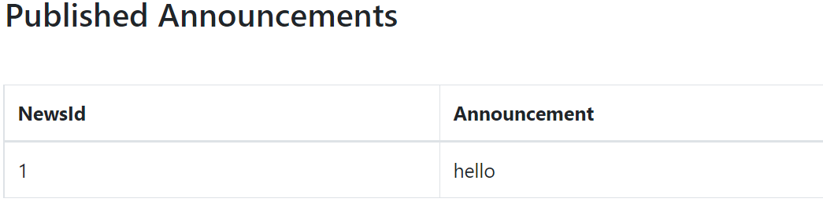
Provide feedback see announcement

Slide 18
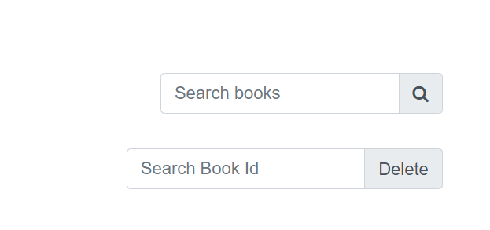
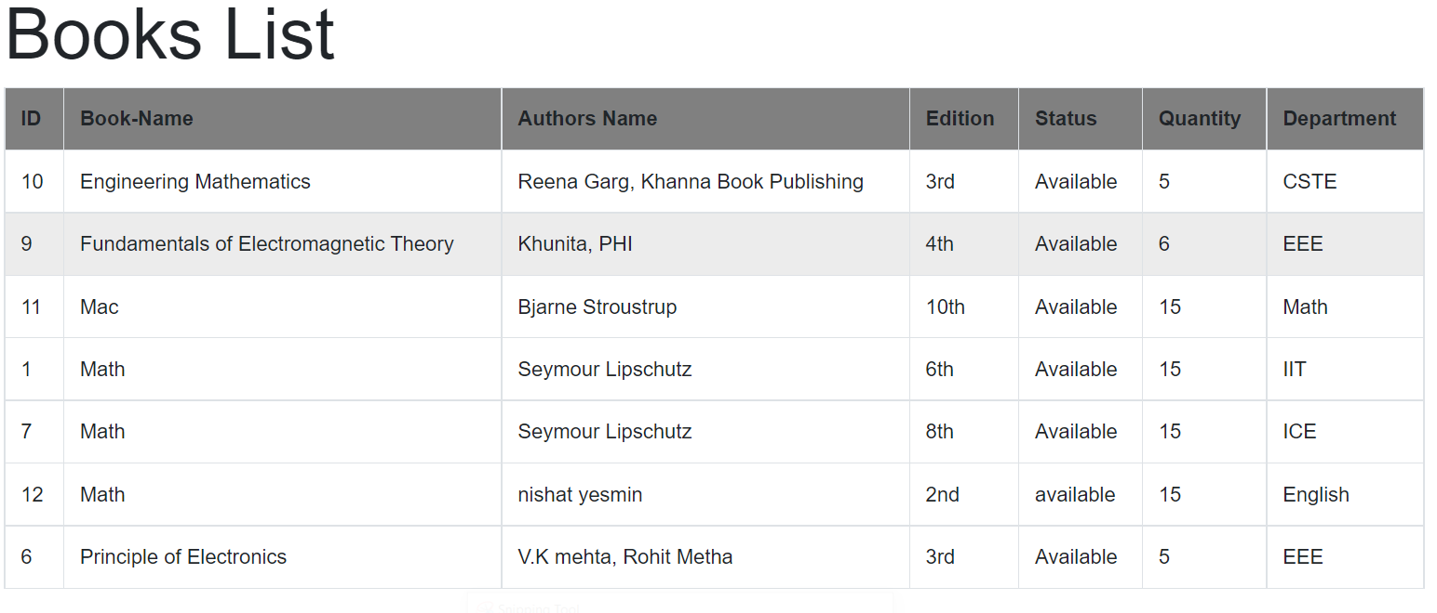
Admin feature

Slide 19
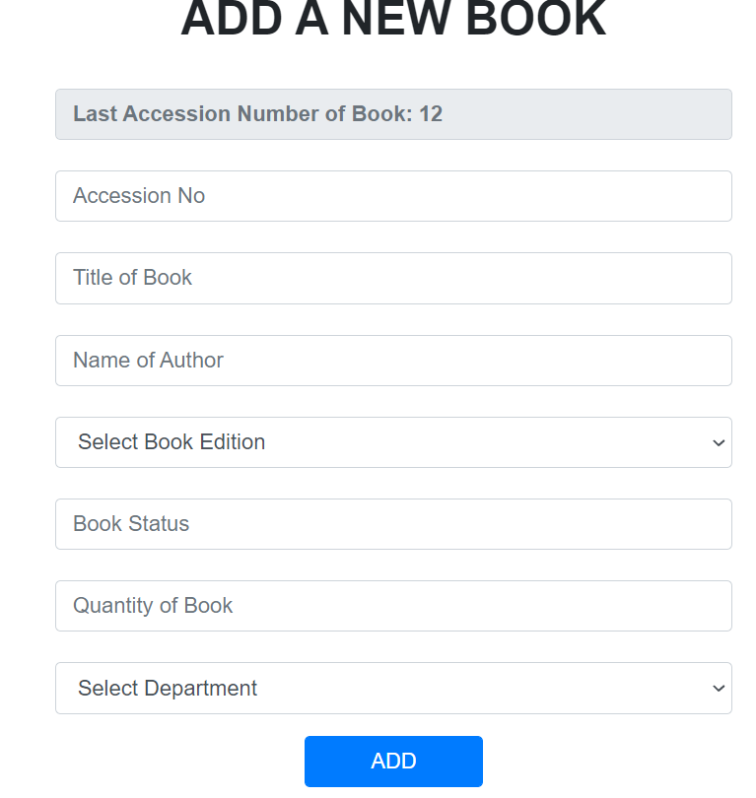
Add Book in Books Table

Slide 20
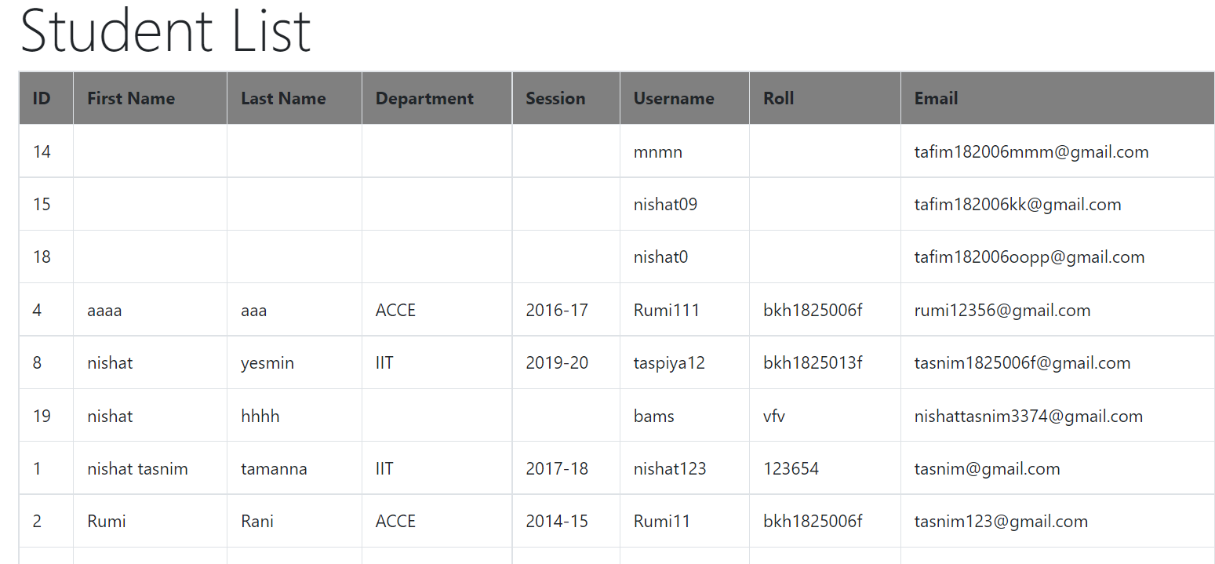
SEARCH STUDENT

Slide 21
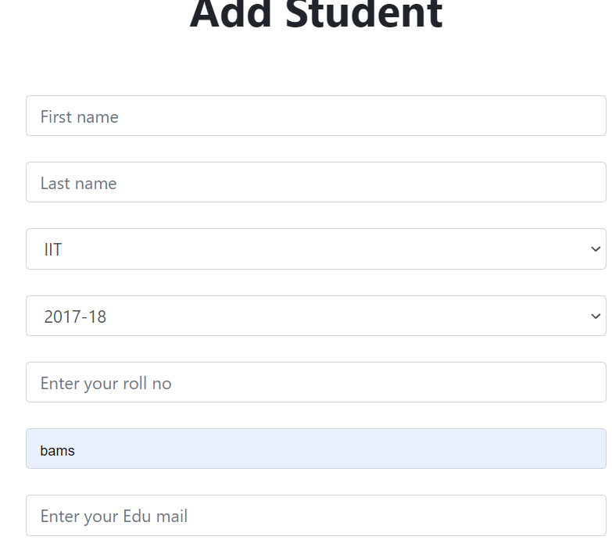
ADD STUDENT

Slide 22
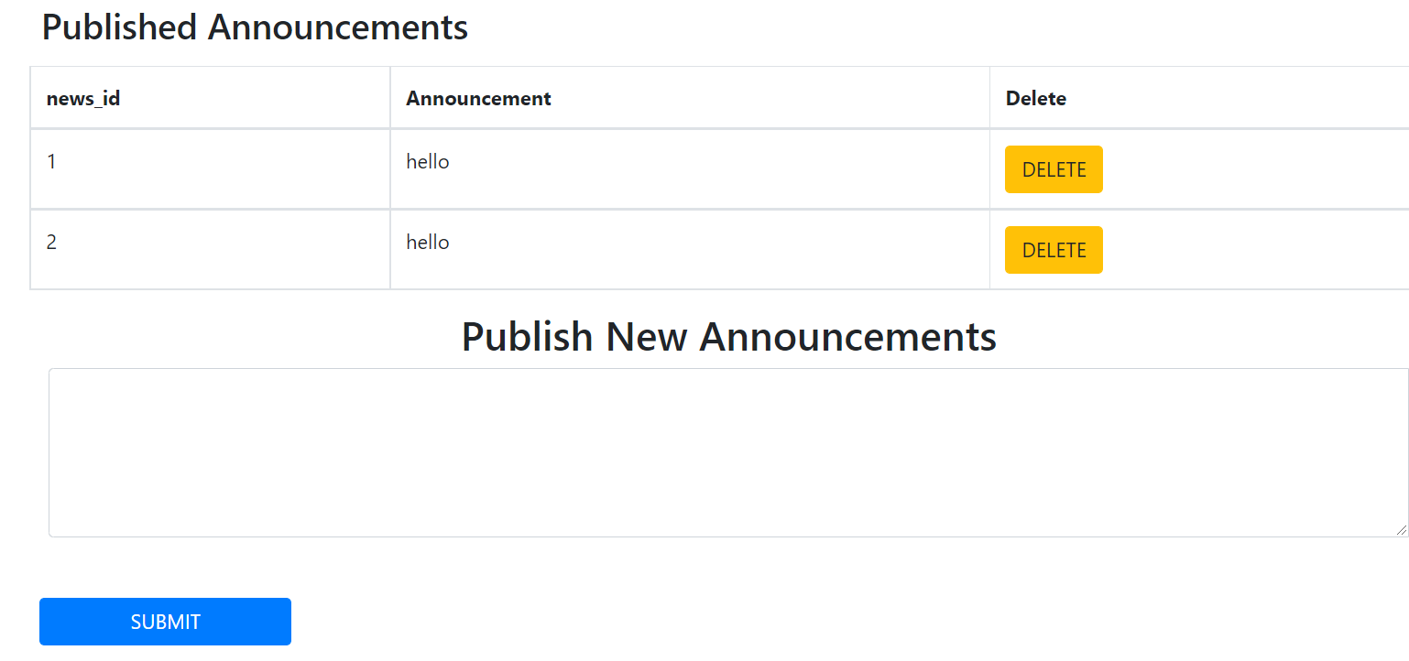
PROVIDE ANNOUNCEMENT

Slide 23
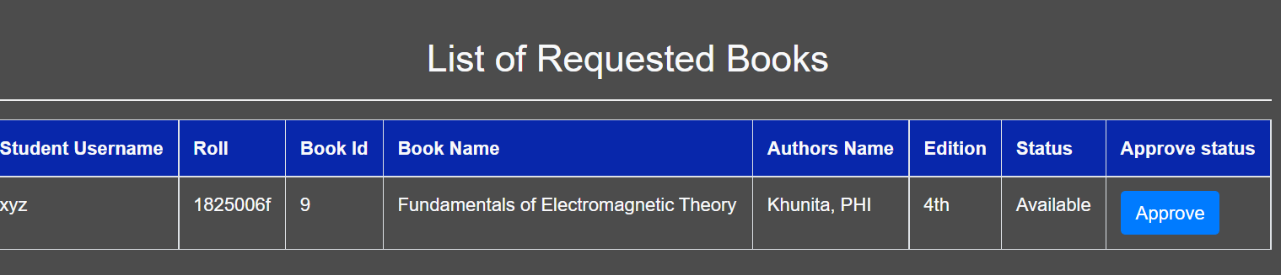
SEE THE BOOK REQUEST INFORMATION

Slide 24
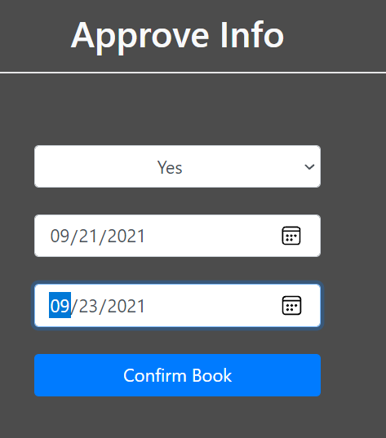
APPROVE BOOK

Slide 25
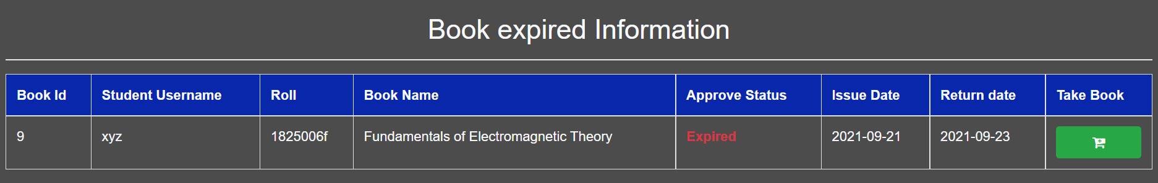
SEE EXPIRED BOOKS INFO

Slide 26
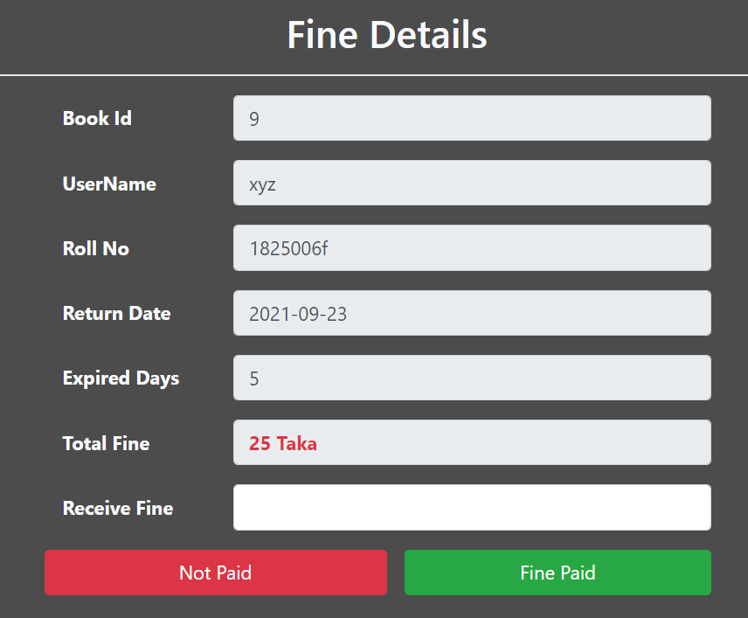
COLLECT FINE FROM STUDENT

Slide 27
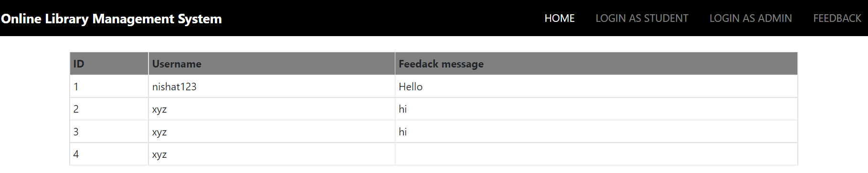
FEEDBACK

Slide 28
FEATURE ADD IN FUTURE
1
Student will be notified by email address about their
return date
2
Student will be able to reply other students feedback.
3
Stockholder able to recover their password
through email
4
Students will be able to pay their fine by their online bank.

Slide 29
THANK YOU…..

