Slide 1
Developing a Feasible Model for the IoT-Based Ubiquitous Healthcare Monitoring System using Data Optimization Technique

Slide 2
Supervised By:
Dr. Mohammad Nuruzzaman Bhuiyan, Assistant Professor (IIT)
Presented By:
Nishat Tasnim Tamanna
BKH1825006F

Slide 3
Contents
Problem Statements
Motivation
Benefits
Implementation Plan

Slide 4
Problem Statement
Continuously collect health data using sensors and store data in the cloud patient database
Mobile applications retrieve data from the cloud database with a transmission delay
Unnecessary data recorded into the patient Database in the cloud

Slide 5
Motivation
Reduce the uses of cloud storage
Only emergency data can be stored in the cloud
Send emergency alerts based on this emergency data

Slide 6
Benefits
Remove Data redundancy from the cloud patient database
Show all critical records of patients
The proposed system has a high potential and is useable in developing countries with fewer memory uses
Reduce transmission delay

Slide 7
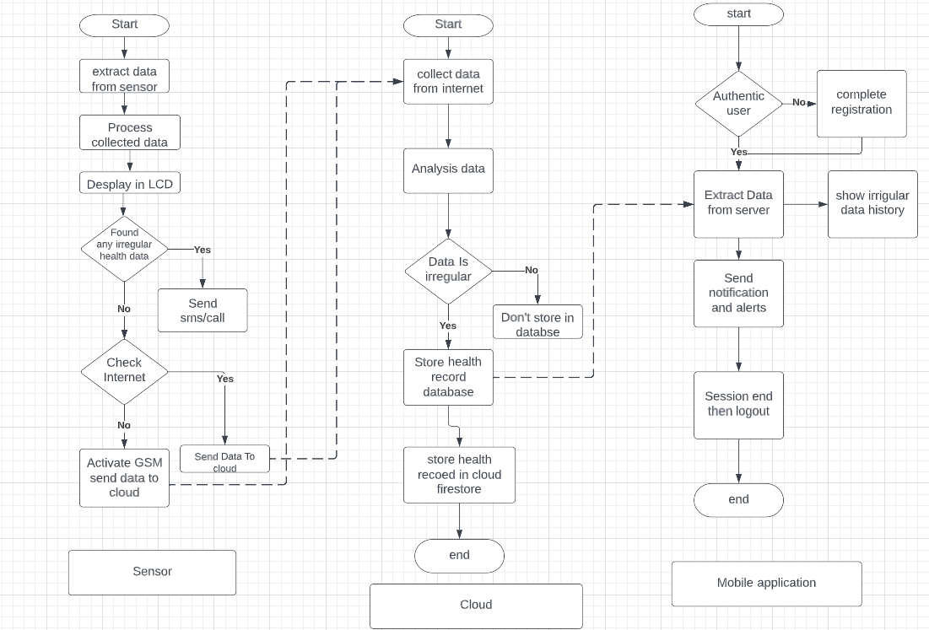
Implementation plan

Slide 8
Thank You…

