Slide 1
Hate Speech Detection
1814038 Vishant Mehta
1814040 Nishavak Naik
1814041 Vighnesh Naik

Slide 2
INTRODUCTION
The implications of hate speech have received considerable attention from legal scholars, philosophers, and the society as a whole.
There has been a rising concern over the effects of hate speech and offensive language.
The analysis is done using many well-known conceptual analysis methods that are different from analytic philosophy.
We aim to classify tweets from a twitter dataset as hate speech and non-hate speech.

Slide 3
APPROACH

Slide 4
Dataset
Information:
Dataset contains tweets with potential abusive or hate speech. It has 56745 rows and 2 columns The columns consists of ‘label’’ and Column 'tweet' contains the actual user tweet content. Column 'label' contains zeros and ones to indicate whether the tweet have hate speech or abusive content in them.
Preprocessing:
The dataset contains tweets, which are filled with special characters. So Using regex all special characters and number are removed and contractions are removed. We have used NLTK Library. "WordNetLemmatizer" to lemmatize the tweets which converts the words into its root form. As the stopwords hold low level information and removal does not affect precision, we removed them using nltk stopwords. Then perform Vectorization by creating vectors from the embeddings by using gensim word2vec class.

Slide 5
Models Implemented
MACHINE LEARNING ALGORITHMS
Support Vector Classification
Random Forest Classifier
Logistic Regression
Neural Network
Adam optimizer and Binary Cross-Entropy loss function based neural network.

Slide 6
Support Vector Classification
The goal of the SVM algorithm is to create the best line or decision boundary that can segregate n-dimensional space into classes so that we can easily put the new data point in the correct category in the future. This best decision boundary is called a hyperplane.
To differentiate various classes, SVM creates a hyperplane in multidimensional space. SVM iteratively generates the best hyperplane, which is then utilised to minimise an error. The goal of SVM is to find a maximum marginal hyperplane (MMH) that splits a dataset into classes as evenly as possible.
SVM can be of two types:
Linear SVM
Non-linear SVM

Slide 7
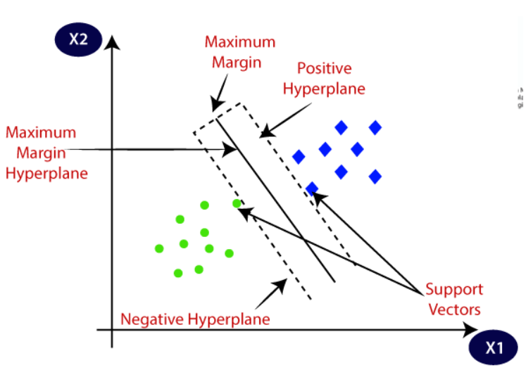

Slide 8
Random Forest Classifier
Random Forest Classifier utilizes ensemble learning, which is a technique that combines several classifiers. It is basically numerous decision trees working together, each individual tree works on sub-sample of the dataset. The average of each trees predicted classes is taken for the end results. More number of trees increases the precision of the outcome and also reduces overfitting.
Random forests work well for a large range of data items than a single decision tree does.
Random forest has less variance then single decision tree.
Random forests are very flexible and possess very high accuracy.

Slide 9
Logistic Regression
Logistic Regression is one of popular supervised learning algorithm used for classification problem. It predicts the output of the dependent variable using the set of independent variable and gives the output value in range of 0 to 1.
The output value gives the likeliness of the dependent variable. Instead of fitting a regression line, we used logistic regression to fit a sigmoidal logistic function that predicts two maximum values. To convert expected values to probabilities, the sigmoid function is used. For regularization we use C value as 100. Regularization is applying a penalty to increasing the magnitude of parameter values in order to reduce overfitting. Smaller the value of C means stronger regularization.

Slide 10
Neural Network
Neural networks rely on training data to learn and improve their accuracy over time. However, once these learning algorithms are fine-tuned for accuracy, they are powerful tools in computer science and artificial intelligence, allowing us to classify and cluster data at a high velocity. Tasks in speech recognition or image recognition can take minutes versus hours when compared to the manual identification by human experts.
One of the most well-known neural networks is Google’s search algorithm.
Adam optimizer is an adaptive learning rate optimization algorithm that’s been designed specifically for training deep neural networks.
Binary cross entropy compares each of the predicted probabilities to actual class output which can be either 0 or 1. It then calculates the score that penalizes the probabilities based on the distance from the expected value. That means how close or far from the actual value.

Slide 11
COLAB LINK
IA1 Code
https://colab.research.google.com/drive/1wpc6ZnZybr4mKZOUK3-mF71ZLqFnu68Q?usp=sharing
IA2 Code
https://colab.research.google.com/drive/1ZnvmPER3lC_CH3hL9WRvqtJYjxAA1g3r?usp=sharing
Notes:
https://nlp.stanford.edu/IR-book/html/htmledition/stemming-and-lemmatization-1.html
https://www.geeksforgeeks.org/python-lemmatization-approaches-with-examples/

Slide 12
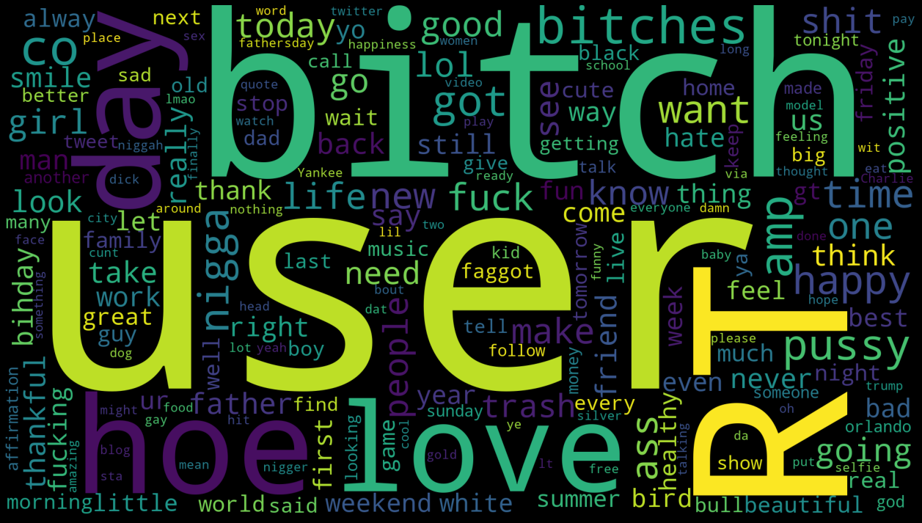
RESULTS

Slide 13
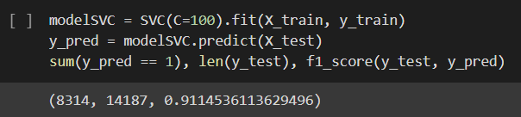
Support Vector Classifier

Slide 14
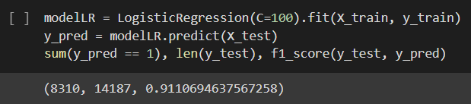
Logistic Regression

Slide 15
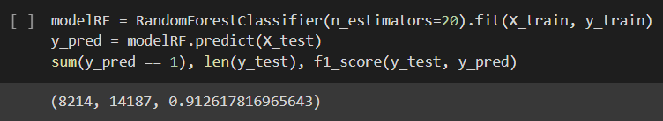
Random Forest Classifier

Slide 16
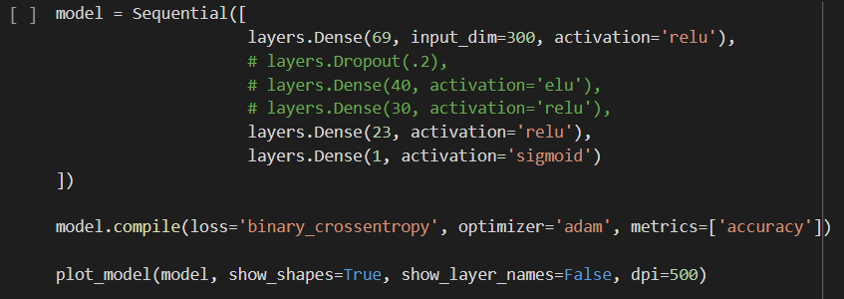
Neural Network

Slide 17
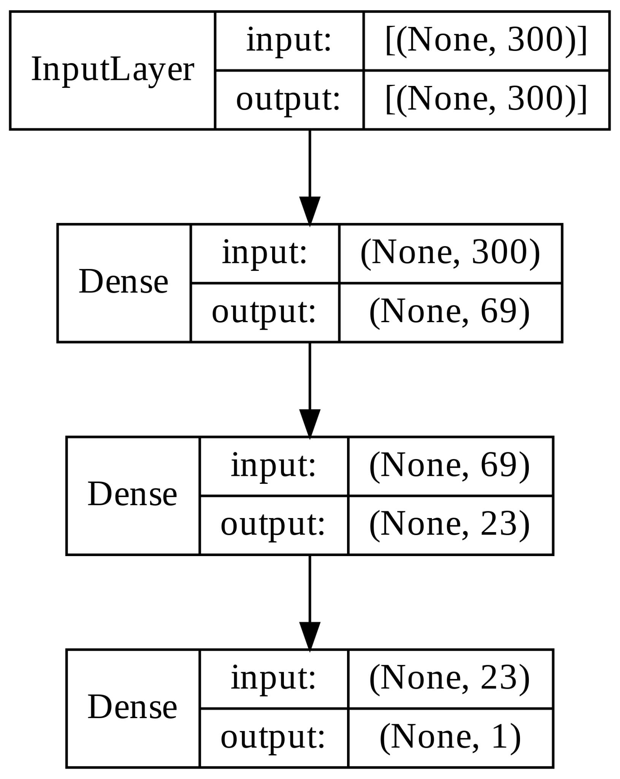

Slide 18
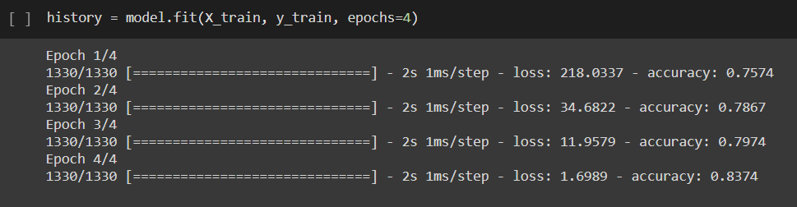
Model Fitting

Slide 19
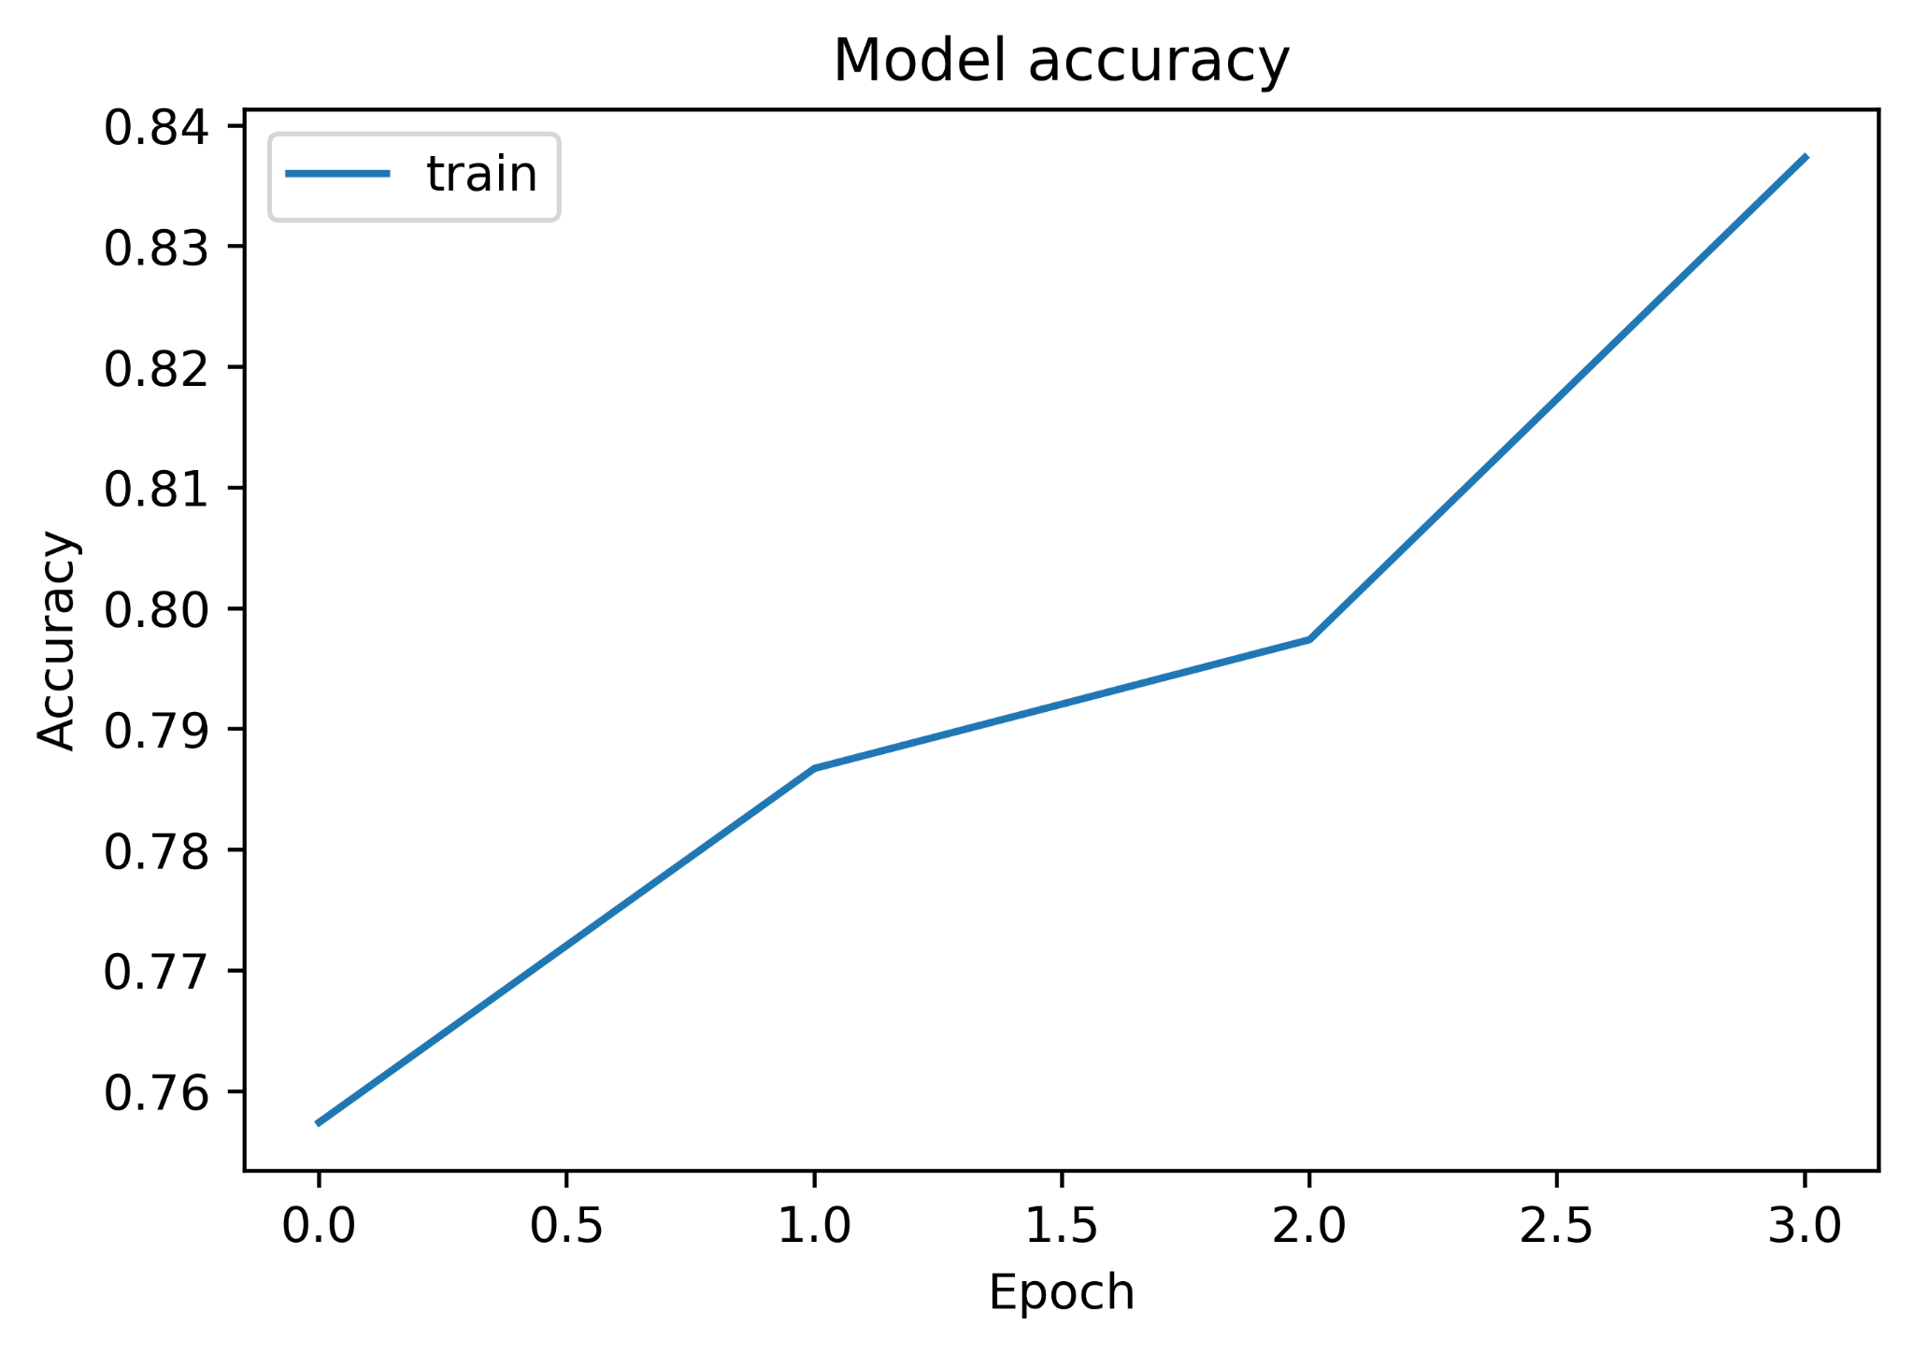

Slide 20
CONCLUSION
We surveyed and studied various research papers and compared the methodology of all the papers. We analysed their approach to detect hate speech. Thereby, we trained and tested several machine learning algorithms - Support Vector Classifier (SVC), Multinomial Naive Bayes (MultinomialNB), Random Forest Classifier (RFC), Stochastic Gradient Descent (SGD) Classifier and Logistic Regression (LR).
After trying out various algorithms for the detection of hate speech, we found that on “Twitter hate speech” dataset, the Logistic Regression model worked the best with a F1 score of 69.2% and an accuracy of 96.3% whereas the Stochastic Gradient Descent Classifier gave the least F1 score of 10.6% and an accuracy of 93.7%.
Considering the sparseness of the dataset, these results are a good achievement. Furthermore, the performance of the models can be increased by combining algorithms to create ensemble models and thus finding the one with the best performance.

Slide 21
Thank you!

