Slide 1
Predicting Diabetes
- Bijay Adhikari
- Merit Kayastha
- Nischal Bhandari
- Saurav Dahal

Slide 2
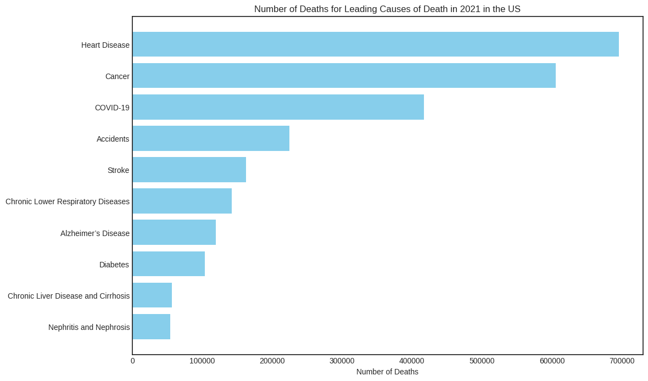
Predicting Diabetes
Introduction -
Diabetes: A Looming Health Crisis
- Bijay Adhikari
- Merit Kayastha
- Nischal Bhandari
- Saurav Dahal
Diabetes, characterized by high blood glucose levels, poses a significant health threat.
CDC reports rank diabetes as the 8th leading cause of death in the United States.
Shockingly, 1 in 5 adults with diabetes in the US remains unaware of their condition.
Mismanagement of diabetes can trigger severe complications like heart disease, stroke, neuropathy, weakened immunity, and kidney damage.

Slide 3
Data Source and Features
Features
Source and Description
Age (1-13)
Sex [B]
HighChol [B]
CholCheck [B]
BMI
Smoker [B]
HeartDiseaseorAttack [B]
PhysActivitity [B]
Fruits [B]
Veggies [B]
HvyAlcoholConsump [B]
GenHlth (1-5)
Ment Hlth (1-30)
PhysHlth (1-30)
DiffWalk [B]
Stroke [B]
HighBP [B]
Diabetes [B]
Kaggle
Compiled from the Behavioral Risk Factor Surveillance System (BRFSS) 2015.
Comprises 70,692 survey responses, encompassing 17 feature variables and 1 target variable, focusing on various health-related aspects.

Slide 4

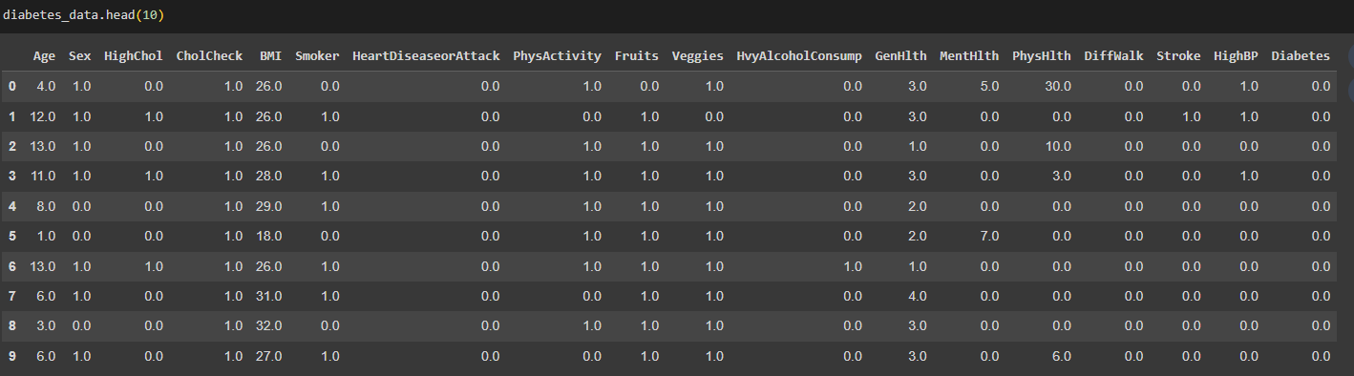
Data Preparation

Slide 5
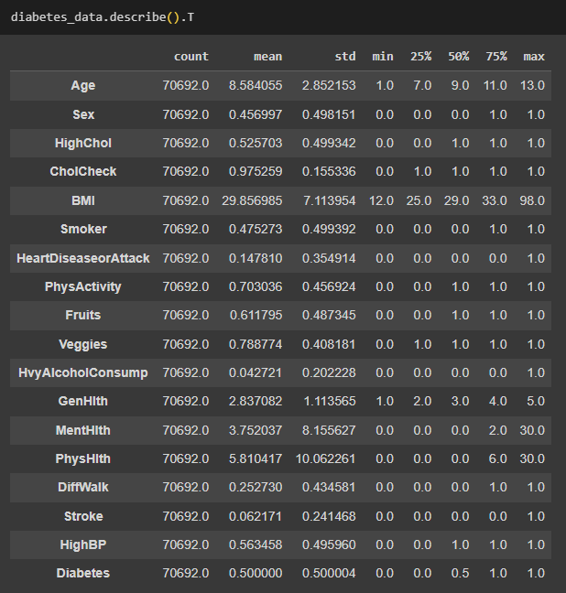
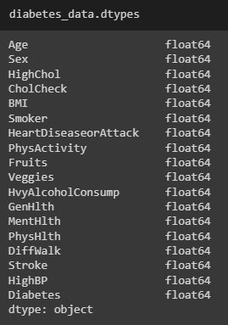
Data Preparation

Slide 6
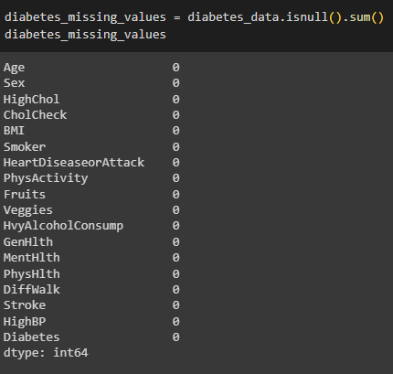
Data Preparation
No Missing Values

Slide 7
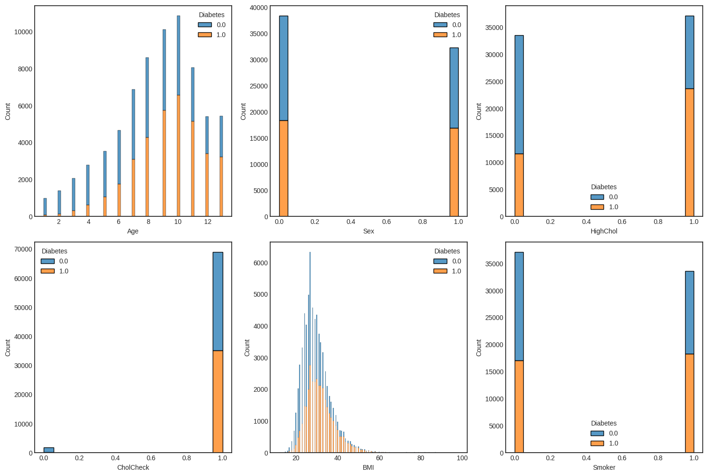
Exploratory Data Analysis (Data Viz)
1=18-24,,
2=25-29,
3=30-34,
4=35-39,
5=40-44,
6=45-49,
7=50-54,
8=55-59,
9=60-64,
10=65-69, 11=70-74,
12=75-79,
13=80+.
0:female.
1: male.
0: no high cholesterol.
1: high cholesterol.
0: not smoked 5 packs of cigarettes in life.
1: smoked at least 5 packs of cigarettes..
0: no cholesterol check in 5 yrs.
1: cholesterol check in 5 yrs.

Slide 8
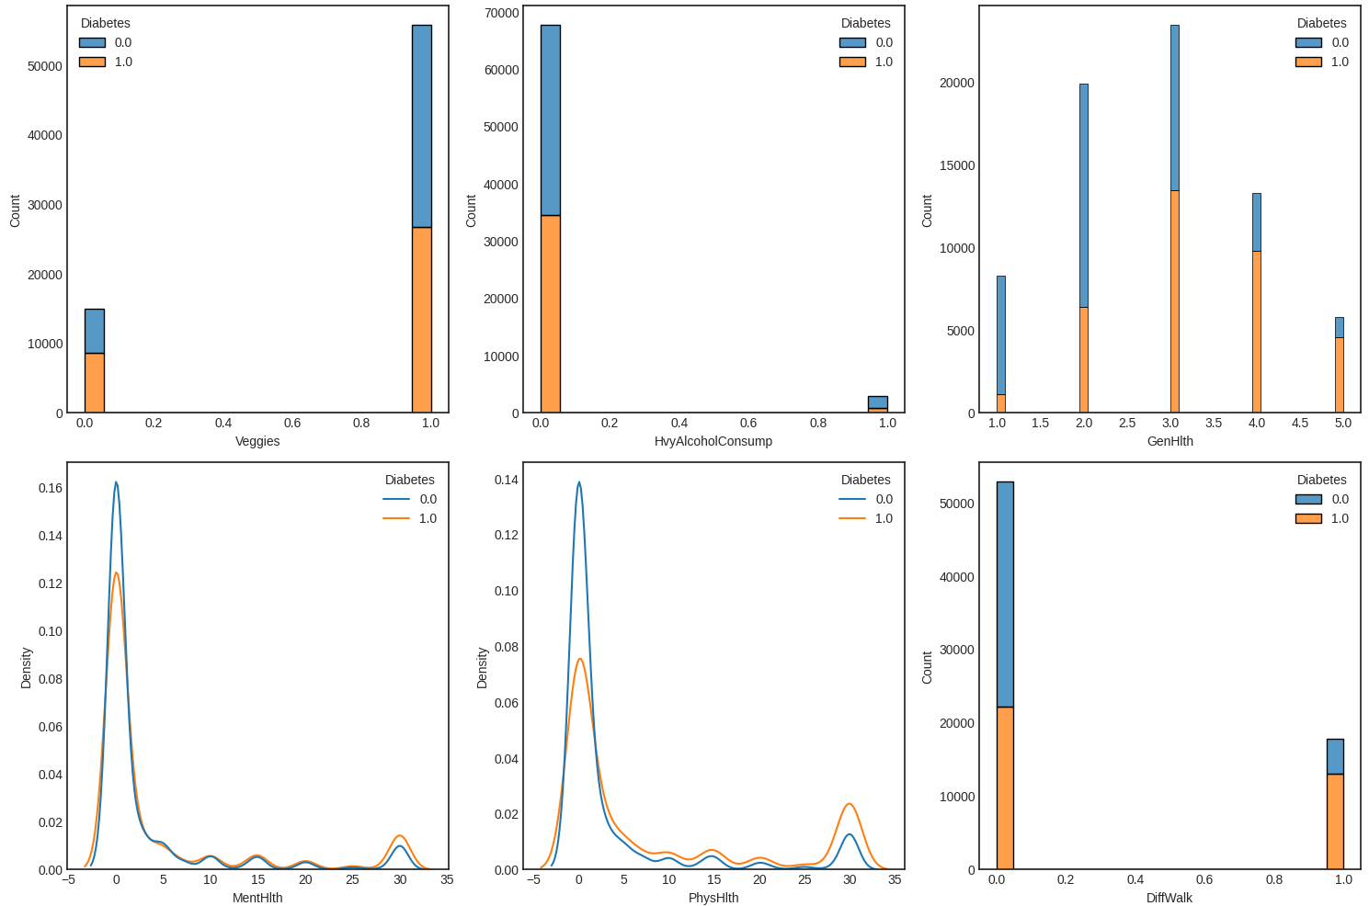
Exploratory Data Analysis (Data Viz)
0: vegetables not consumed at least once a day
1: vegetables consumed at least once a day
0: no heavy alcohol consumption.
1: heavy alcohol consumption.
0: no difficulty while walking.
1: difficulty while walking.

Slide 9
Research Questions
1
2
3
4
5
How do the factors interact with each other in influencing the likelihood of diabetes?
Can we develop a predictive model that most accurately identifies individuals at risks of getting diabetes?
What are the key predictors of diabetes in the most accurate predictive models?
What is the impact of lifestyle factors (like smoking, alcohol consumption, physical activity) on the likelihood of getting diabetes?
Are there significant differences in the prevalence of these health conditions across different demographic groups (e.g. age, gender)?

Slide 10
01
How do the factors interact with each other in influencing the likelihood of diabetes?

Slide 11
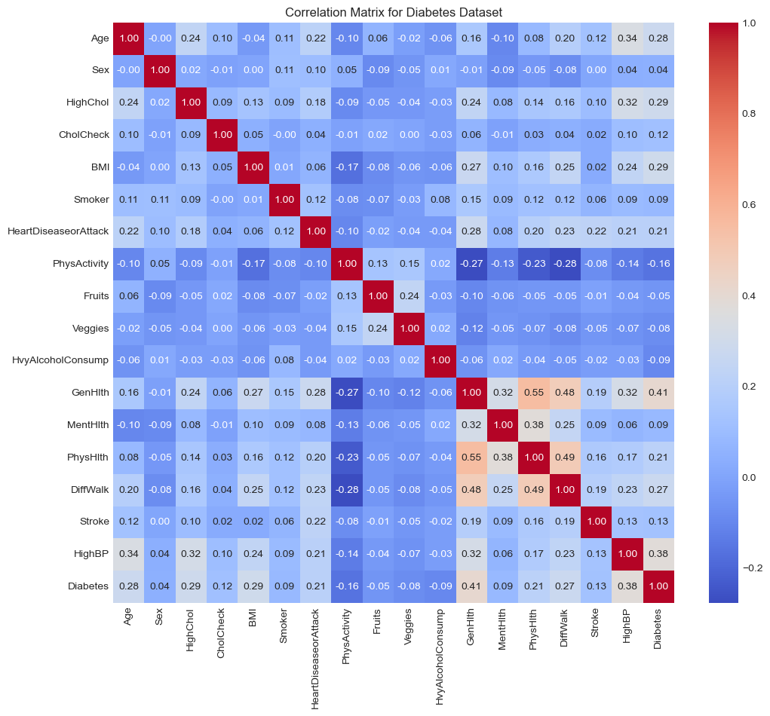
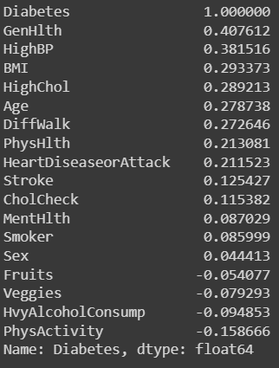
Correlation

Slide 12
02
Can we develop a predictive model that accurately identifies individuals at risks of getting diabetes?

Slide 13
Standardization and data splitting
Standardization of numerical data - Age, BMI, PhysHealth, MentHealth, GenHealth.
Data split into train and test set (80:20).
Train Data: 56,554 rows.
Test Data: 14,138 rows.

Slide 14
Supervised Classification
Machine Learning Algorithms used:
Logistic Regression
K-Nearest Neighbor (KNN): k = 5.
Stochastic Gradient Descent (SGD):
Random Forest: n-estimator: 100
Bagging: n-estimator: 500
Decision Tree
Linear Support Vector Machine (SVM): cost parameter: 10.
Ensemble (voting classifier: Hard)

Slide 15
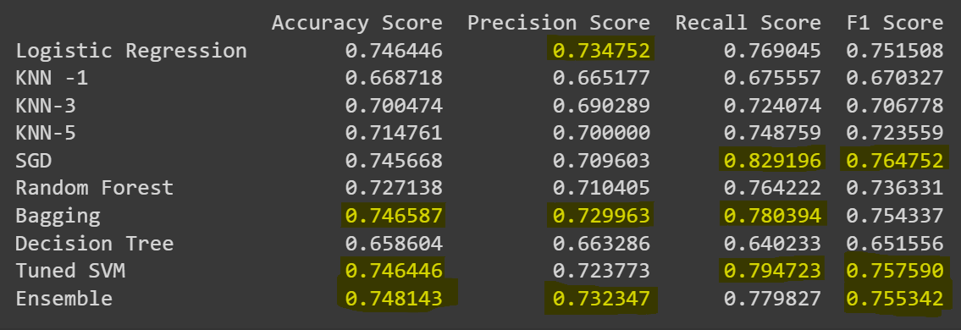

Slide 16
Precision vs Recall ?
For conditions like diabetes, early detection and intervention are often crucial.
Higher recall means the model is better at capturing true positive cases (correctly identifying individuals with diabetes), even if it comes at the cost of more false positives.
Prioritizing recall is beneficial when the priority is to identify as many potential cases of diabetes as possible.

Slide 17
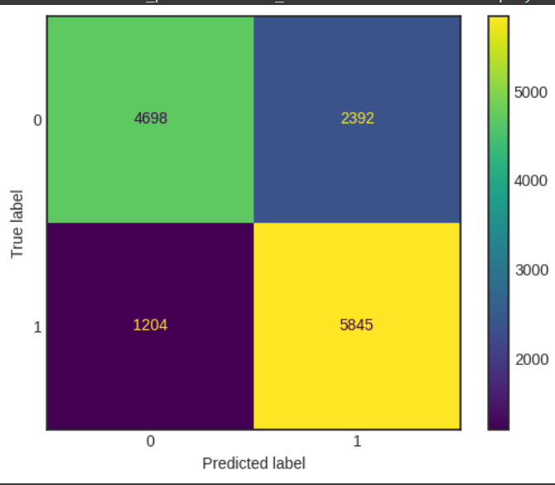
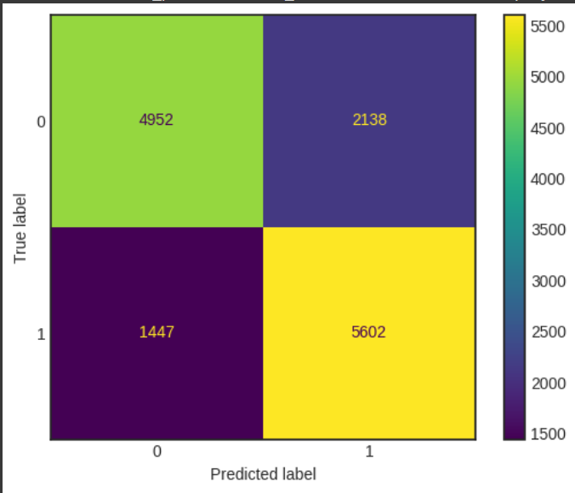
Confusion matrix
SGD
SVM

Slide 18
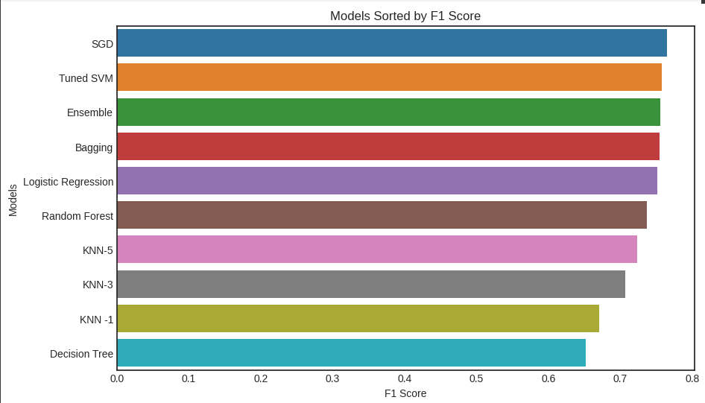
F1: Trade-off Between Precision and Recall

Slide 19
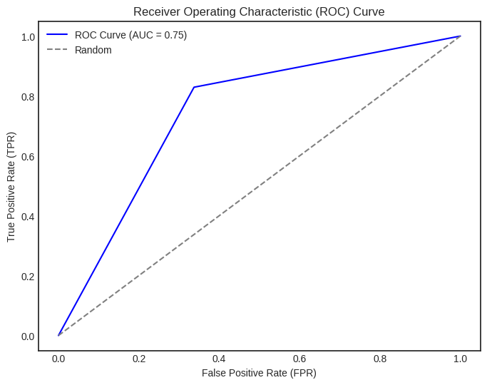
ROC-AUC Curve for SGD model
ROC-AUC of 0.75, meaning the SGD model is capable of distinguishing between individuals with diabetes and those without diabetes fairly well.

Slide 20
03
What are the key predictors of diabetes in the most accurate predictive models?

Slide 21
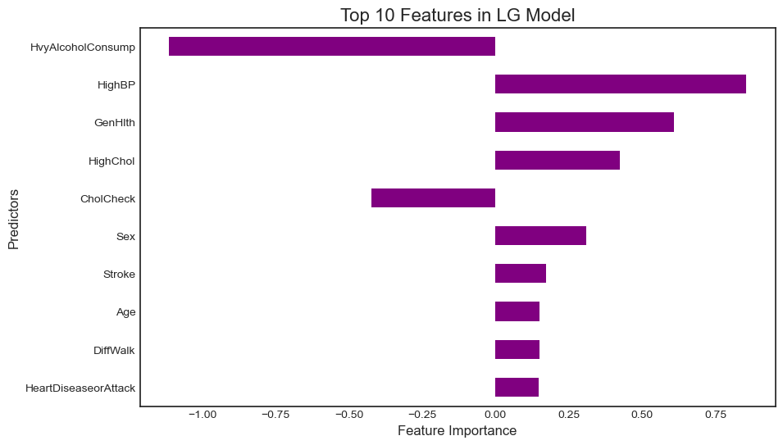
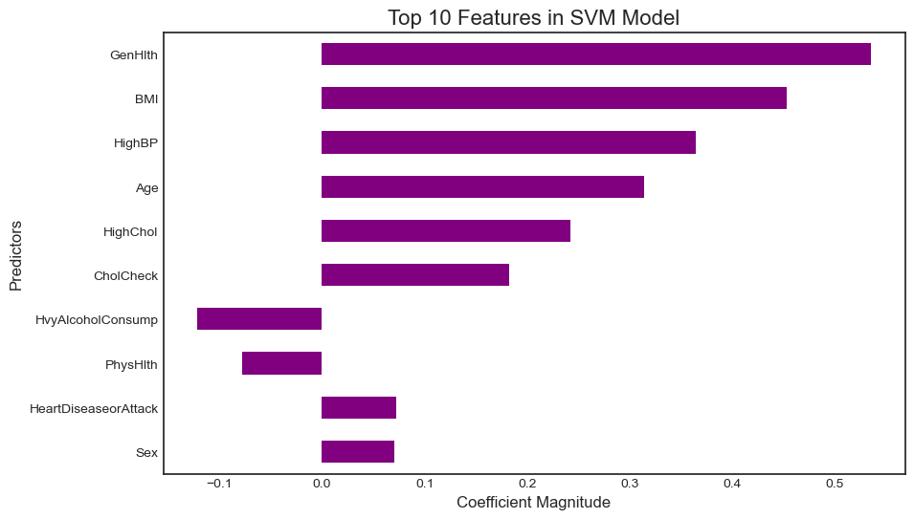
Common predictors:Heavy Alcohol Consumption, Age, Sex, High Chol, High BP
Accuracy of Log Reg:
0.7464460004243582
Accuracy of SVM, c=10:0.7464460004243582

Slide 22
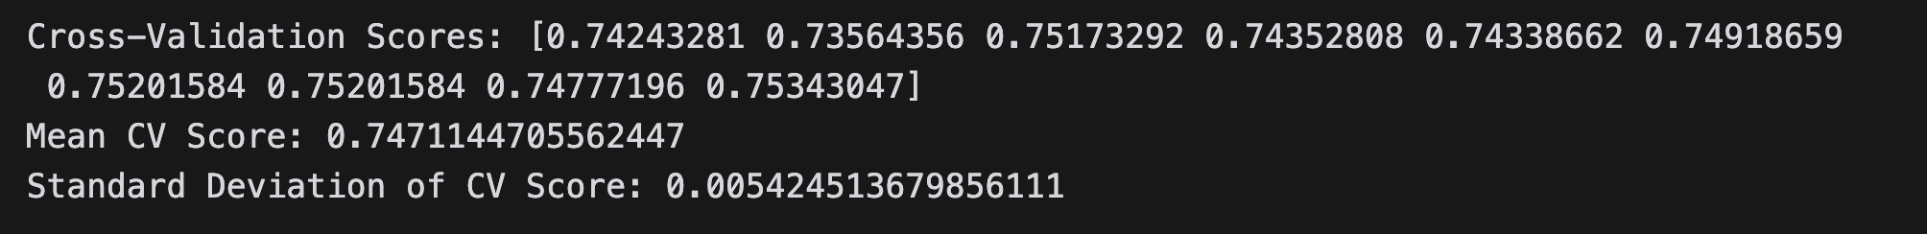
Cross Validation of Logistic Regression
10 folds
Scoring metric: Accuracy
Accuracy score consistent across all folds. Generalizes well across different subsets of data
Overall better model performance (74 %)
Lower variance, not sensitive to a specific subset of data

Slide 23
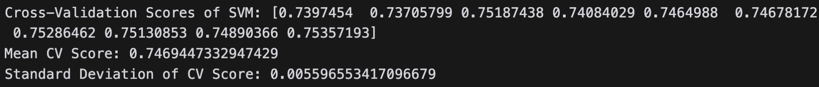
Cross Validation of Tuned SVM
Similar performances as logistic regression

Slide 24
04
What is the impact of lifestyle factors (like smoking, alcohol consumption, physical activity) on the likelihood of getting diabetes?

Slide 25
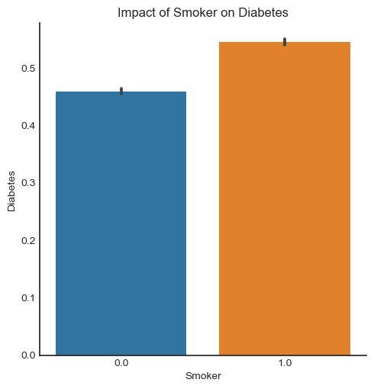
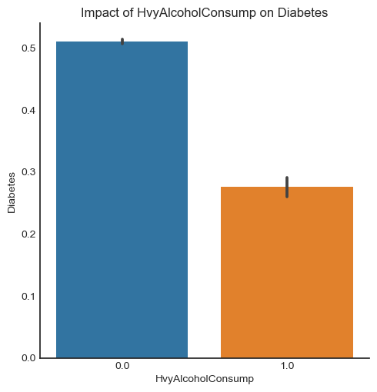
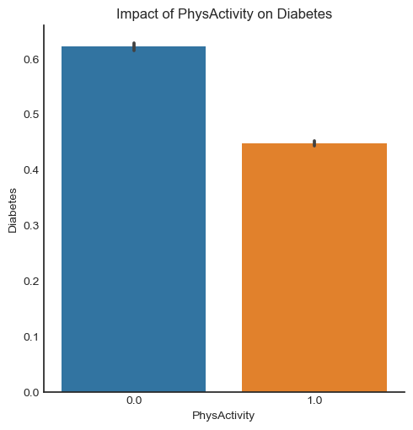
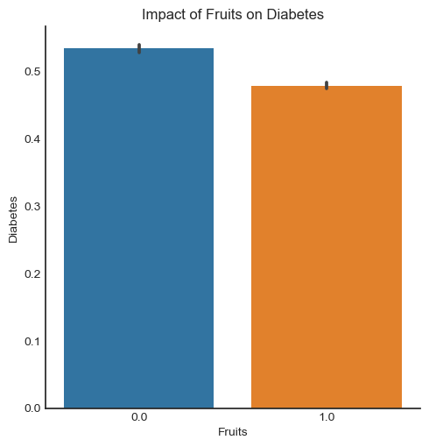
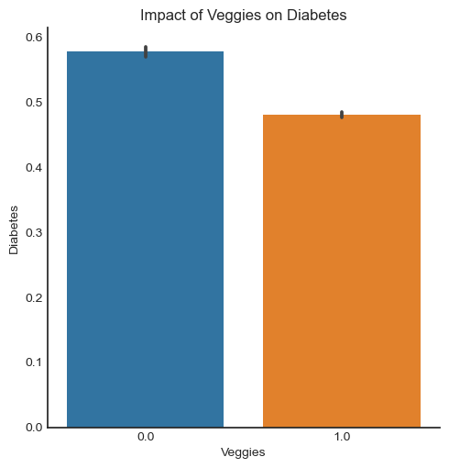
1: Yes 0: No

Slide 26
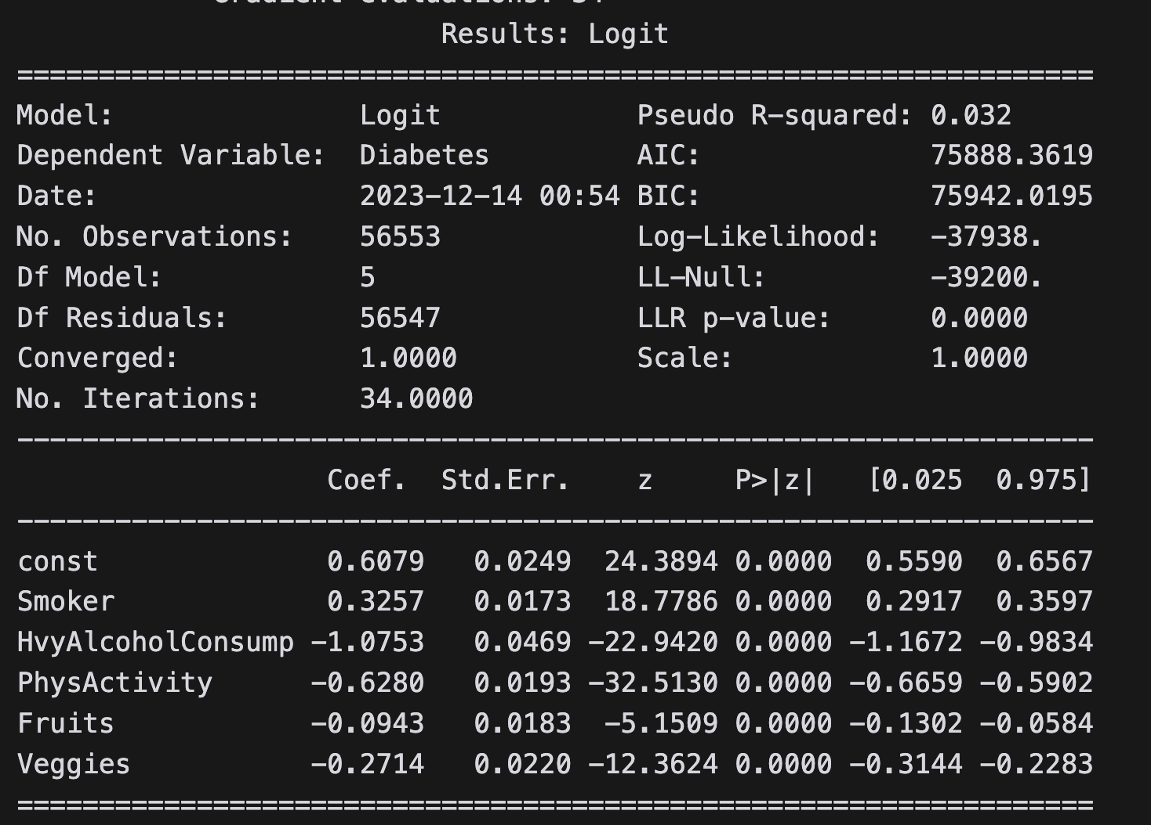
Logistic Regression: Lifestyle Features
Accuracy of logistic regression classifier on lifestyle factors for diabetes: 0.5841
fitted the logistic regression model using scikit-learn, and then convert it to the statsmodels format to obtain a summary using the summary2 method

Slide 27
Findings
The accuracy of predicting diabetes only from the lifestyles factors is 58.4% in logistic regression.
more than 70% accuracy when all predictors were used.
So we can not necessarily isolate other health conditions like stroke, mental health, physical health, cholesterol, and so on that might additionally contribute to diabetes.

Slide 28
05
Are there significant differences in the prevalence of diabetes across different demographic groups?

Slide 29
Prevalence of Diabetes across Age.

Slide 30
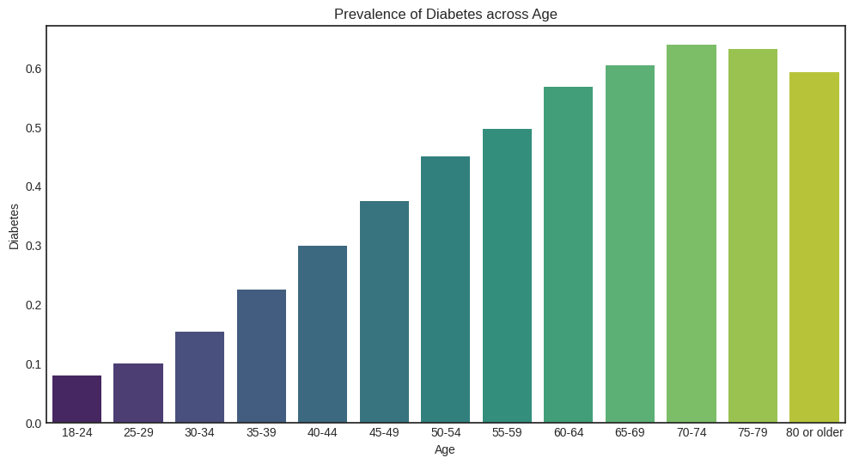

Slide 31
The older you get, chances of being diabetic significantly increases.

Slide 32
Prevalence of Diabetes across Sex.

Slide 33
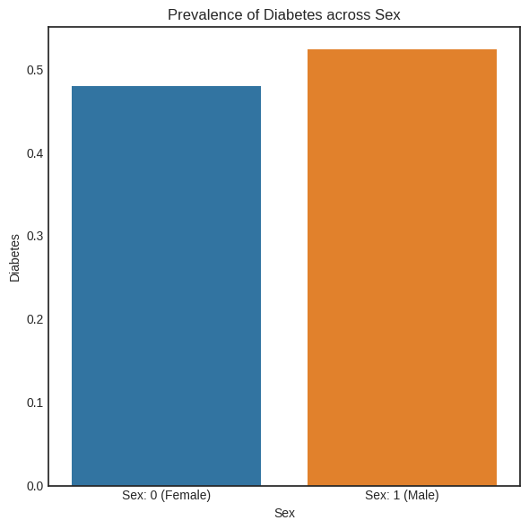
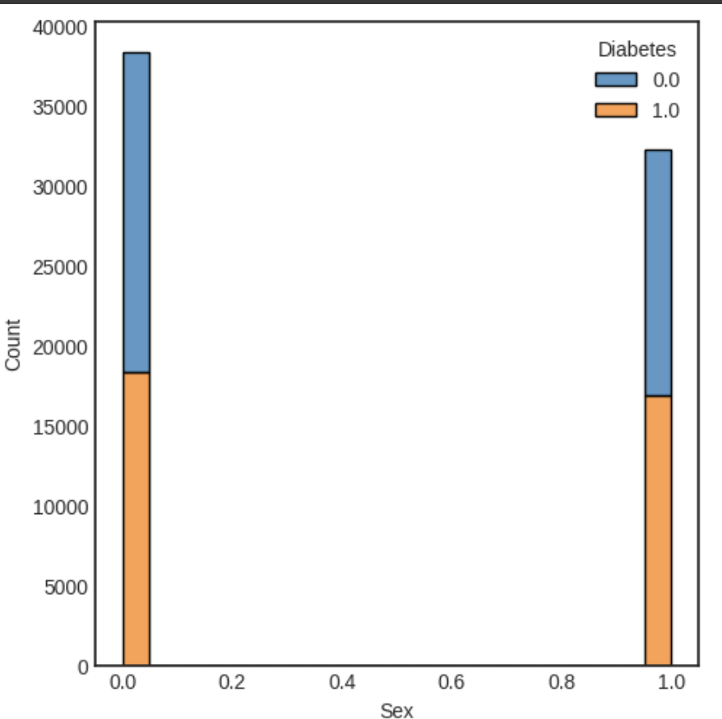

Slide 34
Male are more likely to be diagnosed with diabetes.

Slide 35
Prevalence of Diabetes across BMI.

Slide 36
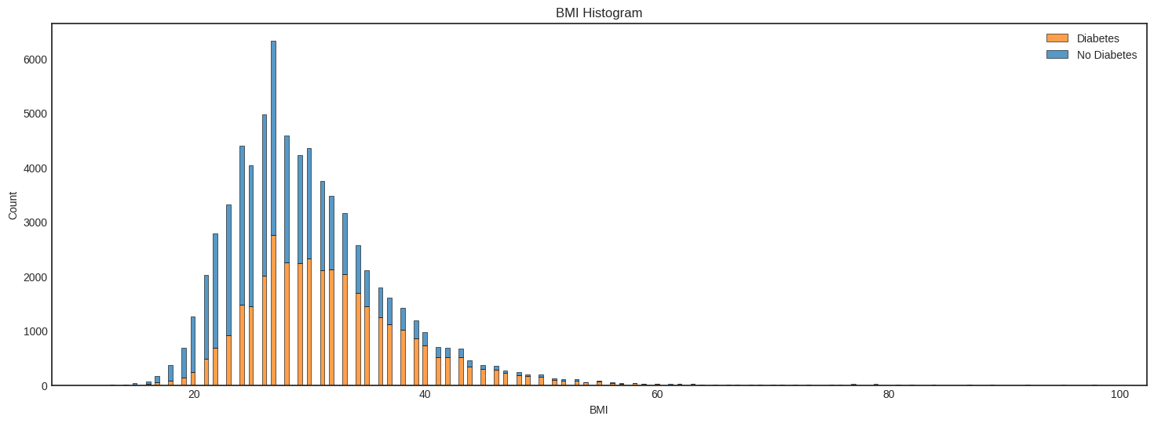

Slide 37
Higher BMI is a key factor in diabetes.

Slide 38
Let’s see how Logistic Regression behaves with just these predictors.

Slide 40
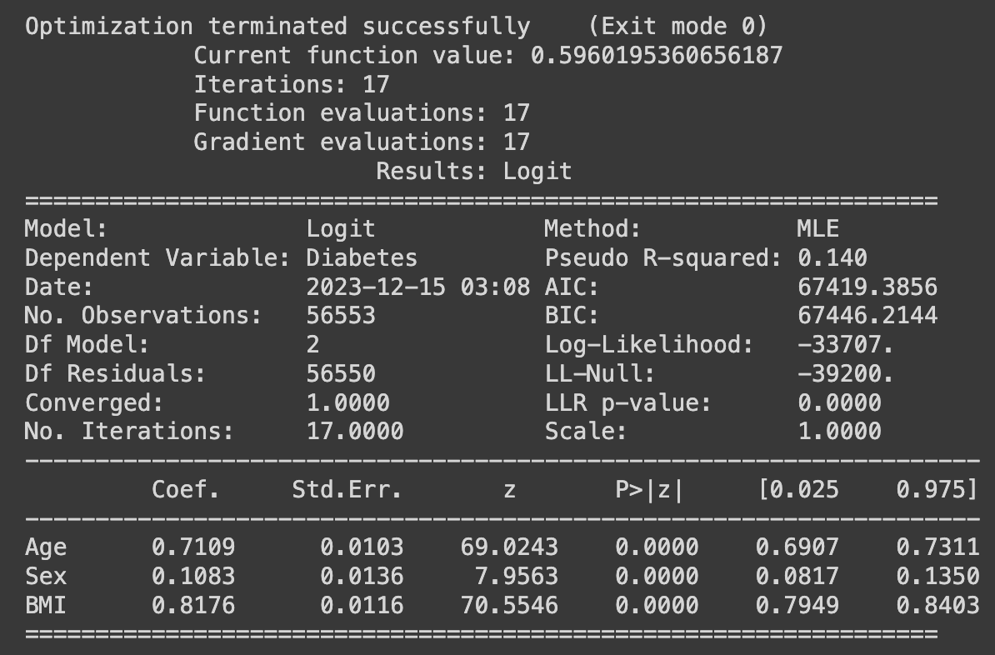
Age and Diabetes Prevalence
Coefficient: 0.7109
Significance: p-value < 0.0001
Implication: Higher age is significantly associated with an increased likelihood of having diabetes.
Sex and Diabetes Prevalence
Coefficient: 0.1083
Significance: p-value < 0.0001
Implication: There is a significant difference in diabetes prevalence between the sexes.
BMI and Diabetes Prevalence
Coefficient: 0.8176
Significance: p-value < 0.0001
Implication: Higher BMI is a strong predictor of diabetes, with higher values increasing the likelihood of the condition.
Model's Explanatory Power
Pseudo R-squared: 0.140
Implication: The model explains approximately 14% of the variability in diabetes status, indicating a moderate level of explanatory power.

Slide 41
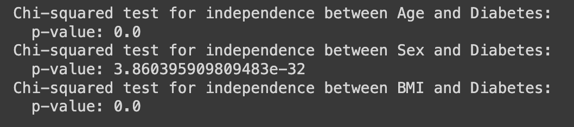
Statistical Association Between Demographics and Diabetes
Age and Diabetes Correlation
Chi-squared test p-value: < 0.0001
Interpretation: Strong statistical evidence that the prevalence of diabetes increases with age.
Sex and Diabetes Correlation
Chi-squared test p-value: 3.86 x 10^-32
Interpretation: Clear statistical evidence of a significant association between gender and the prevalence of diabetes. The risk differs between sexes.
BMI and Diabetes Correlation
Chi-squared test p-value: < 0.0001
Interpretation: High statistical significance for the relationship between BMI and diabetes, indicating that higher BMI is associated with increased diabetes prevalence.

Slide 42
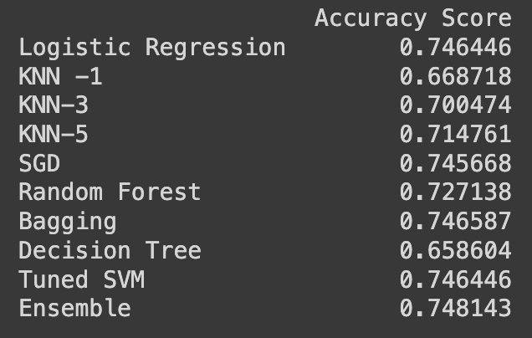

Slide 43
WHY LOW ACCURACIES?

Slide 44
Size of the dataset.
Predictors validity.
Background of the dataset.

Slide 45
Questions?

