Slide 1
Core Java Memory Model
September, 2016

Slide 2
What is a memory model, and why would I want one?
Final/Volatile with Old and New Memory Model
Happen Before Concept.
Memory Barrier (Read Barrier, Write Barrier)
Visibility Problem.
Race Condition Problem.

Slide 3
What is a memory model, and why would I want one?
The Java Memory Model (JMM) was defined in Java SE 5 (JSR 133) and specifies the guarantees a JVM implementation must provide to a Java programmer when writing concurrent code.
The JMM is defined in terms of actions like reading and writing fields, and synchronizing on a monitor. These actions form an ordering (called the “happens-before” ordering) that can be used to reason about when a thread sees the result of another thread’s actions, what constitutes a properly synchronized program, how to make fields immutable, and more.
Suppose on thread assigns a value to aVariable:
aVariable = 3;
A memory model addresses the question “Under what conditions does a thread that reads aVariable see the value 3?” This may sound like a dumb question, but in the absence of synchronization, there are a number of reasons a thread might not immediately—or ever—see the results of an operation in another thread. Compilers

Slide 4
What is a memory model, and why would I want one?
may generate instructions in a different order than the “obvious” one suggested by the source code, or store variables in registers instead of in memory; processors may execute instructions in parallel or out of order; caches may vary the order in which writes to variables are committed to main memory; and values stored in processor-local caches may not be visible to other processors. These factors can prevent a thread from seeing the most up-to-date value for a variable and can cause memory actions in other threads to appear to happen out of order—if you don't use adequate synchronization.
JMM specifies the minimal guarantees the JVM must make about when writes to a variables become visible to other threads .
It was designed to balance the need for predictability and ease of program development with the realities of implementing high – performance JVMs on a wide range of popular processor architectures.
An architecture's memory model tells programs what guarantees they can expect from the memory system, and specifies the special instructions required (called memory

Slide 5
What is a memory model, and why would I want one?
barriers or fences) to get the additional memory coordination guarantees required when sharing data.
In order to shield the Java developer from the differences between memory models across architectures, Java provides its own memory model, and the JVM deals with the differences between the JMM and the underlying platform's memory model by inserting memory barriers at the appropriate places.
Modern shared-memory multiprocessors (and compilers) can do some surprising things when data is shared across threads, unless you've told them not to through the use of memory barriers. Fortunately, Java programs need not specify the placement of memory barriers; they need only identify when shared state is being accessed, through the proper use of synchronization.
The Java Memory Model is specified in terms of actions, which include reads and writes to variables, locks and unlocks of monitors, and starting and joining with threads.

Slide 6
What is a memory model, and why would I want one?
The Java memory model specifies how the Java virtual machine works with the computer's memory (RAM).
The Java memory model specifies how and when different threads can see values written to shared variables by other threads, and how to synchronize access to shared variables when necessary.

Slide 7
Final/Volatile with Old and New Memory Model
Final With Old Memory Model:
One widely held belief, for example, was that if final fields were used, then synchronization between threads was unnecessary to guarantee another thread would see the value of the field. While this is a reasonable assumption and a sensible behavior, and indeed how we would want things to work, under the old memory model, it was simply not true. Nothing in the old memory model treated final fields differently from any other field -- meaning synchronization was the only way to ensure that all threads see the value of a final field that was written by the constructor. As a result, it was possible for a thread to see the default value of the field, and then at some later time see its constructed value.
Final With New Java Memory Model (JMM):
The values for an object's final fields are set in its constructor. Assuming the object is constructed "correctly", once an object is constructed, the values assigned to the final fields in the constructor will be visible to all other threads without synchronization. In addition, the visible values for any other object or array referenced by those final fields will be at least as up-to-date as the final fields.

Slide 8
Final/Volatile with Old and New Memory Model
Final With New Java Memory Model (JMM):
What does it mean for an object to be properly constructed? It simply means that no reference to the object being constructed is allowed to "escape" during construction. In other words, do not place a reference to the object being constructed anywhere where another thread might be able to see it; do not assign it to a static field, do not register it as a listener with any other object, and so on. These tasks should be done after the constructor completes, not in the constructor.
class FinalFieldExample {
final int x;
int y;
static FinalFieldExample f;
public FinalFieldExample() {
x = 3;
y = 4;
}
static void writer() {
f = new FinalFieldExample();

Slide 9
Final/Volatile with Old and New Memory Model
Final With New Java Memory Model (JMM):
}
static void reader() {
if (f != null) {
int i = f.x;
int j = f.y;
}
}
}
The class above is an example of how final fields should be used. A thread executing reader is guaranteed to see the value 3 for f.x, because it is final. It is not guaranteed to see the value 4 for y, because it is not final.
Volatile:
Volatile fields are special fields which are used for communicating state between threads.

Slide 10
Final/Volatile with Old and New Memory Model
Each read of a volatile will see the last write to that volatile by any thread; in effect, they are designated by the programmer as fields for which it is never acceptable to see a "stale" value as a result of caching or reordering. The compiler and runtime are prohibited from allocating them in registers. They must also ensure that after they are written, they are flushed out of the cache to main memory, so they can immediately become visible to other threads. Similarly, before a volatile field is read, the cache must be invalidated so that the value in main memory, not the local processor cache, is the one seen. There are also additional restrictions on reordering accesses to volatile variables.
Volatile With Old Memory Model:
Under the old memory model, accesses to volatile variables could not be reordered with each other, but they could be reordered with nonvolatile variable accesses. This undermined the usefulness of volatile fields as a means of signaling conditions from one thread to another.
Volatile With New Java Memory Model:
Under the new memory model, it is still true that volatile variables cannot be reordered

Slide 11
Final/Volatile with Old and New Memory Model
with each other. The difference is that it is now no longer so easy to reorder normal field accesses around them. Writing to a volatile field has the same memory effect as a monitor release, and reading from a volatile field has the same memory effect as a monitor acquire. In effect, because the new memory model places stricter constraints on reordering of volatile field accesses with other field accesses, volatile or not, anything that was visible to thread A when it writes to volatile field f becomes visible to thread B when it reads f.
Here is a simple example of how volatile fields can be used:
class VolatileExample {
int x = 0;
volatile boolean v = false;
public void writer() {
x = 42;
v = true;
}

Slide 12
Final/Volatile with Old and New Memory Model
public void reader() {
if (v == true) {
//uses x - guaranteed to see 42.
}
}
}
Assume that one thread is calling writer, and another is calling reader. The write to v in writer releases the write to x to memory, and the read of v acquires that value from memory. Thus, if the reader sees the value true for v, it is also guaranteed to see the write to 42 that happened before it. This would not have been true under the old memory model. If v were not volatile, then the compiler could reorder the writes in writer, and reader's read of x might see 0.
Effectively, the semantics of volatile have been strengthened substantially, almost to the level of synchronization. Each read or write of a volatile field acts like "half" a synchronization, for purposes of visibility.

Slide 13
Happens-before Concept
The JMM defines a partial ordering called happens-before on all actions within the program. To guarantee that the thread executing action B can see the results of action A (whether or not A and B occur in different threads), there must be a happens-before relationship between A and B. In the absence of a happens-before ordering between two operations, the JVM is free to reorder them as it pleases.
A data race occurs when a variable is read by more than one thread, and written by at least one thread, but the reads and writes are not ordered by happens-before. A correctly synchronized program is one with no data races; correctly synchronized programs exhibit sequential consistency, meaning that all actions within the program appear to happen in a fixed, global order.
Even though actions are only partially ordered, synchronization actions—lock acquisition and release, and reads and writes of volatile variables—are totally ordered. This makes it sensible to describe happens-before in terms of “subsequent” lock acquisitions and reads of volatile variables.

Slide 14
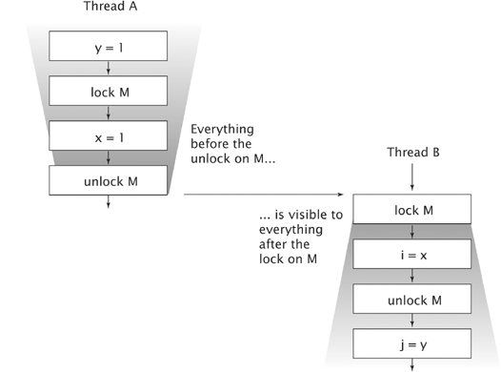
Happens-before Concept

Slide 15
Happens-before Concept
The above figure illustrates the happens-before relation when two threads synchronize using a common lock. All the actions within thread A are ordered by the program order rule, as are the actions within thread B. Because A releases lock M and B subsequently acquires M, all the actions in A before releasing the lock are therefore ordered before the actions in B after acquiring the lock. When two threads synchronize on different locks, we can't say anything about the ordering of actions between them—there is no happens-before relation between the actions in the two threads.

Slide 16
Happens-before Concept
The rules for happens-before are:
Program order rule. Each action in a thread happens-before every action in that thread that comes later in the program order.
Monitor lock rule. An unlock on a monitor lock happens-before every subsequent lock on that same monitor lock.
Volatile variable rule. A write to a volatile field happens-before every subsequent read of that same field.
Thread start rule. A call to Thread.start on a thread happens-before every action in the started thread.
Thread termination rule. Any action in a thread happens-before any other thread detects that thread has terminated, either by successfully return from Thread.join or by Thread.isAlive returning false.
Interruption rule. A thread calling interrupt on another thread happens-before the interrupted thread detects the interrupt (either by having InterruptedException thrown, or invoking isInterrupted or interrupted).
Finalizer rule. The end of a constructor for an object happens-before the start of the finalizer for that object.
Transitivity. If A happens-before B, and B happens-before C, then A happens-before C.

Slide 17
Visibility Problem
Under what conditions the effects of one thread are visible to another. The effects of interest here are writes to fields, as seen via reads of those fields.
Changes to fields made by one thread are guaranteed to be visible to other threads only under the following conditions:
A writing thread releases a synchronization lock and a reading thread subsequently acquires that same synchronization lock. .
If a field is declared as volatile, any value written to it is flushed and made visible by the writer thread before the writer thread performs any further memory operation (i.e., for the purposes at hand it is flushed immediately). Reader threads must reload the values of volatile fields upon each access.
The first time a thread accesses a field of an object, it sees either the initial value of the field or a value since written by some other thread. .
As a thread terminates, all written variables are flushed to main memory. For example, if one thread synchronizes on the termination of another thread using Thread.join, then it is guaranteed to see the effects made by that thread.

Slide 18
Visibility Problem
Visibility problems never arise when passing references to objects across methods in the same thread.
Here is example of a code with visibility problem:
class LoopMayNeverEnd {
boolean done = false;
void work() {
while (!done) {
// do work
}
}
void stopWork() {
done = true;
}
}

Slide 19
Visibility Problem
In this code, imagine that two threads are created; one thread calls work, and at some point, the other thread calls stopWork on the same object. Because there is no synchronization between the two, the thread in the loop may never see the update to done performed by the other thread. In practice, this may happen if the compiler detects that no writes are performed to done in the first thread; the compiler may decide that the program only has to read done once, transforming it into an infinite loop.
One of the key concepts needed to understand the JMM is that of visibility -- how do you know that if thread A executes someVariable = 3, other threads will see the value 3 written there by thread A? A number of reasons exist for why another thread might not immediately see the value 3 for someVariable: it could be because the compiler has reordered instructions in order to execute more efficiently, or that someVariable was cached in a register, or that its value was written to the cache on the writing processor but not yet flushed to main memory, or that there is an old (or stale) value in the reading processor's cache.
It is the memory model that determines when a thread can reliably "see" writes to

Slide 20
Visibility Problem
variables made by other threads. In particular, the memory model defines semantics for volatile, synchronized, and final that make guarantees of visibility of memory operations across threads.
When a thread exits a synchronized block as part of releasing the associated monitor, the JMM requires that the local processor cache be flushed to main memory. (Actually, the memory model does not talk about caches -- it talks about an abstraction, local memory, which encompasses caches, registers, and other hardware and compiler optimizations.) Similarly, as part of acquiring the monitor when entering a synchronized block, local caches are invalidated so that subsequent reads will go directly to main memory and not the local cache. This process guarantees that when a variable is written by one thread during a synchronized block protected by a given monitor and read by another thread during a synchronized block protected by the same monitor, the write to the variable will be visible by the reading thread. The JMM does not make this guarantee in the absence of synchronization -- which is why synchronization (or its younger sibling, volatile) must be used whenever multiple threads are accessing the same variables.

Slide 21
Visibility Problem
If two or more threads are sharing an object, without the proper use of either volatile declarations or synchronization, updates to the shared object made by one thread may not be visible to other threads
Imagine that the shared object is initially stored in main memory. A thread running on CPU one then reads the shared object into its CPU cache. There it makes a change to the shared object. As long as the CPU cache has not been flushed back to main memory, the changed version of the shared object is not visible to threads running on other CPUs. This way each thread may end up with its own copy of the shared object, each copy sitting in a different CPU cache.
The following diagram illustrates the sketched situation. One thread running on the left CPU copies the shared object into its CPU cache, and changes its count variable to 2. This change is not visible to other threads running on the right CPU, because the update to count has not been flushed back to main memory yet.

Slide 22
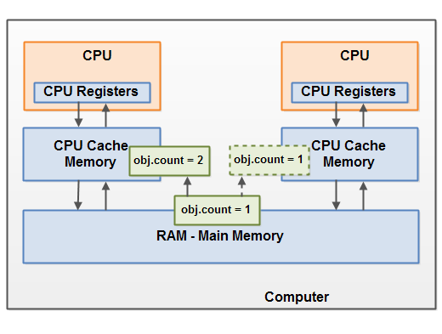
Visibility Problem
To solve this problem you can use Java's volatile keyword. The volatile keyword can make sure that a given variable is read directly from main memory, and always written back to main memory when updated. .

Slide 23
Race Condition Problem
If two or more threads share an object, and more than one thread updates variables in that shared object, race conditions may occur.
Imagine if thread A reads the variable count of a shared object into its CPU cache. Imagine too, that thread B does the same, but into a different CPU cache. Now thread A adds one to count, and thread B does the same. Now var1 has been incremented two times, once in each CPU cache.
If these increments had been carried out sequentially, the variable count would be been incremented twice and had the original value + 2 written back to main memory.
However, the two increments have been carried out concurrently without proper synchronization. Regardless of which of thread A and B that writes its updated version of count back to main memory, the updated value will only be 1 higher than the original value, despite the two increments.

Slide 24
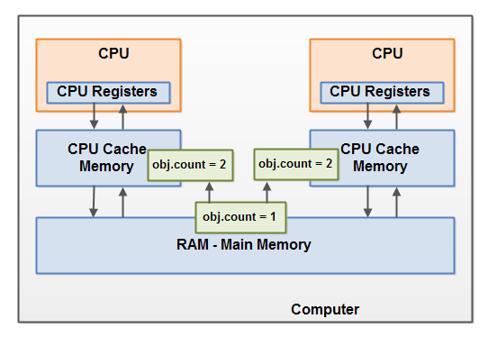
Race Condition Problem
This diagram illustrates an occurrence of the problem with race conditions as described above:
To solve this problem you can use a Java synchronized block. A synchronized block guarantees that only one thread can enter a given critical section of the code at any given time. Synchronized blocks also guarantee that all variables accessed inside the synchronized block will be read in from main memory, and when the thread exits the synchronized block, all updated variables will be flushed back to main memory again, regardless of whether the variable is declared volatile or not.

Slide 25
Memory Barrier
The techniques for making memory visible from a processor core are known as memory barriers or fences.
Memory barriers, or fences, are a set of processor instructions used to apply ordering limitations on memory operations
Memory barriers are CPU instructions that allow you to make certain assumptions about when data will be visible to other processes. In Java, you implement them with the volatile keyword.
Memory barriers provide two properties:
Firstly, they preserve externally visible program order by ensuring all instructions either side of the barrier appear in the correct program order if observed from another CPU and,
secondly, they make the memory visible by ensuring the data is propagated to the cache sub-system.

Slide 26
Memory Barrier
A read barrier will flush the invalidation queue, thus ensuring that all writes by other CPUs become visible to the flushing CPU.
A read barrier invalidates the local memory (cache, registers, etc) and then reads the contents from the main memory, so that changes made by other threads becomes visible to the current Thread.
A write barrier flushes out the contents of the processor's local memory to the main memory, so that changes made by the current Thread becomes visible to the other threads.
Write barrier will flush all the data that was written before the barrier out to cache, therefore any other thread that tries to read that data will get the most up-to-date version regardless of which core or which socket it might be executing by.
Key point of generational GC is what it does need to collect entire heap each time, but just portion of it (e.g. young space). But to achieve this JVM have to implement

Slide 27
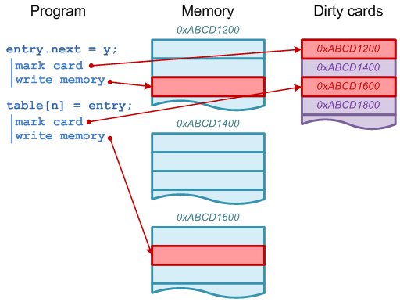
special machinery called “write barrier”. There 2 types of write barriers implemented in HotSpot: dirty cards and snapshot-at-the-beginning (SATB). SATB write barrier is used in G1 algorithms. All other algorithms are using dirty cards.
Dirty cards write barrier
Principle of dirty card write-barrier is very simple. Each time when program modifies reference in memory, it should mark modified memory page as dirty. There is a special card table in JVM and each 512 byte page of memory has associated byte in card table.

Slide 28
Sources and References
Java Concurrency in Practice – Brian Goetz.

Slide 29
Recap
What is a memory model, and why would I want one?
The Java Memory Model (JMM) was defined in Java SE 5 (JSR 133) and specifies the guarantees a JVM implementation must provide to a Java programmer when writing concurrent code.
Final/Volatile with Old and New Memory Model
Nothing in the old memory model treated final fields differently from any other field -- meaning synchronization was the only way to ensure that all threads see the value of a final field that was written by the constructor.
Once an object is constructed, the values assigned to the final fields in the constructor will be visible to all other threads without synchronization.
Under the old memory model, accesses to volatile variables could not be reordered with each other, but they could be reordered with nonvolatile variable accesses.
Under the new memory model, it is still true that volatile variables cannot be reordered.

Slide 30
Recap
Happen Before Concept.
To guarantee that the thread executing action B can see the results of action A (whether or not A and B occur in different threads), there must be a happens-before relationship between A and B. In the absence of a happens-before ordering between two operations, the JVM is free to reorder them as it pleases.
Memory Barrier (Read Barrier, Write Barrier)
The techniques for making memory visible from a processor core are known as memory barriers or fences.
A read barrier will flush the invalidation queue, thus ensuring that all writes by other CPUs become visible to the flushing CPU.
A write barrier flushes out the contents of the processor's local memory to the main memory, so that changes made by the current Thread becomes visible to the other threads.

Slide 31
Recap
Visibility Problem.
Under what conditions the effects of one thread are visible to another. The effects of interest here are writes to fields, as seen via reads of those fields.
Race Condition Problem.
If two or more threads share an object, and more than one thread updates variables in that shared object, race conditions may occur.

Slide 32
References
Java Concurrency in Practice – Brian Goetz

Slide 33
THANK YOU

