Slide 1
Garbage Collection Concepts
September, 2016

Slide 2
Eden Space
Perm Gen Space
Minor GC Vs Major GC
Parallel GS
CMS
JVM Tuning
Thread Dump Analysis (Tool)

Slide 3
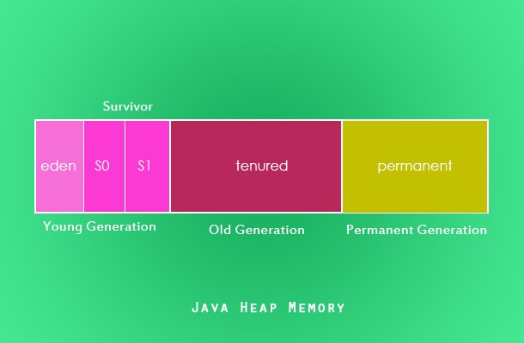
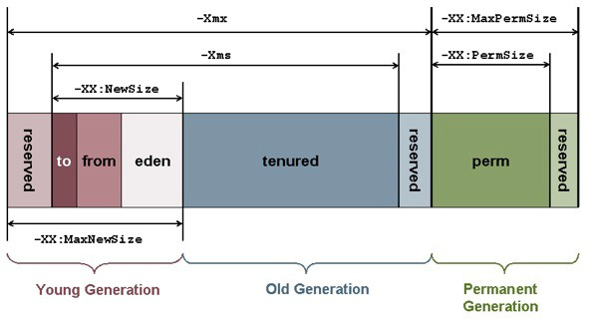
JAVA HEAP MEMORY

Slide 4
Eden Space
Java objects are created in the Heap and Heap is divided into three parts or generations for sake of garbage collection in Java, these are called as Young generation, Tenured or Old generation and Perm area of Heap.
New Generation is further divided into three parts known as Eden space, Survivor 1 and Survivor 2 space. When an object first created in heap its gets created in new generation inside Eden space and after subsequent Minor Garbage collection if object survives its gets moved to survivor 1 and then Survivor 2 before Major Garbage collection moved that object to Old or tenured generation.
The pool from which memory is initially allocated for most objects.
When an instance is created, it is first stored in the eden space in young generation of heap memory area. When an object is created using the new keyword memory is allocated in this space.
After one GC in the Eden space, the surviving objects are moved to one of the Survivor spaces.
After a GC in the Eden space, the objects are piled up into the Survivor space, where other surviving objects already exist.

Slide 5
Eden Space
In Young generation objects are created for the first time. The Young generation is divided into 3 spaces.
One Eden space.
Two Survivor space.
There are 3 spaces in total, two of which are Survivor spaces. The order of execution process of each space is as below.
The majority of newly created objects are located in the Eden space.
After one GC in the Eden space, the surviving objects are moved to one of the Survivor spaces.
After a GC in the Eden space, the objects are piled up into the Survivor space, where other surviving objects already exist.
Once a Survivor space is full, surviving objects are moved to the other Survivor space. Then, the Survivor space that is full will be changed to a state where there is no data at all.
The objects that survived these steps that have been repeated a number of times are moved to the old generation.
Larger eden or younger generation spaces increase the spacing between full GCs. But young space collections could take a proportionally longer time. In general, keep the eden

Slide 6
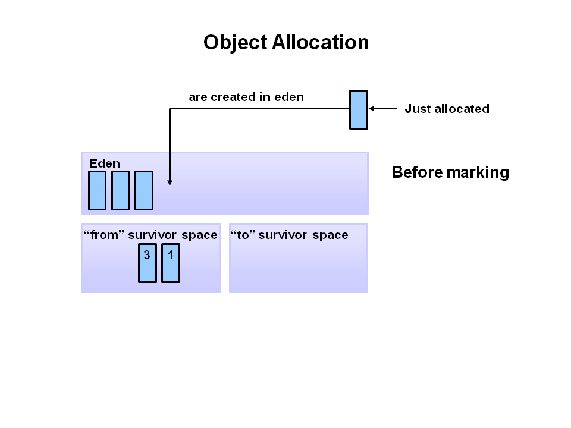
size between one fourth and one third the maximum heap size. The old generation must be larger than the new generation. 1. First, any new objects are allocated to the eden space. Both survivor spaces start out empty.

Slide 7
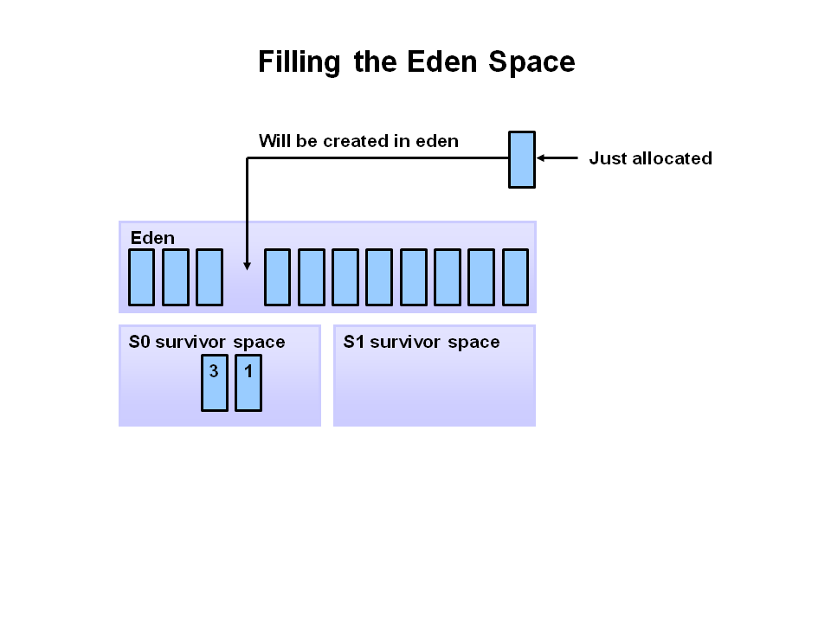
2. When the eden space fills up, a minor garbage collection is triggered.

Slide 8
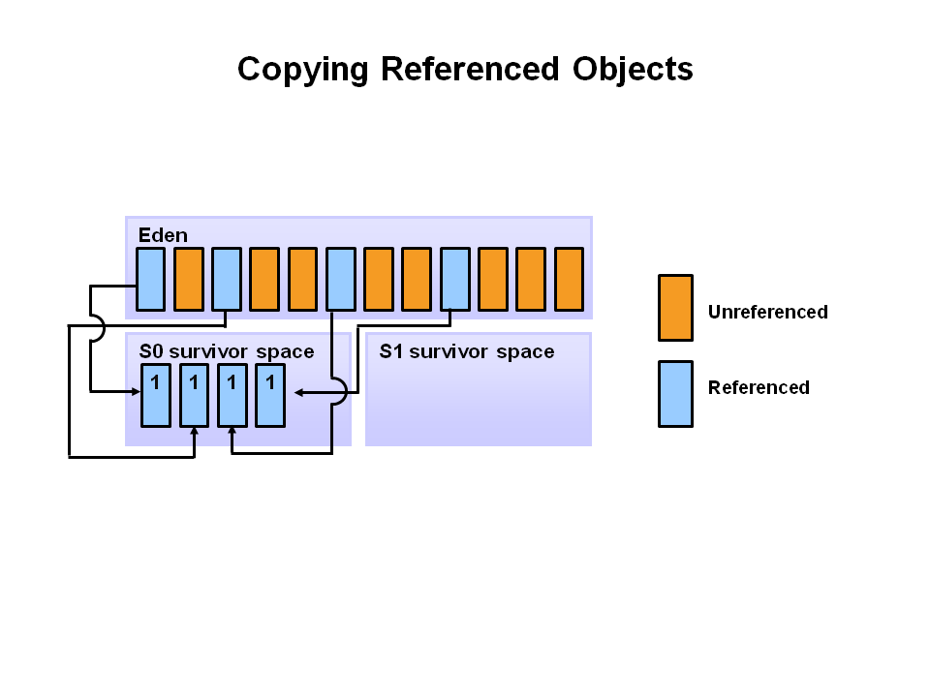
3. Referenced objects are moved to the first survivor space. Unreferenced objects are deleted when the eden space is cleared.

Slide 9
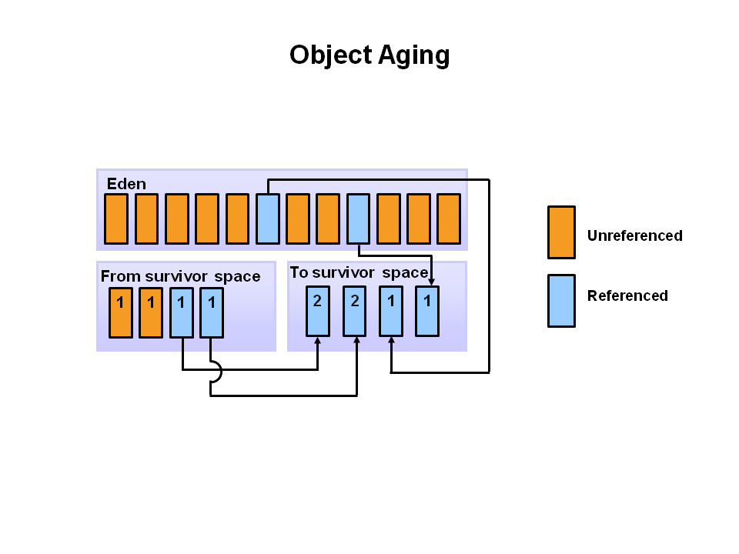
4. At the next minor GC, the same thing happens for the eden space. Unreferenced objects are deleted and referenced objects are moved to a survivor space. However, in this case, they are moved to the second survivor space (S1). In addition, objects from the last minor GC on the first survivor space (S0) have their age incremented and get moved to S1. Once all surviving objects have been moved to S1, both S0 and eden are cleared. We now have differently aged object in the survivor space.

Slide 10
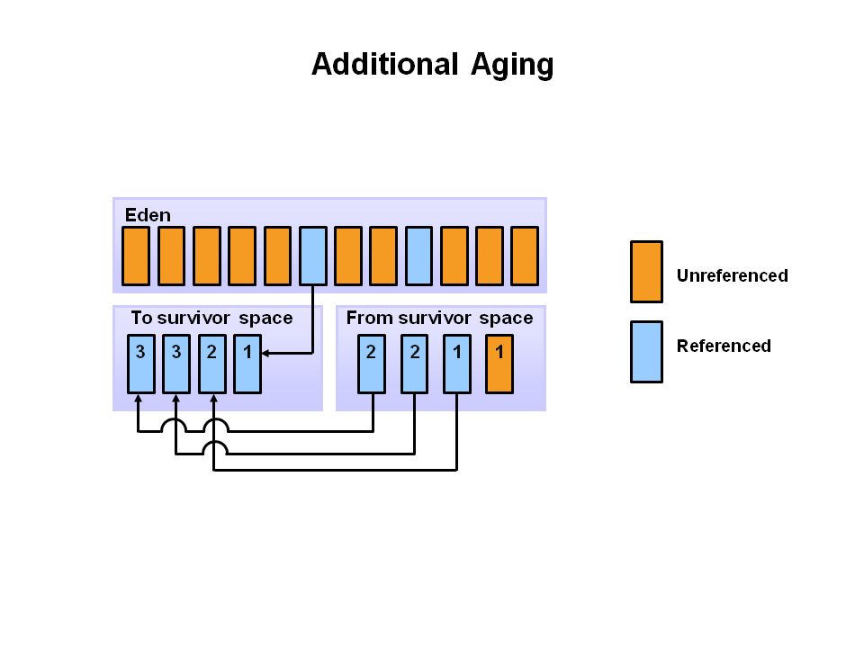
5. At the next minor GC, the same process repeats. However this time the survivor spaces switch. Referenced objects are moved to S0. Surviving objects are aged. Eden and S1 are cleared.

Slide 11
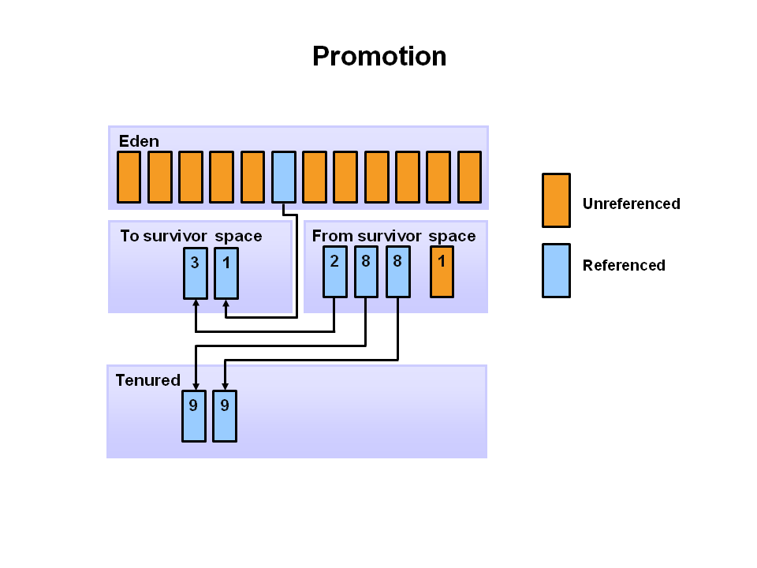
6. This slide demonstrates promotion. After a minor GC, when aged objects reach a certain age threshold (8 in this example) they are promoted from young generation to old generation.

Slide 12

7. As minor GCs continue to occure objects will continue to be promoted to the old generation space.

Slide 13
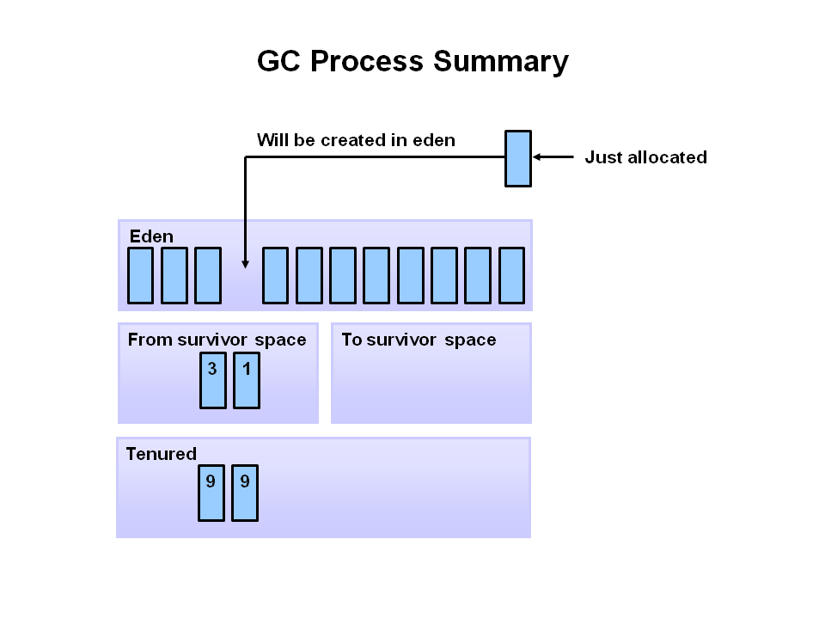
8. Eventually, a major GC will be performed on the old generation which cleans up and compacts that space.

Slide 14
Perm Gen (non-heap) Space
Permanent Generation or “Perm Gen” of Heap is somewhat special and it is used to store metadata related to classes and method in JVM i.e. pointers into the rest of the heap where the objects are allocated.
The PermGen also contains Class-loaders which have to be manually destroyed at the end of their use else they stay in memory and also keep holding references to their objects on the heap.
The perm generation is where the runtime stores objects it “knows” to be effectively immortal, such as Classes and static Strings. It also holds String pool provided by JVM.
Perm Gen is populated by JVM at runtime based on the classes used by the application. Perm Gen also contains Java SE library classes and methods. Perm Gen objects are garbage collected in a full garbage collection.
The pool containing all the reflective data of the virtual machine itself, such as class and method objects. With Java VMs that use class data sharing, this generation is divided into read-only and read-write areas.

Slide 15
Perm Gen (non-heap) Space
In Oracle's JVM, the permanent generation is not part of the heap. It's a separate space for class definitions and related data. In Java 6 and earlier, interned strings were also stored in the permanent generation. In Java 7, interned strings are stored in the main object heap.
Java8 Update: PermGen is replaced with Metaspace which is very similar. Main difference is that Metaspace re-sizes dynamically i.e., It can expand at runtime. Java Metaspace space: unbounded (default).
Prior to Java 8 there existed a special space called the ‘Permanent Generation’. This is where the metadata such as classes would go. Also, some additional things like internalized strings were kept in Permgen. It actually used to create a lot of trouble to Java developers, since it is quite hard to predict how much space all of that would require. Result of these failed predictions took the form of java.lang.OutOfMemoryError: Permgen space. Unless the cause of such OutOfMemoryError was an actual memory leak, the way to fix this problem was to simply increase the permgen size similar to the following example setting the maximum allowed permgen size to 256 MB:
java -XX:MaxPermSize=256m com.mycompany.MyApplication

Slide 16
Minor GC Vs Major GC
Minor GC
Collecting garbage from Young space (consisting of Eden and survivor spaces) is called a Minor GC.
Minor GC is always triggered when JVM is unable to allocate space for a new Object, e.g. the Eden is getting full.
Whenever the pool is filled, its entire content is copied and the pointer can start tracking the free memory from zero again. So instead of classical Mark, Sweep and Compact, cleaning Eden and Survivor spaces is carried out with Mark and Copy instead. So, no fragmentation actually takes place inside Eden or Survivor spaces. The write pointer is always residing on the top of the used pool.
During a Minor GC event, Tenured generation is effectively ignored. References from tenured generation to young generation are considered de facto GC roots. References from young generation to Tenured generation are simply ignored during the markup phase.
All minor garbage collections are "Stop the World" events. This means that all application threads are stopped until the operation completes. Minor garbage collections are always Stop the World events. For most of the applications, the length of the pauses is negligible latency-wise. This is true if most of the objects in Eden can be considered garbage and are never copied to Survivor/Old spaces. If the opposite is true and most of the newborn objects are not eligible for GC, Minor GC pauses start taking considerably more time.
every Minor GC cleans the Young generation.

Slide 17
Minor GC Vs Major GC
Major GC
Major GC is cleaning the tenured space.
The Old Generation is used to store long surviving objects. Typically, a threshold is set for young generation object and when that age is met, the object gets moved to the old generation. Eventually the old generation needs to be collected. This event is called a major garbage collection.
Major garbage collection are also Stop the World events. Often a major collection is much slower because it involves all live objects. So for Responsive applications, major garbage collections should be minimized. Also note, that the length of the Stop the World event for a major garbage collection is affected by the kind of garbage collector that is used for the old generation space.

Slide 18
Minor GC Vs Major GC
How Minor GC is happening in CMS
CMS collector is generational; thus both minor and major collections occur. The CMS collector attempts to reduce pause times due to major collections by using separate garbage collector threads to trace the reachable objects concurrently with the execution of the application threads.
During each major collection cycle, the CMS collector pauses all the application threads for a brief period at the beginning of the collection and again toward the middle of the collection. The second pause tends to be the longer of the two pauses. Multiple threads are used to do the collection work during both pauses. The remainder of the collection (including most of the tracing of live objects and sweeping of unreachable objects is done with one or more garbage collector threads that run concurrently with the application. Minor collections can interleave with an ongoing major cycle, and are done in a manner similar to the parallel collector (in particular, the application threads are stopped during minor collections).

Slide 19
How JVM cleaning memory ?
Why CleanUp?
Every object in a Java program uses computing resources that are finite. Most obviously, all objects use some memory to store their images on the heap. (This is true even for objects that declare no instance variables. Each object image must include some kind of pointer to class data, and can include other implementation-dependent information as well.) But objects may also use other finite resources besides memory. For example, some objects may use resources such as file handles, graphics contexts, sockets, and so on. When you design an object, you must make sure it eventually releases any finite resources it uses so the system won't run out of those resources.
Because Java is a garbage-collected language, releasing the memory associated with an object is easy. All you need to do is let go of all references to the object. Because you don't have to worry about explicitly freeing an object, as you must in languages such as C or C++, you needn't worry about corrupting memory by accidentally freeing the same object twice. You do, however, need to make sure you actually release all references to the object. If you don't, you can end up with a memory leak, just like the memory leaks you get in a C++ program when you forget to explicitly free objects. Nevertheless, so long as you release all references to an object, you needn't worry about explicitly "freeing" that memory.

Slide 20
How JVM cleaning memory ?
Garbage Collector
The JVM runtime environment uses a large memory pool called the heap, for object allocation. The JVM automatically starts garbage collections (GC) to clean up the heap of unreferenced or dead objects.
JVM Spec does not state how much memory will be available to a JVM. It just states that whenever a JVM does run out of memory, it should throw an OutOfMemoryError.
To give Java applications the best chance of executing without running out of memory, most JVMs will use a garbage collector. The garbage collector reclaims the memory occupied by unreferenced objects on the heap, so that memory can be used again by new objects, and usually de-fragments the heap as the program runs.
New objects are allocated in the Eden. When the Eden fills up, the JVM issues a scavenge GC or minor collection to move the surviving objects into one of the two survivor or semi spaces. The JVM does this by first identifying and moving all the referenced objects in the Eden to one of the survivor spaces. At the end of the scavenge GC, the Eden is empty (since all the referenced objects are now in the survivor space) and ready for object allocation.
.

Slide 21
How JVM cleaning memory ?
Garbage Collector
Referenced objects in the survivor space bounce between the two survivor spaces at each scavenge GC, until it either becomes unreferenced or the number of bounces have reached the tenuring threshold. If the tenuring threshold is reached, that object is migrated up to the old heap.
When the old heap fills up, the JVM issues a Full GC or major collection. In a Full GC, the JVM has to first identify all the referenced objects. When that is done, the JVM sweeps the entire heap to reclaim all free memory (for example, because the object is now dead). Finally, the JVM then moves referenced objects to defragment the old heap. The efficiency of the Full GC is dependent on the amount of referenced objects and the size of the heap.

Slide 22
finalize() method
In Java, an object may have a finalizer: a method that the garbage collector must run on the object prior to freeing the object. The potential existence of finalizers complicates the job of any garbage collector in a JVM.
To add a finalizer to a class, you simply declare a method in that class as follows:
// On CD-ROM in file gc/ex2/Example2.java
class Example2 {
protected void finalize() throws Throwable
{ //... super.finalize();
} //...
}
A garbage collector must examine all objects it has discovered to be unreferenced to see if any include a finalize() method. Because of finalizers, a garbage collector in the Java virtual machine must perform some extra steps each time it garbage collects. First, the garbage collector must in some way detect unreferenced objects (call this Pass I). Then, it must examine the unreferenced objects it has detected to see if any declare a finalizer. If it has enough time, it may at this point in the garbage collection process finalize all unreferenced objects that declare finalizers.

Slide 23
finalize() method
After executing all finalizers, the garbage collector must once again detect unreferenced objects starting with the root nodes (call this Pass II). This step is needed because finalizers can "resurrect" unreferenced objects and make them referenced again. Finally, the garbage collector can free all objects that were found to be unreferenced in both Passes I and II.
The Java specifications make the following promise about finalizers:
Before reclaiming the memory occupied by an object that has a finalizer, the garbage collector will invoke that object's finalizer.
Given that you don't know when objects will be garbage collected, but you do know that finalizable objects will be finalized as they are garbage collected, you can make the following grand deduction:
You don't know when objects will be finalized.
The central rule of thumb concerning finalizers is this:
Don't design your Java programs such that correctness depends upon "timely" finalization.
In other words, don't write programs that will break if certain objects aren't finalized by certain points in the life of the program's execution. If you write such a program, it may work on some implementations of the JVM but fail on others.

Slide 24
How Heap Size impacts performance ?
JVM manages Heap and allocates memory from it to new objects as they are created by Java applications running inside the JVM.
The JVM provides controls for the heap size via tuning parameters given to the JVM at startup. These parameters allow us to specify both the minimum heapsize the JVM obtains, as well as the maximum heapsize. Optimal JVM heapsize settings often prove counterintuitive.
JVM accepts both maximum and minimum heapsize settings. The maximum setting prevents the heap from growing too large. The minimum setting tells the JVM how much memory to obtain as it starts up.
The maximum heapsize setting comes from the –Xmx parameter. For e.g. –Xmx512m sets the maximum heapsize to 512MB on some systems. The JVM reads this parameter at initialization., so there’s no changing the maximum heap after the JVM starts. Keep in mind that this parameter sets a maximum. The JVM using this setting never obtains more than 512MB of heap memory during its operation, so even if your application requires more memory, the JVM cannot obtain it.
Too much memory often causes as many performance problems as too little. Large heap requires longer garbage collection cycles, which impacts the performance of the application running in the JVM. Also keep in mind the memory available on your machine. If the JVM grows larger than the

Slide 25
How Heap Size impacts performance ?
available memory, the operating system begins paging the JVM process out of memory. A paging JVM delivers abysmal performance.
The heap sizes should be set to values such that the maximum amount of memory used by the VM does not exceed the amount of available physical RAM. If this value is exceeded, the OS starts paging and performance degrades significantly. The VM always uses more memory than the heap size. The memory required for internal VM functionality, native libraries outside of the VM, and permanent generation memory (for the Sun VM only: memory required to store classes and methods) is allocated in addition to the heap size settings.
In production environments, set the minimum heap size and the maximum heap size to the same value to prevent wasting VM resources used to constantly grow and shrink the heap.
A larger Java memory heap:
Allows more objects to be created
Takes longer to fill
Allows the application to run longer between garbage collection (GC) events
A smaller Java memory heap:

Slide 26
How Heap Size impacts performance ?
Holds fewer objects
Fills more quickly
Is garbage collected more frequently (but the pauses are shorter)
May lead to out-of-memory errors
If the maximum heap size is reached, the garbage collector stops operating asynchronously, and user threads are forced to wait for collection cycles to complete. This situation has a significant negative impact on performance. A maximum heap size of 0 (*NOMAX) assures that garbage collection operates asynchronously at all times..
The maximum heap size can affect application performance. This value specifies the maximum amount of object space the garbage collected heap can consume. If the maximum heap size is too small, performance might degrade significantly, or the application might receive out of memory errors when the maximum heap size is reached. Due to the complexity of determining a correct value for the maximum heap size, a value of 0 (meaning there is no size limit) is recommended unless an absolute limit on the object space for the garbage collected heap size is required.
In a situation where an absolute limit for the garbage collected heap is required, the value specified should be large enough so that performance is not negatively affected.

Slide 27
How Heap Size impacts performance ?
If the maximum heap size is too small, artificial inflation can result in severe performance degradation or system failure if the JVM throws an out of memory error.
If the maximum heap size is set too large the garbage collector might reach a point where it is unable to recover the artificial inflation of the garbage collected heap. In this case, performance is also negatively affected. A value that is too large might not be able to prevent a JVM failure, but it can prevent a run-away JVM from consuming excessive amounts of system resources.
The minimum heapsize, set with the -Xms parameter, is less problematic. For performance testing, we typically recommend that it be set equal to the maximum heap setting. This forces the JVM to acquire all the memory for the maximum heapsize at startup. Acquiring more memory to increase the heap later takes time and may trigger more frequent garbage collection as the heap approaches the current memory allocated. In production, some experts recommend setting –Xms to between 25% and 30% of the maximum heapsize defined by –Xmx.
If minimum heap Size is more than maximum then error would occur.
Setting the minimum and maximum heap size to the same value is typically not a good idea because garbage collection is delayed until the heap is full. In production environments, set the minimum heap size and the maximum heap size to the same value to prevent wasting VM

Slide 28
How Heap Size impacts performance ?
resources used to constantly grow and shrink the heap.
Setting these two parameters to the same value is a best practice. It will prevent the JVM from resizing the heap. The main effect is that all the other parts of the heap, especially the generations, do not change due to heap resizing. This allows to much better understand and configure the heap. It also removes pauses caused by resizing the heap. The only secnario where one would not do it is a client java application, which competes with many other applications over available memory.
If -Xms is larger than -Xmx, then it uses up to –Xms.
For memory extensive applications max heap size could be set as 1024 and min size as 256. For low memory extensive applications max and min heap size could be set as 256.

Slide 29
WeakHashMap
A WeakHashMap is a special Map implementation where the keys of the map are stored in a java.lang.ref.WeakReference. By storing the keys in a weak reference, key-value pairs can dynamically be dropped from the map when the only reference to the key is from the weak reference. This makes the WeakHashMap an excellent implementation for a weakly referenced list, where entries that aren't used elsewhere may be dropped with no side effects.
An entry in a WeakHashMap will automatically be removed when its key is no longer in ordinary use (even having mapping for a given key will not prevent the key from being discarded by the garbage collector that is made finalizable , finalized and then reclaimed). When a key is discarded then its entry is automatically removed from the map , in other words, garbage collected.

Slide 30
Parallel / Throughput GC
This is the JVM’s default collector. Much like its name, its biggest advantage is that is uses multiple threads to scan through and compact the heap. The downside to the parallel collector is that it will stop application threads when performing either a minor or full GC collection. The parallel collector is best suited for apps that can tolerate application pauses and are trying to optimize for lower CPU overhead caused by the collector.
Unlike serial garbage collector, this uses multiple threads for garbage collection. Similar to serial garbage collector this also freezes all the application threads while performing garbage collection.
The parallel garbage collector uses multiple threads to perform the young generation garbage collection. By default on a host with N CPUs, the parallel garbage collector uses N garbage collector threads in the collection.
The number of garbage collector threads can be controlled with command-line options: -XX:ParallelGCThreads=<desired number>.

Slide 31
Parallel / Throughput GC
On a host with a single CPU the default garbage collector is used even if the parallel garbage collector has been requested. On a host with two CPUs the parallel garbage collector generally performs as well as the default garbage collector and a reduction in the young generationgarbage collector pause times can be expected on hosts with more than two CPUs.
The Parallel collector is also called a throughput collector. Since it can use multilple CPUs to speed up application throughput. This collector should be used when a lot of work need to be done and long pauses are acceptable. For example, batch processing like printing reports or bills or performing a large number of database queries.
Parallel Garbage Collector is also called throughput collector because it uses multiple CPUs to speed up the GC performance. Parallel GC uses single thread for Old Generation garbage collection.

Slide 32
Parallel GC – Usage Cases
-XX:+UseParallelGC
With this command line option you get a multi-thread young generation collector with a single-threaded old generation collector. The option also does single-threaded compaction of old generation.
-XX:+UseParallelOldGC
With the -XX:+UseParallelOldGC option, the GC is both a multithreaded young generation collector and multithreaded old generation collector. It is also a multithreaded compacting collector. HotSpot does compaction only in the old generation. Young generation in HotSpot is considered a copy collector; therefore, there is no need for compaction.

Slide 33
Concurrent Mark Sweep (CMS) Collector
The Concurrent Mark Sweep (CMS) collector is designed for applications that prefer shorter garbage collection pauses and that can afford to share processor resources with the garbage collector while the application is running. Typically applications that have a relatively large set of long-lived data (a large tenured generation) and run on machines with two or more processors tend to benefit from the use of this collector. However, this collector should be considered for any application with a low pause time requirement. The CMS collector is enabled with the command-line option -XX:+UseConcMarkSweepGC.
The Concurrent Mark Sweep (CMS) collector (also referred to as the concurrent low pause collector) collects the tenured generation. It attempts to minimize the pauses due to garbage collection by doing most of the garbage collection work concurrently with the application threads. Normally the concurrent low pause collector does not copy or compact the live objects. A garbage collection is done without moving the live objects. If fragmentation becomes a problem, allocate a larger heap.

Slide 34
Concurrent Mark Sweep (CMS) Collector – Usage Cases
The CMS collector should be used for applications that require low pause times and can share resources with the garbage collector. Examples include desktop UI application that respond to events, a webserver responding to a request or a database responding to queries.
Command Line Switches
To enable the CMS Collector use:
-XX:+UseConcMarkSweepGC and to set the number of threads use: -XX:ParallelCMSThreads=<n>
Here is a sample command line for starting the Java2Demo: java -Xmx12m -Xms3m -Xmn1m -XX:PermSize=20m -XX:MaxPermSize=20m -XX:+UseConcMarkSweepGC -XX:ParallelCMSThreads=2 -jar c:\javademos\demo\jfc\Java2D\Java2demo.jar

Slide 35
JVM Tuning
https://access.redhat.com/documentation/en-US/JBoss_Enterprise_Application_Platform/5/html/Performance_Tuning_Guide/chap-Performance_Tuning_Guide-Java_Virtual_Machine_Tuning.html

Slide 36
Thread Dump Analysis (Tool)
During the run time of a Java™ process, some Java Virtual Machines (JVMs) may not respond predictably and oftentimes seem to hang up for a long time or until JVM shutdown occurs. It is not easy to determine the root cause of these sorts of problems.
By triggering a javacore when a Java process does not respond, it is possible to collect diagnostic information related to the JVM and a Java application captured at a particular point during execution. For example, the information can be about the operating system, the application environment, threads, native stack, locks, and memory. The exact contents are dependent on the platform on which the application is running.
On some platforms, and in some cases, javacore is known as "javadump." The code that creates javacore is part of the JVM. One can control it by using environment variables and run-time switches. By default, a javacore occurs when the JVM terminates unexpectedly. A javacore can also be triggered by sending specific signals to the JVM. Although javacore or javadump is present in Sun Solaris JVMs, much of the content of the javacore is added by IBM and, therefore, is present only in IBM JVMs.
IBM Thread and Monitor Dump Analyzer for Java analyzes javacore and diagnoses monitor locks and thread activities in order to identify the root cause of hangs, deadlocks, and resource contention or monitor bottlenecks
https://www.ibm.com/developerworks/community/groups/service/html/communityoverview?communityUuid=2245aa39-fa5c-4475-b891-14c205f7333c

Slide 37
Sources and References
https://docs.oracle.com/cd/E13222_01/wls/docs81/perform/JVMTuning.html
https://access.redhat.com/documentation/en-US/JBoss_Enterprise_Application_Platform/5/html/Performance_Tuning_Guide/chap-Performance_Tuning_Guide-Java_Virtual_Machine_Tuning.html
https://www.ibm.com/developerworks/community/groups/service/html/communityoverview?communityUuid=2245aa39-fa5c-4475-b891-14c205f7333c

Slide 38
Recap
Eden Space
Java objects are created in the Heap and Heap is divided into three parts or generations for sake of garbage collection in Java, these are called as Young generation, Tenured or Old generation and Perm area of Heap.
New Generation is further divided into three parts known as Eden space, Survivor 1 and Survivor 2 space.
Perm Gen Space
Permanent Generation or “Perm Gen” of Heap is somewhat special and it is used to store metadata related to classes and method in JVM i.e. pointers into the rest of the heap where the objects are allocated.
Minor GC Vs Major GC
Collecting garbage from Young space (consisting of Eden and survivor spaces) is called a Minor GC.
Major GC is cleaning the tenured space.

Slide 39
Recap
Parallel GS
This is the JVM’s default collector. Much like its name, its biggest advantage is that is uses multiple threads to scan through and compact the heap. The downside to the parallel collector is that it will stop application threads when performing either a minor or full GC collection.
CMS
The Concurrent Mark Sweep (CMS) collector (also referred to as the concurrent low pause collector) collects the tenured generation. It attempts to minimize the pauses due to garbage collection by doing most of the garbage collection work concurrently with the application threads.
JVM Tuning
There can be various bottlenecks for the entire application, and application JVM may be one of the culprits.There can be various reasons like JVM not tuned optimally to suit your application, Memory leakages, JNI issues etc. They need to be diagnosed, analyzed and then fixed.

Slide 40
Recap
Thread Dump Analysis (Tool)
A tool that allows identification of hangs, deadlocks, resource contention, and bottlenecks in Java threads.

Slide 41
THANK YOU

