Slide 1
Core Java – Multithreading
September, 2016

Slide 2
Seep/Wait/Notify/Interruption/Yield/Join
Inter thread communication by using wait notify/blocking queue/exchanger
Thread Local /Thread Confinement
Runnable interface
Thread Class
Atomic API
Lock / Lock API
Synchronize Keyword
Hardware Locking (CAS )

Slide 3

Multitasking and Multithreading
Multitasking
The ability to have more than one program working at what seems like the same time.
For ex. Print the document while editing the mail.
Multithreading
A program/process can have several light weight threads that run concurrently to perform different tasks.
Programs that run more than one thread are called multi-threaded programs.
Notes:
Multitasking - what seems like - the context switching is so fast that programs seem to working concurrently but in fact they are working sequentially
Amdahl's Law
Concurrency promises to perform certain task faster as these tasks can be divided into subtasks and these subtasks can be executed in parallel. Of course the runtime is limited by parts of the task which can be performed in parallel. The theoretical possible performance gain can be calculated by Amdahl's Law. If F is the percentage of the program which can not run in parallel and N is the number of processes then the maximum performance gain is 1/ (F+ ((1-F)/n)).

Slide 4
Multiprocessing vs Multithreading
Multi-processing
Multiprocessing involved multiple processes, not necessarily multiple processors.
Multiple processes can run on a single processor because the processor does the work of switching from one process to another
Operating system controls switching
Multithreading
Parallel execution on single or multiple processors using more than one threads
All the threads uses single JVM which is nothing but a process

Slide 5
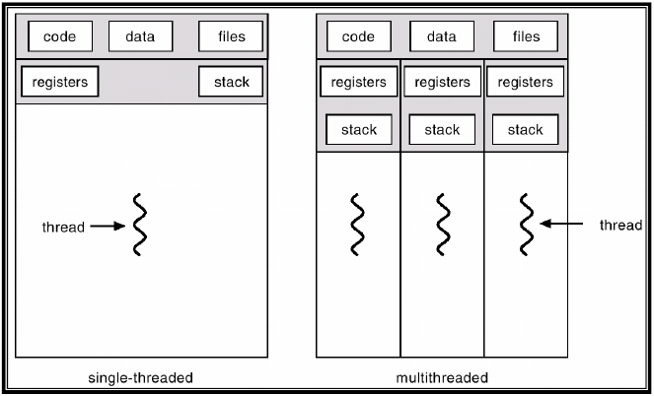
Singlethreading vs Multithreading

Slide 6
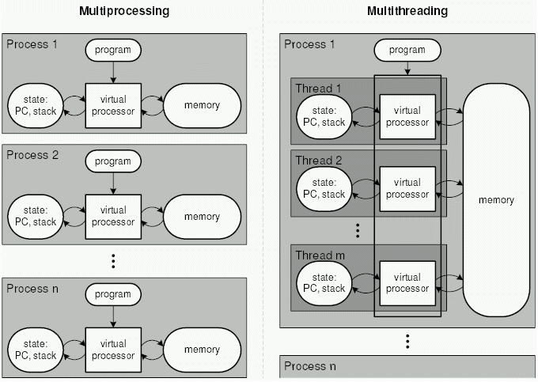
Multiprocessing vs Multithreading
Notes:
6

Slide 7
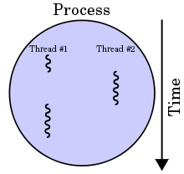
Advantages of Multithreading
Process versus Thread.
Advantages of multithreading over multitasking
Threads share the data so efficient inter-thread communication.
Threads are lightweight.
Threads share the same address space so they save the memory.
Context switching between threads is usually less expensive than between processes.
Improve performance of an application.
Notes:
Process - Complete set of its own variables.
Thread - Shares the variables of a process. A Process can have multiple threads.
Lightweight – It takes less overhead to create/destroy them

Slide 8

What is a thread?
Threads are the tasks that belong to a program and can run ‘simultaneously’.
On a single CPU, each competing thread is given a slice of time to perform its task. The faster context switch simulates concurrency.
On multi-processor system, the threads (processes) may actually run in parallel on different CPUs.
main method runs in one thread called main thread.
Notes:
An instance of Thread is just an ordinary java Object.
A thread of execution is a light weight process that has its own call stack
There is one thread per call stack

Slide 9
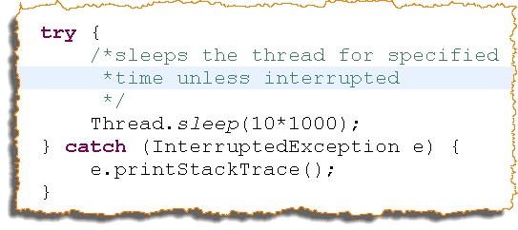
Sleep/Wait/Notify/Interruption/Yield/Join
Sleep
The current thread sleeps for specified time period (in milli seconds).
It guarantees that thread is going to sleep for specified time period but does not guarantees that it will wake up and start running once the specified time elapses.
Throws InterruptedException if interrupted.
No need to call in synchronized context.
If called from synchronized context, lock is not released.

Slide 10
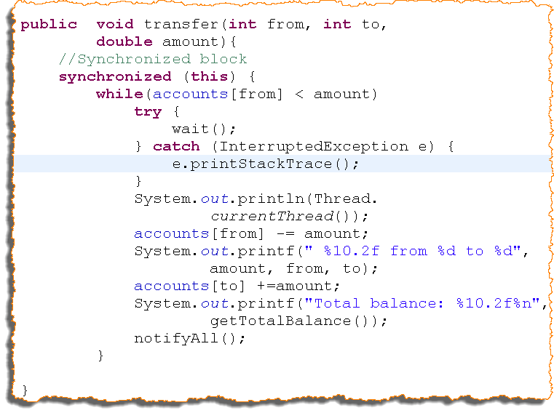
wait, notify and notifyAll
Methods of Object class.
Must be called from synchronized context.
Used for inter-thread communication.
Wait
Waits the current thread.
notify
Used to wake up waiting thread.
Wakes up a single thread (chosen randomly).
notifyAll
Used to wake up waiting threads.
Wakes up all the threads waiting to get lock.

Slide 11


sleep vs. wait
sleep
Thread stops execution.
used to make the thread sleep for a specified time so that other threads get CPU time.
wait
Thread stops execution.
Is used to relinquish lock.
After release of lock thread enters waiting state.
Other threads competing for the lock get a chance to acquire the lock.
Waiting threads need to be notified to make them runnable.

Slide 12
Interruption
Thread Interruption is a cooperative mechanism for a thread to signal another thread that it should, at its convenience and if it feels like it, stop what it is doing and do something else.
Each thread has a boolean interrupted status; interrupting a thread sets its interrupted status to true.
The interrupt method interrupts the target thread, and isInterrupted method returns the interrupted status of the target thread. The poorly names static interrupted method clears the interrupted status of the current thread and returns its previous value; this is the only way to clear the interrupted status.
Blocking library methods like Thread.sleep and Object.wait try to detect when a thread has been interrupted and return early. They respond to interruption by clearing the interrupted status and throwing InterruptedException, indicating that the bloc king operation completed early due to interruption.
A good way to think about interruption is that it does not actually interrupt a running thread; it just requests that the thread interrupt itself at the next convenient opportunity.
public class Thread {
public void interrupt() { ... }
public boolean isInterrupted() { ... }
public static boolean interrupted() { ... }
...
}
Interruption Methods in Thread
Notes:
Even after a call to yield intended thread may not be the currently running thread.
http://www.javamex.com/tutorials/threads/yield.shtml

Slide 13
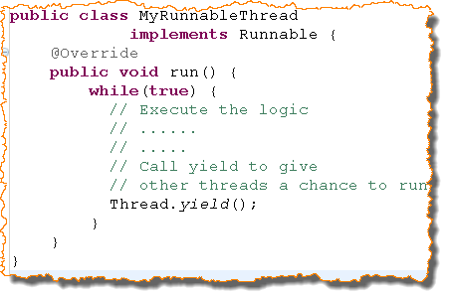
Yield
Yield in English means – Give over, supply, surrender to other.
Causes the currently executing thread to yield.
The highest priority thread from the runnable pool will be chosen by the schedule to run.
It is a static method of Thread class.
Don’t rely on yield or thread priority for correctness of your program.
Notes:
Even after a call to yield intended thread may not be the currently running thread.
http://www.javamex.com/tutorials/threads/yield.shtml

Slide 14
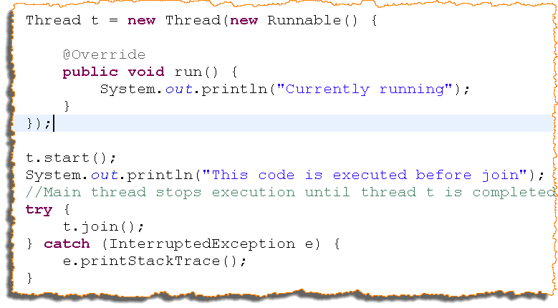
Join
Allows one thread to wait for the completion of another.
Throws InterruptedException if interrupted.

Slide 15
Inter thread communication using wait / notify
http://howtodoinjava.com/core-java/multi-threading/how-to-work-with-wait-notify-and-notifyall-in-java/
Inter thread communication using Blocking Queue
https://vox.publicis.sapient.com/docs/DOC-122847
http://www.java67.com/2015/12/producer-consumer-solution-using-blocking-queue-java.html
Inter thread communication using Exchanger
http://tutorials.jenkov.com/java-util-concurrent/exchanger.html

Slide 16
Thread Confinement
Accessing shared, mutable data requires using synchronization; one way to avoid this requirement is not to share.
If data is only accessed from a single thread, no synchronization is needed. This technique, thread confinement, is one of the simplest ways to achieve thread safety.
When an object is confined to a thread, such usage is automatically thread safe even if the confined object itself is not.
E.g.: Swing uses thread confinement extensively. The Swing visual components and data model objects are not thread safe; instead, safety is achieved by confining them to he Swing event dispatch thread. To use Swing properly, code running in threads other that the event thread should not access these objects.
Another common application of thread confinement is the use of pooled JDBC (Java Database Connectivity)Connection objects. The JDBC specification does not require that Connection objects be thread safe. In typical server applications, a thread acquires a connection from the pool uses, it for processing single request and returns it. Since most requests, such as servlet requests or EJB (Enterprise Java Beans) calls, are processed synchronously by a single thread, and the pool will not dispense the same connection to another thread until it has been returned, this pattern of connection management implicitly confines the connection to that thread for the duration of the request.

Slide 17
Thread Local
A more formal means of maintaining thread confinement is ThreadLocal, which allowed you to associate per-thread value with a value – holding object.
Thread-Local provides get and set accessor methods that maintain a separate copy of the value for each thread that uses it, so a get returns the most recent value passed to set from the currently executing thread.
Thread-local variables are often used to prevent sharing in designs based on mutable Singletons or global variables. For example, a single – threaded application might maintain a global database connection that is initialized at startup to avoid having to pass a Connection to every method. Since JDBC connections may not be thread – safe, a multithreaded application that uses a global connection without additional coordination is not thread-safe either. By using a ThreadLocal to store the JDBC connection, each thread will have its own connection.
private static ThreadLocal<Connection> connectionHolder
= new ThreadLocal<Connection>() {
public Connection initialValue() {
return DriverManager.getConnection(DB_URL);
}
};
public static Connection getConnection() {
return connectionHolder.get();
}

Slide 18
Thread Local
If you are porting a single-threaded application to a multithreaded environment, you can preserve thread safety by converting shared global variables into ThreadLocals, if the semantics of the shared globals permits this.
ThreadLocal is widely used in implementing application frameworks. For example, J2EE containers associate a transaction context with an executing thread for the duration of the EJB call. This is easily implemented using a static ThreadLocal holding the transaction context: when the framework code needs to determine what transaction is currently running, it fetches the transaction context from this ThreadLocal.
http://tutorials.jenkov.com/java-concurrency/threadlocal.html

Slide 19
Thread creation

Slide 20
Create Thread
By extending Thread class:
MyThread extends Thread{
public void run(){
::::::::::::::::::::::::
}
}
By implementing Runnable:
MyThread implements Runnable{
public void run(){
::::::::::::::::::::::::
}
}
What’s the difference?? Which one will you choose and why??
Notes:
20

Slide 21
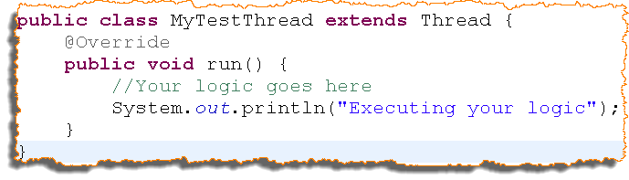
Approach#1 | Writing the Thread class
Extending java.lang.Thread
Extend the java.lang.Thread.
Override the run method.
run method
run method is automatically invoked by the thread which is executing.
Like main method, new thread knows to invoke the run method.
Problem
The Thread class can not extend any other class now.
Your own class is a thread by inheritance. A Business class should not be called a thread.
Separate thread for each task.
Notes:
Thread class has some specific methods that helps in executing tasks
“public void run()” method contains the logic of the task. Thread of execution executes this task.

Slide 22
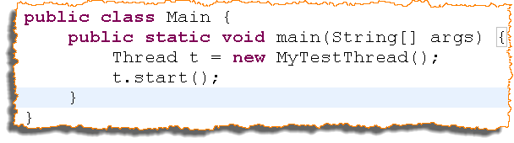
Approach#1 | Starting the Thread
Following snippet illustrates instantiation and starting a thread:
Thread is started by invoking start method on the thread class.
start method is part of Thread class.
start method internally calls the run method of the Thread class.
Other overloaded constructors:
Thread (Runnable runnable, String name);
Thread (String name);
Notes:
Thread is now in runnable state
When the thread gets a chance, it’s run method runs

Slide 23
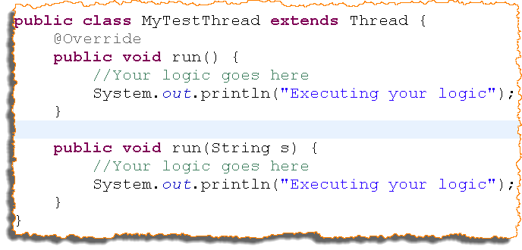
Quiz
Will the following code compile? If yes, which run method will be called by the thread of execution and why ?

Slide 24
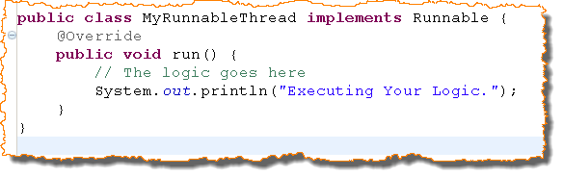
Approach#2 | Writing the Thread Class
Implementing java.lang.Runnable interface
Runnable interface contains only run method.
Provide implementation of the run method.
Advantage:
If you implements your business class with Runnable interface, your business class is treated as a task. Any thread can schedule this task and this task can be scheduled by any number of threads.
Notes:
Runnable is the task. Define your logic in runnable and hand it over to Thread to run the task.

Slide 25
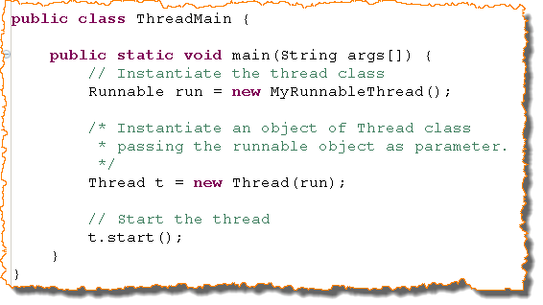
Approach#2 | Starting a Thread
Following snippet illustrates instantiation and starting a thread:
Read the comments in the snapshot to know the purpose of each line.
Problem: Separate thread for each task.
Solution: Thread Pool (Executors).

Slide 26
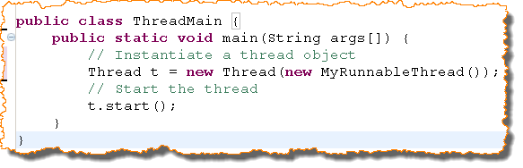
Quiz
Will the following line of code compile? Discuss it’s implications. Refer the previous slide for the code of ThreadMain.

Slide 27
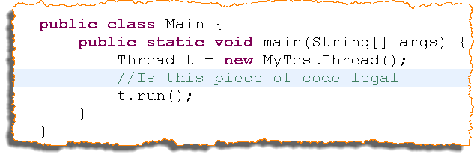
Quiz
Is following piece of code legal? What are the implications (if any)?

Slide 28
Atomic Package
Package: java.util.concurrent.atomic package
The classes in this package supports lock-free and thread-free programming on single variables.
Classes:
AtomicInteger
AtomicBoolean
AtomicLong
AtomicIntegerArray
Notes:
D:\Softwares\JDK16Docs\api\index.html

Slide 29
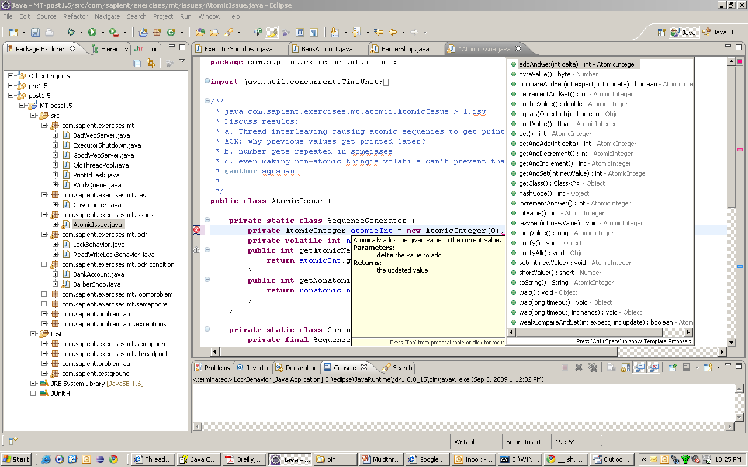
Atomic Variable classes
AtomicInteger
AtomicLong
AtomicBoolean
AtomicReference
All support CAS
Example: AtomicIssue

Slide 30
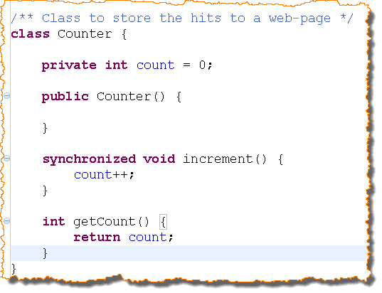
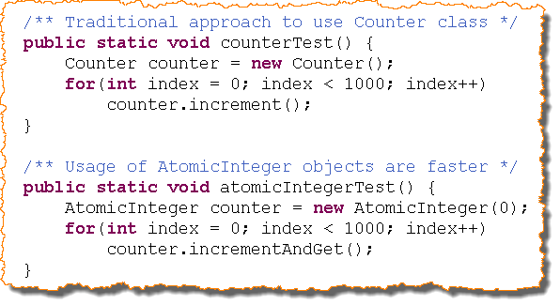
AtomicInteger
Support atomic operation on single variable.
For ex. Counter to maintain the number of users accessing a page.
Notes:
http://technicalmumbojumbo.wordpress.com/2009/08/28/java-util-concurrent-atomic-atomicinteger/

Slide 31
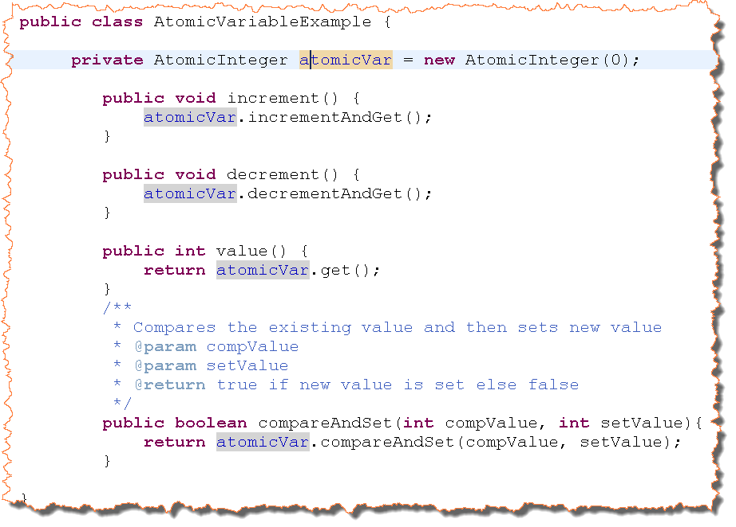
AtomicInteger | Example#2
Support atomic operation on single variable.
Notes:
http://technicalmumbojumbo.wordpress.com/2009/08/28/java-util-concurrent-atomic-atomicinteger/

Slide 32
Lock API

Slide 33
Locks
Why Locks/limitations of synchronized
Doesn’t force block structured locking/unlocking
Allow interruptible lock acquisition and “try lock”
Can define customized implementations
Fair/Unfair

Slide 34
Low Level Locking
Lock
Not a replacement to ‘synchronized’ but extension to support:
Interruptible locking – lockInterruptibly()
non-blocking locking attempt – tryLock()
Timed locking attempt – tryLock(long timeout, TimeUnit unit)
Conditional locking – newCondition()
Lock and unlock need to be done in a try-finally block
ReentrantLock
Conservation locking strategy - provides same mutual exclusion and memory-visibility guarantees as synchronized
Supports all lock-acquisition modes defined by Lock interface
Since Java6, intrinsic lock scales similar to ReentrantLock
Example: LockBehavior
ReadWriteLock
Allows read/read overlap but restricts write/write, read/write overlap
ReadWriteLock scales better than basic ReentrantLock
Example: ReadWriteLockBehavior
Conditional locking
When there are multiple wait-sets per resource
Allows threads to wait, be notified on different “conditions”
Example: BankAccount, BarberShop

Slide 35
Low level Locking – contd.
Fair v/s Unfair Lock
Fair: Lock acquisition in the order of request
Unfair: lock permits barging
Fairness has performance overheads
Points to remember:
Fine-grained locks good from a functionality perspective, but should be avoided unless “functionality” is absolutely required
Its easy to go wrong – not strong enough support from compiler
Use concurrency related detectors in “findBugs”
ThreadDump in Java5 doesn’t provide info. about threading problems caused by ReentrantLock.
Java6 provides management and monitoring interface to do that

Slide 36
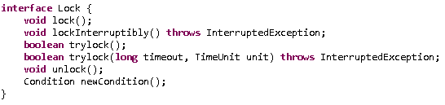
Lock API
Flexibility at expense of Verbosity
lock.lock();
try {
action();
} finally {
lock.unlock();
}

Slide 37
Basics of Lock
private Lock myLock = new ReentrantLock();
myLock.lock();
try{
// synchronized code here
} finally {
myLock.unlock();
}
lock() method blocs until lock is available
This is same as synchronized code block but attempt to acquire lock is explicit.
It is reentrant because a thread can reacquire a lock it already owns.

Slide 38
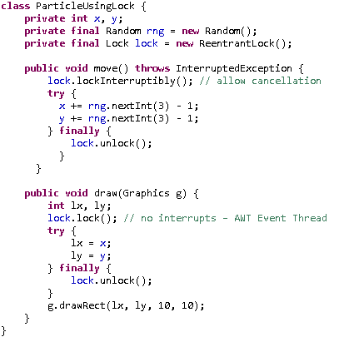
Lock Example

Slide 39
Reentrant Locks
Most widely used implementation class of Lock interface
Provides same locking & memory semantics as intrinsic locking.
Adds features of timed lock waits, interruptible lock waits, fairness.
Contains some utility methods to get the thread holding/waiting the lock
Choosing b/w ReentrantLock and synchronized ??
The ReentrantLock implementation duplicates the functionality of the synchronized keyword but also provides additional functionality such as obtaining information about the state of the lock, non-blocking tryLock(), and interruptible locking.
Notes:
39

Slide 40
Reentrant Locks
When a thread requests a lock that is already held by another thread, the requesting thread blocks. But because intrinsic locks are reentrant, if a thread tries to acquire a lock that it already holds, the requests succeeds.
Reentrancy means that locks are acquired on a per-thread rather than per-invocation basis.
Reentrancy is implemented by associating with each lock an acquisition count and an owning thread. When the count is zero, the lock is considered unheld. When a thread acquires a previously unheld lock, the JVM records the owner and sets the acquisition count to one. If the same thread acquires the lock again, the count is incremented, and when owning thread exits they synchronized block, the count is decremented. When the count reaches zero the lock is released.
Reentrancy facilitates encapsulation of locking behavior, and thus simplifies the development of object-oriented code.
Notes:
40

Slide 41
Reentrant Locks
Example of using an explicit ReentrantLock instance:
public class Counter {
private final Lock lock = new ReentrantLock();
private int value = 0;
public int increment() {
lock.lock();
try {
return ++value;
} finally {
lock.unlock();
}
}
}
Notes:
41

Slide 42

Read-Write Lock
java.util.concurrent.locks also contains a useful class ReentrentReadWriteLock.
Concrete ReentrantReadWriteLock
Almost always the best choice for apps
Each lock acts like a reentrant lock
Those that read do not need synchronized access.
A pair of locks for enforcing multiple-reader, single-writer access
Each used in the same way as ordinary locks
Notes:
42

Slide 43
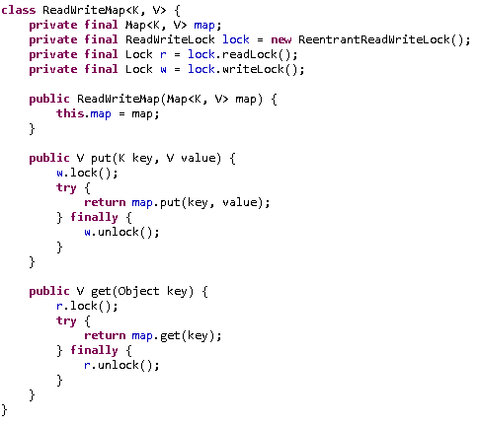
Read-Write Lock Example
Notes:
43

Slide 44
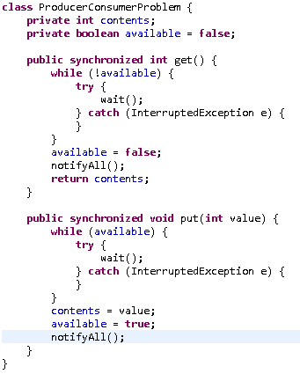
Condition
Notes:
44

Slide 45
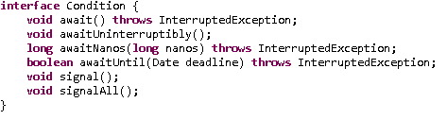
Condition
Need a technique to mimic wait/notify using explicit locks.
Java provides these as condition variables.
Allows more than one wait condition per object
Addition of await() and signal(), signalAll()
Notes:
45

Slide 46
Condition
A Condition is associated with a single Lock, just as Condition queue is associated with a single intrinsic lock; to create a Condition call Lock.newCondition on the associated Lock. And just as Lock offers a richer feature set than intrinsic locking, Condition offers a richer feature set than intrinsic Condition queues: multiple wait sets per lock, interruptible and uninterruptible condition waits, deadline based waiting, and a choice of fair or nonfair queueing.
Unlike intrinsic condition queues, you can have as many Condition objects per Lock as you want. Condition objects inherit the fairness setting of their associated Lock; for fair locks, threads are releases from Condition.await in FIFO order.
In Java SE 5, a new java.util.concurrent.locks.Condition class was added. Condition implements the wait/notify semantics in an API but with several additional features such as the ability to create multiple Conditions per Lock, interruptible waiting, access to statistics, etc.
A Condition object, also known as condition variable, provides a thread with the ability to suspend its execution, until the condition is true. A Condition object is necessarily bound to a Lock and can be obtained using the newCondition() method.
A Condition enables the effect of having multiple wait-sets per object, by combining these sets with the use of a Lock implementation. Moreover, due to the fact that Conditions access portions of state shared among different threads, the usage of a Lock is mandatory. It is important to mention that a Condition must atomically release the associated Lock and suspend the current’s thread execution.
Notes:
46

Slide 47
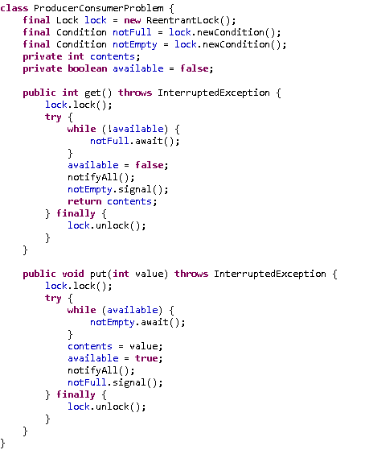
Condition
Notes:
47

Slide 48
Lock vs synchronized
With great power comes great responsibility. – Uncle Ben
Lock provides more visibility and options for locking, unlike synchronized where a thread might end up waiting indefinitely for the lock, we can use tryLock() to make sure thread waits for specific time only.
Synchronization code is much cleaner and easy to maintain whereas with Lock we are forced to have try-finally block to make sure Lock is released even if some exception is thrown between lock() and unlock() method calls.
synchronization blocks or methods can cover only one method whereas we can acquire the lock in one method and release it in another method with Lock API.
synchronized keyword doesn’t provide fairness whereas we can set fairness to true while creating ReentrantLock object so that longest waiting thread gets the lock first.
We can create different conditions for Lock and different thread can await() for different conditions.
Check out https://vox.sapient.com/groups/java/blog/2014/01/19/thread-safe-concurrency-explicit-vs-implicit-locking
Notes:
48

Slide 49
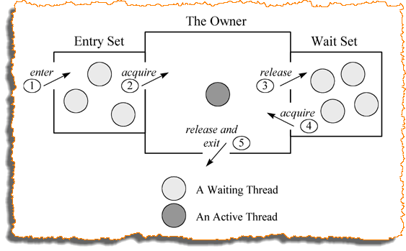
Synchronization
Two or more threads need to share the resources/data.
What if two threads try to modify the same data?
This results in corrupted objects – The situation called as Race Condition.
Synchronization helps to control the access to the shared resources/data in multi-threaded environment.
Calling a synchronized method attempts to acquire the lock
If lock is available, it is acquired
If not available then this thread is placed in the entry set for the lock

Slide 50
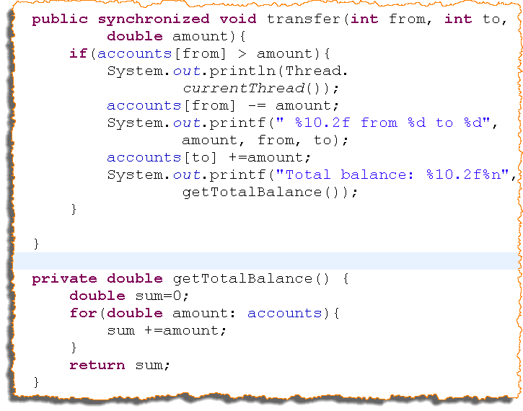
Synchronization
Synchronize the method where atomic operations are required.
A class can have both synchronized and non synchronized methods. Classes can’t be synchronized.
Lock is taken on the object (not on the method).
Once a thread acquires the lock on an object, no other thread can enter any synchronized method in that class.

Slide 51
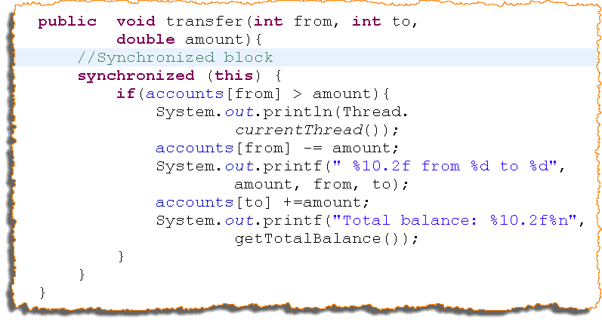
Synchronization (Contd..)
If a class has both synchronized and non-synchronized methods, multiple threads can still access non-synchronized methods at the same time.
You can also synchronize a piece of block rather than a method.
If a thread goes to sleep, it holds any lock it has. A thread can acquire more than one lock.

Slide 52

Synchronization (Contd..)
Synchronization is an overhead, it retards the performance of the application so it should be avoided (not at the cost of functionality).
Synchronized block should be preferred over synchronized methods.

Slide 53
Synchronization -
A way of coordinating access to shared variables without corrupting the state of the variables
Every shared mutable variable should be guarded by exactly one lock
Every shared mutable variable should be guarded at all the places wherever it is accessed
When a class has invariants (state includes more than one dependent shared mutable variables) then each variable participating in the invariant must be guarded by the same lock. This allows to enforce atomicity, preserving the invariant.
Notes:
53

Slide 54
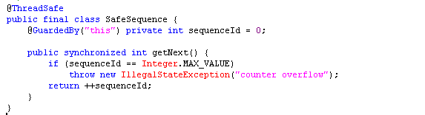
Synchronization
Use of synchronized keyword

Slide 55
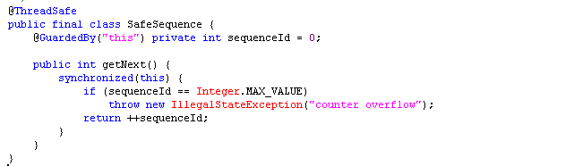
Synchronization
Synchronization at block level
Advantages over method synchronization?
Notes:
55

Slide 56
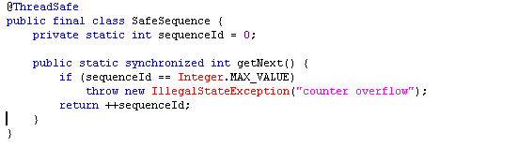
Synchronization
How about this one?
What object it uses for synchronization?
Notes:
56

Slide 57
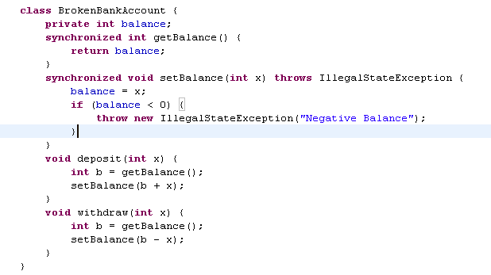
Example 2
Is there any problem here? Racing?
Atomicity
How to resolve?
Notes:
Since all accesses to the shared variable balance are guarded by locks, this code is free of what are called data races, which are basically what happens when you access a variable concurrently without some use of synchronization or volatile or the like.
When code is free from data races, we say it is correctly synchronized. So the code is correct, right? No, of course not. This code is not at all correct, in the sense that it doesn't necessarily do what we want it to do.
Think about what happens if one thread calls deposit(5) and another calls withdraw(5); there is an initial balance of 10. Ideally, at the end of these two calls, there would still be a balance of 10. However, consider what would happen if: The deposit() method sees a value of 10 for the balance, then
The withdraw() method sees a value of 10 for the balance and withdraws 5, leaving a balance of 5, and finally
The deposit() method uses the balance it originally saw (10) to calculate a new balance of 15.
As a result of this lack of "atomicity", the balance is 15 instead of 10. This effect is often referred to as a lost update, because the withdrawal is lost. A programmer writing multi-threaded code must use synchronization carefully to avoid this sort of error.
In Java, if the deposit() and withdraw() methods are declared synchronized, it will ensure that locks are held for their duration: the actions of those methods will be seen to take place atomically.
57

Slide 58
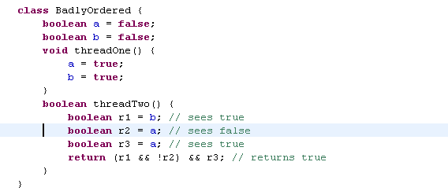
Example 3
Re-ordering– Can threadTwo return true?
If threadTwo returns true, it means that the threadTwo saw both updates by threadOne, but that it saw the change to “b” before the change to “a”.
How to resolve? synchronized? volatile?
Notes:
Well, this code fragment does not use synchronization correctly, so surprising things can happen! It turns out that Java allows this result, contrary to what a programmer might have expected. The assignments to a and b in threadOne() can be seen to be performed out of order. Compilers have a lot of freedom to reorder code in the absence of synchronization; they could either reorder the writes in threadOne or the reads in threadTwo freely. How do you fix it? Synchronize your code carefully! In this case, you can throw a lock around threadOne or threadTwo, or you can declare them both to be volatile, and get the ordering you want.
58

Slide 59
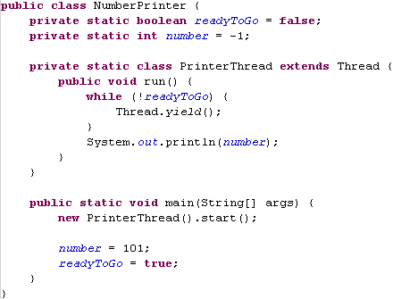
Example 4
Visibility – what will this program output?
Probably 101, but maybe -1, or maybe nothing at all!
How to resolve? synchronized? volatile?
Notes:
Two threads, the main thread and the printer thread, access the shared variables ready and number. The main thread starts
the printer thread and then sets number to 42 and ready to true. The printer thread spins until it sees ready is true, and
then prints out number. While it may seem obvious that NoVisibility will print 42, it is in fact possible that it will print
zero, or never terminate at all! Because it does not use adequate synchronization, there is no guarantee that the values
of ready and number written by the main thread will be visible to the printer thread.
59

Slide 60
Race Condition
“A race condition occurs when the correctness of the computation depends on the relative timing or interleaving of multiple threads by the runtime or in other words, when getting the right answer relies on lucky timing”
A race condition occurs when more than one thread is performing a series of actions on shared resources and several possible outcomes can exist based on the order of the actions from each thread are performed.
A race condition occurs when two or more threads can access shared data and they try to change it at the same time. Because the thread scheduling algorithm can swap between threads at any time, you don't know the order in which the threads will attempt to access the shared data. Therefore, the result of the change in data is dependent on the thread scheduling algorithm, i.e. both threads are "racing" to access/change the data.
Problems often occur when one thread does a "check-then-act" (e.g. "check" if the value is X, then "act" to do something that depends on the value being X) and another thread does something to the value in between the "check" and the "act". E.g:
if (x == 5) // The "Check"
{
y = x * 2; // The "Act"
// If another thread changed x in between "if (x == 5)" and "y = x * 2" above,
// y will not be equal to 10.
}
The point being, y could be 10, or it could be anything, depending on whether another thread changed x in between the check and act. You have no real way of knowing.
Notes:
60

Slide 61
Preventing Race Condition
To prevent race conditions from occurring you must make sure that the critical section is executed as an atomic instruction. That means that once a single thread is executing it, no other threads can execute it until the first thread has left the critical section.
Race conditions can be avoided by proper thread synchronization in critical sections. Thread synchronization can be achieved using a synchronized block of Java code. Thread synchronization can also be achieved using other synchronization constructs like locks or atomic variables like java.util.concurrent.atomic.AtomicInteger.
Race conditions can lead to unpredictable results and subtle program bugs. A thread can prevent this from happening by locking an object. When an object is locked by one thread and another thread tries to call a synchronized method on the same object, the second thread will block until the object is unlocked.
Notes:
61

Slide 62

Exercise01 | Race Condition
Write the following program to simulate the Race Condition:
A bank has few accounts. There are different transactions that transfer the money from one random account to another random account. Each account has one thread and this thread processes all the transactions for this account.
Refer code snapshots in the next slide.
Implement it using UnsyncBankTest.java
Notes:
Demonstrate how the total amount is corrupted when the program is run for few minutes.

Slide 63
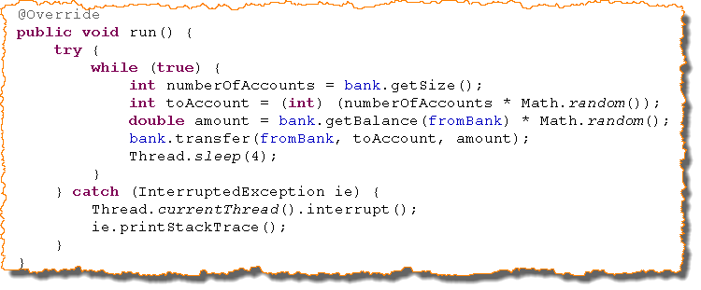
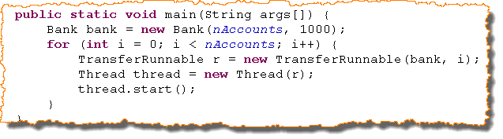
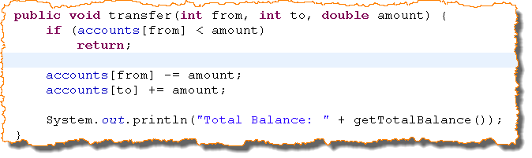
Exercise | Race Condition
Notes:
public class UnsyncBankTest {
public static final int NACCOUNTS = 100;
public static final double INITIAL_BALANCE = 5000;
public static void main(String[] args) {
Bank bank = new UnsyncBank(NACCOUNTS, INITIAL_BALANCE);
for (int i = 0; i < NACCOUNTS; i++) {
TransferRunnable r = new TransferRunnable(bank, i, INITIAL_BALANCE);
Thread t = new Thread(r);
t.start();
}
}
}
public class UnsyncBank extends Bank{
private static int count;
double[] accounts = null;
public UnsyncBank(int n, double intiBalance) {
this.accounts = new double[n];
for (int i = 0; i < accounts.length; i++) {
accounts[i] = intiBalance;
}
}
public void transfer(int from, int to, double amount) {
if(accounts[from] < amount)
return;
accounts[from] -= amount;
accounts[to] += amount;
System.out.printf("Total balance: ", getTotalBalance());
}
private double getTotalBalance() {
double sum = 0;
for (double amount : accounts) {
sum += amount;
}
return sum;
}
public int size() {
return accounts.length;
}
public static int getCount() {
return count;
}
}
public class TransferRunnable implements Runnable {
private Bank bank;
private int fromAccount;
private double maxAmount;
private int DELAY = 10;
public TransferRunnable(Bank bank, int from, double max){
this.bank = bank;
this.fromAccount = from;
this.maxAmount = max;
}
@Override
public void run() {
while(true){
int toAccount = (int)(bank.size()*Math.random());
double amount = maxAmount*Math.random();
bank.transfer(fromAccount, toAccount, amount);
try {
Thread.sleep((int)(DELAY*Math.random()));
} catch (InterruptedException e) {
e.printStackTrace();
}
}
}
}

Slide 64
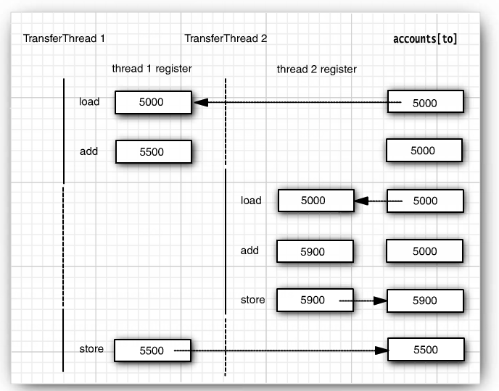
Race Condition Explained…
Source: Core Java Volume#1

Slide 65
Mutex
Every Java object can implicitly act as a lock for purposes of synchronization; these built-in locks are called intrinsic locks or monitor locks.
Intrinsic lock in Java act as mutexes (or mutual exclusion locks), which means that at most one thread may own the lock. When thread A attempts to acquire a lock held by thread B, A must wait, or block, until B releases it. If B never releases the lock, A waits forever.
Mutexes are typically used to serialize access to a section of re-entrant code that cannot be executed concurrently by more than one thread.
A mutex object only allows one thread into a controlled section, forcing other threads which attempt to gain access to that section to wait until the first thread has exited from that section.
Mutex = Mutually Exclusive Semaphore

Slide 66
Hardware Locking (CAS)
The first processors that supported concurrency provided atomic test-and-set operations, which generally operated on a single bit. The most common approach taken by current processors, including Intel and Sparc processors, is to implement a primitive called compare-and-swap, or CAS. (On Intel processors, compare-and-swap is implemented by the cmpxchg family of instructions. PowerPC processors have a pair of instructions called "load and reserve" and "store conditional" that accomplish the same goal; similar for MIPS, except the first is called "load linked.")
A CAS operation includes three operands -- a memory location (V), the expected old value (A), and a new value (B). The processor will atomically update the location to the new value if the value that is there matches the expected old value, otherwise it will do nothing. In either case, it returns the value that was at that location prior to the CAS instruction. (Some flavors of CAS will instead simply return whether or not the CAS succeeded, rather than fetching the current value.) CAS effectively says "I think location V should have the value A; if it does, put B in it, otherwise, don't change it but tell me what value is there now."
The natural way to use CAS for synchronization is to read a value A from an address V, perform a multistep computation to derive a new value B, and then use CAS to change the value of V from A to B. The CAS succeeds if the value at V has not been changed in the meantime.
Instructions like CAS allow an algorithm to execute a read-modify-write sequence without fear of another thread modifying the variable in the meantime, because if another thread did modify the variable, the CAS would detect it (and fail) and the algorithm could retry the operation. Listing 3 illustrates the behavior (but not performance characteristics) of the CAS operation, but the value of CAS is that it is implemented in hardware and is extremely lightweight (on most processors):
Notes:
66

Slide 67
Hardware Locking (CAS)
Implementing counters with CAS
Concurrent algorithms based on CAS are called lock-free, because threads do not ever have to wait for a lock (sometimes called a mutex or critical section, depending on the terminology of your threading platform). Either the CAS operation succeeds or it doesn't, but in either case, it completes in a predictable amount of time. If the CAS fails, the caller can retry the CAS operation or take other action as it sees fit. Listing 4 shows the counter class rewritten to use CAS instead of locking:
public class CasCounter {
private SimulatedCAS value;
public int getValue() {
return value.getValue();
}
public int increment() {
int oldValue = value.getValue();
while (value.compareAndSwap(oldValue, oldValue + 1) != oldValue)
oldValue = value.getValue();
return oldValue + 1;
}
}
Notes:
67

Slide 68

Quiz
Thread class is __________ and Runnable is __________ .
Worker and task
Thread can be created in two ways __________ and __________ .
Extending Thread class and implementing runnable interface
Volatile keyword is used for synchronization of __________.
Variable
Sleep is the method of __________ class and wait is the method of class __________ .
Thread and Object
Notify awakes __________ thread and notifyAll awakes __________ sleeping threads.
One(Random) and all

Slide 69
Good Links
Threads and Locks:
http://java.sun.com/docs/books/jls/second_edition/html/memory.doc.html#28733
http://java.sun.com/docs/books/jls/third_edition/html/memory.html
Memory model, volatile, synchronization, atomicity:
http://gee.cs.oswego.edu/dl/cpj/jmm.html
http://www.cs.umd.edu/~pugh/java/memoryModel/index.html
Happens before relationship: http://java.sun.com/javase/6/docs/api/java/util/concurrent/package-summary.html#MemoryVisibility
Concurrency JDK1.5:
http://www.ibm.com/developerworks/edu/j-dw-java-concur-i.html
A number of good articles on http://www.ibm.com/developerworks
MT Test cases:
http://www.dzone.com/links/multithreaded_testing_with_junit_and_java_5_concu.html
ConTest: http://www.ibm.com/developerworks/java/library/j-contest.html
Others:
http://forward.com.au/javaProgramming/HowToStopAThread.html
http://pitfalls.wordpress.com/2008/05/25/javavolatile/
http://www.ibm.com/developerworks/java/library/j-jtp06197.html?S_TACT=105AGX02&S_CMP=EDU
http://codeidol.com/java/java-concurrency/

Slide 70
Recap
Sleep/Wait/Notify/Interruption/Yield/Join -
We discussed the concept of sleep, wait, notify, notifyAll. We also discussed the difference between sleep and wait.
Then we discussed the concept of Interruption and various methods for Interruption in the Thread class.
Lastly we discussed the concept of Yield and Join.
Inter thread communication by using wait notify/blocking queue/exchanger –
Here practical examples of Inter thread communication using wait notify, blocking queue and exchanger were discussed.
Thread Local /Thread Confinement –
The concept of Thread Confinement was discussed.
The concept of ThreadLocal was discussed.
Runnable interface –
Implement threads using Runnable Interface was discussed.
Thread Class –
Implementing thread using Thread class was discussed.

Slide 71
Recap
Atomic API –
Atomic package and classes in the Atomic variable classes were discussed.
AtomicInteger was discussed using an example.
Lock / Lock API –
Lock APIs were discussed in detail – Basics of Lock, ReEntrantLock, Read-Write Lock and Condition were discussed in detail.
Differences between Lock and Synchronized was also discussed.
Synchronize Keyword – The concept of synchronization was discussed with various examples.
Hardware Locking (CAS ) -
. Finally the concept of Hardware Locking was discussed with an example of how to implement counters using CAS.

Slide 72
References
Java Concurrency in Practice – Brian Goetz et al

Slide 73
THANK YOU

