Slide 1

Presentation by: Group 7
Unraveling ASD Susceptibility Markers for Predictive Diagnosis
BIO221
Winter Semester
2024

Slide 2
ASD
Autism spectrum disorder (ASD) is a neurological and developmental disability caused by differences in the brain. People with ASD often have problems with social communication and interaction and restricted or repetitive behavior. Their symptoms can also affect their ability to function in school, work or other areas of life.

Slide 3
Problem Statement
Our objective was to contribute to a deeper comprehension of the genetic architecture of ASD. We aimed to identify genes whose mutations cause ASD, look for these mutations, and understand their effect.

Slide 4
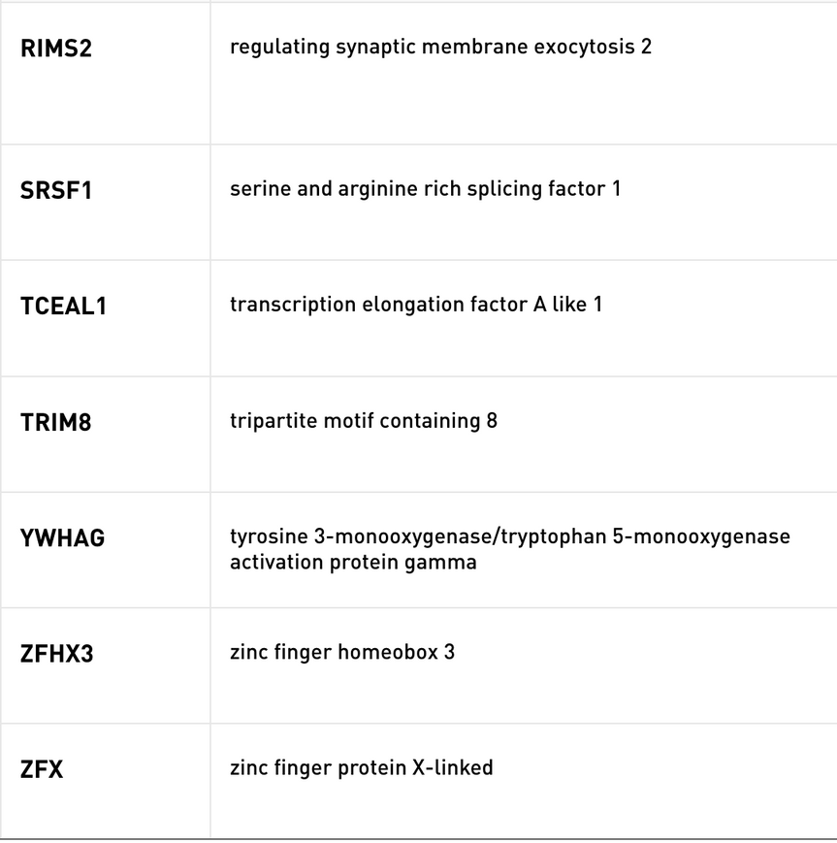
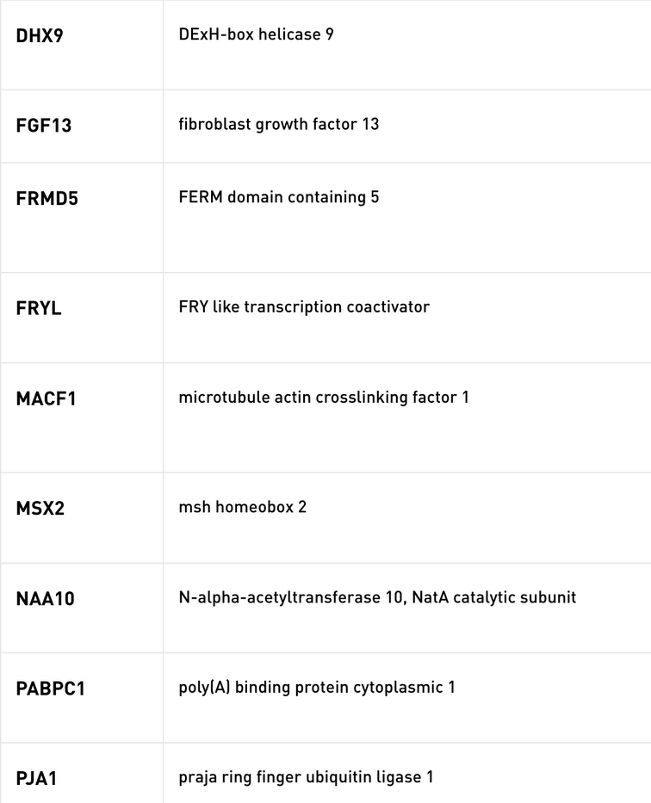
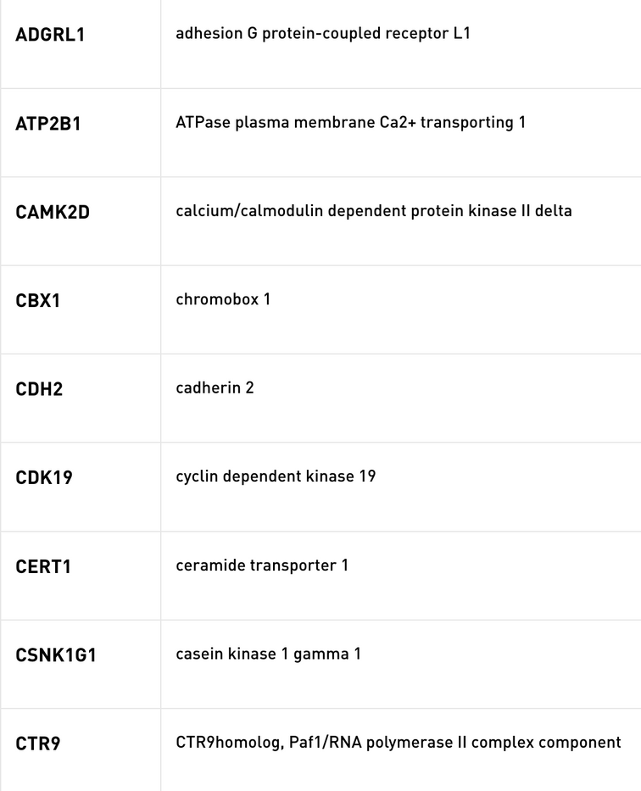
Syndromic Genes
with gene score = 3
Ref: Sfari Gene

Slide 5
DAVID
QUERY PASSED
TOOL USED
FURTHER ANALYSIS
The genes identified as syndromic and of type 3(sfari gene scoring) are passed as the Query Gene List which is further analysed.
Functional Annotation:
Functional Annotation Clustering
Functional Annotation Chart
Functional Annotation Table
The results from DAVID are analyzed to find an association between ASD and related neurodivergence.

Slide 6
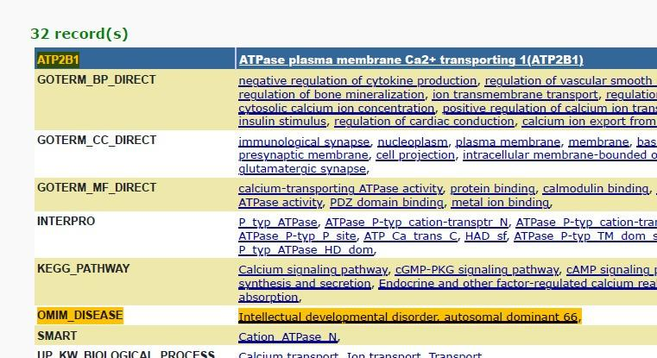

Slide 7
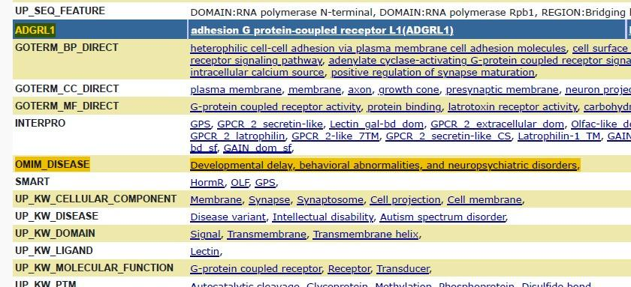

Slide 8
OMIM DISEASE
It is a database cataloging all known diseases with a genetic component, and it provides detailed information about the genetic basis, clinical features, and inheritance patterns of these diseases.
Out of 32 results obtained from DAVID, 12 had the SiPhy_29way_logOdds value greater than 5, indicating stronger evolutionary conservation.
These 12 identified genes are also linked to neurological disorders and neurodivergence closely associated with autism spectrum disorder (ASD).

Slide 9
Gene Plots
Polyphen2_HVAR_score
SIFT_score
SIFT score predicts the impact of genetic variants on protein function, categorizing them as tolerated (higher score) or damaging (lower score).
It is used as a metric to predict the potential impact of a genetic variant on protein function.
It expresses the likelihood of it being damaging or deleterious with scores ranging from 0 to 1 (0 being benign, 1 being damaging).
Note: Both plots are scatter plots done against locus, categorized by chromosome.

Slide 10


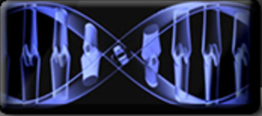
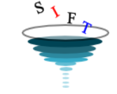

Tools Used

Slide 11
Challenges || Further Expansions
There's a lack of comprehensive data on gene expressions, coupled with a significant amount of discrepancies.
If gene expression data is accessible, conducting Differential Expression Analysis becomes feasible.
01
01
With consistent and comprehensive data, the integration of ML models can streamline the analysis of large datasets.
Available tools have slow response times, which makes working with large amounts of data infeasible.
02
02

Slide 12
Code Snippets

Slide 13
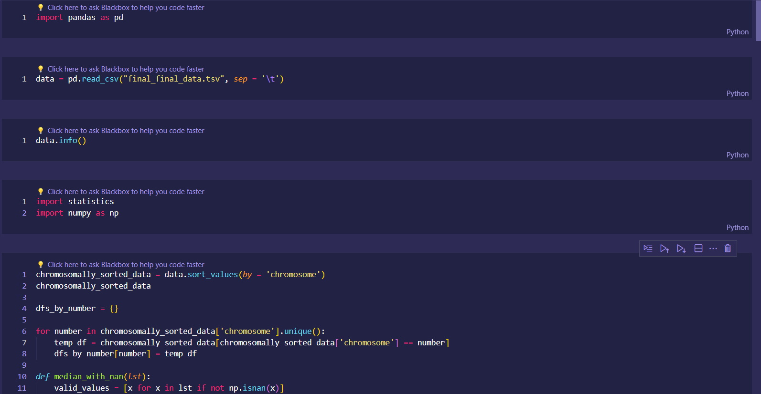

Slide 14
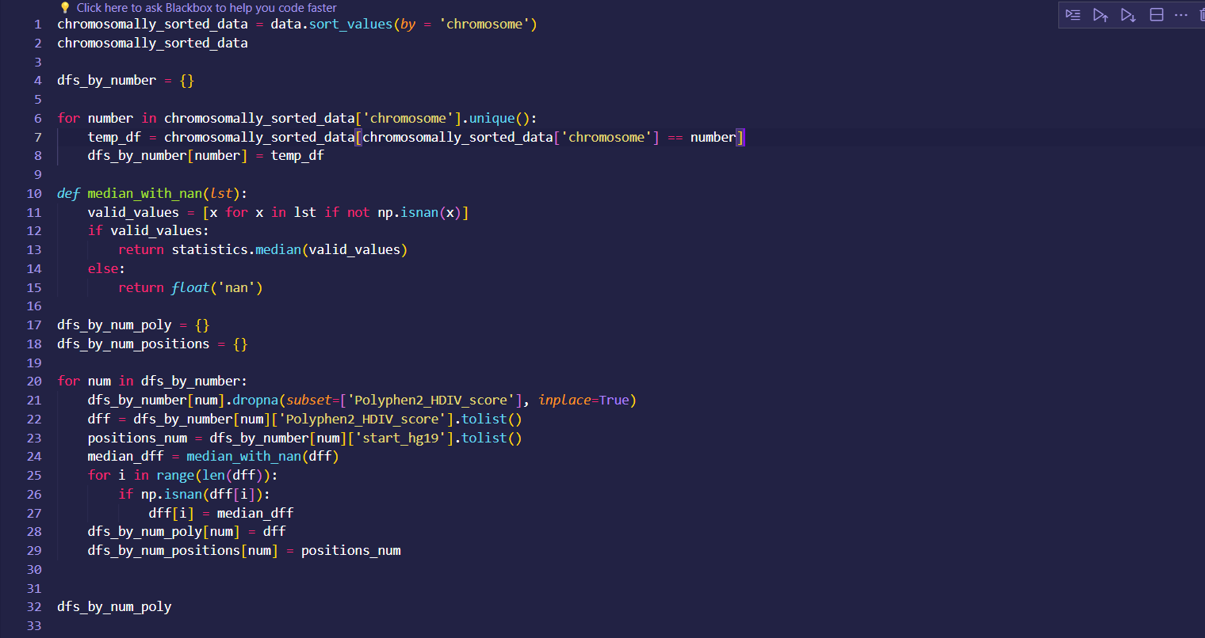

Slide 15
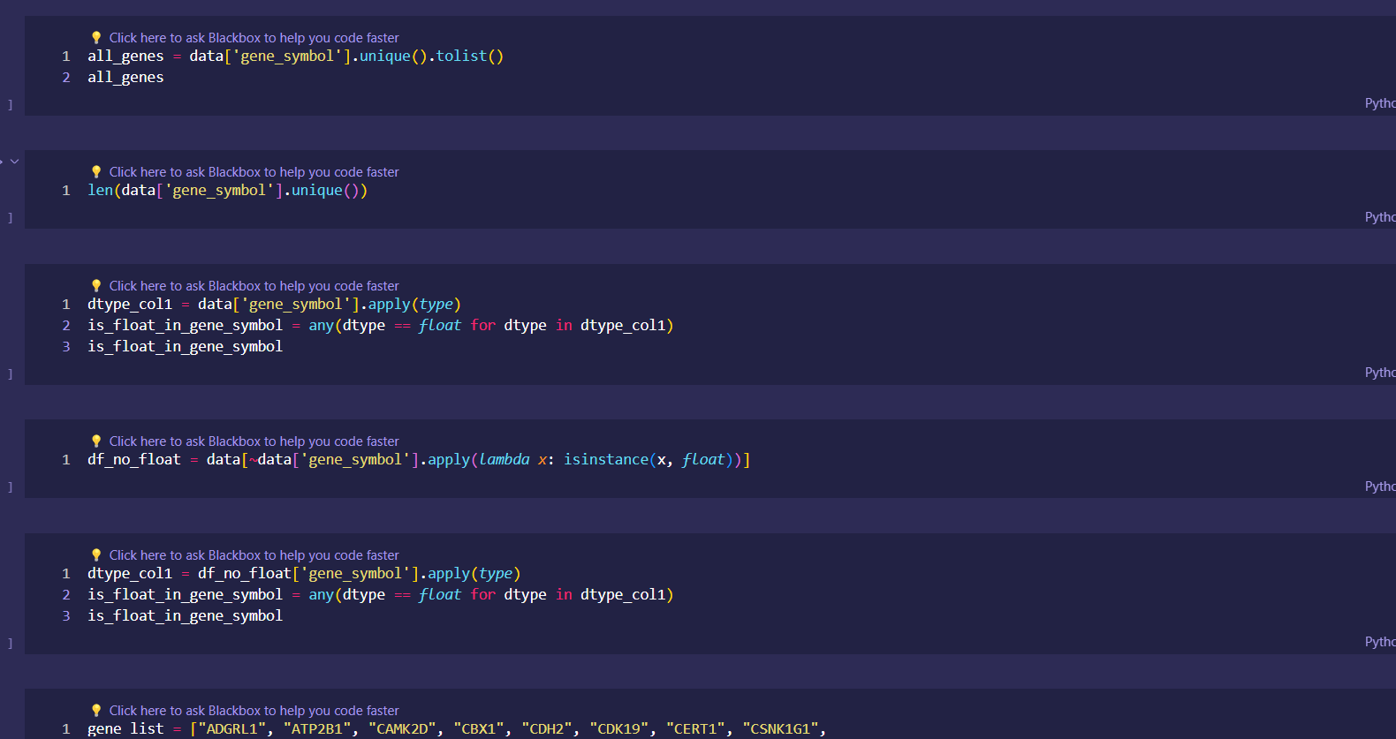

Slide 16
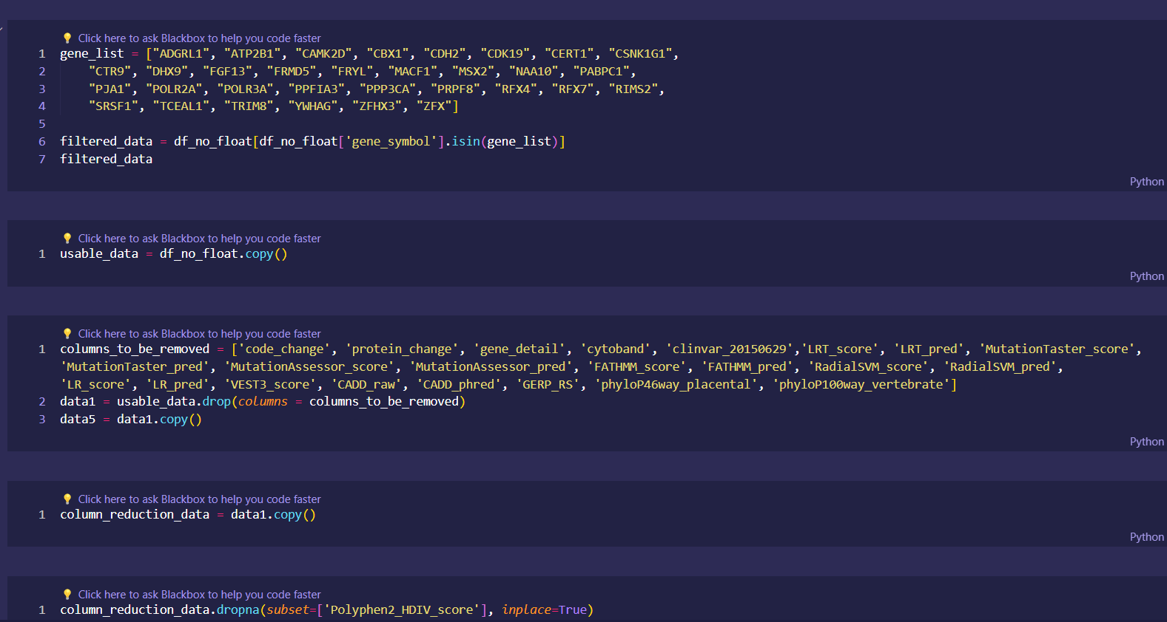

Slide 17
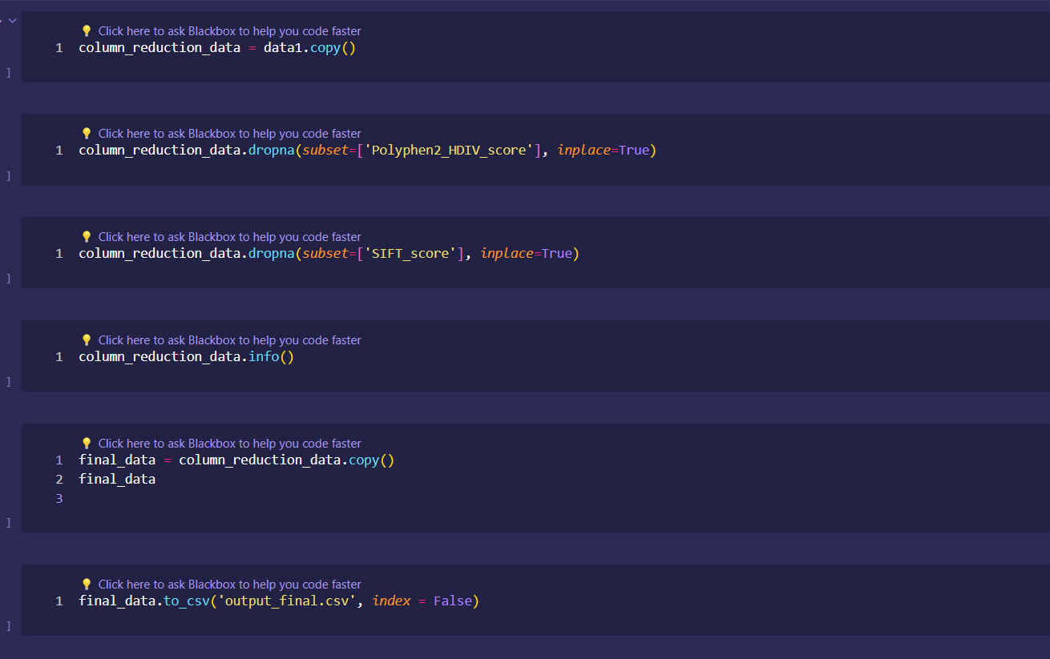

Slide 18
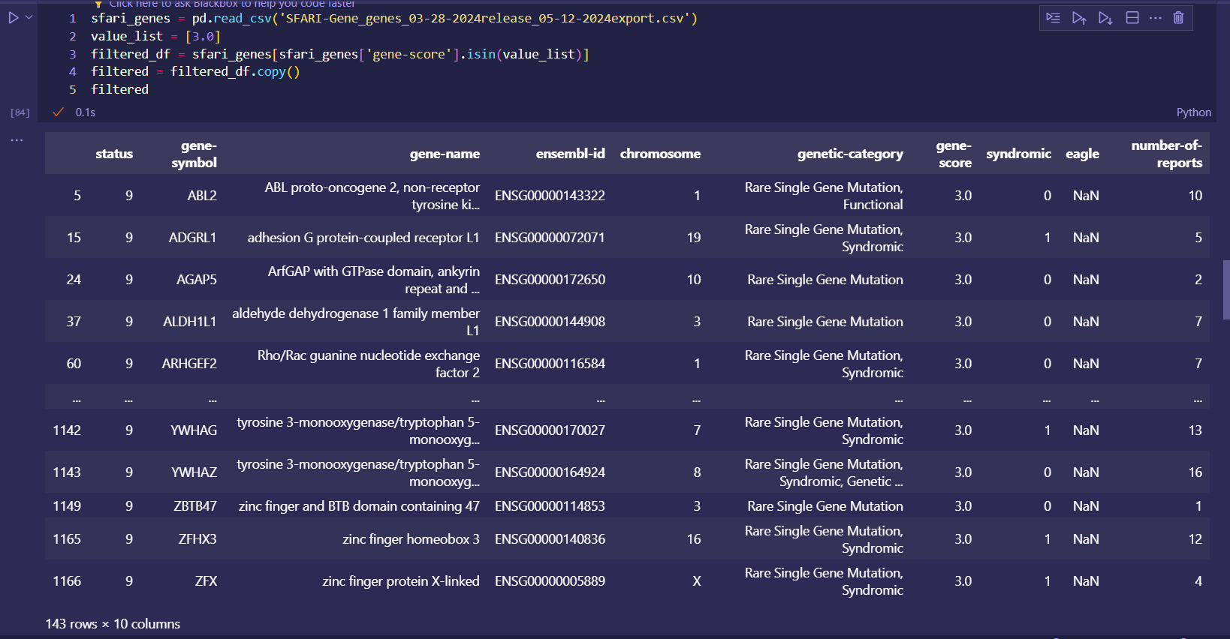

Slide 19
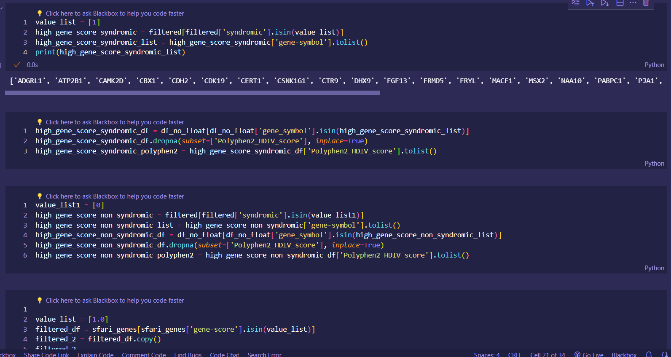

Slide 20
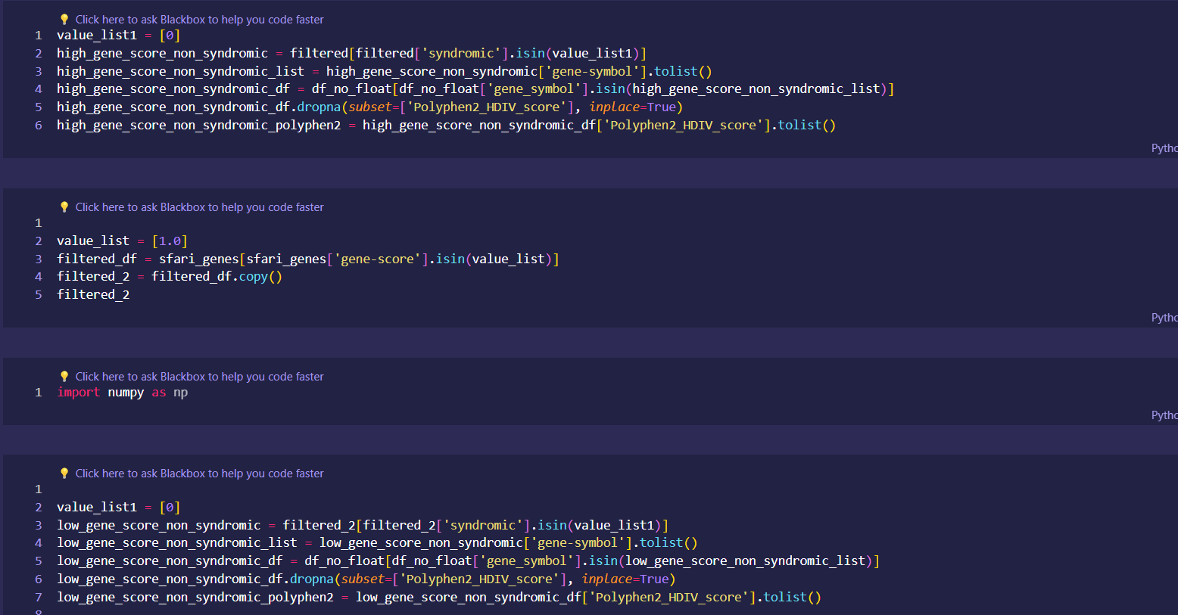

Slide 21
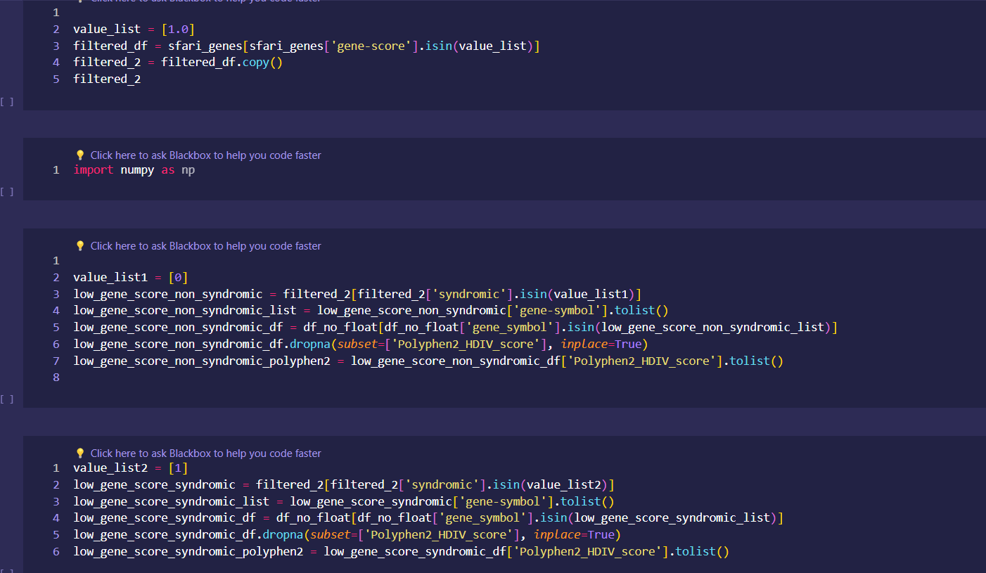

Slide 22
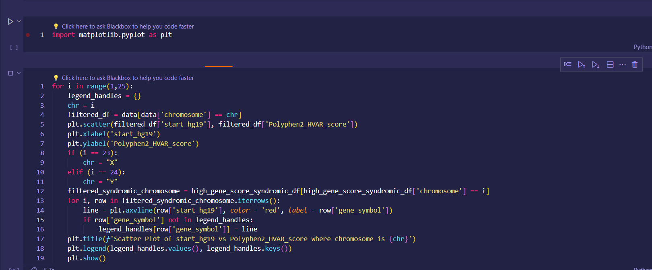

Slide 23
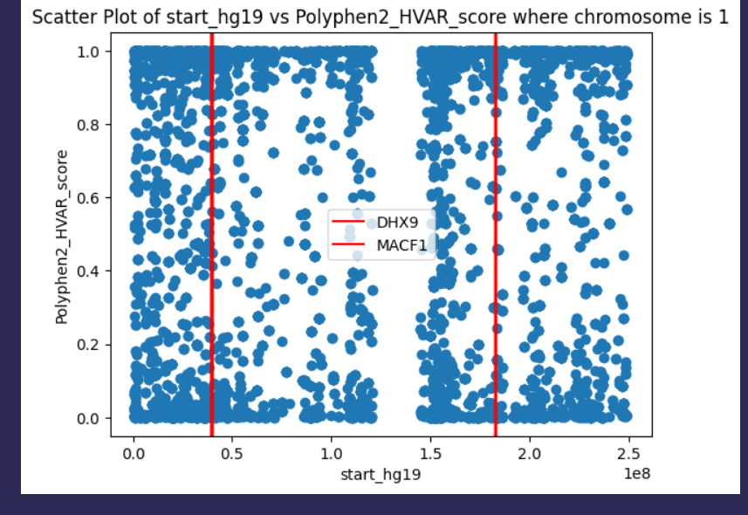

Slide 24
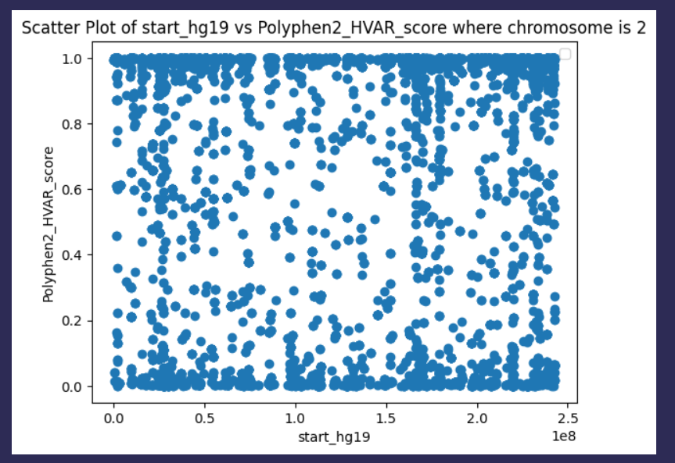

Slide 25
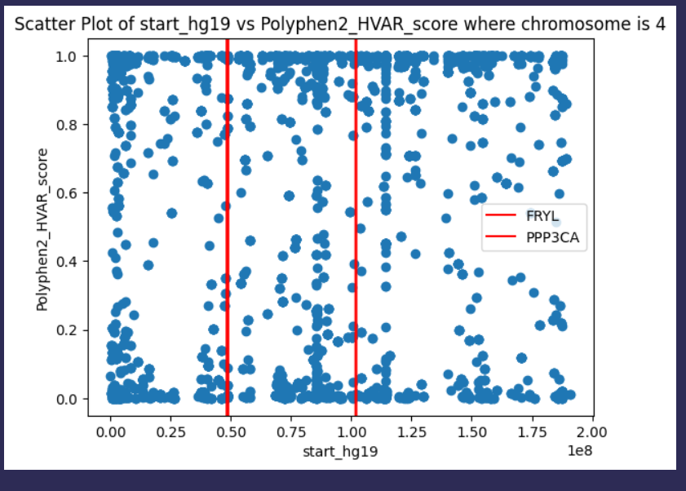

Slide 26
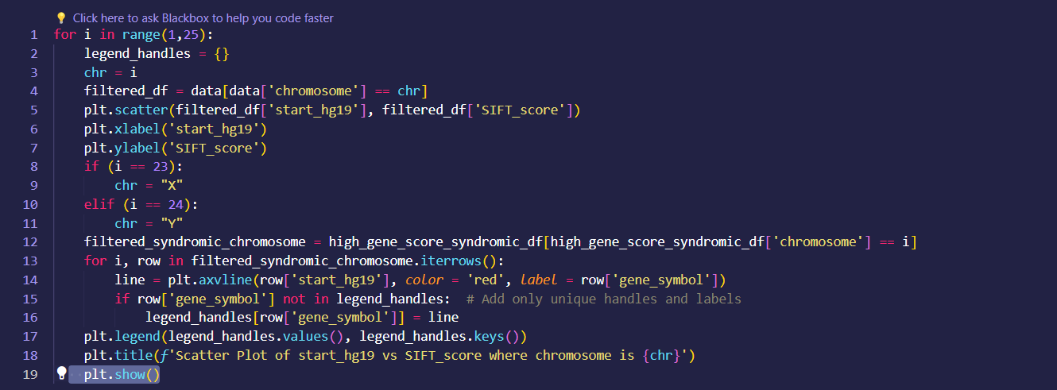

Slide 27
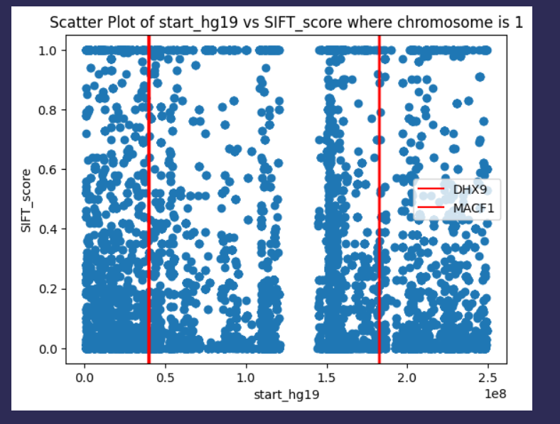

Slide 28
References
https://gene.sfari.org/database/human-gene/
https://varicarta.msl.ubc.ca/downloads
https://david.ncifcrf.gov/tools.jsp
http://genetics.bwh.harvard.edu/pph2/
Kong, Sek Won, Christin D. Collins, Yuko Shimizu-Motohashi, Ingrid A. Holm, Malcolm G. Campbell, In-Hee Lee, Stephanie J. Brewster et al. "Characteristics and predictive value of blood transcriptome signature in males with autism spectrum disorders." PloS one 7, no. 12 (2012): e49475.
Rastegari, M., Salehi, N. & Zare-Mirakabad, F. Biomarker prediction in autism spectrum disorder using a network-based approach. BMC Med Genomics 16, 12 (2023). https://doi.org/10.1186/s12920-023-01439-5.

Slide 29
Member Contributions
Mann Nariya (2022278): SIFT plot, data indentification
Medha Kashyap (2022292): SFARI and DAVID analysis, research
Nischaya Roy (2022333): Data Identification, polyphen2 and sift plot, Research
Aditi Sharma (2022025): Data analyzing, pre-processing, research
Ananya Garg (2022068): DAVID , Polyphen2, Data processing
Gurupriya (2022191): OMIM data check, SIFT

Slide 30
Thank You
Presentation by: Group 7
BIO221
Winter Semester
2024

