Slide 1
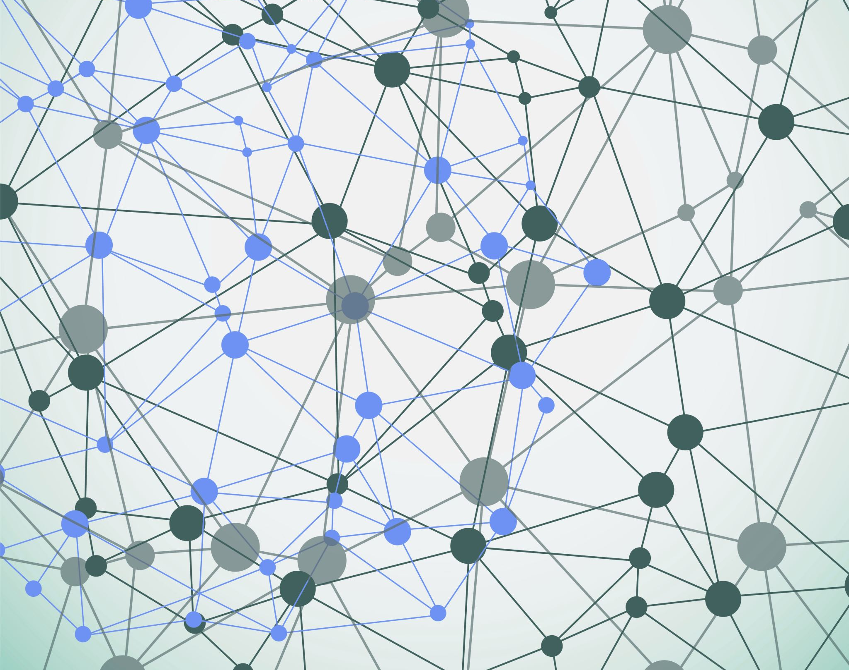
IoT Home Security System
- Nishchint (Nish) Upadhyaya

Slide 2
Quick Intro
What is the device?
Keyword used: Recludo!

Slide 3

Problem and Motivation
Notes:
No existing security system at my home
Thought about getting one through internet provider a few years ago
Monthly fee
Providing more personal data to internet provider – video/voice recordings
A personalized and easy to customize home security system

Slide 4
Market and User Needs
Home Security and Automation
Benefits anyone that would like a quick and easy security system
Easy to download and deploy for anyone
People with code knowledge can customize the Arduino code to cater to their needs

Slide 5

Real World Feedback
Brought up idea to Professor
Classmates
Discussion with an Uncle
Notes:
Brought up idea to Professor
Mentioned some capstone ideas to the professor at the beginning of the semester
Gave me more confidence that this is not “too easy” for a capstone
Classmates
Everyone discussed their ideas
Classmates gave me some ideas of their own when I talked about my topic
Discussion with Uncle
Spoke to uncle at the beginning of the semester, who is in the industry, about my classes and idea for this one
Gave me some ideas on what I can implement which sparked something in me to pursue this

Slide 6
System-Level Architecture
Edge Impulse
Build and test the model
Deploy model to Arduino through “Arduino Library”
CDA: Arduino Nano BLE 33
Edge device running the Edge Impulse model
Use the in-built microphone for keyword detection
GDA: Macbook
Connected to CDA through USB
Listens to the serial port for appropriate message
Sends payload to Ubidots, through Mqtt, based on serial message
Cloud: Ubidots
Receives payload from GDA through Mqtt
Payload saved within Device on Ubidots, and data can be used to build dashboards
Create data (voice recordings) for building model

Slide 7
Sensor Choices
Sensor Used:
Microphone
Reason:
Onboard availability
Edge Impulse Compatibility
Audio Quality
Limitations:
Range
Background Noise
Redesign Ideas:
Camera
Door Detection
Apple HomeKit
Wi-Fi Module
Speaker
Fingerprint Scanner
Text Message

Slide 8
Machine Learning Pipeline
Data – Unknown, Noise, Keyword (Recludo)
Feature extraction using MFCC (Mel Frequency Cepstral Coefficients)
Model used is NN-Classifier
Deployment using Arduino Library
Surprises
Notes:
Data
Phone Mic and Arduino Mic
Normal
Fast
Whispers
Soft voice
Frustrated
Distance and looking away from mic
Hard Negatives
Reclu
Cludo
Ludo
Do?
MFCC
Converts raw audio into a format that the model can understand
NN-Classifier
Takes the features from, looks for patterns, and classifies what it hears based on the labels added to the data.
Surprises
Ease collecting data – Phone, Arduino, upload existing
Availability of pre-built datasets
How smooth it is to train a model step-by-step after the required data is collected
Ease of analyzing the classifications by the model, cleaning up and re-training it
Option to test the model on phone before deploying

Slide 9
Reflection
What pushed me technically?
The fun part
The non-as-fun part
Notes:
What pushed me technically?
Trying to get the button on the board to work
Training the model, updating dataset, cleaning up data from test results and re-training model until desired accuracy
The fun part
Seeing the model train and then work on Edge Impulse
Watching the model, Arduino Code and Mqtt+Ubidots work as desired
The non-as-fun part
Initial keyword: git push home
Slight hiccups uploading data using phone

Slide 10
Final Thoughts before Demo
The achievement I’m most proud of
One thing I didn’t know before this class and can now do confidently

Slide 11
System Demo

