Slide 1
Electronic Finance: Reshaping the Financial Landscape Around the World
Stijn Claessens
Tom Glaessner
Daniela Klingebiel
Notes:
Presenting joint work with Stijn Claessens and Tom Glaessner

Slide 2
Structure of Presentation
The New World of Financial Services: A (R)evolution?
Public Policy Implications
Impact on Emerging Markets
Notes:
Objective of paper twofold; sketch out the impact of advances in technology in the financial services area and assess implications for public policy
Presentation will be divided in three parts:
-- first section will review developments and changes in financial service provision;
-- second part will explore public policy issues that these trends in provision of financial services and technology might imply for developed and emerging market economies
-- thirdly, initial assessment of what these changes imply for emerging markets in particular

Slide 3
The New World of Financial Services
Three major factors impacting financial services:
  Globalization
  Deregulation (geographic and product)
  Advances in information technology
Notes:
Three major factors are impacting financial products and financial services provision..
-- globalization is proceeding in all types of financial services through capital flows, cross border provision of financial services and entry of foreign financial institutions
-- further helped along by deregulation across markets and geographic areas; and across product areas, i. e. dismantling barriers between investment and commercial banking either through legislative changes or regulatory practice;
-- lastly advances in information technology; will look at impact in greater detail

Slide 4
Technology is Revamping Industrial Structure for Financial Services
Entry of new specialized financial service providers
  direct product providers
  aggregators
Entry of non-bank entities (telecoms/utilities)
Consolidation around recognized brand names
Emergence of mixed financial and non-financial conglomerates
Globalization of markets and trading systems
Notes:
Technology has three important impacts on the world of financial services;
1. Technology is changing the industrial structure for financial services;
-- here we can observe four distinct developments:
1. See entry of new specialized financial service providers; be it on-line brokers, e-payment providers; or so called aggregators that allow consumers to comparison shop; or financial portals that provide access to different financial service providers
2. Entry of non-bank entitities (telecom, utilities; supermarkets in UK acquiring a bank; transport company in Hongkong that is offering payment services) providing financial services;
3. Incumbents are consolidating around recognized brand names to achieve size and be able to offer whole range of services to their clients; Deutsche Bank’s acquisition of Dresdner Bank etc.
4. Lastly, increases in communications links allow market participants to trade from remote locations; trading services are becoming a commoditized product; alternative trading networks are emerging; as a result and in response to competitive pressures trading systems are consolidating and becoming increasingly global; link between Deutsche Boerse and London and Nasdaq; etc.

Slide 5
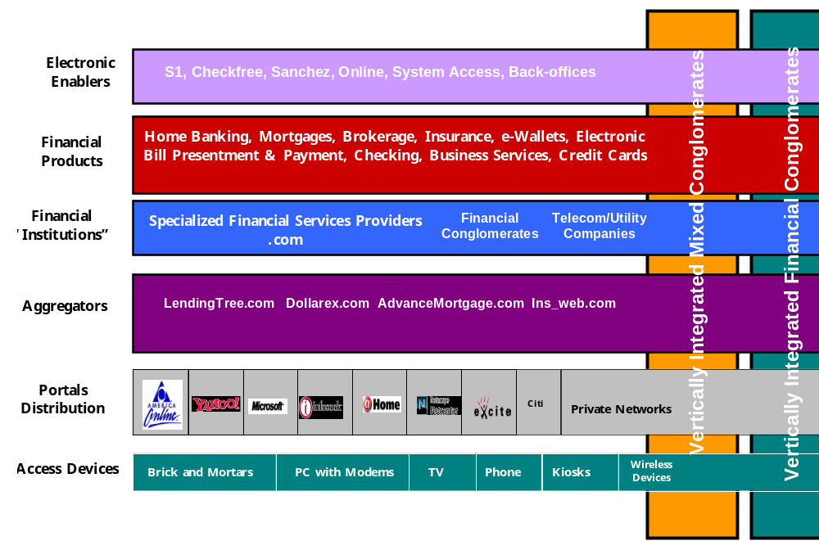
Technology is Revamping Industrial Structure for Financial Services
Notes:
Diagram is depicting the (new) industrial structure for financial services; in production and distribution process six steps can be distinguished which in practice will often overlap or be integrated vertically.
1) access device: multitude of possibilities from PC over mobile, TV set; Phone, Kiosk etc; in Hongkong a number of phones provide internet connections etc
2) So called portals/distribution channels form the critical link between access device and financial services;
3) Aggregators that allow for comparison shopping
4) financial institutions providing financial services either as monoliners, i. e. specialized or diversified entities
5) financial products are either commoditized or specifically tailored through specialized financial services providers
6) Enablers that provide software software and hardware support to financial services companies
.

Slide 6
Technology: Changing Financial Service Provision
  Massive cost reductions in technology and communications cost
  In particular, the internet
    reduces processing and labor costs
    allows for new distribution channel
    allows for better and more cost effective customer stratification and personalized pricing
    permits unbundling of financial products and commoditization
    lowers barriers to entry
Notes:
Second, technology is leading to massive cost reductions, and increase potential to provide financial services more efficiently;
-- direct cost reduction as, costs of technology per see decreased drastically; for example computer power risen by a factor of 10,000 over the past 20 years;
-- and indirect cost reduction as internet eliminates many processing steps;
-- provides for a relatively low cost new distribution channel;
-- allows for better and more cost effective customer stratification and personalized pricing;
-- permits unbundling of financial products and commoditization
-- lastly, lowers barriers to entry in various ways (electronic delivery modes do not rely on bank network; information asymmetries diminish so local knowledge about borrowers becomes less important; cheaper to establish de-novo bank as you can purchase off the shelf products etc)

Slide 7
Benefits to Consumers of Financial Services
Benefits to retail consumers
  Reduction in price and search costs
  Improvement in quality of services
  speed and timeliness of information (information-asymmetries reduced)
Benefits to corporates
  Reduction in transaction, search and monitoring costs
  Widening of access to financial services including for SMEs
Notes:
-- Lastly, advances in technology provide benefits to consumers of financial services; financial services industry has become much more competitive in many segments; thus benefits derived from technological advances will not exclusively accrue to financial services providers but is and will be shared with consumer of financial services;
-- on retail side; services are becoming cheaper; example entry of online brokerage services lead to decline in brokerage fees in US from $ 56 per trade to 8 and now to zero $
-- and aggregators help consumers to find best offer in terms of price and other dimensions as they aggregate different suppliers of financial services and coordinate information flows in rational ways;
-- overall increase in competition leads to improvement in service quality and speediness of service; loan application on-line etc;
-- wholesale side; benefit also from reductions in transactions and search costs; and importantly widening of access to financial services for smes through credit scoring models; or new financial service providers that act as incubators for new ideas, provide additional services and serve as screening device for venture capital firms; in US garage.com and in HK techpacific.com

Slide 8
Implications for Public Policy in the Areas of:
Safety and soundness regulations
Competition policy
Consumer protection and education
Global public policies
Notes:
Now we have sketched out changes in the world of financial services and now would like to turn our attention to the second part of the presentations;
what do these developments mean for public policy;
-- here look at following four areas;

Slide 9
Safety and Soundness
The need to review the extent of safety net
  Special nature of banks eroding
  Safety net and associated prudential regulation and supervision
  Guarantees of payment finality a last resort
Over short term, given technology advances important to
  Prevent extension of safety net in EM countries
  Decline of franchise value of incumbent institutions and financial stability
Notes:
-- Banks have long been perceived to be special; question now arises whether advances in technology are eroding special nature of banks and thus allow for and necessitate a review of the safety net;
-- Special nature of bank is eroding, mainly due to two factors: (1) substitutes are emerging for bank deposit and loan products; and (2) transactions costs are reduced and information more widely available which in turn decreases information asymmetries and accordingly banks’ proprietary information on borrowers;
-- This allows for a review of safety net and potentially substantially reduction in the extent of safety net
-- Among others, a reduction of the safety net may also appear necessary for the following reason. The entry of non-financial service providers, is blurring the lines between financial and non-financial institutions; Blurring of lines makes it difficult for supervisors to monitor financial service providers and increases potential for leakage of the safety net to activities that are not related to deposit taking;
- Finally, over the long run, if safety net substantially reduced there will be less need for prudential regulation and supervision.

Slide 10
Competition Policy
A more active competition policy will be needed
Market and product definition more difficult
Barriers to entry can arise from
  Sunk costs and/or high fixed costs and switching costs
  Network externalities
  Links between banking and commerce or vertical integration/horizontal integration
Competition policy in financial services needs to be harmonized.
Notes:
-- Reduction of the safety net allows for the financial sector and markets to be treated like other markets and competition policy becomes thus both more feasible and more important
-- Yet, market and product definitions that are critical for competition tests will become more complex; defining markets has become more difficult as many markets are becoming more global, rendering geographic definitions useless; at the same time, non-financial products are taking on properties of financial contracts;
-- Entry is important to ensure that benefits of technological advances are reaped by consumers; yet entry in new world adversely affected by sunk costs, here we mean branding/reputation and first mover advantages; network externalities, benefit to participants of network increases the more participate in network will become important particular in payment and trading services
-- As markets become global, competition policy will need to be harmonized worldwide to coordinate the definition of and sanctions for violations on a global basis

Slide 11
Consumer and Investor Protection
Consumer and investor education and protection more important
What role for ISP providers?
What role for Portal Companies and Investment Advice?
What role(s) for financial service providers?
Notes:
-- Consumer and investor protection and education will become more important as a public policy function with the advent of e-finance; raises a number of issues such as the role of standards in those areas as fraud, privacy, transparency, who will develop those standards and what entity will enforce them
-- let me just pick out one example in the investor protection area; non-traditional financial services providers complicate application of investor protection mechanism that are based on current institutional framework; Who has jurisdiction over ECNs or portals? Many portals are providing (objective) investment advice on their sites; yet they may be off-line in the underwriting business; or they may have exclusivity agreements with a small number of financial services providers; then disclosure becomes important;

Slide 12
Global public policy dimensions
Access to cross-border financial services raises the following issues
  Move to single license (passport) with home rule regulation?
  Which country standards and jurisdictions apply?
Market disturbances could increase
  Easier spread of misinformation, commoditization, less risk sharing by institutions could increase asset price volatility
  Herding, contagion, and susceptibility to spurious currency attacks may increase
  Capital account restrictions more difficult to enforce
  Coordination of creditors in a crisis more difficult
Notes:
From a global public policy perspective, increased ability to deliver services across borders raises issues of harmonization of standards and practices;
-- Today, countries still limit cross border provision of financial services; which the internet will make harder to impose over time; question is whether worldwide regulators could agree to something like a single passport comparable to EU;
-- Cross border provision of financial services raises issue of what jurisdiction applies;
Increased economic integration may raise some risk
-- because spread of misinformation easier to achieve, increased commoditization may mean less risk sharing by institutions; both could increase asset price volatility;
-- countries may be more susceptible to herding, contagion and spurious currency attacks
-- Capital account restrictions to limit capital flows will be more difficult to enforce;
-- Increase in number of creditors may further complicate coordinating actions prior to or during crisis

Slide 13
Impact on Emerging Markets
E-finance and related e-commerce and overall penetration is growing very rapidly
E-finance has the potential to
  Improve quality and scope of financial services
  Venues for trading risks
  Offer more cost-effective delivery of services
  Widen the access of retail and commercial clients
Survey Results Suggest Uneven Development of Preconditions to obtain the benefits.
Notes:
Including in emerging market economies e-finance and related e-commerce is growing rapidly;
-- rate of growth of internet rapid in emerging economies and some countries are at par with developed economies;
-- in Korea, 67% of trading takes place online
-- India, online bank accounts and online services are growing rapidly and even lower income customers are moving on line
Especially in emerging market economies where access to financial services and the quality of services delivered is limited, e-finance offers important opportunities as electronic finance has the potential to
-- Improve quality and scope of financial services and venues for trading risks
-- Widening of access to financial services to a much greater set of retail and commercial clients by offering more cost-effective delivery of services

Slide 14
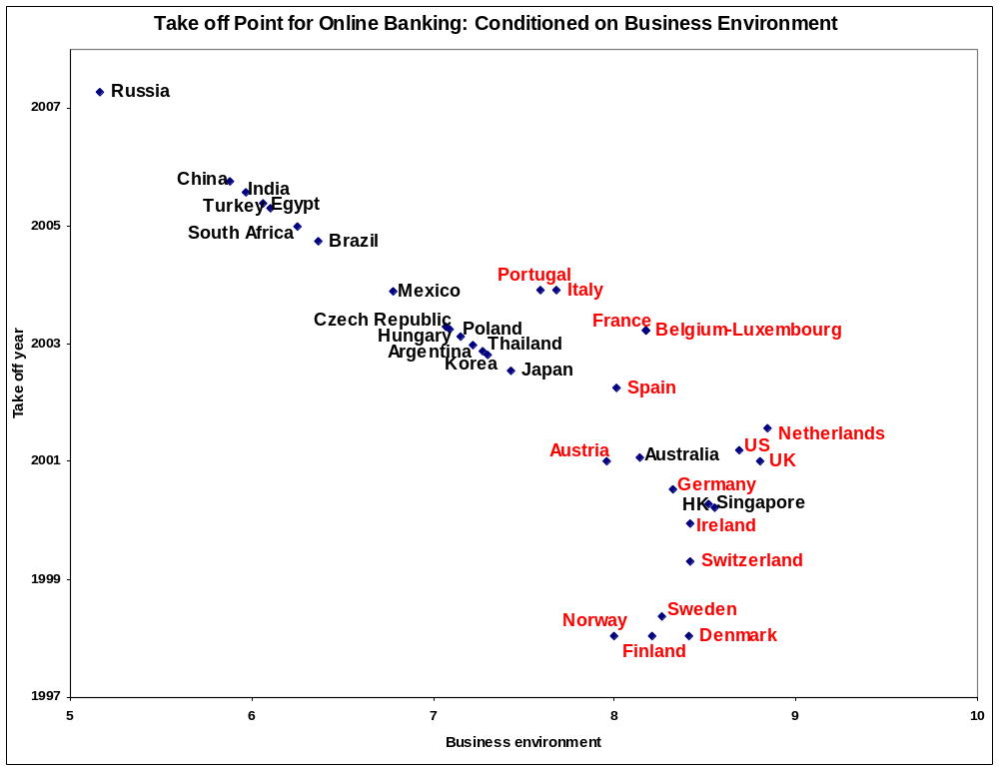
Notes:
This chart gives a sense for the potential benefits and so-called speed of take off in the growth of on-line banking across a selected sample of developed and emerging markets where we have used sample data for 16 developed countries in red to paramterize the relationship between business conditions (as measured by the—index) and on-line provision of banking services as measured by online bank customers as a percent of total bank customers.
This exercise (albeit somewhat arbitrary) suggests that the take off point for some emerging market countries may be far off unless they improve critical areas of infrastructure. (Next Slide)

Slide 15
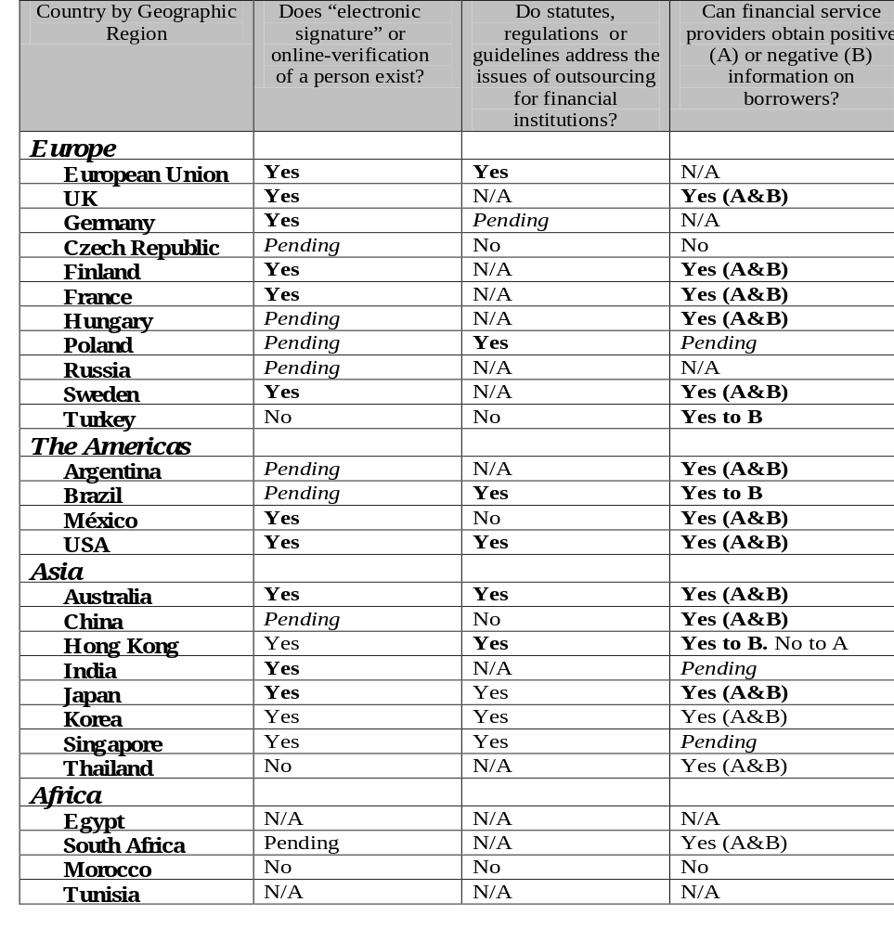
EXISTING REGULATION OF E-FINANCE PROVIDERS AND INFORMATION INFRASTRUCTURE

Slide 16
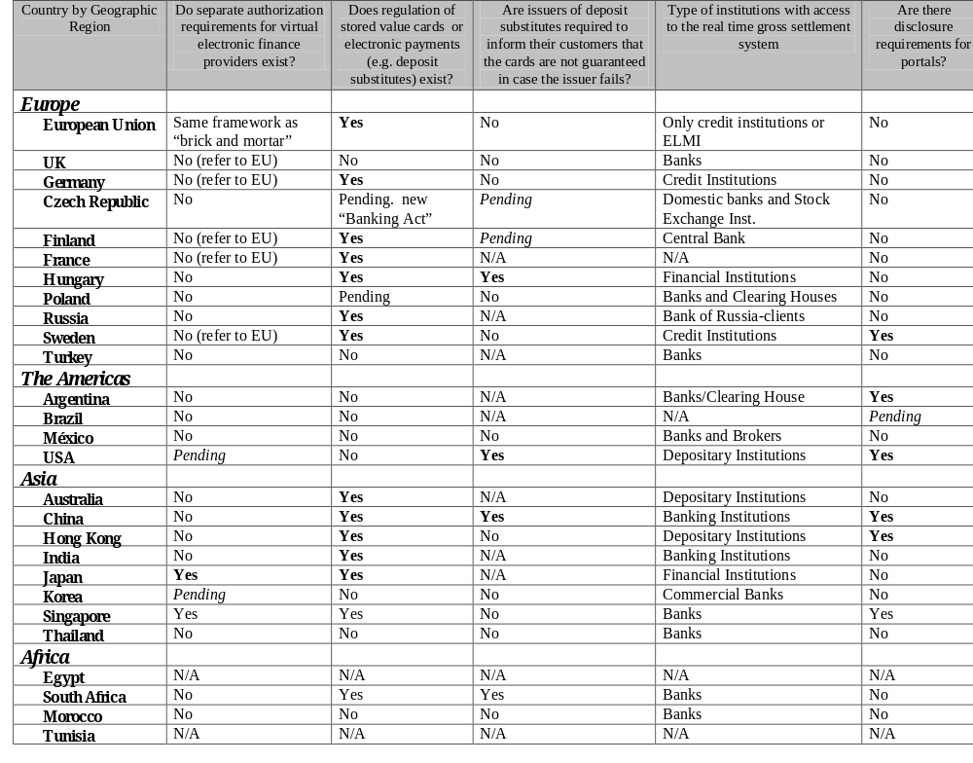
EXISTING REGULATION OF E-FINANCE PROVIDERS AND INFORMATION INFRASTRUCTURE

Slide 17
Impact on Emerging Markets
Financial Sector Development: A New Paradigm?
  A more functional versus institutional approach
  Focus on the enabling environment: basic legal, information, and communications infrastructure
  Reassess approach to financial regulation and supervision
  Reassess whether very small and/or underdeveloped countries should have domestic equity, bond, and even banking systems
Notes:
The emergence of e-finance will allow for and require a reassessment of the paradigm that has been used to pursue financial sector development:-- four lessons emerge:
(1) As outlined before, e-finance can allow emerging market economies to avoid establishing an elaborate safetuy net (issue of confidence and access to savings vehicles). Allows for a reduction of the extent of safety net
(2) E-finance allows also for much easier access--inward and outward-- to global capital and financial service providers which offers not only potential gains in terms of increased financial sector stability but also means that countries have less of a need to build up a full fledged domestic supervisory capacity;
(3) As services can be imported should very small countries even build up domestic stock, bond and in extreme banking systems;
(4) For many emerging markets, to reap the gains of e-finance, more focus on reforms in basic legal, information, and technological infrastructure is required.

Slide 18
Some Preconditions
Communications Infrastructure
Security Arrangements
Privacy and Information
Contract Enforcement

Slide 19
Communications Infrastructure
Privatize Post Telegraph and Post Administrations
Improve licensing of competitive operators
Reduce international trade barriers
Impose mandatory interconnections Introduce an independent/ accountable regulatory authority
Develop price cap regulations
Notes:
In many countries post telegraph and post administrations are still in public hands and in many cases this impedes progress in development of telecom infrastructure.
and unbundling of public switched telephone networks

Slide 20
Security Arrangements
Security breaches becoming more common
Should the Certification Authority be public or private?
How stiff are penalties for security infractions?
How can private keys be made much more secure to permit authentication?
Biometrics

Slide 21
Privacy and Information
Is Privacy consistent with Security?
Screen scraping
Sharing positive and negative credit information
Technology and its role in data mining and scoring—the case of ICICI and Global Trust Bank

Slide 22
Contract Enforcement
Weak Contract Enforcement implies less liquidity
Cross Border Issues and Dispute resolution
Can technology improve collateral and foreclosure processes?
Can technology improve contract enforcement?

Slide 23
Applications: E-Finance in Emerging Markets
Smart Cards a way to Leapfrog
Insurance: E-financeable
E-Finance for Small and Medium Enterprises
Micro finance: E-financeable?
Housing Finance: A new approach
ECNs in emerging markets?

