Slide 1


Field Project in Financial Market and Services
FinTech
20 March 2016
Baert Corentin – Best Thomas - Smets Sarah

Slide 2






Table of content
−
Introduction
Big Data
Threats and opportunities for banks
Regulation
Valuation
Conclusion

Slide 3

Introduction
FinTech combine Finance and Technologies
Start 65 years ago with credit card creation (1950s), ATMs (1960s) and electronic stock trading (1970)
Strengthen with e-commerce development (2000s) and today face a new boom with mobile phone applications and social networks development
User-friendly and high quality service in the same way it happens in other sectors : transport, distribution and renting
What are the impacts on traditional banks ?

Slide 4

Big Data
Notion of big data: analyse and capture value from large and complex data sets
Peer-to-peer lending: Data collection and analysis
Traditional Bank
FinTech
- Information collected through various modern channels
- Basic credit scoring based on long term relationship
- Data treatment with complex algorithms
- Other kind of Fintech will be able to generate additional data: Payment platform, assets management.
Better knowledge of clients, better targeted services
Data security and personal information protection ?

Slide 5
Threats and Opportunities for Banks
Global Investment In FinTech
2014, global Investment have tripled
Banks are the first one to be affected by the growing popularity of FinTech
Various department are threaten
2014
$12.00 m
2000
$447 m
2013
$677 m
Competitors or New Opportunities ?

Slide 6

Threats and Opportunities for Banks
Crowdfundings
Peer-To-Peer Lending
Allow projects that maybe can’t get a bank loan to benefit from external financing
Challenging the core activity of a bank
Putting in relation borrowers with many lenders based on their risk aversion
Straightforward
More transparent for lenders → they choose the amount they wish to invest and they directly know where it goes
Big Data is used for a more precise risk profile → more efficient credit selection process
Question the traditional banking system and its credit selection capacity
Faster collection and treatment of the information
Reduction in the complexity of transactions
Biggest challenge for the banking industry → Credit Selection Process
Acquisition / Partnership
Improvement / Changes in their Business Model

Slide 7

Threats and Opportunities for Banks
Payment Platforms
Assets Management
Faster moving sector in terms of innovations
Development of algorithms and use of Big Data → “Right Allocation of the Resources?”
Customers expectations are growing
Digital Generation
Faster (instantaneous), cheaper and easier to use
Banks may still have an advantage in this sector, but for how long ?
Forecasts keep predicting an increase in the use of online payments
More transparency are required by clients
Faster respondent to technological changes
Security still stay one of the main concern→ Regulation ?
Partnership / Improve their business model or strategies
Monitor the evolutions / Improvement and investments in their business model

Slide 8
Shadow Banking
“Financial intermediaries that are outside the traditional banking system and that are indispensable to the funding
of the global economy”
Investment banks, hedge funds, money market funds, crowdfunding platforms, virtual currency platforms, …
No deposit from the public → no guarantees by States nor Central Banks
Systemic risk → establishment of the Financial Stability Board
Basel III is supposed to provide limits on certain activities of the Shadow Banking at the international level

Slide 9
Existing Regulation
New economy means new regulations
Innovation makes the traditional financial system more complex and opaque
MiFID 2 & IMD 2 → more transparency
Labels CIP & IFP → legal professional status of crowdfunding platforms
The aim of the regulator is to protect customers and to follow the evolution of the technologies

Slide 10
Regulate with caution
Importance to push competition
Risks of Fintech <--> Creation of barriers to competition
Set the regulatory agenda → motivate firms to bring innovation in the financial services market
Regulation should maintain and foster stability because Fintech brings modernization in the financial system

Slide 11
Objectives of regulators
Cooperation → positive outcomes can be achieved thanks to constructive dialogues
Approachability → important for investors to have a point of contact with regulators
Reliability & Commitment → binding responses to decrease the business risk of startups
Timeliness → shorter internal processes to react faster to innovation
Harmonization → to foster growth and to limit regulatory arbitrage

Slide 12
Valuation
Fintech: Two comparative advantages : Low costs and low regulatory constraints
Thanks to light capital activities
Peer-to-peer lending, crowd funding:
they don’t hold risk in their balance sheets
Avoid two traditional bank risks: maturity mismatch and leverage.
However: untested credit model

Slide 13
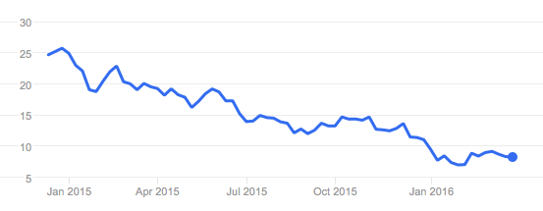
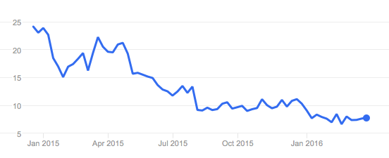
Valuation
Two IPOs examples, both leader in their domain:
Lending Club
OnDeck
Source: Google finance
Emphasize excessive reactions from investors

Slide 14
Conclusion
Rapid growth and expansion of FinTech → Massive challenge for Banks
Many Departments inside banks are threaten by technological innovations
Different solutions need to be consider:
Partnership
Acquisition
Changes / Improvement of strategies and business model
Monitor the evolution of the Regulation for FinTech
Keep up-to-date

Slide 15
Thank you for your attention
Any Questions?

