Slide 1
Quick note before the instructions
In the following screens, you will see instructions that describe what will happen during the experiment and how you will be compensated for your participation. It is important that you read them carefully.
When you’re done reading them, you will take a simple test to check your understanding. You will proceed to the experiment only if you pass the test. Otherwise, the experiment will end, and you lose your chance to earn any bonuses.
Press the right arrow key to proceed, left arrow key to go back.

Slide 2
Welcome!
The goal of this experiment is to study how your brain encodes information when you make simple decisions.
We are very grateful for your participation in the study.
Press the right arrow key to proceed, left arrow key to go back.

Slide 3
What will you do during the experiment?
During the next hour, you will be asked to make about 800 decisions.
Each time, you will be asked to decide if you want to buy the right to play the slot machine shown on the screen for a price.
If you choose NO, your payoff for the decision is $0.
If you choose YES, you pay the purchase price, but also earn the random monetary prize generated by the slot machine.
Press the right arrow key to proceed, left arrow key to go back.

Slide 4
Each time, you will see one of these slot machines:
Љ
Ѧ
Ж
Ѿ
Press the right arrow key to proceed, left arrow key to go back.

Slide 5
Each decision will start with a short duration fixation screen, as shown below.
During this time, you should direct your gaze to the location of the cross. This is where the information for the next decision will appear.
Press the right arrow key to proceed, left arrow key to go back.

Slide 6

Next, you will see one of the four slot machines, a purchase price, and a timer.
To play the slot machine for the purchase price, press the LEFT arrow key.
If you do not want to purchase it, press the RIGHT arrow key.
Yes
No
$10?
Press the right arrow key to proceed, left arrow key to go back.

Slide 7
Once you have made the choice, the computer will show you the outcome for that decision.
If you choose YES, you will earn the gross return MINUS the purchase price.
For example, if the purchase price is $10 and the slot machine returns $12, you win $2 and will see the following outcome screen:
Price: 10.00
Return: 12.00
Yes
Win: 2.00
Press the right arrow key to proceed, left arrow key to go back.

Slide 8
Here is another example.
If you choose YES, the purchase price is $10, and the slot machine returns $5.5, you lose $4.5 and will see the following screen:
Price: 10.00
Return: 15.50
Yes
Lose: 4.50
Press the right arrow key to proceed, left arrow key to go back.

Slide 9
Here is another example to show what happens if you choose NO.
If you choose NO, you neither win nor lose money in the trial, i.e. you earn $0. However, you are still shown what you might have won or lost. The screen will look like:
Price: 10.00
Return: 15.50
Lose: 4.50
No
Press the right arrow key to proceed, left arrow key to go back.

Slide 10
To help you remember that you will not win or lose money if you choose NO, you will see “Earn: 0.00” flash on the screen towards the end, as shown below:
Price: 10.00
Return: 15.50
Lose: 4.50
No
Earn: 0.00
Press the right arrow key to proceed, left arrow key to go back.

Slide 11


Each slot machine will appear in a consistent location that is slightly offset from the center throughout the experiment. You already saw one example slot machine in the previous instruction screens. Here are two more:
Yes
No
Yes
No
$6.5?
$13.25?
Press the right arrow key to proceed, left arrow key to go back.

Slide 12
Here is more information about the experiment.
First, please make your choices as quickly as you feel comfortable doing so, and ideally under two seconds.
To help you do so, the computer will show you a line under the slot machine that will act as a timer: it will gradually decrease in size until the time is up.
Yes
No
Time starts
.
.
.
$10?
Time up
Press the right arrow key to proceed, left arrow key to go back.

Slide 13
Here is more information about the experiment.
First, please make your choices as quickly as you feel comfortable doing so, and ideally under two seconds.
If you do not respond within that time frame, we treat that decision as if you chose NOT to play, i.e. you earn $0. However, you will not see any potential earnings on the screen:
Price: ?
Return: ?
Earn: ?
Please respond faster!
Press the right arrow key to proceed, left arrow key to go back.

Slide 14
Here is more information about the experiment.
First, please make your choices as quickly as you feel comfortable doing so, and ideally under two seconds.
Note: responding quickly will NOT speed up the experiment. If you do, you will wait with a blank screen before it is time for your next decision. Hence, it is in your best interest to spend enough time on each decision to maximize your earnings.
Press the right arrow key to proceed, left arrow key to go back.

Slide 15
Here is more information about the experiment.
First, please make your choices as quickly as you feel comfortable doing so, and ideally under two seconds.
Note: responding quickly will NOT speed up the experiment. If you do, you will wait with a blank screen before it is time for your next decision. Hence, it is in your best interest to spend enough time on each decision to maximize your earnings.
Finally, the experiment will take approximately 60 minutes to complete. To make the experience more enjoyable, we have divided the experiment into 4 blocks of about 200 decisions each.
We encourage you to take short breaks in between.
Press the right arrow key to proceed, left arrow key to go back.

Slide 16
At the beginning of the experiment, you will see the following screen, and you start the block by pressing the space key on the keyboard:
Press space when ready
Press the right arrow key to proceed, left arrow key to go back.

Slide 17
At the end of each block, you will see a screen like the one below. Please take a few moments to rest, and when ready, press the space key to start the next block:
This concludes block 1
Press space to start block 2
Press the right arrow key to proceed, left arrow key to go back.

Slide 18
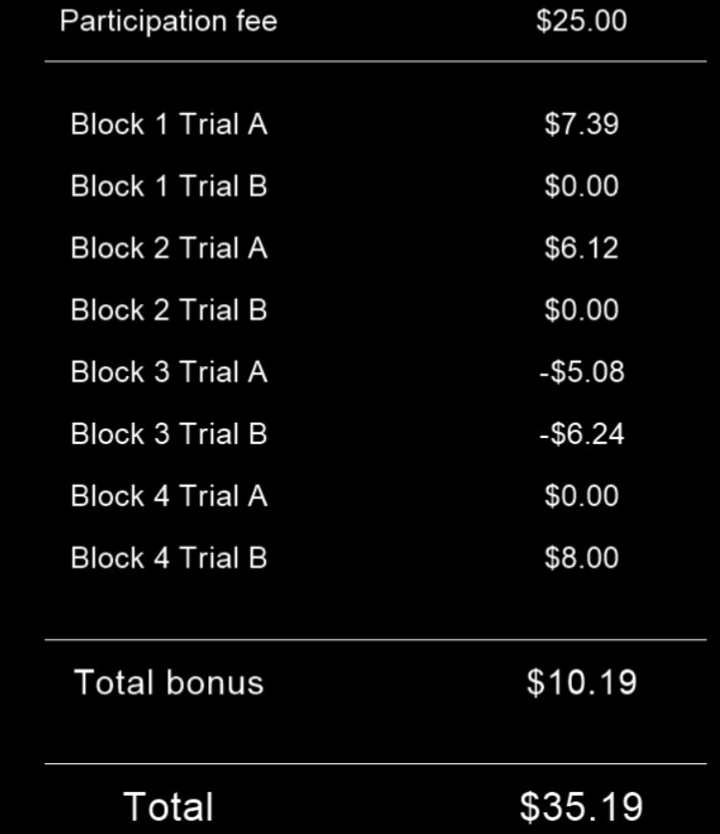
What determines your final compensation?
You will receive a participation fee of $25 dollars upon completing the experiment.
In addition, the computer will randomly select two decisions from each of the four blocks and add their outcome to your overall earnings. If the total bonus is negative, you will receive the minimum $25 participation fee. Here is an example:
Press the right arrow key to proceed, left arrow key to go back.

Slide 19
What determines your final compensation?
You will receive a participation fee of $25 dollars upon completing the experiment.
In addition, the computer will randomly select two decisions from each of the four blocks and add their outcome to your overall earnings. If the total bonus is negative, you will receive the minimum $25 participation fee.
Note that under this rule only a small fraction of your decisions will affect your final earnings. However, since you don’t know in advance which decisions will count, your best strategy is to treat each decision as if it were one that counts and make the best possible choice.
Press the right arrow key to proceed, left arrow key to go back.

Slide 20
What determines your final compensation?
You will receive a participation fee of $25 dollars upon completing the experiment.
In addition, the computer will randomly select two decisions from each of the four blocks and add their outcome to your overall earnings. If the total bonus is negative, you will receive the minimum $25 participation fee.
Note that under this rule only a small fraction of your decisions will affect your final earnings. However, since you don’t know in advance which decisions will count, your best strategy is to treat each decision as if it were one that counts and make the best possible choice.
You will receive payment for your participation and performance in the experiment by inputting the completion code in your account. Please note that it may take 2-3 working days, i.e. excluding weekends, to process your additional earnings in Prolific.
Press the right arrow key to proceed, left arrow key to go back.

Slide 21
Ready?
That concludes all the instructions. To review them, press the left arrow key to go back.
If you are ready to proceed to the test, press the space key.
Press space to begin.

