Slide 1
SOCWatch: a Wazuh SOC monitoring lab proves four detection
capabilities end-to-end on AWS
CCA Cyber Security Internship - Individual Project
Candidate Name: Nishen Madawa Abedeera
Student Number: CCA5008
nishenmadawa15@gmail.com
Mentor checkpoint review | 24 September 2026

Slide 2
Security signal is scattered across every host, so incidents go undetected until someone manually reconstructs them
No central visibility: each host keeps its own logs, so an analyst has to SSH or RDP into every machine to see what happened.
Evidence is hard to produce: reconstructing 'what changed, when, from where' after the fact means stitching together logs by hand.
Attacks blend into noise: a single failed login means nothing; a dozen from one IP in ten seconds means something - but only if a system is watching for the pattern.
Motivation drawn from the project brief's SOC-analyst workflow requirements (CCA_Cyber_Security_Internship_Project_Brief.pdf).
1

Slide 3
This lab must prove four SOC detection capabilities end-to-end, with real evidence, not just working infrastructure
Log ingestion | File integrity monitoring | Vulnerability detection | Authentication-failure / brute-force detection
Each use case must show a real, captured alert - rule ID, evidence, and an explanation of why it matters to an analyst, not just 'it's configured.'
The environment: one Wazuh manager (server + indexer + dashboard) and three monitored endpoints (2 Linux, 1 Windows) inside a purpose-built VPC.
2

Slide 4
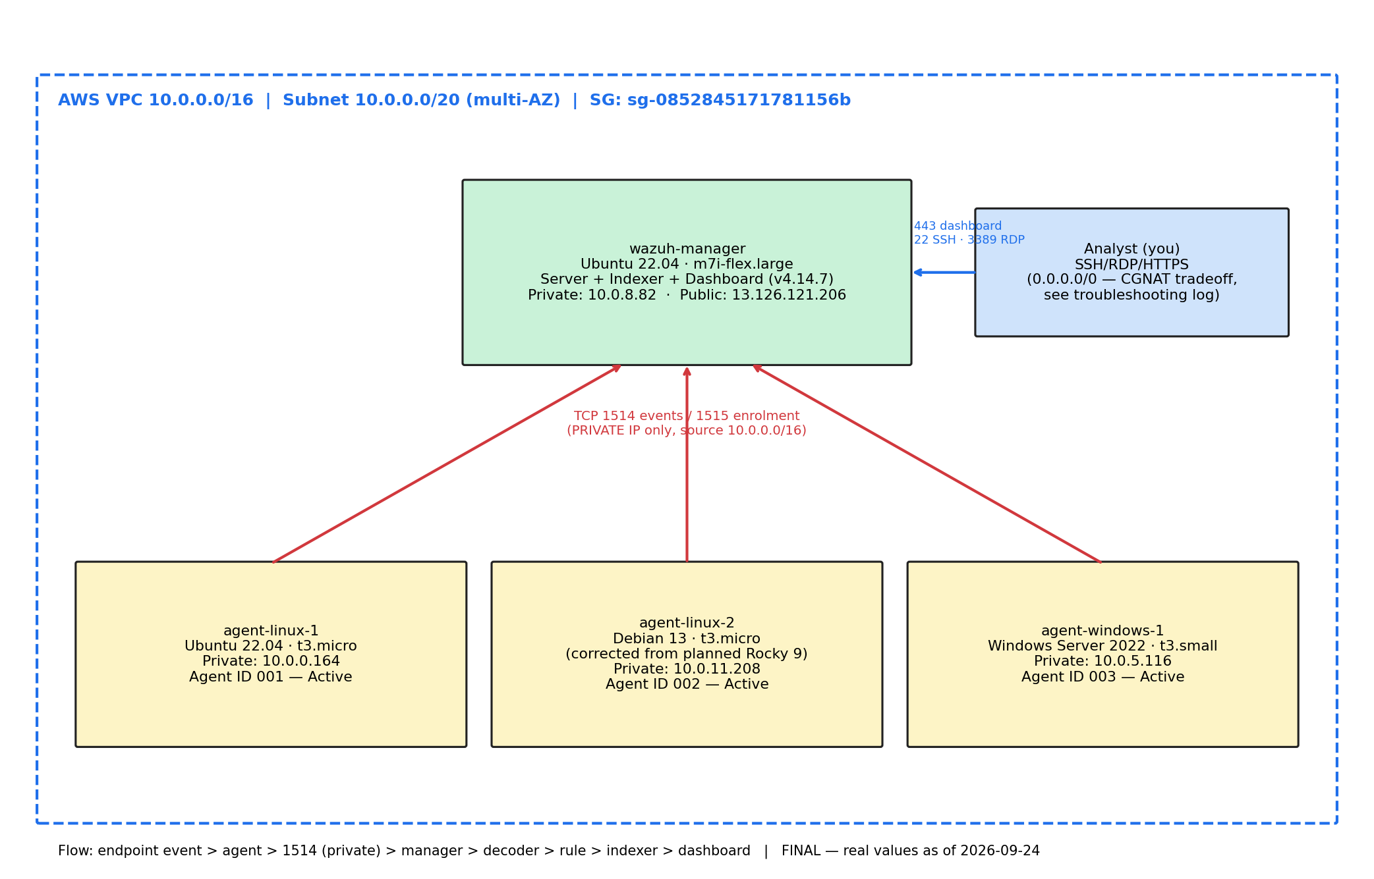
One manager and three monitored endpoints run inside a single VPC, with agent traffic scoped to the network and admin access via SSH keys
Access design
22 / 443 / 3389 (SSH, dashboard, RDP): open to 0.0.0.0/0 - a deliberate tradeoff after the operator's mobile ISP's carrier-grade NAT made any CIDR restriction unworkable. SSH keys and dashboard/Windows login remain the real access control.
1514 / 1515 (agent traffic): scoped to the VPC CIDR only, unchanged throughout the project.
All four instances provisioned manually via the AWS Console after local Terraform credentials could not be configured; infra/main.tf is retained as reference IaC.
Architecture diagram: week7/architecture-final.png, redrawn with real IPs 2026-09-24.
3

Slide 5
Every host's security events reach the manager continuously, with no extra configuration required
PAM/sudo/sshd events flow continuously from both Linux agents - confirmed directly in alerts.log, no setup needed.
Windows Event Log ingestion (Application/Security/System channels) separately verified 2026-09-24: a real windows_application-tagged alert (rule 60642) reached the manager via EventChannel.
Dashboard screenshots captured 2026-09-26: Threat Hunting event tables for both agents, including live real-world attack traffic (see risk note, next section).
Data flow
Endpoint event
Agent (wazuh-agent)
TCP 1514 -> Manager
Decoder -> Rule match
Indexer (OpenSearch)
Dashboard
Evidence: week4/windows-eventlog-ingestion-proof.txt; week5/log-ingestion-linux.png, week5/log-ingestion-windows.png.
4

Slide 6
File integrity monitoring fires a distinct, evidenced alert for every stage of a file's lifecycle
554
File added to monitored directory
Tested on agent-linux-1: /home/ubuntu/fim-test monitored in realtime mode (Linux inotify); create -> modify -> delete all fired correctly.
Rule 550's diff shows the exact line an attacker added - the strongest single piece of evidence in the project, since the file timestamp alone would not reveal this.
Applies to catching an attacker modifying /etc/passwd, planting a webshell, or tampering with a binary.
Level 5
550
File modified - diff captured (report_changes="yes")
Level 7
553
File deleted from monitored directory
Level 7
Evidence: week5/fim-config.md, week5/fim-explanation.md; dashboard screenshots week5/fim-alert-created.png, -modified.png, -deleted.png.
5

Slide 7
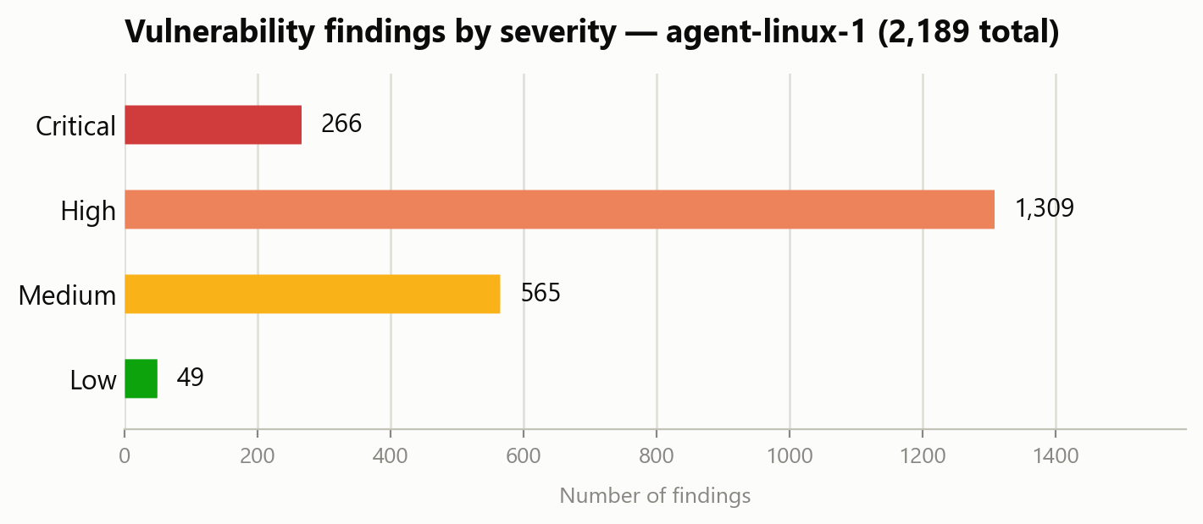
Wazuh already flags 3,910 real vulnerability findings, without needing to stage a fake CVE
3,910
The CVE feed correlates each agent's package inventory (via syscollector) against known-vulnerable ranges, refreshed on a 60-minute interval.
Feed was wiped by the disk-full incident (Sept 22) and successfully re-downloaded - confirmed via "Feed update process completed" in the logs.
Each finding includes severity, CVSS score, and the fixed version where one exists - turning 'what's installed' into 'what's exploitable.'
real findings indexed against genuinely unpatched packages on the live agents
Evidence: week6/detection-explanations.md; dashboard screenshots week6/vulnerability-cve-list.png, -cve-detail.png.
6

Slide 8
Twelve failed logins from one host trigger a single high-severity correlation alert, not twelve separate pages
5710
5716
5712
Non-existent user login attempt
SSH authentication failed
SSHD brute force - correlated
Level 5
Level 5
Level 10
Test: 12 failed SSH logins (wrong password, nonexistent user) from agent-linux-2 against agent-linux-1's private IP.
Result: rule 5710 fired 12 times, and the correlation rule 5712 fired once at level 10, correctly attributing source IP 10.0.11.208.
The distinction matters operationally: 5710/5716 alone are noise; 5712 only fires once several arrive from one source inside a time window - that source IP is what would feed a blocklist or active-response rule in production.
Evidence: week6/rule-ids.md, week6/detection-explanations.md; dashboard screenshots week6/auth-failure-single.png, -bruteforce.png (real internet-sourced attack traffic, not staged).
7

Slide 9
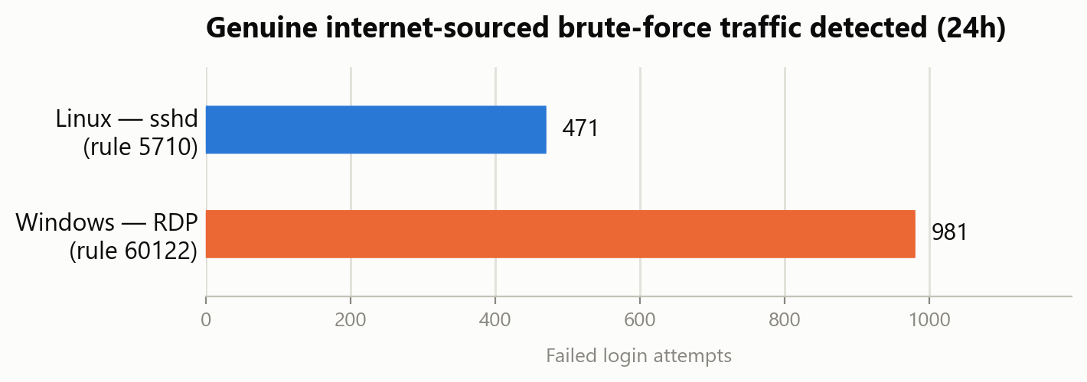
The lab's open admin ports drew genuine internet-sourced brute-force scanning during evidence capture
Not staged: these are real unsolicited login attempts against SSH and RDP, captured while logging in to take the Week 3-6 dashboard screenshots (2026-09-26).
Because admin ports are deliberately 0.0.0.0/0 (Section 9), this is consistent with routine opportunistic internet scanning - and it is exactly the traffic the brute-force use case is designed to catch.
Operational note: narrow the security group or stop the instances once grading/demo is complete, now that evidence capture no longer needs the wide-open rule.
Evidence: week6/auth-failure-windows-bruteforce.png, week5/log-ingestion-windows.png; rule 60204 "Multiple Windows Logon Failures" (level 10).
8

Slide 10
Two real incidents - a disk-full outage and an unworkable IP restriction - were diagnosed and resolved within the same session
Manager disk fills up, crashing the indexer (2026-09-22)
Root cause: the vulnerability-feed updater retried a failed download into an already-full disk. Fix: cleared 16GB of stale temp/feed-cache files, restarted services; both agents auto-reconnected within 15s.
Operator's mobile ISP breaks any CIDR-restricted security group rule (2026-09-22/23)
Root cause: carrier-grade NAT (CGNAT) rotated the operator's public IP across a pool wider than a /21. Fix: widened admin ports to 0.0.0.0/0 as a deliberate tradeoff; SSH keys and dashboard login remain the real access control.
Full write-ups: troubleshooting-log.md (5 total incident entries, well above the runbook's 2-minimum).
9

Slide 11
Production readiness requires closing six specific gaps beyond this lab's scope
CA-issued TLS
External retention
Replace the self-signed dashboard certificate.
Ship alerts to an external SIEM or S3 beyond the indexer's window.
Bastion / VPN
Tuned active response
Put the dashboard behind a VPN instead of an IP allowlist - supersedes the current 0.0.0.0/0 tradeoff.
Careful thresholds; document the risk of auto-blocking an admin.
HA topology
MITRE ATT&CK mapping
Split manager and indexer; add a second manager node.
Add triage context to detection rules.
10

Slide 12
Weeks 1-7 are substantively complete; only the Week 8 live demonstration remains
All 4 required detection use cases proven with real, captured evidence - not just working infrastructure.
Infrastructure, root MFA, and all 3 agents (2 Linux + 1 Windows) confirmed healthy and Active as of 26 September 2026.
Two real incidents diagnosed and resolved, demonstrating the operational process the grading criteria weight at 15%.
All 12 required dashboard screenshots plus 3 bonus captures taken 2026-09-26 (Section 2.2). Remaining: only the Week 8 live demonstration, for which a rehearsal script is already written.
Contact: Nishen Madawa Abedeera (CCA5008) | nishenmadawa15@gmail.com
Are there questions or feedback?
11

Slide 13
References
Wazuh Documentation. Rule reference (5710, 5712, 550/553/554, 60642) and vulnerability detection. documentation.wazuh.com/current/
AWS. EC2, VPC, Systems Manager Run Command, and IAM documentation. docs.aws.amazon.com
CCA Cyber Security Internship Project Brief (project specification and grading weights).
SOCWatch_Runbook.md - internal week-by-week execution runbook (this project).
SOCWatch-Evidence/troubleshooting-log.md, instance-inventory.md - primary evidence sources cited throughout this deck.
12

