Slide 1
NexSkill
Intelligent Skill-Based Opportunity Matching Platform
Technology Challenges and Competitions (TCC) Module · CCS2360
Faculty of Computing · SLTC Research University
Shakkya Sanketh (CIT-24-01-0573) · Malitha Gayashan (CIT-24-01-0562) · Nishen Madava (CIT-24-01-0256)
Chamika Janith (CIT-24-01-0182) · Tharusha Pieris (CIT-24-01-0486) · Chamoda Dulhari (CIT-24-01-0598)
Academic Year 2026

Slide 2
No Sri Lankan platform ranks internship fit — only manual CVs and passive job boards
Manual, unranked process: students email CVs; companies screen hundreds by hand for each role.
Persistent skills-jobs mismatch: verifiable experience is a primary employment barrier, independent of GPA [2].
TopJobs.lk: performs no candidate-to-posting matching; no university-facing reporting.
Handshake, Internshala: not localised for Sri Lanka; no local university integration.
[2] Ariyawansa, R. G. (2008). Employability of Graduates of Sri Lankan Universities. Sri Lanka Journal of HRM, 2(1).

Slide 3
No surveyed platform combines transparent ranking, skill-gap guidance, and a digital offer workflow
Feature | TopJobs.lk | LinkedIn | Handshake | Internshala | NexSkill
Skill-based ranking | No | Partial (opaque) | Partial (opaque) | Filter-only | Yes, transparent
Explainable score | No | No | No | No | Yes — 5-factor
Skill-gap guidance | No | No | No | Unrelated courses | Yes — per posting
University dashboard | No | No | Yes | No | Yes — analytics+CSV
Digital offer workflow | No | No | No | No | Yes — send/accept
Sri Lanka localised | Yes | No | No | No | Yes
Novelty: unlike every platform surveyed, NexSkill uniquely combines a transparent 5-factor match score, a per-posting skill-gap analyser, a university placement dashboard, and a full digital offer-letter workflow — purpose-built and localised for Sri Lanka.

Slide 4
Aim: an explainable weighted-matching platform for Sri Lanka’s internship market, delivered across 6 objectives
Objectives
Proposed Solution
O1 Weighted matching engine (45/20/15/10/10) + evaluation
O2 Student portal — profile, CV skill extraction, 1-click apply
O3 Skill Gap Analyser + course recommendations
O4 Digital offer-letter workflow with PDF generation
O5 University dashboard — real-time analytics + report
O6 2 documented optimisation iterations w/ metrics
Student — build profile → ranked matches → apply → accept offer
Company — post role → ranked candidates → shortlist → send offer
University — placement analytics → downloadable report
Admin — verify accounts → moderate → platform analytics

Slide 5
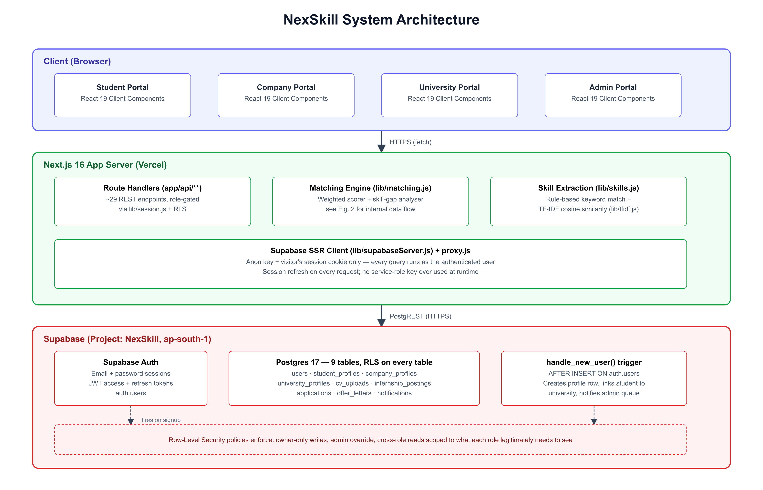
Three-layer architecture: React client, Next.js server, Supabase Postgres with Row-Level Security on every table
Database-level security: RLS enabled on every one of 9 Postgres tables — Postgres itself, not app code, decides what a query may touch.
Auto-provisioning: a signup trigger creates the role-specific profile row and links students to their university.
No privileged runtime credential: every query runs with the visitor’s own session.

Slide 6
Built on Next.js 16 / React 19 and Supabase Postgres, evaluated against a 40-pair seeded dataset
Tools & Technologies
Demonstration Dataset
Layer | Technology
Frontend | Next.js 16.3.8 (App Router)
UI runtime | React 19.3.0
Styling | Tailwind CSS 3.4.4
Backend / DB | Supabase (Postgres 17 + Auth)
PDF generation | jsPDF 2.5.1
TF-IDF engine | Custom (lib/tfidf.js)
3
5
10
Universities
Companies
Students
4
9
40
Postings
Applications
Eval. pairs
10 students × 4 postings = 40 pairs scored by the real, unmodified matching engine for evaluation (Slide 9).

Slide 7
7 functional-requirement groups trace directly to shipped code, enforced by Row-Level Security
Code | Requirement
FR-MATCH / -04 | Rank postings for a student / candidates for a posting by weighted match score
FR-NLP-01 / -04 | Extract candidate skills from CV text; student confirms/edits before saving
FR-COMP-02 / -03 | Verified companies post internships and manage their own postings
FR-OFR | Digital, auditable offer letters — send, accept, decline, timestamped
FR-UNI | University placement analytics scoped to its own enrolled students
FR-ADM-01..04 | Admin verification queue, user listing, posting moderation, analytics
NFR-PERF-01: ranked match list computed and rendered in under 3 seconds — measured live on every page load.

Slide 8
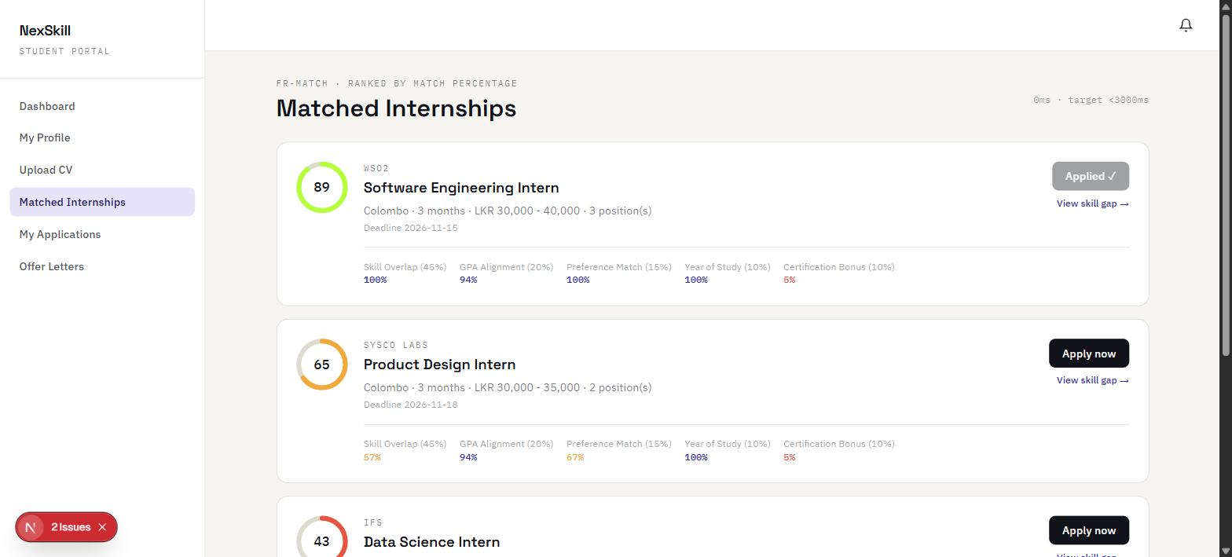
Every match score ships with a real, explainable 5-factor breakdown
WSO2 posting — 100% skill overlap: every required skill matched exactly.
Sysco LABS posting — 57% skill overlap: real TF-IDF partial credit (React ↔ UI/UX tag overlap), not a curated match.
Same transparent score, both sides: students and recruiters see the identical 5-factor breakdown.
Figure — ranked matches, real app output

Slide 9
90% precision, 90% recall — and two real defects found, root-caused, and fixed
90%
90%
90%
TC-05 (security): RLS WITH CHECK clause silently blocked admin writes while reporting success — found, fixed, re-tested.
TC-09 (framework): Next.js 16 async-params change broke every dynamic route — found, fixed, re-tested.
GPA correlation r = −0.01: informed Sprint 5 weight shift (skill overlap 45% → 55%, GPA 20% → 10%).
Precision
Recall
F1
11 / 11
test cases passing (counting re-tests after fixes)
Baseline confusion matrix (40 pairs): 9 TP · 1 FP · 1 FN · 29 TN

Slide 10
Six-member team — full individual contributions detailed in Final Report, Appendix A
Member | Index No. | Contribution summary
Shakkya Sanketh (Lead) | CIT-24-01-0573 | See Appendix A — written by each member in their own words
Malitha Gayashan | CIT-24-01-0562 | See Appendix A — written by each member in their own words
Nishen Madava | CIT-24-01-0256 | Supabase/RLS migration, matching engine + TF-IDF layer, algorithm evaluation (Ch.8), RLS security fix (TC-05), Next.js 16 upgrade
Chamika Janith | CIT-24-01-0182 | See Appendix A — written by each member in their own words
Tharusha Pieris | CIT-24-01-0486 | See Appendix A — written by each member in their own words
Chamoda Dulhari | CIT-24-01-0598 | See Appendix A — written by each member in their own words
Per the report guideline, each member’s contribution, learnings, and problems encountered must be written individually — not summarised by one author.

Slide 11
Conclusion
5 of 6 objectives fully achieved; 90% precision/recall; 11/11 tests passing
Limitations
Further Work
No live user study — evaluation is dataset-driven against an algorithm-independent ground truth.
CV parser is rule-based dictionary matching, not a fine-tuned spaCy NER model.
Notifications are in-app only — no Firebase Cloud Messaging push (O4 partially achieved).
Small dataset (40 pairs) — the weight shift changed no classification outcome at this scale.
Fine-tune a spaCy NER model for CV skill extraction, as originally proposed.
Integrate Firebase Cloud Messaging for real-time push notifications.
Re-run the optimisation experiment on a larger, real-usage dataset.
Conduct a live user study — student survey and recruiter interviews.
Project repository and Final Report available on request · nishenmadava15@gmail.com

