Slide 1
Homicide Analysis Report
By:
Nitish Gaddam
nitishg@bu.edu

Slide 2
About the dataset
Dataset: www.kaggle.com/murderaccountability/homicide-reports
Includes murders from the FBI's Supplementary Homicide Report from 1976 to the present
This dataset includes more than 22,000 homicides were reported in different states were reported
This dataset includes the
Age
Race
Sex
Ethnicity of victims and perpetrators
Relationship between the victim and perpetrator
Weapon used

Slide 3
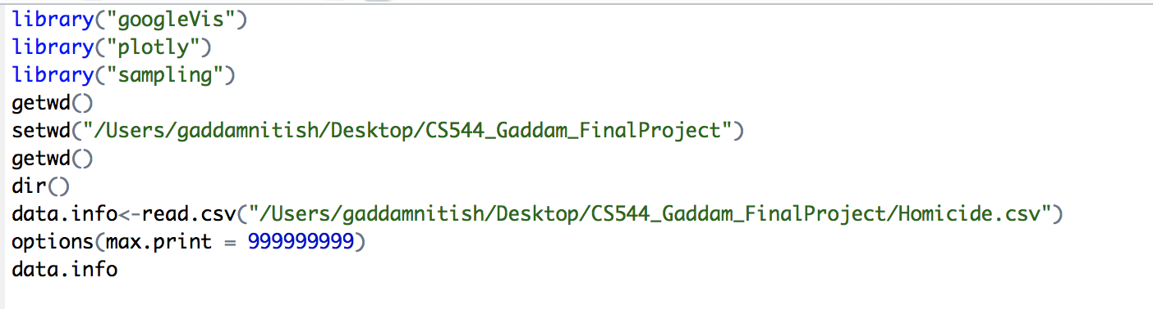
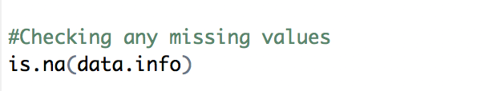
Preparing data
Installed all required libraries
Read the dataset through read.csv()
To check missing values: There were no missing values

Slide 4
Analyzing the data
Categorical Data
Victim Race
State where crime happened
By applying R techniques, I can interpret which state and race is highly
victimized
Numerical Data
Victim Age
Similarly, for Victim age, I can determine which range of age is most prone to murders

Slide 5
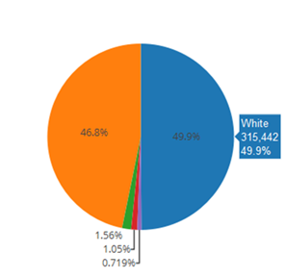
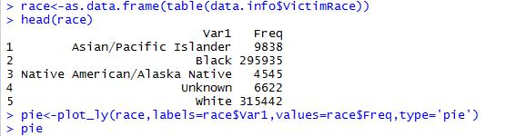
Categorical Attribute
Victim Race:
White race is highly victimized
Native American shares mere 0.7% of population

Slide 6
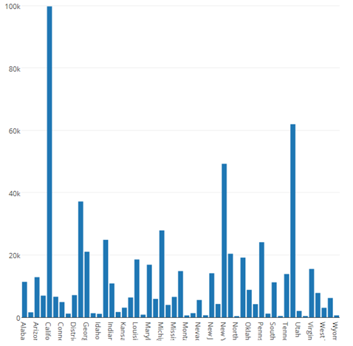
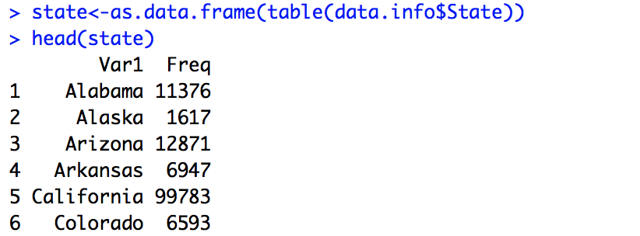
Categorical Attribute
State:
Visualize through Bar Plot
California has highest crime rate
Vermont has lowest crime rate

Slide 7
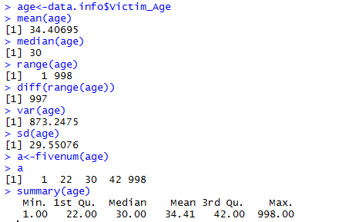
Numerical Attribute
Victim Age
Mean is larger than median
Positive skew

Slide 8
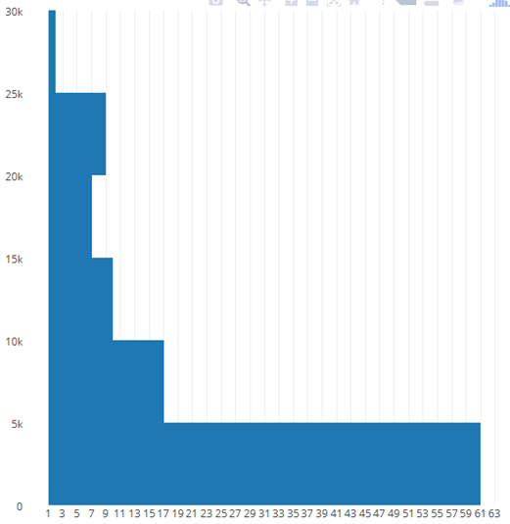
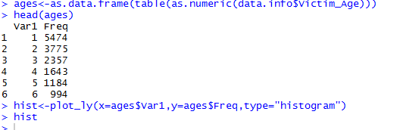
Numerical Attribute
Victim Age:
Age below 30 more prone as
compared to above 30

Slide 9

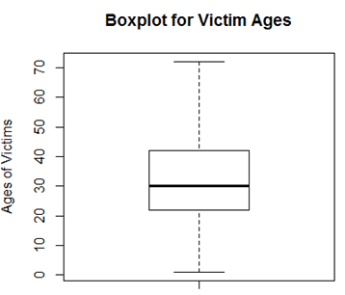
Numerical Attribute
Victim Age
Box Plot
Distribution on five number summary

Slide 10
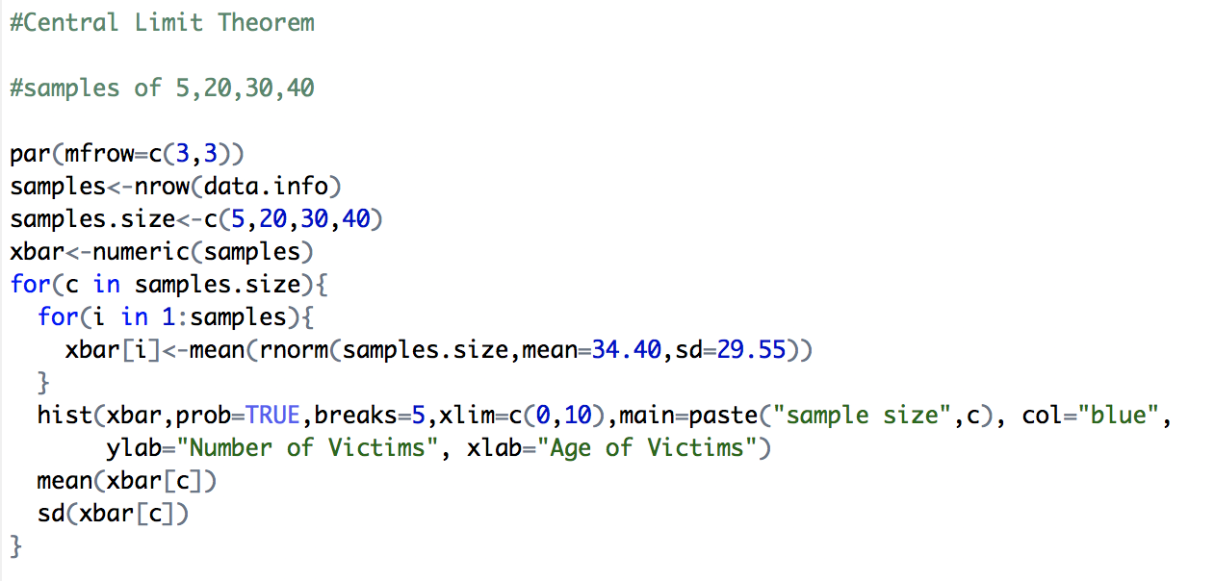
Central Limit Theorem
Mean of all the sample means is equal to the mean of the population
Sample sizes of 5, 20, 30, 40

Slide 11
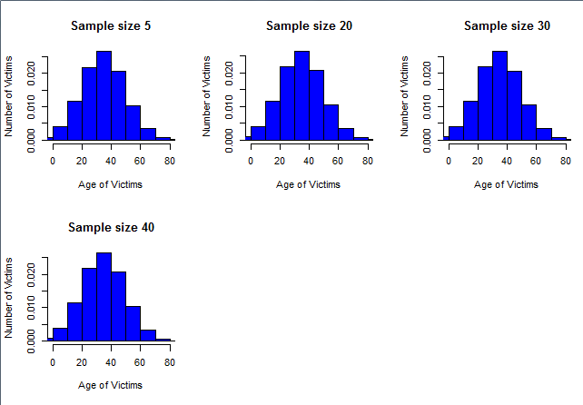
Central Limit Theorem

Slide 12
Sampling Methods
Simple Random Sampling
Random sample size of 500
With Replacement
Without Replacement
Systematic Sampling
Sample size 500
Stratified Sampling
Cluster sampling
Cluster size of 8

Slide 13
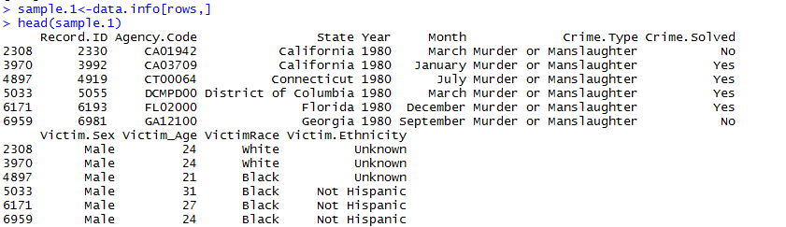
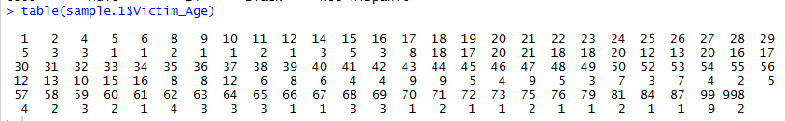
Sampling Methods
Simple Random Sampling with Replacement
The frequency of Victim age in each state

Slide 14

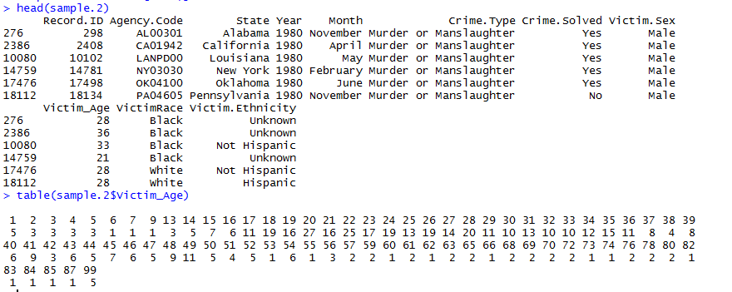
Sampling Methods
Simple Random Sampling w/o Replacement
Sample Size 500
Frequency of victim age state wise

Slide 15
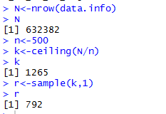
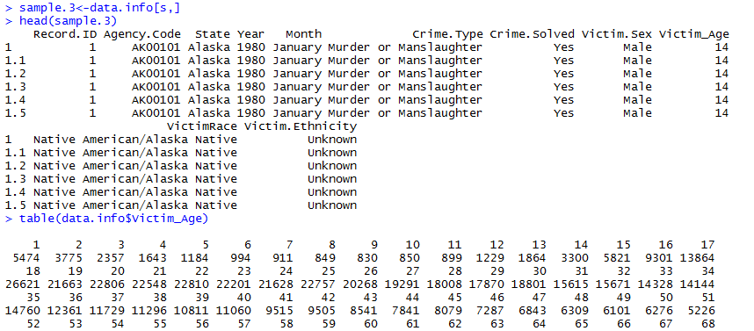
Sampling Methods
Systematic Sampling
Sample size 500
Divided into 1265 groups
Frequency of victim age

Slide 16
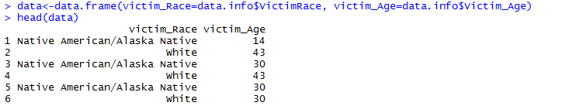
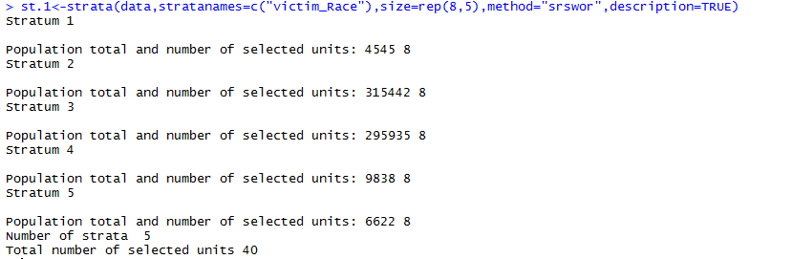
Sampling Methods
Stratified Sampling
Sample size 8 without replacement

Slide 17
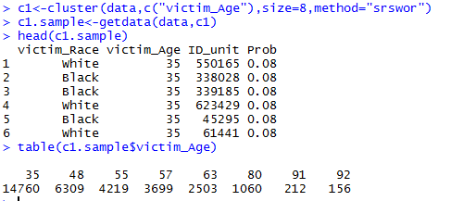
Sampling Methods
Cluster Sampling
Cluster size 8 grouped by victim age

Slide 18
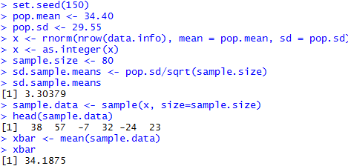
Confidence Interval
Provide information about the accuracy of the estimate.
Sample size 80

Slide 19
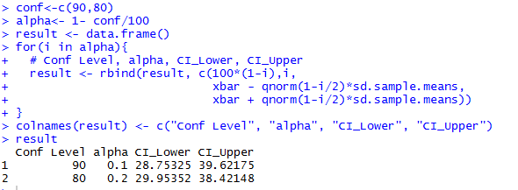
Confidence Interval
Confidence intervals for the confidence levels 90% and 80%
Population mean lies between the ranges
Length of the confidence interval provides the precision
90% confidence interval is more precise

Slide 20
Thank you!

