Slide 1

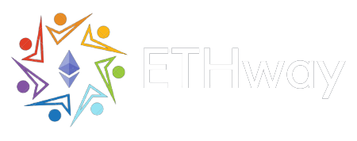
ETHIndia 2022
Team macBlockers
Presents

Slide 2
Need for Web3.0
Decentralized systems.
More power to the individuals.
Direct Ownership through NFTs.
Ultimate security provided by Immutable Block technology.

Slide 3
Peer to peer DeFi app
Distributed technology
Implemented on GoerliETH and Polygon MATIC
Receive timely Notifications
Enhanced Security
Based on proof of concepts (smart contracts)

Slide 4
Tools Used
Front end:
HTML
Tailwind CSS
React JS
Vite
Back end:
Solidity
Hardhat
Push Protocol

Slide 5
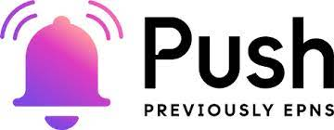
Push protocol is a communication network, enabling cross-chain notifications and messaging for dApps, wallets, and services.
Applying Push Protocol to send and receive notifications on Web3.0
The one-and-only notification provider on the Web3.0 platform
For every transaction, the beneficiary receives a Push notification from the Sender’s channel.

Slide 6
Future Prospects
ETHway can be used as a payment gateway for other Web3 platforms.
Various platforms can design and implement their own customized ETHway payment portal.
ETHway hopes to collab with various Web3 crowd funding platforms.

Slide 7
Conclusion
ETHway has the potential to be the web 3.0 phonepay or gpay
Here we have created a Defi app that not only sends the receiver push notifications for each transaction but also has tremendous potential for customizable

