Slide 1


COMPUTER NETWORKING & CYBER SECURITY
WESTFOLD
TEXTILE MILLS
Multi-Site Routing, Access Control & Address Translation
CASE STUDY NO. 46
Nishi Chopda
150096725128

Slide 2

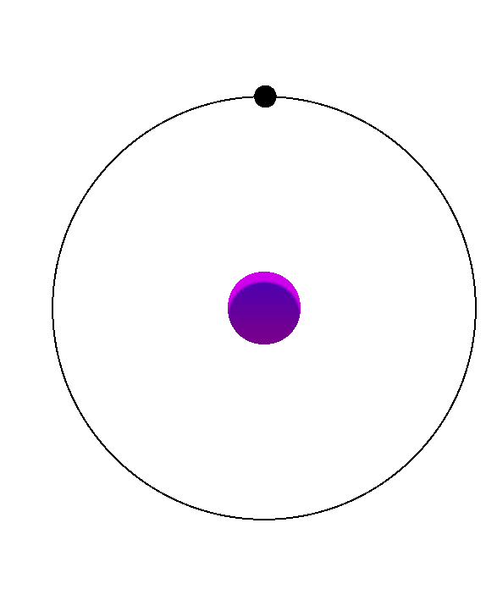
CASE STUDY & OBJECTIVES
Case Study
KEY OBJECTIVES
Westfold Textile Mills consists of a Headquarters, a Weaving Plant, and the recently acquired Loomcraft Fabrics network. The network is designed to provide communication between these sites while maintaining the existing EIGRP environment at Loomcraft.
  Multi-area OSPF for HQ–Plant routing
  EIGRP AS 950 for Loomcraft
  OSPF–EIGRP redistribution & summarization
  eBGP with two Internet Service Providers
  VLANs, ACLs & NAT/PAT for security and connectivity

Slide 3
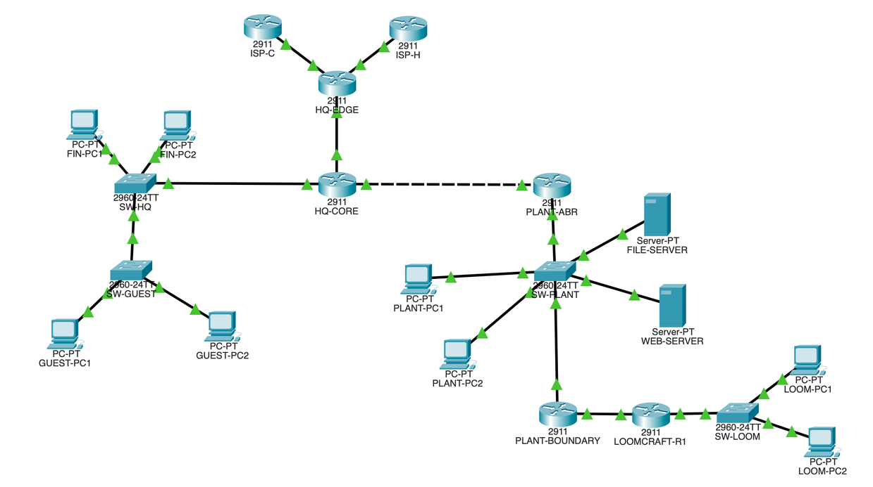
NETWORK TOPOLOGY & ADDRESSING
NETWORK SEGMENTS
  HQ–Plant: 172.31.0.0/30
  Plant LAN: 172.31.10.0/24
  Finance VLAN 15: 172.31.15.0/24
  Guest VLAN 85: 172.31.85.0/24
  Loomcraft: 172.31.50.0/24
  Public NAT Block: 198.51.100.24/29
7 Routers • 4 Switches • 10 End Devices • Dual ISP Connectivity

Slide 4
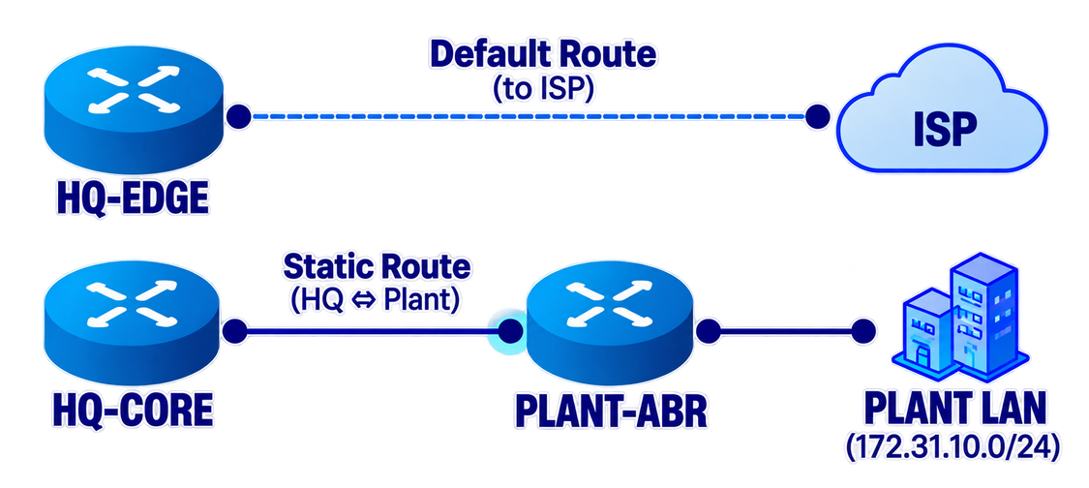
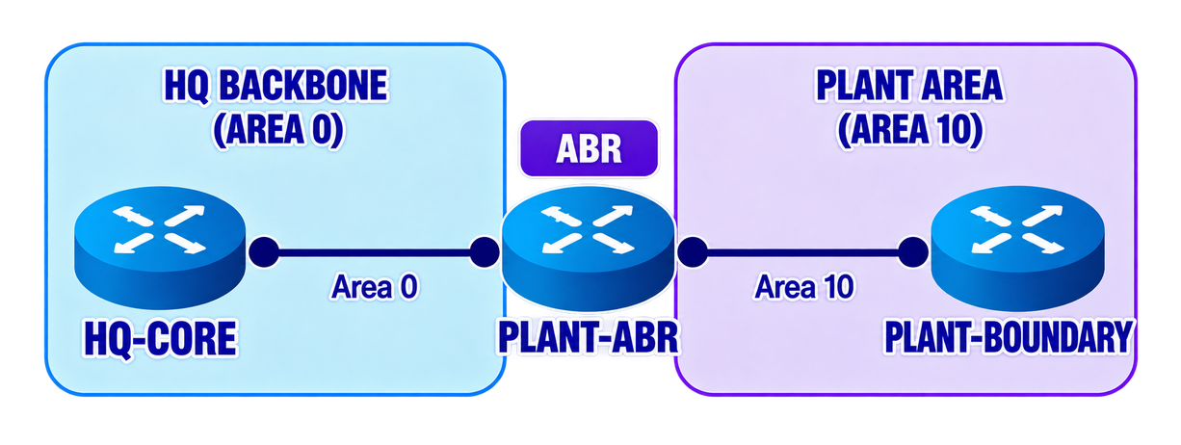
ROUTING ARCHITECTURE
OSPF
Dynamic Routing
  Process ID: 10
  Area 0: HQ backbone
  Area 10: Plant LAN
  PLANT-ABR connects Area 0 ↔ Area 10
  DR/BDR election verified on Plant LAN
STATIC ROUTING
Initial Connectivity
  Initial HQ–Plant connectivity
  Default route from HQ-EDGE toward the ISP
  HQ–Plant static routes were later replaced by OSPF
OSPF adjacency: FULL • Plant route learned dynamically: 172.31.10.0/24

Slide 5
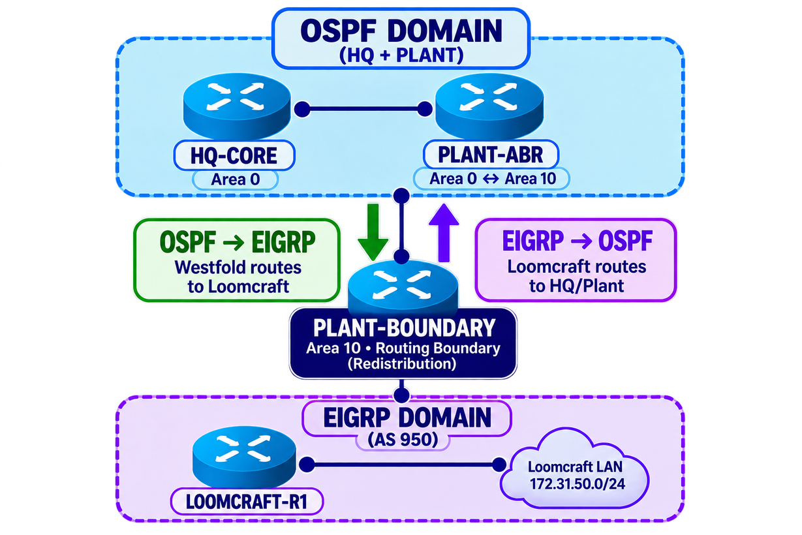
EIGRP & REDISTRIBUTION
EIGRP — LOOMCRAFT
  AS 950
  Existing Loomcraft routing domain maintained
  Loomcraft LAN: 172.31.50.0/24
  PLANT-BOUNDARY acts as the routing boundary
ROUTE REDISTRIBUTION
  OSPF → EIGRP routes advertised to Loomcraft
  EIGRP → OSPF routes advertised toward HQ/Plant
  Bidirectional connectivity verified
ROUTE SUMMARIZATION
172.31.0.0/16
Internal Westfold networks summarized toward Loomcraft

Slide 6
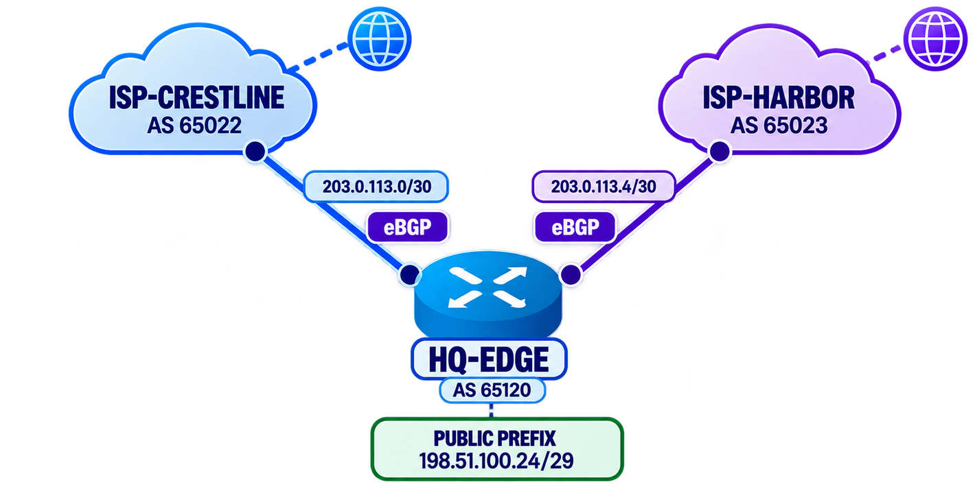

BGP & DUAL ISP CONNECTIVITY
BGP ARCHITECTURE
  HQ-EDGE: AS 65120
  ISP-Crestline: AS 65022
  ISP-Harbor: AS 65023
  eBGP used between different Autonomous Systems
  Public network: 198.51.100.24/29
Dual eBGP connections provide redundant Internet connectivity with failover between two independent ISPs.

Slide 7
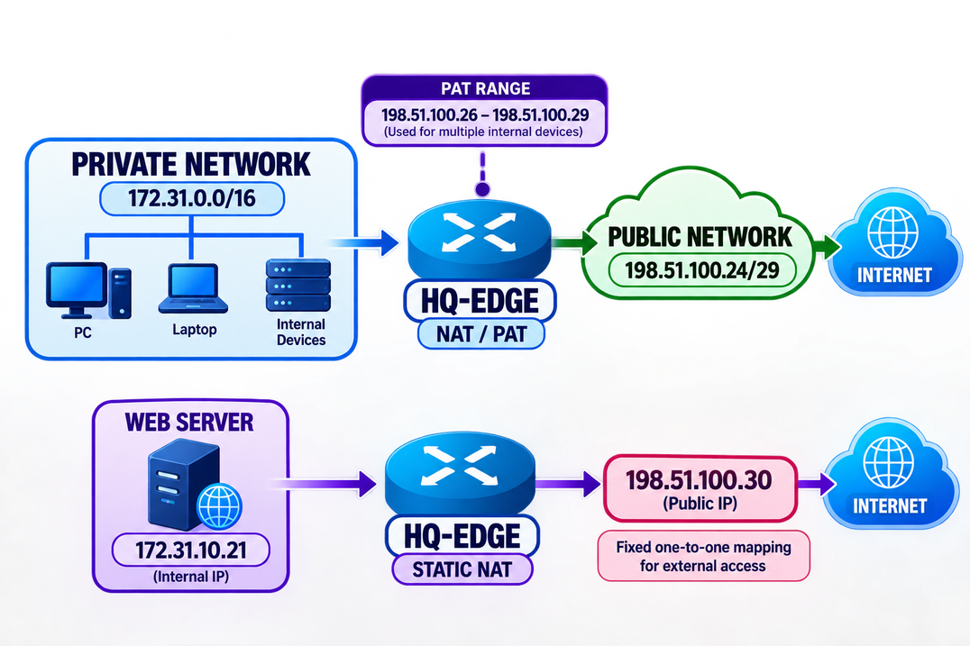

NAT/PAT & STATIC NAT
NAT / PAT
  Internal network: 172.31.0.0/16
  Public NAT block: 198.51.100.24/29
  PAT: 198.51.100.26 – .29
  HQ-EDGE performs NAT/PAT
  Multiple internal devices share public addresses through PAT
STATIC NAT
  Web Server: 172.31.10.21
  Public mapping: 198.51.100.30
  Fixed one-to-one mapping for external access
NAT/PAT and Static NAT were configured on HQ-EDGE for controlled Internet connectivity.

Slide 8

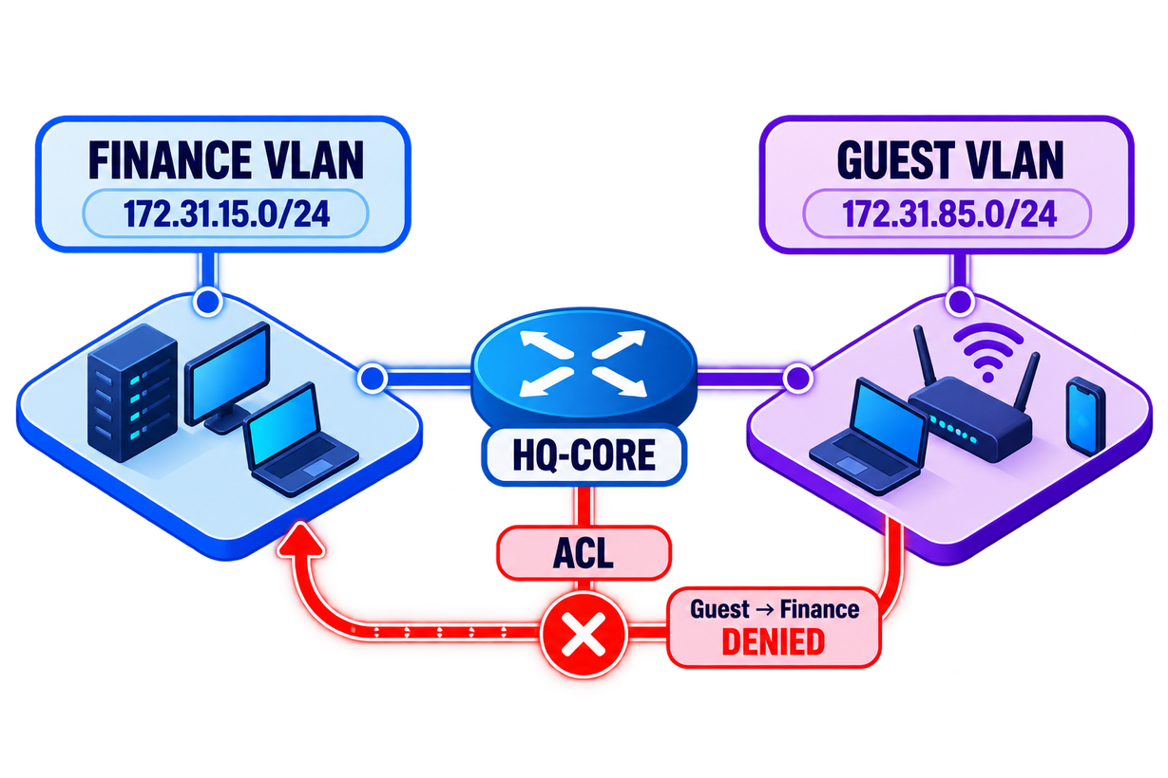
NETWORK SECURITY
VLAN SEGMENTATION
  Finance VLAN: 172.31.15.0/24
  Guest VLAN: 172.31.85.0/24
  VLANs separate Finance and Guest traffic
  HQ-CORE subinterfaces provide inter-VLAN routing
ACCESS CONTROL LIST
  Extended ACL applied to Guest VLAN
  Guest → Finance traffic is denied
  Other required traffic remains permitted
ACL verification confirmed that Guest devices cannot initiate connections to the Finance VLAN.

Slide 9
THANK YOU!
Westfold Textile Mills — Multi-Site Networking & Cyber Security

