Slide 1

GreenCycle
Community Waste Collection & Recycling Scheduler
Presented by Nishi Chopda

Slide 2
Problem Statement + Objectives
Problem Statement
  GreenCycle manages household waste collection and recycling schedules.
  The database stores households, routes, vehicles, waste types and collection schedules.
  The system automatically generates the next collection after a completed collection.
Objectives
  Design an ER model
  Create a normalized relational schema
  Maintain PK/FK relationships
  Perform SQL queries for collection analysis
  Automatically generate the next collection using a trigger

Slide 3
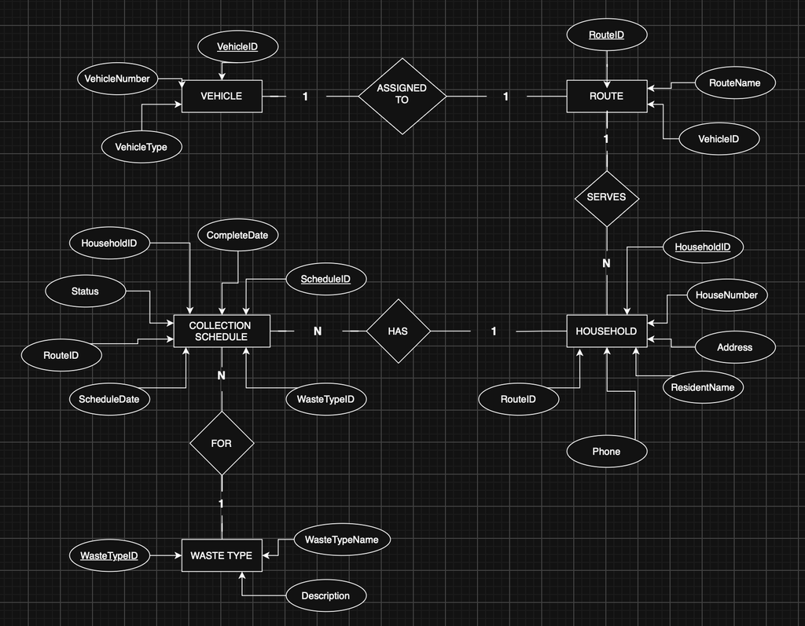
Database Design
ER Diagram
Tables & Keys
Entities / Tables
  Vehicle — VehicleID (PK)
  Route — RouteID (PK), VehicleID (FK)
  Household — HouseholdID (PK), RouteID (FK)
  WasteType — WasteTypeID (PK)
  CollectionSchedule — ScheduleID (PK), HouseholdID (FK), RouteID (FK), WasteTypeID (FK)
Design: Normalized relational schema with primary and foreign keys to maintain data integrity.

Slide 4
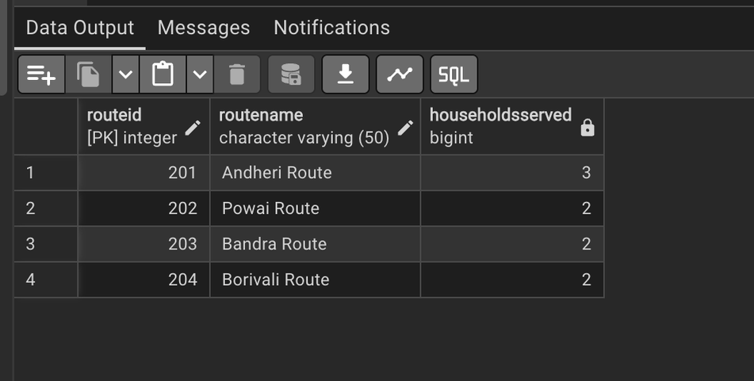
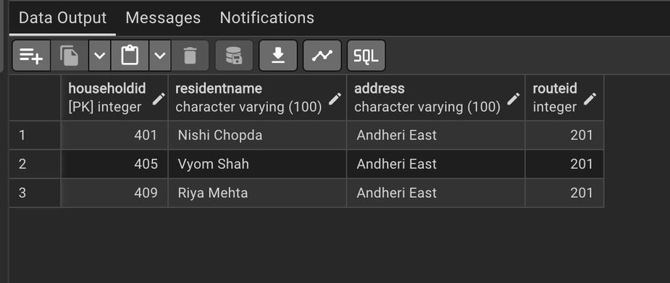
SQL Implementation & Queries
Queries
Missed Households
  LEFT JOIN
  NULL check
Route Analysis
  COUNT()
  GROUP BY
Household Filtering
  Subquery
  HAVING COUNT() > 2
SQL Implementation
DDL
  CREATE TABLE
  Primary & Foreign Keys
  NOT NULL constraints
DML
  INSERT
  UPDATE
  SELECT
Database: PostgreSQL

Slide 5
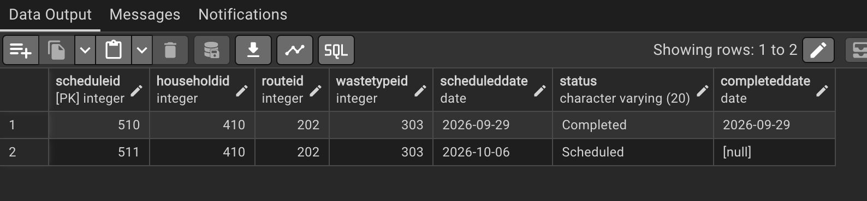
Trigger Implementation
Trigger Logic
Automatic Next Collection
  Trigger executes after Status is updated.
  Activates when status changes to Completed.
  Creates the next CollectionSchedule automatically.
  Next collection date = Current Date + 7 days
  New record gets status Scheduled.
  CompletedDate is initially NULL.

Slide 6
Results & Analysis
Key Results
  Missed collections identified using LEFT JOIN and NULL checks.
  Route efficiency analyzed using COUNT() and GROUP BY.
  Households with multiple collections identified using a subquery and HAVING COUNT() > 2.
  Automatic rescheduling implemented using a trigger.
  Next collection is generated 7 days after a collection is marked Completed.
GreenCycle successfully manages household collections, route analysis, missed collections, and automatic rescheduling.

Slide 7
Thank You

