Slide 1


INVENTORY MANAGEMENT
SYSTEM
A Web-Based Inventory Management System
PRESENTED BY:
NISHI CHOPDA

Slide 2
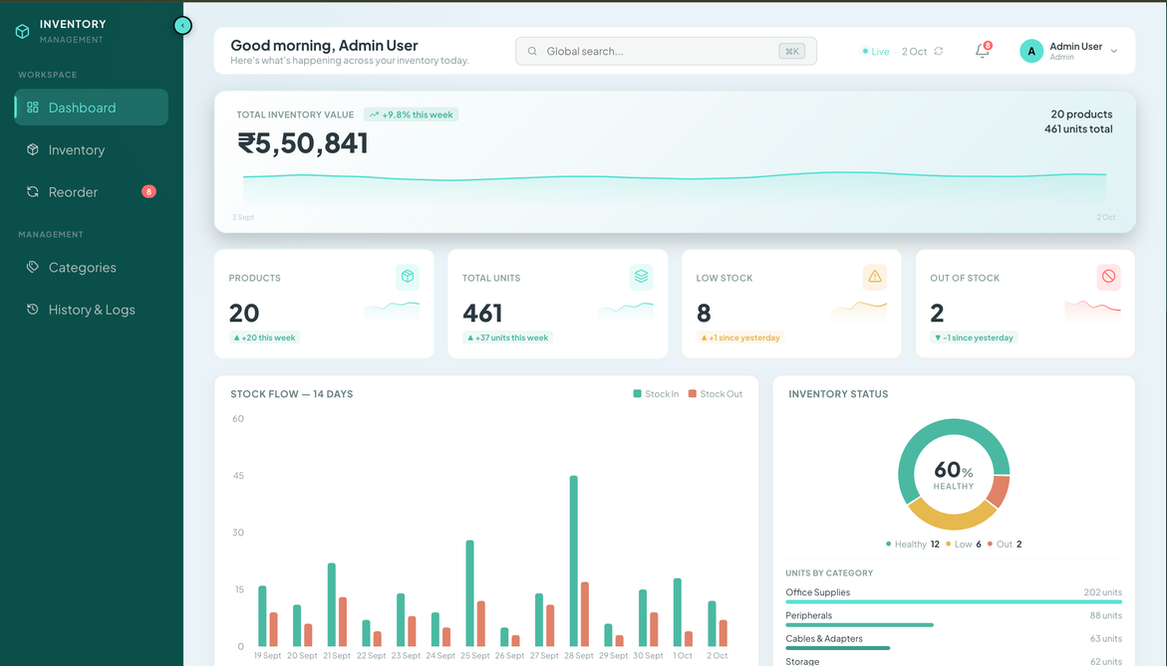
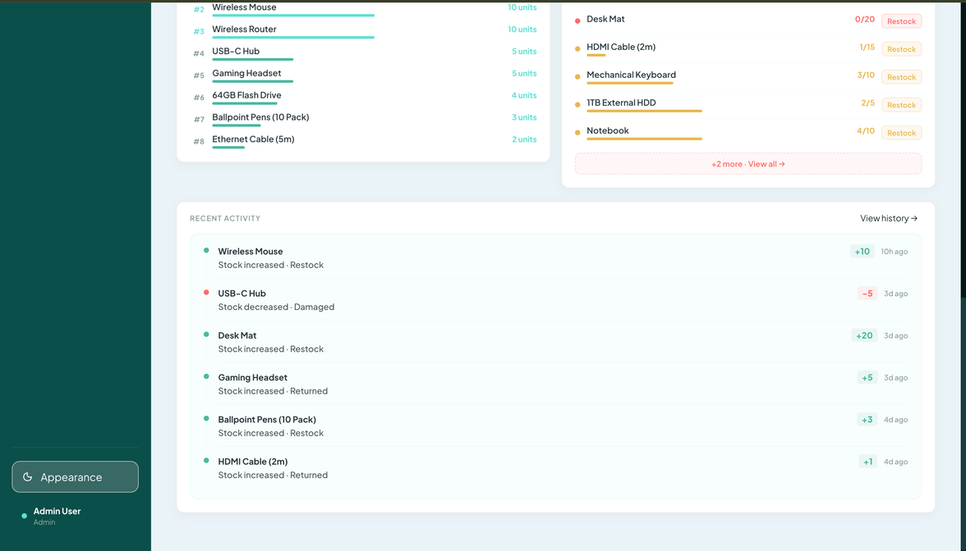
PROBLEM
STATEMENT
  Manual Tracking
Difficulty maintaining accurate stock information.
  Stock Visibility
  Hard to identify low-stock products quickly.
  Inventory data becomes harder to manage as products increase.
  Manual updates can lead to stock inconsistencies.
  A centralized and secure system is needed.

Slide 3
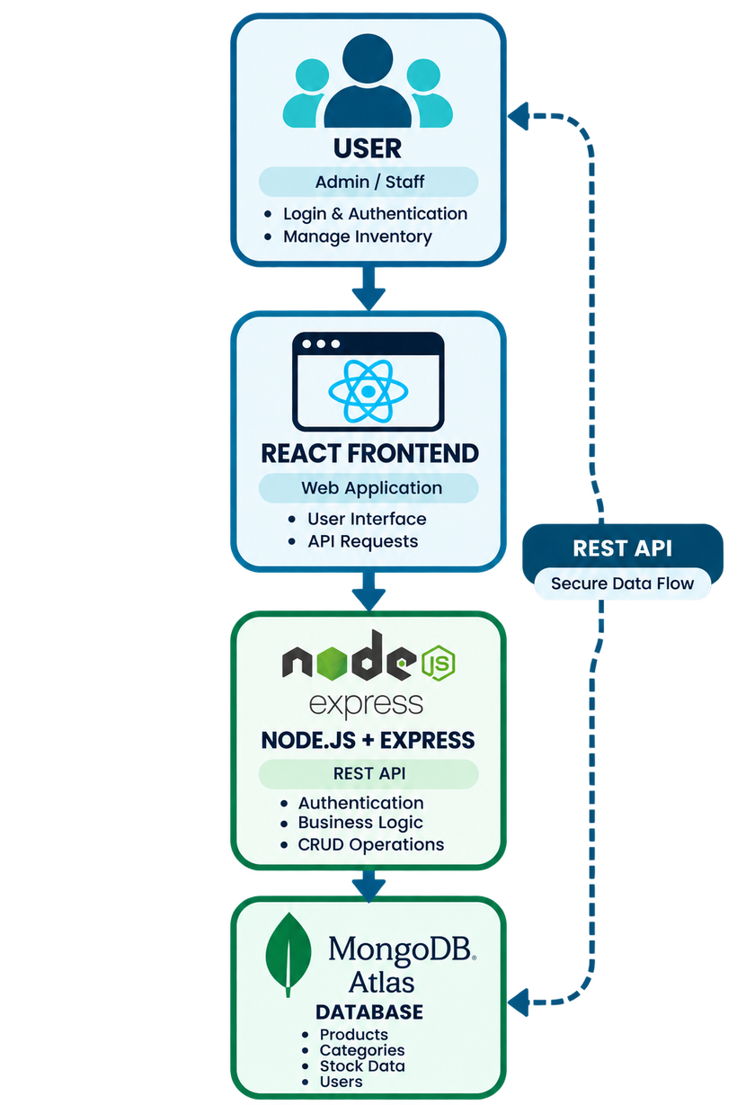
SYSTEM OVERVIEW
1. USER
Admin / Staff
Login & Authentication
2. APPLICATION
React Frontend
Node.js + Express API
3. DATABASE
MongoDB Atlas
Products • Categories • Stock

Slide 4
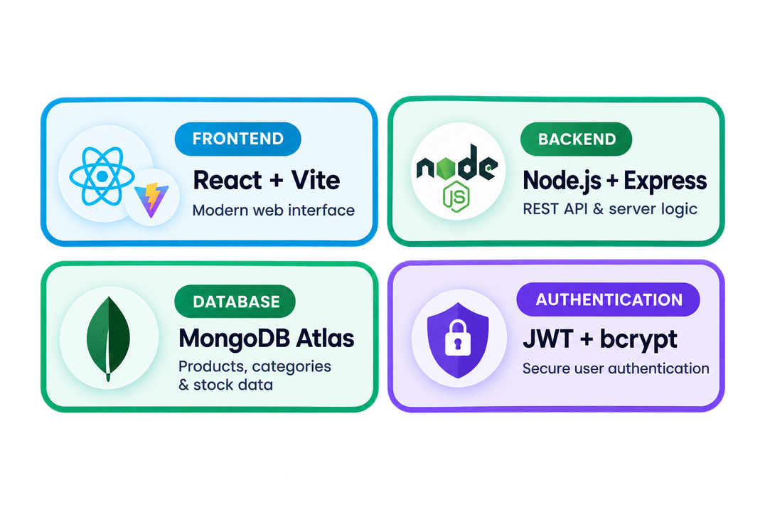
TECHNOLOGY
STACK
FRONTEND
React + Vite
Modern Web Interface
BACKEND
Node.js + Express
REST API & Server Logic
DATABASE
MongoDB Atlas
AUTHENTICATION
JWT + bcrypt

Slide 5
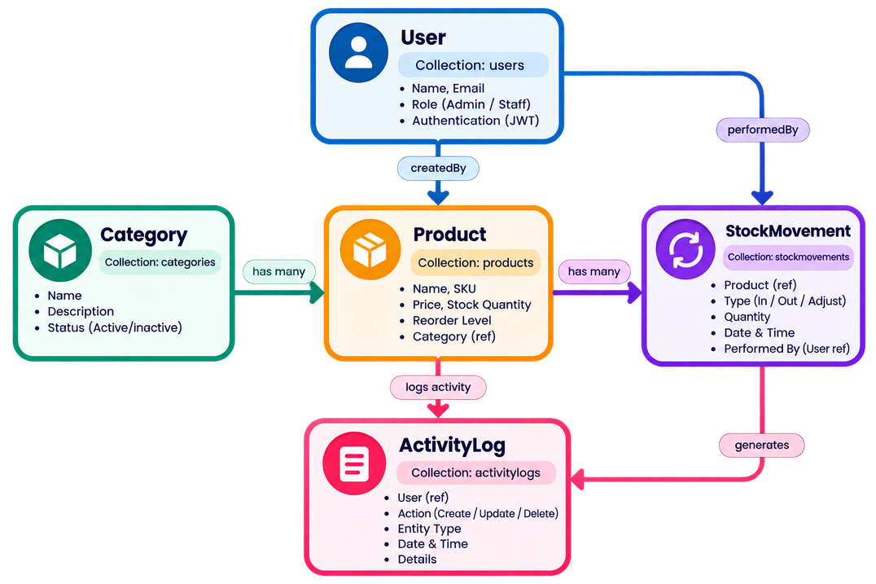
DATABASE
DESIGN
COLLECTIONS
5 Core Collections
COLLECTION OVERVIEW
• User — authentication & roles
• Category — product classification
• Product — inventory details
• StockMovement — stock change history
• ActivityLog — system activity tracking

Slide 6
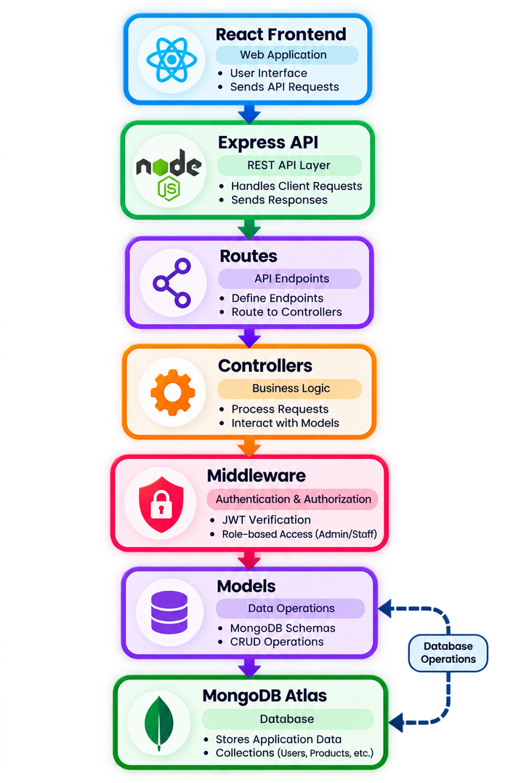
BACKEND ARCHITECTURE
API LAYER
RESTful APIs
Handles client requests & responses
SECURITY
JWT Authentication
Role-based access
• Routes — API endpoints
• Controllers — Business logic
• Middleware — Access control
• Models — Database operations

Slide 7
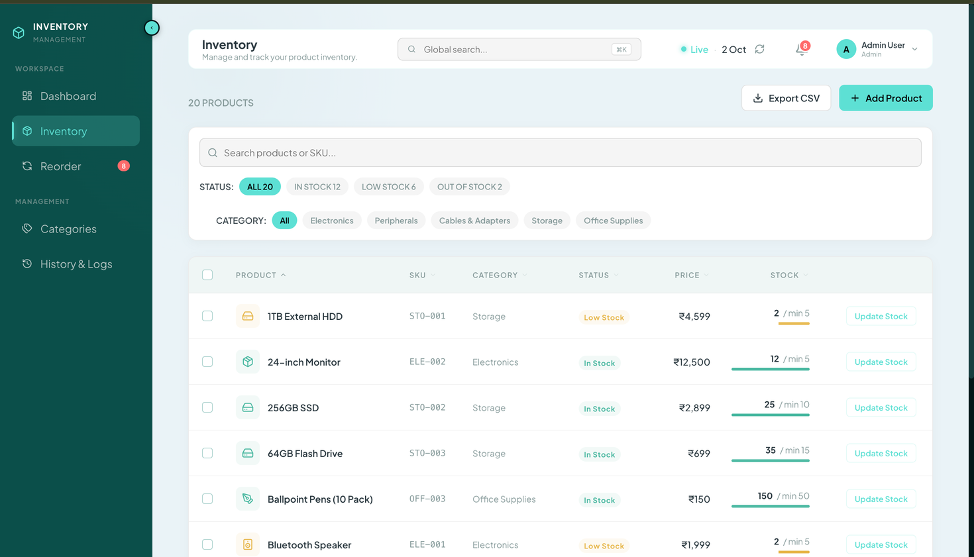
KEY
FEATURES
INVENTORY MANAGEMENT
Product CRUD & stock updates
LOW-STOCK MONITORING
Automatic low-stock alerts
• Category Management — Organize products efficiently
• Stock History — Track inventory movements
• Activity Logs — Monitor system actions
• Role-Based Access — Admin & Staff permissions

Slide 8
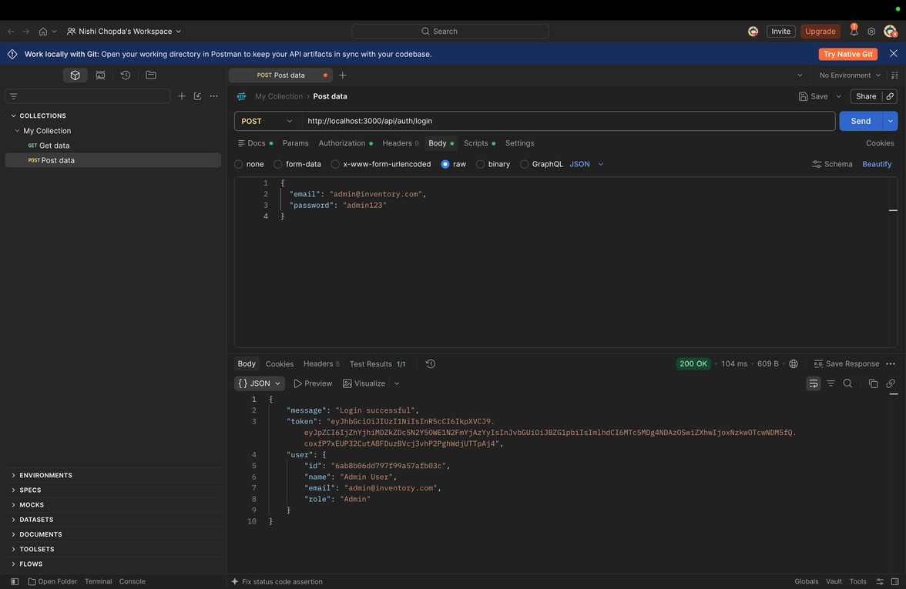
IMPLEMENTATION,
TESTING & DEPLOYMENT
USER INTERFACE
React-based responsive dashboard
API TESTING
REST APIs tested using Postman
DEPLOYMENT
Frontend → Vercel
Backend → Render
Database → MongoDB Atlas

Slide 9

THANK YOU
  Supplier concentration risk
  International shipping volatility
  Risk exposure is actively monitored.
  Mitigation actions are being prepared.

