Slide 1


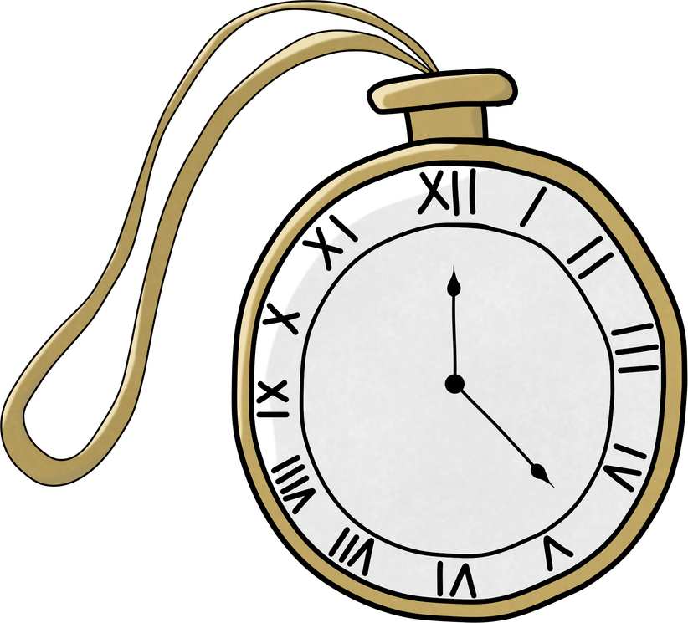

MINDSPACE
Library Fine Management System
PRESENTED BY
NISHI CHOPDA

Slide 2



PROBLEM & OBJECTIVES
Problem
Managing library books, students, issue and return records manually can make it difficult to track availability, overdue returns and fines.
Objectives
  Manage books and student records
  Track book issue and return operations
  Calculate overdue days and fines
  Maintain records using file handling
  Provide a simple Java Swing interface

Slide 3
SYSTEM WORKFLOW
1. STUDENT
STUDENT IS SELECTED/ENTERED.
3. ISSUE
BOOK IS ISSUED AND THE TRANSACTION IS RECORDED.
2. BOOK
BOOK AVAILABILITY IS CHECKED.
4. RETURN
RETURN DATE IS CHECKED AGAINST THE DUE DATE.
5. FINE
DELAYED DAYS AND CATEGORY ARE USED TO CALCULATE THE FINE.
6. RECORD
BOOK AVAILABILITY AND LIBRARY RECORDS ARE UPDATED.

Slide 4
TECHNOLOGIES & CONCEPTS USED
TECHNOLOGIES
JAVA
JAVA SWING
SCANNER
ARRAYLIST
LOCALDATE
FILE I/O
JAVA CONCEPTS
CLASSES & OBJECTS
ENCAPSULATION
CONSTRUCTORS & METHODS
IF-ELSE
SWITCH-CASE
LOOPS & OPERATORS
EVENT HANDLING
CONSOLE-BASED + JAVA SWING GUI

Slide 5

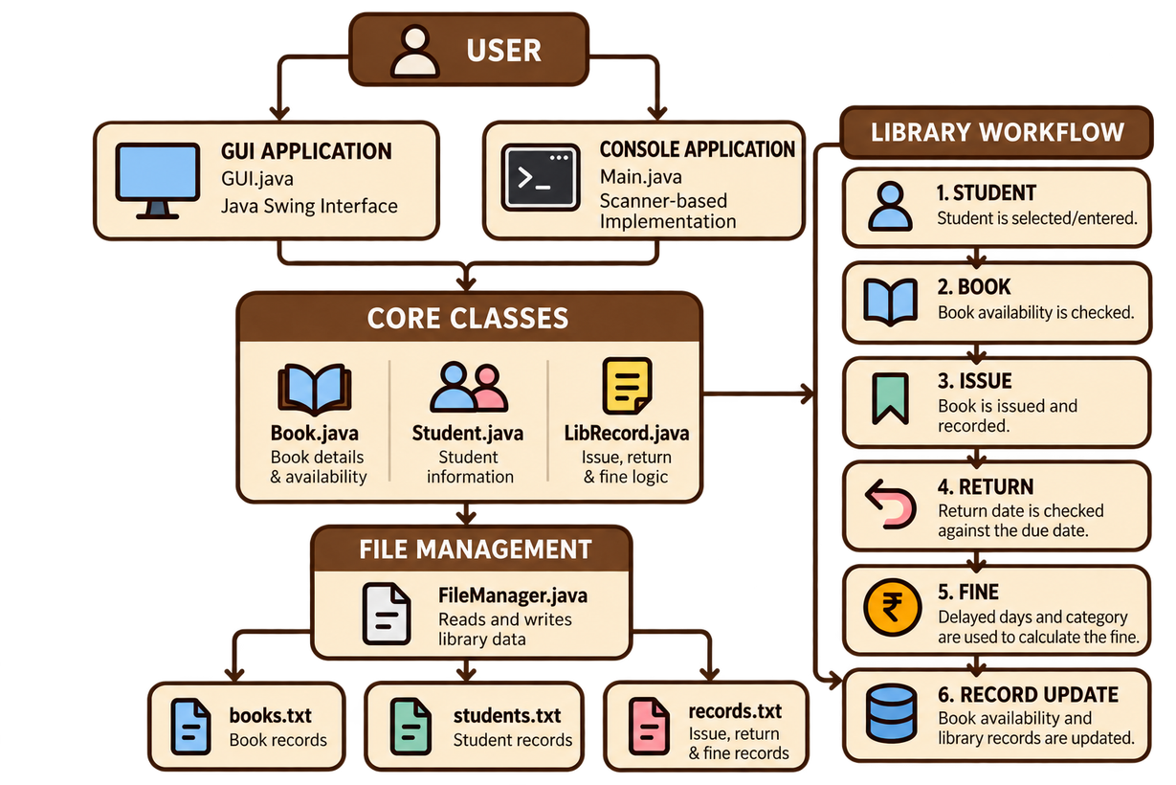
SYSTEM ARCHITECTURE

Slide 6

CONCLUSION
MindSpace successfully provides a simple Java-based solution for managing library books, students, issue and return operations, and overdue fines. The project demonstrates core Java concepts, object-oriented programming, file handling, and Java Swing through a practical library management application.

Slide 7
Thank You

