Slide 1
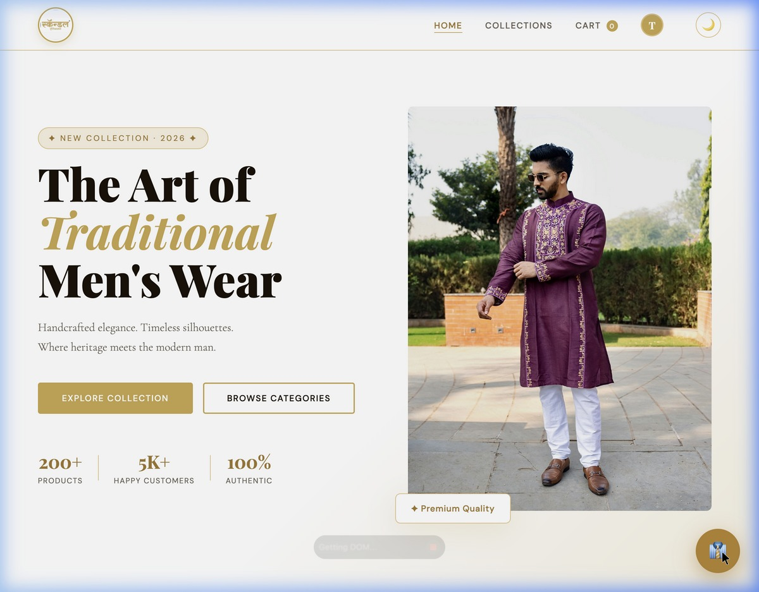
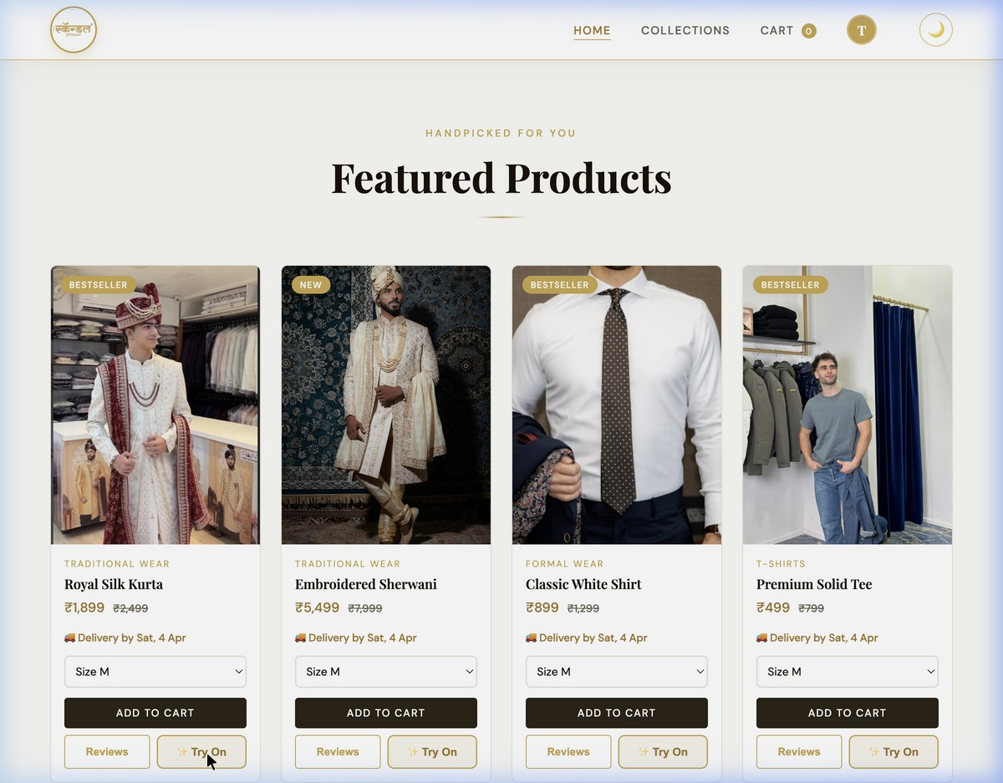
Scandal-Traditional Men’s Wear
E-Commerce Platform
Nishi Shah - 16010125808
Khush Satra - 16010125815
Harshit Panchal - 16010125810
KJ Somaiya School of Engineering

Slide 2
Problem Statement
No online ordering – customers must visit the store physically
No size guidance – wrong purchases cause returns
No visibility beyond local area, growth is limited
No order tracking or flexible payment options
No personalized style recommendations for customers

Slide 3
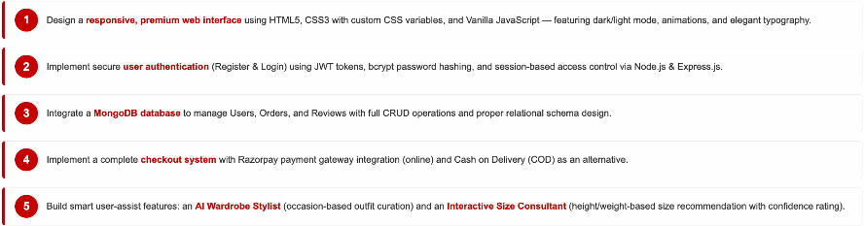
Project Objectives

Slide 4

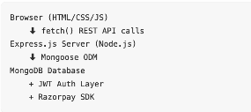


Tools & Technologies Used
System Architecture

Slide 5
UI Design – Homepage & Product Catalogue
Custom gold schema + Playfair Display typography
Dark/Light mode toggle with LocalStorage persistance
Animated product bagdes (Bestseller, New, Trending)
Delivery date shown dynamically on every card

Slide 6
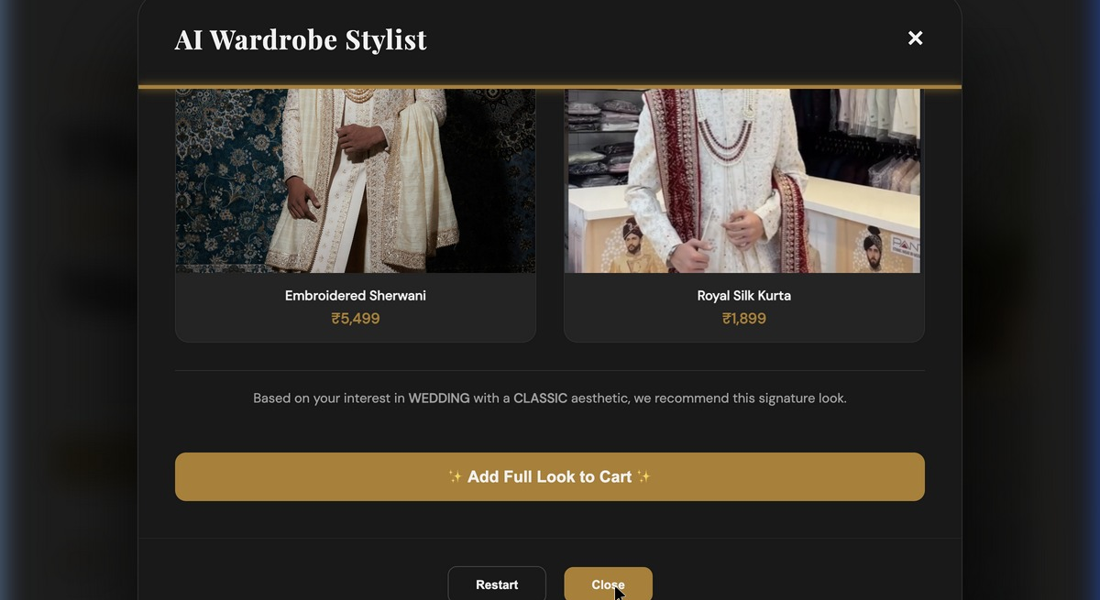
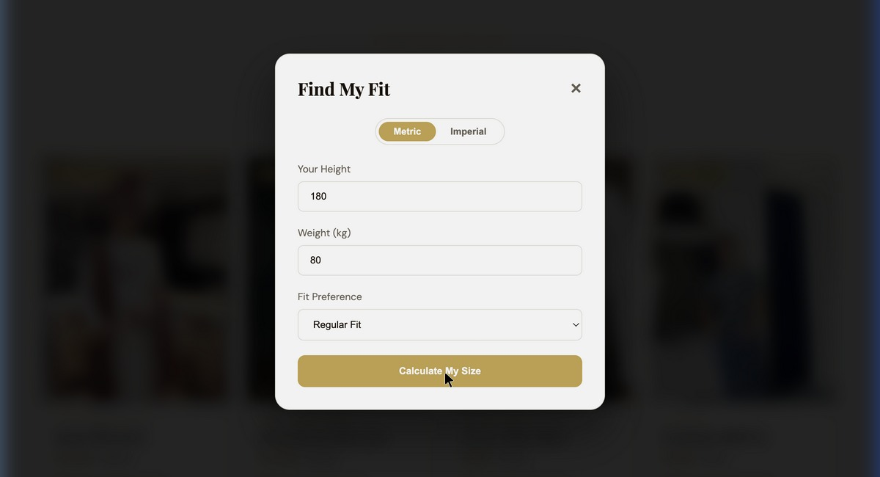
Smart User Features – AI Stylist & Size Consultant
AI Wardrobe stylist
Interactive Size Consultant
12 outfit recipes across 4 occasions
“Add full look to Cart” – One-click shopping
Metric & imperial units supported
Auto-fills size dropdown on product card

Slide 7
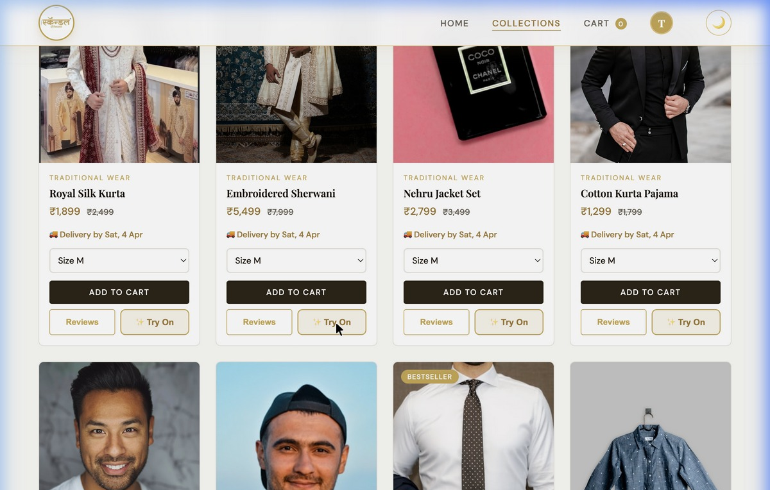
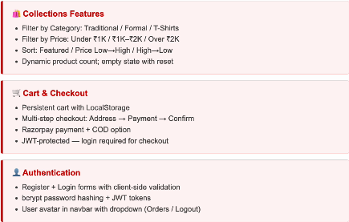
UI Design – Collections, Cart & Authentication

Slide 8
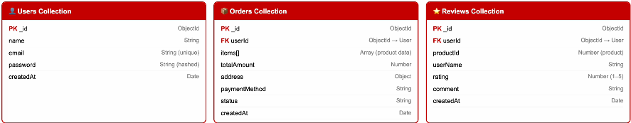
Database Schema – MongoDB Collection Design

Slide 9
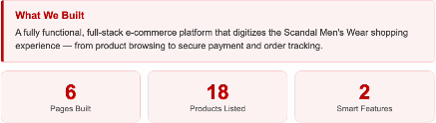
Future Scope & Conclusion
Future Enhancements
Interactive Lookbook – Shop outfits directly from editorial photography with hover-to-add-cart
Admin Dashboard– Product management, inventory control, order analysis
Live Order Tracking – Real-time logistics integration with shipment APIs
Mobile App – React native extension for iOS and Android platforms
Premium Gifting – Gold-stamped gift notes, custom packaging for festive season
Project Summary

