Slide 1
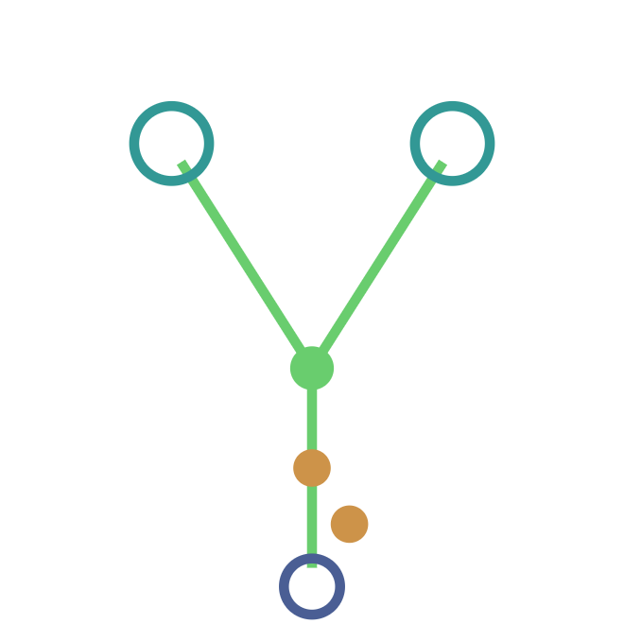
IN-SILICO PEPTIDE MAPPING · ANTIBODY–DRUG CONJUGATES
ADC Peptide Mapper v0.8
An end-to-end, ADC-native platform — from FASTA sequence to instrument-ready transition lists, uniqueness-checked and mass-validated.
Nishikant Wase, PhD
|
MIT · Open source
|
DOI 10.5281/zenodo.20681412
Notes:
Welcome. This is ADC Peptide Mapper, version 0.8 — a free, open-source platform for in-silico peptide mapping of antibody-drug conjugates. Over the next ten minutes I'll walk from the analytical problem ADCs pose, through the workflow, to how it's validated.

Slide 2
THE PROBLEM
The characterization problem
An antibody, a cytotoxic payload, and a labile linker — in one molecule. Standard peptide mapping wasn't built for it.
01
02
03
Heterogeneous drug load
Labile linker chemistry
Site localization
Conjugation follows a distribution, not a fixed number. Every DAR0–DAR _{n} species must be modeled and monitored.
Maleimide hydrolysis, ring-opening, and oxidation shift peptide masses during sample handling.
Cysteine and lysine conjugation sites must be pinpointed and confirmed against the sequence.
Notes:
An ADC is three things fused into one molecule: a monoclonal antibody, a cytotoxic payload, and a chemically labile linker. Standard peptide mapping assumes a clean, fixed sequence — ADCs violate that on three fronts: heterogeneous drug load, unstable linker chemistry, and ambiguous conjugation sites.

Slide 3
WHY IT'S HARD TODAY
The tooling gap
Generic proteomics engines
Commercial ADC suites
Accurate and free — but ADC-blind. No DAR distribution, no linker biotransformations, no drug-linker payload library.
Purpose-built — but closed and licensed per seat. A barrier for method development and academic labs.
The fallback is spreadsheets and one-off scripts. There has been no free, ADC-native, end-to-end mapper — until now.
Notes:
So what do people use today? Two options, each with a catch. Generic proteomics engines are accurate and free but ADC-blind. Commercial ADC suites are purpose-built but closed and licensed per seat. Most teams end up stitching spreadsheets and one-off scripts by hand.

Slide 4
THE SOLUTION
One integrated workflow
Seven connected tabs take a sequence from upload to confirmed, instrument-ready methods.
01
03
04
05
Input & Setup
02
Results & Coverage
Transition List
06
07
Modifications & DAR
Heavy Labelling
MS/MS Search
AI Assistant
FASTA upload, chain auto-detect, enzymes, background species.
→
→
Peptide table, coverage map, cross-species uniqueness.
→
Per-instrument MRM/DIA lists and collision energies.
→
SIL light/heavy peptide pairs for quantitation.
→
→
Claude chat with live ADC/proteomics context.
PTMs, payloads, DAR distribution, linker biotransformations.
MS Amanda / Tide with target–decoy FDR.
Notes:
Here's the whole tool at a glance. Seven connected tabs carry a sequence from upload to confirmed, instrument-ready methods. Each hand-off is automatic — the peptide list from the digest feeds coverage, transitions, labeling, and the search cross-reference.

Slide 5
STEPS 01–02 · DIGESTION
The digest engine
▪
Optional second enzyme — sequential dual-enzyme digestion.
▪
0–2 missed cleavages per run.
11
proteases
▪
Fixed, variable, special & custom PTMs — any residue, any mass shift.
Trypsin
Trypsin/P
Lys-C
Lys-C/P
Lys-N
▪
ADCDB drug-linker payloads — MMAE, DM1, DXd, SN-38, and more.
Asp-N
Glu-C
Arg-C
Chymotrypsin
Papain
▪
Full b/y ion series + averagine isotope envelope per peptide.
Elastase
isotope envelope
Notes:
The foundation is the digest engine. Eleven proteases, an optional second enzyme for sequential dual digestion, and zero to two missed cleavages. On top sit fixed, variable, special, and fully custom modifications — including the ADCDB drug-linker payload library. Every peptide gets a full b/y ion series and an averagine isotope envelope.

Slide 6
STEP 02 · THE ADC CORE
DAR & linker biotransformations
Linker biotransformations as variable mods
DAR distribution modeling
Transformation
Δ mass
Res
Maleimide ring hydrolysis
+18.011
C
Succinimide ring-opening
+18.011
C
Thioether → sulfoxide
+15.995
C
Disulfide loss
−31.990
C
Conjugation-site deamidation
+0.984
N
Conjugation chemistry: cysteine thiol-maleimide · lysine NHS-ester / hydrazone · site-specific (engineered Cys, ncAA).
0
1
2
3
4
5
6
7
8
A full MRM transition list per DAR level, from DAR0 to DAR_{n}.
Notes:
This is the heart of the tool — and what makes it ADC-native. DAR distribution modeling generates a complete MRM transition list for every drug-to-antibody-ratio species, DAR0 through DARn. And the five linker biotransformations that plague ADC samples are built in as variable modifications with exact monoisotopic mass shifts. Three conjugation chemistries are supported out of the box.

Slide 7
STEP 03 · SPECIFICITY
Uniqueness & coverage
Checked against reference proteomes
Sequence coverage map
HC: 74.0% covered
20.4k
1.2k
8.2k
Human
Cyno
Rat
▪
Cross-species co-uniqueness — unique across all selected species at once.
Colour by uniqueness, missed cleavages, or length · 300 dpi PNG export.
▪
cRAP contaminants flagged in the background build.
Notes:
Once you have peptides, two questions matter: are they specific, and do they cover the molecule? The tool checks every peptide against pre-built Human, Cynomolgus, and Rat proteomes — plus a cross-species co-uniqueness filter and cRAP contaminant flagging. The sequence coverage map shows exactly what you're monitoring, colored by uniqueness, missed cleavages, or length, and exports at 300 dpi.

Slide 8
STEPS 04–05 · EXPORT
Instrument-ready export
Six instrument families
Thermo
SCIEX
Heavy labelling (SIL-IS)
Orbitrap / TSQ · linear CE
QTRAP / TripleTOF · MRM & SWATH
Light / heavy peptide pairs for quantitative LC-MS/MS — six presets or custom.
Bruker
Agilent
¹³C₆ ¹⁵N₂ Lys
+8.0142
timsTOF · PASEF
QQQ / QTOF · MRM
¹³C₆ ¹⁵N₄ Arg
+10.0083
Waters
Skyline
D₄ Lys
+4.0251
Xevo / Synapt · MRM
Generic · direct import
Notes:
When the method is ready, the tool speaks your instrument's language. Six platform families, each with its own collision-energy formula and CSV column layout — Thermo, SCIEX, Bruker, Agilent, Waters, and a generic Skyline import. And for absolute quantitation, the heavy labeling tab generates stable-isotope light/heavy peptide pairs from six presets or a custom shift.

Slide 9
STEP 06 · CONFIRMATION
Confirmation & search
INPUT
SEARCH
SCORE
CROSS-REF
Spectra
→
MS Amanda 3.0 / Tide · Crux
→
Target–decoy FDR
→
PSMs ↔ theoretical
mzML from MSConvert
both free — no licence, no Java
dynamic score filter
against your peptide list
Or skip the search: upload precomputed results directly — .mzid · .pepXML · psm.tsv · Amanda .csv. Format is auto-detected.
Notes:
Planning a method is one thing; confirming it is another. Tab six runs a real search engine locally — MS Amanda 3.0 as primary, Tide/Crux as fallback, both completely free. It estimates target-decoy FDR, or you can upload precomputed results in any common format. Every PSM is cross-referenced against the theoretical peptide list from earlier in the workflow.

Slide 10
VALIDATION
Validated to sub-mDa accuracy
≤0.05
79
10/10
mDa mass error vs IgG1 tryptic references
unit tests · 100% pass rate
benchmark reference peptides pass
Reference peptides:
GPSVFPLAPSSR
ELASGLSFPVGFK
CASIQKFGR
DTLMISR
Methods: averagine (Senko 1995) · target–decoy FDR (Käll 2008)
Notes:
None of this matters if the masses are wrong. The core engine is validated to sub-milliDalton accuracy against IgG1 tryptic reference peptides. Seventy-nine unit tests cover mass functions, cleavage rules, DAR, isotopes and constants — a hundred percent pass rate. Ten reference peptides benchmark at or below 0.05 milliDaltons. The science underneath uses established methods — Senko averagine, Käll target-decoy.

Slide 11
STEP 07 · ASSIST
Built-in AI assistant
A Claude-powered chat, pre-loaded with ADC / proteomics context — to interpret results, explain MS concepts, and troubleshoot workflows.
● digest context on
Why a +18 Da shift on my conjugated cysteine peptide?
▪
Live digest context — attach ADC name, chains, enzyme, and peptide count to each message.
That matches maleimide ring hydrolysis (+18.011 Da on C) — a common linker biotransformation. Enable it as a variable mod in Tab 2 and re-check the DAR-conjugated peptides.
▪
Your key, your control — dynamic model selection; API key stored locally.
Notes:
New in version 0.8: a built-in AI assistant. It's a Claude-powered chat pre-loaded with ADC and proteomics context, so it can interpret your results, explain a mass shift, or troubleshoot a workflow. A toggle attaches live digest context — the ADC name, chains detected, enzyme, and peptide count. It uses your own Anthropic key, stored locally.

Slide 12
FREE · OPEN · CITABLE
Free, open, and citable
MIT licensed
Open source
Live app
Zenodo DOI
Free for research use
GitHub · R Shiny
Trastuzumab demo pre-loaded
10.5281/zenodo.20681412
Nishikant Wase, PhD
nishiw.shinyapps.io/ADC_Peptide_Mapper
nishikant.wase@gmail.com
Notes:
To close: this is free, open, and citable. MIT licensed, open source on GitHub, running live on shinyapps.io, with a real Zenodo DOI. Try it with the pre-loaded Trastuzumab demo, and if it helps your work, please cite it. Thank you.

