Slide 1
Executive summary template
Insight 1
Major Customers
Insight 2
Churn Time period
Insight 3
Popular Sales Campaign

Slide 2
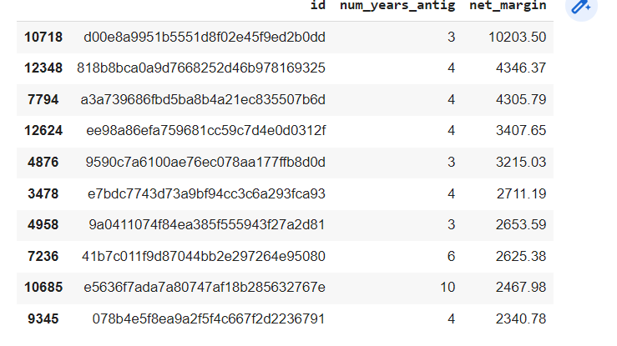
Major Customers
There are customers that contribute majorly to the net profit
These customers should be given importance so as to retain them
List of customers:

Slide 3
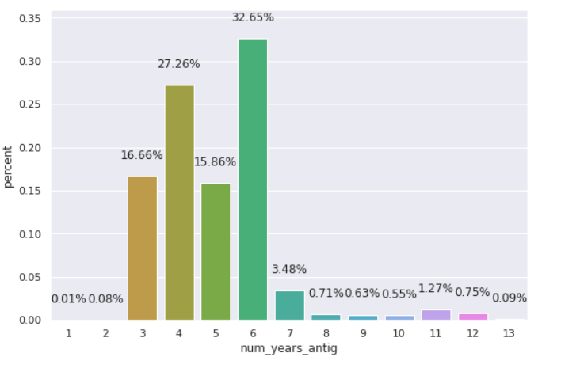
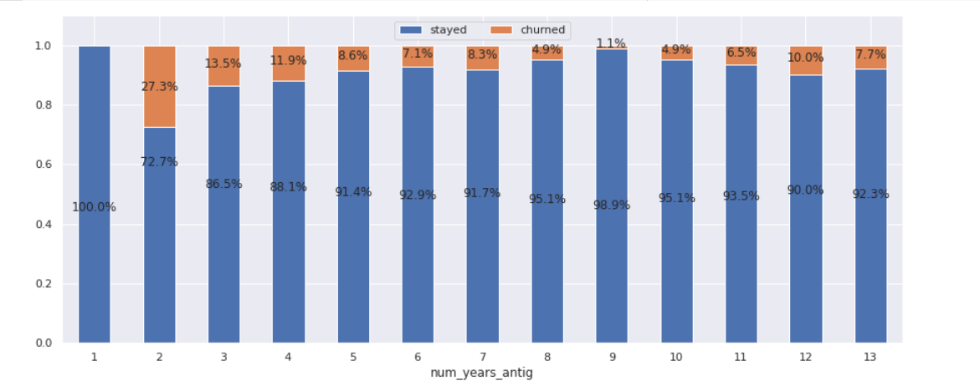
Churn Time period
Situation
Mostly customers are churning in 3 to 5 years of tenure
As prices are the concern the discount can be planned to be given during these years
Tenure of most of the customers is from 3 to 6 years while churning rate is higher in 2nd to 5th year

Slide 4
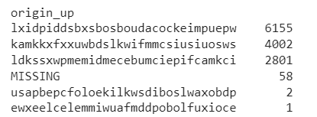
Popular Sales Campaign
Situation
Mostly popular campaign is lxidpiddsbxsbosboudacockeimpuepw
It has attracted 6,155 current customers
The campaign should be used to bring more customers

