Slide 1

IS 590 PR Final Project – Monte Carlo Simulation Airport Check-In Simulation
Nishi Mehta
Devansh Gandhi

Slide 2
Objectives
Calculate the average waiting time of a passenger at the check-in counter at the airport.
To obtain the dependency of number of passengers and check-in agents by varying them and simulate the result.
Another parameter taken under consideration is changing the number of flights and then obtaining the average waiting time.

Slide 3
Process
Built the hypothesis and the assumptions
Decide upon the Scenarios and the variable.
Use Monte Carlo to simulate the scenario
Result Analysis

Slide 4
Hypothesis and Assumptions
Hypothesis
The average waiting time decreases as the number of check-in counters increase.
Also, as the number of passengers increases, the waiting time in the queue increases.
Assumptions
All the agents take the same amount of time to serve the passenger.
It takes 5 minutes for each agent to attend the passenger.
Passengers are in a queue of random length.

Slide 5
Scenarios
Single airplane with 215 passengers and 3 check-in counters
1
Single aircraft with different number of passengers and check-in counters
2
Multiple aircraft different number of passengers and check-in counters
3

Slide 6
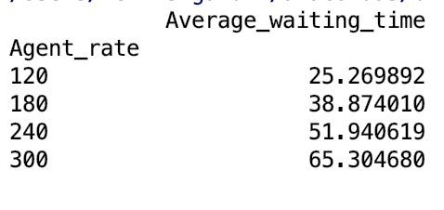
Scenario 1
For this case, we have obtained the average waiting time for 215 passengers in the queue and 3 check-in counters.
The Monte-Carlo simulation is achieved for 10000 runs.
Variables of uncertainty
Length of the queue.
The rate an agent serves each passenger.
Result

Slide 7
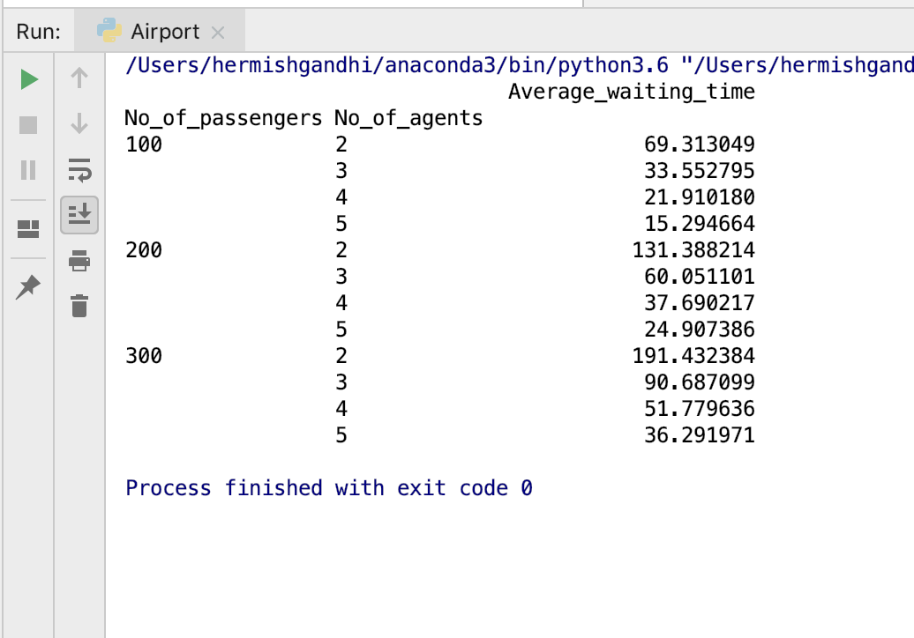
Scenario 2
There is a single flight with different number of passengers and check-in counters.
Variables of uncertainty
Number of passengers travelling in a particular flight
Number of check-in agents to perform the check-in process.
Length of the queue.
Result

Slide 8
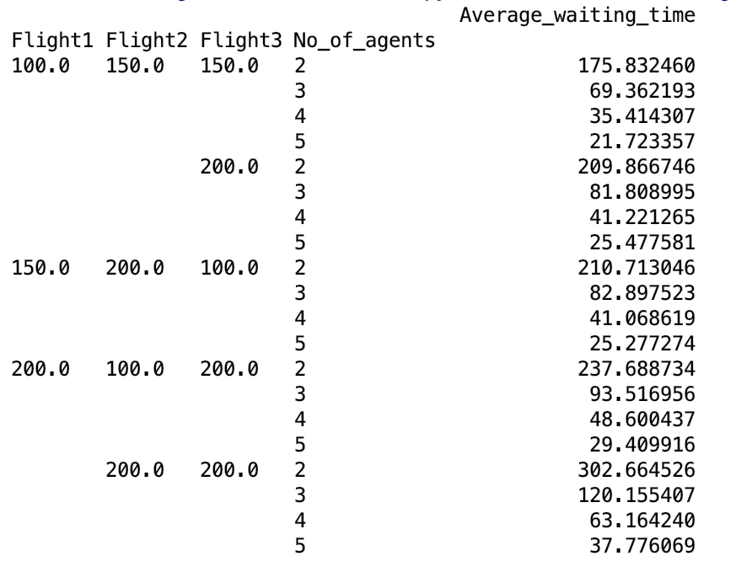
Scenario 3
There are multiple flights with different number of passengers and check-in counters.
Variables of uncertainty
Number of passengers travelling per flight ( in total 3 flights)
Number of check-in agents to perform the check-in process.
Length of the queue.
Result

Slide 9
Limitations
Different agents take different amounts of time to process individual passenger.
Some agents may remain idle or closed for some duration of the service hours.
Different queues exist for different class of passengers – business and coach

Slide 10
Conclusion
The average waiting time decreases as the number of check-in counters increases.
Our hypothesis that if the number of passengers increases, the waiting time also increases is proved to be true in the results accrued.
The above simulation explains that more check-in agents should be incorporated if there is a huge rush of passengers at the airport.

Slide 11
Future work
We are trying to refine the cases by:
Generating different number of passengers served per agent. i.e. a varying agent rate.
Having different queue for different class of customer ( business , coach)
Calculating the efficiency of the agent / check – in counter by considering the amount of time the agent / counter was idle and busy.
Graphical analysis and representation of the simulation analogous to the distribution chosen.

Slide 12
Thank You

