Slide 1
Welcome to our Endgame!
By bliashenko’s team

Slide 2
IDEA
01
02
03
DETECTIVE
HORROR
VISUAL
NOVEL
Welcome to the suspicious world of our psychological horror with detective elements.
Get ready to unravel an exciting storyline full of tension and mystery.

Slide 3
Timeline
01
02
03
The game's initial idea and core theme were brainstormed and refined.
Storyboarding, scriptwriting, and conceptualizing the game mechanics took place.
Art asset creation, programming, and level design were executed based on the pre-production plans.

Slide 4
Overview of the plot and setting

Slide 5
The game takes place in a secluded town where mystical incidents occur. As a detective, the player uncovers a web of dark secrets.
The player will have to communicate with the characters and get acquainted with the area in order to unravel the disturbing story.
The game creates a mysterious environment that enhances the player's experience.

Slide 6
Characters and their roles in the story

Slide 7
Protagonist
Antagonist
The main character, a girl named Alice with disturbing thoughts, seeks to uncover the truth about a series of mysterious disappearances.
A manipulative figure with a dark secret, pulling the strings behind the scenes to thwart the protagonist's investigation.
Supporting Characters
A cast of diverse individuals, each with their own motives and secrets, adding depth and complexity to the unfolding narrative.

Slide 8
Sound-design and music

Slide 9

01
02
03
Samples:
Audio Mixing
Original Composition
Immersive Experience

Slide 10
Development process
P.S. the hardest part

Slide 11
Programmed features include:
Animated characters (sprites)
Shifting between different locations
Adjusting screen resolution
Modifying background music
Interactive dialogues
Switching between day and night
Transitioning through doors to access various locations
User-friendly in-game menu
Volume control

Slide 12
Artistic Direction

Slide 13
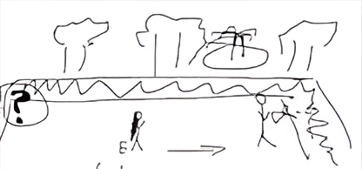
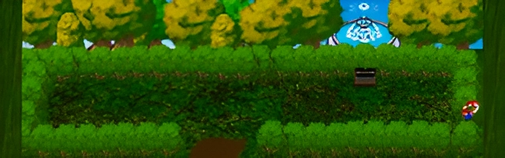
Art style
Sketch
Final

Slide 14
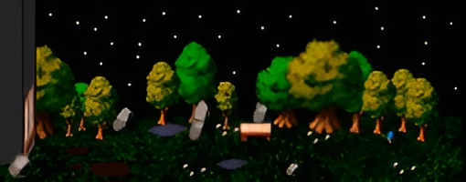
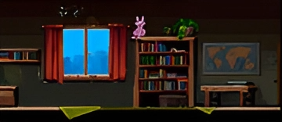
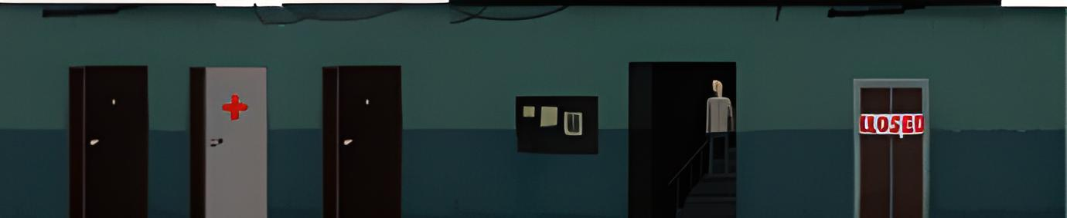
Locations

Slide 15

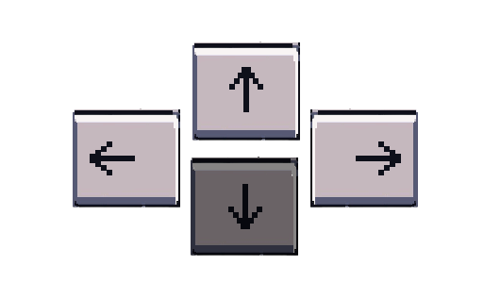
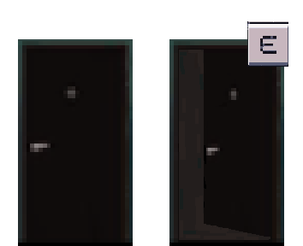




Visual design
Each character in our game has their own unique traits and style that reflects their personality and importance in the story, making every interaction with them memorable and exciting.

Slide 16
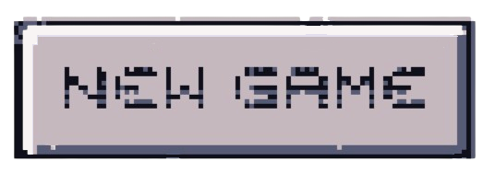

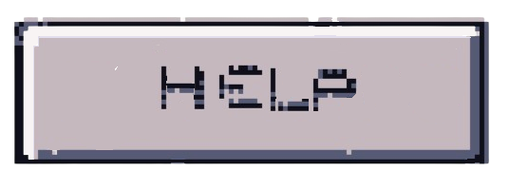
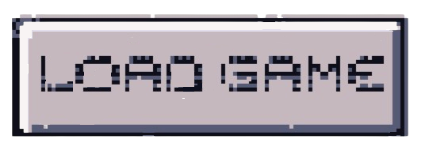

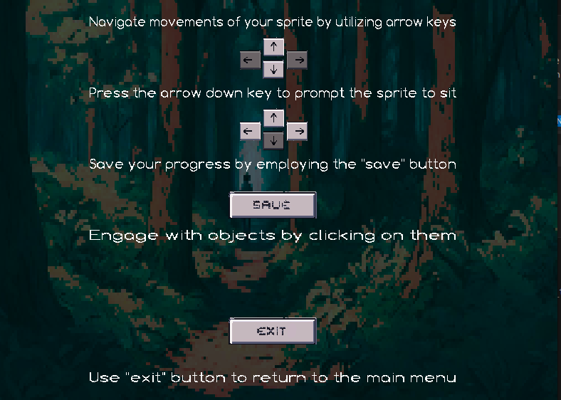
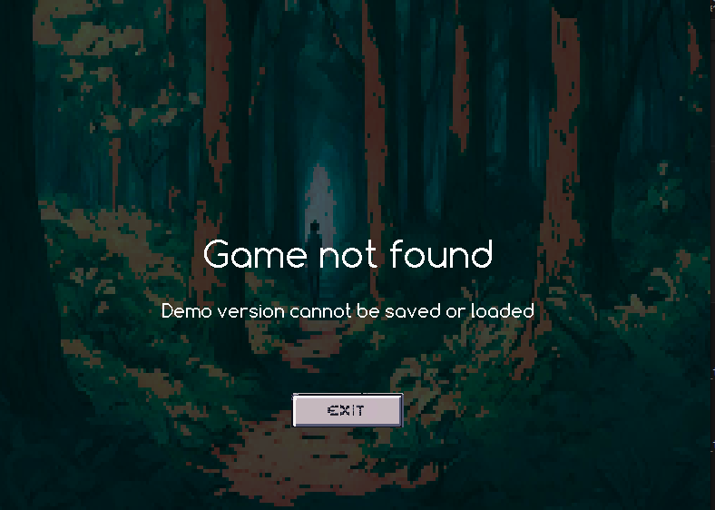
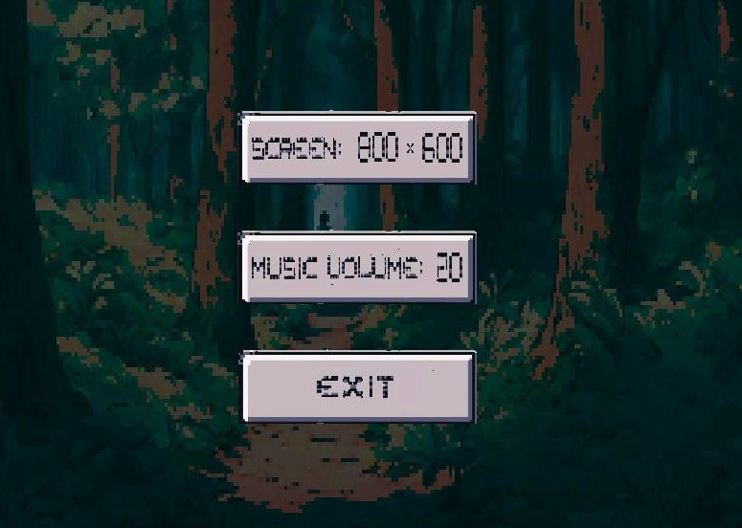
MENU

Slide 17
Marketing and Target Audience

Slide 18
Target Audience
Our game is designed for sophisticated gamers who enjoy psychological thrillers and detective mysteries.
Marketing Strategy
We plan to promote the game through immersive cinematic trailers and engaging social media campaigns to captivate our audience.

Slide 19
Future plans and updates

Slide 20
OUR PLANS
01
02
03
04
add new gameplay mechanics & fix diff. bugs, puzzles, and challenges.
add additional storylines and plot twists.
update music and sound effects, creating a more intense and immersive experience.
provide more backstory and interactions.

Slide 21
Gameplay Mechanics
YouTube Video

Slide 22

THANKS FOR YOUR ATTENTION
Do you have any questions?
We fixed some bugs in this version:
https://github.com/nishiinoya/endgame.git

