Slide 1
// part 3
Branches & Teamwork
main
branch · merge · undo · pull request
feature
$ git switch -c new-me
Switched to a new branch 'new-me'
merged (HEAD)
// slides made by a developer. merge conflicts included free.
Notes:
Ab tak sab kuch ek hi line (main) pe tha. Ab: branches, merge, conflicts, galti undo karna (reset), aur team ke saath GitHub pe kaam - issues, assignees, pull requests.

Slide 2
$ What we'll do today
$ ls branches/
01-what-is-a-branch/
02-branch-and-switch/
03-merge/
04-branch-commands/
05-merge-conflicts/
06-undo-with-reset/
07-issues-and-assignees/
08-pull-requests/
By the end:
[x] make & switch branches
[x] merge without crying
[x] fix a merge conflict
[x] undo add / commit
[x] issue -> PR -> merge
// TODO: fewer slides. (lol)
Notes:
Agenda: branch kya hai, banana aur switch karna, merge, saari branch commands, conflicts, reset se undo, aur last mein multi-user: issues, assignees, pull requests.

Slide 3
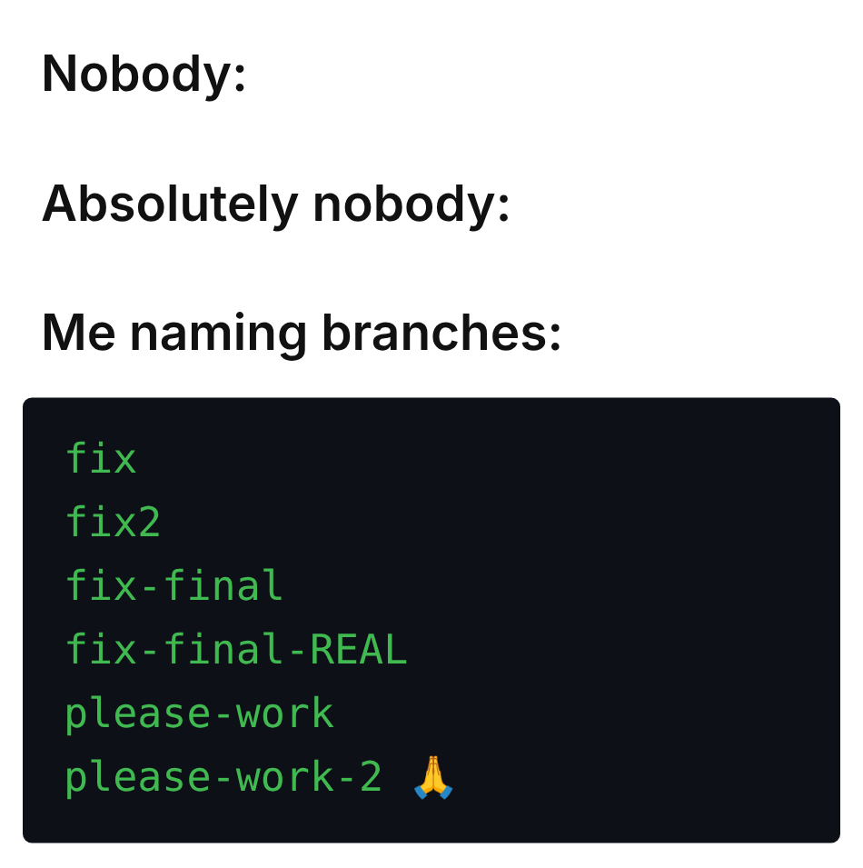
$ What is a branch?
> a parallel timeline for your code
> main stays safe, you experiment
> just a pointer to a commit (cheap!)
login-page
main
merge
Notes:
Branch = ek alag timeline. main ko safe rakho, naya feature alag branch pe banao. Branch sirf ek pointer hai kisi commit pe - banana bilkul sasta hai. Kaam ho gaya toh wapas main mein merge. Meme: branch ke naam achhe rakho, fix-final-REAL nahi.

Slide 4
$ Create a branch & switch
MINGW64:/c/Users/student/team-project
— □ ✕
git branch
list. * = you are here
git branch <name>
create (no switch!)
git switch <name>
move to that branch
student@LAPTOP-7K2 MINGW64 ~/team-project (main)
$ git log --oneline
20be3ad (HEAD -> main) add styles
100eab4 first commit
student@LAPTOP-7K2 MINGW64 ~/team-project (main)
$ git branch
* main
student@LAPTOP-7K2 MINGW64 ~/team-project (main)
$ git branch login-page
student@LAPTOP-7K2 MINGW64 ~/team-project (main)
$ git branch
login-page
* main
student@LAPTOP-7K2 MINGW64 ~/team-project (main)
$ git switch login-page
Switched to branch 'login-page'
student@LAPTOP-7K2 MINGW64 ~/team-project (login-page)
$
watch the prompt:
(main) -> (login-page)
Notes:
Pehle 2 commits main pe (first commit, add styles). git branch - sirf main, star = tum yahan ho. git branch login-page - nayi branch bani, lekin tum abhi bhi main pe ho. git switch login-page - ab shift ho gaye. Prompt mein (main) se (login-page) dekho.

Slide 5
$ Commit on the branch
MINGW64:/c/Users/student/team-project
— □ ✕
100eab4 first
student@LAPTOP-7K2 MINGW64 ~/team-project (login-page)
$ git add .
student@LAPTOP-7K2 MINGW64 ~/team-project (login-page)
$ git commit -m "add login page"
[login-page 5e8d57f] add login page
1 file changed, 1 insertion(+)
create mode 100644 login.html
student@LAPTOP-7K2 MINGW64 ~/team-project (login-page)
$ git log --oneline
5e8d57f (HEAD -> login-page) add login page
20be3ad (main) add styles
100eab4 first commit
20be3ad main
5e8d57f login
main did not move.
only login-page did.
Notes:
login.html banao, add, commit. git log --oneline: HEAD -> login-page sabse upar, aur (main) ek commit peeche. main ko kuch nahi hua - wahi safe rehti hai.

Slide 6
$ Merge it back
MINGW64:/c/Users/student/team-project
— □ ✕
Merge rule
1. switch to the branch
that RECEIVES
2. git merge <other>
student@LAPTOP-7K2 MINGW64 ~/team-project (login-page)
$ git switch main
Switched to branch 'main'
student@LAPTOP-7K2 MINGW64 ~/team-project (main)
$ git merge login-page
Updating 20be3ad..5e8d57f
Fast-forward
login.html | 1 +
1 file changed, 1 insertion(+)
create mode 100644 login.html
student@LAPTOP-7K2 MINGW64 ~/team-project (main)
$ git branch -d login-page
Deleted branch login-page (was 5e8d57f).
Fast-forward
main just slides
ahead. no new commit.
-d = delete branch
Notes:
Merge ka rule: jis branch mein changes CHAHIYE uspe jao (git switch main), phir git merge login-page. Yahan 'Fast-forward' aaya - main bas aage khisak gayi, koi naya commit nahi bana. Kaam ho gaya toh git branch -d login-page se branch delete.

Slide 7
$ All the branch commands
git branch
list branches
* = current
git branch -M main
rename current
branch (-M = force)
git switch <name>
go to a branch
(new way)
git checkout <name>
go to a branch
(old way)
git switch -c <new>
create + switch
(new way)
git checkout -b <new>
create + switch
(old way)
git branch -d <name> delete (merged only) -D = force delete
// checkout does 10 jobs. switch does 1. use switch.
Notes:
Saari commands ek jagah. git branch -M main: current branch ka naam badal deta hai (GitHub pe master -> main ke liye common). checkout purana tareeka hai - woh files bhi restore karta hai, isliye confusing. switch sirf branches ke liye bana hai. -d sirf merged branch delete karega, -D zabardasti.

Slide 8
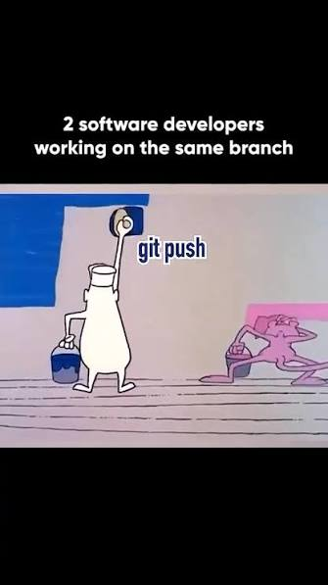
$ Merge conflicts: how?
$ git switch -c navbar-blue
# style.css: black -> blue
# git add . + git commit
$ git switch main
# style.css: black -> red
# git add . + git commit
Blue navbar
CONFLICT
same line,
two answers
black
Red navbar
Notes:
Conflict tab hota hai jab do branches ne SAME file ki SAME line alag tarah se badli ho. Demo: git switch -c navbar-blue, style.css mein black ko blue karo, commit. git switch main, wahi line red karo, commit. Ab Git confuse hai - red ya blue?

Slide 9
$ git diff, then merge
MINGW64:/c/Users/student/team-project
— □ ✕
git diff <branch>
- = navbar-blue has
+ = main (you) has
student@LAPTOP-7K2 MINGW64 ~/team-project (main)
$ git diff navbar-blue
diff --git a/style.css b/style.css
index 2ec5bbc..483f994 100644
--- a/style.css
+++ b/style.css
@@ -1 +1 @@
-nav { color: blue; }
+nav { color: red; }
student@LAPTOP-7K2 MINGW64 ~/team-project (main)
$ git merge navbar-blue
Auto-merging style.css
CONFLICT (content): Merge conflict in style.css
Automatic merge failed; fix conflicts and then commit the result.
student@LAPTOP-7K2 MINGW64 ~/team-project (main|MERGING)
$
(main|MERGING)
you are mid-merge.
scared? run:
git merge --abort
Notes:
git diff navbar-blue: main aur navbar-blue mein kya farak hai. Minus wali line navbar-blue ki, plus wali hamari (main). Phir git merge navbar-blue - CONFLICT. Prompt mein (main|MERGING) aa gaya. Darr lage toh git merge --abort - sab pehle jaisa.

Slide 10
$ Fix the conflict
style.css !
The markers
<<<<<<< HEAD
yours (main)
======= divider
>>>>>>> navbar-blue
incoming
Accept Current Change | Accept Incoming Change | Accept Both Changes | Compare Changes
1
<<<<<<< HEAD (Current Change)
nav { color: red; }
=======
nav { color: blue; }
>>>>>>> navbar-blue (Incoming Change)
1. pick one (or mix both) - VS Code buttons help
2. delete ALL the <<<<<<< ======= >>>>>>> lines
3. git add style.css (= "I fixed it")
4. git commit
Notes:
VS Code mein style.css kholo. Upar HEAD = hamara (main), neeche navbar-blue = aane wala. Accept Current / Incoming / Both buttons use karo ya khud edit karo. Saare <<<<<<< ======= >>>>>>> markers hatao. git add style.css (Git ko batana ki fix ho gaya), phir git commit.

Slide 11
$ Conflict solved
MINGW64:/c/Users/student/team-project
— □ ✕
Merge commit
has 2 parents:
navbar red +
navbar blue
student@LAPTOP-7K2 MINGW64 ~/team-project (main|MERGING)
$ git add style.css
student@LAPTOP-7K2 MINGW64 ~/team-project (main|MERGING)
$ git commit -m "merge navbar-blue, keep blue"
[main 452265d] merge navbar-blue, keep blue
student@LAPTOP-7K2 MINGW64 ~/team-project (main)
$ git log --oneline --graph
* 452265d (HEAD -> main) merge navbar-blue, keep blue
|\
| * 8e7cfab (navbar-blue) navbar blue
* | 1b35244 navbar red
|/
* 5e8d57f add login page
* 20be3ad add styles
* 100eab4 first commit
--graph draws it:
two lines split,
then join again.
// hands up if your graph has a diamond
Notes:
Commit ke baad git log --oneline --graph. Do lines alag hui aur phir mil gayi - woh merge commit hai, jiske do parents hain. Kisi ka conflict nahi suljha toh help karo.

Slide 12
$ Undoing changes: which reset?
1
2
3
Staged
Last commit
Many commits
git reset <file>
git reset
git reset HEAD~1
git reset <hash>
un-stage. edits safe
commit gone. edits safe
back to that commit.
edits safe
git reset --hard <hash> = same, but your edits get DELETED
Notes:
Undo ke teen case: (1) sirf stage kiya hai - git reset file ya git reset. (2) last commit galat - git reset HEAD~1. (3) bahut saare commits - git reset <hash>. Teeno mein tumhari files ke edits safe rehte hain. --hard alag hai: woh edits bhi uda deta hai.

Slide 13
$ 1. Undo staged changes
MINGW64:/c/Users/student/undo-demo
— □ ✕
status --short decoder
A new, staged
M modified, staged
M modified, NOT staged
?? untracked
student@LAPTOP-7K2 MINGW64 ~/undo-demo (main)
$ git add .
student@LAPTOP-7K2 MINGW64 ~/undo-demo (main)
$ git status --short
A app.js
M style.css
student@LAPTOP-7K2 MINGW64 ~/undo-demo (main)
$ git reset app.js
student@LAPTOP-7K2 MINGW64 ~/undo-demo (main)
$ git status --short
M style.css
?? app.js
student@LAPTOP-7K2 MINGW64 ~/undo-demo (main)
$ git reset
Unstaged changes after reset:
M style.css
student@LAPTOP-7K2 MINGW64 ~/undo-demo (main)
$ git status --short
M style.css
?? app.js
git reset <file> = un-stage one
git reset = un-stage all
= git restore --staged (part 1)
Notes:
git add . ke baad realize hua ki app.js stage nahi karni thi. git reset app.js - sirf woh unstage. git reset - sab unstage. File ke andar ke changes safe rehte hain. --short output: left column green = staged, right column red = not staged, ?? = untracked. Ye wahi hai jo git restore --staged karta hai.

Slide 14
$ 2. Undo the last commit
MINGW64:/c/Users/student/undo-demo
— □ ✕
HEAD~1 = 1 commit before HEAD
student@LAPTOP-7K2 MINGW64 ~/undo-demo (main)
$ git log --oneline
1c7865c (HEAD -> main) oops wrong commit
9b42315 add styles
c3b846c first commit
student@LAPTOP-7K2 MINGW64 ~/undo-demo (main)
$ git reset HEAD~1
Unstaged changes after reset:
M style.css
student@LAPTOP-7K2 MINGW64 ~/undo-demo (main)
$ git log --oneline
9b42315 (HEAD -> main) add styles
c3b846c first commit
student@LAPTOP-7K2 MINGW64 ~/undo-demo (main)
$ git status --short
M style.css
?? app.js
first commit
add styles (HEAD)
oops <- gone
commit gone. changes still
in your files: fix, add, commit.
Notes:
Galat commit kar diya? git reset HEAD~1. HEAD~1 matlab HEAD se ek peeche. Commit history se hat gaya, lekin files mein changes waise hi hain - theek karo aur dubara commit karo. HEAD~2 = do peeche.

Slide 15
$ 3. Undo many commits
MINGW64:/c/Users/student/undo-demo
— □ ✕
Step 1
git log --oneline
copy the hash you
want to go back to
student@LAPTOP-7K2 MINGW64 ~/undo-demo (main)
$ git log --oneline
e659606 (HEAD -> main) bug 2
cff0ebe bug 1
9ba5146 add app.js
9b42315 add styles
c3b846c first commit
student@LAPTOP-7K2 MINGW64 ~/undo-demo (main)
$ git reset 9b42315
Unstaged changes after reset:
M style.css
student@LAPTOP-7K2 MINGW64 ~/undo-demo (main)
$ git log --oneline
9b42315 (HEAD -> main) add styles
c3b846c first commit
Step 2
git reset <hash>
later commits: gone
your files: kept
Notes:
Bahut saare commits wapas lene hain? git log --oneline se us commit ka hash copy karo jahan wapas jaana hai. git reset 9b42315 - uske baad ke saare commits hat gaye, lekin changes files mein safe hain (default mode --mixed hai).

Slide 16
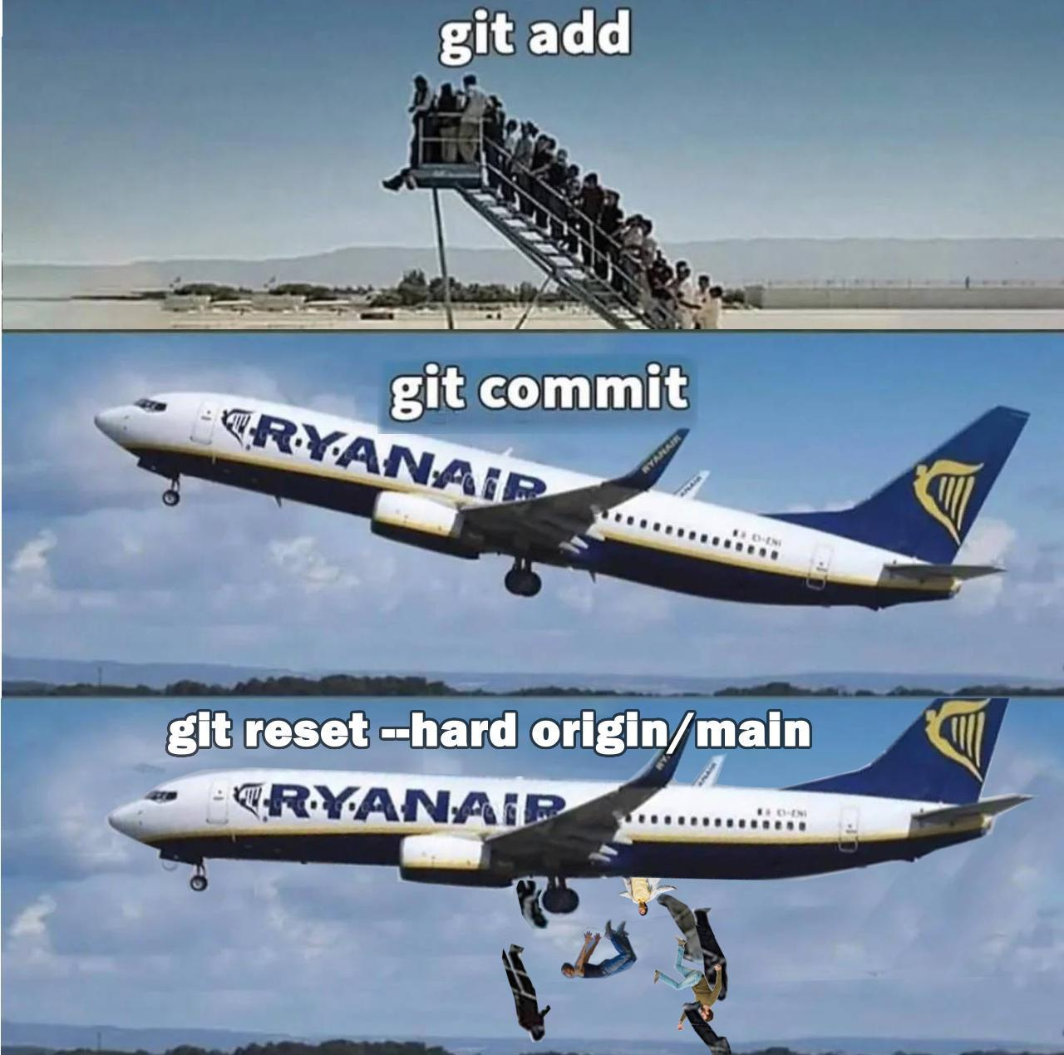
$ git reset --hard (danger zone)
MINGW64:/c/Users/student/undo-demo
— □ ✕
student@LAPTOP-7K2 MINGW64 ~/undo-demo (main)
$ git status --short
M style.css
?? app.js
student@LAPTOP-7K2 MINGW64 ~/undo-demo (main)
$ git reset --hard 9b42315
HEAD is now at 9b42315 add styles
student@LAPTOP-7K2 MINGW64 ~/undo-demo (main)
$ git status
On branch main
nothing to commit, working tree clean
--hard = files ALSO reset.
uncommitted work: GONE.
no undo button. no "are you sure?"
Notes:
git reset --hard: commits bhi peeche aur files bhi us commit jaisi ho jaati hain. Uncommitted kaam hamesha ke liye gaya. Git confirm bhi nahi karta. Use tabhi karo jab sach mein sab phenkna ho. (Commits kabhi kabhi git reflog se wapas mil jaate hain, uncommitted changes nahi.)

Slide 17
$ Working with multiple users
1. Issue
what to do
2. Assign
who's doing it
3. Branch
git switch -c
4. Push
git push -u
// GitHub = where
// the team talks
7. Merge
issue closes
6. Review
comment, approve
5. Pull Request
please merge
// nobody pushes straight to main. main is sacred.
Notes:
Team mein kaam ka flow: pehle Issue (kya karna hai), kisi ko Assign karo, woh apni Branch banata hai, commit karke Push karta hai, phir Pull Request kholta hai, team Review karti hai, aur Merge hote hi issue band. Koi seedha main pe push nahi karta.

Slide 18
$ Issues & assignees
Login button does nothing on mobile #12
Issue
a to-do / bug on GitHub
gets a number: #12
Assignee
who's working on it
Labels
bug, feature,
good first issue
Repo > Issues > New
Open
aryan opened this issue · 2 comments
aryan commented
Assignees
What happens
Tapping Login on a phone does nothing.
Steps
1. Open the site on mobile
2. Tap Login
3. Nothing happens
Expected
Login form should open.
AR
aryan
RA
rahul
Labels
bug
good first issue
Development
No branches or pull requests
Notes:
GitHub repo pe Issues tab -> New issue. Title, description (kya ho raha hai, steps, expected). Right side se Assignees (kaun karega) aur Labels (bug, feature, good first issue). Har issue ka number hota hai - #12. Live: workshop repo pe ek issue banao aur kisi student ko assign karo.

Slide 19
$ Push a branch, open a PR
MINGW64:/c/Users/student/team-project
— □ ✕
then on GitHub:
1. "Compare & pull
request"
2. write Closes #12
3. teammate reviews
4. Merge pull request
5. locally:
git switch main
git pull
student@LAPTOP-7K2 MINGW64 ~/team-project (main)
$ git switch -c fix-login
Switched to a new branch 'fix-login'
student@LAPTOP-7K2 MINGW64 ~/team-project (fix-login)
$ git add .
student@LAPTOP-7K2 MINGW64 ~/team-project (fix-login)
$ git commit -m "fix login button on mobile"
[fix-login 3a9c2e1] fix login button on mobile
1 file changed, 4 insertions(+), 1 deletion(-)
student@LAPTOP-7K2 MINGW64 ~/team-project (fix-login)
$ git push -u origin fix-login
...
remote: Create a pull request for 'fix-login' on GitHub by visiting:
remote: https://github.com/student/team-project/pull/new/fix-login
* [new branch] fix-login -> fix-login
Notes:
Issue #12 ke liye branch: git switch -c fix-login. Fix karo, add, commit. git push -u origin fix-login - Git khud PR ka link de deta hai. GitHub pe 'Compare & pull request', description mein 'Closes #12' likho. Review, approve, Merge. Last mein local pe git switch main aur git pull.

Slide 20
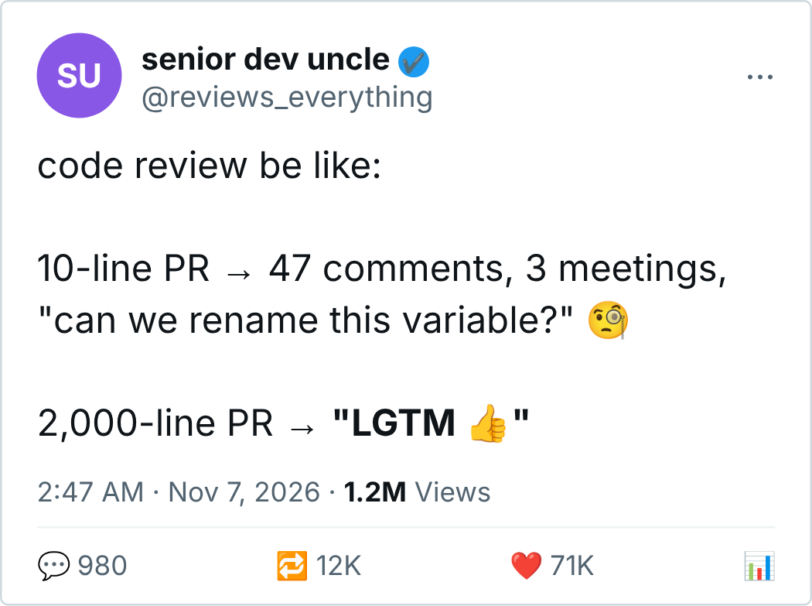
$ Pull requests
Fix login button on mobile #13
Open
aryan wants to merge 1 commit into main from fix-login
Conversation 2 Commits 1 Checks 0 Files changed 1
aryan commented
Login button now works on mobile.
Closes #12
RA
rahul ✓ approved these changes
This branch has no conflicts with the base branch
Merging can be performed automatically.
PR = "please merge my
branch into main"
Closes #12 = issue
auto-closes on merge
Merge pull request
Notes:
Pull Request = 'meri branch ko main mein merge kar do please'. Team code dekhti hai, comment karti hai, approve karti hai. 'Closes #12' likha hai toh merge hote hi issue #12 apne aap band. Meme: chhote PR banao - bade PR koi dhyan se nahi padhta.

Slide 21
$ Cheat sheet
I want to... | command
list branches | git branch
create + switch | git switch -c <name>
switch | git switch <name>
rename current branch | git branch -M <new>
delete a branch | git branch -d <name>
merge into current | git merge <name>
compare with a branch | git diff <name>
un-stage | git reset [<file>]
undo last commit | git reset HEAD~1
go back (keep edits) | git reset <hash>
go back (DELETE edits) | git reset --hard <hash>
Notes:
Cheat sheet - photo le lo. Aur yaad rakho: --hard sirf tab jab sach mein sab phenkna ho.

Slide 22

THANK YOUUU

