Slide 1
// session 1
Git & GitHub
first idea
Intro to Hands-on Git
add memes
$ git init first-years
Initialized empty knowledge in your brain
ship it (HEAD)
// slides made by a developer. bugs are features.
Notes:
Intro: 'Aaj hum Git seekhenge - bilkul zero se.' Ask: kis kis ne kabhi final_v2_REAL.zip banaya hai? Session 1 = intro to hands-on Git. Session 2 = stashing se leke GitHub pe hosting.

Slide 2
$ What we'll do today
$ ls session-1/
01-why-git-and-github/
02-version-control/
03-centralised-vs-distributed/
04-install-git/
05-cli-vs-vscode-vs-desktop/
06-how-git-works/
07-hands-on-the-big-4/
08-edit-restage-commit/
09-git-push/
By the end:
[x] track a folder
[x] make commits
[x] read git log
[x] un-stage a mistake
[x] know what push does
// TODO: make agenda prettier. (never)
Notes:
Agenda: pehle why/what, phir install, phir hands-on. Session 2 mein stashing se leke GitHub hosting aayega.

Slide 3

$ Why Git & GitHub?
> Git = tool on your laptop. Remembers every change.
> GitHub = website to store & share Git projects.
> Teamwork without final_v2_REAL.zip
Notes:
Meme: 'What is a git hub?'. Git = tool jo tumhare laptop pe chalta hai aur har change yaad rakhta hai. GitHub = website jahan Git projects store aur share hote hain. Dono alag cheezein hain.

Slide 4
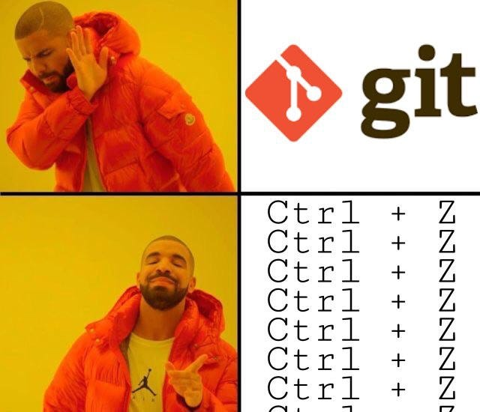
$ What is Version Control?
> A system that records every change to your files over time
> Go back to any old version (a real Ctrl+Z)
> See who changed what, and when
> Many people, one project, no chaos
Notes:
Meme: Drake - Git nahi, Ctrl+Z Ctrl+Z Ctrl+Z. Version control = ek system jo files ke saare changes time ke saath record karta hai. Purane version pe wapas ja sakte ho, kaun ne kya badla dekh sakte ho.

Slide 5
$ Centralised vs Distributed
Centralised
Distributed
SERVER
copy + history
copy + history
copy + history
dev
dev
dev
> One central server for everyone
> Server down = nobody works
> Everyone has the full history
> Offline? Keep working!
e.g. SVN
e.g. Git
Notes:
CVCS (jaise SVN): ek central server, sab uspe depend. Server down = kaam band. DVCS (Git): har developer ke paas poori history ki copy. Offline kaam, backup har jagah.

Slide 6
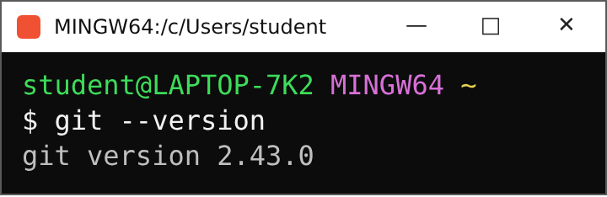
$ How to install Git
1
Open Chrome, search: download git
2
Open git-scm.com, pick your OS
3
Run the installer: Next, Next, Next
// check it worked
4
Open Git Bash / terminal and check
tip: if the installer asks for the initial branch name, choose main
Notes:
Chrome kholo, 'download git' search karo, git-scm.com. OS select karo, installer chalao - Next Next Next. Installer initial branch name puchhe toh 'main' choose karo. Phir terminal (Git Bash) kholke git --version check karo. NOTE: web screenshots yahan add kar sakte ho (git-scm.com download page).

Slide 7
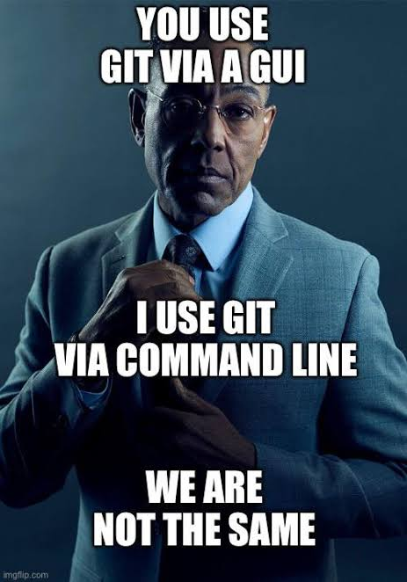
$ 3 ways to use Git
CLI
Type commands. Full power. We use this today.
<- today
VS Code
Buttons for add / commit / push inside the editor.
GitHub Desktop
Pure GUI. Click, click, done.
// buttons are just commands in a trench coat
Notes:
Meme: Gus Fring - 'You use Git via a GUI / I use Git via command line'. Teen tareeke: CLI, VS Code, GitHub Desktop (GUI). Aaj CLI seekhenge. Baaki do mein buttons wahi kaam karte hain jo commands karte hain.

Slide 8
$ Hands-on: setup
1
Make a folder: my-first-repo
my-first-repo/
|-- index.html
|-- style.css
`-- script.js
2
Put 3 files in it
3
Open the folder in VS Code
// content doesn't matter. write anything.
4
Open the terminal: Ctrl + `
Notes:
Ek folder banao aur usme 3 files rakho (index.html, style.css, script.js). VS Code mein folder kholo, terminal kholo (Ctrl + `). Content se koi farak nahi padta - kuch bhi likh do.

Slide 9
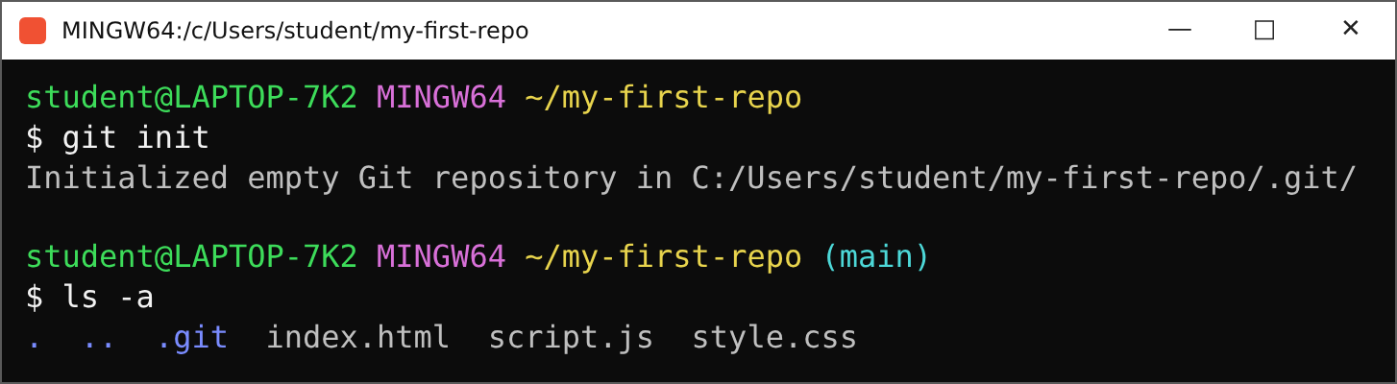
$ Step 1: git init
// git init = start tracking this folder. .git is hidden: turn on 'Show hidden items' in Explorer to see it.
Notes:
git init - ye folder ko Git ke under le aata hai. Explorer mein hidden items ON karke .git folder dikha dena. Yahi woh folder hai jahan Git sab kuch store karta hai. ls -a se bhi dikhta hai.

Slide 10
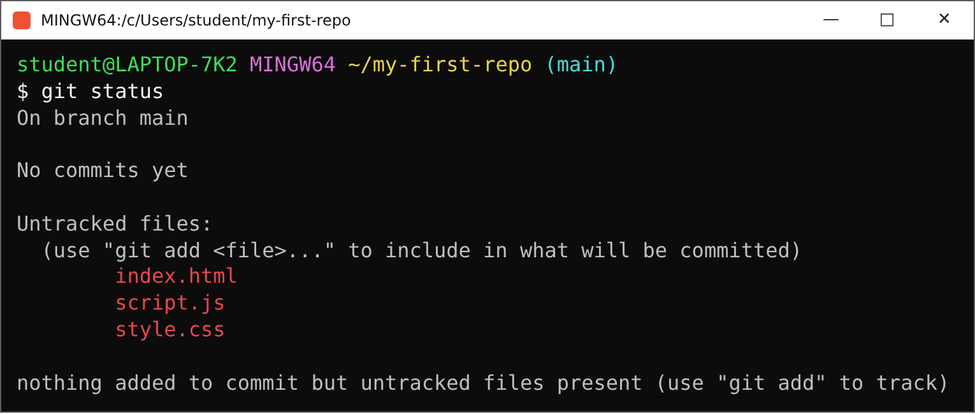
$ Step 2: git status
red = untracked (Git ko pata nahi) No commits yet = koi save point nahi
Notes:
git status chalao - students ko tracked aur untracked files dikhao. Red = untracked: Git ko in files ke baare mein kuch nahi pata. 'No commits yet' = abhi tak koi save point nahi bana.

Slide 11
$ Code rehta kahaan hai??
Working Directory
Local files jo tum edit karte ho
Staging Area
Jahaan changes commit ke liye tayyar hote hain
Local Repository
Local commits yahan store hote hain
Remote Repository
Code remote server pe (GitHub)
git add
git commit
git push
// hamara code rehta kahaan hai?? yahi 4 jagah.
Notes:
Hamara code rehta kahaan hai? 4 jagah: Working Directory (local files), Staging Area (jahan changes commit ke liye prepare hote hain), Local Repository (local commits store hote hain), Remote Repository (code remote server pe store hota hai). Commands: git add, git commit, git push.

Slide 12
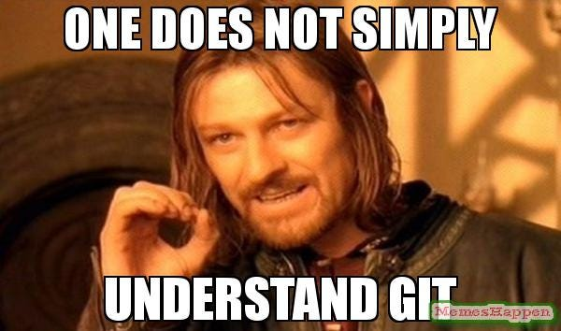
$ Naya repo ya purana?
Concept thoda heavy tha? Relax.
Naya repo banao
git init
Purana repo lao
git clone <url>
// aaj: git init
Notes:
Meme: One does not simply understand Git. Relax - aaj sirf 4 commands. Repo shuru karne ke do tareeke: ya toh nayi repo banao (git init), ya existing repo pull/clone karo (git clone <url>). Aaj git init use karenge.

Slide 13
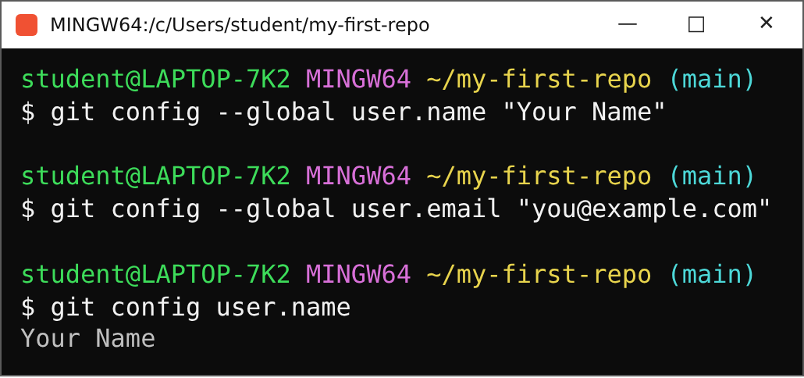
$ Step 3: who are you?
Why?
Every commit is stamped with your name + email
--global = set once for the whole laptop
Use the same email as your GitHub account
Notes:
git config --global user.name aur user.email - ye ek baar set karna hota hai. Har commit pe ye naam + email stamp hota hai. Same email use karo jo GitHub account mein hai.

Slide 14
$ THE BIG 4
1
2
3
4
git init
git add
git commit
git log
Start watching this folder
Put files in the staging area
Save a snapshot with a message
See your history
// bas yehi 4. baaki sab inke upar hi bana hai.
Notes:
The Big 4 commands: git init, git add, git commit, git log. Bas yehi 4 - baaki sab inke upar bana hai.

Slide 15
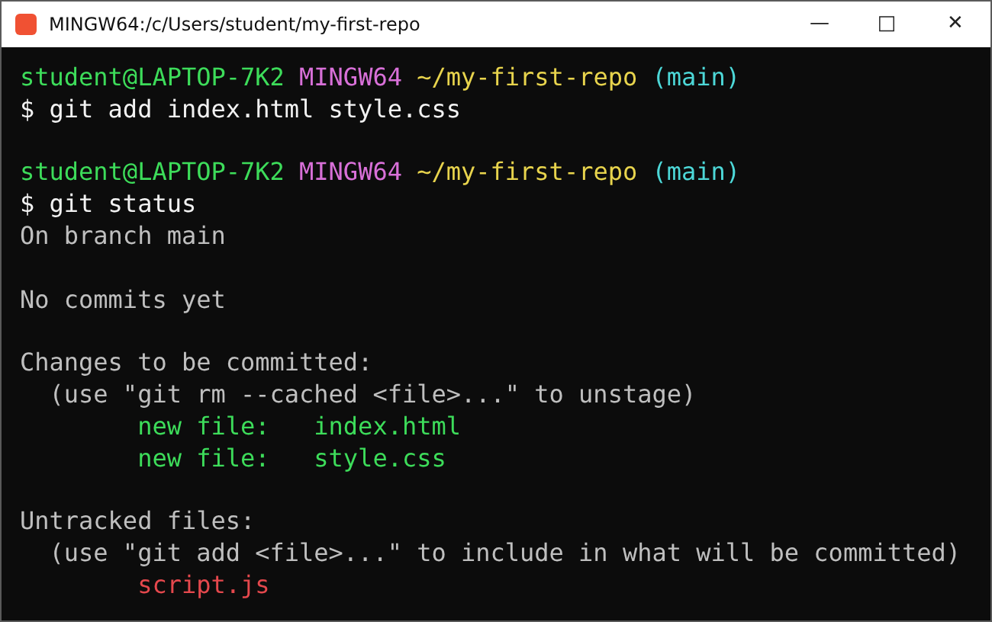
$ git add
What happened
git add <file> <file>
pulls files from working directory into the staging area
green = staged, ready to commit
red = untracked. script.js was left out
git add . = everything (careful!)
Notes:
git add <file> <file> - working directory se staging area mein le jaata hai. git status se tracked aur untracked files dikhao: green = staged, red = untracked (script.js ko hamne add nahi kiya).

Slide 16
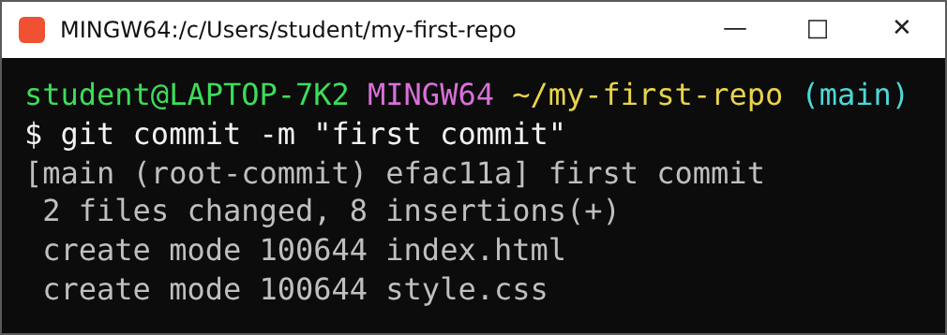
$ git commit
Good message
add navbar styles
fix login bug
Bad message
asdf
final_final
pagal hai kya
-m = message. Only staged files get committed.
Notes:
git commit -m "message" - staged files ka snapshot save karta hai. Message mein batao kya kiya. 'pagal hai kya' commit message nahi hota. Sirf staged files commit hoti hain - script.js left out hai.

Slide 17
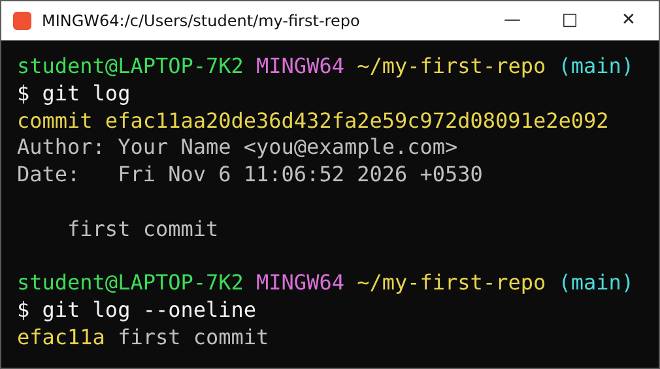
$ git log
git log
full history: hash, author, date, message
--oneline
short & sweet: one line per commit
// stuck in the log view? press q
Notes:
git log - saare commits ki history. git log --oneline - chhota aur seedha. Log kholne ke baad bahar aane ke liye q dabao.

Slide 18
$ Checkpoint: level 1
Ab aap apni files track kar sakte ho.
first commit
[x] git init
[x] git status
[x] git add
[x] git commit
[x] git log
// hands up if git log shows your commit
Notes:
Checkpoint: ab aap log apni files at least track kar sakte ho. Poochho: kis kis ka git log mein 1 commit dikh raha hai? Haath upar.

Slide 19
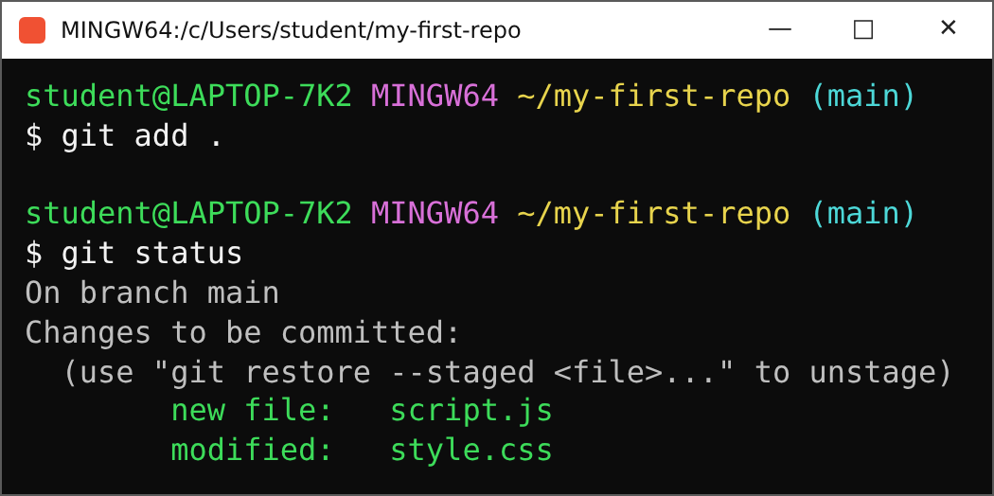
$ Edit, add, status
Careful!
Changes to be committed
= STAGED. Ready, but NOT committed yet.
new file = first time tracked
modified = already tracked, now changed
Notes:
Ab files edit kar do (style.css). Phir git add . aur git status. Dhyan do: 'Changes to be committed' ka matlab STAGED hai - abhi commit nahi hua. new file = script.js (pehli baar track), modified = style.css (pehle se tracked).

Slide 20
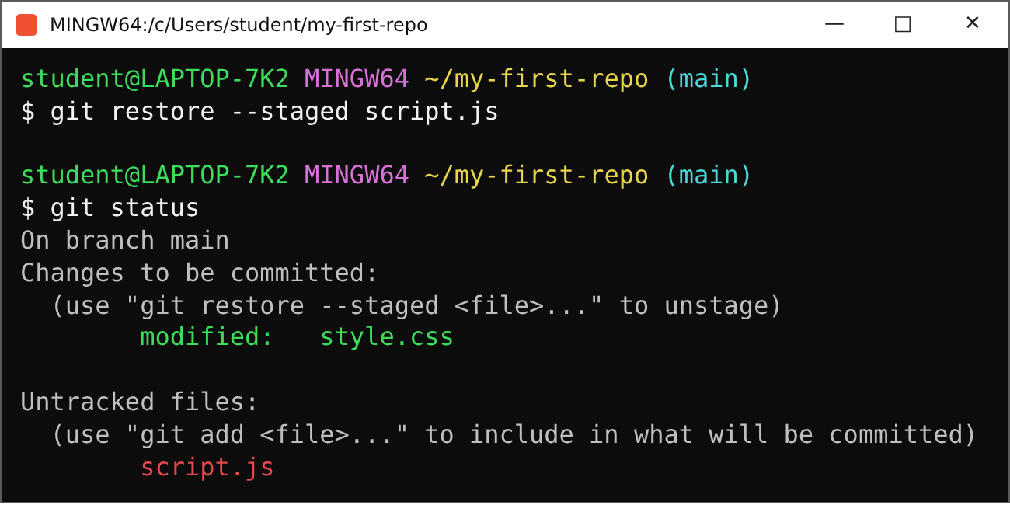
$ Oops, don't stage that
Un-stage
git restore --staged <file>
takes it back out of staging
your edit is safe in the file
script.js is untracked again. no problem
Notes:
Agar koi file stage nahi karni toh: git restore --staged <file name>. Phir git status chalakar dikhao. Sirf unstage hota hai - tumhara edit safe rehta hai.

Slide 21
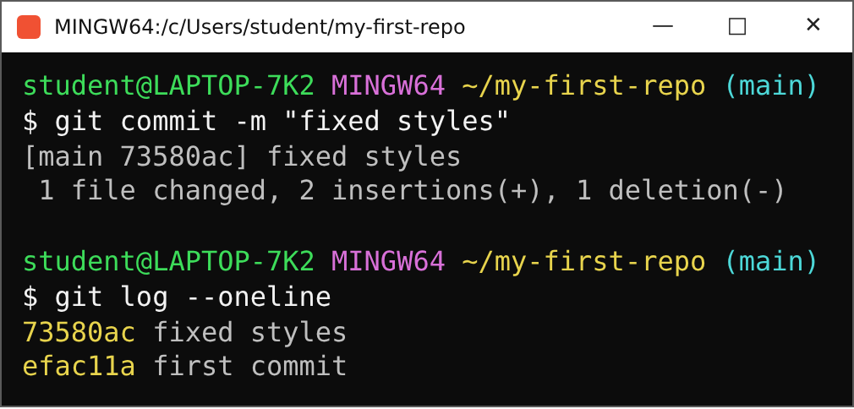
$ Commit #2
first commit
fixed styles
// two save points. history is growing.
Notes:
git commit -m "fixed styles", phir git log --oneline. Ab do commits dikhenge - history ban rahi hai.

Slide 22
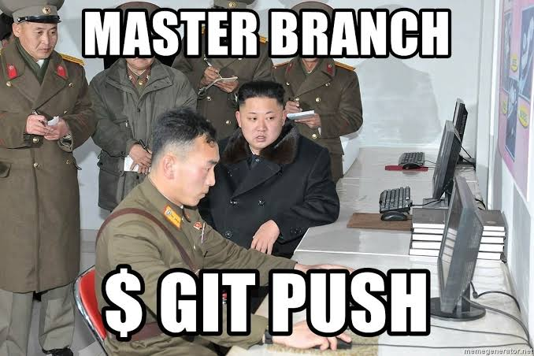
$ git push
> git push = send your commits to a remote (GitHub)
> git pull = get your team's changes
> main = default branch (old name: master)
$ git push
$ git pull
Notes:
Meme: master branch, $ git push. Ab teach karo git push: local commits ko remote (GitHub) pe bhejna. Agar team ke changes chahiye toh git pull. main = default branch (purana naam master tha). Remote set karna agla slide.

Slide 23
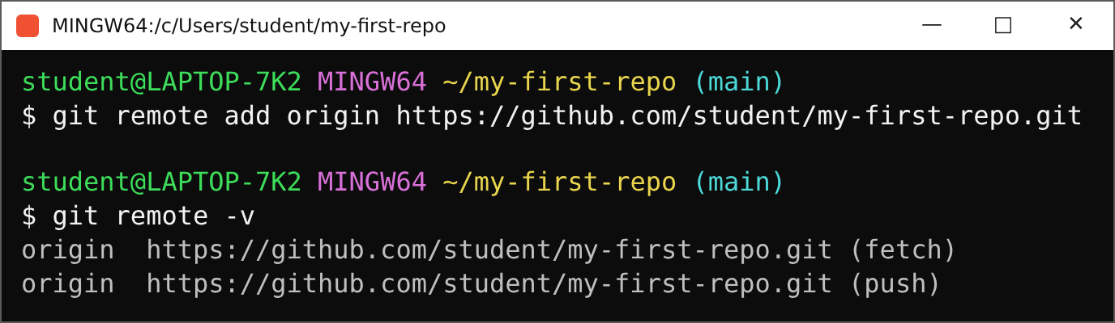
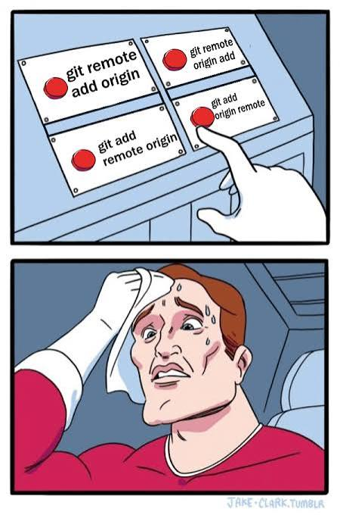
$ Tell Git where to push
> origin = nickname for the remote URL
> -u = remember it, next time just git push
> Order: remote, add, origin
// full GitHub setup = Session 2
Notes:
Push se pehle Git ko batana padta hai remote kahan hai: git remote add origin <url>. Meme: order yaad rakho - remote, add, origin. -u ka matlab Git yaad rakhega, agli baar sirf git push. Poora GitHub setup (repo banana, login) Session 2 mein.

Slide 24
$ Cheat sheet
I want to... | command
start / copy a repo | git init / git clone <url>
see what's tracked | git status
set my identity (once) | git config --global user.name
stage files | git add <file> | git add .
un-stage a file | git restore --staged <file>
save a snapshot | git commit -m "msg"
see history | git log --oneline
link a remote | git remote add origin <url>
send / receive | git push | git pull
Notes:
Cheat sheet: ye table share kar do. Roz ka routine: git pull, kaam karo, git add, git commit, git push.

Slide 25
Questions?
first commit
$ git commit -m "session 1 done"
[main f00ba42] session 1 done
fixed styles
next: Session 2 - stashing, then hosting repos on GitHub
session 1 done
// found a bug? raise your hand (issue).
Notes:
Session 1 khatam. Questions? Next: Session 2 - stashing se leke GitHub pe repositories host karna.

