Slide 1
// session 2
Git & GitHub
stash it
Stashing -> Hosting on GitHub
tag it
$ git stash
Saved working directory and index state
push it (origin)
// ab code laptop se bahar jaayega.
Notes:
Session 2: stashing se leke GitHub pe repositories host karna. Session 1 mein local Git seekha, aaj usko internet pe le jaayenge.

Slide 2
$ What we'll do today
$ ls session-2/
01-stashing/
02-tags/
03-github-signup-and-new-repo/
04-git-clone/
05-private-repos-ssh-key/
06-push-test/
07-branch-rename/
08-fetch-vs-pull/
By the end:
[x] stash your mess
[x] tag a version
[x] make a GitHub repo
[x] clone + push
[x] fetch vs pull
// rebase? not today. (breathe)
Notes:
Agenda: stash, tags, phir GitHub.com: repo banana, clone, private repo + SSH, push test, fetch vs pull. Rebase aaj nahi.

Slide 3
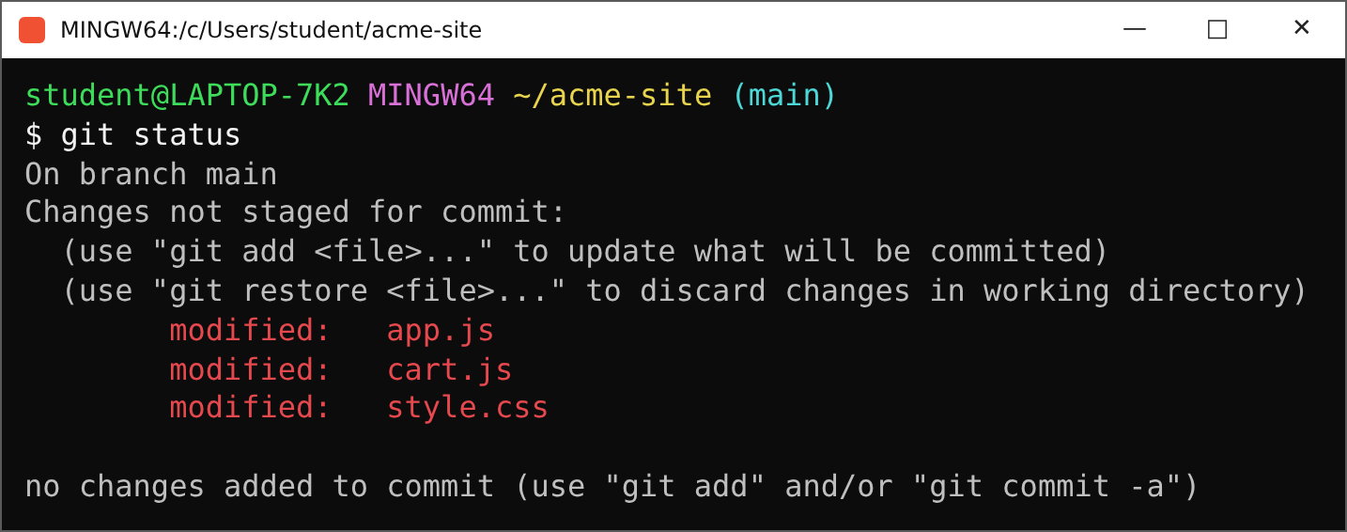
$ Scenario: emergency!
> Code mein raita faila hua hai
> Boss: "company ke naam mein spelling error hai, abhi push karo!"
> Kya karoge??
// 3 files half-done. push karna = adhura kaam bhi push.
Notes:
Scenario: tumhare code mein raita faila hua hai (kai files half-edited) aur boss bolta hai: company ke naam mein spelling error hai, abhi push karo. Kya karoge? Ye wala git status dikhao: 3 files modified.

Slide 4

$ Why stash?
> Bohot saare changes kiye, abhi push nahi karna
> Push kiya toh unreviewed changes bhi dikh jaayenge
> stash = temporary storage for changes
> stash != trash
Notes:
Meme: GIT STASH / GIT TRASH. Stash trash nahi hai. Bohot saare changes kiye hain, abhi push nahi karna kyunki jo changes review nahi kiye woh bhi dikh jaayenge. Toh stash karo: temporary storage.

Slide 5
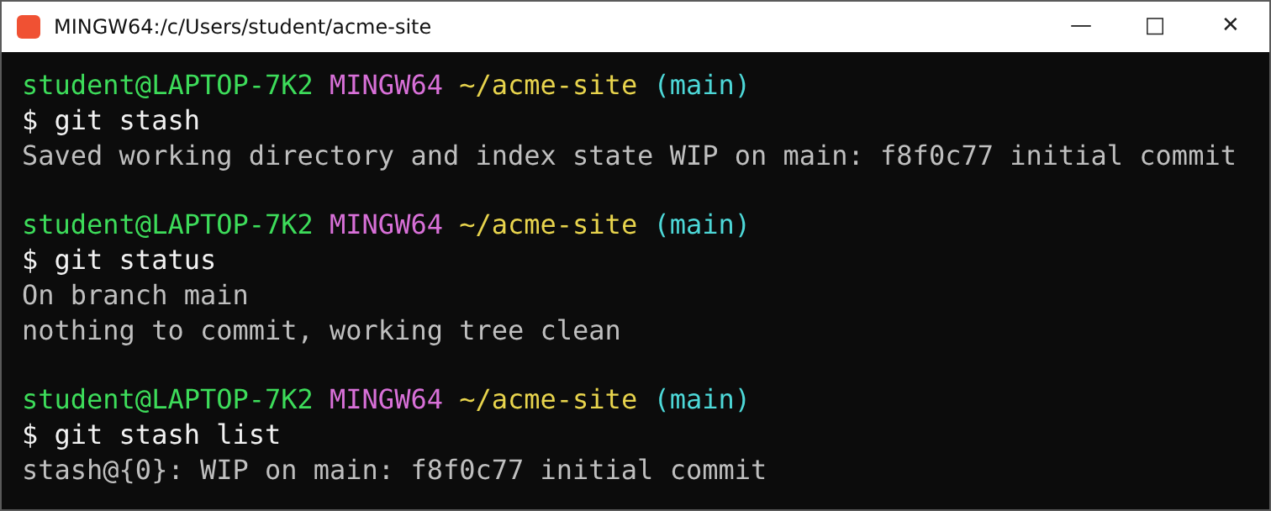
$ git stash
// git stash -> tree clean. stash list -> changes safe.
Notes:
git stash chalao: saare changes temporary storage mein chale gaye. git status chalao: working tree clean ho gaya. git stash list se dekho ki stash mein kya hai.

Slide 6
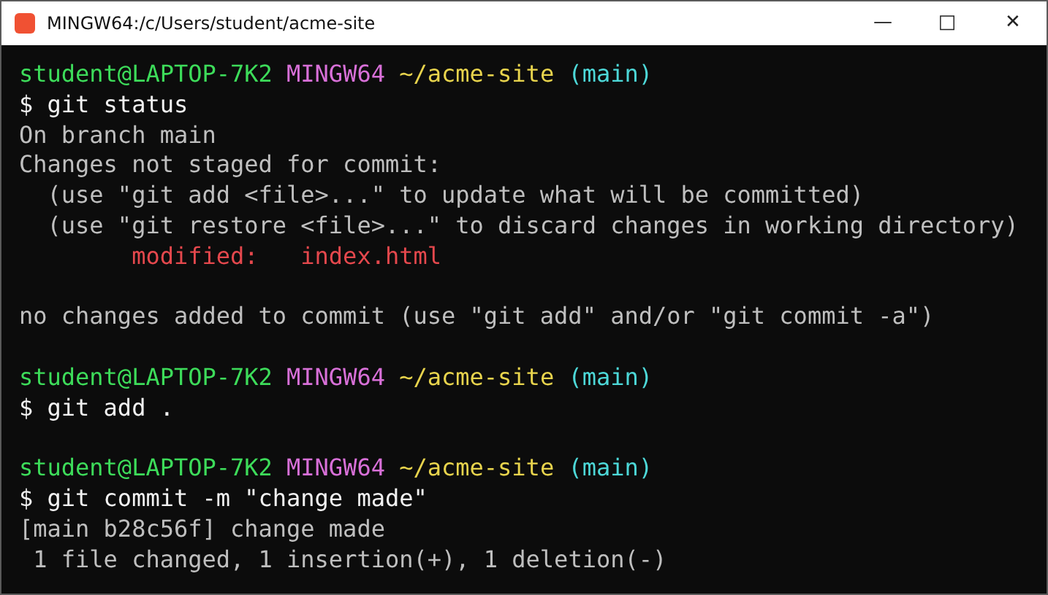
$ Do the emergency change
1
Fix the spelling
2
git status
3
git add .
4
git commit -m "change made"
Notes:
Ab tree clean hai, toh emergency fix karo (Tecnologies -> Technologies). git status se check, git add ., git commit -m 'change made'.

Slide 7
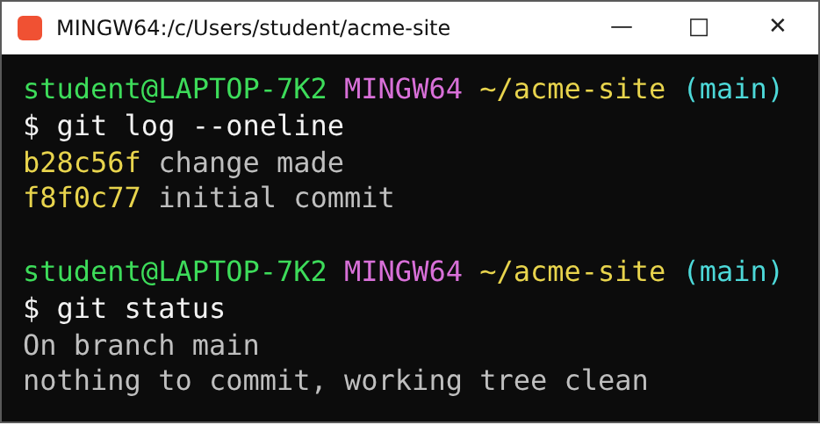
$ Check the log
Dekho:
git log --oneline -> emergency commit aa gaya
git status -> working tree clean hi hogi
now hehehe...
Notes:
git log --oneline: emergency commit dikh gaya. git status: working tree clean hi hogi, kyunki baaki changes stash mein hain. Ab hehehe: stash pop.

Slide 8
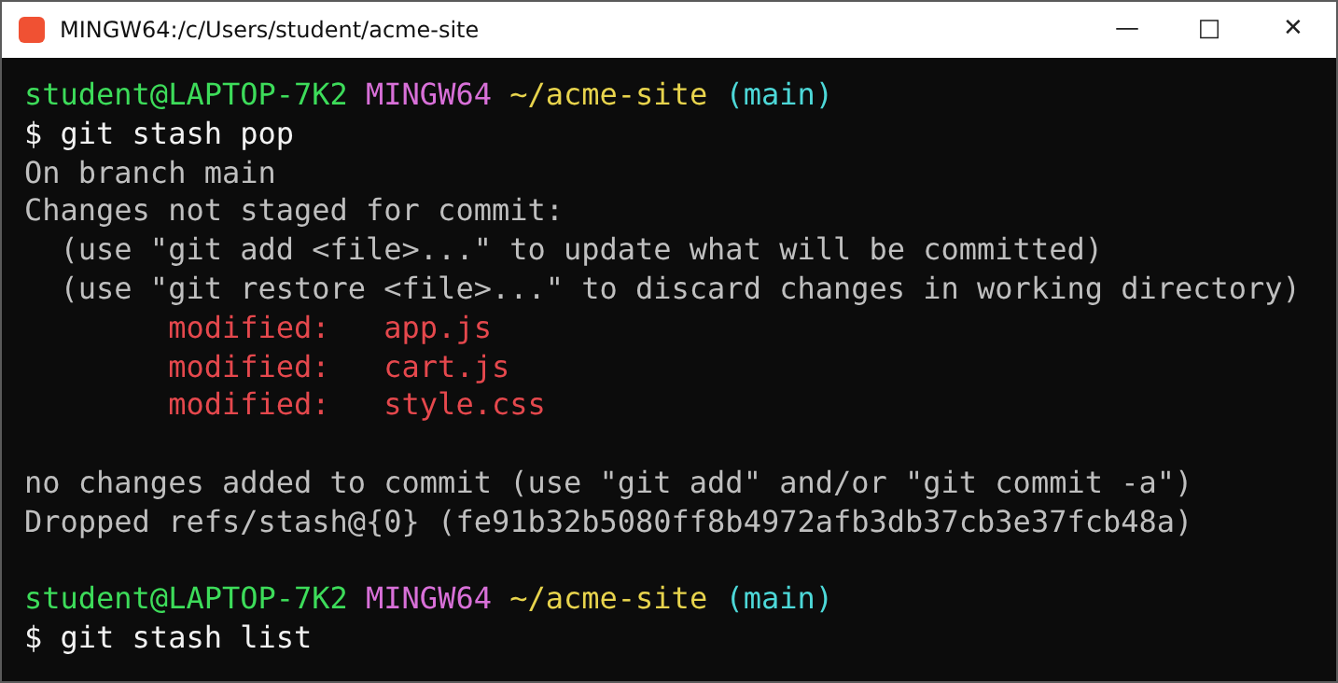
$ git stash pop
pop =
stash se nikaalo
working tree mein wapas
stash list ab khaali
Notes:
git stash pop: saare changes stash se nikaalkar working tree mein le aaya. Ab saare changes aa gaye. git stash list mein ab zero entries.

Slide 9
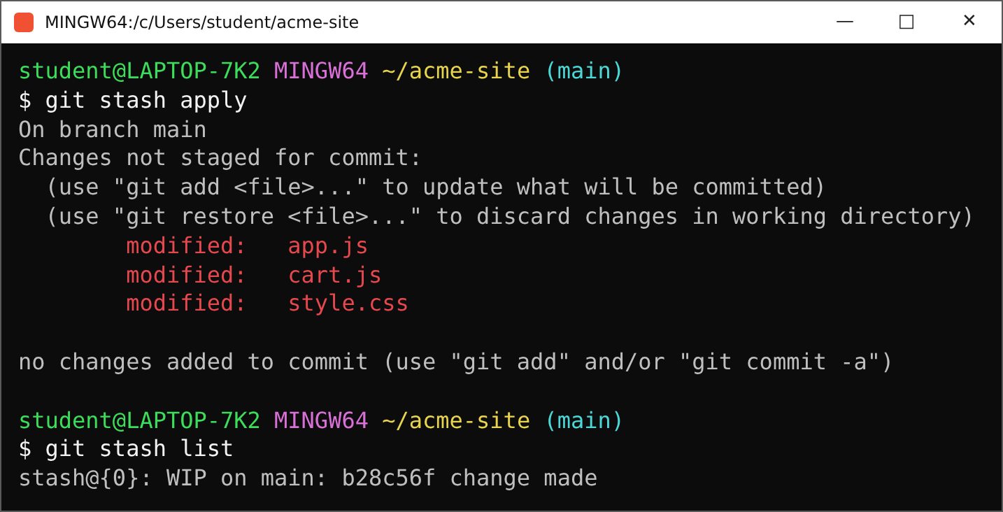
$ pop vs apply
stash pop
changes aaye, list se hata
stash apply
changes aaye, list mein bhi rahe
// apply = photocopy. pop = original.
Notes:
git stash apply bhi kar sakte ho: changes working tree mein aayenge aur git stash list mein bhi rahenge. pop = nikaal do, apply = copy karke lao.

Slide 10
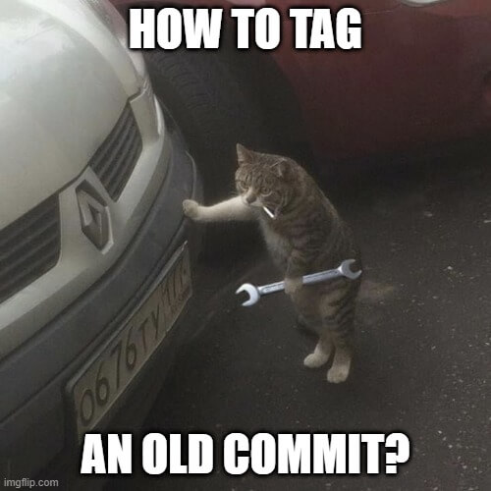
$ Tagging
> Tag = a name for a commit, like v1.0
> annotated tag: has a message
> lightweight tag: just a name
# bonus: tag an OLD commit
$ git tag -a v0.9 <commit-hash>
Notes:
Meme: HOW TO TAG AN OLD COMMIT? Git mein tags laga sakte hain, kisi commit ko naam dena (v1.0). Do types: annotated aur lightweight. Bonus: purane commit pe tag lagane ke liye git tag -a v0.9 <commit-hash>.

Slide 11
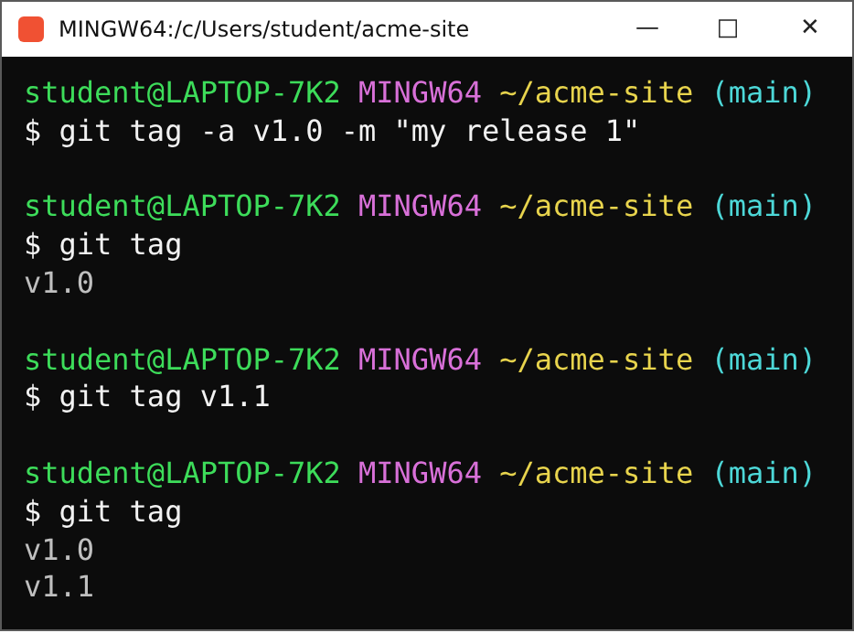
$ Tags: hands-on
annotated
git tag -a v1.0 -m "..."
lightweight
git tag v1.1
// git tag = list all tags
Notes:
git tag -a v1.0 -m 'my release 1' annotated tag banata hai. git tag se list. git tag v1.1 lightweight tag hai.

Slide 12

$ GitHub.com kaise use karein
> Remote repo = repo on GitHub, not your laptop
> How to host the code
laptop --push--> GitHub
laptop <-clone-- GitHub
friend <-clone-- GitHub
Notes:
Meme: SpongeBob. Ab tak sab laptop pe tha. GitHub pe remote repo banayenge aur code host karenge, jisse dost bhi access kar sake.

Slide 13
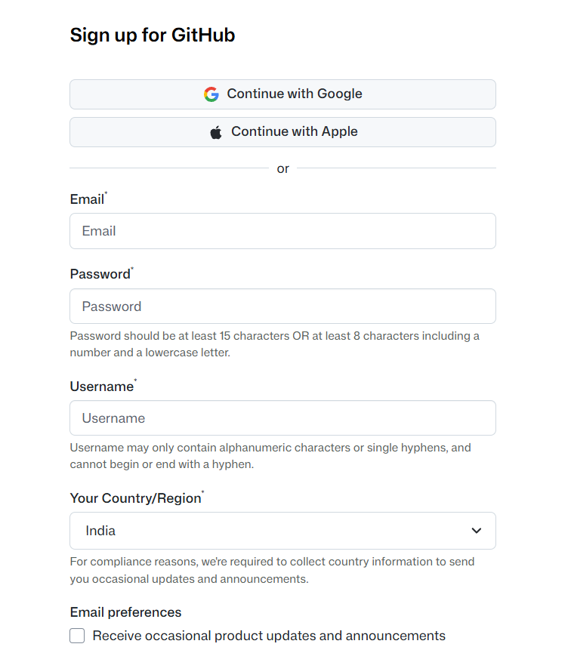
$ First: sign up / login
1
Open github.com
[ paste screenshot here ]
github.com sign-up / login page
2
Sign up: email, password, username
3
Verify your email
4
Sign in
Notes:
github.com kholo. Sign up: email, password, username. Email verify karo. Phir sign in. [Yahan apna github.com sign-up/login ka screenshot paste karo.]

Slide 14
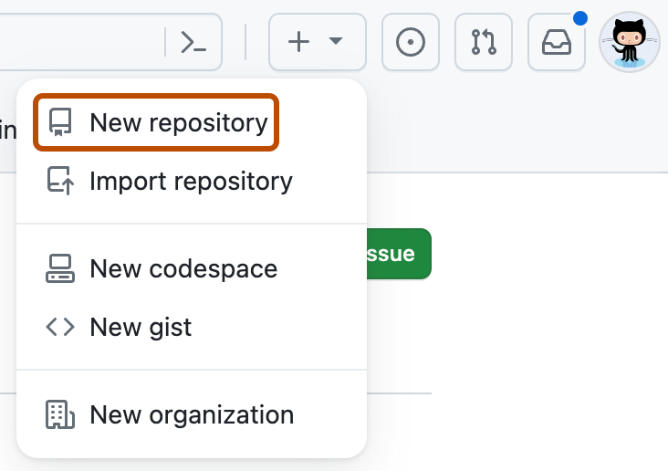
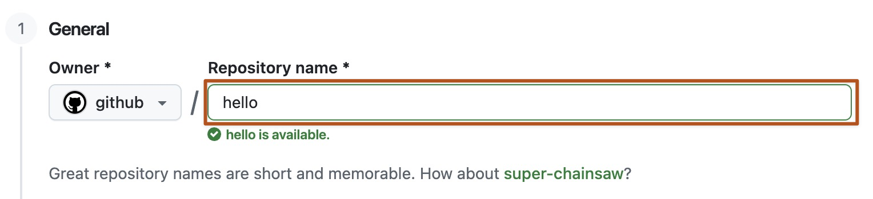
$ Create a new repo
> + -> New repository
> Give it a name
> Click Create repository
screenshot: GitHub Docs (CC BY 4.0)
Notes:
Top right + button, New repository. Repository name dalo. Create repository dabao. Source: GitHub Docs.

Slide 15
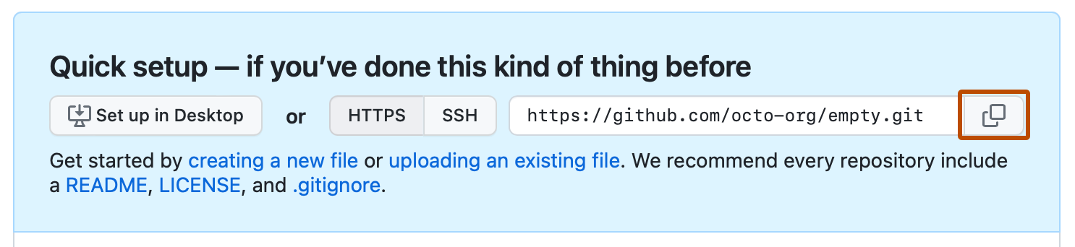
$ Empty repo: copy the URL
> Keep HTTPS selected
> Click the copy icon -> URL copied
screenshot: GitHub Docs (CC BY 4.0)
Notes:
Naya repo bana toh Quick setup page aata hai. HTTPS select rakho aur copy icon dabao: URL clipboard mein.

Slide 16
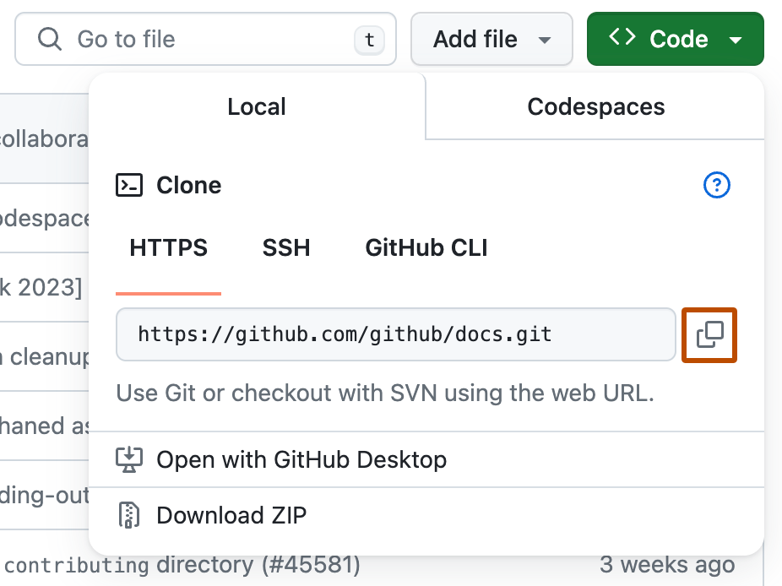
$ Existing repo: Code button
> Open the repo page
> Green Code button
> HTTPS tab -> copy URL
screenshot: GitHub Docs (CC BY 4.0)
Notes:
Kisi bhi repo ke page pe green Code button: HTTPS tab mein URL, copy icon. Yahi URL git clone mein dalenge.

Slide 17
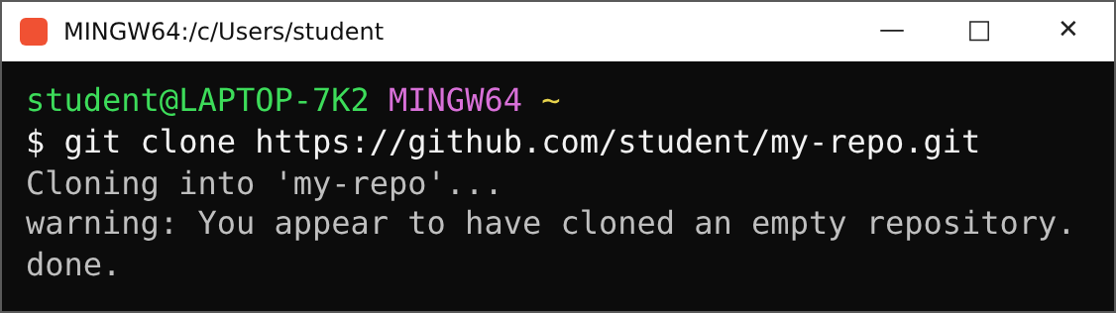
$ Clone it in Git Bash
> Type git clone then paste the URL (Ctrl+V)
> Ctrl+V not working? Shift+Insert or right-click
> "empty repository" warning = normal
Notes:
Git Bash kholo, folder mein jao. git clone likho, space, phir Ctrl+V. Git Bash mein Ctrl+V na chale toh Shift+Insert ya right-click paste. Empty repo ka warning normal hai.

Slide 18
$ Agar repo private hai
Private repo? Login on Git Bash to authenticate.
TAREEKA 1: SSH key
ssh-keygen
public key GitHub pe add
git clone git@github.com:...
TAREEKA 2: HTTPS login
git clone https://...
browser / popup mein GitHub sign in karo
// aaj: tareeka 1 (SSH key)
Notes:
Private repo ho toh Git Bash mein login/authenticate karna padega. Tareeka 1: SSH key. Tareeka 2: HTTPS pe browser sign-in / credential manager.

Slide 19
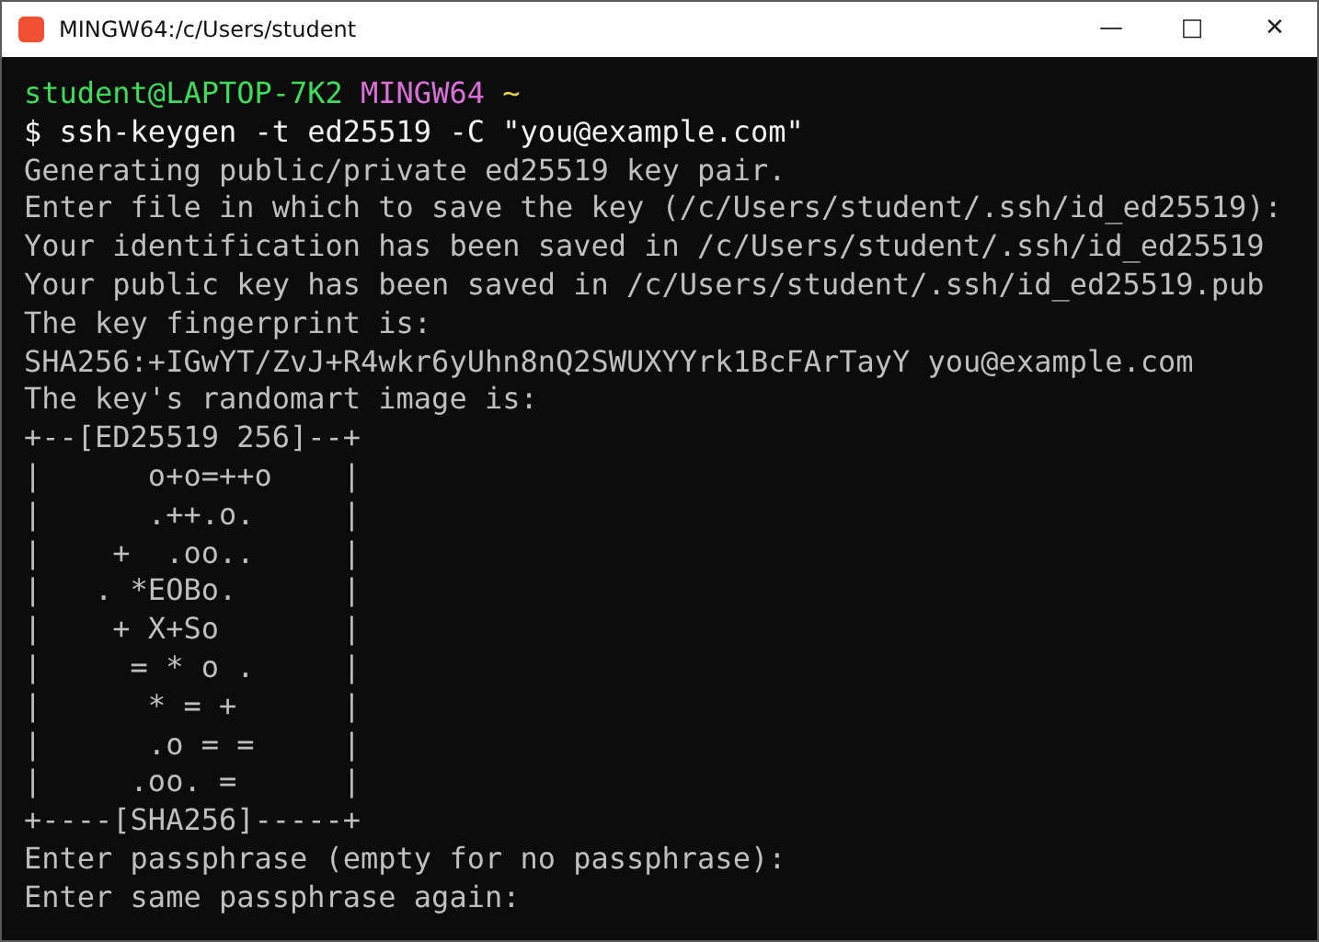
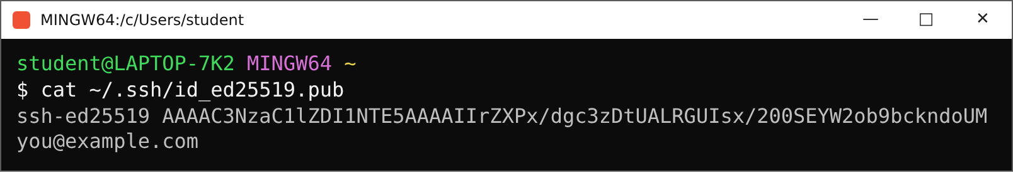
$ SSH key: generate
// copy this .pub line
Steps
Run ssh-keygen, press Enter x3
cat ~/.ssh/id_ed25519.pub
never share the private key
Notes:
ssh-keygen -t ed25519 -C 'email'. Enter dabate raho (default path, no passphrase). Phir cat ~/.ssh/id_ed25519.pub se PUBLIC key copy karo. Private key (bina .pub) kabhi share nahi karna.

Slide 20
$ SSH key: add it to GitHub
1
Profile photo -> Settings
[ paste screenshot here ]
Settings -> SSH and GPG keys -> New SSH key
2
SSH and GPG keys
3
New SSH key
4
Paste the .pub line, Add
$ git clone git@github.com:student/my-repo.git
Notes:
GitHub: profile photo, Settings, SSH and GPG keys, New SSH key. Title dalo, key paste karo, Add SSH key. Phir git clone git@github.com:USER/REPO.git. [Yahan apna Settings > SSH keys ka screenshot paste karo.]

Slide 21
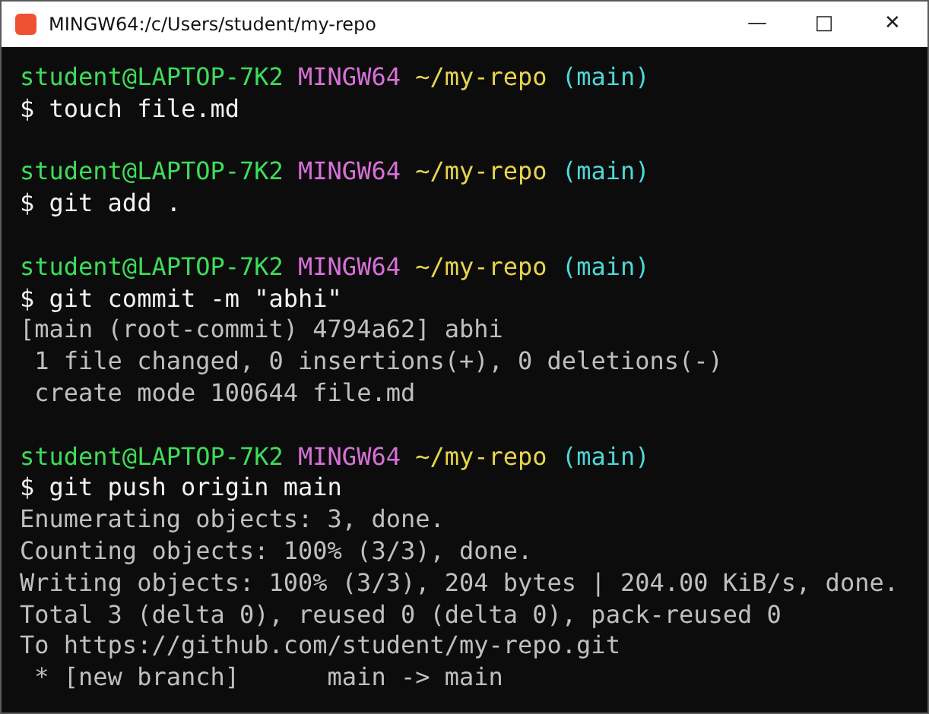

$ TEST: push to GitHub
// refresh the GitHub page: file.md aa gayi?
Notes:
Test: touch file.md, git add ., git commit -m 'abhi', git push origin main. Phir GitHub page refresh karo: file.md dikhegi. Meme: 1 star.

Slide 22
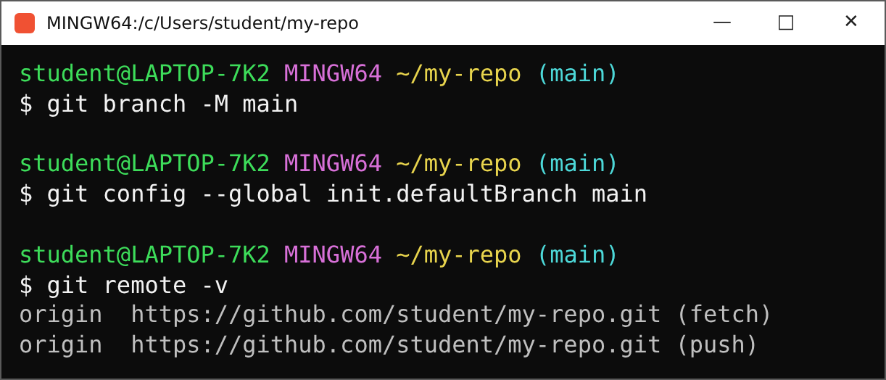
$ Branch name + remote -v
rename branch
-M main
default branch
init.defaultBranch
see remotes
git remote -v
// for info. just so you've seen it.
Notes:
Branch rename: git branch -M main. Default branch set karne ke liye git config --global init.defaultBranch main. git remote -v se remote URL dekho. For info only.

Slide 23
$ git fetch vs git pull
git pull = fetch + merge
GitHub (remote)
fetch
local repo (origin/main)
merge
your files (working dir)
git fetch
downloads new commits only
your files stay untouched
safe: look first, decide later
git pull
fetch + merge in one go
your files change right now
Notes:
Theory: git fetch sirf naye commits download karta hai, tumhari files touch nahi karta. git pull = git fetch + git merge: download karke current branch mein merge bhi kar deta hai. Pehle fetch karke dekhna safe hai.

Slide 24
$ Cheat sheet
I want to... | command
put work aside / bring back | git stash | git stash pop
bring back, keep in stash | git stash apply
name a version | git tag -a v1.0 -m "msg"
download a repo | git clone <url>
make an SSH key | ssh-keygen -t ed25519
send to GitHub | git push origin main
rename branch | git branch -M main
see remotes | git remote -v
download only | git fetch
download + merge | git pull
Notes:
Cheat sheet: session 2 ke saare commands.

Slide 25
Questions?
stashed
$ git push origin main
main -> main
tagged
next: Part 3 picks up from here
pushed
// found a bug? raise your hand (issue).
Notes:
Session 2 khatam. Questions?

