Slide 1
// part 2
Git, solo mode
mkdir
Single User Setup
first snapshot
$ git init solo-player
Initialized empty repo. No teammates. No drama.
.gitignore (HEAD)
// slides made by a developer. still buggy. still features.
Notes:
Intro: 'Ab hum Git ko akele use karna seekhenge - single user setup.' Koi team nahi, sirf tum aur tumhara laptop. Is part mein: folder banana, init, status, add, commit, log, phir .gitignore aur .gitkeep.

Slide 2
$ What we'll do today
01-why-gitignore/
02-gitignore-hands-on/
03-empty-folders-gitkeep/
By the end:
[x] start a repo from zero
[x] read git status
[x] commit = snapshot
[x] read git log --oneline
[x] hide secrets (.gitignore)
[x] keep empty folders
// TODO: make agenda prettier. (still never)
Notes:
Agenda: pehle ek naya project zero se, status padhna seekhenge, commits = snapshots, log. Phir .gitignore kyun aur kaise, aur last mein empty folders ka jugaad (.gitkeep).

Slide 3
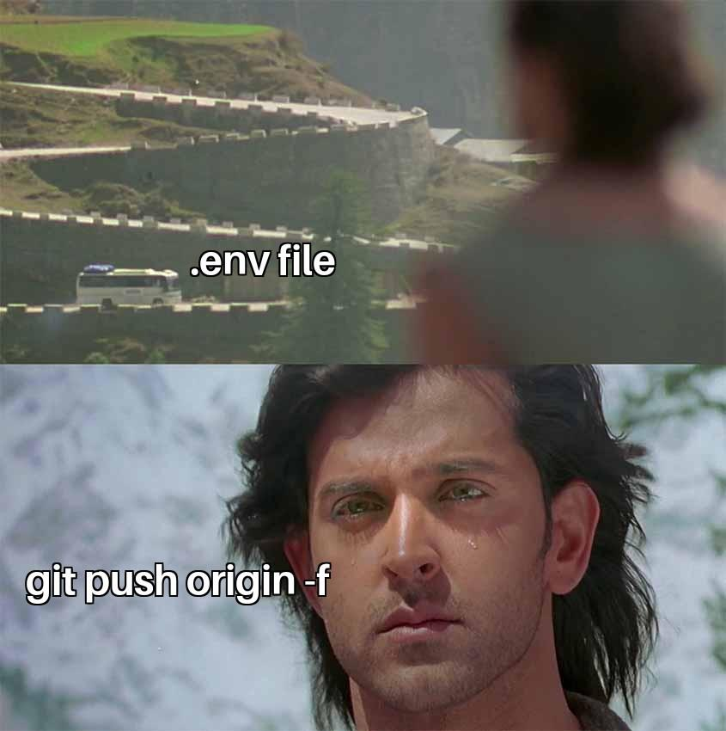
$ Why do we ignore??
bahut saare reasons ho sakte hain:
Secrets
.env, API keys,
passwords
Rebuildable junk
node_modules/,
dist/, __pycache__/
OS / editor stuff
.DS_Store,
Thumbs.db, .vscode/
Logs & big files
*.log, *.zip,
videos
kuch files secret hoti hain, ya aisa kuch
contain karti hain jo public ko nahi dikhana.
Notes:
Why do we ignore?? Bahut saare reasons ho sakte hain - maybe kuch files secret hon, ya kuch aisa contain kar rahi hon jo humein public ko nahi dikhana, jaise .env files (API keys, passwords). Phir junk jo dubara ban sakta hai (node_modules), OS ki files (.DS_Store), logs. Meme: bots GitHub pe leaked keys minutes mein dhoondh lete hain - ye real hota hai.

Slide 4
$ Problem: Git sees everything
MINGW64:/c/Users/student/solo-project
— □ ✕
Don't want these:
.env > secrets
debug.log > junk
node_modules/
> 1000s of files
student@LAPTOP-7K2 MINGW64 ~/solo-project (main)
$ ls -a
./ .env app.js index.html notes.txt
../ .git/ debug.log node_modules/ style.css
student@LAPTOP-7K2 MINGW64 ~/solo-project (main)
$ git status
On branch main
Untracked files:
(use "git add <file>..." to include in what will be committed)
.env
debug.log
node_modules/
nothing added to commit but untracked files present (use "git add" to track)
// git add . would happily commit your API key. git is not your mom.
Notes:
Ek .env file banao (API_KEY=kuch bhi), ek debug.log, ek node_modules folder. git status: sab red. Agar abhi git add . kiya toh API key bhi commit ho jaayegi. Git ko batana padega - inhe ignore karo.

Slide 5
$ Make a .gitignore
MINGW64:/c/Users/student/solo-project
— □ ✕
Pattern cheat card
.env exact file
node_modules/ whole folder
*.log every .log
!keep.log except this
# note a comment
student@LAPTOP-7K2 MINGW64 ~/solo-project (main)
$ cat .gitignore
.env
node_modules/
*.log
student@LAPTOP-7K2 MINGW64 ~/solo-project (main)
$ git status
On branch main
Untracked files:
(use "git add <file>..." to include in what will be committed)
.gitignore
student@LAPTOP-7K2 MINGW64 ~/solo-project (main)
$ git add .gitignore
student@LAPTOP-7K2 MINGW64 ~/solo-project (main)
$ git commit -m "add gitignore"
[main 7918119] add gitignore
1 file changed, 3 insertions(+)
create mode 100644 .gitignore
.gitignore itself SHOULD be
committed. it is the rulebook.
Notes:
VS Code mein project root pe nayi file: .gitignore (naam mein dot zaroori). Andar likho: .env, node_modules/, *.log. Save. git status - ab sirf .gitignore dikh raha hai, baaki gayab. .gitignore ko commit karo - ye rulebook hai, team ke saath share hona chahiye.

Slide 6
$ Oops, already committed .env?
MINGW64:/c/Users/student/solo-project
— □ ✕
student@LAPTOP-7K2 MINGW64 ~/solo-project (main)
$ git rm --cached .env
rm '.env'
student@LAPTOP-7K2 MINGW64 ~/solo-project (main)
$ echo ".env" >> .gitignore
student@LAPTOP-7K2 MINGW64 ~/solo-project (main)
$ git add .gitignore
student@LAPTOP-7K2 MINGW64 ~/solo-project (main)
$ git commit -m "stop tracking .env"
!
Already pushed?
Change (rotate) that key.
Deleting the file does NOT
delete it from old commits.
--cached = remove from Git,
keep the file on your laptop.
// .gitignore only works for files git is NOT already tracking
Notes:
Common galti: .env pehle hi commit ho gaya. .gitignore mein daalne se kuch nahi hoga, kyunki Git usse already track kar raha hai. Fix: git rm --cached .env (Git se hatao, laptop pe rehne do), .gitignore mein daalo, commit. Agar push ho chuka hai, toh key badlo - purane commits mein woh abhi bhi hai.

Slide 7
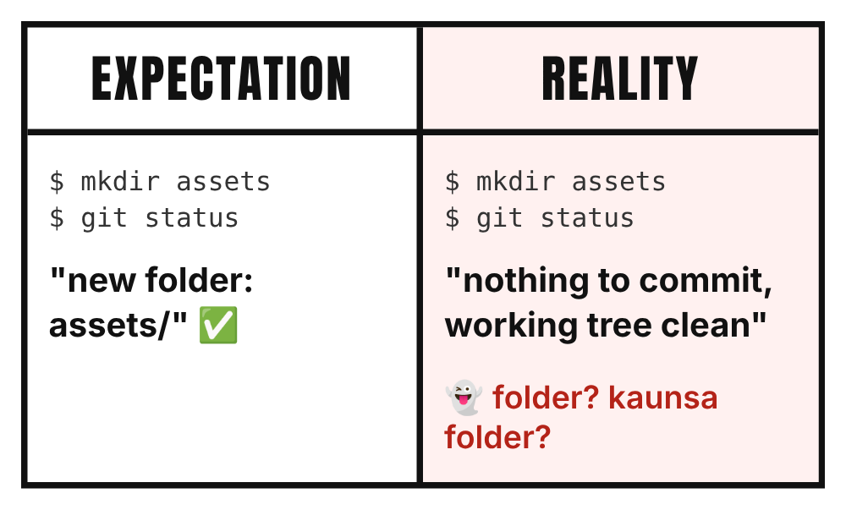
$ Tracking empty folders
MINGW64:/c/Users/student/solo-project
— □ ✕
student@LAPTOP-7K2 MINGW64 ~/solo-project (main)
$ mkdir assets
student@LAPTOP-7K2 MINGW64 ~/solo-project (main)
$ git status
On branch main
nothing to commit, working tree clean
student@LAPTOP-7K2 MINGW64 ~/solo-project (main)
$ touch assets/.gitkeep
student@LAPTOP-7K2 MINGW64 ~/solo-project (main)
$ git status
On branch main
Untracked files:
(use "git add <file>..." to include in what will be committed)
assets/
Git tracks files, not folders.
empty folder = invisible.
Notes:
mkdir assets, git status - 'nothing to commit, working tree clean'. Git ko empty folder dikhta hi nahi, kyunki Git sirf files track karta hai. Fix: andar ek khaali file daal do - touch assets/.gitkeep. Ab git status mein assets/ dikhega.

Slide 8
$ .gitkeep to the rescue
solo-project/
|-- assets/
| `-- .gitkeep <- empty file
|-- .gitignore
|-- app.js
|-- index.html
`-- style.css
What is .gitkeep?
Just a name people agreed
on. NOT a Git feature.
Any file works. .gitkeep
just tells humans:
"keep this folder"
$ touch assets/.gitkeep
$ git add assets/.gitkeep
$ git commit -m "track empty assets folder"
Notes:
.gitkeep koi special Git file nahi hai - sirf convention hai. Koi bhi file daal do folder track ho jaayega, .gitkeep naam se sabko samajh aa jaata hai ki ye bas folder ko zinda rakhne ke liye hai. touch, add, commit.

Slide 9
$ Cheat sheet
I want to... | command
start a repo | git init
what's going on? | git status
stage everything | git add .
take a snapshot | git commit -m "msg"
short history | git log --oneline
ignore files | add them to .gitignore
stop tracking a file | git rm --cached <file>
keep an empty folder | folder/.gitkeep
Notes:
Cheat sheet - photo le lo. Roz ka routine: status, add, commit, log.

Slide 10
Questions?
first commit
$ git commit -m "single user done"
[main 1a2b3c4] single user done
add gitignore
next: branches, merges, undo & teamwork
single user done
// found a bug? raise your hand (issue).
Notes:
Single user part khatam. Questions? Next: branches, merge, conflicts, undo, aur team ke saath kaam (issues, PRs).

