Slide 1
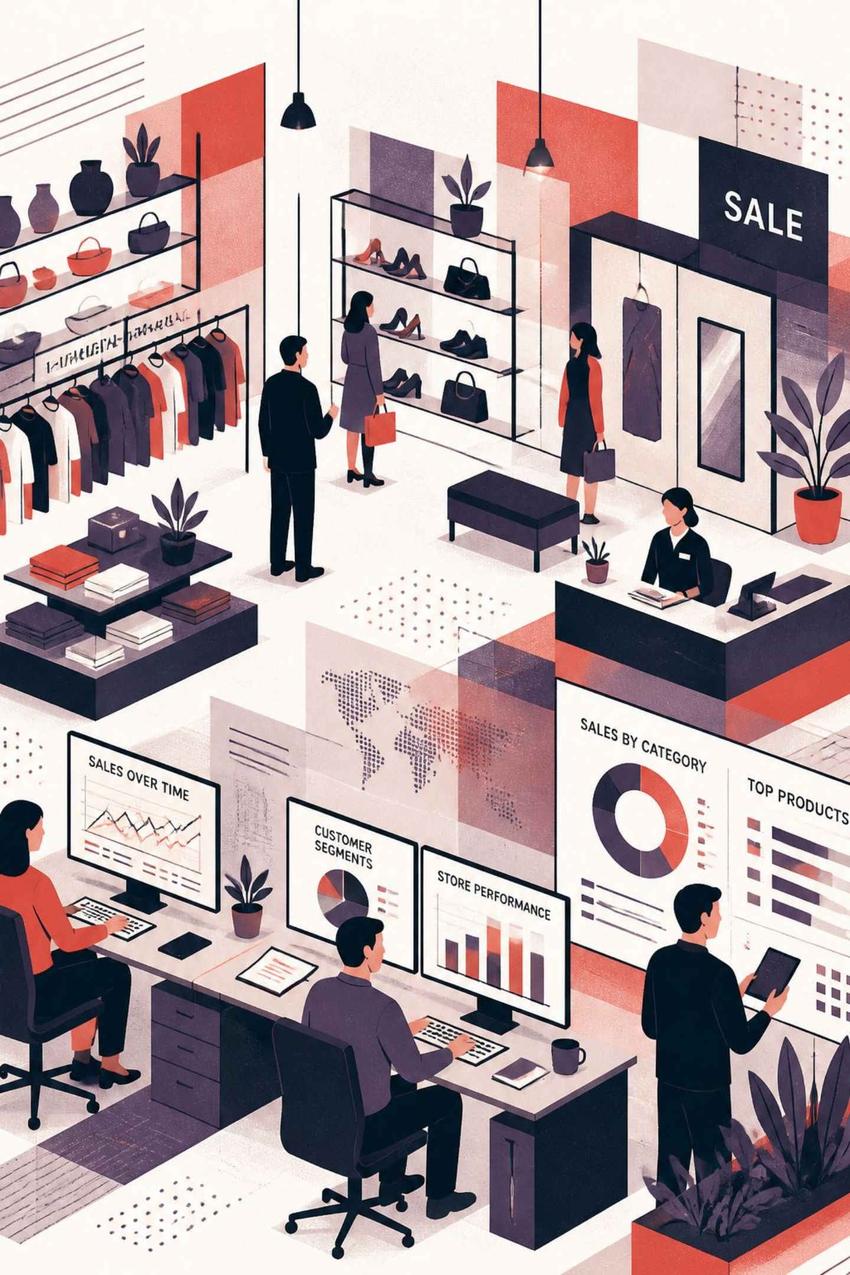
Customer Shopping Behavior Analysis
Business Analyst Portfolio Project
NISHIKA

Slide 2


Problem Statement & Business Question
Business Context
Primary Objectives
A retail company seeks to understand customer shopping behavior patterns across demographics, product categories, and purchase channels to drive strategic decision-making.
Improve overall sales performance and revenue growth
Increase customer satisfaction through data-backed insights
Strengthen customer loyalty and reduce churn
Key Question: How can we leverage shopping transaction data to identify actionable trends and optimize marketing strategy?

Slide 3
Dataset Overview
Dataset Structure
Data Quality Summary
3,900
Metric
Value
Total Transactions
3,900
Transactions
Total Columns
18
Total records analyzed
Missing Values
37
18
Data Completeness
99.05%
Missing values are isolated to the Review Rating column (0.95% of records) — minimal impact on analytical integrity.
Columns
Attributes per record
99%
Completeness
Only 37 missing values
Key Data Fields
Demographics
Purchase
Age, Gender, Location
Category, Amount, Season
Behavior
Subscription, Discount, Shipping

Slide 4



Methodology: 3-Step Analytical Workflow
This project follows a structured end-to-end analytical pipeline — from raw data ingestion to executive-ready visualization — using three industry-standard tools in sequence.
Step 1 — Python
Step 2 — SQL / PostgreSQL
Step 3 — Power BI
Data cleaning, feature engineering, exploratory data analysis, and statistical summaries using pandas and matplotlib.
Business queries, revenue aggregations, customer segmentation logic, and cohort analysis using structured relational queries.
Interactive dashboard development, KPI card visualization, and dynamic filtering for stakeholder-ready insights presentation.
Each tool handles a distinct layer of the workflow — Python for preparation, SQL for querying, Power BI for communication.

Slide 5
Data Cleaning Highlights
Cleaning Steps Performed
Feature Engineering
1
Missing Value Imputation
Age Group Bins
Applied category-wise median imputation for the 37 missing Review Rating values — preserving segment-level accuracy rather than using a global mean.
Created categorical age_group segments (e.g., Young Adult, Middle-Aged) to enable demographic cohort analysis.
2
Column Standardization
Purchase Frequency Days
Converted all 18 column headers to consistent snake_case format for downstream SQL compatibility and code readability.
Engineered purchase_frequency_days field to quantify recency and identify high-frequency buyer patterns.
3
Redundancy Removal
Validation & Deduplication
Identified and dropped the promo_code_used column, which was fully redundant with the discount applied field.
Verified all data types matched expected schemas and confirmed zero duplicate transaction records in the final dataset.

Slide 6
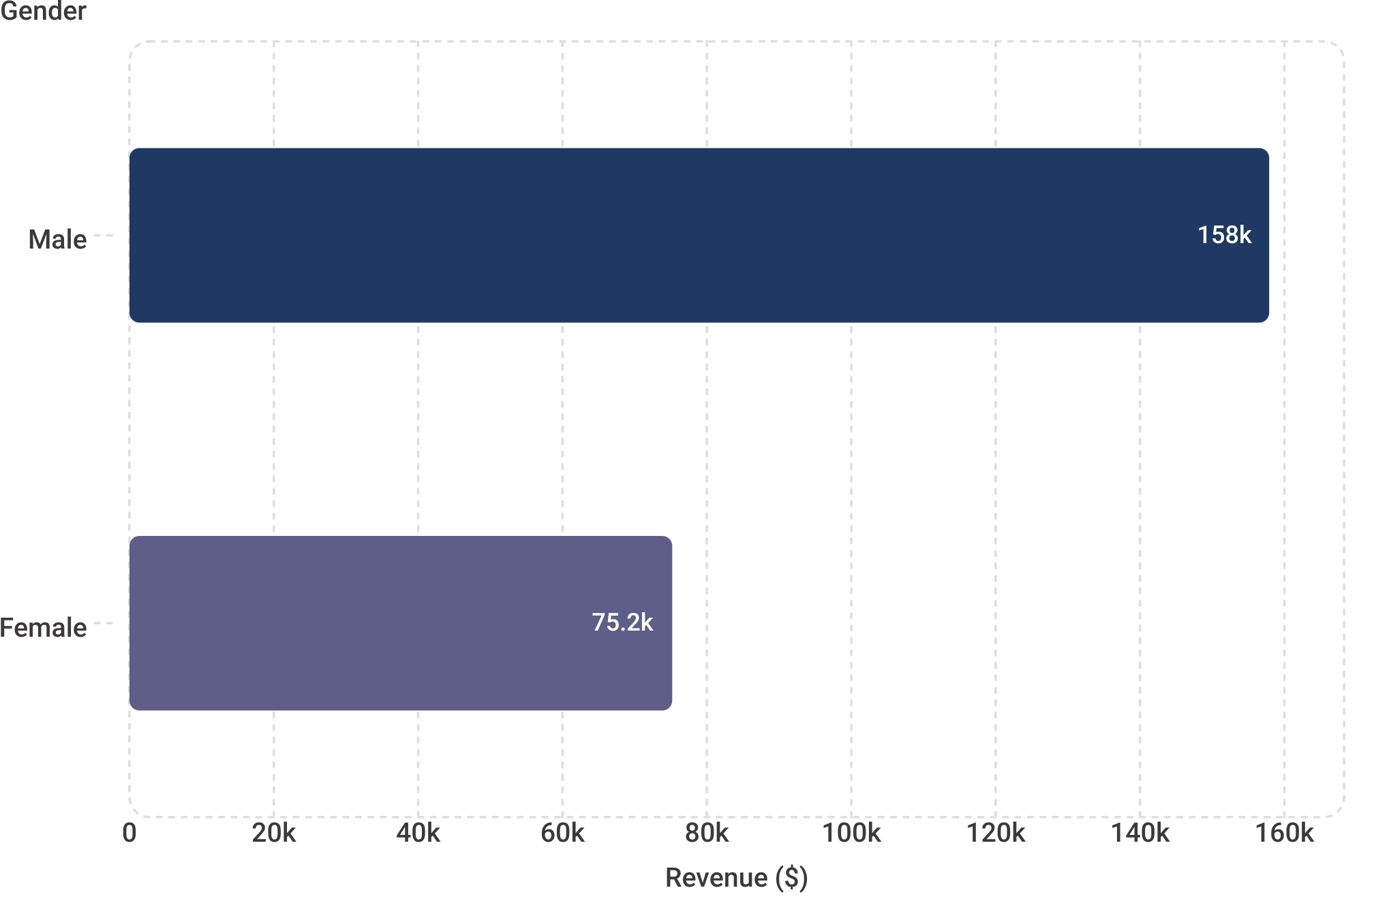
Revenue by Gender
Gender Revenue Breakdown
$157K
Male Revenue
67.7% of total
$75K
Female Revenue
32.3% of total
2.1× Revenue Multiplier
Male customers generate more than double the revenue of female customers — a statistically significant disparity warranting targeted strategy.
Marketing Implication
Female segment may represent an underserved growth opportunity. Tailored campaigns could substantially close the revenue gap.

Slide 7
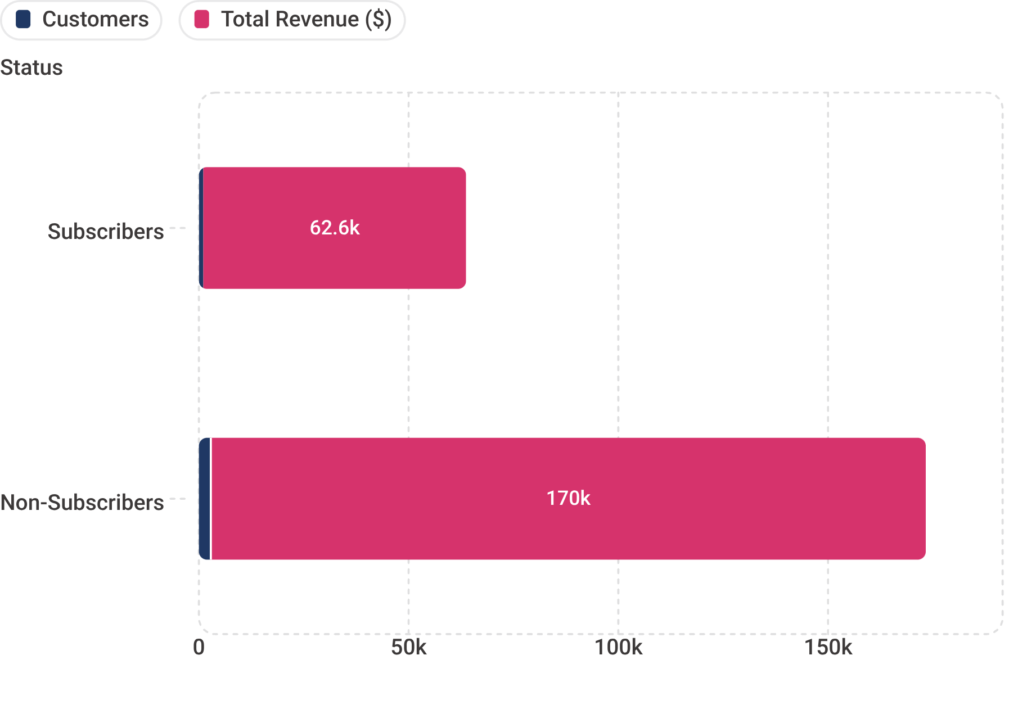
Subscribers vs. Non-Subscribers
Key Findings
Metric
Subscribers
Non-Subscribers
Customers
1,053
2,847
Total Revenue
$62,645
$170,436
Avg Spend
$59.49
$59.87
Revenue Share
27%
73%
Strategic Opportunity: Average spend is nearly identical across both groups — meaning subscription conversion is a volume play, not a spend-behavior change.

Slide 8
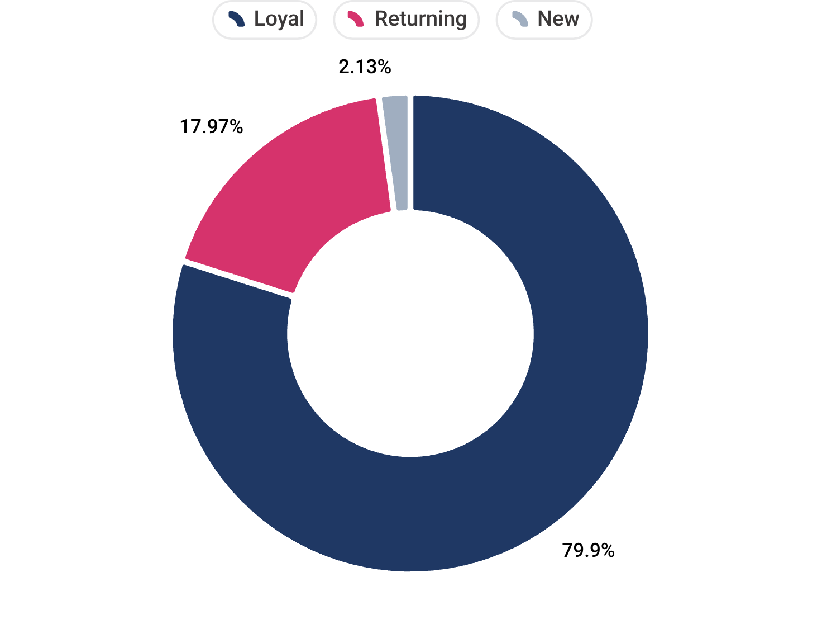
Customer Segmentation
Segment Profiles
Loyal — 3,116 (79.9%)
Returning — 701 (18.0%)
Repeat purchasers with highest lifetime value. Core revenue engine of the business. Priority retention segment.
Occasional repeat buyers. Key conversion target — incentives and personalized outreach can accelerate loyalty transition.
New — 83 (2.1%)
First-time purchasers. Small but strategically important — onboarding experience determines long-term retention trajectory.
Conversion Strategy: Design a deliberate funnel — New → Returning → Loyal — using targeted engagement at each stage.

Slide 9
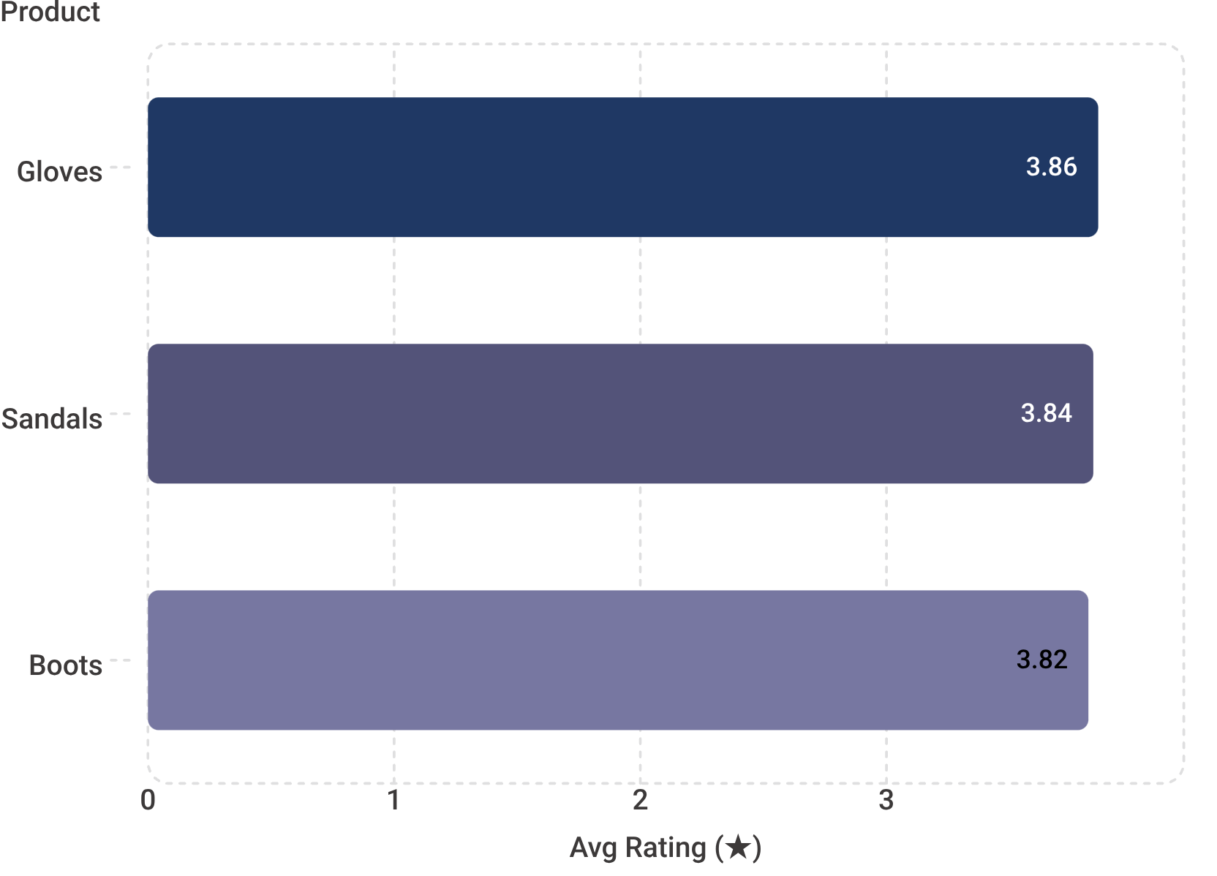
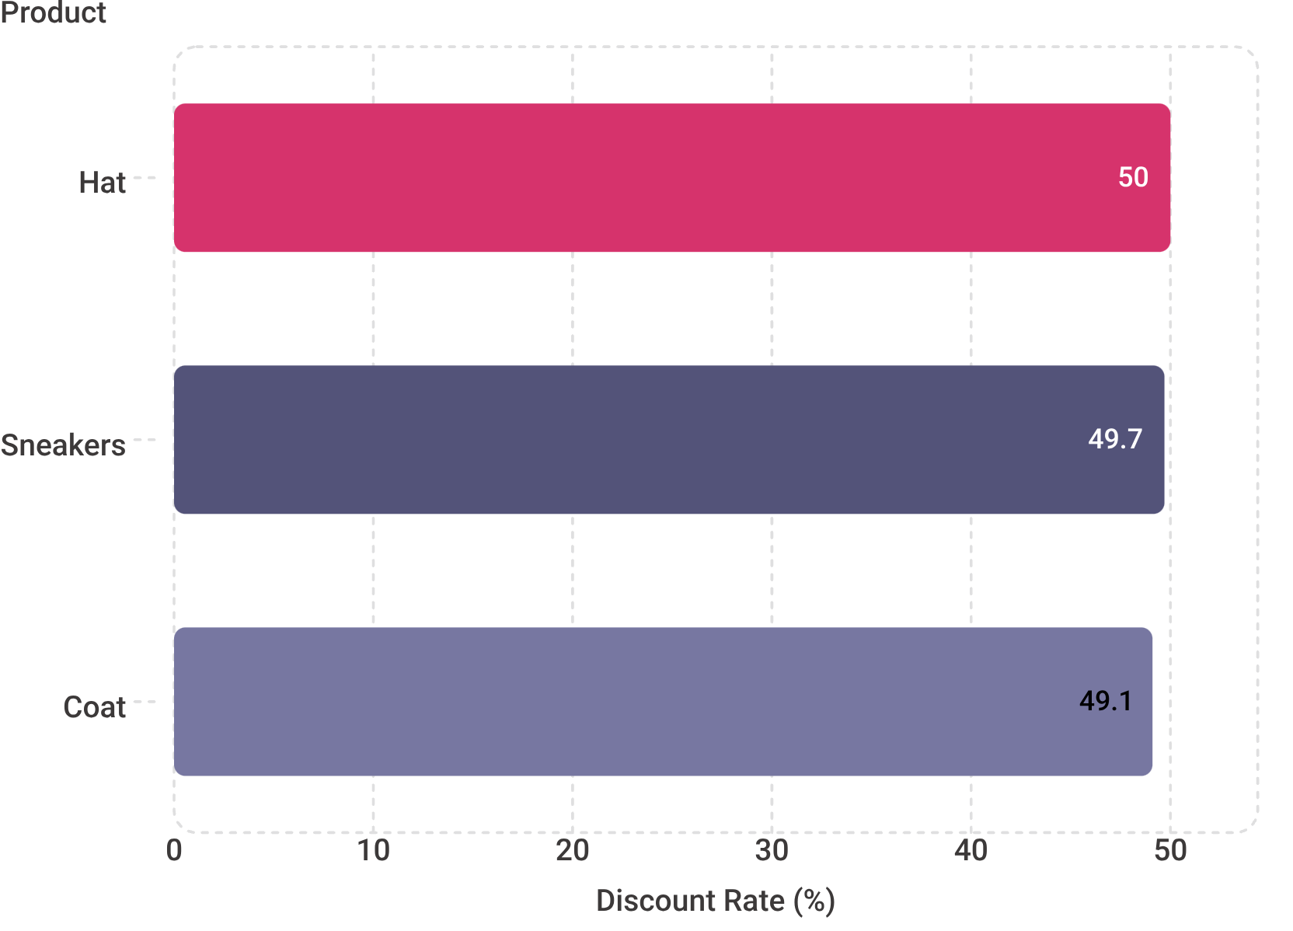
Top Products & Discount Dependency
Top-Rated Products (Avg Star Rating)
Most Discount-Dependent Items (%)
Key Insight
Recommendation
Premium-rated products (Gloves, Sandals, Boots) maintain customer satisfaction without heavy promotional pricing — signaling strong organic demand.
Reduce discount dependency on Hat, Sneakers, and Coat. Test margin-protective pricing while monitoring volume impact and rating trends.

Slide 10
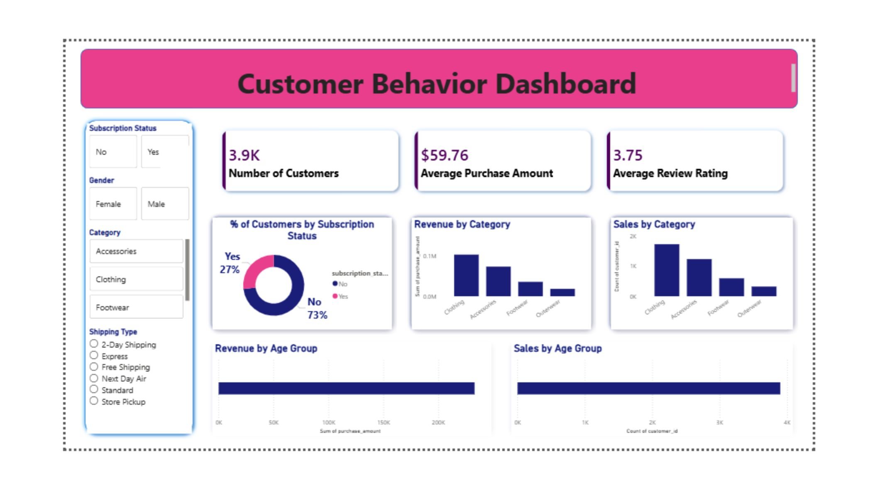
Power BI Dashboard
3.9K
$59.76
Total Customers
Avg Purchase
Analyzed across all segments
Per transaction amount
3.75
27%
Avg Rating
Subscription Rate
Customer review score
Share of active subscribers

Slide 11

Business Recommendations
Five data-driven strategic actions derived from SQL findings, segmentation analysis, and behavioral patterns across 3,900 transactions.
Boost Subscriptions
Loyalty Programs
Review Discount Policy
Promote exclusive member benefits, early access, and personalized offers. Conversion at current avg spend levels directly scales revenue.
Reward repeat buyers with tiered incentives to accelerate Loyal segment growth and increase customer lifetime value.
Strategically reduce reliance on deep discounts for Hat, Sneakers, and Coat. Balance promotions with margin protection goals.
Product Positioning
Targeted Marketing
Feature top-rated items — Gloves, Sandals, Boots — prominently in campaigns and homepage placements to leverage organic demand signals.
Prioritize Young Adults and Express-shipping users, identified as highest-revenue cohorts, in paid acquisition and retention efforts.
All recommendations are directly traceable to SQL query outputs and segmentation findings — no assumptions beyond the data.

Slide 12
THANKYOU

