Slide 1
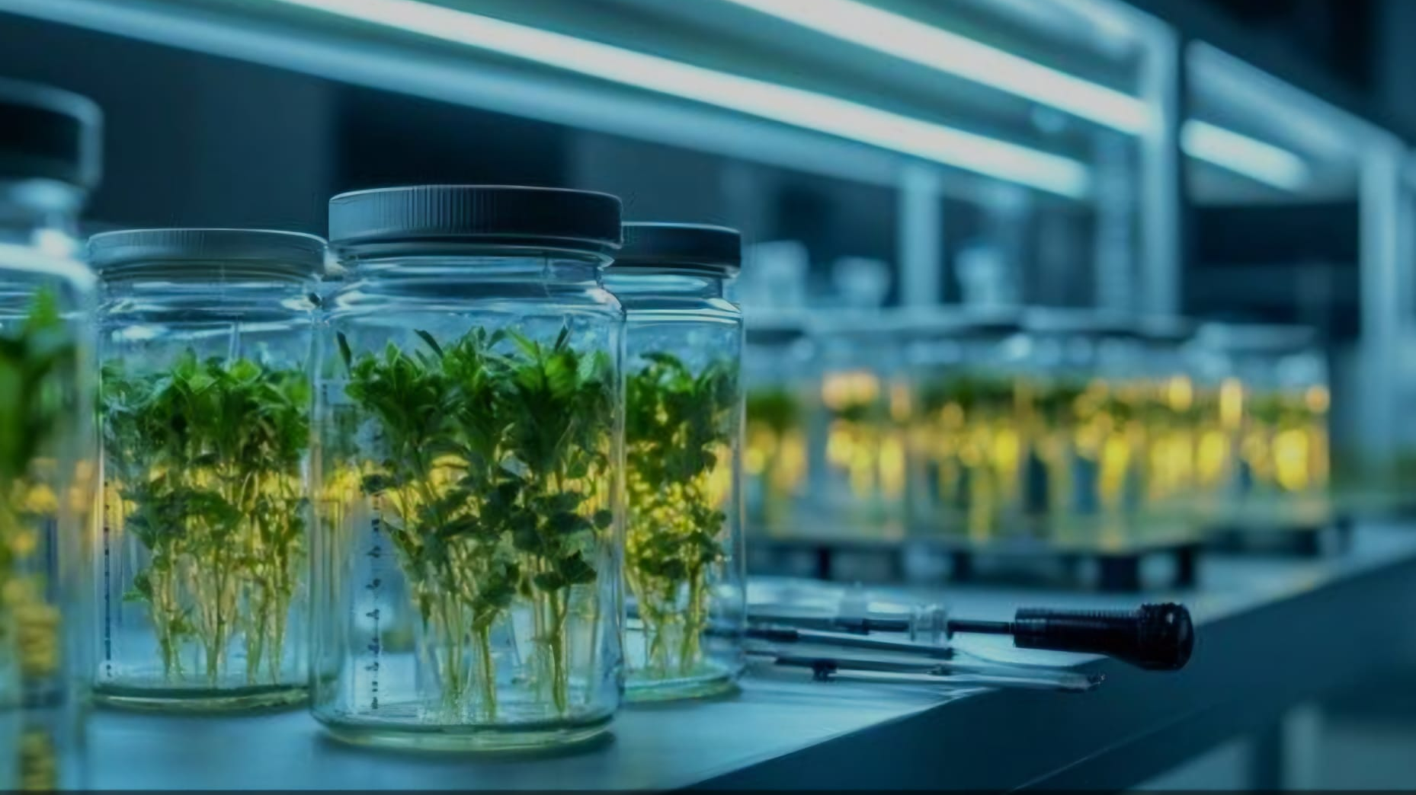
Plant tissue culture
Present by: Nishita Kachhadiya

Slide 2
Introduction
Title: Identifying Optimal Growth Regulator Combinations in Plant Tissue Culture
Plant tissue culture is a powerful method for propagating plants, preserving endangered species, and producing genetically uniform plants. However, current methods face key challenges:
Contamination during the culture process
Soma clonal variation affecting plantlet consistency
Dependence on growth regulators, with inconsistent outcomes across different species.
Research Gap: Despite its importance, the precise effects of various auxin-cytokinin combinations on contamination control and tissue uniformity remain inadequately explored. Identifying the best combinations can significantly improve plant tissue culture reliability.
Objective: This study aims to optimize the use of auxins and cytokinins to reduce contamination rates, improve tissue homogeneity, and enhance plantlet growth in tissue cultures, making these techniques more reliable for agriculture, horticulture, and conservation.

Slide 3
Aims of the Study
Specific Aims
Evaluate the impact of auxin-cytokinin combinations on contamination rates.
Assess the influence of growth regulators on tissue homogeneity and plantlet growth.
Compare the growth outcomes across multiple plant species.

Slide 4
Experimental Design
Methods
Step 1: Optimize sterilization techniques to ensure minimal contamination.
Step 2: Test varying concentrations and combinations of auxins and cytokinins across different species.
Step 3: Measure plantlet growth rates, contamination levels, and tissue uniformity.
Control Group: Tissue culture without growth regulators.

Slide 5
Expected Outcomes and Impact
Expected Outcomes: Reduced contamination and improved plantlet homogeneity.
Identification of the most effective growth regulator combinations for specific plant species.
Enhanced applicability in horticulture, agriculture, and conservation​.

Slide 6
Conclusion
This study will address critical limitations in plant tissue culture by refining the use of growth regulators, ultimately improving propagation techniques for research and practical applications.

Slide 7
Thank you

