Slide 1
EECS 767 - Information Retrieval
Web Search Engine
Data Devils -
Nishil Parmar
Shruti Goel
Guided by -
Dr. Bo Luo
May 2, 2018

Slide 2
Contents
Architecture
Web Crawler
Preprocessing & Tokenization
Inverted Index & Vector Space Model
Demo
Q & A

Slide 3
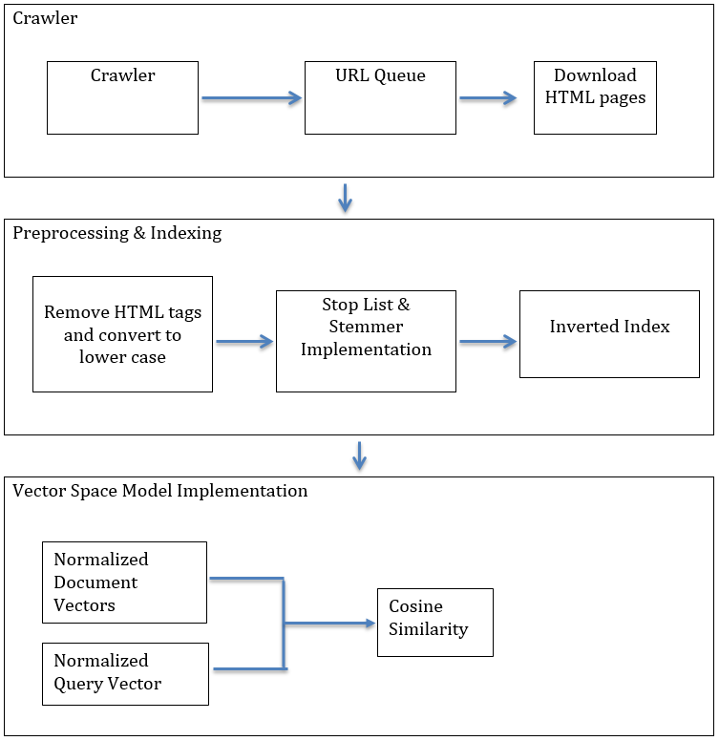
Search Engine Architecture
Programming Language used: Python 3.6.5

Slide 4
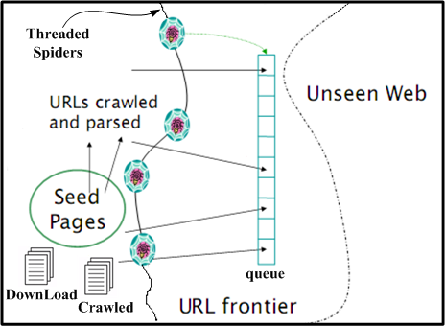
Web Crawler
Seed = ‘https://techcrunch.com/’
Crawler Features:
Multi-threaded
Polite
Scalable
Domain restricted
URLs are normalized to absolute URLs
source: EECS767 IR Course Documents
Notes:
a). The urls to crawl are stored in queue
b). The crawled urls are stored in Crawled
c). For crawled urls, the page source is
downloaded and url is stored in DownLoad
Crawled 1029 web pages, and feed using 401 valid web pages to the search engine.

Slide 5
Preprocessing & Tokenization
Preprocessing and Tokenization for each Document:
Remove the HTML tags
Excluding punctuations and special characters
Convert into lower case
Using NLTK package to:
Remove Stop Words
Potter Stemmer
Preprocessing for Query
Handled in same way as documents

Slide 6
Indexing
Indexing
DS used Dictionary of Lists
Pickle serializes index DS into byte stream file
Index can be loaded back into memory easily
index = {term0:[df, tf(all), posting_list],...}
posting_list = {‘file1’: [[positons1],tf],...}

Slide 7
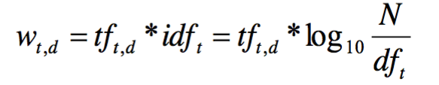
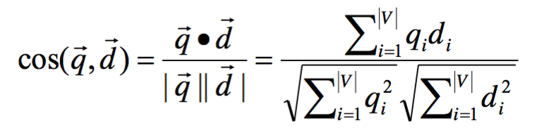
Vector Space Model
TF-IDF normalized vector
Normalized Query vector
Cosine Similarity

Slide 8
Statistics
Documents crawled: 2934
Dictionary Size: 23k words
Index size: 16 MB
Document Vectors: 15 MB
Time to build vectors and Index: 17 Mins

Slide 9
Future Modifications
Term Proximity
Positions already available in the Index!
Web Interface – In progress
Using Django

Slide 10
Demo

Slide 11
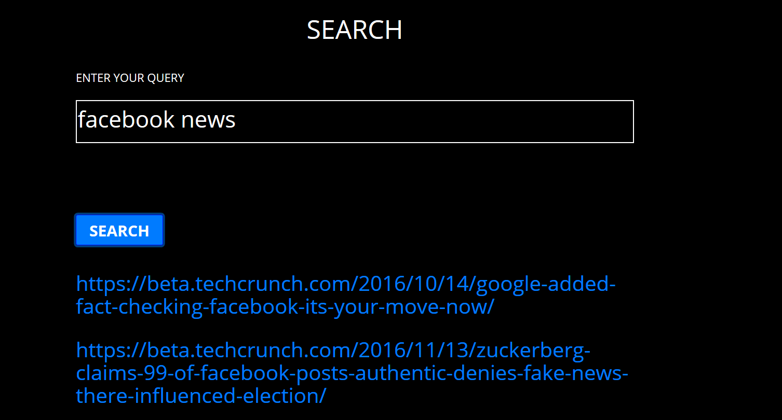
Demo

Slide 12
Questions ?
Thank you!

