Slide 1
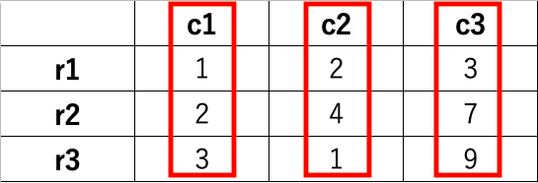
DataFrame
columns
index
series
series
series

