Slide 1


EMLR-GIKONDO Cathedral Parish
Digital Media & Live Streaming Project Proposal

Slide 2

General Objective: Professional Production
The Core Goal
The general objective of this project is to establish a fully operational live streaming and digital media system that supports the church’s activities of evangelism, discipleship, and community service through professional-quality production and distribution.
This project aims to establish a professional live streaming and digital media platform for EMLR–Gikondo Cathedral Parish to expand outreach, improve service quality, support members who cannot attend physically, and build a strong foundation for long-term digital growth and engagement.
Support evangelism, discipleship, and community service.
Ensure consistent and message delivery.
Expand the church's reach to a wider community.

Slide 3
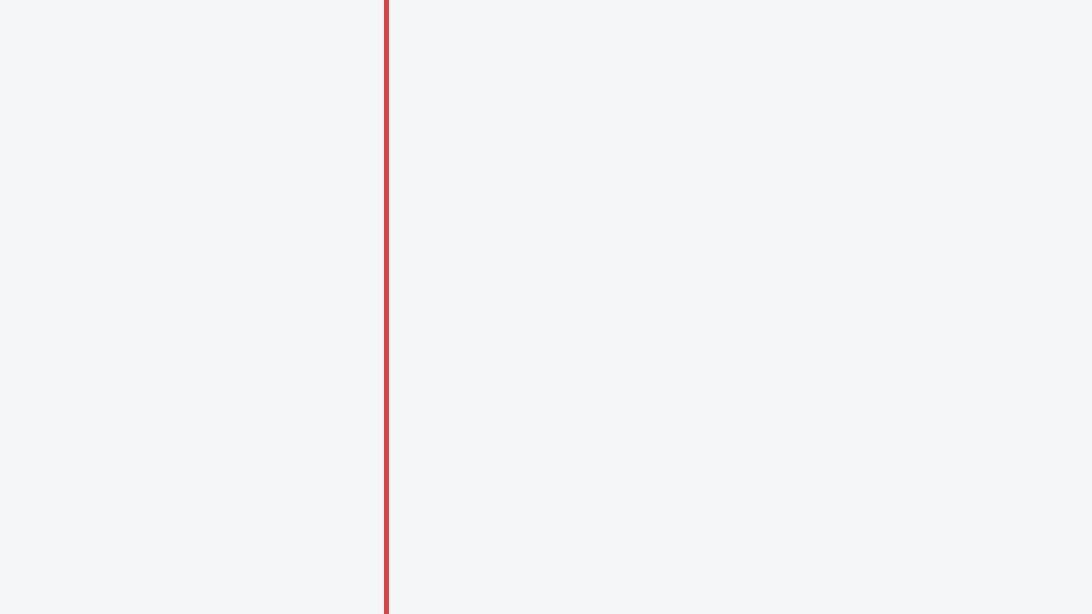
Main objectives of Live streaming project
▪
Broadcast services and events in high quality.
This ensures church services, conferences, and special programs are delivered clearly and professionally, enhancing viewer engagement and credibility.
Digital ministry initiative for EMLR–Gikondo Cathedral Parish.
▪
Reach members beyond physical location
“Go into all the world and preach the Gospel to all creation.” (Mark 16:15)
Live streaming allows members who are traveling, sick, working, or living abroad to stay spiritually connected to the church.
▪
Live streaming allows EMLR–Gikondo Cathedral Parish to:
Preach beyond walls.
Reach beyond Kigali.
Impact beyond Rwanda.
Share the Gospel globally
Digital platforms enable the church to spread the message of Christ
beyond Kigali and Rwanda to audiences worldwide.
▪
Ensuring Long-term Spiritual Growth
A structured digital ministry builds sustainable engagement, consistent teaching access, and stronger long-term faith development among members.

Slide 4
Benefits :Key Benefits of Live streaming projects
01
Expand evangelism.
Live streaming multiplies outreach by taking the Gospel beyond church walls to local, national, and global audiences in real time and on replay.
Live streaming enables the church to share the Gospel beyond physical walls, reaching people locally and worldwide, including those unable to attend in person, while fulfilling Christ’s command in Mark 16:15, Matthew 28:19–20, and Acts 1:8 to preach to all nations and be witnesses to the ends of the earth.
02
Strengthen member connection.
Online access keeps members spiritually engaged and informed even when distance, illness, or work prevents physical attendance.
03
Empower youth.
The project creates opportunities for young people to serve, develop technical skills, and actively participate in modern ministry.
04
Create income opportunities.
Digital platforms open pathways for online giving, monetization, event broadcasting services, and partnership sponsorships.

Slide 5
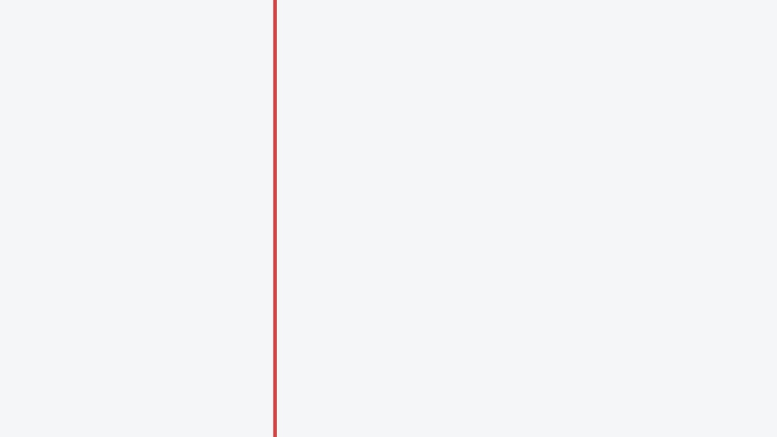
Estimated Budget for Live Streaming Equipment – EMLR Gikondo Cathedral Parish
Long-Term Sustainability & Technical considerations
Item Name | Specification | Quantity | Price (Rwf)
DSLR Camera | Canon R with | 1 | 2,500,000
Lens | Wide lens 24-105mm | 1 | 800,000
Streaming Camera | Black magic 6k Pro | 1 | 3,000,000
Camera lens | Sigma 28-105mm f/2.8 DG DN Art (L-Mount) | 1 | 800,000
Tripod | Live streaming camera tripod | 2 | 300,000
Lightings | Zsyb light | 2 | 800,000
Video capture |  | 2 | 80,000
HDMI Splitter | 4 ports | 1 | 50,000
HDMI cables | 30 meters for camera | 2 | 100,000
The selected equipment ensures professional-quality video and audio production.
The system is scalable and allows future expansion (additional cameras or streaming upgrades).
Proper installation and training will maximize performance and durability.
This investment supports long-term digital evangelism and church growth.
High-quality production enhances viewer trust, engagement, and retention during online services and events.

Slide 6
Long-Term Sustainability & Technical considerations
Estimated Budget for Live Streaming Equipment – EMLR Gikondo Cathedral Parish
HDMI cables | 50 meters for Projection Screens | 2 | 140,000
Screen | Projection screen | 2 | 1,100,000
Soundcard | Behringer |  | 300,000
Computer | Laptop i7, 1TB SSD, 32GB RAM, NVidia Graphic card | 1 | 1,000,000
Router | 4G internet router | 1 | 50,000
Headphones |  | 1 | 80,000
Field vest | Dressing coats | 6 | 120,000
Screen wall mount |  | 2
Total |  |  | 11,220,000
The project creates opportunities for training and developing an internal media team, reducing dependency on external service providers.
Investing in durable, professional-grade equipment reduces long-term maintenance and replacement costs.
Proper installation and training will maximize performance and durability.
This investment supports long-term digital evangelism and church growth.
Total Investment
11,220,000 Rwf

Slide 7

▪
Strategic Growth
Expanding the church's capacity to communicate and reach broader audiences.
Investing in the Future of Free Methodist Church
▪
Spiritual Impact
Integrating digital tools to foster deeper spiritual growth among members.
A strategic commitment to digital excellence and spiritual outreach.
▪
Sustainability
Ensuring the church remains relevant and impactful in the modern digital era.

