Slide 1
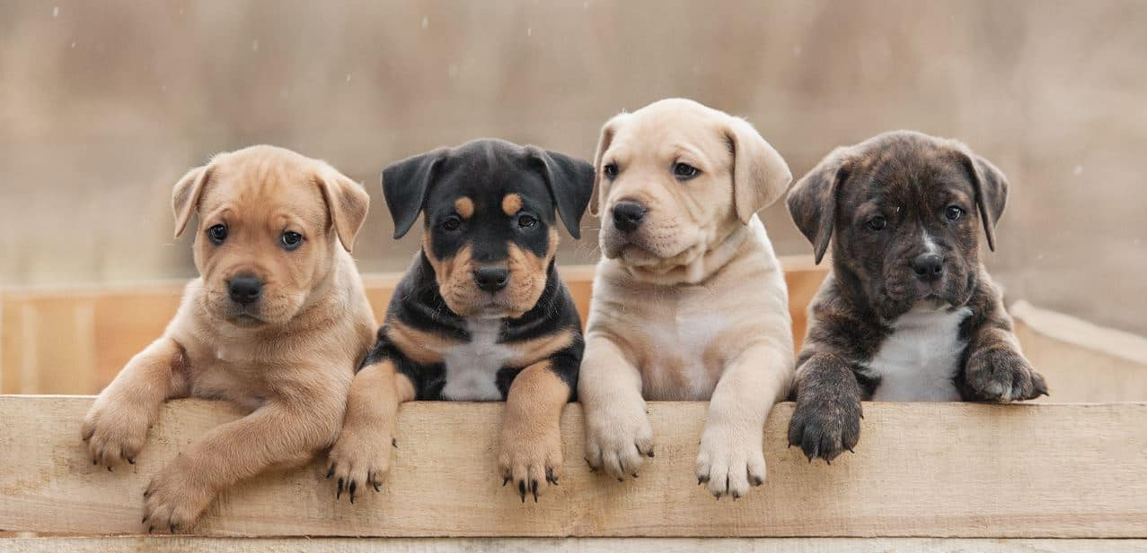
FurrFect
Anay Abhijit Joshi Nishit Grover
Pet Social Media and Health-Care Platform

Slide 2
FurrFect at a Glance: Team, Advisor, & Overview
Anay Abhijit Joshi ( joshi2an@mail.uc.edu )
Nishit Grover ( grovernt@mail.uc.edu )
FurrFect is a specialized social media blog app designed for pet owners and enthusiasts. The platform allows users to share daily moments of their pets' lives, access pet healthcare information, browse adoption resources, find veterinary services, and manage their pets' appointments.
FurrFect aims to foster a supportive community where users can engage with others, exchange pet care tips, and ensure their pets remain healthy and happy.
Professor Nitin Nitin ( nitinfu@ucmail.uc.edu )

Slide 3
Vision & Objectives: Pioneering Pet Care Innovation
FurrFect is designed to revolutionize the pet owner community by providing a dedicated social media platform where users can seamlessly share cherished pet moments while accessing critical resources for pet healthcare, adoption, and veterinary services. Our goal is to build an engaging, supportive ecosystem that empowers pet lovers with timely expert advice, interactive community features, and cutting-edge technology, ensuring every pet receives the best care and attention.
Leveraging a robust tech stack that includes React.js, Node.js, MongoDB, and AWS, FurrFect delivers a highly responsive and secure user experience. By integrating third-party APIs and employing JWT-based authentication, we not only ensure seamless data flow and real-time updates but also prioritize user privacy and safety. This project embodies our commitment to innovation and community-driven excellence, setting a new standard in pet care and social connectivity...

Slide 4
Innovative Edge: Breaking New Ground in Pet Tech
FurrFect represents a pioneering fusion of social media and pet care, offering an innovative approach to community building for pet owners. The project leverages advanced API integrations, a robust JWT-based authentication system, and real-time data processing to create an engaging and secure user experience. Our design not only emphasizes aesthetic and usability in the UI/UX but also integrates critical pet care functionalities, positioning FurrFect as a novel solution in the pet tech space.
By merging social interaction with vital pet healthcare resources, FurrFect sets a new standard in digital pet care innovation. The application’s architecture, built on a modern tech stack including React.js, Node.js, and MongoDB, exemplifies cutting-edge methods in scalable and efficient software design. This interdisciplinary approach showcases our commitment to both technical excellence and a deep understanding of pet owner needs, thereby contributing original insights and methodologies to the field.

Slide 5
Societal Benefits: Enhancing Pet Wellness & Community Connectivity
FurrFect not only connects pet owners but also cultivates a supportive ecosystem that enhances community well-being and animal care. By centralizing essential pet healthcare information, adoption resources, and veterinary services, the platform empowers users to make informed decisions that directly benefit the health and happiness of their pets. This, in turn, contributes to reducing the strain on traditional veterinary services and promotes preventive care within communities.
Moreover, FurrFect fosters social inclusion by providing a dedicated space for pet enthusiasts to share experiences and advice, thereby strengthening community bonds and emotional support networks. The platform's innovative integration of technology and pet care resources paves the way for future initiatives aimed at improving animal welfare and public health, positioning it as a catalyst for positive societal change in the realm of pet care and beyond.

Slide 6
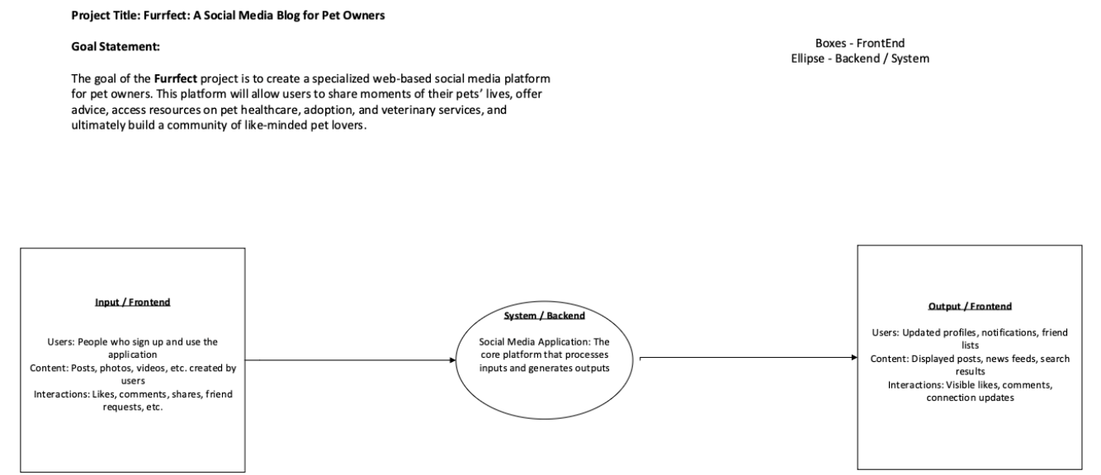
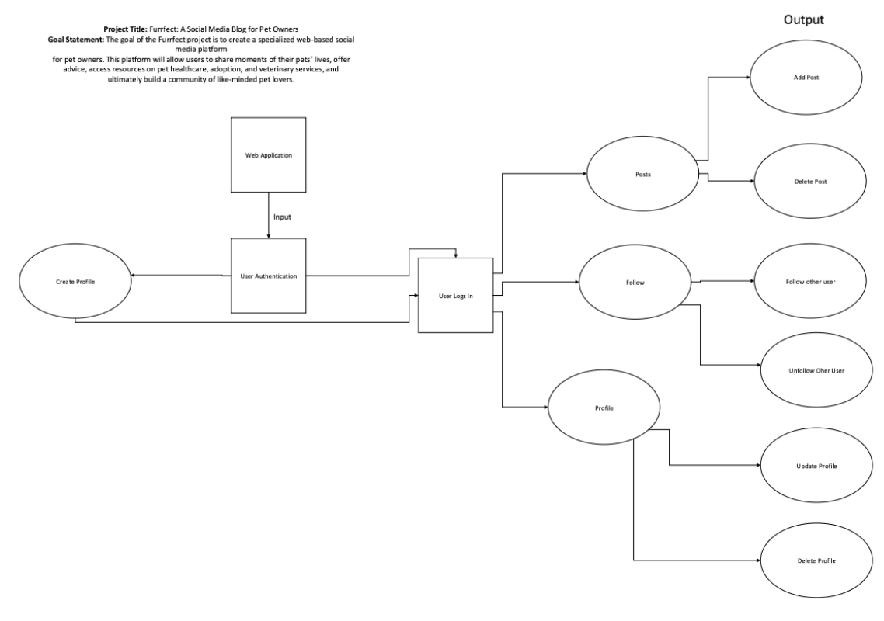
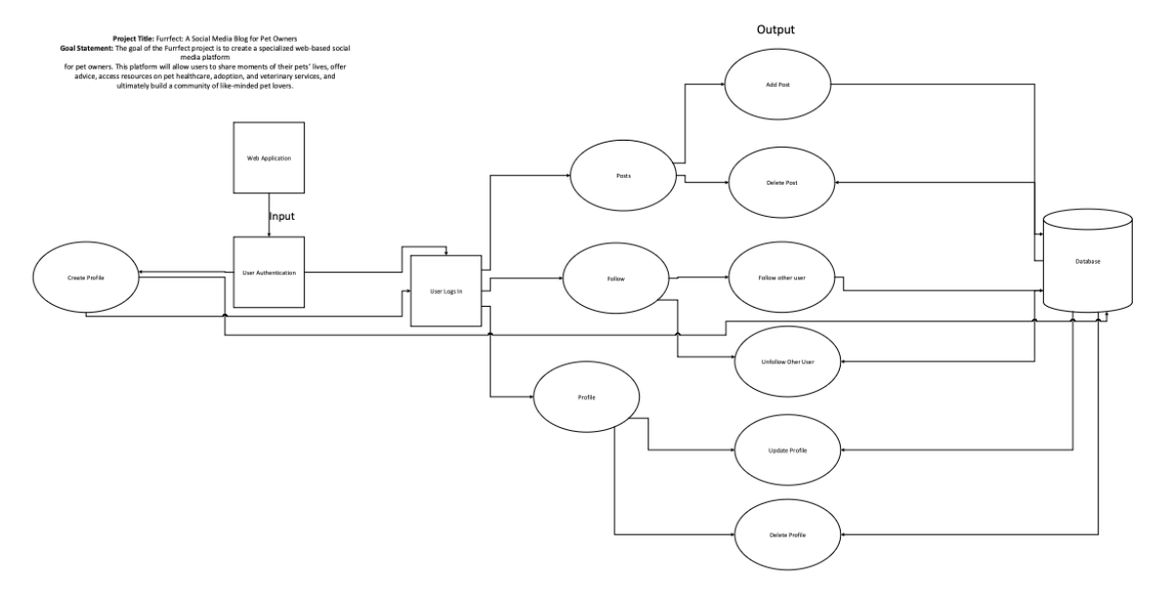
Architecture Unveiled: System Overview & Design Mastery

Slide 7
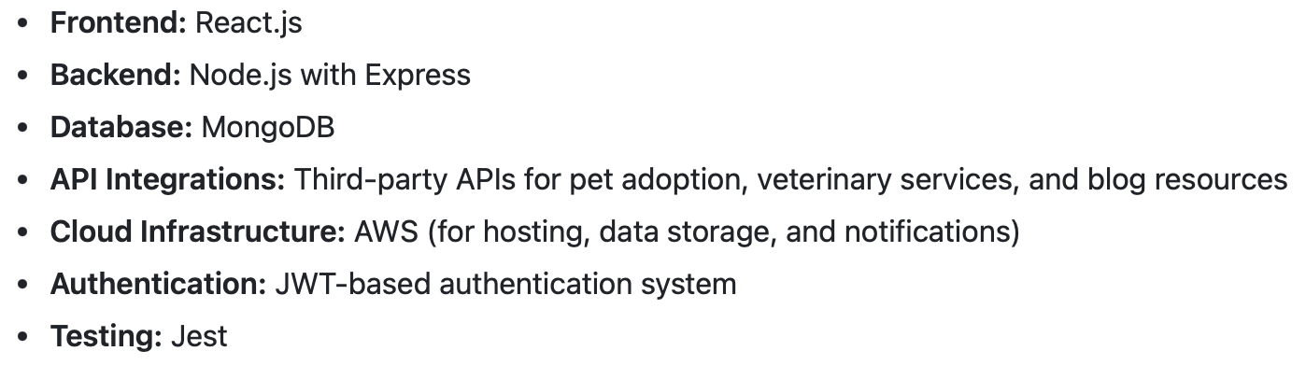
Cutting-Edge Technologies: Powering the Future of Pet Social Media
FurrFect is built using a modern and robust technology stack that seamlessly integrates both front-end and back-end components. The front-end is developed with React.js, ensuring a dynamic, responsive, and user-friendly interface that adapts well across devices. On the server side, Node.js with Express forms the backbone of our RESTful API, enabling efficient handling of requests and smooth integration of third-party services. Our data layer is powered by MongoDB, which offers scalability and flexibility in managing diverse datasets related to user profiles, pet information, and veterinary services.
In addition to the core application, FurrFect incorporates JWT-based authentication to secure user sessions and protect sensitive data. We also leverage AWS for cloud hosting, data storage, and real-time notifications, ensuring high availability and performance. Rigorous testing is conducted using Jest, which helps maintain the reliability and integrity of the platform. This comprehensive integration of advanced technologies not only ensures a high-quality user experience but also provides a scalable foundation for future expansion and innovation in pet care services.
As we are following an Agile methodology/strategy - features, technologies, or timelines, etc. may evolve until final project delivery...

Slide 8
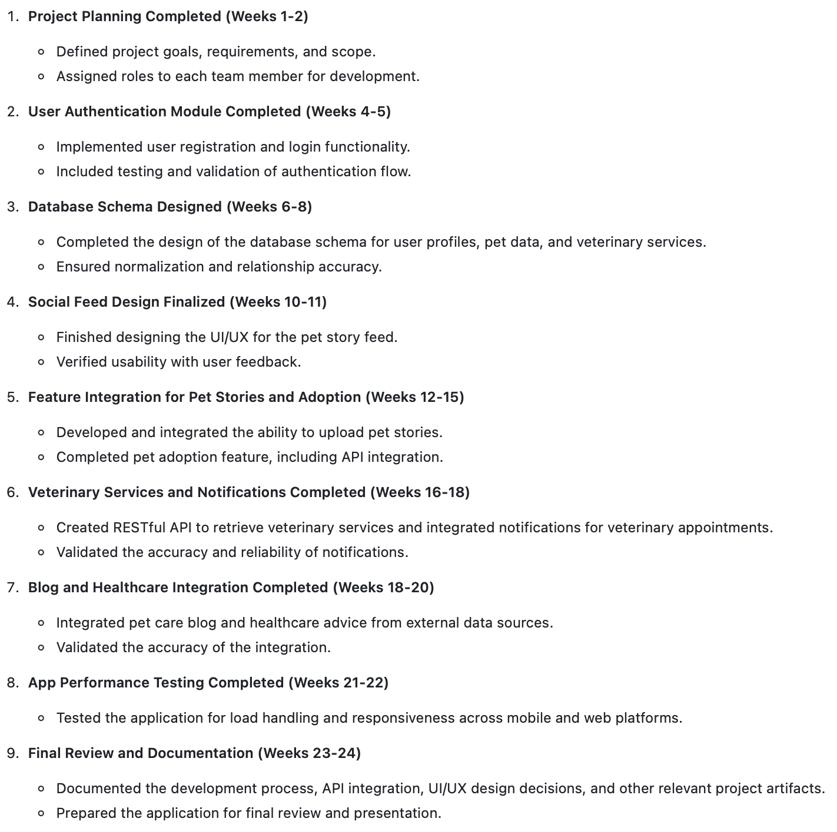
Roadmap to Success: Strategic Milestones & Deliverables
Final Project Delivery Date (Expected):
March 29, 2025

Slide 9
Progress & Achievements: Realizing Our Vision Step by Step
To date, FurrFect has achieved several significant milestones that showcase a robust foundation and steady progress toward our final goals. We have successfully implemented and rigorously tested the user authentication module, completed the design of our comprehensive database schema, and finalized the UI/UX for the social feed, ensuring an engaging user experience. In addition, critical API integrations for pet adoption and veterinary services have been executed, reinforcing our platform’s commitment to connecting pet owners with essential care resources.
While these accomplishments underscore our dedication and technical prowess, our agile approach means we continuously iterate on features and enhancements. All refinements and final deliverables will be fully available on the final project delivery date of March 29, 2024, ensuring that FurrFect meets the highest standards of functionality and user satisfaction...

Slide 10
Overcoming Obstacles: Innovative Solutions to Complex Challenges
Throughout the development of FurrFect, our team encountered several significant challenges that tested our technical and collaborative skills. One of the key hurdles was integrating diverse third-party APIs to ensure seamless communication between pet adoption services, veterinary data, and our custom modules. We also faced scalability issues as we optimized our database architecture to efficiently handle a growing volume of user data, and stringent security requirements demanded robust, dynamic solutions...
To overcome these challenges, we adopted an agile methodology, which allowed us to iteratively refine our approach. We, as a team, contributed significantly by leading the API integration efforts and designing resilient security protocols, ensuring that our JWT-based authentication system remained robust. Collaborative problem-solving and proactive iteration have been instrumental in addressing these issues, and we are confident that all refinements will be fully implemented by the final project delivery date...

Slide 11
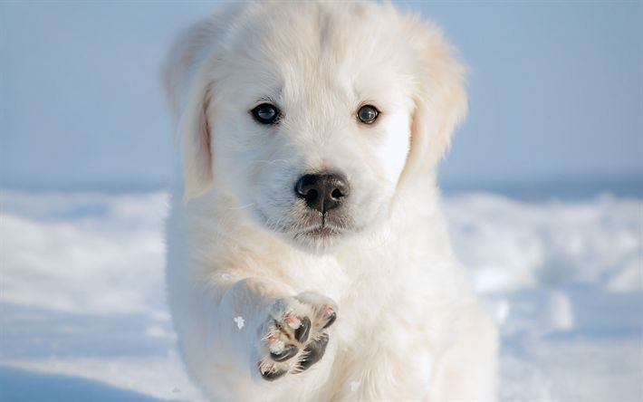
Thank You for Exploring FurrFect !!!

