Slide 1
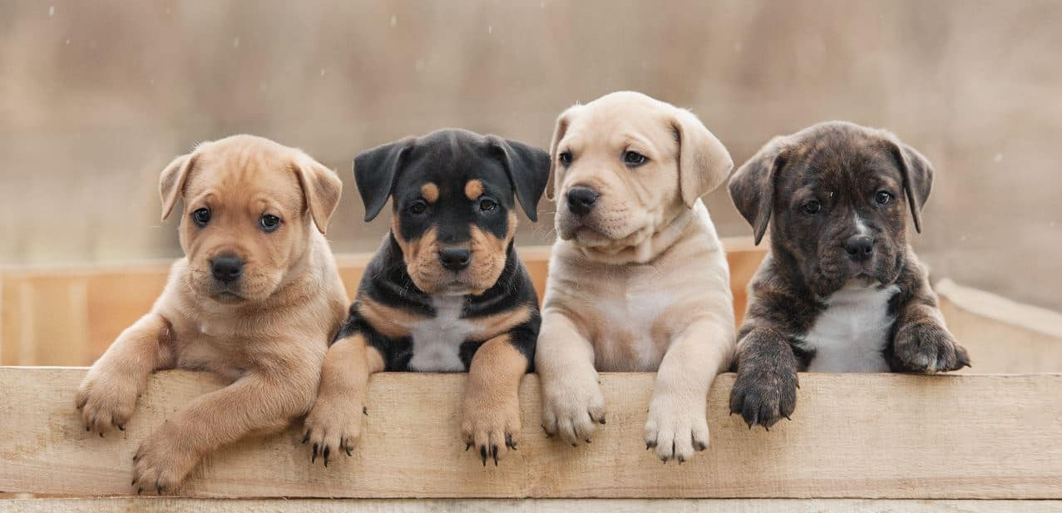
FurrFect
Anay Abhijit Joshi Nishit Grover
Pet Social Media and Health-Care Platform

Slide 2
Overview
FurrFect is a specialized social media blog app designed for pet owners and enthusiasts. The platform allows users to share daily moments of their pets' lives, access pet healthcare information, browse adoption resources, find veterinary services, and manage their pets' appointments.
FurrFect aims to foster a supportive community where users can engage with others, exchange pet care tips, and ensure their pets remain healthy and happy.

Slide 3
Team Members
Anay Abhijit Joshi ( joshi2an@mail.uc.edu )
Nishit Grover ( grovernt@mail.uc.edu )
Project Advisor
Professor Nitin Nitin ( nitinfu@ucmail.uc.edu )

Slide 4
FurrFect’s Abstract
FurrFect is an innovative pet-centric social media and healthcare platform tailored for pet owners and enthusiasts. It enables users to share daily pet moments, access detailed healthcare tips, explore adoption resources, find and compare veterinary services, and manage pet appointments. The platform aims to create a vibrant community of pet lovers, fostering interaction and learning through blog content and expert advice. Built using React.js, Node.js, MongoDB, and AWS, FurrFect offers a secure, seamless experience with JWT-based authentication, third-party API integrations, and automated notifications.

Slide 5
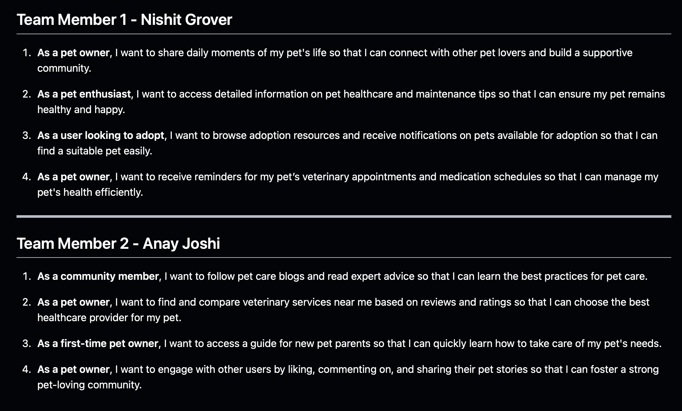
User Stories

Slide 6
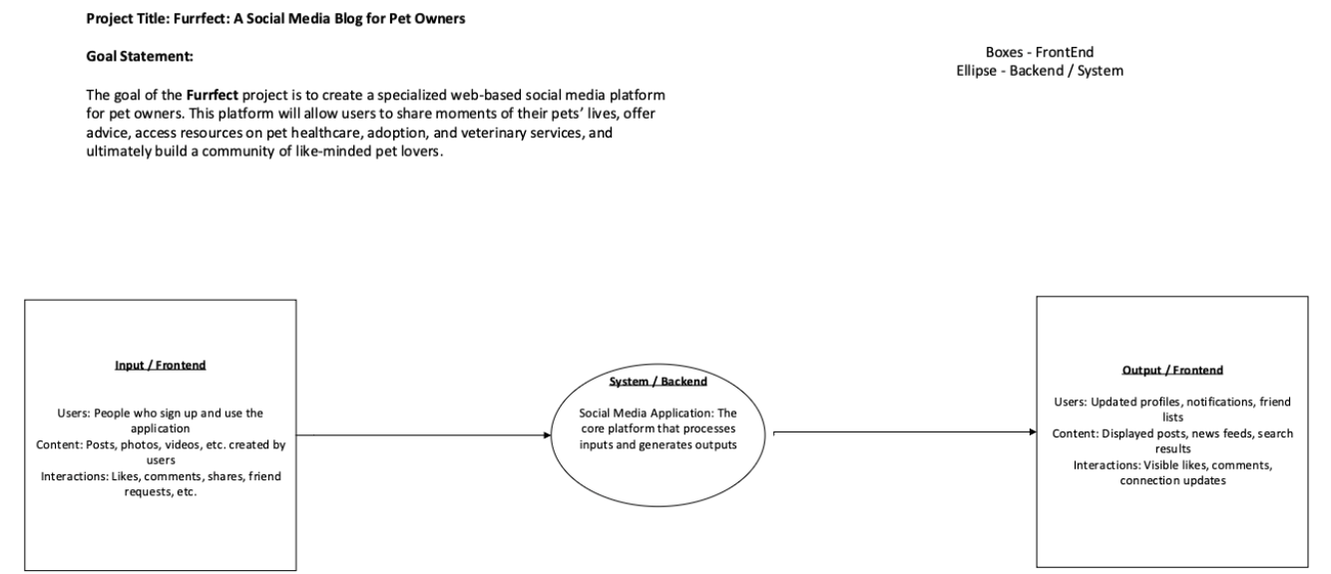
Design Diagram(s)

Slide 7
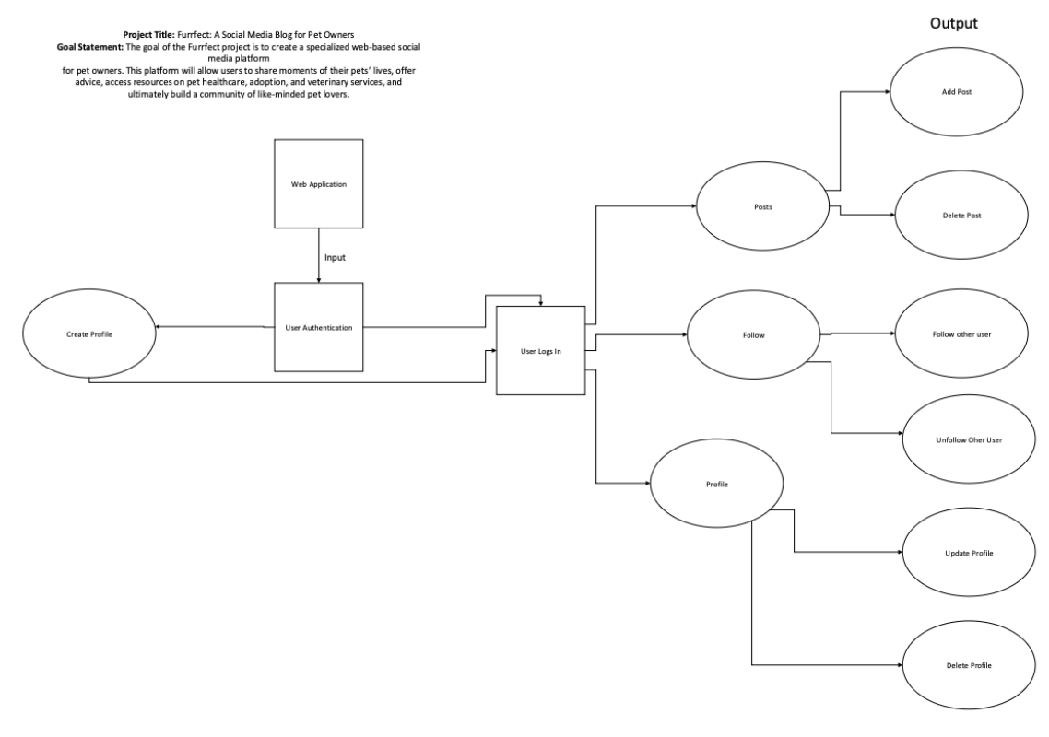

Slide 8
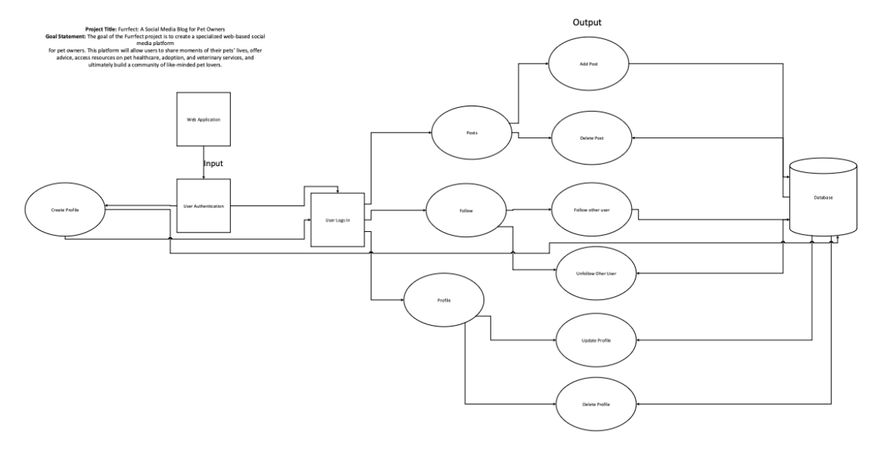

Slide 9
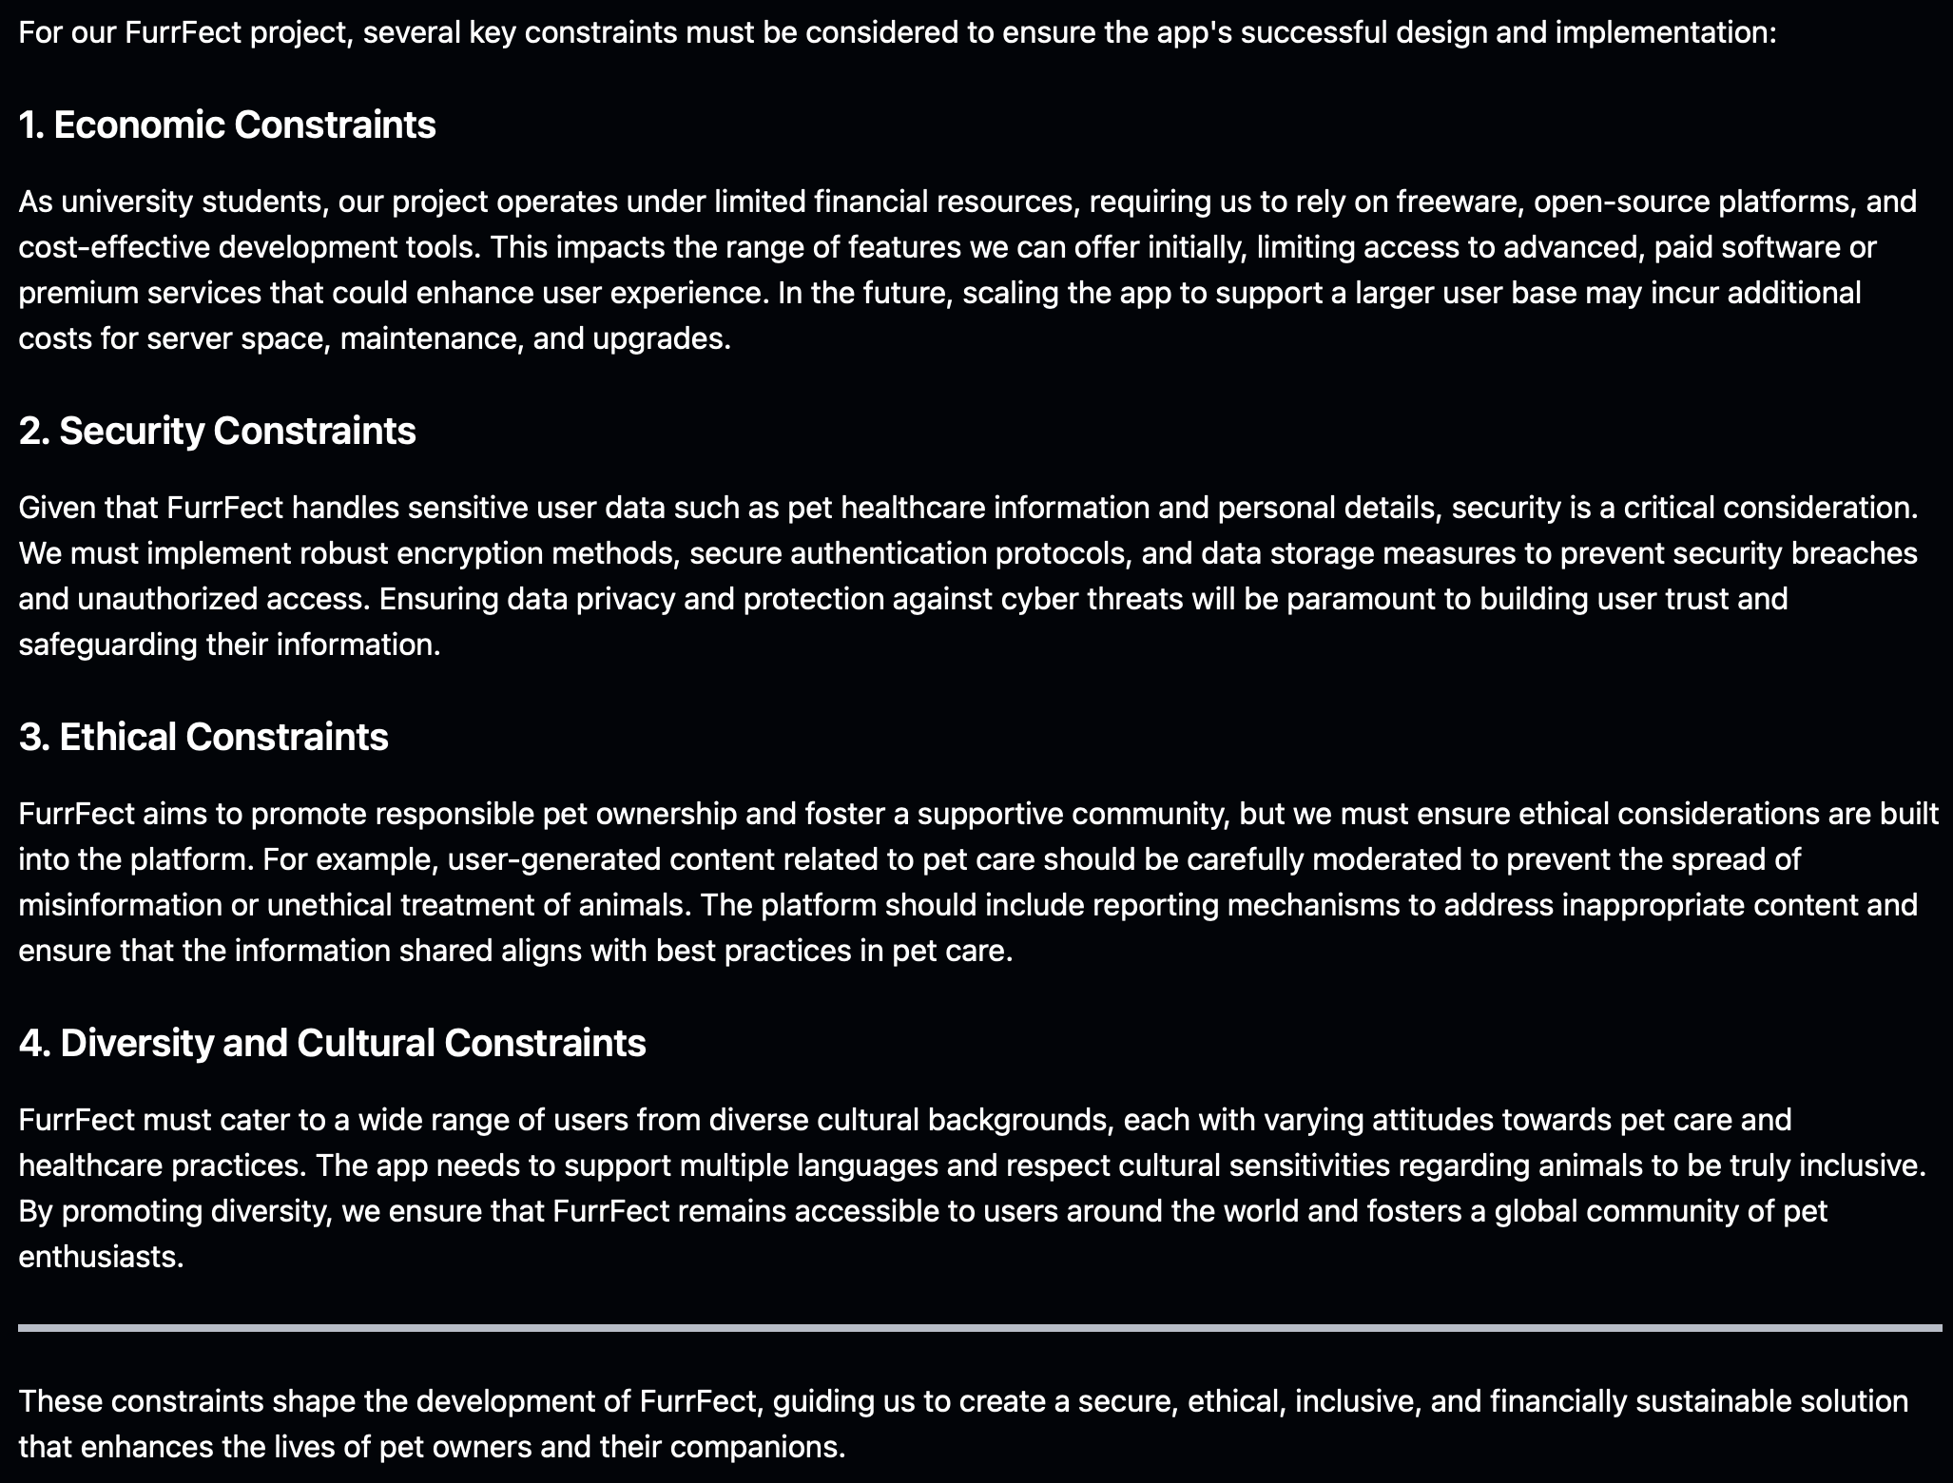
FurrFect’s Constraints

Slide 10
FurrFect’s Progress
As of Week 8, I, Anay Abhijit Joshi, along with Nishit Grover, have reached the halfway point in the development of FurrFect - Pet Social Media and Healthcare Platform.
Key milestones achieved so far include:
Project Planning: Completed successfully during Weeks 1-2, with clear definition of goals, requirements, and scope, and assignment of roles for each team member of FurrFect, i.e., Anay Abhijit Joshi and Nishit Grover.
User Authentication Module: We implemented and tested the user registration and login functionalities, completing this module on time in Weeks 4-5. The authentication flow has been validated to ensure a secure user experience.
Database Schema Design: The schema for user profiles, pet data, and veterinary services is in progress, focusing on normalization and relationships. This milestone is on track to be completed by the end of Week 8.
UI/UX Design for Social Feed: We’ve started working on the initial design for the pet story feed, aiming for a user-centric interface. The design phase aligns with the goal of finalization by Week 11, with feedback from early user interactions incorporated.
Both Nishit and I (Anay) have been working in sync, maintaining a balanced effort distribution and ensuring consistent progress. We’re well-prepared to tackle the next phases and keep the project on track toward its completion...

Slide 11
FurrFect’s Accomplishments (Fall 2024)
By the end of the term (i.e., Fall 2024), I (Anay) and Nishit expect the following key milestones to be achieved for FurrFect - Pet Social Media and Healthcare Platform:
Social Feed Design Finalization (Week 11):
Complete the UI/UX for the pet story feed, ensuring it aligns with user feedback and is intuitive for users to interact with. This includes refining the design for posting, liking, commenting, and sharing pet stories.
Feature Integration for Pet Stories and Adoption (Weeks 12-15):
Successfully develop and integrate the features that enable users to upload pet stories, including media files, and browse pet adoption resources.
Integrate the Pet Adoption API (Application Programming Interface) to allow users to browse real-time listings of adoptable pets.
Veterinary Services and Notifications (Weeks 16-18):
Build the veterinary services feature, allowing users to find and compare nearby services based on ratings and reviews.
Implement appointment scheduling and reminder notifications, ensuring accurate and timely delivery.
Validate the reliability and accuracy of the notifications for veterinary appointments and other pet healthcare activities.
These accomplishments will mark significant progress towards achieving the FurrFect’s core functionalities and user engagement features. Both Nishit and I (Anay) will continue to focus on delivering each module efficiently, maintaining our pace and collaboration...

Slide 12
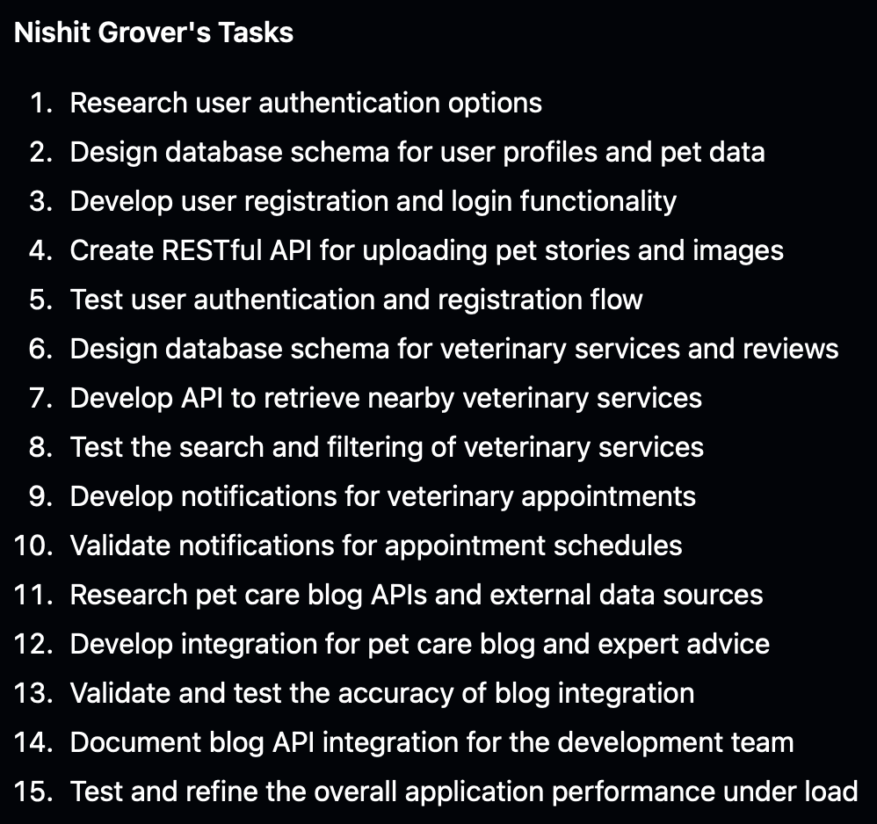
FurrFect’s Work Distribution (Nishit Grover)

Slide 13
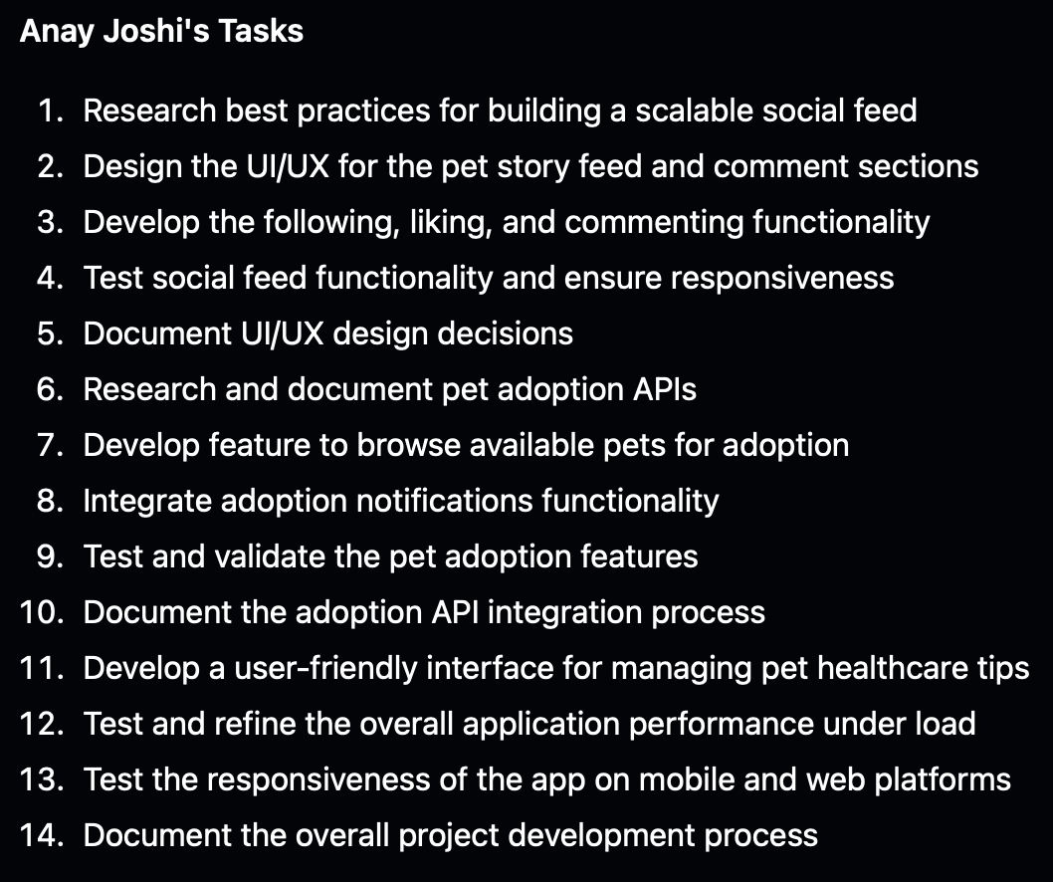
FurrFect’s Work Distribution (Anay A. Joshi)

Slide 14
FurrFect’s Demo (Expo)
At the Expo, we will deliver an engaging live demo of FurrFect, showcasing its cutting-edge features designed to create a dynamic, pet-centric community:
Effortless User Experience: From secure login to a vibrant social feed, we’ll (Anay and Nishit) demonstrate how users can seamlessly share pet stories, engage with others through liking, commenting, and following - fostering a thriving pet lover's hub.
Real-Time Adoption Integration: We’ll (Anay and Nishit) showcase live adoption listings and instant notifications, empowering users to connect with their perfect pet in real time. This feature is designed to be a game-changer in accelerating pet adoption.
Advanced Veterinary Services Locator: Users can find, compare, and book appointments with nearby veterinary services. We’ll (Anay and Nishit) emphasize the smart notification system, ensuring users never miss a critical appointment or medication schedule.
Comprehensive Pet Healthcare Tips: FurrFect offers a wealth of healthcare tips, blogs, and expert advice, all accessible through a user-friendly interface, helping pet owners provide top-tier care for their pets.
Our demo will highlight FurrFect’s sleek design, seamless functionality, and high-impact user experience - all built for scalability and real-world impact. With a blend of advanced tech, social interaction, and user-focused design, FurrFect is set to impress as an innovative solution in the pet care space. We’re (Anay and Nishit) excited to demonstrate how our collaborative approach and technical excellence can make a tangible difference. We (Anay and Nishit) believe our project reflects the passion, skills, and drive needed to excel in any tech-focused role!

Slide 15
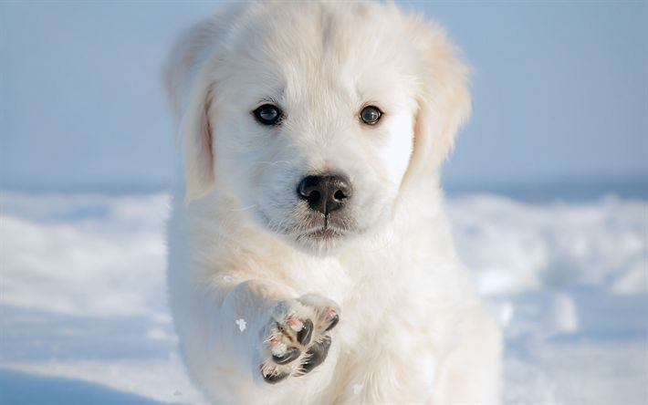
Thank You for Exploring FurrFect !!!

