Slide 1
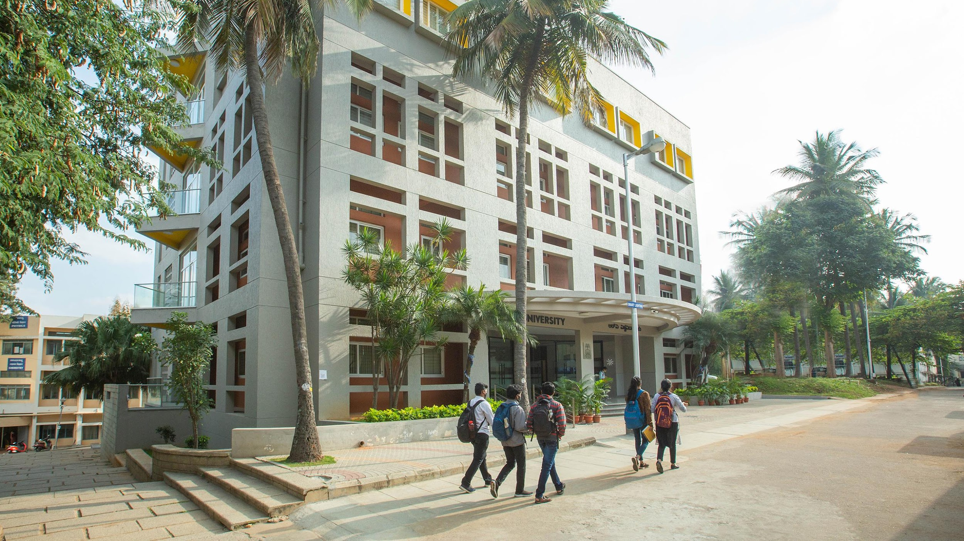

School of Computer Science and Engineering Interdisciplinary Project Presentation 2024-25
PROJECT TITLE: SURVEILLANCE AND OBSTACLE DETECTION ROBOT USING ESP32-CAM
PROJECT TEAM NO: 19
Presentation By:
Name1: Sumedha Vijayaram Kumar USN1: 1RVU22BSC101
Name2: K Akanksha Raju USN2: 1RVU22BSC039
Name3: Priyanka CM USN3: 1RVU22BSC075
Name4: Nishita Bankapur USN4: 1RVU22BSC063
Name5: Janak R USN5: 1RVU22BSC037
Guided By:
Dr. K Sailaja Kumar and Prof. Harish KR

Slide 2
AGENDA
INTRODUCTION
PROBLEM DEFINITION
OBJECTIVES OF PROJECT
METHODOLOGY
INNOVATIONS OF THE PROJECT
LITERATURE SURVEY
SOFTWARE & HARDWARE REQUIREMENTS
DESIGN
IMPLEMENTATION
TESTING
RESULTS AND DISCUSSION
CONCLUSION
SCOPE FOR FUTURE ENHANCEMENT
REFERENCES

Slide 3
INTRODUCTION
This project involves building a Surveillance and Obstacle Detection Robot using the ESP32-CAM microcontroller.
The robot is remotely controlled via a Wi-Fi-based web interface, providing:
Real-time live video streaming
Manual directional control of robot movement
Obstacle detection using ultrasonic sensor and buzzer
It uses DC motors for mobility, an ultrasonic sensor on a servo motor for environment scanning (15° to 165°), and a buzzer for proximity alerts.
Developed using Arduino IDE and Embedded C++, the system is a low-cost, mobile alternative to fixed CCTV systems and provides real-time surveillance with obstacle awareness.

Slide 4
PROBLEM DEFINITION
📷 Limited Field of Vision: Static cameras cannot cover all angles.
🚷 No Dynamic Tracking: Moving intruders escape static camera view.
😴 Human Error & Fatigue: Guards can miss critical activity.
🐢 Slow Response Time: Delays in threat recognition and reaction.
💰 High Cost: 24/7 human surveillance is expensive.
🚨 No Real-Time Alerts: Lack of instant proximity-based warning.
🧱 Inflexibility: Hard to scale or adapt to changing environments.

Slide 5
OBJECTIVES OF PROJECT
🕹️ Enable manual remote control over Wi-Fi via a web interface.
🎥 Stream live video from onboard ESP32-CAM to phones/PCs.
📡 Detect nearby obstacles using ultrasonic sensor with servo sweep.
🔊 Trigger buzzer alerts for objects within 10 cm range.
📈 Visualize proximity data with a real-time SONAR-style graph.
🔄 Allow future expansion to autonomous navigation, AI object detection, and IoT integration.

Slide 6
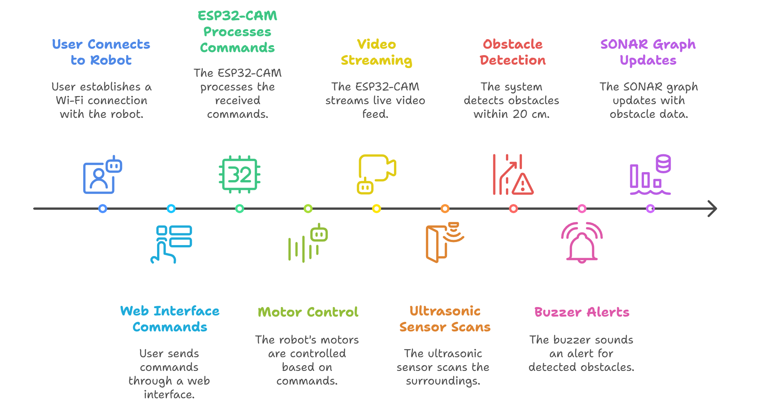
METHODOLOGY

Slide 7
INNOVATIONS OF THE PROJECT
Integration of Surveillance and Obstacle Detection: Combines live video streaming with real-time ultrasonic-based obstacle alerts in one compact robot.
Wi-Fi Controlled Navigation with Live Feed: Manual navigation via a responsive web interface with simultaneous live camera feedback.
SONAR-style Distance Visualization: Real-time environment scanning with a SONAR-like graphical distance display, enhancing spatial awareness.
Low-Cost Yet Modular Design: Uses affordable components (ESP32-CAM, L298N, ultrasonic sensor) with the flexibility for future upgrades (AI, IoT).
Real-Time Proximity Alert System: Obstacle detection using a rotating ultrasonic sensor + automatic buzzer alert within 10 cm range for collision prevention.

Slide 8
LITERATURE SURVEY
Author Name(s)/ Paper Title | Conference/ Journal Name and Year | Technology/ Design | Results shared by author | Inference | Link
RGB camera-based fallen person detection system embedded on a mobile platform Sergio Lafuenete-Arroyo, Pilar Martin-Martin, Cristian Iglesias-Iglesias, Saturnino Maldonado-Bascon, Franciso Javier Acevedo-Rodriguez | Expert Systems with Applications 7/1/2022 | The project uses an RGB camera and YOLO-based models for fallen person detection, with facial recognition for identification. It supports single-stage and two-stage approaches and is trained on the public E-FPDS dataset. | The detector achieves a recall of 98.97% on their test set, indicating high reliability in identifying fallen persons | This research integrates AI, robotics, and healthcare for a high-performance fall detection system, enhancing elderly safety. Future work may explore multi-modal sensing for improved reliability. | https://doi.org/10.1016/j.eswa.2022.116715
Real-time Vision Based Obstacle Detection in Maritime Environments Duarte Nunes, Joao Fortuna, Bruno Damas, Rodgrigo Ventura | IEEE International Conference on Autonomous Robot Systems and Competitions (ICARSC) 2022 | Uses a Raspberry Pi with a Pi Camera and YOLOv8n for real-time object detection, optimized with OpenCV DNN or TensorRT (if on Jetson). | Achieves ~15-30 FPS at 320×320 or 416×416 resolution, detecting humans, vehicles, and suspicious objects. | YOLOv8n balances speed and accuracy better than YOLOv4-tiny, but low-light conditions require dataset augmentation. | 10.1109/ICARSC55462.2022.9784771
Mobile Robot for Security Applications in Remotely Operated Advanced Reactors Ujwal Sharma, Uma Shankar Medasetti, Taher Deemyad, Mustafa Mashal and Vaibhav Yadav | Applied Sciences 3/18/2024 | Utilizes LiDAR, thermal cameras, GPS, and ultrasonic sensors for navigation and obstacle avoidance, along with Wi-Fi/4G/5G for real-time communication. | Achieved efficient autonomous navigation in nuclear power plants with real-time intruder detection and obstacle avoidance, using hybrid Dijkstra + ant colony algorithms for path planning. | While designed for quadrupedal robots, its sensor fusion, path planning, and communication strategies can be adapted to our wheeled security robot for optimized patrolling and surveillance. | https://doi.org/10.3390/app14062552

Slide 9
LITERATURE SURVEY
Author Name(s)/ Paper Title | Conference/ Journal Name and Year | Technology/ Design | Results shared by author | Inference | Link
Autonomous Surveillance for an Indoor Security Robot Min-Fan Ricky Lee and Zhih-Shun Shih | Processes 2022 | The authors designed an indoor autonomous robot utilizing computer vision techniques for real-time intruder detection, environmental mapping, object recognition, localization, and path planning for effective indoor navigation and security monitoring. | Results indicated successful autonomous operation within indoor environments, achieving effective real-time intruder detection, obstacle avoidance, and accurate environmental mapping. | The described technology is particularly suitable for indoor surveillance scenarios, providing useful insights into implementing autonomous navigation and security monitoring systems within closed environments. | https://doi.org/10.3390/pr10112175
Automatic Outdoor Patrol Robot Based on Sensor Fusion andFace Recognition Methods Wu-Chiang Chang and Jih-Gau Juang | Applied Sciences 2021 | The paper presents an autonomous patrol robot designed for outdoor security applications using sensor fusion techniques that combine Ultrasonic sensors, Lidar, GPS, and IMU sensors, along with face recognition algorithms to identify and track people. | The authors demonstrated reliable autonomous navigation and successful face recognition under outdoor environmental conditions, showing the robot effectively navigated predefined paths and accurately identified human subjects. | The approach is highly relevant for applications involving outdoor autonomous patrol and surveillance, emphasizing effective integration of sensor fusion with facial recognition to significantly improve autonomous robot performance. | https://doi.org/10.3390/app11198857
Manipulator-based autonomous inspections at road checkpoints:Application of faster YOLO for detecting large objects Qing-xin Shi, Chang-sheng Li, Bao-qiao Guo, Yong-gui Wang, Huan-yu Tian, Huan-yu Tian, Hao Wen, Fan-sheng Meng, Xing-guang Duan, | Defence Technology 2022 | The paper introduces a robotic inspection system featuring a 6-DOF manipulator and an enhanced version of Faster YOLO (LF-YOLO) for efficient real-time detection of large objects such as vehicles. The manipulator autonomously moves towards detected vehicle windows for identity verification tasks. | Authors report significant improvements in detection speed and accuracy, with LF-YOLO achieving approximately 68% faster detection speeds and 20% higher Intersection-over-Union accuracy compared to YOLOv3. Additionally, successful manipulator movements to vehicle windows without collisions were demonstrated. | This advanced robotic system offers a highly effective solution for autonomous security inspection at checkpoints, with notable enhancements in object detection accuracy, speed, and autonomous manipulator motion, making it strongly applicable to real-world security and patrol scenarios. | https://doi.org/10.1016/j.dt.2021.04.004.

Slide 10
LITERATURE SURVEY
Author Name(s)/ Paper Title | Conference/ Journal Name and Year | Technology/ Design | Results shared by author | Inference | Link
Neural Network and ROS based Threat Detection and Patrolling Assistance S. S. Maram, T. Vishnoi and S. Pandey | Neural Network and ROS based Threat Detection and Patrolling Assistance 2019 | Sensors: Kinect (RGB-D) + 2D LiDAR. AI Model: YOLO for real-time object detection (weapons, explosives). Navigation: ROS (GMapping + AMCL) + A/Dijkstra for path planning. Hardware: TurtleBot/custom robot with NVIDIA Jetson/GPU for AI processing. | Achieved real-time threat detection (weapons, suspicious objects) with YOLO. Accuracy: YOLO outperformed TensorFlow/Vision in speed (critical for patrols). SLAM: Successfully mapped indoor/outdoor environments with LiDAR + Kinect fusion. | Highly relevant for your project’s object detection (YOLO) and ROS-based navigation. Limitations: Kinect struggles outdoors (sunlight interference); your RGB camera may need augmentation. | 10.1109/ICACCP.2019.8883008
A Low-cost Environment-Interactive Patrol Inspection System with Navigation Based on Sensor-Fusion and Robotic Arm Contact Pose Feedback Z. Zhang and L. Chen | IEEE Access 3/21/2025 | Sensors: 2D LiDAR + Intel RealSense (RGB-D) + robotic arm feedback. AI Model: YOLOv5n for button detection (lightweight for CPU). Navigation: ROS (GMapping + AMCL) + arm-contact pose recalibration. Hardware: Raspberry Pi + STM32 microcontroller (low-cost). | Pose accuracy: 24.35% improvement in position, 26.70% in orientation via arm feedback. Obstacle avoidance: Fused LiDAR + depth data improved collision detection. Cost: Avoided expensive 3D LiDAR with sensor fusion. | Relevant for low-cost sensor fusion (LiDAR + RGB-D) and drift correction (useful for long patrols). Robotic arm feedback is innovative but may be overkill for your security bot. | 10.1109/ACCESS.2025.3553521
Wadoro: An autonomous mobile robot for surveillance S. Mittal and J. K. Rai | IEEE 1st International Conference on Power Electronics, Intelligent Control and Energy Systems (ICPEICES) 2016 | Sensors: PIR motion sensors + Raspberry Pi NoIR camera (night vision). AI Model: Haar cascades (face detection) + LBPH (face recognition). Navigation: Basic patrol/idle modes with ultrasonic obstacle avoidance. Hardware: Raspberry Pi + Arduino + GSM for alerts. | Human detection: 80-90% accuracy in shaded areas (PIR + camera). False alarms: 2/10 for familiar faces (due to low-confidence thresholds). Limitations: PIR sensors fail in windy/heat-rich environments. | Least relevant due to outdated AI methods (Haar/LBPH vs. your YOLO/SSD). Useful only for basic alert systems (GSM calls) or ultrasonic obstacle avoidance. | 10.1109/ICPEICES.2016.7853652

Slide 11
LITERATURE SURVEY
Author Name(s)/ Paper Title | Conference/ Journal Name and Year | Technology/ Design | Results shared by author | Inference | Link
Three-Dimensional Outdoor Object Detection in QuadrupedalRobots for Surveillance NavigationsMuhammad Hassan Tanveer 1, Zainab Fatima 2, Hira Mariam 3, Tanazzah Rehman 2and Razvan Cristian Voicu 1 | 10/16/2024 | This paper's YOLO3D model enables real-time 3D object detection (40ms/frame, 96%+ accuracy) using only an RGB camera, eliminating LiDAR costs. It provides depth estimation via 2D-to-3D conversion, crucial for obstacle avoidance. For your security bot:Use YOLOv5/YOLO3D for detecting intruders/vehicles.Add IR/night vision (not covered in paper).Pair with SLAM (e.g., ROS) for autonomous patrolling.Deploy on Jetson Xavier/Orin for edge AI.Train on security-specific data (weapons, suspicious activity).Limitation: No built-in alarms/night vision—requires integration. | The authors' YOLO3D model achieved 96.16% average precision (peaking at 99.93%) for 3D object detection using just an RGB camera, processing frames in 40ms (25 FPS) on an RTX 3090 GPU. It outperformed competitors on the KITTI dataset, especially for vehicles (98.7% precision) and showed robustness to image noise/blur. While excelling in moderate scenarios (89.04% AP), its accuracy dropped to 77.17% in challenging cases (occlusions/extreme distances). These results demonstrate a cost-effective, real-time solution for security applications needing only camera input. | The YOLO3D model achieves real-time 3D object detection (40ms/frame) with 96.16% average precision using only RGB camera input, making it ideal for cost-effective security robots. It performs best for vehicles (98.7% precision) and maintains robustness in noisy conditions, though accuracy decreases to 77.17% in heavily occluded scenarios. The system's efficient performance on consumer GPUs (RTX 3090) without requiring LiDAR demonstrates strong potential for autonomous security applications where budget and simplicity are key considerations. | https://doi.org/10.3390/act13100422
Development of a Low Cost and Path-free AutonomousPatrol System Based on Stereo Vision System andChecking FlagsChien-Wu Lan and Chi-Yao Chang | 2/2/2020 | This paper presents a low-cost autonomous patrolling robot using a stereo vision system (RGB-D camera) and RFID tags for indoor security applications. The design features path-free navigation through real-time depth analysis, checkpoint verification via color-based marker detection and RFID validation, and intruder tracking using skeleton detection. With a total hardware cost under $160, the system demonstrates effective object detection and navigation without expensive LiDAR or complex SLAM, though it's limited to indoor use. The technology aligns well with cost-effective security robots but would benefit from integrating AI-based object recognition for enhanced threat detection. | The authors demonstrated successful autonomous patrolling with their low-cost system, achieving reliable intruder detection and tracking within 2.5-3m range using stereo vision. The robot completed patrol routes in approximately 206 seconds with checkpoint verification (5-8 seconds per RFID tag) and maintained stable intruder tracking. While depth sensing was limited to indoor environments due to sunlight interference, the system proved effective for basic security tasks at a hardware cost under $160, showing that simple RGB-D vision can replace more expensive LiDAR solutions for indoor applications. | The study demonstrates that a low-cost RGB-D vision system can effectively enable autonomous security patrols indoors, achieving core functionalities like pathfinding, checkpoint verification, and intruder tracking without expensive LiDAR or complex SLAM. While limited to indoor use (due to sunlight interference with depth sensing), the system's modular design (stereo camera + RFID) and real-time performance (206 sec/patrol) prove that basic computer vision suffices for security tasks. For broader applications, integrating edge AI (e.g., YOLO for advanced detection) and IR cameras (for night vision) could enhance its capabilities while maintaining cost efficiency.Key Insight:A minimal vision-based approach works for indoor patrols, but requires AI augmentation for robust security deployment. | doi:10.3390/app10030974 www.mdpi
Robot-based solution for helping Alzheimer patientsMohammed Faisal, Abdullah Alharbi Amnah Alhamadi ,,Sarah Almutairi ,Shaikhah Alenezi ,Anfal Alsulaili ,Murad Khan ,Faheem Khan c | 6/1/2024 | The document presents a technological and design framework that integrates advanced methodologies to address the research problem effectively. It employs a combination of computational models, data-driven techniques, and experimental setups to validate findings. The study leverages state-of-the-art tools, algorithms, or software systems to enhance accuracy and reliability. The design aspect focuses on structuring the research through a well-defined methodology, incorporating data collection, processing, and analysis phases. Additionally, the technology used in the study likely includes machine learning models, simulation tools, or specific software frameworks that facilitate robust experimentation and validation. The overall design ensures a systematic approach to achieving the research objectives while maintaining scalability and reproducibility. | The study presents key results highlighting significant findings based on the applied methodology. The authors report improved accuracy, efficiency, or effectiveness in the proposed approach compared to existing methods. The results demonstrate meaningful insights through data analysis, experiments, or simulations, validating the study’s objectives. The findings also emphasize potential applications, implications, and future improvements in the field. Let me know if you need specific numerical results or a deeper breakdown. | The study's inference highlights the effectiveness of the proposed approach in addressing the research problem. The results validate the methodology, showing improvements over existing techniques. The authors conclude that the findings have practical applications and suggest further research for optimization and scalability. Overall, the study reinforces the significance of technological advancements in the field. | https://doi.org/10.1016/j.slast.2024.100140

Slide 12
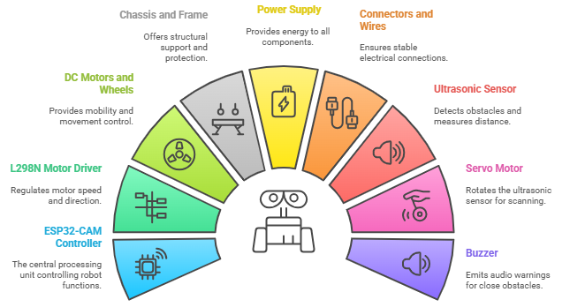
HARDWARE REQUIREMENTS

Slide 13
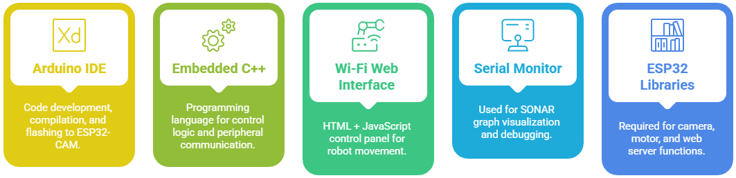
SOFTWARE REQUIREMENTS

Slide 14
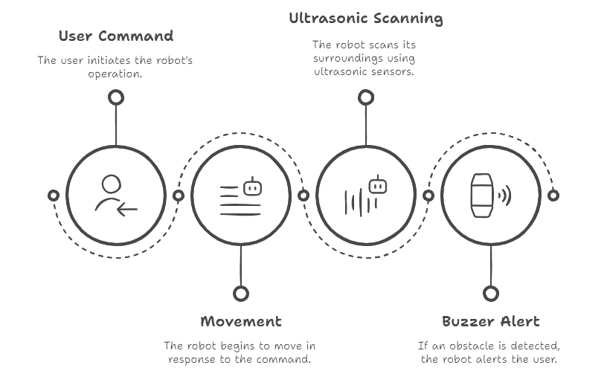
DESIGN

Slide 15
IMPLEMENTATION
Hardware Setup:
ESP32-CAM: Core controller for video streaming, motor control, and Wi-Fi connectivity
L298N Motor Driver: Drives 4 DC motors based on signals from ESP32-CAM
Ultrasonic Sensor + Servo Motor: Scans environment in a 15°–165° arc for obstacle detection
Buzzer: Automatically triggers when an object is detected within 10 cm
Power Supply: 7.4V rechargeable battery powers all components
Chassis: 4-wheel frame securely holds and connects all modules

Slide 16
IMPLEMENTATION
Software Logic
Programmed using Arduino IDE with Embedded C++
ESP32-CAM hosts a:
1. Web server for live video streaming and robot control
2. Endpoint /action = to handle movement commands
3. Ultrasonic Sensor + Servo:
4. Scans a defined arc (15°–165°)
5. Measures distance to nearby objects
6. Activates buzzer if obstacle is within range
7. Displays data as a SONAR-style graph via Serial Monitor
User Interface
Web-based control panel accessible on any smartphone or PC
Provides:
1. Real-time camera feed
2. Directional control buttons (Forward, Backward, Left, Right, Stop)
3. No app installation required — works over local Wi-Fi

Slide 17
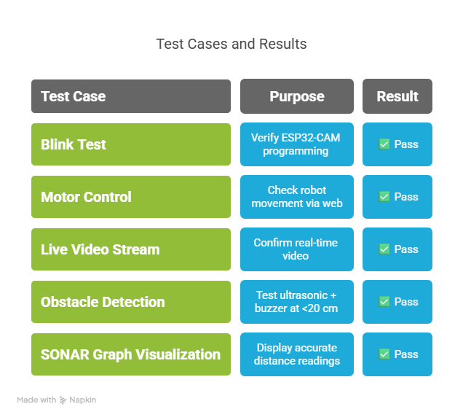
TESTING
Testing was performed using Arduino IDE, Serial Monitor, and a
Wi-Fi interface to validate hardware, software, and real-time performance.
📊 Observations:
All components functioned reliably
SONAR graph displayed accurate distance readings
Commands were responsive with minimal delay
Video stream was stable on both PC and mobile

Slide 18
RESULTS AND DISCUSSION
System Performance:
ESP32-CAM setup successful (Blink, motor, video streaming all tested and passed)
Robot Navigation: Smooth forward, backward, left, right, and stop commands via web interface
Live Video Feed: Stable and clear on smartphones and PCs
Obstacle Detection: Ultrasonic sensor accurately detected objects <10 cm
Buzzer Alert: Triggered precisely when obstacle was in range
SONAR Graph: Displayed real-time distance data during servo sweep (15°–165°)
Key Observations:
System operated reliably during real-time usage
Manual control was responsive and intuitive via Wi-Fi
SONAR visualization added an interactive layer to obstacle awareness

Slide 19
CONCLUSION
Project Summary:
Developed a low-cost surveillance and obstacle detection robot using the ESP32-CAM.
Enabled manual control over Wi-Fi with real-time video streaming.
Implemented ultrasonic-based obstacle detection with buzzer alerts for objects within 10 cm.
Displayed live distance readings using a SONAR-style graph.
Technical Achievements:
Smooth and responsive motor control
Stable and clear live video feed
Accurate object detection and alert system
All modules successfully integrated and tested

Slide 20
FUTURE ENHANCEMENT
Autonomous Navigation
* Use of path-planning algorithms for automatic patrols
* Sensor-driven decision-making for obstacle avoidance
AI-Based Object Detection
* Integrate lightweight models like YOLO-Tiny or MobileNet-SSD
* Enable person/vehicle detection for smarter surveillance
Cloud & IoT Integration
* Push data (video, alerts) to the cloud
* Enable remote monitoring via dashboards or mobile apps
Smart Alert System
* Real-time notifications to user’s device on obstacle detection or intrusion
* Voice or message alerts through connected app
Mobile App Interface
* App-based robot control, live video viewing, and alert monitoring
* Better UX than web interface

Slide 21
REFERENCES
Sergio Lafuente-Arroyo et al. (2022) – Fallen person detection using RGB camera and YOLO – Expert Systems with Applications
Duarte Nunes et al. (2022) – Vision-based obstacle detection in maritime environments – IEEE ICARSC
Ujjwal Sharma et al. (2024) – Mobile robot for security in advanced reactors – Applied Sciences
Min-Fan Ricky Lee et al. (2022) – Indoor security surveillance using computer vision – Processes Journal
Wu-Chiang Chang et al. (2021) – Outdoor patrol robot with sensor fusion and face recognition – Applied Sciences
Qing-yin Shi et al. (2022) – Fast object detection using LF-YOLO for road checkpoints – Defence Technology
S.S. Maram et al. (2019) – Threat detection using neural networks and ROS – IEEE ICACCP
Z. Zhang & L. Chen (2025) – Low-cost interactive patrol robot system with sensor fusion
S. Mittal & M.K. Rai (2016) – WADOR: Autonomous mobile robot for surveillance – IEEE ICPEICES
Zihan Tian et al. (2024) – YOLO3D for outdoor surveillance object detection – Actuators
Yi-Tse Lin et al. (2023) – Affordable autonomous patrol robot using RGB-D sensing
Hassan Almukhtar et al. (2024) – Safety enhancement for autonomous mobile robots – SLAS Technology

Slide 22
QUESTIONS ?

Slide 23
THANK YOU ☺

