Slide 1
COMPILER DESIGN LABORATORY -- PROJECT PROPOSAL & DESIGN REVIEW
ZENITH COMPILER
A Strongly-Typed Procedural Language Compiler with AST Visualization,
Scoped Symbol Table Management, and Intermediate Code Generation
- Project Type: Individual Project Submission (Strictly Independent Implementation)
- Course Component: Compiler Design Laboratory (Review 1: Proposal & System Design)
- Key Innovation: Interactive Arbitrary User Input Engine, Compile-Time Immutability, AST Visualizer
- Deliverables: Formal EBNF Grammar, Hand-Crafted Lexer & Parser, Scoped Symbol Table, Prototype

Slide 2
PROBLEM UNDERSTANDING & MOTIVATION
Project Motivation & Background Study
Deficiencies in Existing Approaches
The Zenith Value Proposition
- Dynamically Typed Scripting Languages (Python, JS):
Postpone typing and scoping errors until runtime, leading to silent production failures and lack of static safety.
- Industrial Black-Box Compilers (GCC, Clang/LLVM):
Feature millions of lines of code where intermediate syntax trees and representation lowering are completely opaque.
- Toy Lab Interpreters & Calculators:
Directly evaluate syntax trees without symbol tables, lexical scopes, intermediate representations, or code optimizations.
- Full Pedagogical Transparency:
Exposes every compiler phase (Token Table, AST Tree, Scoped Symbol Table, and TAC Intermediate Code) as inspectable artifacts.
- Strict Compile-Time Safety:
Enforces static type checking, variable immutability (let vs const), and scope resolution before code execution begins.
- Interactive Problem Input Engine:
Accepts arbitrary user-supplied programs and algorithms dynamically at runtime, allowing any computational problem to be verified.
- Zero Dependency Architecture:
Engineered entirely in pure standard library Python, eliminating build failures and toolchain friction.

Slide 3
PROBLEM FORMULATION
Formal Problem Statement & Problem Domain
Formal Problem Definition
To formulate, design, implement, and rigorously validate a modular multi-pass compiler for a strongly-typed procedural language named Zenith. The system transforms human-readable source programs through deterministic lexical scanning, LL(1) recursive descent parsing, Abstract Syntax Tree (AST) synthesis, and hierarchical scoped symbol table management, establishing an intermediate representation pipeline for optimization and execution.
1. Arbitrary User Input Engine
2. Deterministic Parsing & AST
3. Scoped Symbol Table
- Dynamic Execution:
Accepts arbitrary source programs from the user at runtime.
- Flexible Problem Solving:
Any mathematical, algorithmic, or control-flow problem can be entered and compiled.
- Live Interactive Testing:
Includes REPL mode for immediate verification.
- LL(1) Recursive Descent:
Unambiguous context-free grammar with zero left-recursion.
- Precedence Climbing:
7 operator priority levels evaluated deterministically.
- AST Visualization:
Discards concrete punctuation while preserving semantic structure.
- Environment Tree:
Parent-chained scopes for global, function, and block levels.
- Immutability Tracking:
Distinguishes let (mutable) from const (immutable).
- Duplicate Prevention:
Detects illegal redeclarations within the same scope in O(1).

Slide 4
MEASURABLE OBJECTIVES
Project Objectives & Phased Deliverables
Primary Engineering Objectives
Phased Project Roadmap
- Formal EBNF Grammar: Formulate an unambiguous, mathematically sound Context-Free Grammar covering procedural constructs.
- Lexical Analysis & Coordinates: Build a lookahead scanner with precise line and column tracking for exact error reporting.
- Recursive Descent Parser: Implement LL(1) top-down parsing with operator precedence climbing and panic-mode error recovery.
- Abstract Syntax Tree Synthesis: Construct a strongly-typed, object-oriented AST representation with ASCII tree visualizer.
- Hierarchical Symbol Table: Implement an environment tree tracking identifier types, categories, and lexical levels.
- Interactive User CLI & REPL: Provide dynamic user input capabilities to verify any arbitrary program logic on-the-fly.
- Phase 1: Problem Definition & Front-End Prototype [COMPLETED]
Formal EBNF grammar, hand-crafted Lexer, LL(1) Parser, AST tree visualizer, Scoped Symbol Table, and interactive user input checker.
- Phase 2: Core Implementation [UPCOMING TARGET]
Semantic analysis, static type checking, immutability enforcement, function signature validation, and Three-Address Code (TAC) generation.
- Phase 3: Final Implementation & Optimization [UPCOMING TARGET]
Machine-independent optimizations (constant folding, algebraic simplification, dead code elimination) and stack-based virtual machine execution.

Slide 5
SCOPE BOUNDARIES
Scope of the Project -- In-Scope vs. Boundaries
In-Scope Language & Compiler Features
Out-of-Scope Boundaries (Design Non-Goals)
- Primitive Data Types: int, float, bool, string, and void (function returns).
- Variable Declarations: Explicit let (mutable variable) and const (immutable constant).
- Expression Hierarchy: Arithmetic (+, -, *, /, %), Relational (==, !=, <, <=, >, >=), and Logical (&&, ||, !).
- Structured Control Flow: Conditionals (if-elif-else), while loops, and initialized for loops.
- Function Definitions: Formal typed parameters, explicit return types, and local activation records.
- Intermediate Representation: Three-Address Code (TAC) quadruples with temporary register assignment.
- Execution Engine: Stack-based virtual machine evaluating intermediate instructions.
- Dynamic Heap Garbage Collection:
Memory follows structured lexical activation records. Complex mark-and-sweep or generational GC is excluded to prioritize compiler translation fundamentals.
- Complex OOP Inheritance & Virtual Tables:
Class hierarchies and polymorphic virtual method tables are omitted to maintain focus on procedural compiler pipeline clarity.
- Hardware Machine Assembly Emission:
Direct emission of x86-64/ARM machine assembly is replaced with Three-Address Code and bytecode execution to eliminate platform-specific ABI linking quirks.
- Asynchronous Concurrency:
Threading primitives and async event loops are omitted to preserve deterministic parsing and intermediate code generation.

Slide 6
CURRICULUM MAPPING
Compiler Design Concepts Involved
1. Finite Automata & Lexing
2. Context-Free Grammars
3. Recursive Descent Parsing
Regular expressions modeled as Deterministic Finite Automata (DFA). Hand-crafted scanner tracking coordinates (line:col) and handling string escapes and comments.
Formal 4-tuple G = (V, Sigma, R, S) in Extended Backus-Naur Form (EBNF). Eliminates left-recursion and grammar ambiguities.
Top-down LL(1) parsing where each non-terminal is a dedicated function. Precedence climbing resolves 7 operator tiers deterministically.
4. Abstract Syntax Trees
5. Scoped Symbol Tables
6. Panic-Mode Recovery
Discards syntactic punctuation (semicolons, parentheses) while preserving operator binding power and statement structure.
Environment tree with parent-pointers. Enforces lexical scoping, O(1) duplicate detection, and variable immutability checks.
Synchronizes at statement boundaries (semicolons and statement keywords) to report multiple errors in a single compiler pass.

Slide 7
ENGINEERING METHODOLOGY
Proposed Methodology & Development Lifecycle
Multi-Pass Compiler Engineering Model
- Pass 1: Lexical Analysis (Scanner): Converts continuous source text into a discrete Token stream with coordinate attributes.
- Pass 2: Syntax Analysis (Parser): Validates token stream against EBNF grammar productions and constructs the Abstract Syntax Tree.
- Pass 3: Scoped Symbol Resolution: Traverses AST to construct lexical scopes, register symbol types, and detect duplicate declarations.
- Pass 4: Semantic Analysis & Type Checking (Phase 2): Validates expression types, return types, and prevents mutation of constant identifiers.
- Pass 5: Intermediate Code Generation (Phase 2): Flattens AST into linear Three-Address Code (TAC) quadruples with temporary variables.
- Pass 6: Code Optimization (Phase 3): Applies machine-independent optimizations: Constant Folding, Algebraic Simplification, Dead Code Elimination.
- Pass 7: Target Execution (Phase 3): Executes optimized TAC instructions via a stack-based virtual machine.

Slide 8
ARCHITECTURAL PIPELINE
System Architecture & Component Interaction
Data Flow Pipeline
Source Input (.zen / User Prompt) ===> [ Lexical Analyzer (lexer.py) ] ===> Token Stream
│
▼
Token Stream ===> [ Recursive Descent Parser (parser.py) ] ===> AST
│
▼
Abstract Syntax Tree (AST) ===> [ Symbol Table Builder (symbol_table.py) ] ===> Scoped Environments
│
▼
AST & Scoped Environments ===> [ Terminal Visualizer & CLI (printer.py / main.py) ]
src/tokens.py
src/lexer.py
src/ast_nodes.py
TokenType enum (34 token types) and Token dataclass with line/col metadata.
Hand-crafted scanner handling keywords, identifiers, literals, comments, and lookahead.
Object-oriented AST dataclasses for statements, expressions, blocks, and parameters.
src/parser.py
src/symbol_table.py
src/main.py & printer.py
LL(1) recursive descent parser with precedence climbing and panic-mode recovery.
Hierarchical scoped symbol table managing local, function, and global environments.
CLI driver, ASCII tree visualizer, and interactive REPL checker for user input.

Slide 9
TOOLS & GRAMMAR
Technology Stack & Language Specification
Technology Stack & Feasibility
Operator Precedence Hierarchy
- Language: Python 3.9+ (Standard Library Only).
- Zero Toolchain Dependencies: Eliminates build and linking failures common in C/C++ Flex/Bison cross-platform configurations.
- High Code Maintainability: Leverages Python dataclasses, recursive functions, and pattern matching for clean AST traversal.
- Cross-Platform Portability: Runs natively on macOS, Linux, and Windows without binary recompilation.
- Level 1 (Lowest): Logical OR (||) -- Left-to-Right
- Level 2: Logical AND (&&) -- Left-to-Right
- Level 3: Equality (==, !=) -- Left-to-Right
- Level 4: Relational (<, <=, >, >=) -- Left-to-Right
- Level 5: Additive (+, -) -- Left-to-Right
- Level 6: Multiplicative (*, /, %) -- Left-to-Right
- Level 7 (Highest): Unary (- , !) -- Right-to-Left prefix binding

Slide 10
PROJECT NOVELTY
Innovation, Originality & Unique Features
1. Dynamic User Input Engine
2. Compile-Time Immutability
The compiler includes an interactive CLI and REPL (run_interactive.py) allowing users to enter ANY arbitrary computational problem or algorithmic logic at runtime. It is not restricted to static files.
Explicit semantic enforcement of let (mutable) vs const (immutable). Reassignments to constants are caught and rejected at compile time before execution begins.
3. Pedagogical AST Visualizer
4. Panic-Mode Synchronization
Renders complete hierarchical ASCII syntax trees in terminal output, allowing evaluators and students to visually trace parsing decisions and operator binding power.
Recovers from syntax errors at statement boundaries (semicolons and keywords), preventing cascading crashes and discovering multiple independent errors in one pass.

Slide 11
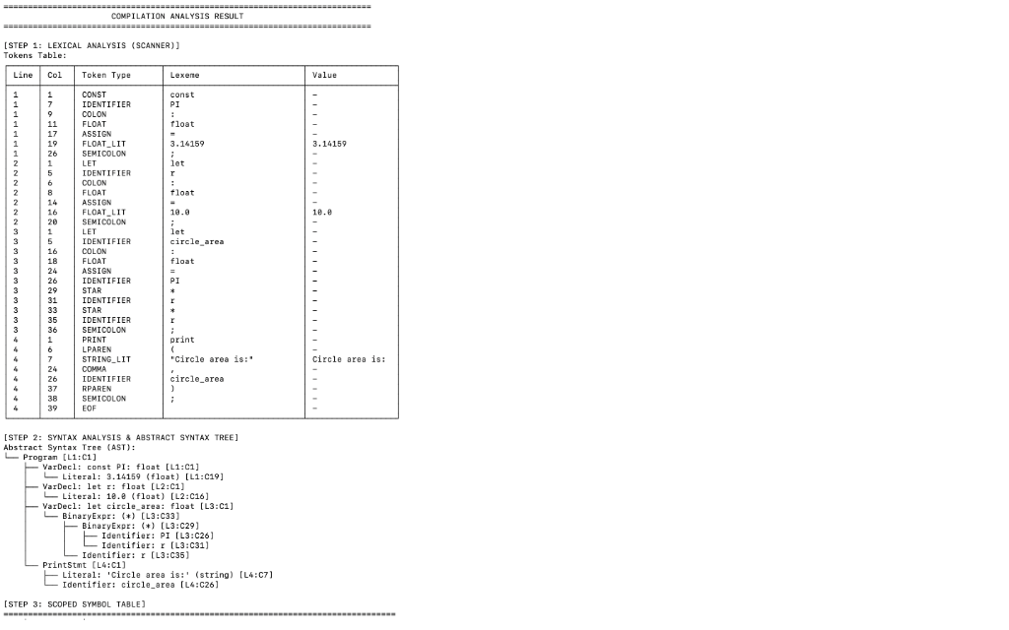
WORKING EVIDENCE
Working Prototype Demonstration -- Lexical & Syntax Analysis
Interactive Input Test Case
- Problem Evaluated:
User-input circle area calculation.
- Input Source:
const PI: float = 3.14159;
let r: float = 10.0;
let circle_area: float = PI * r * r;
print('Circle area is:', circle_area);
- Front-End Verification:
• Lexer identified all 39 tokens with coordinates.
• Parser built hierarchical AST with correct operator precedence (* binds tighter than +).
• Zero syntax or lexical errors.

Slide 12
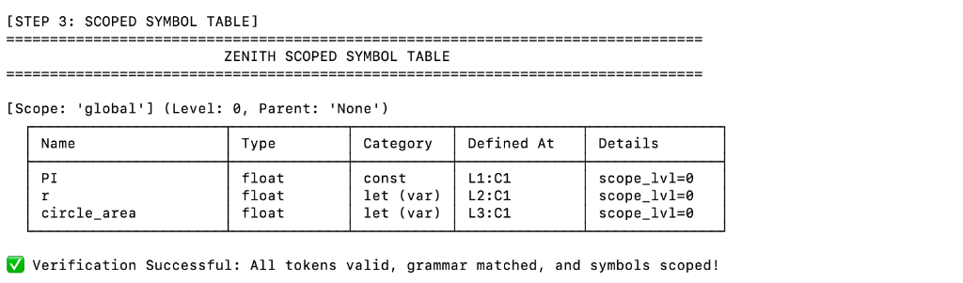
EXECUTION EVIDENCE & ROADMAP
Scoped Symbol Table Verification & Future Phases
Phase 2: Core Implementation
Phase 3: Optimization & VM
- Static Type Checking across expressions.
- Function signature & return type verification.
- Immutability enforcement (prevent reassigning to const).
- Three-Address Code (TAC) quadruple generation.
- Machine-independent TAC optimizations (Constant folding, DCE).
- Stack-based virtual machine execution of intermediate bytecode.
- Comprehensive boundary testing & performance evaluation.
- Final project documentation and demonstration.

