Slide 1



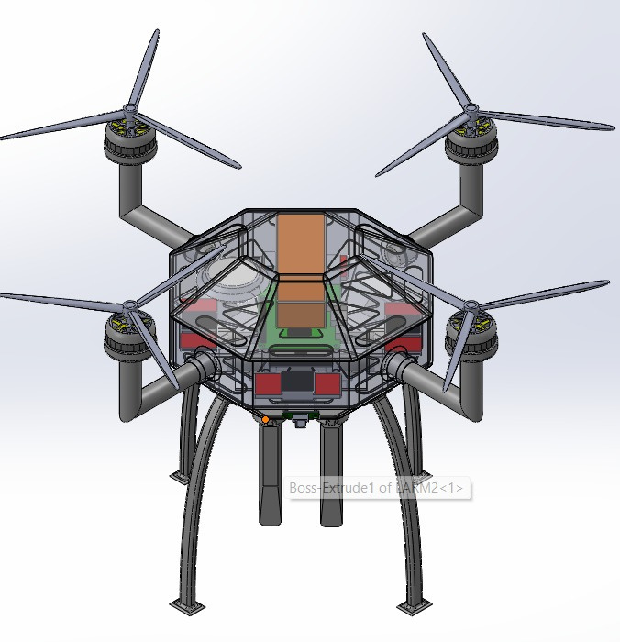
Design presentation: Autonomous Disaster-Response Multirotor UAS
Presented by team udaan
Team UDAAN
Team ID : AT2025054
College : National Institute of Technology, Rourkela
14th June, 2025

Slide 2
Motivation & objectives
Our team’s effort is motivated by the critical need for rapid, reliable aerial support in disaster-stricken areas. Conventional aircraft often cannot navigate collapsed structures or narrow passages common in urban disaster zones. By developing a compact, vision-equipped UAS, we aim to provide real-time situational awareness and precise payload delivery—capabilities that can significantly accelerate search, rescue, and relief efforts when every second counts
Technical Requirements
UAS Type | Multirotor
UAS Category | Micro UAS
UAS MTOW | 2 kg
Payload Capacity | 200 g
Propulsion System | Electric
Communication Range | At least 1kg
Objectives:
Onboard vision-based intelligence with pretrained ML model
Reliable payload delivery in complex environments
High maneuverability in constrained spaces and cluttered environments
Stable flight performance in disaster-affected areas
Real-time object detection and classification
Navigate collapsed urban structures and narrow alleys

Slide 3
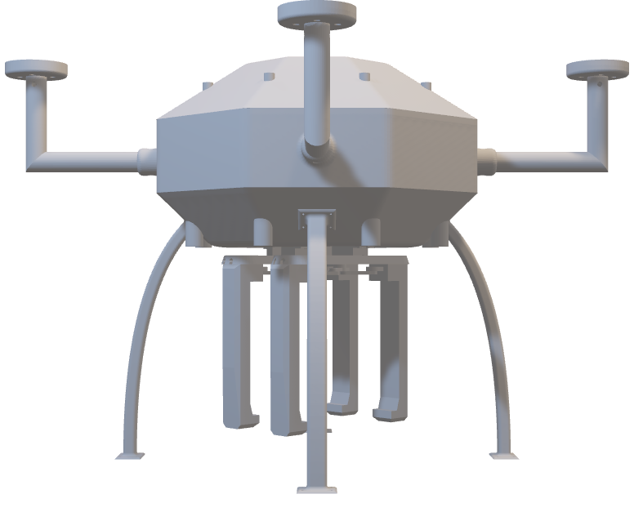
UAS DESIGN WORKFLOW
Mechanical System
Electronics System
Autonomous System

Slide 4
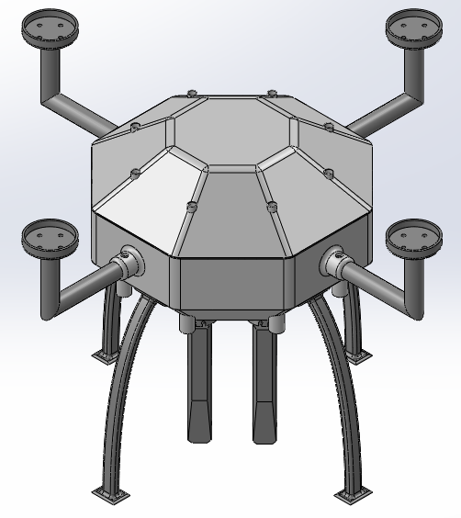
Mechanical system
These systems collectively determine the structural integrity, aerodynamics, and mechanical reliability of the drone.
Objectives:
Structural Integrity
Compactness and Maneuverability
Weight Optimization & Stability
Aerodynamic Efficiency
Material Cost-Effectiveness
“The best design is the simplest one that works.” -Albert Einstein

Slide 5
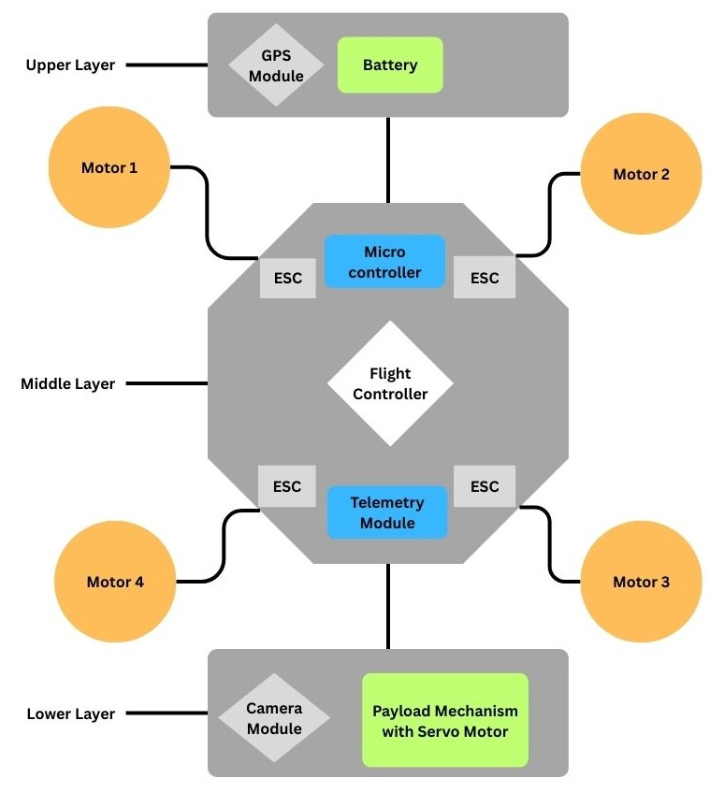
Conceptual design
Upper Layer (Battery & GPS):
Battery placement near the propeller plane minimizes CG shift.
GPS module sits atop this layer for an unobstructed sky view, enhancing positional accuracy.
Middle Layer (Flight Controller, ESCs, Microcontroller):
Flight controller centrally located at the CG to reduce rotational inertia.
ESCs and microcontroller flank the controller, shortening wiring runs and isolating electrical noise.
Key Benefits:
Stability: Centralized mass distribution around the CG yields balanced lift and responsive control.
Modularity: Stacked decks allow straightforward integration of additional sensors or payloads without redesigning the entire frame.
Protection: Sealed housings and ordering of electronics (battery above, sensitive controllers in the middle, payload below) safeguard components against dust, moisture, and mechanical shocks.
Lower Layer (Payload Mechanism & Camera):
Payload release mechanism hangs below the CG to ensure clear drop paths without interfering with other systems.
Camera mounted on this layer enjoys a low-vibration, clear field of view for real-time vision processing.

Slide 6

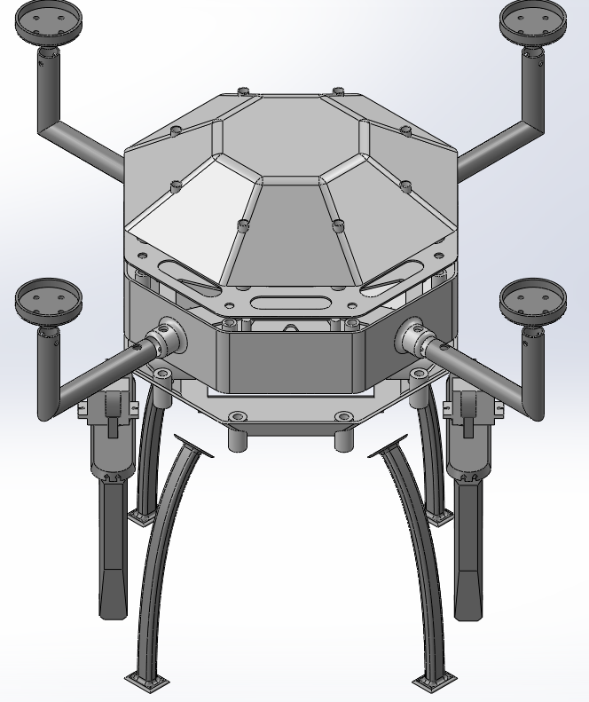
Mechanical design
Motor Mount
The motor mounts are constructed from carbon fiber to ensure high stiffness and minimal weight, effectively transmitting high-RPM torque and thrust without adding mass. Their dimensional stability under thermal and mechanical stress maintains precise motor alignment, reducing vibrations and preventing imbalances. Integrated vibration damping enhances sensor performance by isolating motor oscillations from the avionics
Rotor Arm
The rotor arms are designed using carbon fiber for a high strength-to-weight ratio, providing stiffness to prevent bending during flight. Their tubular L-shaped structure ensures rigidity with minimal weight. The upward extension allows for larger propellers to enhance thrust, offers clearance for wiring protection, and maintains an unobstructed camera view. The lightweight design reduces rotational inertia, improving flight responsiveness and battery efficiency, while excellent fatigue and environmental resistance ensure long-term durability.
Landing Gears
The landing gear is made of carbon fiber, offering excellent impact absorption to protect the fuselage and payload during landings. Its lightweight and durable structure ensures stable ground clearance while minimizing mass to extend flight time. Designed with optimal height, it prevents interference with the payload mechanism and provides ample propeller clearance. The gear maintains stiffness and shape over repeated use and harsh conditions, withstanding temperatures from −40 °C to +70 °C and resisting moisture and UV degradation for long-term reliability.

Slide 7
Mechanical design
Top Cover
The top cover is aerodynamically optimized with a reduced angle to minimize drag while maintaining internal volume. Made from ABS plastic, it offers a low-drag surface and heat resistance up to 105 °C, protecting against battery heat. Its design allows integration of sensor cutouts, vents, and mounts in a single print, reducing hardware complexity. The material’s dimensional stability ensures reliable protection for critical components like the flight controller, GPS, and telemetry systems under varying environmental conditions.
Central Hub
The central hub features an octagonal shape with 180 mm spacing between opposite sides, designed to house all key components in a compact layout. It is built with three stacked layers to ensure balanced weight distribution and structural organization. Carbon fiber is used in high-stress areas for superior strength and stiffness, while ABS plastic is chosen for the hub body to reduce costs without compromising durability.
Bottom Cover
The bottom cover is aerodynamically contoured to reduce drag while preserving internal volume. Made from ABS, it offers strong abrasion resistance against rough surfaces like gravel or concrete, maintaining structural integrity. It supports 200 payload without bending, preserving center-of-gravity alignment. Custom features such as mounting bosses, wiring slots, and sensor ports are integrated into the print, reducing hardware and enabling rapid payload changes. Its low-cost, quick-replacement design allows field teams to swap damaged panels efficiently, enhancing operational readiness.

Slide 8
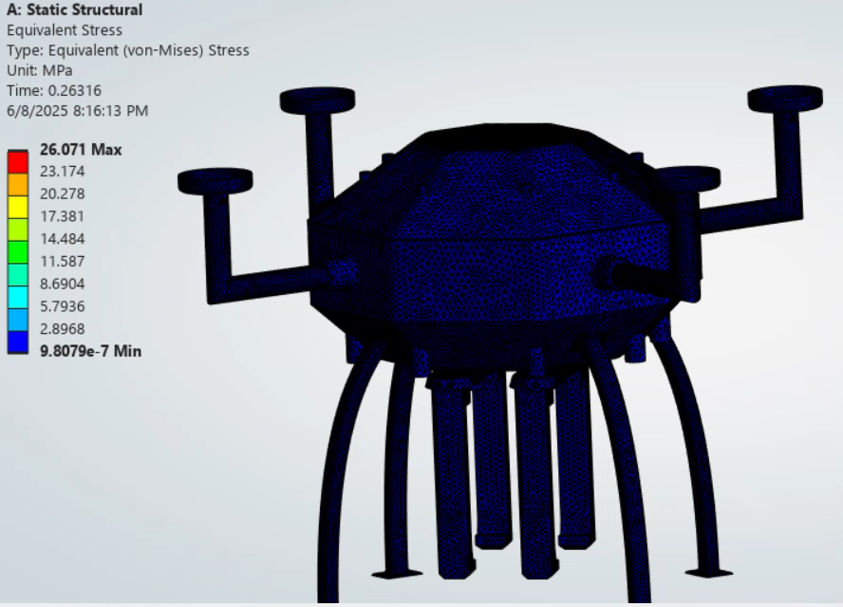
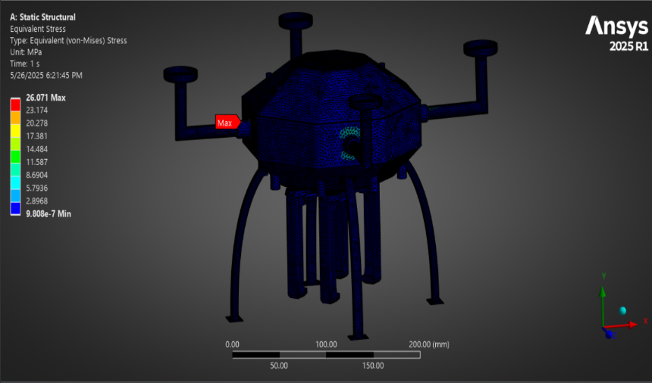
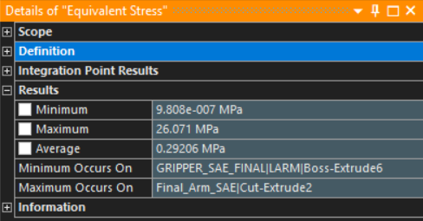
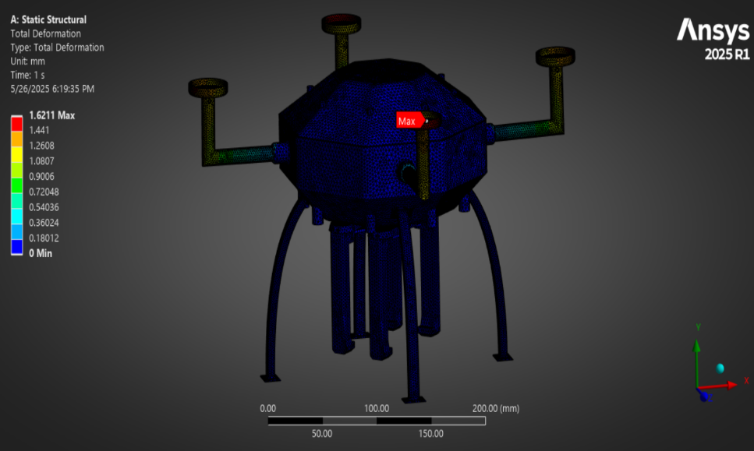
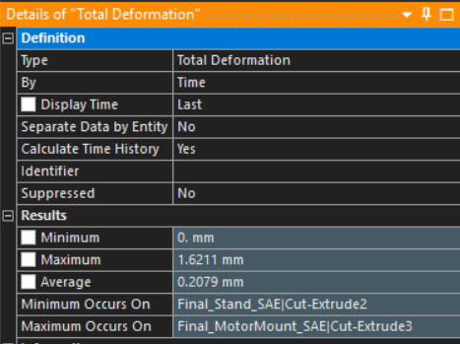
Computational Analysis
Static Structural Analysis
Pre-Processing
Materials: Carbon Fiber (230 GPa) and ABS Plastic (High Impact)
Processing
Boundary Conditions: Base of landing gears fixed
Results
Total Deformation: Highest deformation observed at distal end of carbon-fiber motor mounts (well within material limits)
Contacts: Bonded between mating surfaces
Mesh Details:
Motor mount, rotor arm, landing gear: 2 mm element size
Central hub: 3 mm element size
Payload mechanism: 2.5 mm element size
Element quality target: ≥ 0.20 (majority of elements meet this criterion)
Loads:
Thrust: 25 N upward on each motor mount base
Gravity: Standard Earth gravity downward
Payload: 2 N on gripping arm
Component weight: 13 N applied at hub base
Equivalent (Von Mises) Stress: Maximum stress appears at the rotor arm–hub junction (carbon fiber), remaining below carbon fiber’s yield stress; fasteners will secure components at these high-stress locations

Slide 9
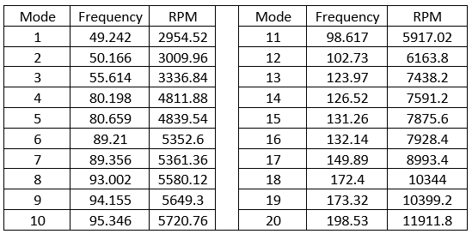
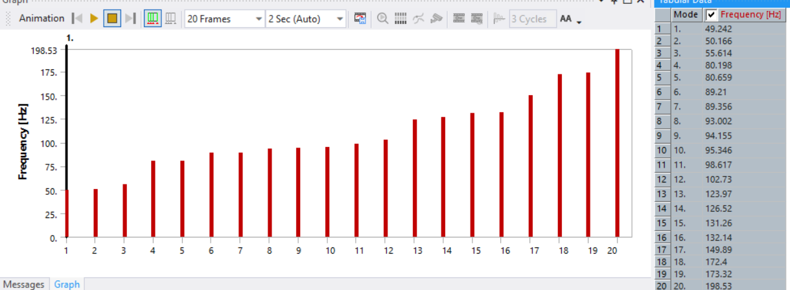
Computational Analysis
Pre-Processing
Materials: Carbon Fiber (230 GPa) and ABS Plastic (High Impact)
Processing
Boundary Conditions: Base of landing gears fixed
Results
Identified modal frequencies; confirmed that typical operating motor RPM (> 11,000 RPM) falls outside critical modal frequency ranges, ensuring safe operation without resonance-induced failure
Contacts: Bonded between mating surfaces
Mesh Details:
Motor mount, rotor arm, landing gear: 2 mm element size
Central hub: 3 mm element size
Payload mechanism: 2.5 mm element size
Element quality target: ≥ 0.20 (majority of elements meet this criterion)
Computed first 20 natural frequencies (modal frequencies) of entire structure
Modal Analysis
Frequency & RPM

Slide 10
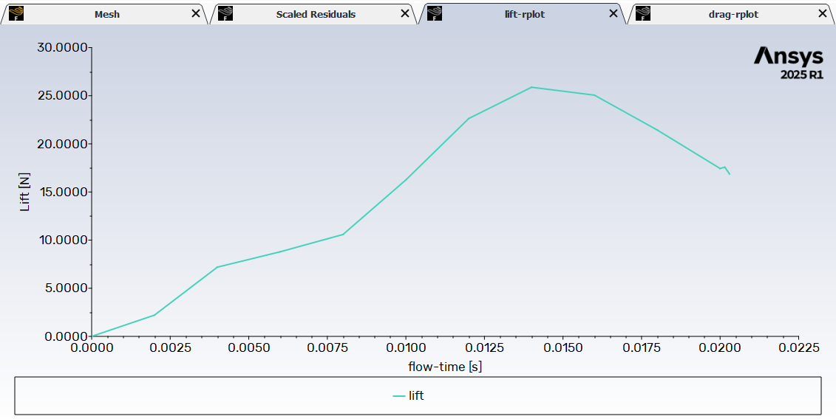
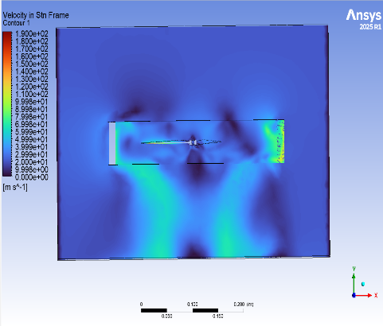
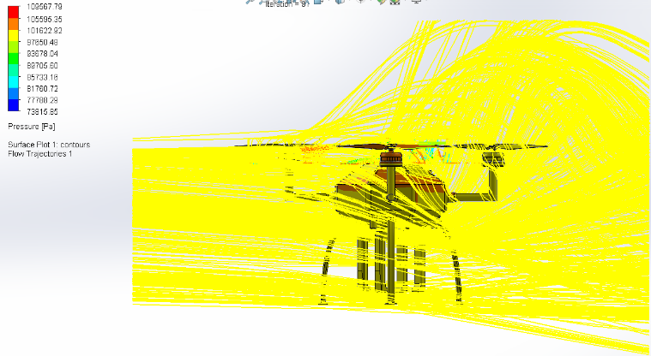
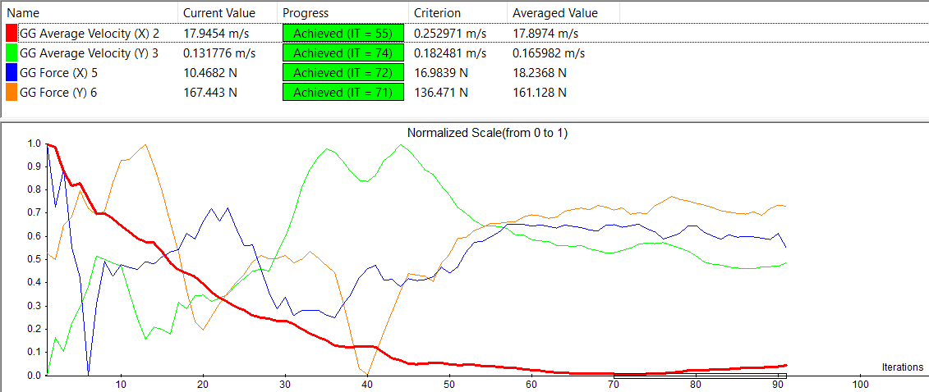
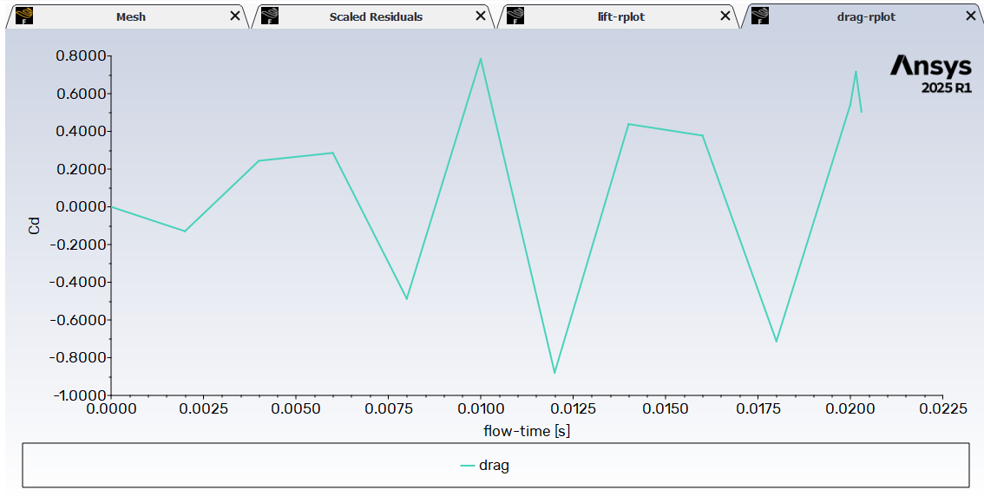
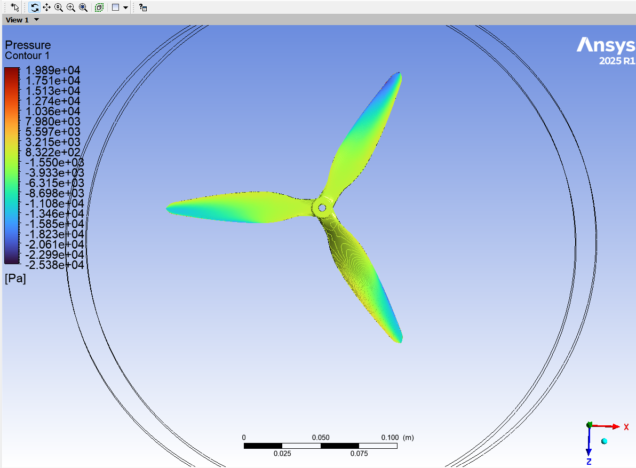
Computational Analysis
Aerodynamic Analysis
Domain Setup
Geometry: Enclosed “box” around full UAS geometry
Boundary Condition
Propellers: 23,000 RPM imposed on rotational domains
Results
Flow Patterns: Majority of flowlines bypass the frame; some impinge and rebound due to optimized top/bottom cover angles that balance drag reduction and internal volume
Rotational Domain: Cylindrical regions around each of the four propellers, assigned opposite‐spin directions (two clockwise, two counterclockwise)
Mesh:
Rotational (propeller) domain: 2 mm element size
External (static) domain: 10 mm element size
Inlet Wind: 20 m/s velocity in the X-direction
Fluid & Model: Air medium; K-omega SST turbulence model; ABS material properties assigned to propeller surfaces
Other Conditions: Standard gravity and atmospheric pressure
Drag Reduction: Reduced frontal area and cover angles yield lower drag coefficients while maintaining internal space
Propeller Thrust: Single-propeller analysis (20,000 RPM, 20 m/s wind) produced a maximum thrust of ≈ 25 N
Coefficient of drag ranged within (–0.8, 0.8) over simulation conditions.
Figure – Flowlines about UAS
Figure 18 -Drag Analysis of UAS

Slide 11
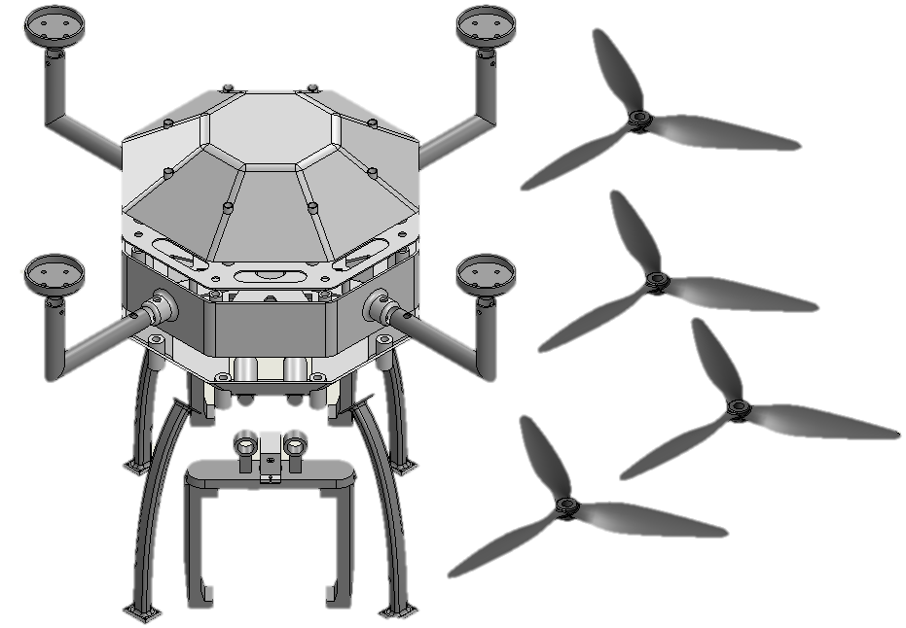
Center of gravity & stability
Center of Gravity
Importance: An accurately placed CG is essential for balanced lift, control responsiveness, and overall flight performance.
Desired CG Positioning:
Horizontal: At the geometric center of the “X” formed by the four motor arms, ensuring uniform lift from each propeller.
Vertical: At or just below the propeller plane.
A higher CG (closer to prop plane) improves positional stability (e.g., hover), yet may reduce speed stability.
A lower CG (below prop plane) enhances speed stability but can slightly compromise hovering precision.
Methodology (SolidWorks Mass Properties):
Assemble Full CAD Model: All structural and electronic components (frame, motors, battery, flight controller, sensors, etc.) are positioned in their intended locations.
Hand Calculation: Using measure feature to estimate the distance of different components from origin and CG is calculated using formulas.
Preliminary Coordinates (Approximate):
𝑥 = -0.20 mm
𝑦 = +1.08 mm
𝑧 = +28.94 mm
Figure 24 - Exploded Final CAD

Slide 12
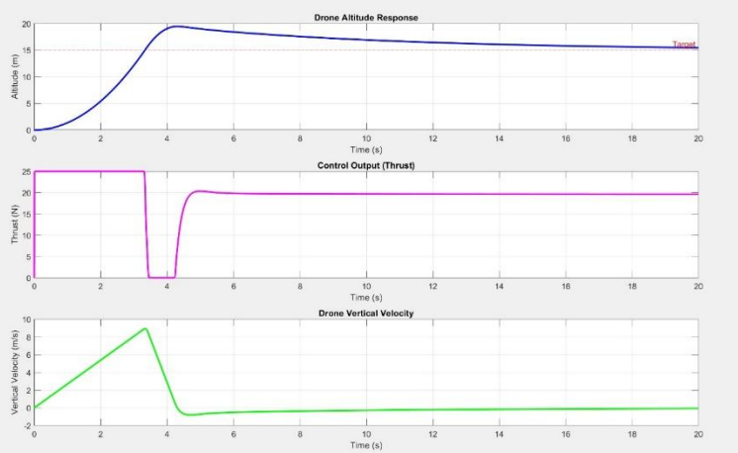
Center of gravity & stability
Stability Analysis
Control System Validation (MATLAB Simulation)
Simplified vertical dynamics model including thrust and air damping
PID Controller implemented for altitude regulation
Tuned PID Parameters
Proportional Gain (Kp): 30
Integral Gain (Ki): 50
Derivative Gain (Kd): 10
Simulation Insights
Smooth altitude response with no overshoot
Thrust control remains within safe limits
fig. MATLAB Simulation for Stability Analysis

Slide 13


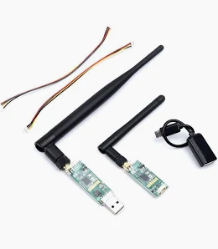
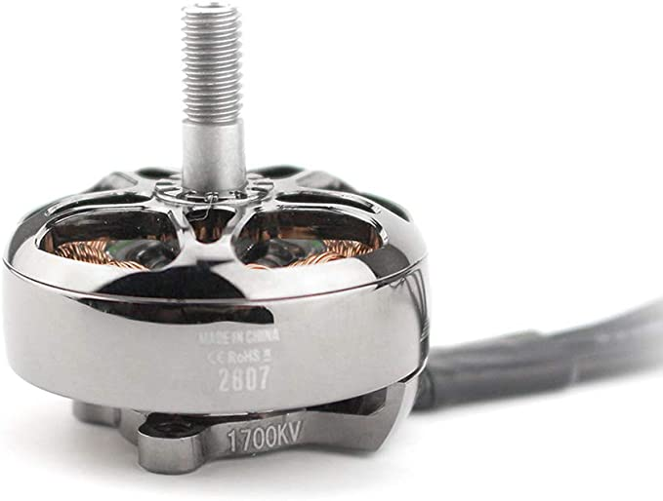
Electronics & Communication Systems
UAS electronics integrate flight controllers, power management, sensors , and onboard computing, while communication systems employ radio telemetry, RF links, and ground station interfaces for data exchange and control.
Objectives:
Stable Power Distribution
Precise Flight Control & Navigation
Reliable Telemetry
Onboard Processing
Environmental Sensing
robu.in

Slide 14
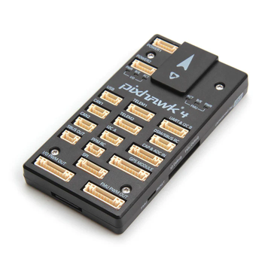
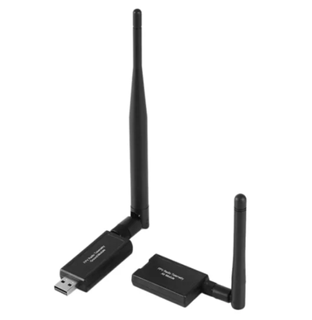
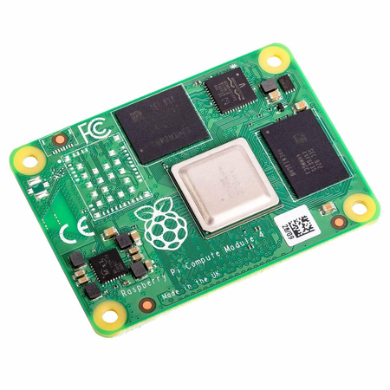
Subsystem Selection
Communication System
Control & Navigation
Pixhawk–Raspberry Pi Interface
Pixhawk 4: Real-time flight control and stabilization
Neo M8N GPS: High-precision navigation with RTK support
Raspberry Pi 5: Onboard object detection, sensor fusion, and decision-making
Mission Planner: GUI-based flight planning with RTH and waypoint support
3DR 433MHz Telemetry Radio Compatible with MAVLink & Mission Planner
UART Communication: Enables bidirectional data flow (telemetry, commands)
I2C Integration: High-accuracy data for environmental monitoring

Slide 15
Avionics and Sensors
Avionics & Sensors
System Integration
Functional Performance
Analog Camera: Real-time video, object detection (YOLO)
MQ2 Gas Sensor: Detects LPG, CO, CH₄, smoke, etc.
GL5537 LDR: Ambient light monitoring for camera adaptation
ADS1115 ADC: Converts analog signals to digital (for MQ2, LDR)
Ultrasonic Sensor: Flood-level detection & obstacle avoidance
Servo Motor: Controls object-grabbing gripper arm
All sensors feed data to the microcontroller for real-time processing.
Microcontroller communicates with Pixhawk for autonomous flight decisions.
YOLO processes video feed for AI-based object detection.
Pixhawk handles waypoint navigation using GPS input.
Environment data enhances decision-making and mission adaptability.
Navigation: GPS-based waypoint missions via Pixhawk
Object Detection: AI-driven object recognition using camera + YOLO
Object Interaction: Servo-triggered payload delivery system
Environment Monitoring: Real-time humidity, temperature, gas, light sensing

Slide 16
UAS Performance Estimation
Power Requirements
Battery Selection
Endurance Estimation
Total Estimated Power: ~270 W
Motors (4x EMAX ECOII 2807): 235.2 W
Raspberry Pi 5: 10 W
Pixhawk 4 Flight Controller: 1.5 W
BEC Module(5V@3A): 15 W
Sensors & Peripherals (SHT31, MQ2, LDR, ADS1115, GPS, servos, etc.): < 5 W
Theoretical Maximum Flight Time: ~20 minutes (88.8 Wh / 270 W)
Practical Flight Time (with reserve): 12–15 minutes
Designed for short-duration autonomous missions such as survey and payload delivery
Battery: 14.8V, 6000mAh (88.8 Wh), 50C LiPo
Key Characteristics:
High energy density, low weight
300 A peak discharge capability
Stable voltage under high load
Suitable for aggressive flight maneuvers and critical missions

Slide 17

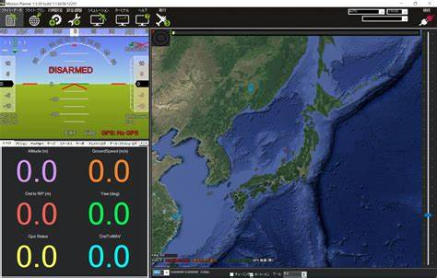
Autonomous Systems
The autonomous system uses Mission Planner with Python scripts to generate optimized waypoints, employs onboard YOLO processing for object detection, integrates multi-sensor fusion, and supports fail-safes via real-time telemetry.
Objectives:
Optimized Waypoint Navigation
Real-Time Hazard & Survivor Detection
Multi-Sensor Fusion
Autonomous Payload Deployment
Robust Fail-Safes

Slide 18
Autonomous mission methodology
Operational Workflow
1. Mission Initialization:
Pre-planned waypoint generation using Mission Planner or Python scripts.
Trajectories are optimized for minimal energy consumption and maximum coverage.
2. Real-Time Environment Mapping:
YOLO v8 model used for fast object detection.
U-Net segmentation ensures precise boundary detection of features like debris, flood zones, and collapsed structures.
Fused with multi-sensor data (temperature, gas, humidity) to validate detections.
Mission Planner: Ground control software that plans autonomous drone flights by generating waypoints, managing geo-fenced boundaries, and monitoring telemetry data in real-time.
Target Confirmed
Hover & Stabilize
Estimate Distance (Monocular Depth)
Generate Waypoint (Align over Target)
Descend to Low Altitude (10 m)
Verify Drop Success
Activate Servo Motors (Release Payload)
Ascend & Return
YOLO (You Only Look Once): A real-time object detection model that identifies objects like floods, debris, or humans in drone imagery using bounding boxes and confidence scores. A recent version of the You Only Look Once real-time object detection system is Yolov8, offering improved speed and accuracy for identifying objects (like floods, humans, or debris) in drone imagery through bounding boxes and class predictions.

Slide 19
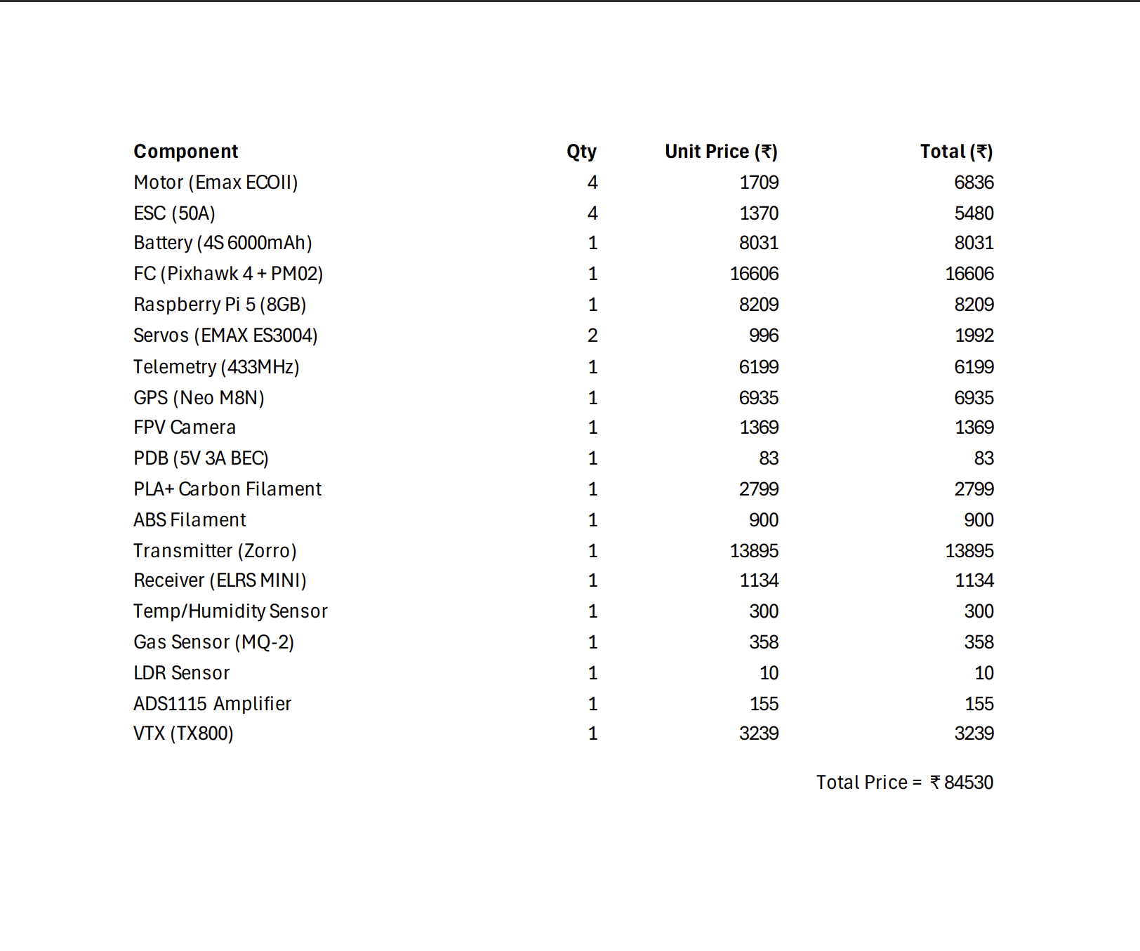
Bill of materials

Slide 20
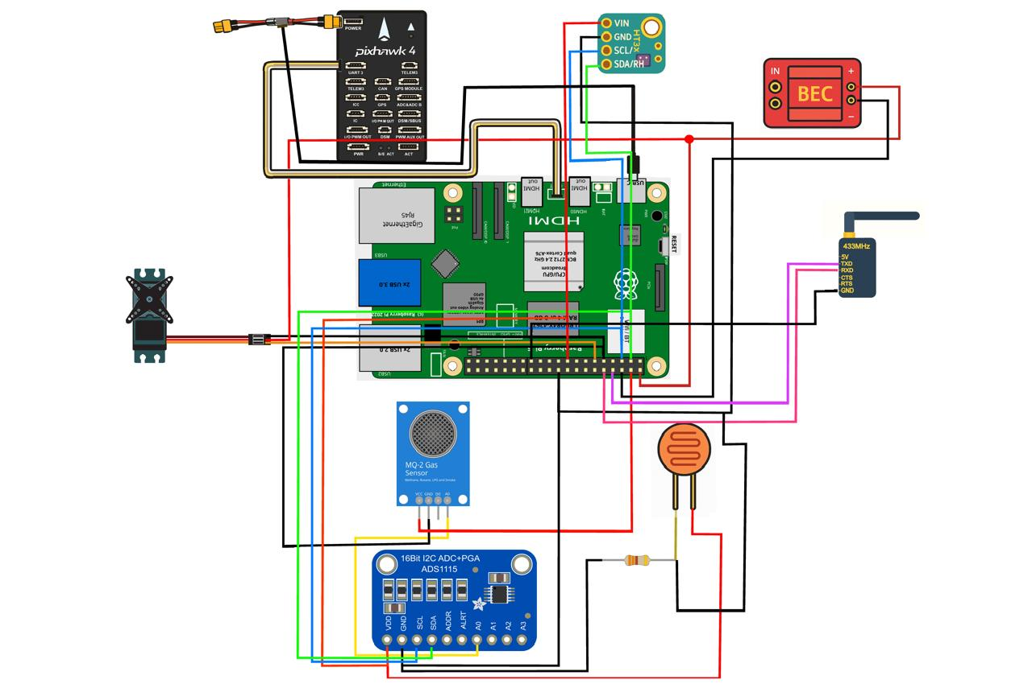
Final uas specifications
S No. | Parameter | Specification
1 | UAS Type | Quadcopter
2 | Propulsion System | Electric
3 | Weight | 1570.54 g
4 | Payload | 200 g
5 | Thrust-to-Weight | 3.4:1
6 | Flight Time | 15-20 min
7 | Cost | 85000 (Approximate)
Figure 25 - Circuit Diagram
Key innovations:
Rotor Arm Design
Material Integration
Fastener Usage
Integrated Sensor Suite
Geo-Tagging of Humans
Target Detection Methodology
Off-Loading
Key innovations include upward-extending rotor arms for enhanced propeller sweep and aerodynamic efficiency, and carbon fiber–ABS integration ensuring structural strength with lightweight, modular design. A robust multi-sensor suite (RGB, gas, temperature, humidity, ultrasonic) enables accurate environmental detection. YOLOv8 allows real-time survivor geo-tagging, while time-synchronized logs support edge off-loading, reducing thermal stress and enabling future drone swarming applications.

Slide 21
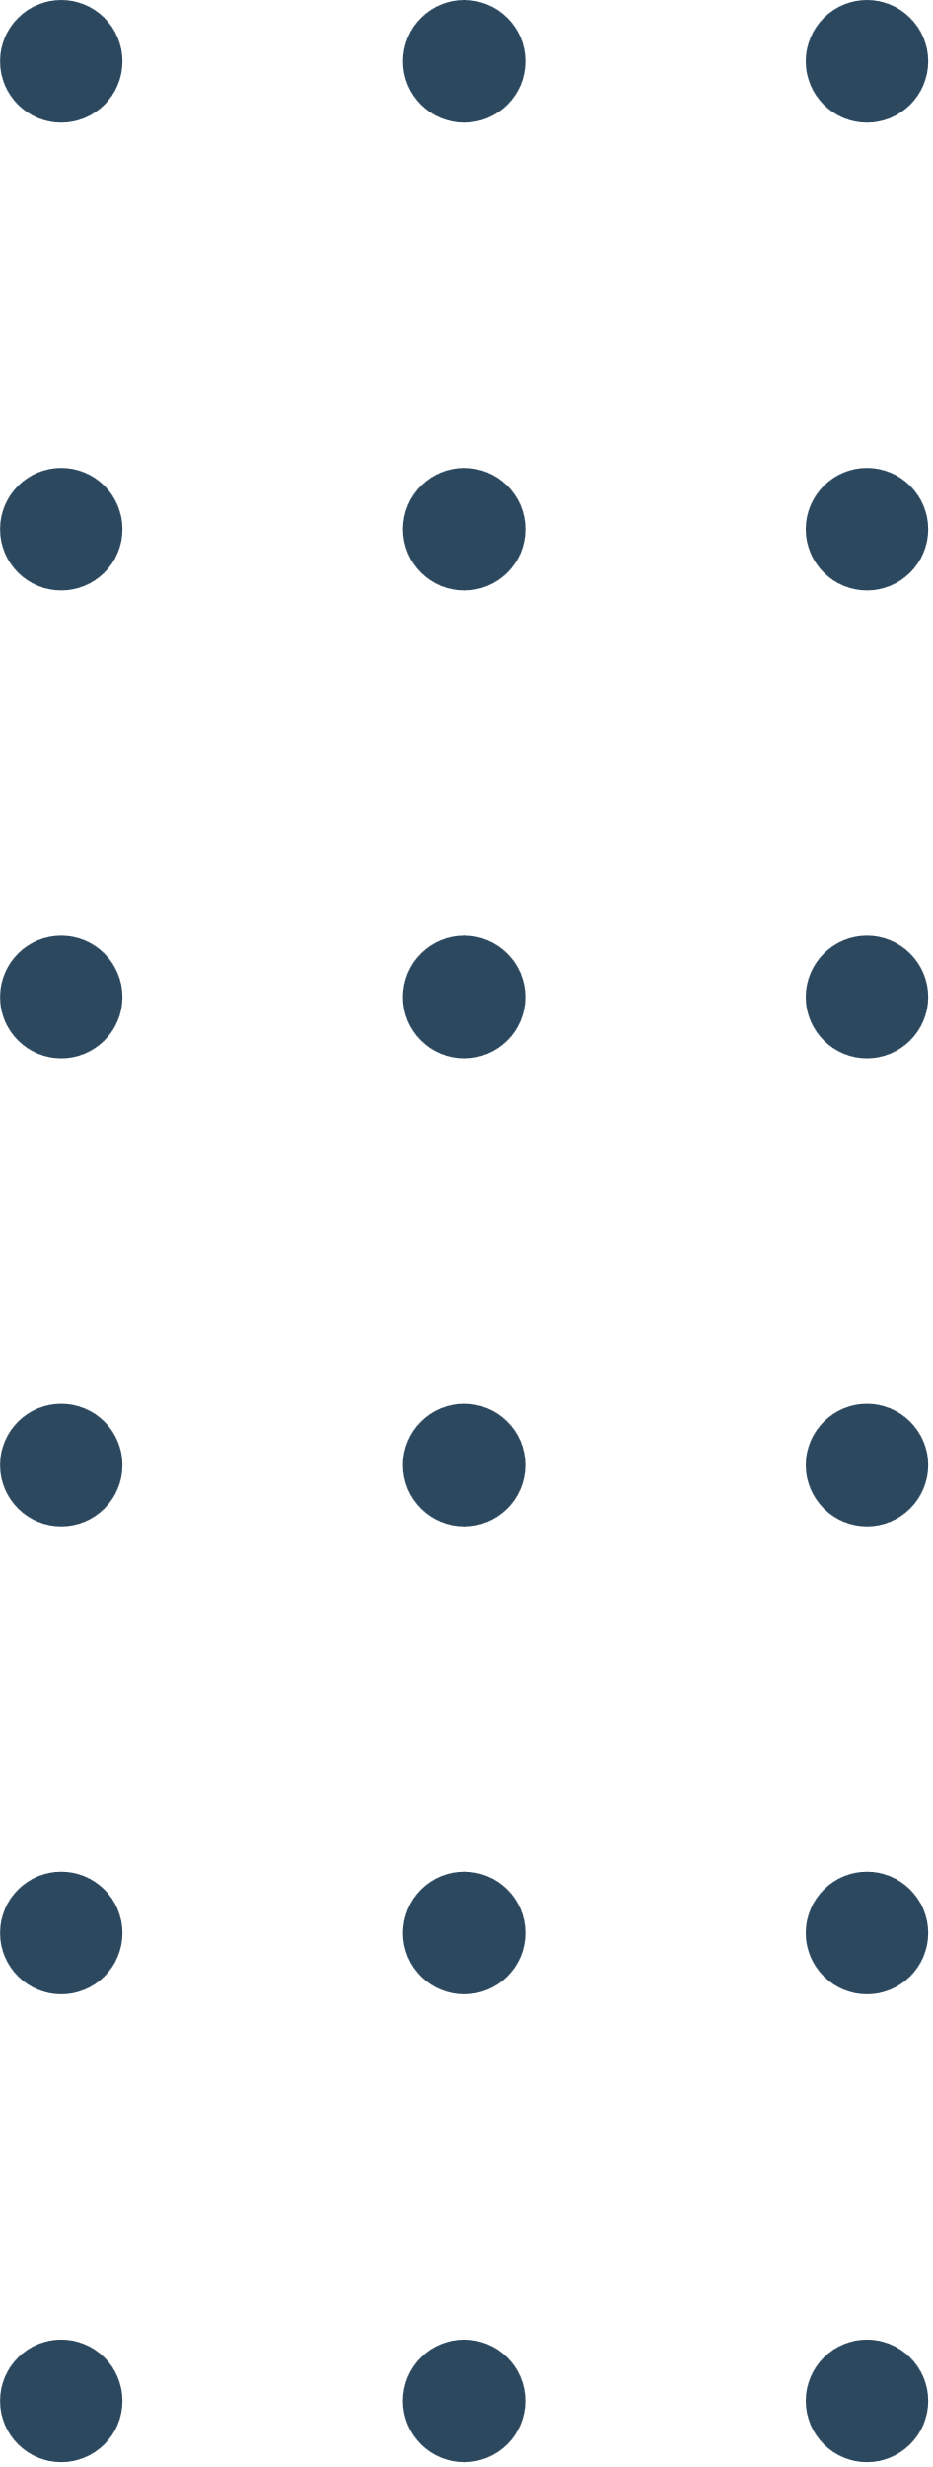
Thank You

