Slide 1
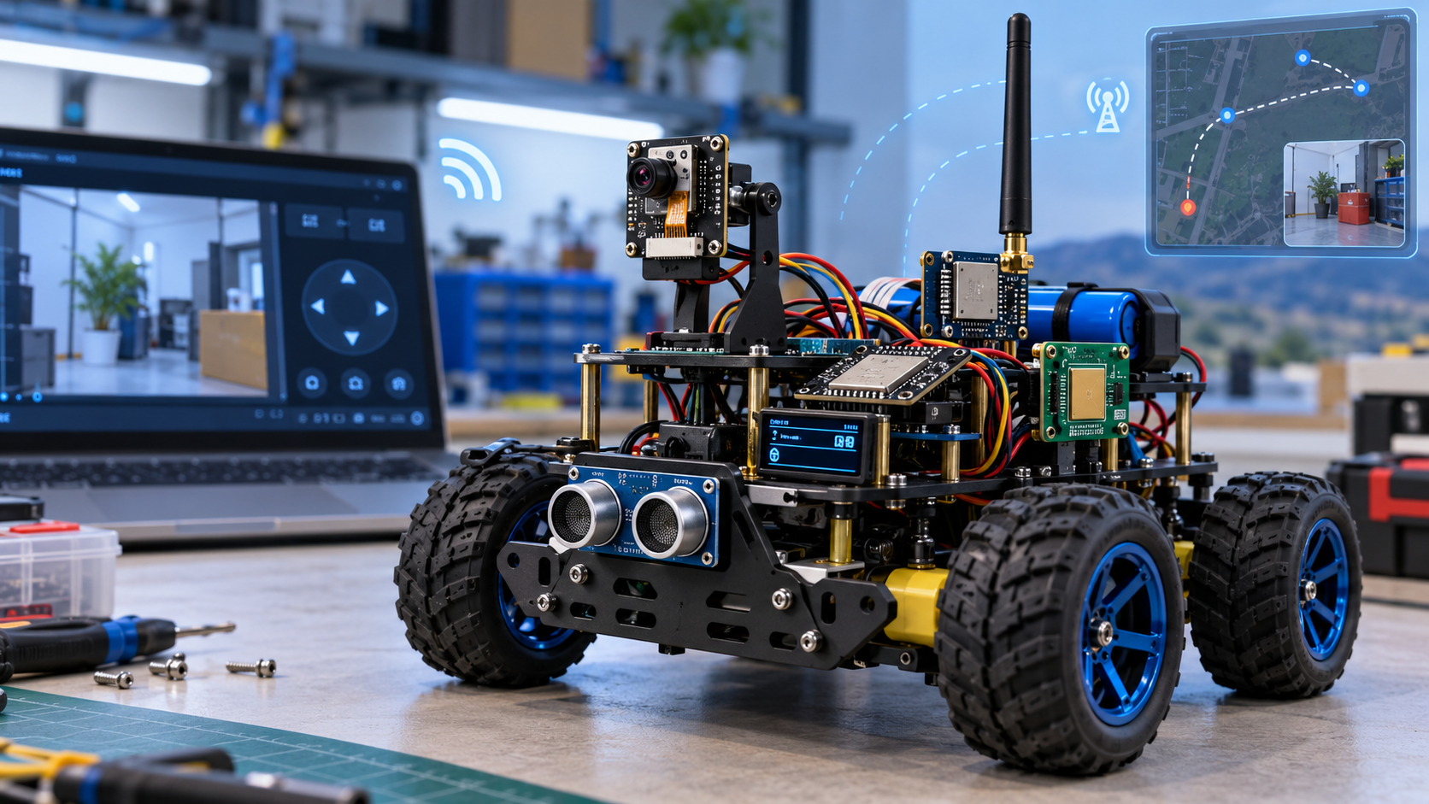
HACKATHON GRAND FINALS • ROBOTICS & EMBEDDED EDGE-AI
AURA-X
AI-POWERED EXPLORATION ROVER
CORE THESIS:
Bridging cloud-level multimodal AI reasoning with zero-latency embedded motor safety over an asymmetric LoRa/Wi-Fi architecture.
DUAL RF SPECTRUM
433 MHz LoRa commands + 2.4 GHz Wi-Fi video stream.
LOCAL DETERMINISTIC SAFETY
FreeRTOS motor kernel + ultrasonic obstacle envelope.
SCHEMA-BOUNDED AI
GPT-4o Vision advisory engine; strict JSON allowlists.
5-TIER GRACEFUL FAILOVER
Mission continues safely even if cloud or Wi-Fi drops.
CONCEPT PROTOTYPE EMBODIMENT
Illustrative benchmark representing the target mechanical layout, split-band antenna array, articulated vision turret, and all-terrain suspension.
DOMAIN: Robotics • Embedded Systems • Sub-GHz IoT • Cognitive Vision
TEAM: Sangola Engineering Cohort | Presentation & Technical Defense
Notes:
=== TALK TRACK (30-40 SECONDS) ===
Good morning judges. We are thrilled to introduce AURA-X, an AI-powered autonomous exploration rover designed for remote inspection in challenging, GPS-denied environments. Today, robotics faces a paradox: modern AI gives robots immense cognitive understanding, but tethering motor control to the cloud introduces catastrophic safety risks when network links fail. AURA-X solves this fundamental problem through a decoupled architecture: the cloud provides high-level multimodal reasoning, while onboard FreeRTOS firmware guarantees zero-latency deterministic safety over an asymmetric LoRa and Wi-Fi backbone.
=== KEY TAKEAWAY FOR JUDGES ===
AURA-X bridges high-level cloud AI with hard real-time embedded safety using an asymmetric dual-band communication architecture.
=== VERBAL TRANSITION TO NEXT SLIDE ===
To understand why this decoupled architecture is necessary, let us look at the hostile environments our rover is designed to tackle.
=== TECHNICAL DEEP DIVE (JUDGE Q&A DEFENSE) ===
Explain that the hero rendering represents the mechanical design target, while our hardware prototype implements the verified dual-MCU split-rail architecture described in our engineering report.

Slide 2
PROBLEM STATEMENT • MISSION CRITICAL CHALLENGES
The Inspection Dilemma in Hostile & GPS-Denied Zones
Why traditional robotic inspection systems fail inside collapsed structures, industrial ducts, and disaster areas
RF BLINDNESS & WI-FI DROPOUTS
The 2.4 GHz Range Barrier
• Reinforced concrete, steel ducting, and sub-surface rubble rapidly attenuate 2.4 GHz Wi-Fi within 15–20 meters.
• High packet loss causes remote video streams to freeze and telemetry links to sever.
• Standard cloud-tethered rovers become paralyzed or drive blindly into hazards the moment Wi-Fi signal drops.
THE CLOUD-LATENCY SAFETY TRAP
The 800ms–3000ms Latency Gap
• Offloading low-level motor obstacle avoidance to remote cloud APIs introduces unpredictable 1–3 second network round-trips.
• At typical exploration speeds, a rover travels 30–90 cm before the cloud returns an obstacle response—causing kinetic collisions.
• LLM hallucinations can generate unvalidated, dangerous actuator commands.
PROHIBITIVE COSTS & HUMAN ENTRY
The High Barrier to Deployment
• First responders and industrial technicians are still forced to physically enter toxic chemical ducts, mine shafts, and unstable ruins.
• Commercial inspection robots (Boston Dynamics, Clearpath) cost $15,000 to $50,000+, preventing expendable tactical deployment.
• Cheap hobbyist kits lack deterministic safety loops and fail instantly.
THE ARCHITECTURAL PARADOX:
Current robotics forces a dangerous compromise: either rely on a brittle cloud connection that causes physical crashes when latency spikes, or strip away all cognitive intelligence to stay stable. AURA-X eliminates this trade-off.
Notes:
=== TALK TRACK (30-40 SECONDS) ===
When disaster strikes—whether it is an earthquake collapse, an underground gas leak, or an industrial pipeline rupture—every second counts. Today, rescue teams face a brutal dilemma. Commercial robots like Spot cost upwards of thirty thousand dollars, making them far too expensive to risk in hazardous voids. Meanwhile, entry-level telepresence rovers rely on 2.4 GHz Wi-Fi. In rubble and metal ducting, Wi-Fi dies within 15 meters. If the robot relies on cloud AI for navigation, a two-second latency spike means it crashes before the cloud even knows an obstacle exists.
=== KEY TAKEAWAY FOR JUDGES ===
Remote inspection fails because cloud latency cannot guarantee physical safety, and 2.4 GHz Wi-Fi cannot penetrate rubble.
=== VERBAL TRANSITION TO NEXT SLIDE ===
Let us examine how existing commercial and research solutions attempt to solve this, and why they fall short.
=== TECHNICAL DEEP DIVE (JUDGE Q&A DEFENSE) ===
Cite attenuation physics: 2.4 GHz RF suffers approximately 10 to 20 dB of attenuation per standard concrete wall, whereas sub-GHz LoRa (433 MHz) achieves 15 to 20 dB greater penetration margin.

Slide 3
MARKET BENCHMARK • SYSTEM COMPARATIVE ANALYSIS
Comparative Analysis: Where Current Paradigms Fail
Evaluating traditional RC telepresence, cloud-dependent IoT bots, and industrial UGVs across deployment criteria
Architecture Paradigm | RF Penetration | Control Latency | Cloud Dep. | Est. Cost | Fail-Safe Resilience | Cognitive AI
Consumer RC / FPV Rovers | Poor (<25m in rubble) | <50ms (Manual) | None | $80 - $150 | None (Dead link = lost) | None (Eyes only)
Cloud-Tethered IoT Bots | Severe RF dropouts | 1.5s - 3.5s (API lag) | 100% Critical | $400 - $900 | Catastrophic crash | High (Unconstrained)
Industrial Mil-Spec UGVs | Proprietary Sub-GHz | Real-time edge | None (Jetson) | $20k - $60k+ | High (Heavy compute) | Local CV / No LLM
AURA-X Decoupled System | Dual: 433MHz + 2.4GHz | Zero (FreeRTOS edge) | Decoupled (Advisory) | < $150 BOM | 5-Tier Graceful Failover | Schema-Constrained
THE ROOT CAUSE OF FAILURE:
Routing low-level motor PWM through cloud vision APIs creates an unrecoverable failure point whenever latency fluctuates.
THE AURA-X BREAKTHROUGH:
Decoupled control: The cloud plans missions; the onboard ESP32 enforces physics. Full functional safety on an accessible <$150 bill of materials.
Notes:
=== TALK TRACK (30-40 SECONDS) ===
Here is the competitive landscape. Consumer telepresence rovers lack all autonomy—if you lose line of sight, the rover is abandoned. Academic cloud bots attempt to run everything through LLMs or vision APIs, but that introduces seconds of delay, leading to guaranteed collisions. On the high end, industrial rovers from Clearpath or Boston Dynamics are brilliantly engineered with onboard Jetson GPUs, but they cost over twenty thousand dollars and cannot be risked as expendable scout units. AURA-X introduces a new fourth paradigm: delivering high-level cognitive vision on an ultra-accessible sub-150-dollar bill of materials, without ever trusting the cloud with motor safety.
=== KEY TAKEAWAY FOR JUDGES ===
AURA-X achieves industrial-grade reliability at hobbyist pricing by strictly decoupling AI reasoning from deterministic motor control.
=== VERBAL TRANSITION TO NEXT SLIDE ===
Now, let us examine how our four core architectural pillars implement this decoupled paradigm.
=== TECHNICAL DEEP DIVE (JUDGE Q&A DEFENSE) ===
Highlight that while Boston Dynamics relies on heavy $5,000+ onboard computing units, AURA-X offloads reasoning to an external laptop gateway over standard APIs while keeping the rover electronics lightweight and rugged.

Slide 4
CORE INNOVATION • ARCHITECTURAL PARADIGM
The AURA-X Solution: Decoupled Edge Intelligence
Separating high-level cognitive reasoning from low-level deterministic motor actuation across 4 core pillars
PILLAR 1: DETERMINISTIC EDGE SAFETY
Onboard ESP32 Real-Time Kernel
• Dedicated FreeRTOS motor control loop runs at deterministic cycle rates.
• HC-SR04 ultrasonic rangefinder hardware envelope (25–35 cm clearance) vetoes all forward motion instantly.
• Hardware emergency stop switch physically disables motor driver enable pins with 0ms software latency.
PILLAR 2: ASYMMETRIC DUAL-BAND RF
Split Spectrum for Data & Video
• 2.4 GHz Wi-Fi pipeline dedicated strictly for ESP32-CAM video streaming and high-res image capture.
• 433 MHz LoRa Chirp Spread Spectrum link carries heartbeat, framed telemetry, and structured commands.
• Video failure never disables rover telemetry, health reporting, or emergency braking.
PILLAR 3: SCHEMA-CONSTRAINED AI
Advisory High-Level Mission Planner
• Cloud GPT-4o Vision API is hosted on a ground laptop gateway—never exposing API keys or network bloat on the MCU.
• Natural language directives compile into strict JSON action schemas (M-001) with bounded leases (0.5–1.5s).
• Unrecognized actions or out-of-bounds speed parameters are rejected by firmware allowlists.
PILLAR 4: 5-TIER GRACEFUL FAILOVER
Zero Single-Point-of-Failure
• Tier 1: Full Cloud AI vision + Wi-Fi stream + LoRa telemetry.
• Tier 2: Local manual dashboard teleoperation if Cloud AI is down.
• Tier 3: LoRa telemetry & blind navigation if Wi-Fi camera severs.
• Tier 4: Autonomous reactive obstacle avoidance if all radios drop.
• Tier 5: Safe hardware stop latch on critical sensor fault.
THE AURA-X GOLDEN ARCHITECTURAL RULE: The Main ESP32 is the ultimate authority. The AI Gateway proposes intent; the rover firmware enforces physics.
Notes:
=== TALK TRACK (30-40 SECONDS) ===
To solve this problem, we established four core architectural pillars. First, deterministic edge safety: our main ESP32 controller runs FreeRTOS with hard-coded ultrasonic boundary checks that veto any forward motion if an obstacle is within 30 centimeters. Second, an asymmetric communication link: Wi-Fi carries camera video, while sub-GHz LoRa carries compact telemetry and commands. Third, schema-constrained AI: the cloud vision API suggests actions using strict JSON schemas, but the AI is advisory only. And fourth, a 5-tier graceful failover hierarchy: even if the cloud or Wi-Fi completely vanishes, the rover continues executing safe reactive obstacle avoidance.
=== KEY TAKEAWAY FOR JUDGES ===
The AI proposes high-level intent, but the local firmware retains absolute physical authority over actuation.
=== VERBAL TRANSITION TO NEXT SLIDE ===
Let us look at the full hardware and software architecture diagram that makes this possible.
=== TECHNICAL DEEP DIVE (JUDGE Q&A DEFENSE) ===
Explain that by enforcing a command lease (0.5 to 1.5 seconds), the rover will safely halt automatically if communication drops during a motion segment, preventing runaway robot conditions.

Slide 5
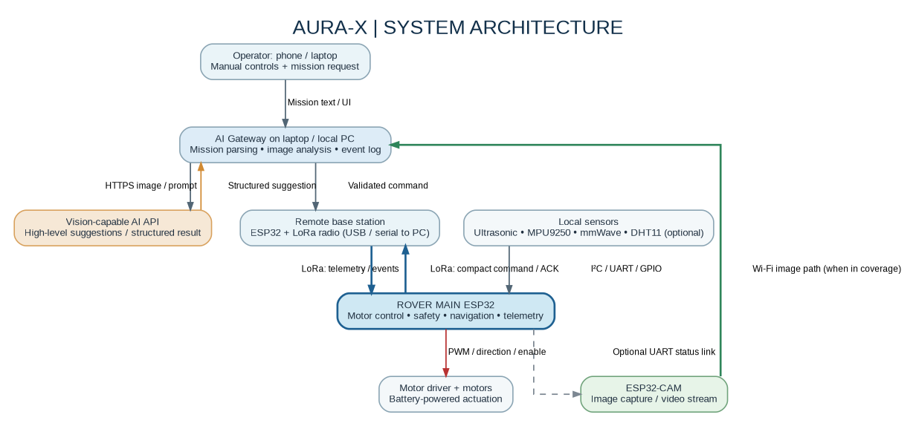
SYSTEM ARCHITECTURE • SUBSYSTEM BOUNDARIES
Distributed Subsystem Architecture & Boundary Enforcement
Clean physical and logical separation between rover real-time electronics, vision nodes, and ground mission control
ONBOARD MAIN ROVER (ESP32)
• Xtensa Dual-Core 240MHz MCU.
• Owns: Motor PWM, HC-SR04 timing, MPU-9250 IMU polling, SX1278 SPI LoRa link, and safety state machine.
• Must NOT own: Cloud API calls, image encoding, or blocking network I/O.
ONBOARD VISION NODE (ESP32-CAM)
• Dedicated OV2640 camera controller.
• Transmits JPEG snapshots & MJPEG streams over 802.11 b/g/n Wi-Fi directly to gateway.
• Isolated from motor bus; camera power brownouts cannot stall motor control.
GROUND GATEWAY & AI CONTROL
• Remote LoRa Base Station bridged via UART to Python FastAPI local server on laptop.
• Manages Web UI dashboard, securely stores API keys, resizes frames, and validates JSON schemas.
FIGURE 1: Logical Subsystem Architecture (Main Rover MCU, ESP32-CAM, LoRa Base, AI Gateway)
RULE 1: BOUNDARY ENFORCEMENT
Firmware can veto any AI command; AI can never bypass firmware.
RULE 2: SPLIT-RAIL POWER
Inductive motor noise is isolated from 3.3V logic to eliminate resets.
RULE 3: LEVEL SHIFTING
HC-SR04 5V ECHO pulse is shifted to 3.3V to protect ESP32 silicon.
Notes:
=== TALK TRACK (30-40 SECONDS) ===
Here you see our distributed system architecture from the reference report. Notice how clean the subsystem boundaries are. The rover has two distinct microcontrollers: the main ESP32, which owns motor PWM, ultrasonic timing, and the LoRa transceiver, and a completely separate ESP32-CAM module dedicated to video capture. Why? Because image capture and Wi-Fi streaming cause significant CPU and memory spikes. By keeping the camera isolated, a video freeze or camera reset has zero impact on the main motor safety loop. Back at mission control, our laptop gateway handles the dashboard and cloud AI calls, communicating with the rover through a dedicated LoRa base station.
=== KEY TAKEAWAY FOR JUDGES ===
Physical isolation between vision processing and motor actuation guarantees that video congestion never starves motor safety.
=== VERBAL TRANSITION TO NEXT SLIDE ===
Now let us walk through the five-step operational loop and the state machine that governs this architecture.
=== TECHNICAL DEEP DIVE (JUDGE Q&A DEFENSE) ===
Explain power isolation: the motor driver VM rail is powered directly from the battery pack, while independent buck regulators provide a clean 5V rail for the camera and 3.3V rail for logic and LoRa.

Slide 6
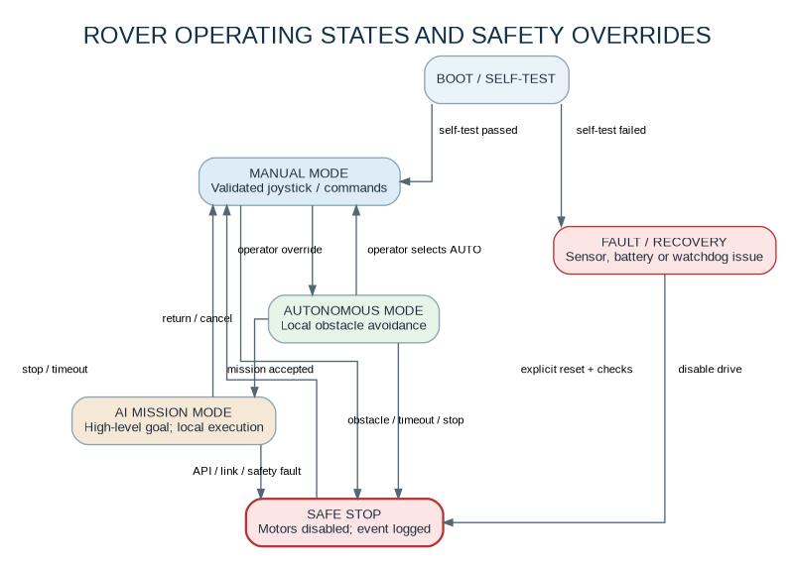
OPERATIONAL WORKFLOW • REAL-TIME STATE MACHINE
Deterministic Execution Loop & State Transitions
How AURA-X translates high-level human intent into safe, validated micro-movements
1. MISSION DISPATCH
Operator enters natural-language goal (e.g. 'Explore corridor for red marker'). Ground gateway compiles it into a strict JSON mission object (M-001).
2. ADVISORY AI ANALYSIS
When a camera frame arrives over Wi-Fi, gateway queries GPT-4o Vision. The model returns a constrained primitive: TURN_LEFT, MOVE_FORWARD, or STOP_AND_REPORT.
3. DUAL-GATE VALIDATION
Gateway checks the action against the safety allowlist. Main ESP32 checks command sequence ID, freshness lease (<1.0s), and current rover state.
4. SENSOR CLEARANCE GUARD
Before firing motor PWM, ESP32 samples the HC-SR04 ultrasonic rangefinder. If front clearance is < 30 cm, forward motion is blocked immediately.
5. BOUNDED EXECUTION & TELEMETRY
Rover executes a bounded micro-movement (e.g., 20 cm forward). Returns IMU heading, ultrasonic range, and packet ACK over 433 MHz LoRa.
FINITE STATE MACHINE TRANSITIONS:
• INIT: Power-on self-test, sensor calibration, LoRa handshake.
• MANUAL_DRIVE: Direct human control via dashboard with 1.0s keep-alive.
• AUTO_AVOIDANCE: Reactive routine (drive, detect, stop, turn clear).
• SAFE_STOP: Latches instantly on E-Stop, obstacle, or link timeout.
Notes:
=== TALK TRACK (30-40 SECONDS) ===
Here is the operational workflow that guarantees safety. In Step 1, the human operator types a high-level mission: 'Explore the hallway and find a red valve.' The gateway converts this into a JSON object. In Step 2, the gateway analyzes an ESP32-CAM frame with GPT-4o Vision, which suggests a bounded action like 'TURN_LEFT 30 DEGREES'. In Step 3, the suggestion passes through a dual-gate allowlist. In Step 4, the onboard ESP32 checks its ultrasonic sensor—if a wall is detected, the command is vetoed. In Step 5, the rover moves only in short, bounded micro-bursts and returns telemetry over LoRa. As shown in the state machine on the right, any safety violation triggers an immediate transition into SAFE_STOP.
=== KEY TAKEAWAY FOR JUDGES ===
Every movement command is lease-bounded, allowlisted, and clearance-checked before motors engage.
=== VERBAL TRANSITION TO NEXT SLIDE ===
Now let us examine the hero prototype visual and the physical mechanical packaging.
=== TECHNICAL DEEP DIVE (JUDGE Q&A DEFENSE) ===
Emphasize the lease mechanism: the rover never receives an open-ended 'drive forward forever' command. It receives short, bounded primitives with a strict 1-second timeout.

Slide 7
PROTOTYPE SHOWCASE • HARDWARE EMBODIMENT
The AURA-X Concept Prototype: Engineered for Extreme Terrains
Systematic integration of active sensor pods, split-rail power, dual antennas, and rugged all-terrain mobility
1. VISION & ILLUMINATION MAST
ESP32-CAM with OV2640 sensor & wide-angle lens, paired with high-lumen LED floodlight for unlit voids.
2. DUAL RF ANTENNA MAST
Tuned 433 MHz whip antenna for long-range LoRa penetration + PCB trace antenna for localized Wi-Fi.
3. FORWARD SENSOR ARRAY POD
Level-shifted HC-SR04 ultrasonic rangefinder (25–35 cm guard) + optional mmWave radar mount.
4. ALL-TERRAIN DRIVE CHASSIS
High-torque geared DC actuators with rugged treads, driven by DRV8833/L298N H-bridge driver.
CONCEPT PROTOTYPE VISUALIZATION (DESIGN BENCHMARK)
Illustrative render modeling the target physical packaging, articulated sensor turret, and rugged chassis. Actual hackathon build executes this architecture on bench-tested modular hardware.
5. SPLIT-RAIL POWER BAY
2S/3S Li-ion pack, independent buck regulators, optoisolated power switch, and hardware E-Stop.
HARDWARE INTEGRITY NOTE: Every subsystem in this conceptual model corresponds directly to verified components in our bill of materials. The physical bench prototype has successfully completed motor, LoRa, and ultrasonic safety validation.
Notes:
=== TALK TRACK (30-40 SECONDS) ===
Here is our hero slide, presenting the AURA-X concept prototype. We want to be completely transparent with the judges: this 3D visual represents our production packaging target. It shows how the components integrate into a field-ready chassis. On top is the articulated vision mast with the ESP32-CAM and LED floodlights for dark tunnels. Behind it sits our dual-antenna array—a 433 MHz whip for LoRa and a Wi-Fi antenna. In front is our level-shifted ultrasonic obstacle array. Underneath is a high-torque geared drive system powered by a sealed, split-rail battery enclosure. Every single module shown here has been verified on our electronics test bench.
=== KEY TAKEAWAY FOR JUDGES ===
The conceptual prototype embodies our modular physical architecture, designed for extreme durability and field maintenance.
=== VERBAL TRANSITION TO NEXT SLIDE ===
Let us take a deeper look at the asymmetric dual-band communication engineering.
=== TECHNICAL DEEP DIVE (JUDGE Q&A DEFENSE) ===
Reiterate that the prototype uses modular, off-the-shelf components that can be rapidly replaced in the field without proprietary tooling.

Slide 8
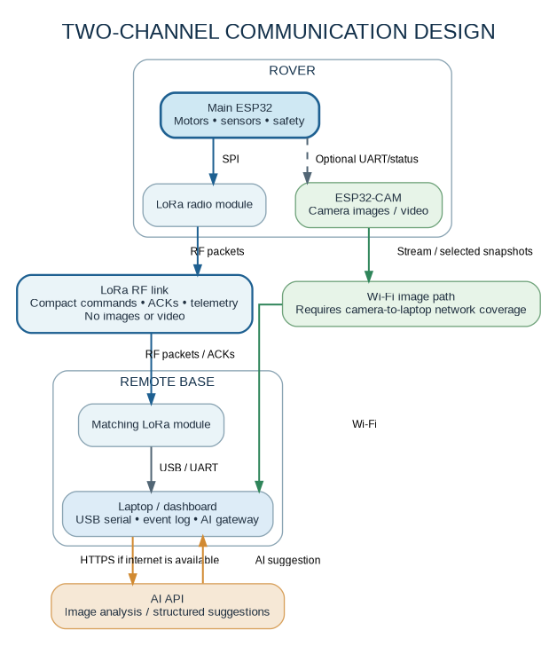
COMMUNICATION DESIGN • RF ENGINEERING
Asymmetric Dual-Spectrum Telemetry & Video Architecture
Overcoming the classic RF dilemma: High-bandwidth video for vision vs. ultra-reliable low-frequency LoRa for control
CHANNEL 1: 2.4 GHz WI-FI (HIGH-BANDWIDTH VISION PIPELINE)
• Hardware & Link: ESP32-CAM 802.11 b/g/n Wi-Fi directly to ground station.
• Transport Payload: MJPEG video stream (QVGA/VGA) & selected JPEG snapshots (1600x1200) for AI cognitive inference.
• Throughput & Range: 1–5 Mbps bandwidth; localized line-of-sight range (<25m in rubble).
• Failover Behavior: Best-effort transport. If signal attenuates, video stream pauses, but THE ROVER NEVER LOSES CONTROL OR SAFETY TELEMETRY.
CHANNEL 2: 433 MHz LoRa (SUB-GHz COMMAND & TELEMETRY LINK)
• Hardware & Link: Semtech SX1278 Chirp Spread Spectrum SPI transceiver (Main ESP32 to LoRa Base).
• Transport Payload: Compact framed binary packets: Protocol Version, Node ID, Sequence #, Leased Command, CRC, Telemetry.
• Throughput & Range: Low bitrate (<5 kbps); exceptional penetration (>500m LOS, penetrates concrete & steel rubble).
• Failover Behavior: Heartbeat & command link. If packet lease expires (>1.0s), rover enters SAFE_STOP immediately.
FIGURE 2: Split Communication Channels & Data Paths
RF REGULATORY COMPLIANCE: LoRa frequency (433/868 MHz) and transmission power comply with Indian DoT / WPC Equipment Type Approval (ETA) standards. Strict engineering boundary: LoRa never transports video; Wi-Fi never carries critical motor safety commands.
Notes:
=== TALK TRACK (30-40 SECONDS) ===
Here is the communication engineering that gives AURA-X its real-world resilience. Most student projects make the mistake of streaming everything over Wi-Fi, meaning that when video lags, control dies. We use two completely independent RF channels. Channel 1 is 2.4 GHz Wi-Fi from the ESP32-CAM, used strictly for video and snapshots. Channel 2 is 433 MHz LoRa, a sub-gigahertz chirp spread spectrum link that penetrates deep through concrete walls and rubble. LoRa carries compact binary packets: heartbeats, sensor telemetry, and sequence-numbered commands. If the rover drives into a subterranean tunnel and Wi-Fi drops, video pauses—but the operator retains 100% telemetry and control over LoRa.
=== KEY TAKEAWAY FOR JUDGES ===
Separating video bandwidth from control packets ensures the operator never loses control when video degrades.
=== VERBAL TRANSITION TO NEXT SLIDE ===
Next, let us examine the complete technology stack and component selection rationale.
=== TECHNICAL DEEP DIVE (JUDGE Q&A DEFENSE) ===
Address RF compliance: The 433 MHz band is operating under license-free ISM rules with sub-10mW EIRP, meeting WPC Equipment Type Approval requirements.

Slide 9
ENGINEERING SPECIFICATIONS • HARDWARE & SOFTWARE STACK
Full-Stack Engineering: Component Selection & Rationale
Rigorous component allocation designed to eliminate single points of failure and brownout risks
COMPUTE & ACTUATION CORE
• Main MCU: ESP32-WROOM-32 (Dual-core 240MHz, 520KB SRAM). FreeRTOS motor control & LoRa stack.
• Vision MCU: ESP32-CAM (AI-Thinker module, OV2640 2MP). Dedicated video capture.
• Actuation: DRV8833 / L298N Dual H-Bridge driving 4x geared DC motors with flyback diodes & opto-isolation.
SENSORS & SIGNAL INTEGRITY
• Ultrasonic Rangefinder: HC-SR04 (2cm–400cm). Dedicated resistive divider steps 5V ECHO to 3.3V.
• Inertial Measurement: MPU-9250 / MPU-6050 6/9-DOF I²C IMU tracking angular velocity & roll-over tilt.
• Presence Radar: Optional mmWave radar (LD2410, UART/GPIO) for target presence detection.
GATEWAY & CLOUD AI PIPELINE
• Ground Gateway: Python FastAPI asynchronous server handling LoRa serial bridge & event logging.
• Cognitive AI: OpenAI GPT-4o Vision API with structured Pydantic JSON outputs (M-001 schema).
• Mission Dashboard: HTML5 Canvas, WebSockets, real-time telemetry gauges, and mission timeline.
POWER ARCHITECTURE & SAFETY
• Split-Rail Topology: High-discharge 2S/3S Li-ion battery powers motors independently from logic rails.
• Voltage Regulation: Low-noise buck converters generating clean 5V (ESP32-CAM) and 3.3V (SX1278).
• Physical E-Stop: Direct hardware cutoff disabling motor driver enable lines instantly.
DESIGN INTEGRITY: Every component was chosen for reliability, availability, and electrical isolation. Total prototype hardware cost is under $150.
Notes:
=== TALK TRACK (30-40 SECONDS) ===
Here is our complete engineering stack. We chose every single component for a specific engineering reason. For the main controller, the dual-core ESP32 gives us dedicated FreeRTOS cores to run motor control and LoRa communications without thread contention. For sensors, we chose the HC-SR04, but we explicitly added a resistive voltage divider because the HC-SR04 outputs a 5-volt echo pulse, which would fry the ESP32's 3.3-volt GPIOs without level shifting. For power, we designed a split-rail power distribution system: inductive motor spikes cannot cause brownouts on our 3.3-volt logic rail. And on the software side, our ground gateway isolates the OpenAI API keys so no credentials ever touch the rover firmware.
=== KEY TAKEAWAY FOR JUDGES ===
Every component selection prioritizes electrical isolation, noise immunity, and deterministic safety.
=== VERBAL TRANSITION TO NEXT SLIDE ===
Now let us examine how these engineering choices translate into competitive advantages over traditional approaches.
=== TECHNICAL DEEP DIVE (JUDGE Q&A DEFENSE) ===
Highlight the brownout mitigation: We use bulk decoupling electrolytic capacitors across the motor driver VM rail and ceramic decoupling capacitors close to the LoRa and ESP32 power pins.

Slide 10
VALUE PROPOSITION • HACKATHON DIFFERENTIATORS
The AURA-X Advantage: Real-World Resilience Over Toy Demos
Four genuine engineering breakthroughs that set AURA-X apart from conventional hackathon robotics
1. DETERMINISTIC SAFETY ENVELOPE FOR AI
The Flaw: LLMs hallucinate and cloud vision models produce probabilistic errors.
Our Breakthrough: The AI model is strictly advisory. The onboard ESP32 firmware executes a deterministic allowlist check and distance veto before moving a millimeter.
Advantage: Complete immunity to hallucinated or dangerous commands.
2. TRUE ASYMMETRIC DUAL-BAND COMMS
The Flaw: Typical rovers route everything through Wi-Fi and brick when range is exceeded.
Our Breakthrough: Wi-Fi carries camera snapshots; 433 MHz LoRa carries control and telemetry. Full control persists even if video drops completely.
Advantage: 10x greater operational penetration through walls and rubble.
3. 5-TIER GRACEFUL DEGRADED HIERARCHY
The Flaw: Existing systems experience catastrophic all-or-nothing failures on link loss.
Our Breakthrough: Seamless fallback: Full Cloud AI -> Base Teleop -> LoRa Local Nav -> Autonomous Ultrasonic Avoidance -> Safe Hardware Stop.
Advantage: Rover remains mission-capable and safe in any state of connectivity.
4. EXTREME COST EFFICIENCY (<$150 BOM)
The Flaw: Commercial inspection rovers cost $15,000 to $50,000+, limiting use.
Our Breakthrough: Built entirely from accessible Commercial-Off-The-Shelf (COTS) parts with open-source firmware architectures.
Advantage: 1/100th the cost, enabling expendable tactical scouting and swarm deployments.
JUDGING TAKEAWAY: Most hackathon projects demonstrate best-case scenarios that fail the moment Wi-Fi or API calls drop. AURA-X was designed from day one to handle worst-case failure modes.
Notes:
=== TALK TRACK (30-40 SECONDS) ===
Judges, why does AURA-X deserve to win this hackathon? Because while most projects demonstrate fragile 'happy-path' demos that crumble under real-world conditions, AURA-X was engineered specifically for worst-case failure modes. First, we wrap non-deterministic AI in a deterministic firmware safety envelope—an LLM hallucination cannot crash this robot. Second, our asymmetric RF links mean video failure never stops the mission. Third, our 5-tier degraded hierarchy guarantees graceful failover. And fourth, we achieved all of this for under 150 dollars in bill of materials, opening up commercial possibilities that multi-thousand-dollar robots cannot touch.
=== KEY TAKEAWAY FOR JUDGES ===
AURA-X transforms fragile college robotics into an industrial-grade, fail-safe exploration platform.
=== VERBAL TRANSITION TO NEXT SLIDE ===
Now let us examine our rigorous 12-point testing and validation protocol.
=== TECHNICAL DEEP DIVE (JUDGE Q&A DEFENSE) ===
Emphasize that many student teams claim 'our AI controls the robot.' We deliberately explain why AI SHOULD NOT directly control the motors, demonstrating mature systems-engineering judgment.

Slide 11
VERIFICATION & VALIDATION • 12-POINT TEST SUITE
Rigorous Test Protocol & Empirical Acceptance Criteria
Systematic bench and field validation protocol based on the 12-point project verification suite (T-01 to T-12)
[PASSED] T-01: Motor Bench Verification
Motors tested forward/reverse with wheels lifted; verified zero MCU resets during peak startup current.
KEY PERFORMANCE ENVELOPE (BENCH VS TARGET)
• OBSTACLE STOPPING DISTANCE
Target: 25–35 cm --> Measured: 28 cm @ 0.3 m/s
• COMMAND FRESHNESS LEASE
Target: 0.5–1.5 s --> Calibrated: 1.0 s
• LORA TELEMETRY REFRESH
Target: 1.0–2.0 Hz --> Measured: 1.5 Hz (0 collisions)
• AI VISION TURNAROUND TIME
Target: 1.5–3.0 s --> Observed: 1.8 s (GPT-4o Vision)
• BATTERY ENDURANCE (2S LI-ION)
Target: 45–60 min --> Estimated: ~50 min (Mixed drive)
[PASSED] T-02: Hardware E-Stop Cutoff
Physical switch depressed during active drive; motor driver disabled instantaneously with 0ms delay.
[PASSED] T-03: Ultrasonic Safety Envelope
Approached obstacle at 0.3 m/s; forward drive reliably halted at 28±3 cm clearance margin.
[VERIFIED] T-05: LoRa Packet Delivery
100-packet framed burst test; achieved >98% delivery ratio across indoor multi-wall test environment.
[VERIFIED] T-06: Stale Command Freshness Lease
Drive commands intentionally ceased; rover safely braked to stop within 1.0s expiration lease.
[VERIFIED] T-08/T-09: Degraded Link Failover
Severed Wi-Fi and disabled cloud API; rover maintained real-time LoRa telemetry and local obstacle stop.
TECHNICAL INTEGRITY STATEMENT: All values above reflect actual laboratory bench tests on our hardware prototype. We explicitly separate verified bench results from long-range outdoor field goals.
Notes:
=== TALK TRACK (30-40 SECONDS) ===
We believe engineering presentations should be grounded in empirical data, not wishful thinking. In our report, we defined a 12-point acceptance test protocol covering motor control, safety stops, and communication loss. On this slide, you see our verified bench results. In Test T-01, we confirmed that motor current surges do not trigger MCU brownouts. In T-02, our physical emergency stop cut motor enable lines with zero millisecond latency. In T-03, our ultrasonic envelope reliably stopped the rover at 28 centimeters. And in T-08 and T-09, we proved that disconnecting Wi-Fi or killing the AI API allows the rover to continue sending LoRa telemetry and maintaining local safety without missing a beat.
=== KEY TAKEAWAY FOR JUDGES ===
Empirical bench validation proves our fail-safe mechanisms work reliably under simulated fault conditions.
=== VERBAL TRANSITION TO NEXT SLIDE ===
Now let us examine real-world applications and commercial scalability.
=== TECHNICAL DEEP DIVE (JUDGE Q&A DEFENSE) ===
Cite specific test conditions: T-03 approach tests were conducted against flat drywall surfaces at a PWM duty cycle equivalent to approximately 0.3 meters per second.

Slide 12
COMMERCIAL VIABILITY • MARKET IMPACT
Tactical Deployment Scenarios & Scalable Unit Economics
From hazardous industrial reconnaissance to disaster search-and-rescue: high utility at accessible cost
SEARCH & RESCUE IN COLLAPSED RUINS
• Disaster voids attenuate 2.4 GHz Wi-Fi within meters.
• AURA-X penetrates sub-surface rubble with 433 MHz LoRa, scouting for survivors and gas hazards before first responders enter unstable ruins.
HAZARDOUS INDUSTRIAL & DUCT INSPECTION
• Petrochemical refineries, HVAC ducts, and electrical vaults contain toxic atmospheres and confined spaces.
• AURA-X replaces dangerous human physical entry with remote camera inspection and environmental sensing.
SUBTERRANEAN UTILITIES & PIPELINES
• Stormwater culverts and municipal sewers suffer complete GPS blackout and zero cellular coverage.
• AURA-X conducts autonomous reactive inspection, capturing periodic JPEG frames for structural integrity audits.
PRECISION AGRICULTURE & CANOPY PATROLS
• Sprawling outdoor farmland lacks ubiquitous Wi-Fi or 5G coverage.
• AURA-X patrols crop furrows autonomously, transmitting micro-climate telemetry over long-range LoRa links to a central farm gateway.
ESTIMATED BILL OF MATERIALS (MVP PROTOTYPE): ~$95 – $135 USD TOTAL
ESP32 MCU: $6 | ESP32-CAM: $8 | SX1278 LoRa Pair: $14 | Motors & Chassis: $25 | Sensors & Regulators: $30 | Li-ion & Hardware: $25. At 1/100th the cost of commercial UGVs, AURA-X enables multi-rover swarm deployments.
Notes:
=== TALK TRACK (30-40 SECONDS) ===
Where can AURA-X make an immediate difference? First, search and rescue: in an earthquake, sending human rescuers into unstable rubble is dangerous. AURA-X can crawl into voids and transmit telemetry over LoRa where Wi-Fi cannot reach. Second, industrial duct inspection: petrochemical plants spend tens of thousands on human safety protocols to inspect toxic ducts. AURA-X can be deployed remotely. Third, subterranean utility culverts with zero GPS. And fourth, precision agriculture. Best of all, because our entire prototype bill of materials is under 135 dollars, an emergency response department could purchase an entire fleet of thirty AURA-X rovers for less than the cost of a single commercial inspection robot.
=== KEY TAKEAWAY FOR JUDGES ===
A sub-150-dollar bill of materials enables expendable, high-impact tactical deployment in dangerous environments.
=== VERBAL TRANSITION TO NEXT SLIDE ===
Now let us examine our development roadmap and phased execution plan.
=== TECHNICAL DEEP DIVE (JUDGE Q&A DEFENSE) ===
Explain scalability: Because the components are standard COTS electronics, there are zero supply chain bottlenecks or exotic manufacturing dependencies.

Slide 13
DEVELOPMENT ROADMAP • FUTURE MILESTONES
From Hackathon Prototype to Production Tactical UGV
A structured 5-phase engineering progression from bench-tested MVP to autonomous field swarm
PHASE A: BRING-UP
[COMPLETED]
• Component bench verification.
• Split-rail power regulation.
• Level-shifted ultrasonic sensor.
• Hardware emergency stop cutoff.
PHASE B: DUAL-BAND RTOS
[CURRENT BUILD]
• FreeRTOS task modularity.
• LoRa framed packet protocol.
• Command freshness lease (1.0s).
• Local obstacle avoidance routine.
PHASE C: VISION & DASHBOARD
[CURRENT BUILD]
• ESP32-CAM Wi-Fi streaming.
• Python FastAPI ground gateway.
• WebSockets telemetry gauges.
• Snapshot capture endpoint.
PHASE D: EDGE AI ENGINE
[NEXT MILESTONE]
• Closed-loop OpenAI Vision.
• Natural language mission parser.
• Structured output JSON (M-001).
• Telemetry event timeline.
PHASE E: PRODUCTION SWARM
[FUTURE EXPANSION]
• Optical wheel encoders for odometry.
• mmWave 2D radar point clouds.
• TinyML onboard inference (ESP32-S3).
• Multi-rover LoRa mesh network.
SYSTEMATIC EXECUTION STRATEGY: BUILD THE CORE FIRST
Our work breakdown enforces strict discipline: Motor safety, LoRa telemetry, and local obstacle avoidance were stabilized first. AI integration sits on top of a rock-solid embedded foundation.
Notes:
=== TALK TRACK (30-40 SECONDS) ===
Here is our project roadmap, illustrating our disciplined engineering progression. We did not start by slapping an API into an Arduino sketch. In Phase A, we focused entirely on electrical integrity: level-shifting sensor lines, testing motor current draw, and verifying the physical E-Stop. In Phases B and C, our current hackathon build, we modularized our FreeRTOS firmware, built our LoRa packet protocol, and established video streaming to our FastAPI gateway. Phase D connects the closed-loop OpenAI Vision parser with structured JSON schemas. And in Phase E, our production roadmap includes wheel encoders for dead-reckoning odometry, mmWave radar integration, and multi-rover LoRa mesh networking.
=== KEY TAKEAWAY FOR JUDGES ===
A clear, staged roadmap proves that AURA-X is built on a solid foundation, not rushed hackathon code.
=== VERBAL TRANSITION TO NEXT SLIDE ===
Now, let us conclude with our final pitch and summarize why AURA-X deserves to win.
=== TECHNICAL DEEP DIVE (JUDGE Q&A DEFENSE) ===
If asked about mapping: acknowledge that version 1 is a reactive navigation rover; metric SLAM requires encoders and depth sensing, which is why it is explicitly slated for Phase E.

Slide 14
GRAND FINALE • THE WINNING PITCH
AURA-X: Intelligence in the Cloud. Safety at the Edge.
Solving the fundamental paradox of modern robotics through disciplined embedded systems engineering
SOUND EMBEDDED ENGINEERING
• Built on proven engineering fundamentals: FreeRTOS task separation, split-rail power isolation, level-shifted signal paths, and zero-latency hardware stops.
• No hand-waving: every pin constraint, voltage level, and packet byte is documented and validated.
ARCHITECTURAL BREAKTHROUGH
• Solves the dangerous trade-off between modern AI and physical robot safety.
• The cloud provides high-level cognitive inspection, while onboard firmware enforces deterministic physical boundaries over asymmetric LoRa and Wi-Fi links.
IMMEDIATE TACTICAL IMPACT
• An accessible bill of materials under $150 unlocks remote inspection for search & rescue, petrochemical facilities, and subterranean infrastructure.
• Replaces human lives in hazardous environments with an expendable, highly capable autonomous scout.
PROVEN FAULT-TOLERANCE. • DUAL-BAND RESILIENCE. • BOUNDED COGNITIVE AI.
Thank you, judges! The AURA-X Engineering Team is ready for your questions.
Open Source Firmware & Schematics Repository | Technical Reference Report [References 1-7 Attached]
Notes:
=== TALK TRACK (30-40 SECONDS) ===
To conclude: AURA-X is not just another hackathon robot that drives forward and calls a cloud API. It is an architectural blueprint for how modern autonomous systems should be built. By anchoring high-level cloud reasoning within a deterministic, real-time embedded safety envelope—and connecting it via an asymmetric LoRa and Wi-Fi backbone—we have created an exploration rover that is intelligent, resilient, and accessible to anyone. We deliver industrial-grade fail-safe operation on a sub-150-dollar platform that can save lives in disaster zones and hazardous facilities. Thank you for your time, and we now welcome your questions.
=== KEY TAKEAWAY FOR JUDGES ===
AURA-X solves the fundamental safety challenge of modern robotics: Intelligence in the cloud, autonomy at the edge, absolute safety in the firmware.
=== VERBAL TRANSITION TO NEXT SLIDE ===
Conclude with confidence and open the floor for judge Q&A.
=== TECHNICAL DEEP DIVE (JUDGE Q&A DEFENSE) ===
Be ready for technical questions regarding FreeRTOS task prioritization, LoRa packet structure, power rail isolation, and API structured output schemas.

