Slide 1


Topic - Prediction of Mutual Fund’s rating and sentiment analysis
of its top stock’s news using Machine Learning
By - Nishit Gala (K2056567)
Supervisor(s) – Dr Nabajeet Barman, Dr Nada Philip

Slide 2
Overview of Project
Data Collection and Processing
Web Scrapping
Data Analysis
MF Rating Prediction using ML
Model Training
Model Evaluation
Sentiment Analysis of top 3 equities in MF
Web Scrapping News Data
Sentiment Analysis using NLTK-Vader
Data Pre-processing
Model Generalization
Notes:
Morningstar is an American Financial Services Company based in Chicago, USA

Slide 3
ML – Prediction of MF Rating (Modelling Approach)
ML Algorithms
Random Forest, Bagging Classifier, Logistic Regression,
XG Boost, Gradient Boost, Voting Classifier, Artificial Neural Network
Important Points covered in training
CV-5fold cross validation used on Training Data to check model Performance
Accuracy Score, Balanced Accuracy score, F1-score checked in training, evaluation
Confusion matrix plotted for evaluation and generalization checks
Training (75%)
UK,
Europe Developed
Testing (25%)
UK,
Europe Developed
Generalization Check
Asia Developed

Slide 4
Challenges faced in MF Rating prediction
Challenge 1 – Model underfitting to training data (Default split)
Model performed better in the testing compared to training
Hint of data leakage from training to testing
Challenge 2 – Model overfitting to training data (Manual Split)
Top 70% data used for training and remaining 30% for testing
Model overfit to training data, thus making our assumption true about data leakage
Resolution –
Similar Funds were identified in data that were having unique ID’s
Grouped the similar funds together and selected 1 fund from the group

Slide 5
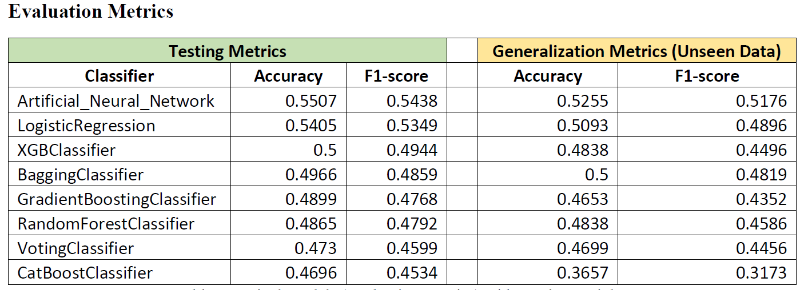
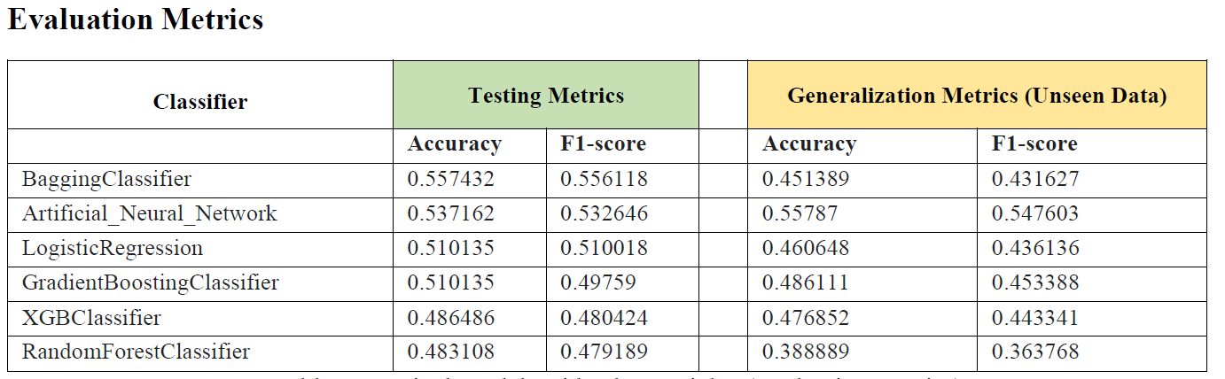
Results of MF Rating prediction
Approach 1 – Models without class weight initialization
Approach 2 – Models with class weight initialization

Slide 6
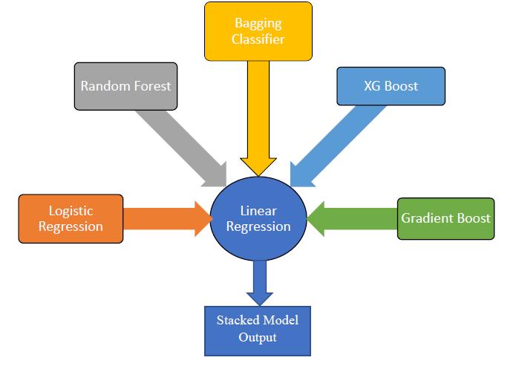
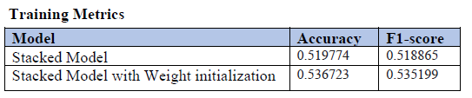
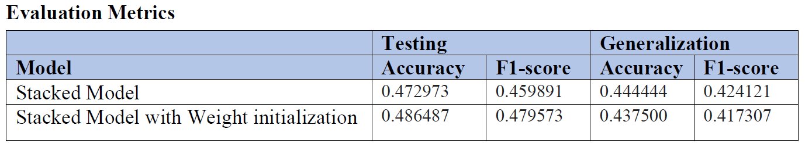
Results of MF Rating prediction
Approach 3 – Stacked Models

Slide 7

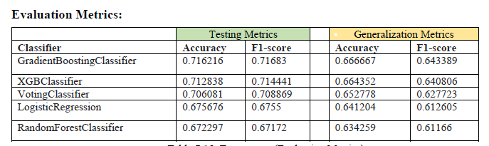
Results of MF Rating prediction
Approach 4 – Target Class Reset
Target Class Representation to 3 classes

Slide 8
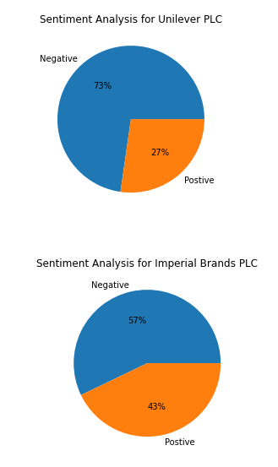
Sentiment Analysis of top 3 funds
The process flow to perform Sentiment Analysis is as below
Scraped Top 10 Stocks per Mutual Fund and saved in CSV file
Web Scraped Tickers for the Stocks captured using python library Beautiful Soup
Web Scraped using Beautiful Soup, the Latest News Data for all the Tickers and saved it in JSON file
Sentiment Analysis for Top 3 stocks in the Mutual Fund will be done using above news data

Slide 9
Conclusion
The main objectives of the proposal were met
Models were generalizing well to the unseen data
The best performing model is Nueral Network followed by Logistic Regression for 5-class problem
For 3-class problem, Boosting algorithms had the upper hand
Sentiment analysis was done using pre-trained library of NLTK-Vader to classify news into positive, negative
Future Work
More data collection from bigger geographies to train and generalization check for the models
Identify alternative sources to Morningstar and check for new features (if available)
Hyper parameter optimization for algorithms

Slide 10
Code Links
Approach | Link
Approach 1 | https://colab.research.google.com/drive/1oNNFDjXLzcxtMRxpn_ijBQjOaiIyY5Wk
Approach 2 | https://colab.research.google.com/drive/1T0CLNMynJ_QFqO8gtlHESKTMHmpCMYUT
Approach 3 | https://colab.research.google.com/drive/1SRe_QXuY2uZ32yJkZdXRrblMA1AxA7Ql
Approach 4 | https://colab.research.google.com/drive/1umk0OU0-FNOyEvSvkj-o-uF_MmuFxQqo
Sentiment Analysis | https://colab.research.google.com/drive/10Bxon7dIuiEh01riLE6tTy9TbIeJ6wU5

