Slide 1
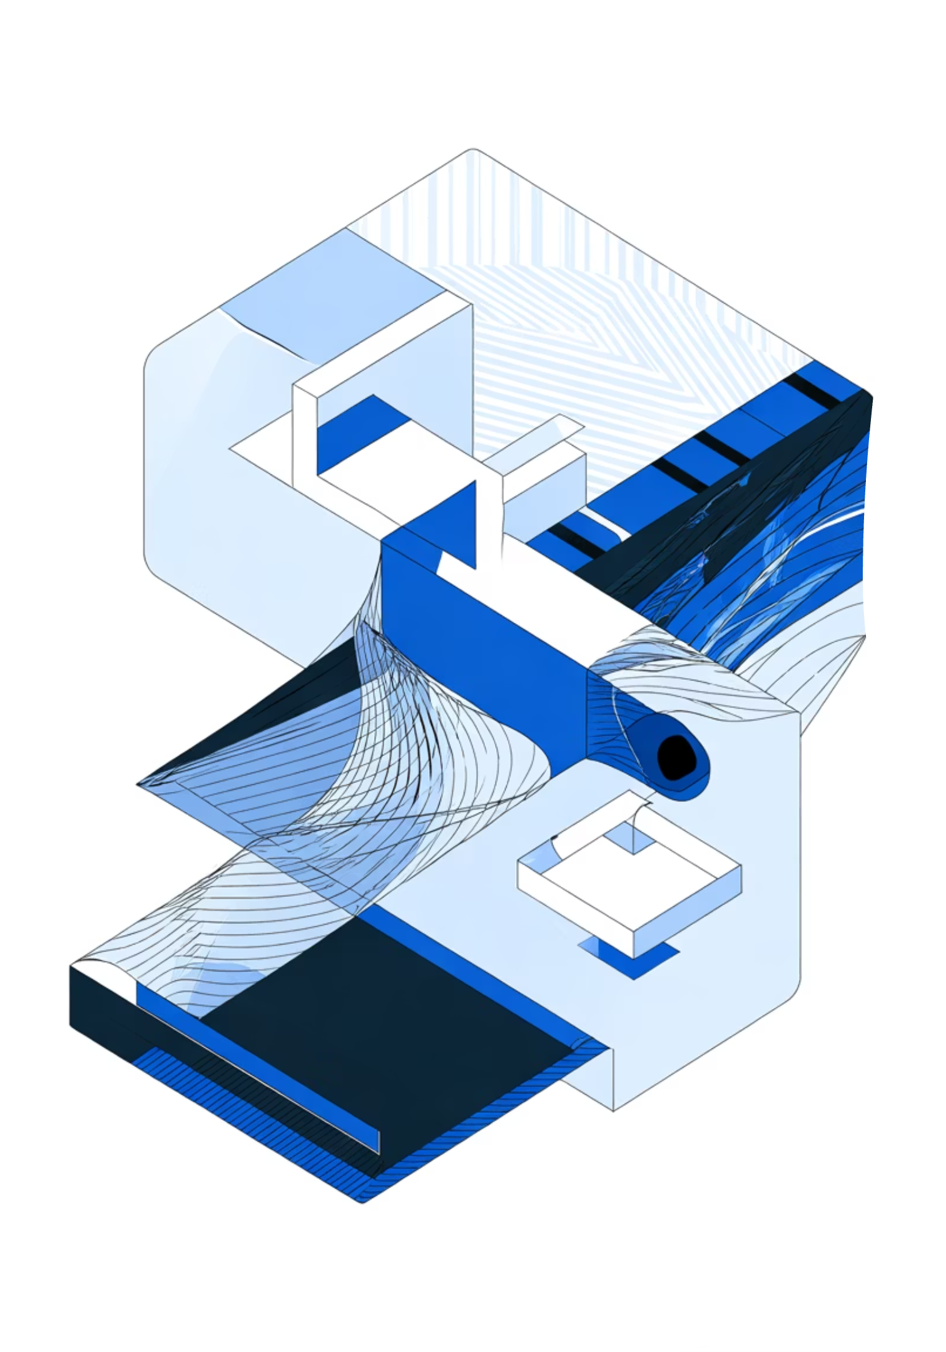
Shape Detection and Object Counting using Connected Component Labeling and Shape Descriptors
21CSE454T – Computer Vision
SRM Institute of Science and Technology

Slide 2
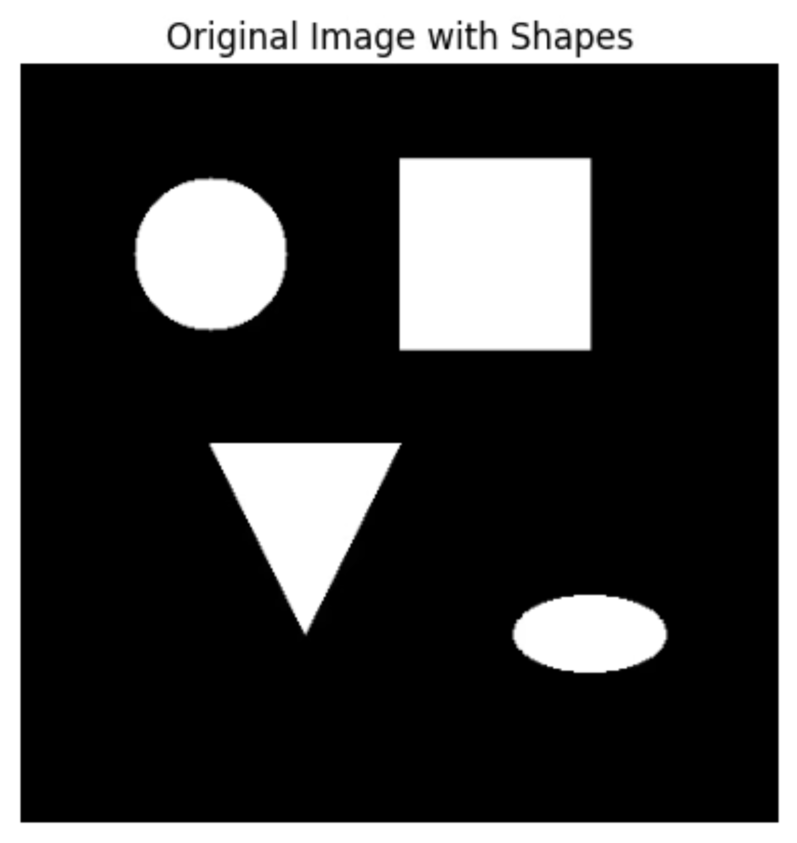
Aim & Objectives
Aim
Detect, label, and count distinct geometric shapes using connected component labeling and advanced shape descriptors for robust object recognition.
Objectives
Perform binary shape analysis using adaptive thresholding techniques
Apply 8-connectivity for accurate object labeling and counting
Filter small components to enhance shape clarity
Extract region properties including centroid, area, and moment invariants
Classify shapes using contour approximation and Hu Moments

Slide 3

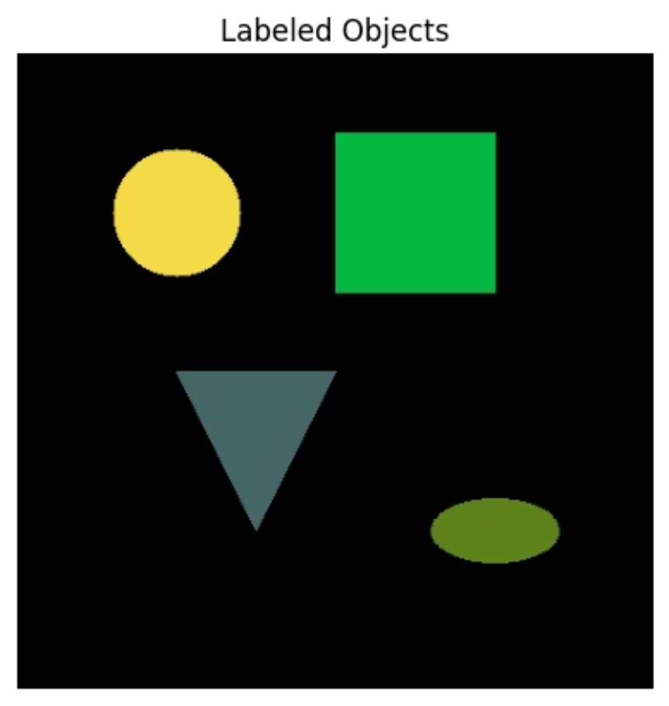
Methodology & Algorithm Pipeline
The shape detection workflow follows a systematic progression through multiple image processing stages, each refining the results for accurate object classification.
01
02
03
Grayscale Conversion
Binary Thresholding
Connected Component Labeling
Transform input image to single-channel representation for efficient processing
Apply threshold to create binary image isolating shapes from background
Label each distinct object using 8-connectivity rules and counting
04
05
Size Filtering
Contour Detection & Classification
Remove noise and small artifacts for cleaner shape analysis
Identify shape boundaries and classify using moment invariants

Slide 4

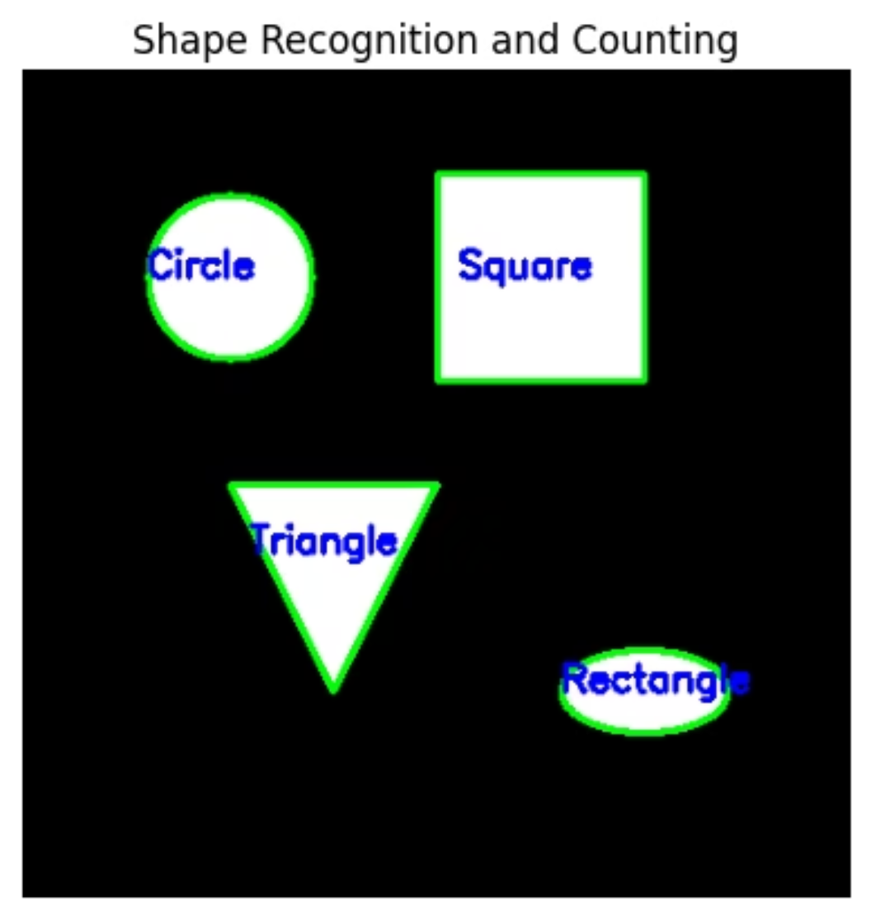
Implementation & Shape Recognition
Tools & Libraries
Dataset
Pipeline
Python, OpenCV, NumPy, Matplotlib, Google Colab
Synthetic geometric shapes with controlled properties
Binary → Labeling → Filtering → Contour Detection
The implementation leverages classical computer vision techniques to achieve robust shape detection through systematic image analysis and feature extraction.
After Size Filtering
Final Shape Recognition

Slide 5
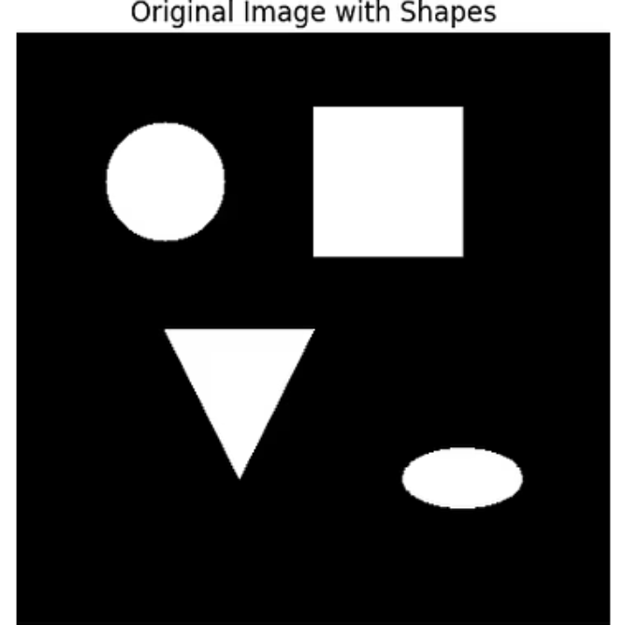


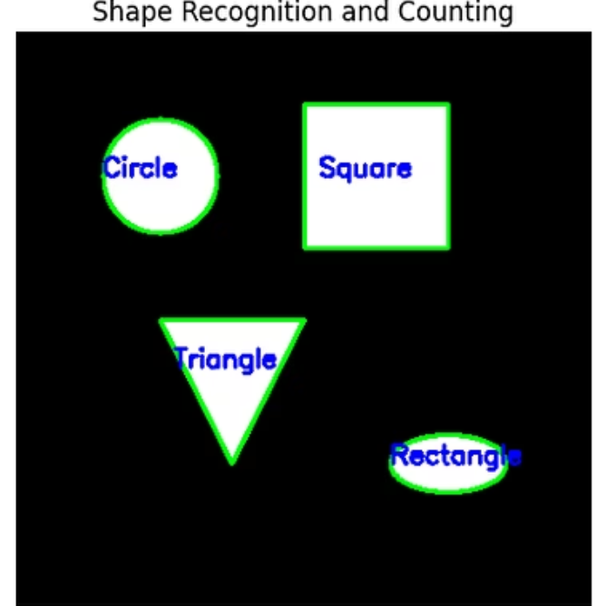

Results & Visual Analysis
The following progression demonstrates each processing stage and validates the effectiveness of the connected component labeling approach for shape detection and counting.
Binary thresholding successfully isolates shapes from background with minimal artifacts
Connected component labeling accurately counts objects and assigns unique identifiers
Hu moments and contour approximation identify shapes with high classification accuracy

Slide 6
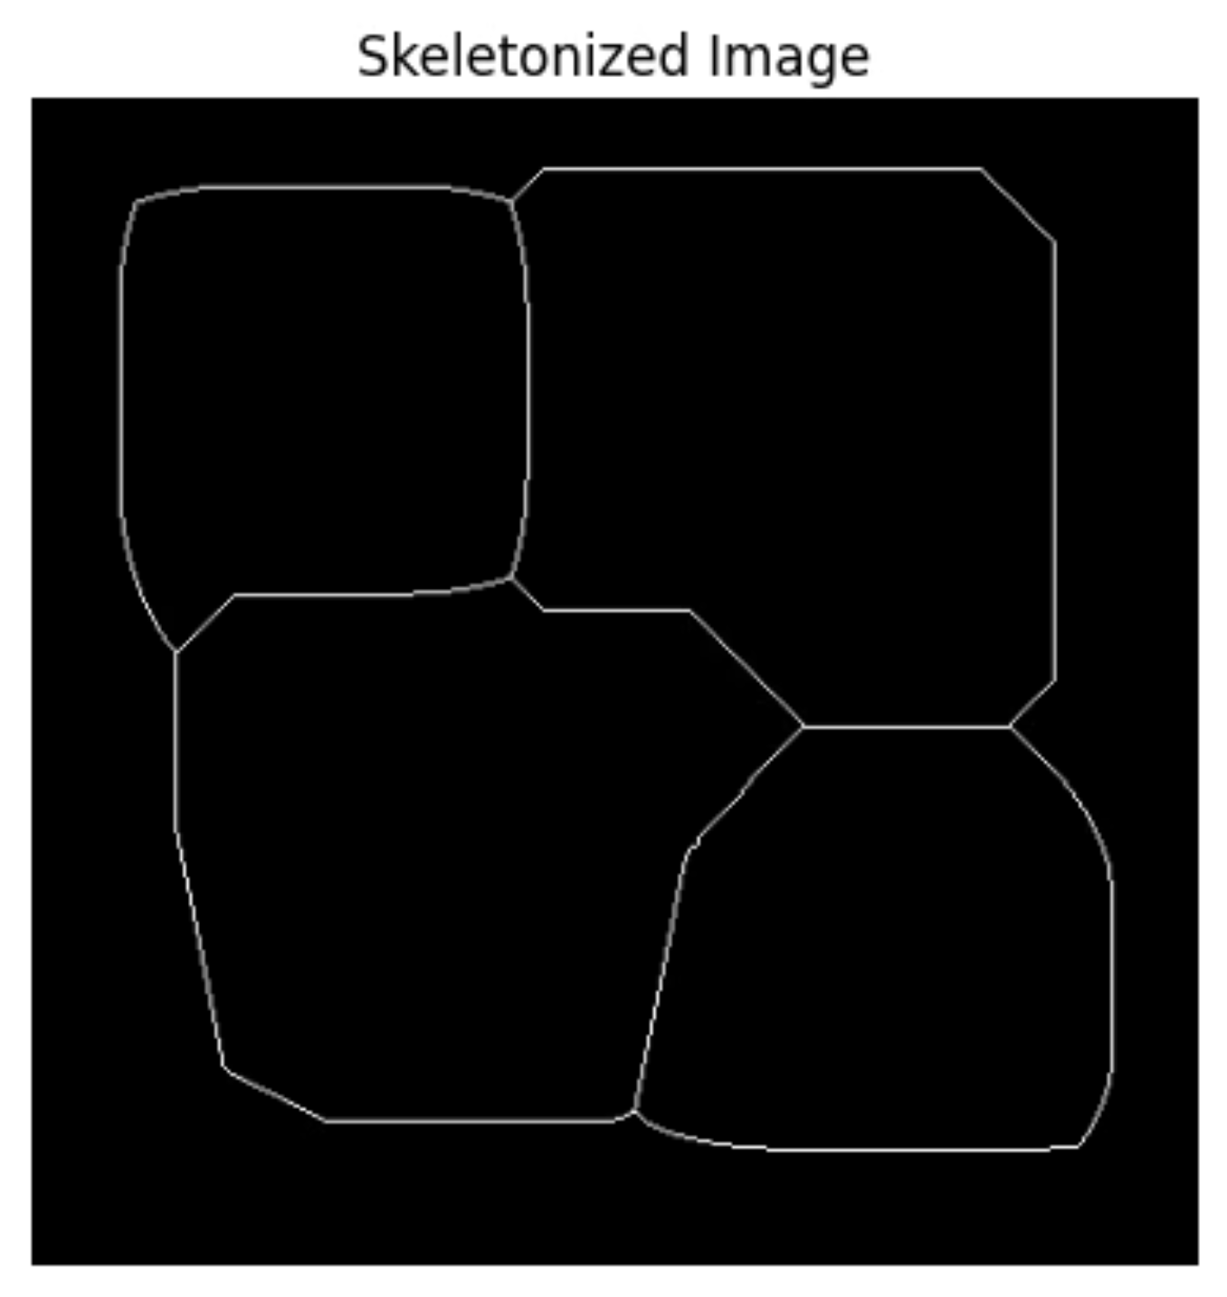
Conclusion & Future Scope
Conclusion
Skeletonized Image
This project successfully implemented binary shape analysis using classical computer vision techniques. Connected component labeling efficiently counted and classified geometric objects based on connectivity, region properties, and moment invariants, demonstrating the practical effectiveness of these foundational methods.
Future Scope
Extend to real-world object detection scenarios
Integrate skeletonization for structural analysis
Apply deep learning for complex shape recognition
Optimize for real-time video processing

