Slide 1


NYC Taxi Trip Duration
Submitted by: K Lakshmi Nishitha
Reg no: 221FA14105
Submitted to: Dr Abraham Peele

Slide 2

Contents:
Introduction
Industrial Overview
Business Problem Statement
Aim
Plan of Action
Exploratory Data Analysis
Data Preprocessing
Regression Modelling
Model Evaluation
Significant Improvements
Model Explanation
Technical Information
conclusion

Slide 3
Introduction
The NYC Taxi Trip Duration problem focuses on predicting the time it takes for a taxi to complete a trip based on a set of variables. These include features such as the pickup and drop-off locations, trip distance, time of day, and more. Understanding trip duration is essential for improving efficiency in urban transport, enhancing customer experience, and optimizing resource allocation.

Slide 4
Industrial Overview
The NYC taxi industry plays a crucial role in the city's transportation ecosystem, catering to millions of residents, commuters, and tourists. The industry is vast, dynamic, and heavily influenced by various socioeconomic and environmental factors. An overview of the industrial landscape concerning NYC taxi trip duration encompasses several key aspects:
1. Market Size and Demand
2. Economic Impact
3. Technological Innovations
4. Competition from Ridesharing Services
5. Regulation and Traffic Management
6. External Factors Affecting Trip Duration
7. Future Trends

Slide 5

Problem statement
The problem of NYC taxi trip duration prediction involves accurately estimating the time it will take for a taxi to complete a trip, given various influencing factors such as the pickup and drop-off locations, trip distance, time of day, traffic conditions, and weather. This is crucial for improving efficiency, managing customer expectations, optimizing route planning, and increasing the overall profitability of taxi services. The challenge is to develop a model that can account for the complexities and unpredictabilities of New York City traffic patterns while providing reliable trip duration estimates.

Slide 6
Aim
1. ..Accurately Predict Trip Durations..
2. ..Optimize Route Efficiency..
3. ..Enhance Customer Experience..
4. ..Improve Traffic Management..
5. ..Maximize Driver and Fleet Productivity..
6. ..Leverage Data Analytics..
7. ..Sustainability and Environmental Impact

Slide 7
Plan Of Action
1. Data Collection and Analysis
2. Develop Predictive Models
3. Implement Route Optimization Tools
4. Enhance Customer Interfaces
5. Collaborate with Traffic Management Authorities
6. Monitor and Adjust Operations
7. Promote Sustainable Practices
8. Train and Support Drivers

Slide 8
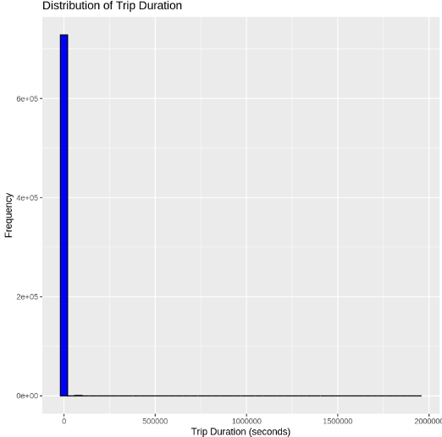
Charts Related Exploratory Data Analysis
The histogram shows the distribution of trip durations. The x-axis represents the trip duration in seconds, and the y-axis represents the frequency of trips with that duration. The chart shows that most trips are very short, with a few longer trips. The distribution is heavily skewed to the right, indicating that there are a few very long trips that significantly affect the overall distribution.

Slide 9
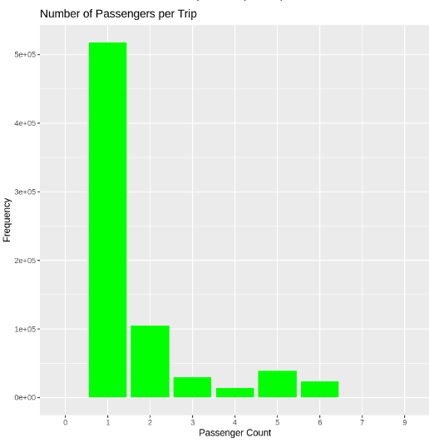
The bar chart shows the distribution of the number of passengers per trip. The x-axis represents the number of passengers, and the y-axis represents the frequency of trips with that number of passengers. The chart shows that most trips have only one passenger, with decreasing frequency for larger numbers of passengers.

Slide 10
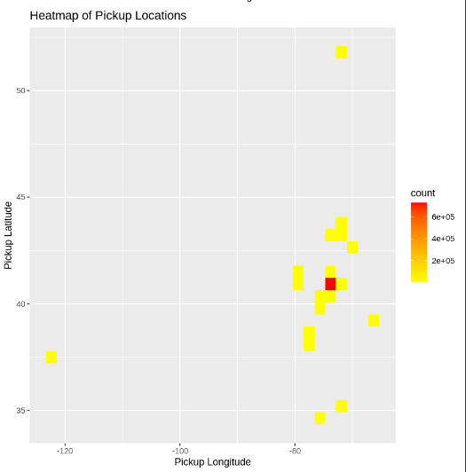
The heatmap shows the density of pickup locations in a given area. The color intensity indicates the number of pickups in a particular region. Redder areas represent higher concentrations of pickups, while yellow areas indicate lower concentrations. The graph suggests that there are several clusters of high pickup activity, potentially indicating popular areas for ride-hailing services.

Slide 11
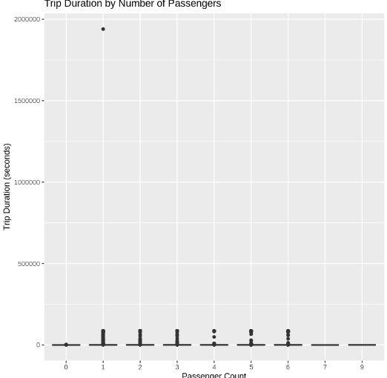
The graph shows the relationship between trip duration (in seconds) and the number of passengers. It appears that there is a weak positive correlation between the two variables, meaning that as the number of passengers increases, the trip duration tends to increase slightly. However, there are also some outliers, which are points that are significantly different from the general trend.

Slide 12
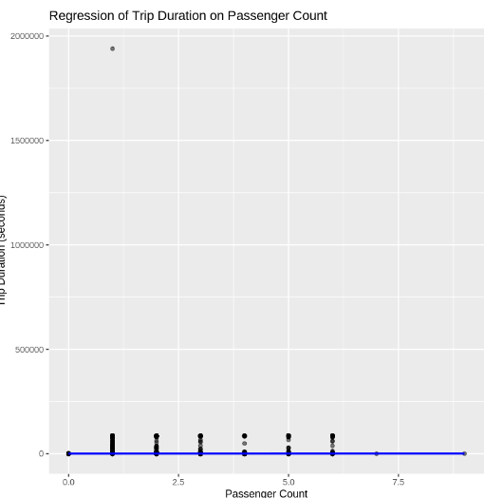
The graph shows the relationship between trip duration (in seconds) and passenger count. It appears that there is a weak positive correlation between the two variables. This means that as the passenger count increases, the trip duration tends to increase slightly, but the relationship is not very strong.​

Slide 13
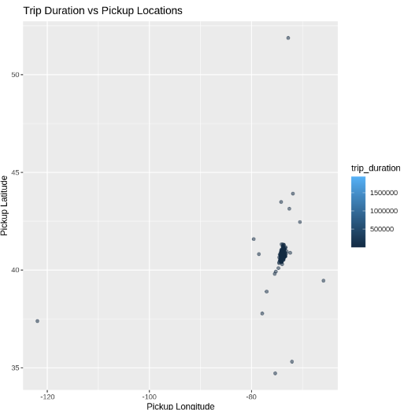
The graph shows the relationship between trip duration and pickup locations. The color of each dot represents the trip duration, with darker colors indicating longer trips. The graph suggests that there is a cluster of longer trips in a specific geographic area, while shorter trips are more evenly distributed. This could be due to factors such as traffic congestion, distance to popular destinations, or other local conditions.

Slide 14
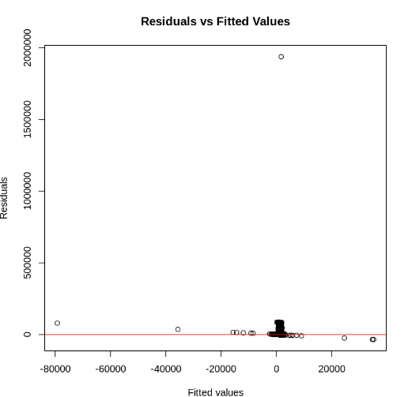
Linear Regression Charts
The graph shows the residuals (the difference between the actual values and the predicted values) plotted against the fitted values (the predicted values) from a regression model. The horizontal line at zero represents the line of best fit.
If the residuals are randomly scattered around the horizontal line, it suggests that the model is a good fit for the data. However, if there is a pattern in the residuals, it indicates that the model may not be appropriate. In this case, there seems to be a cluster of residuals around the fitted value of 0, suggesting that the model may not be accurately predicting the values for those data points.

Slide 15
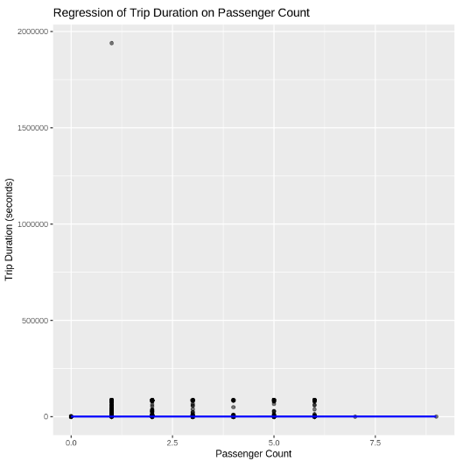
The graph shows the regression of trip duration on passenger count. The x-axis represents the passenger count and the y-axis represents the trip duration in seconds. The blue line is the regression line, which shows the relationship between the two variables. The black dots represent the individual data points.
From the graph, we can see that there is a weak positive relationship between trip duration and passenger count. This means that as the number of passengers increases, the trip duration tends to increase slightly, but the relationship is not very strong. There is a lot of variability in the data, and many of the data points are far from the regression line. This suggests that other factors besides passenger count are also influencing trip duration.

Slide 16
Data Preprocessing Methods
Data preprocessing is a crucial step in data analysis and machine learning. It involves transforming raw data into a suitable format for modeling. Here are some common data preprocessing methods.
Data Wrangling: Data wrangling refers to the process of cleaning, tidying, and transforming data to make it suitable for analysis. This often involves:
Handling missing values: Dealing with missing data points by removing them, imputing values, or predicting them.
Dealing with outliers: Identifying and handling extreme values that can skew the data.
Correcting errors: Identifying and fixing inconsistencies or errors in the data.
Formatting data: Ensuring data is in a consistent format, such as converting dates or times.
Data integration: Combining data from multiple sources into a single dataset.

Slide 17
Feature Engineering
Feature engineering is the process of creating new features from existing ones to improve model performance. This involves:
Transforming existing features: Applying mathematical operations or functions to existing features to create new ones.
Creating new features: Combining or aggregating existing features to create new features that capture relevant information.
Feature selection: Choosing the most relevant features for the task to avoid overfitting and improve model efficiency.

Slide 18
Significant Improvements Due to Hyperparameter Tuning
Increased Accuracy
Optimized model complexity: Tuning hyperparameters like the number of layers or neurons in a neural network can help find the optimal balance between underfitting and overfitting.
Improved feature importance: Hyperparameter tuning can help identify the most relevant features for predicting trip duration, leading to more accurate models.
Enhanced generalization: By tuning hyperparameters like regularization strength, you can improve the model's ability to generalize to unseen data, reducing overfitting.
Faster Training and Inference
Efficient hyperparameter selection: Careful tuning can help identify hyperparameter combinations that lead to faster training times without sacrificing accuracy.
Optimized model architecture: Hyperparameter tuning can help choose model architectures that are computationally efficient, reducing inference time.
Improved Interpretability
Feature importance identification: Hyperparameter tuning can help identify the most important features for predicting trip duration, providing insights into the factors influencing trip times.
Hyperparameter tuning is a critical step in machine learning models, especially in complex tasks like predicting NYC taxi trip durations. By carefully adjusting hyperparameters, you can significantly enhance model performance, leading to more accurate predictions.

Slide 19
Model Explainability
Model explainability is the ability to understand how a machine learning model arrives at its predictions. In the context of NYC taxi trip duration, this means being able to explain why a model predicts a certain trip duration based on the input features (e.g., pickup location, drop-off location, passenger count, time of day).
Why is Model Explainability Important?
Trust and Transparency: Understanding how a model works can help build trust in its predictions, especially in critical applications like transportation.
Regulatory Compliance: In many industries, regulations require transparency into decision-making processes.
Error Analysis: If a model makes incorrect predictions, understanding its reasoning can help identify and rectify biases or errors.
Model Improvement: Explanations can provide insights into how to improve the model's performance by identifying missing features or correcting biases.
Business Decision Making: Explainable models can support informed business decisions, such as pricing strategies, resource allocation, and service improvements.

Slide 20
Business Impact of Explainable Models
Fairness and Equity: Explainable models can help identify and mitigate biases in trip duration predictions, ensuring fair treatment for all passengers.
Customer Satisfaction: By understanding the factors influencing trip duration, taxi companies can provide more accurate estimates and improve customer satisfaction.
Operational Efficiency: Explainable models can help optimize operations by identifying peak demand times and areas, allowing for better resource allocation and pricing strategies.
Risk Management: Understanding the factors that contribute to longer or shorter trip durations can help mitigate risks associated with unexpected delays or cancellations.
Regulatory Compliance: Explainable models can help taxi companies comply with regulations related to fair pricing and service quality.

Slide 21
Technical Information
Historical data: Analyzing historical data on taxi trips can provide insights into average trip durations for different routes, times of day, and weather conditions.
Real-time data: Using real-time traffic data and GPS information can help estimate trip durations more accurately.
Machine learning models: Machine learning models can be trained on historical data to predict trip durations based on various factors.
Statistical analysis: Statistical analysis can be used to identify patterns and trends in trip duration data.
By understanding these factors and leveraging available data and technology, it is possible to make more accurate predictions and improve the efficiency of taxi services in NYC.

Slide 22

Step-by-Step Approach
1. Data Collection and Cleaning:
Gather the necessary data from relevant sources (e.g., NYC Taxi & Limousine Commission).
Clean the data to handle missing values, inconsistencies, and outliers.
2. Exploratory Data Analysis (EDA):
Understand the data distribution and relationships between variables.
Visualize data using histograms, scatter plots, and other visualizations.
Identify potential correlations and patterns.
3. Feature Engineering:
Create new features that might be relevant to trip duration, such as:
Trip distance
Pickup and drop-off locations
Time of day
Day of week
Weather conditions

Slide 23
4. Model Selection:
Choose a suitable regression model based on the data distribution and relationships.
Common choices include linear regression, decision trees, random forests, and gradient boosting.
5. Model Training and Evaluation:
Split the data into training and testing sets.
Train the model on the training set.
Evaluate the model's performance on the testing set using metrics like mean squared error (MSE), root mean squared error (RMSE), and R-squared.
6. Model Tuning:
Experiment with different hyperparameters to optimize the model's performance.
Use techniques like grid search or random search.
7. Deployment:
Deploy the trained model to make predictions on new data.

Slide 24
Conclusion
The presentation focuses on summarizing the analysis and results of the NYC Taxi Trip Duration problem, emphasizing the importance of predicting trip duration for operational efficiency in the taxi industry. It acknowledges the use of data collection, regression modelling, and feature engineering to enhance model accuracy, as well as the role of hyperparameter tuning in improving performance. The overall goal is to leverage data and machine learning techniques to predict taxi trip durations more effectively, optimize routes, and improve both customer satisfaction and traffic management.

Slide 25
THANK YOU

