Slide 1
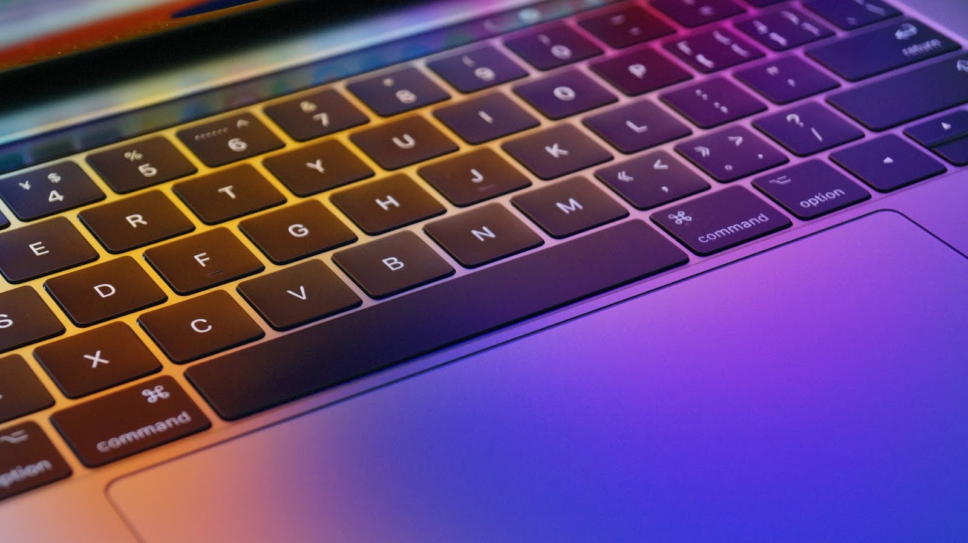
Test your Speed
120cs0011
120cs0047
This Photo by Unknown author is licensed under CC BY.

Slide 2
INTRODUCTION
It is built using tkinter module to give a user-friendly design view.
The application is simple windowed design that has only textboxes and text.
The purpose of this application is to test your typing speed and to fasten it.
This Photo by Unknown author is licensed under CC BY.

Slide 3
MODULES USED
tkinter is the most commonly and friendly used GUI (Graphical user interface). Python with tkinter is the fastest and easiest way to create the GUI applications.
random-random.shuffle() method is used to shuffle a sequence (list). Shuffling means changing the position of the elements of the sequence. Here, the shuffling operation is inplace.
This Photo by Unknown author is licensed under CC BY.

Slide 4
EXPLANATION
When the code is compiled, a tab opens which gives some random words when we start typing the timer decreases with time and we should type the words as fast as we can, after the completion of time we will get the result of our attempt.
This Photo by Unknown author is licensed under CC BY.

Slide 5
THANK YOU
This Photo by Unknown author is licensed under CC BY.

